Slide 1
Image thresholding and smoothing
2020.10

Slide 2
Contents
Image thresholding
Simple thresholding
Adaptive Thresholding
Otsu’s method
Image smoothing
Average
Gaussian
Media
bilateral

Slide 3
Simple thresholding
The image can be considered as the combination of the all pixels.

Slide 4
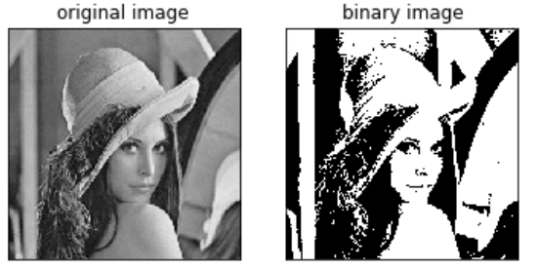
Simple Thresholding (global threshold)
For every pixel, the same threshold value is applied. If the pixel value is smaller than the threshold, it is set to 0, otherwise it is set to one maximum value.

Slide 5
How to do it?
numpy
Im>thr(im is the image, thr is the threshold)
opencv
Cv2.threshold()

Slide 6
Cv2.threshold
image
threshold
Cv2.threshold(src, thr, maxValue, type)
TYPE:
cv.THRESH_BINARY (two values in the results, 0 or maxvalue)
cv.THRESH_BINARY_INV (two values in the results, maxvalue or 0)
cv.THRESH_TRUNC (larger than thr set to the maxvalue)
cv.THRESH_TOZERO (smaller than thr , set to 0)
cv.THRESH_TOZERO_INV (larger than thr, set maxvalue)

Slide 7
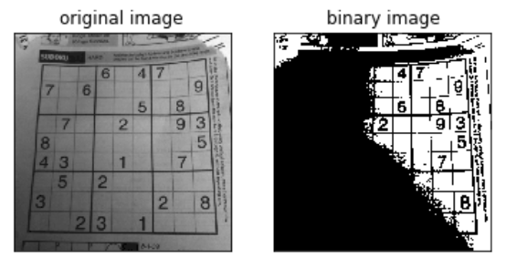
Adaptive threshold
In the above, we used one global value as a threshold for all the pixels in the image.
If an image has different lighting conditions in different areas, the global threshold can not obtain a good result. In that case, an adaptive threshold can help. The threshold for a pixel is determined on a small region.

Slide 8
Global threshold
Threshold is 120

Slide 9
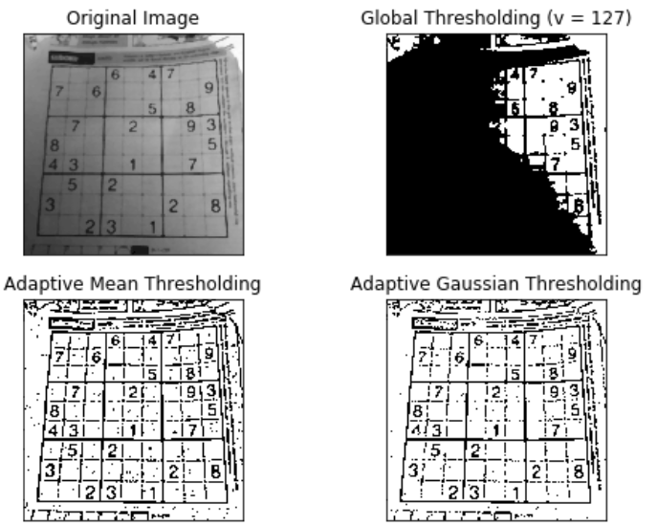
Adaptive threshold

Slide 10
How to do using opencv?
Cv2.adaptiveThreshold(src, maxvalue, adaptiveMethod, blockSize, c)
Cv2. ADAPTIVE_THRESH_MEAN_C(The threshold value is the mean of the neighbourhood area minus the constant C.)
Cv2.ADAPTIVE_THRESH_GAUSSIAN_C(The threshold value is a gaussian-weighted sum of the neighbourhood values minus the constant C.)

Slide 11
Two methods
The threshold value is the mean of the neighbourhood area minus the constant C.
The threshold value is a gaussian-weighted sum of the neighbourhood values minus the constant C.

Slide 12
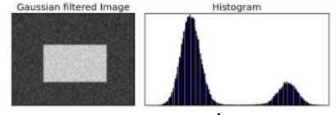
Otsu's Binarization
Bimodal image: the image has two distinct image values, where the histogram has two peaks.

Slide 13
Otsu’s method
A good threshold would be in the middle of those two values. Similarly, Otsu's method determines an optimal global threshold value from the image histogram.
Find one threshold

Slide 14
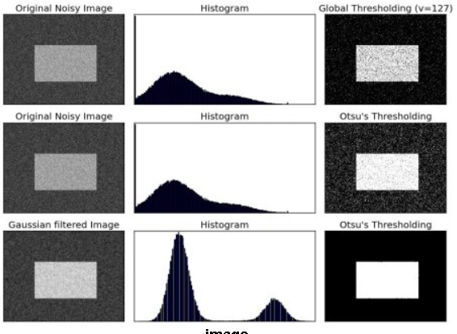

Slide 15
How to do?
Cv2.threshold()
cv2.threshold(img,0,255,cv2.THRESH_BINARY+cv2.THRESH_OTSU)

Slide 16
Image smooth
Review:
Image transformation including spatial domain and transform domain.
Focus on the spatial domain (cv2.filter2D)

Slide 17
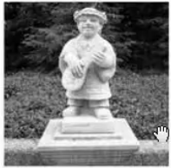
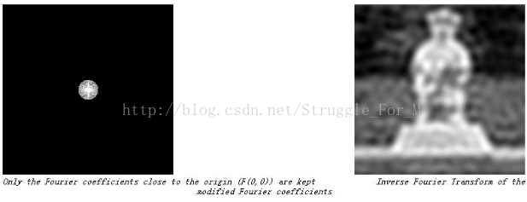
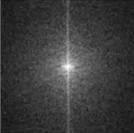
FFT(transform domain)
High frequency information may contain noise. If we remove the high frequency information, the noise will be removed and the image will become smooth.

Slide 18
Image smoothing (spatial domain)
Image blurring (image smoothing) is achieved by convolving the image with a low-pass filter kernel.
It is useful for removing noises. It actually removes high frequency content

Slide 19
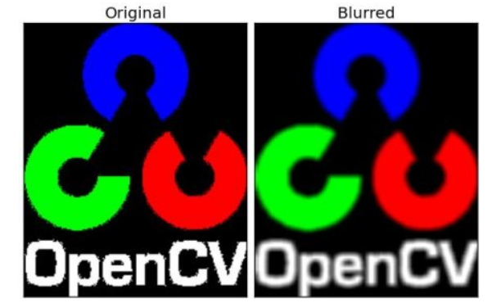
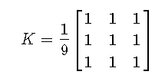
Image smoothing methods
Averaging: Set the value as the average of the neighbours

Slide 20
How to do
1. create kernel by hand, and use cv2.filter2d
2. cv2.blur()

Slide 21
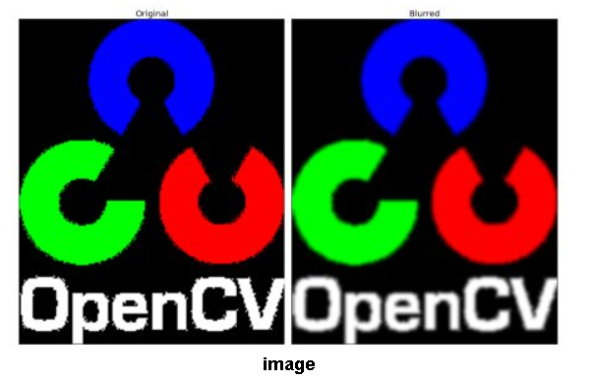
Image smoothing methods
Set the value as the weighted averaging using gaussian.
Gaussian blurring is highly effective in removing gaussian noise from the image.

Slide 22
How to do
1. create the gaussian kernel by hand, and use cv2.filter2d
2. create gaussian kernel using cv.getGaussianKernel()., and use cv2.filter2d()
3. cv2.gaussianBlur()

Slide 23
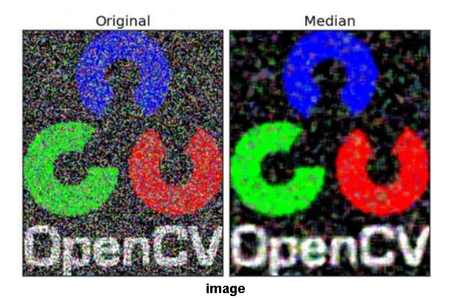
Median Blurring
takes median of all the pixels under kernel area and central element is replaced with this median value. This is highly effective against salt-and-pepper noise in the images.

Slide 24
How to do
Cv2. medianBlur(src, ksize)
Neighbor region size

Slide 25
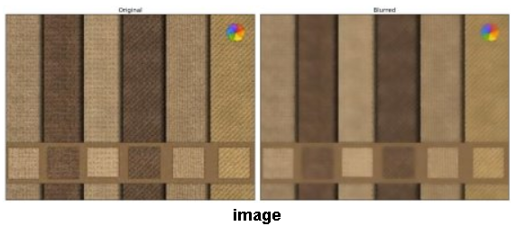
Bilateral Filtering
highly effective in noise removal while keeping edges sharp.
Gaussian function of space make sure only nearby pixels are considered for blurring while gaussian function of intensity difference make sure only those pixels with similar intensity to central pixel is considered for blurring. So it preserves the edges since pixels at edges will have large intensity variation.

Slide 26
How to do it
Cv2.bilateralFilter(src, d,sigmaColor, sigmaSpace)
Filter sigmal in space
Neighborhood size
Filter sigmal in color

Slide 27
Exercises
Using opencv and numpy to threshold one image.(do it by yourself.)
Try to use cv2.threshold with different parameters , including adaptive thresholding.
Try to use cv2.blur to smooth image (average smoothing)
Try to use cv2.gaussianBlur to smooth image (gaussian smoothing)
Try to use cv2.medianBlur to smooth image (media smoothing)
Try to use cv2.bilateralBlur to smooth image (bilateral smoothing)

