Slide 1
Image Histogram
2020.10

Slide 2
Contents
Histogram
Definitioin
Method to define histogram
Get histogram using numpy and opencv
Mask histogram
Histogram equalization
What is histogram equalization
Histogram equalization using numpy and opencv
Adaptive histogram equalization

Slide 3
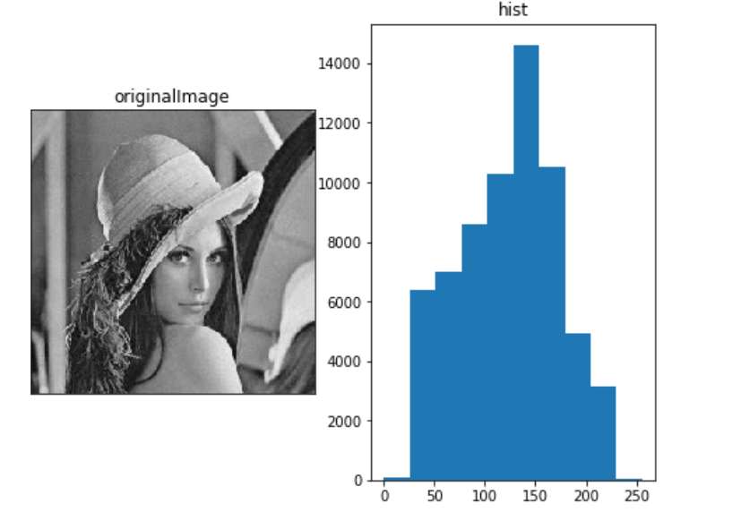
What is the histogram
Histogram is a graph or plot, which can give you an overall idea about the intensity distribution of image.

Slide 4
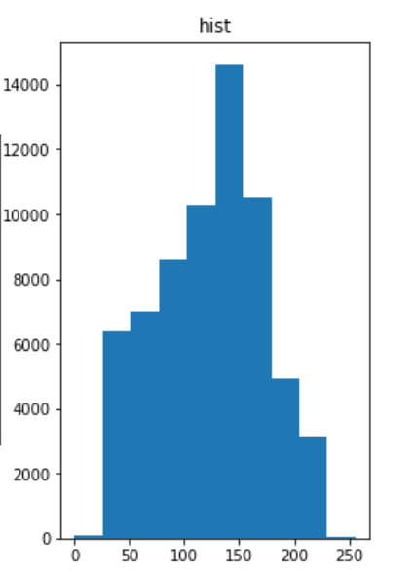
What is histogram
X-axis pixel values (intensity)
Y-axis corresponding number of pixels
Histograms are collected counts of data organized into a set of predefined bins
bin

Slide 5
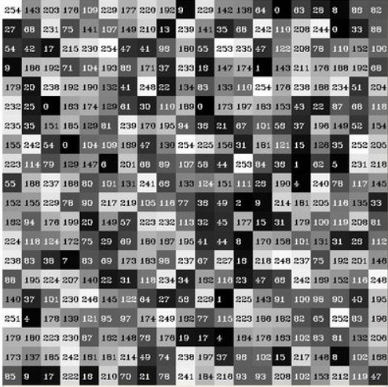
How to get the histogram
Image that a matrix contains pixels of an image.

Slide 6
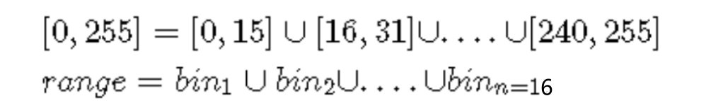
Step1: Segment the range in subparts
Since we know that the range of information value for this case is 256 values, we can segment our range in subparts (called bins) like:

Slide 7
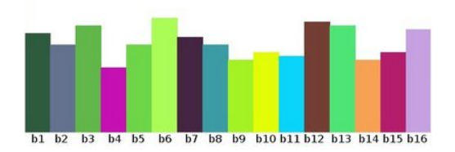
Step2: count the number of pixels in range
we keep count of the number of pixels that fall in the range of each bin. Applying this to the example above we get the image below ( axis x represents the bins and axis y the number of pixels in each of them).

Slide 8
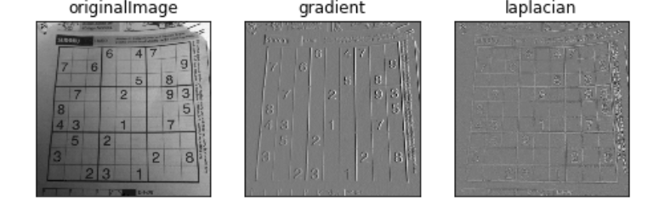
Notes
An histogram can keep count not only of color intensities, but of whatever image features that we want to measure (i.e. gradients, directions, etc).

Slide 9
How to do using numpy
np.histogram(a, bins, range, weight, density)
Weight of the image pixels
Intensity range
Normalized as probability

Slide 10
Opencv
cv2.calcHist(images, channels, mask, histSize, ranges)
R[0],G[1],B[2]?
bins
Where to calculate histogram

Slide 11
How to draw it
Matplotlib
Opencv

Slide 12
Using matplotlib
plt.hist(img.ravel(),256,[0,256])
bins
range

Slide 13
Using opencv to draw
Cv2.line()
Cv2.polyline()
You can refer : https://github.com/opencv/opencv/blob/master/samples/python/hist.py

Slide 14
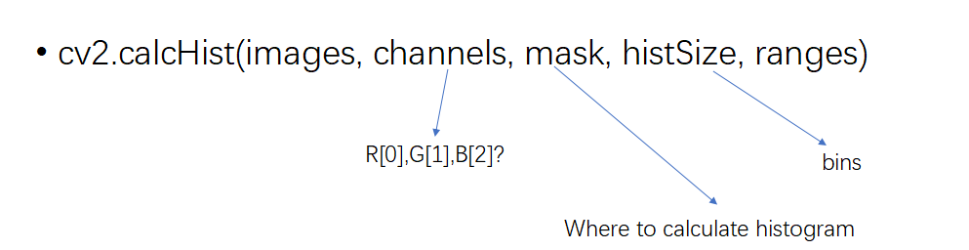
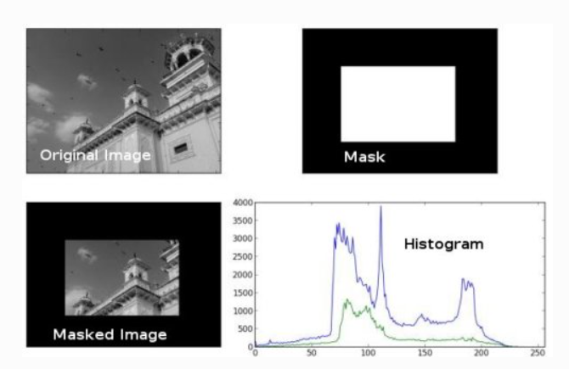
Histogram with mask
Only obtain the histogram in eon special region, you can use the mask

Slide 15


Histogram Equalization
Brighter image will have all pixels confined to high values. While darker image will have pixels confined to low values.

Slide 16
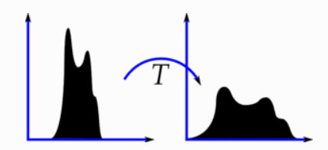
Histogram Equalization
A good image will have pixels from all regions of the image, so we need to stretch this histogram to either ends

Slide 17
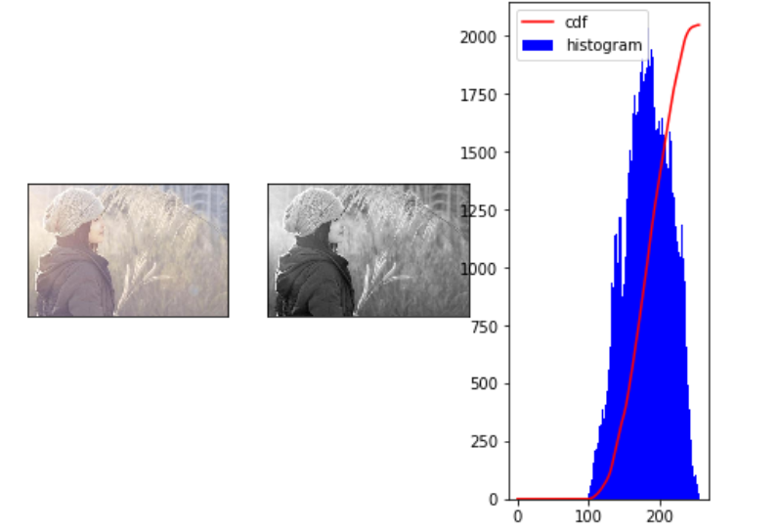
The histogram lies in the brighter region.
Find a transformation that maps the pixels in brighter region to the output pixels in full region. That is histogram equalization does.
The values are 0 from 0-100

Slide 18
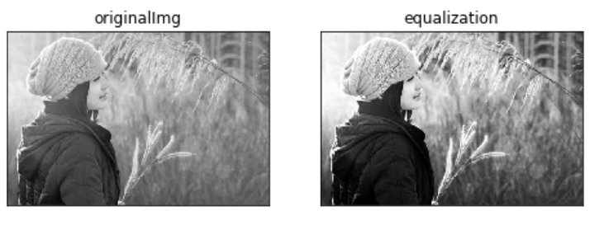
How to equalization

Slide 19
Histogram equalization using numpy
Calculate the Histogram
Cumulative distribution function (CDF)
Normalize the CDF
Mapping the image to new image

Slide 20
Histogram equalization using opencv
cv2.equalizeHist(src)
Input is the source image

Slide 21
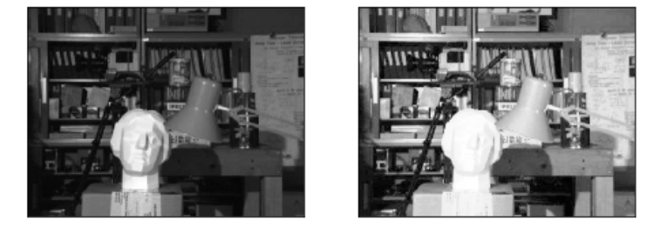
Adaptive histogram equalization
Background contrast has improved after histogram equalization. But compare the face of statue in both images. We lost most of the information there due to over-brightness

Slide 22
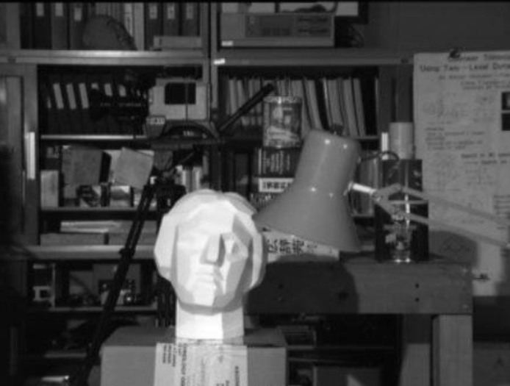
Divide the image into same size grid, such as
8*8, and do the histogram equalization in each
Grid.

Slide 23
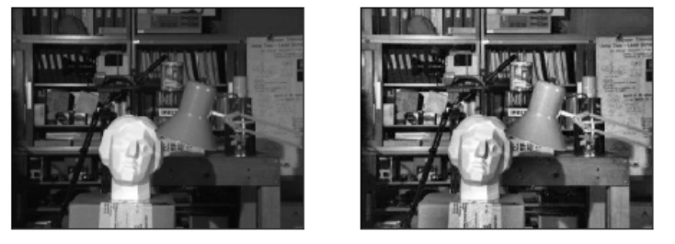
Adaptive histogram equalization using opencv
clahe = cv2.createCLAHE(clipLimit=2.0, tileGridSize=(8,8))

Slide 24
Exercises about histogram
1. image histogram using numpy
2. image histogram using opencv

Slide 25
Exercises about histogram equalization
1. image histogram equalization using numpy
2. image histogram equalization using opencv
3. adaptive histogram equalization using opencv

