Slide 1
Morphology Transformation
2020.10

Slide 2
Contents
Morphology Transformation
Erosion
Dilation
Opening
Closing
Gradient
topHat
blackHat
Structuring element

Slide 3

What is morphology
Simple operations based on the image shape, performed on binary image.
Usually have two inputs, one is the original image, the other is structuring element (kernel), which decides the nature of operation.

Slide 4
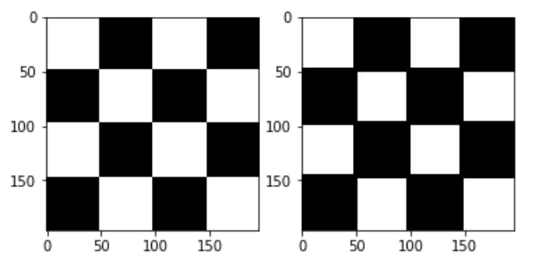
Basic morphology operator -erosion
It erodes away the boundaries of foreground object (Always keep foreground in white).
The kernel slides through the image (as in 2D convolution). A pixel in the original image (either 1 or 0) will be considered 1 only if all the pixels under the kernel is 1, otherwise it is eroded (made to zero).

Slide 5
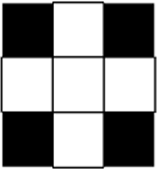
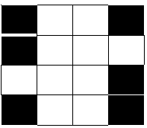
Toy example
considered 1 only if all the pixels under the kernel is 1
kernel
original image
blue eroded image

Slide 6
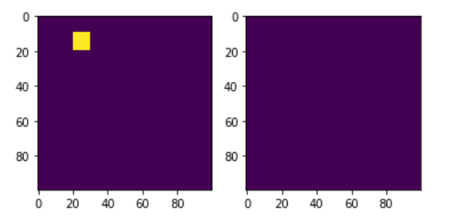
Application of erosion
All the pixels near boundary will be discarded depending upon the size of kernel. The thickness or size of the foreground object decreases or simply white region decreases in the image. It is useful for removing small white noises

Slide 7
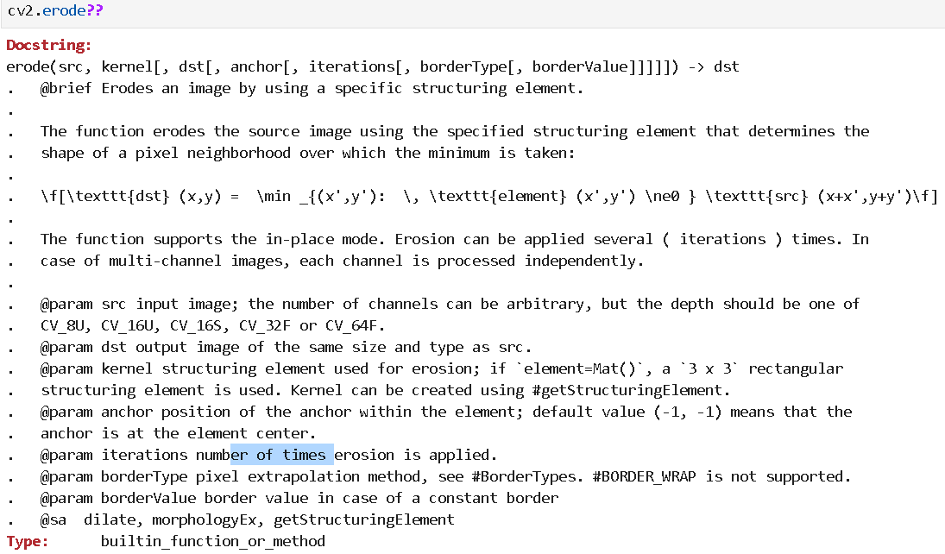
Function in opencv

Slide 8
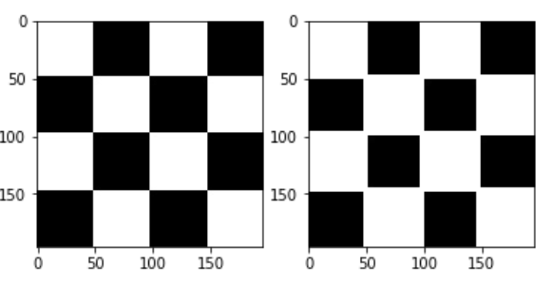
Basic morphology operator - Dilation
It is just opposite of erosion.
One pixel element is '1' if at least one pixel under the kernel is '1’. So it increases the white region of object

Slide 9
Example of dilation

Slide 10
Gif animation
Erosion and dilation.flv

Slide 11
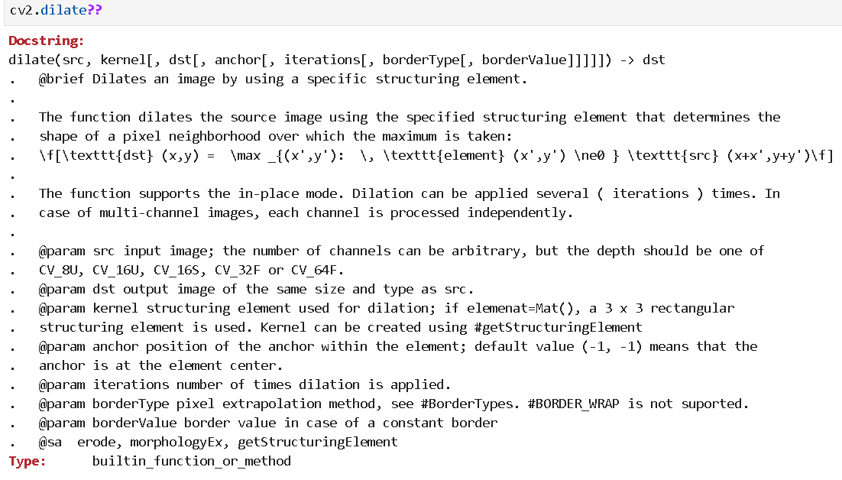
Function in opencv

Slide 12
Opening
Erosion
Dilation
Opening
Opening = erosion + dilation

Slide 13
Function in opencv
opening = cv.morphologyEx(img, cv.MORPH_OPEN, kernel)

Slide 14
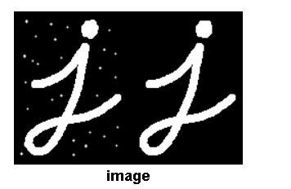
Example of opening

Slide 15
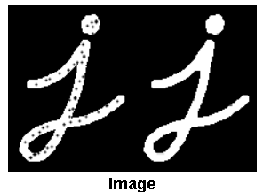
Closing
Closing is reverse of Opening, Dilation followed by Erosion. It is useful in closing small holes inside the foreground objects, or small black points on the object.

Slide 16
Morphological Gradient
It is the difference between dilation and erosion of an image.
Dilation
Erosion
Gradient

Slide 17
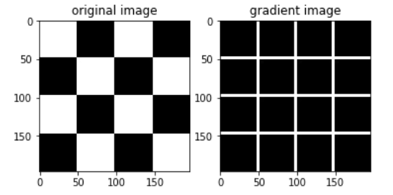

Slide 18
gradient = cv.morphologyEx(img, cv.MORPH_GRADIENT, kernel)

Slide 19
Top Hat
It is the difference between input image and Opening of the image
Input Image
Opening
Top hat

Slide 20
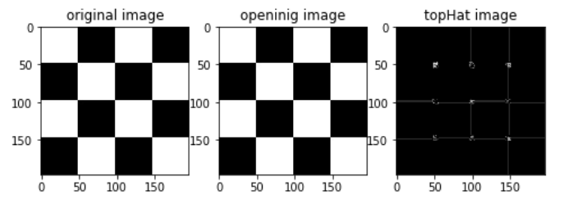
An example

Slide 21
tophat = cv.morphologyEx(img, cv.MORPH_TOPHAT, kernel)

Slide 22
Black hat
Closing
Input image
Black hat
It is the difference between the closing of the input image and input image.

Slide 23
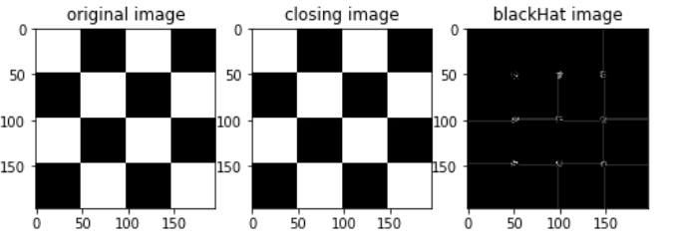
An example

Slide 24
blackhat = cv.morphologyEx(img, cv.MORPH_BLACKHAT, kernel)

Slide 25
Structuring Element
Kernel can be square, and also can be circle, ellipse, cross.
You can use cv.getStructuringElement()

Slide 26
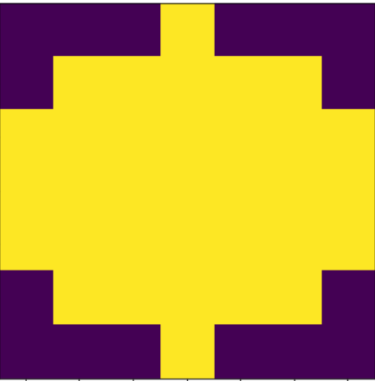
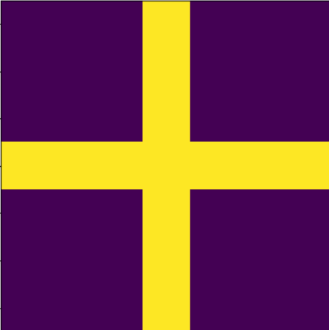
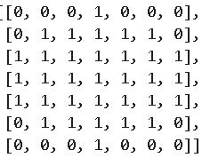
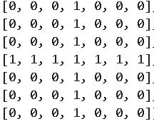
Ellipse kernel
ellipse
cross

Slide 27
Exercises/homework
Do one example using erosion, dilation, opening, closing, gradient, topHat, blackHat operations, with different kernel (square, ellipse, cross).

Slide 28
Homework
I will provide one noise image
Pleasse remove the image with morphology technology

