Slide 1
Mean shift for image segmentation
2020.11

Slide 2
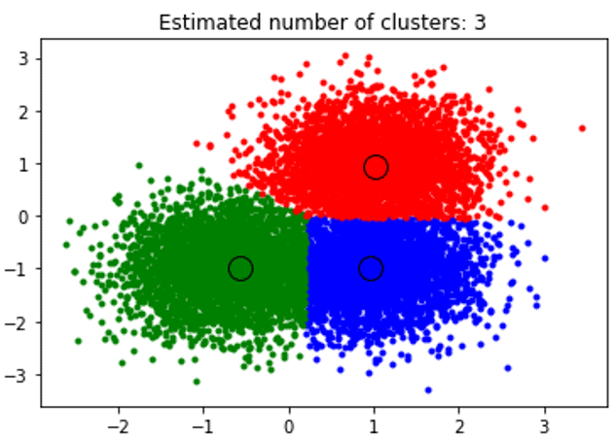
Contents
Meanshift algorithm

Slide 3
What is meanshift algorithm
Mean Shift Algorithm is an unsupervised learning technique, is one of the clustering algorithms that is associated with the highest density points or mode value as the primary parameter for developing machine learning.

Slide 4
Intuitive Description
Region of
interest
Center of
mass
Mean Shift
vector
Objective : Find the densest region
Distribution of identical billiard balls

Slide 5
Intuitive Description
Region of
interest
Center of
mass
Mean Shift
vector
Objective : Find the densest region
Distribution of identical billiard balls

Slide 6
Intuitive Description
Region of
interest
Center of
mass
Mean Shift
vector
Objective : Find the densest region
Distribution of identical billiard balls

Slide 7
Intuitive Description
Region of
interest
Center of
mass
Mean Shift
vector
Objective : Find the densest region
Distribution of identical billiard balls

Slide 8
Intuitive Description
Region of
interest
Center of
mass
Mean Shift
vector
Objective : Find the densest region
Distribution of identical billiard balls

Slide 9
Intuitive Description
Region of
interest
Center of
mass
Mean Shift
vector
Objective : Find the densest region
Distribution of identical billiard balls

Slide 10
Intuitive Description
Region of
interest
Center of
mass
Objective : Find the densest region
Distribution of identical billiard balls

Slide 11
other demos in opencv
https://docs.opencv.org/3.4/d7/d00/tutorial_meanshift.html

Slide 12
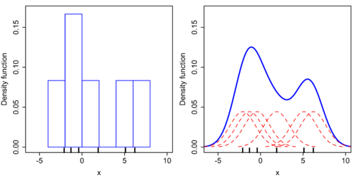
Segmentation with meanshift
Non-Parametic Density Estimation
6 data points -2.1, -1.3, -0.4, 1.9, 5.1, 6.2. Let’s draw the histogram. Set width of each bin as 2 and we can get following histogram (left one) (from wiki).

Slide 13
Disadvantages of histogram
1. It is not smooth.
2. It highly depends on the width of the bin and the start point.
We should calculate the probability density of every point (right one).

Slide 14

For 2D image, change the shape of the “bins” to a circle. We can simply count the number of the points inside the circle and divided by the total number to get the density distribution p=K/N. If the circle is small enough, we can get
The histogram is the density estimation and the counting function is called kernel function.

Slide 15
processing of meanshift
Mean Shift Segmentation should have three steps:
Filtering (Mode Searching)---key part
Merge Similar Regions (Mode clustering)
Merge Small Regions

Slide 16
Filtering process is the main part of the algorithm.
1 Determined the Uniform kernel for filtering.
2 Based on one point((R, G, B, x, y)), within the space bandwidth, calculate every point color distance to the center point.
3 For all points, which color distance is within the color bandwidth, calculate the shift vector.
4 for the center point and add together.
5 Shift the center point. center = center + shift (include color).
6 Repeat above steps and stop after 5 iterations or the center point doesn’t move.
7 Assigned color to the original point the color. This original point belong to this cluster.

Slide 17

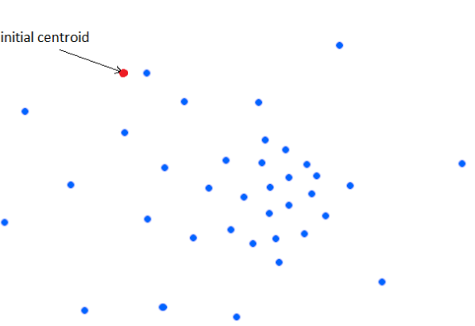
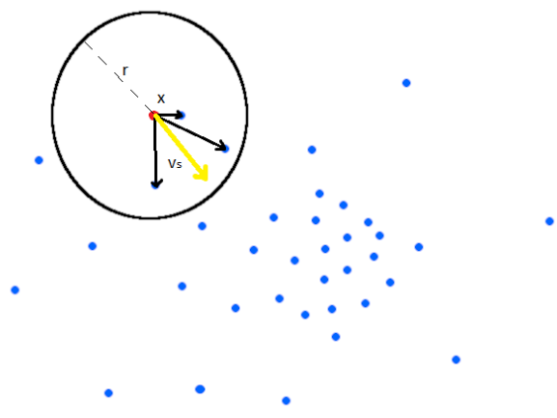
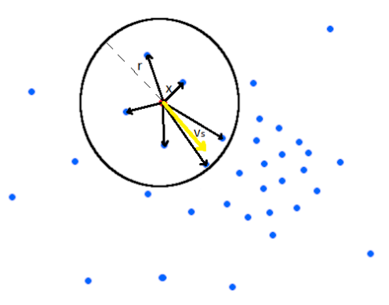
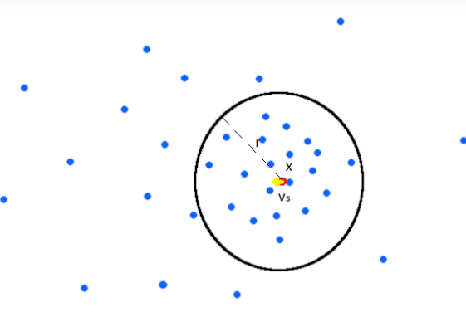

Slide 18
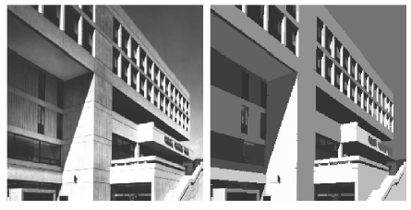
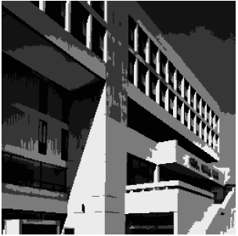
segmentation
…when feature space is only
gray levels…

Slide 19
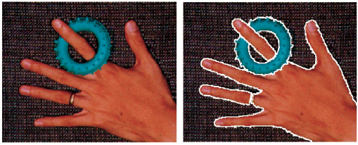
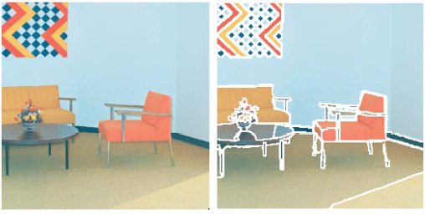
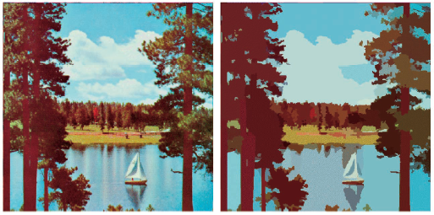

Slide 20
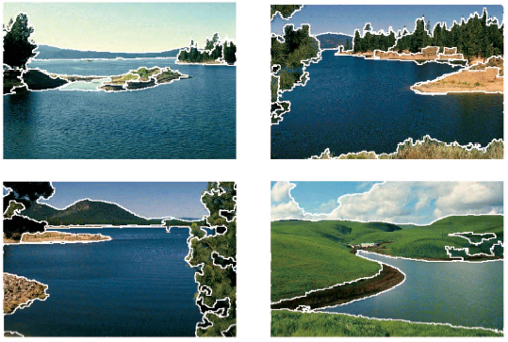
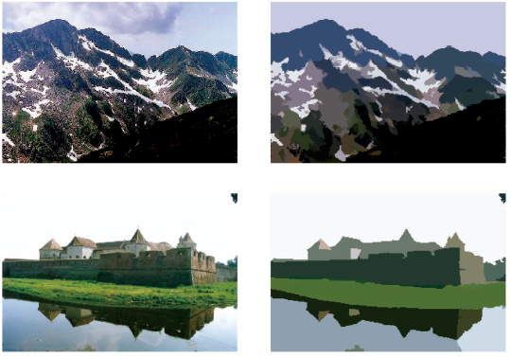

Slide 21
Another applications of meanshift
clusetering
tracking
smoothing

Slide 22
clustering

Slide 23
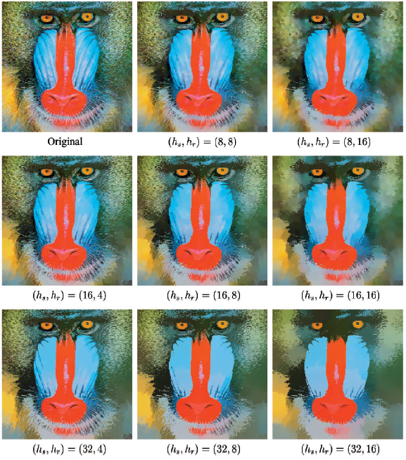
Smoothing
The effect of
window size
in spatial and
range spaces

Slide 24
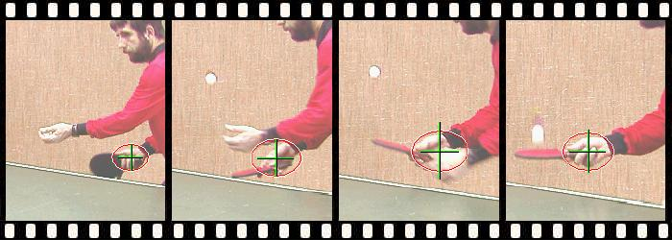
Tracking

Slide 25
Exercise
Doing clusetering using meanshift
Segmentation using meanshift

