Slide 1
Image processing
Shifeng Li
2020.8

Slide 2
Content
My self
python install
Digital image processing(Introduction)

Slide 3
Introduction of myself
Name:Shifeng Li(chinese name)
Research:CV(computer vision)
Education:
- Bachelor: Liaoning university of technology
- Master: Northeast University
- Doctor: Dalian University of technology

Slide 4
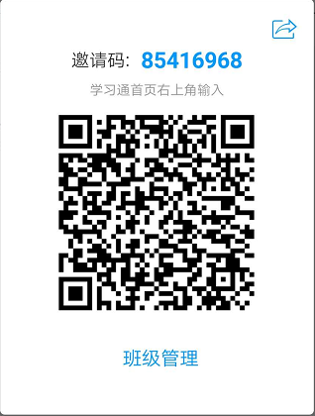
Join the class
scan this 2-d code and join the class

Slide 5
Requirements
familar with python
has some knowlegy of the 3rd part library (opencv, numpy, matplotlib, sklearn, pandas, and so on)
can use one IDE for code (spyder, pycharm, visual code, jupyter, etc)

Slide 6
python
install anaconda https://www.anaconda.com/products/individual

Slide 7
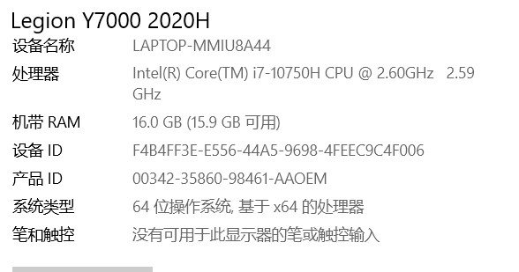
python installing
first open the proerty of the my computer(win10)
check the type of the OS

Slide 8
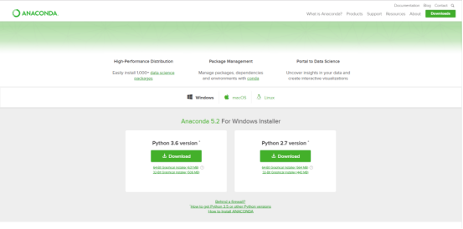
then download the right version of anacoda from web (https://www.anaconda.com/products/individual)

Slide 9
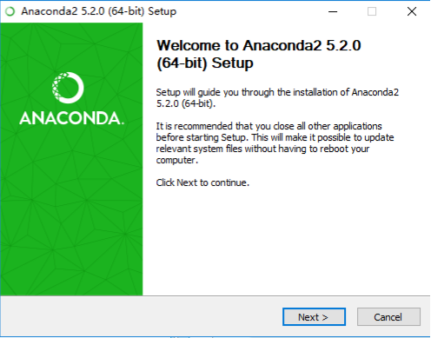
install the anaconda,next,

Slide 10
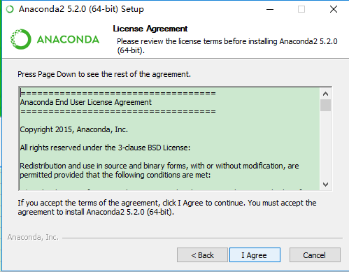
I agree

Slide 11
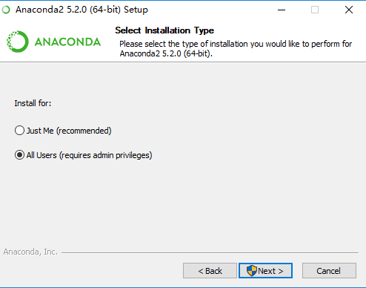
just me or all users

Slide 12
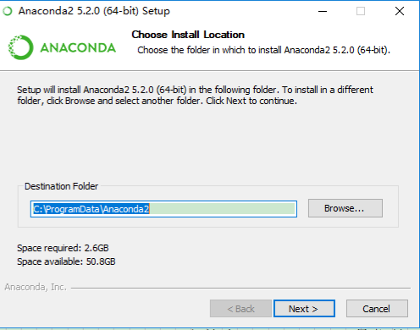
select the suitable path

Slide 13
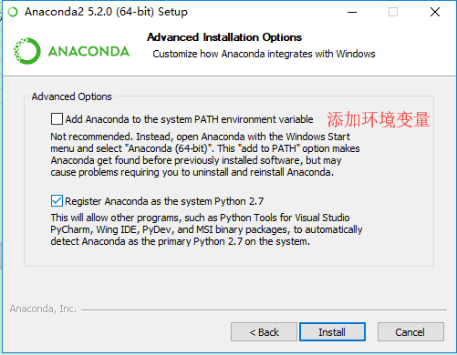
add the environment path

Slide 14
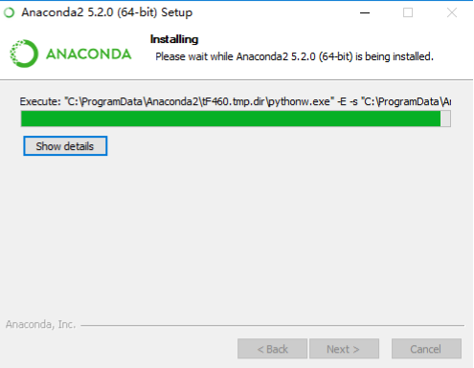
just wait

Slide 15
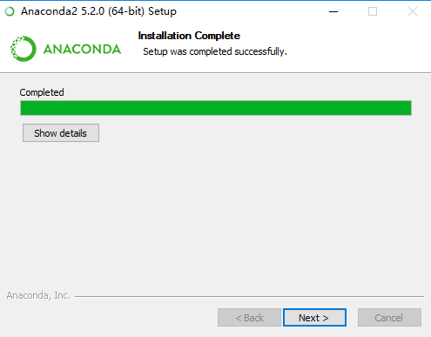
when the installation is finished

Slide 16
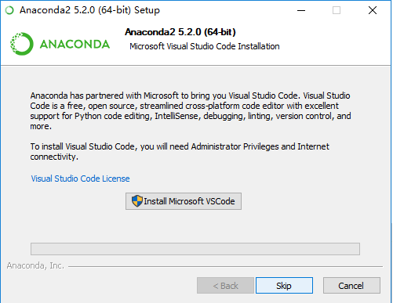
you can install the vscode,or not install it

Slide 17
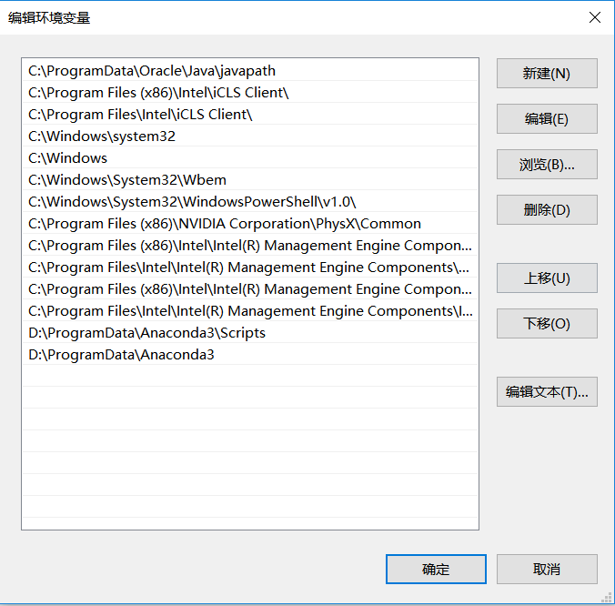
Last config the OS path, add the installation path into the OS environment(vesion3.6 is not needed)

Slide 18
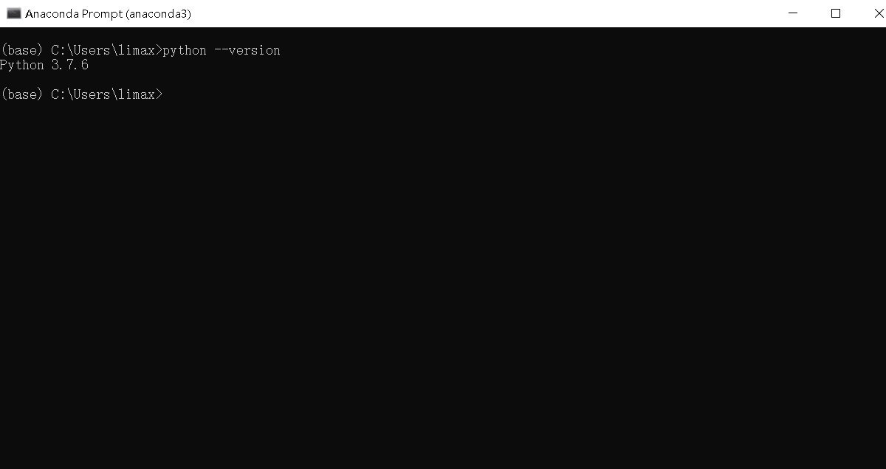
Test the anaconda
open the cmd or anaconda,input the commends: python --version

Slide 19
congratulation!
you have installed the python successfully,
Next familar with the tools for code (pycharm, vscode, jupyter, spyder)

Slide 20
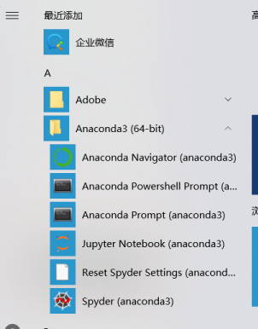
Jupyter
when you finished the installation, you can see from the start menu:

Slide 21
click the jupyter notebook

Slide 22
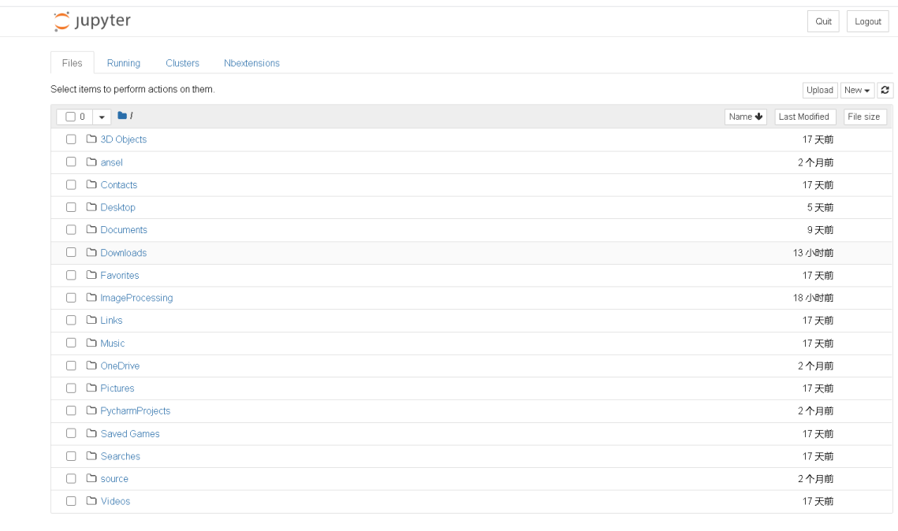
notebook in the brower

Slide 23
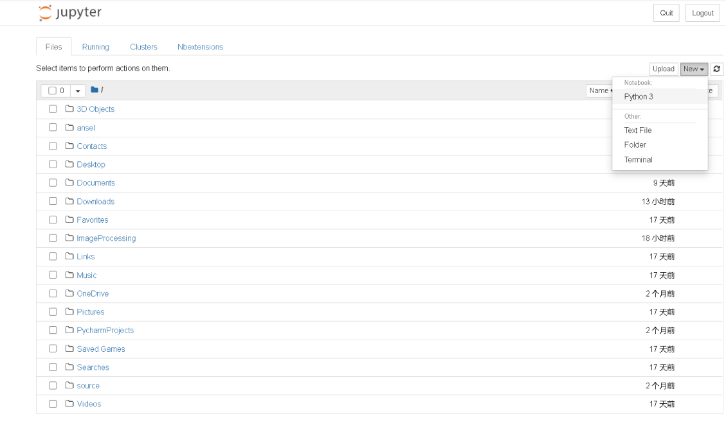
click new --> python3, coding can be began

Slide 24
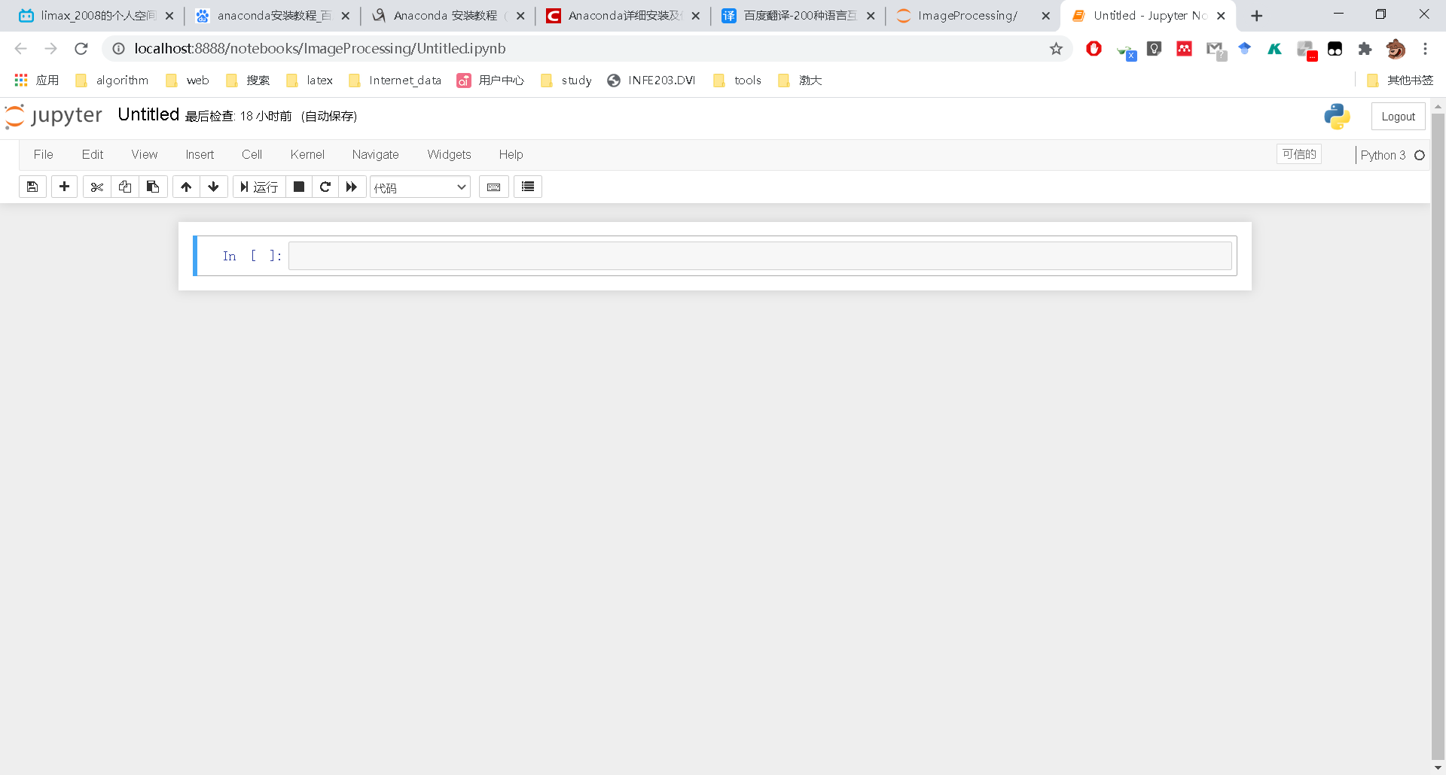
input the python code, begin your programming

Slide 25
spyder
start menu, click spyder

Slide 26
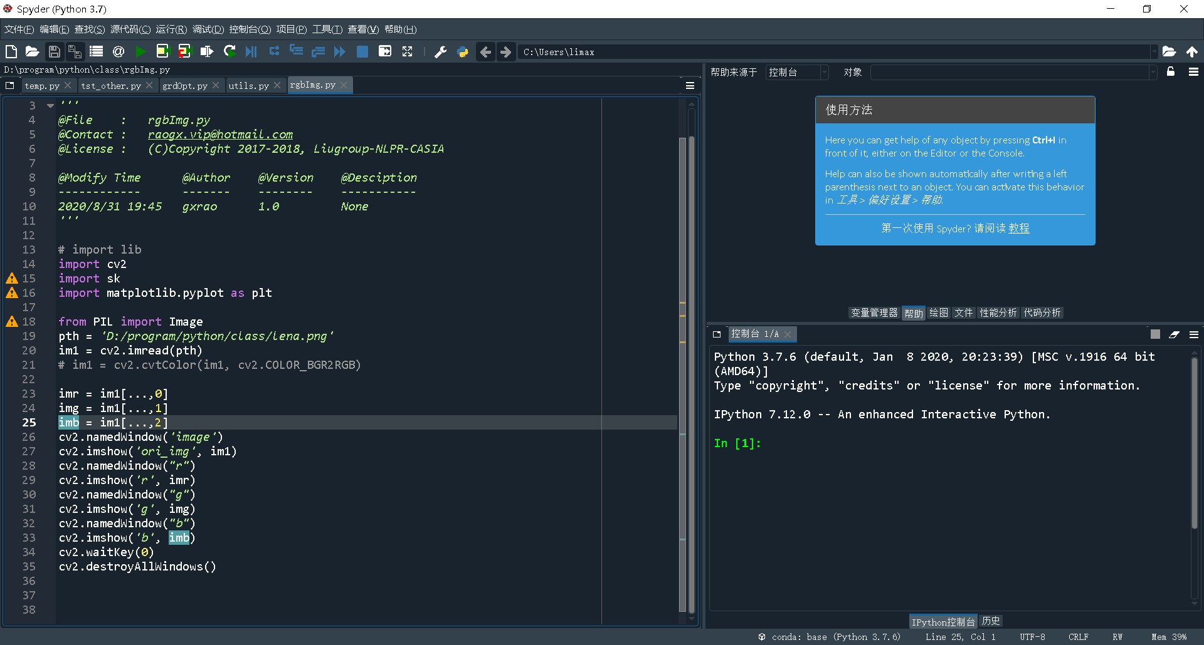
open the spyder

Slide 27
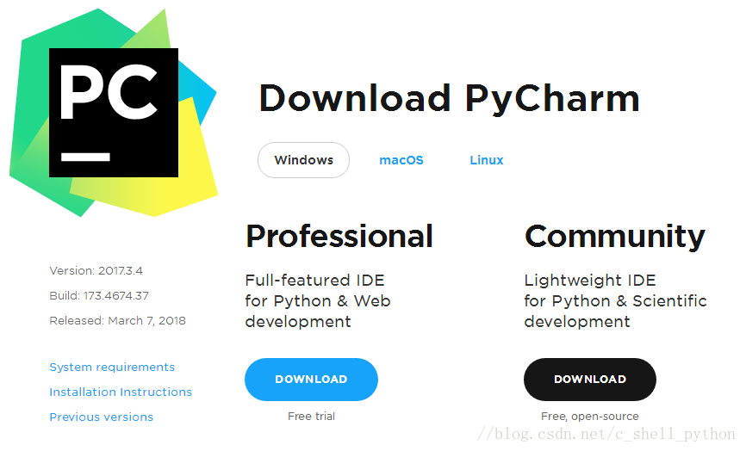
pycharm
first you must download the pycharm from https://www.jetbrains.com/pycharm/download/

Slide 28
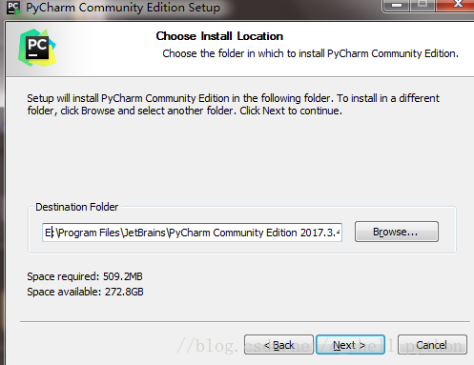
then install the software, just like the anaconda, select the appropriate path, next, next ..., utill the finish

Slide 29
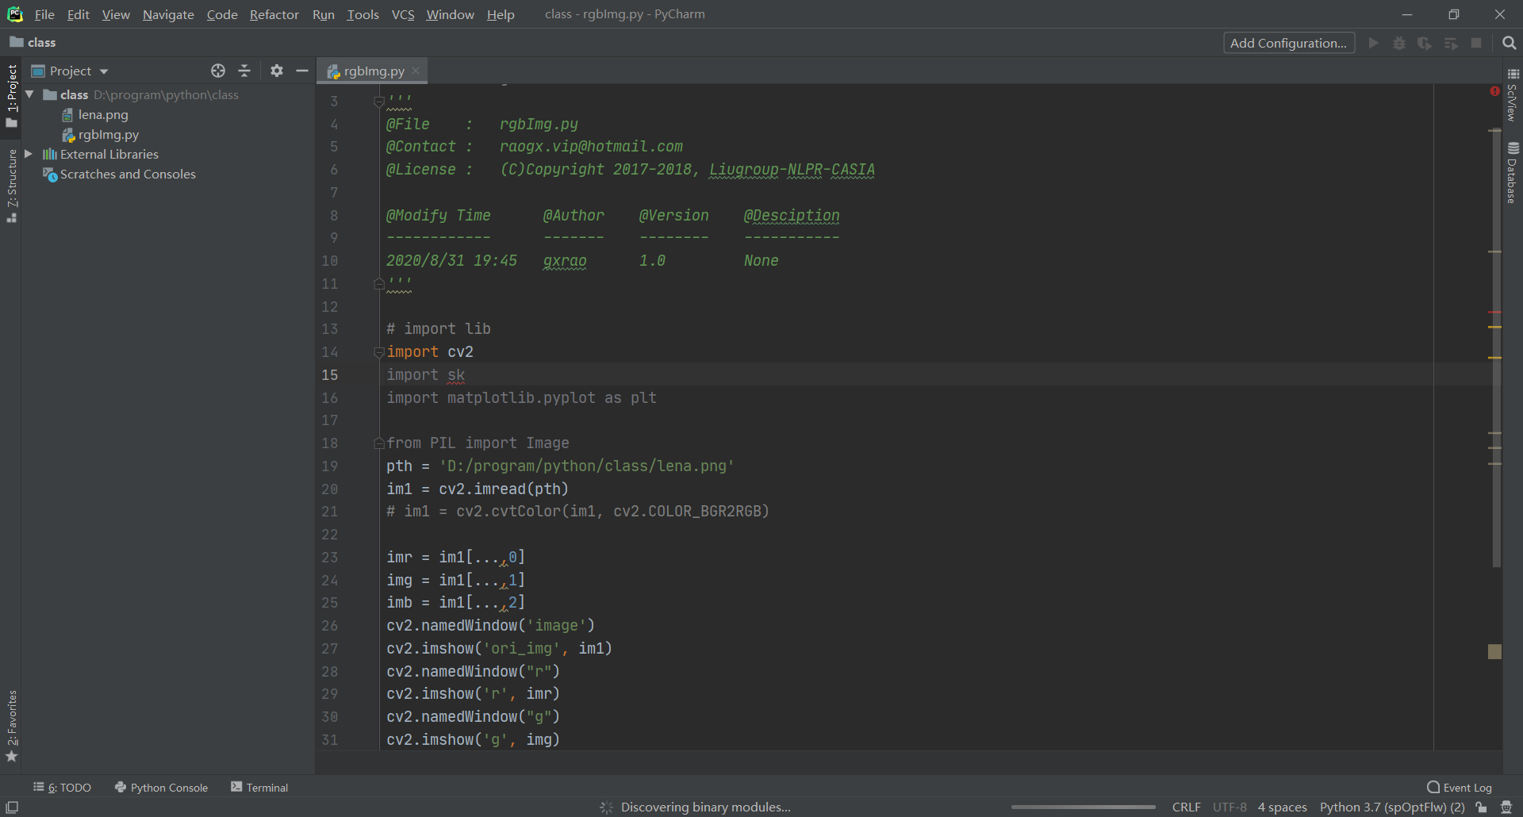
pycharm
start menu, click pycharm

Slide 30
then new a file, and begin the coding

Slide 31
Introduction
Digital image
Digital image processing
Pixel

Slide 32
Digital image
a two-dimensional function
  x and y are spatial coordinates
  The amplitude of f is called intensity or gray level at point (x,y)

Slide 33
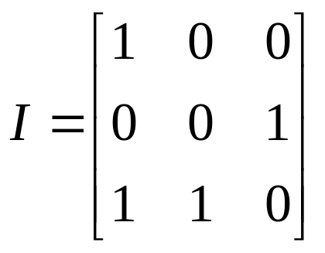
Black-white image
black-white image with value 0 and 1
y
x

Slide 34
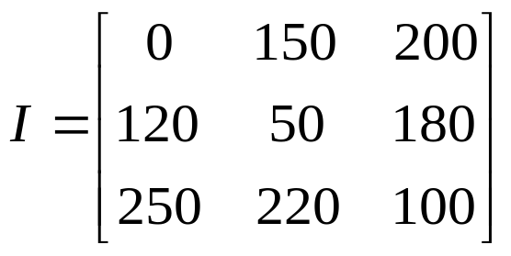
Gray image
gray-level image with values 0-255
灰阶
黑
0
灰
128
白
255

Slide 35
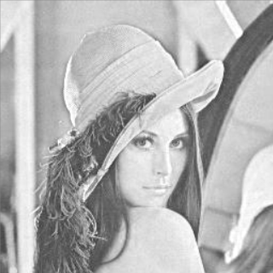
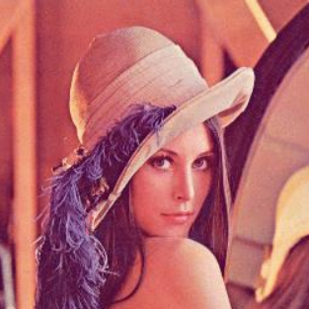
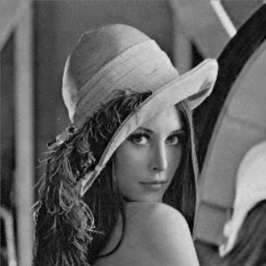
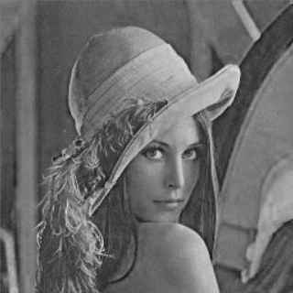
Color image
Color image with RGB channels
R
G
B

Slide 36
Digital image processing
process digital images by means of computer; it covers low-, mid-, and high-level processes
  low-level: inputs and outputs are images
  mid-level: outputs are attributes extracted from input images
  high-level: use computer to emulate human vision

Slide 37
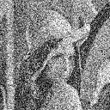
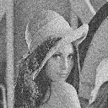
Low-level processing
noise image
denoised image

Slide 38
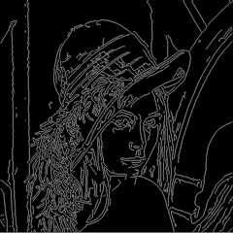

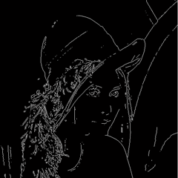
Mid-level processing
Canny detection
Sobel detection

Slide 39
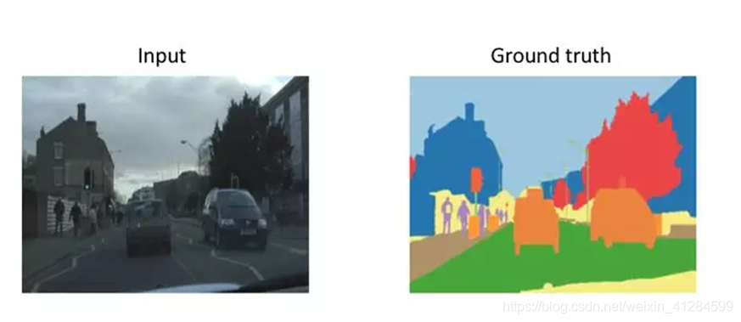

Slide 40
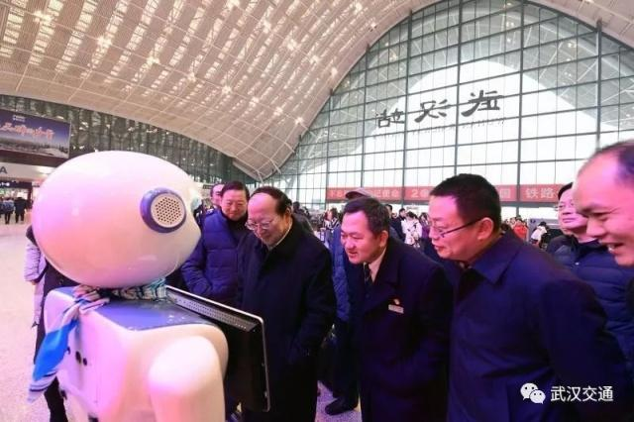
High-level processing
use the computer to do something like people (station robot, answer some simple questions).

Slide 41
Pixel
the element of a digital image; they are aslo called picture elements, image elements, pels, etc

Slide 42
9 pixels in this black-white image

Slide 43
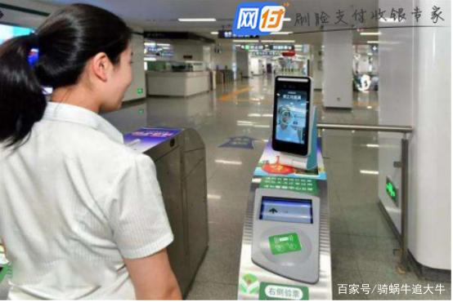
Applications of image processing
face recognition(supermart)

Slide 44
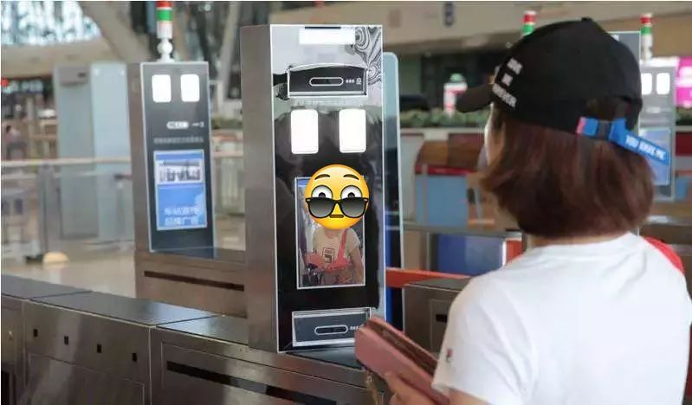
train station

Slide 45
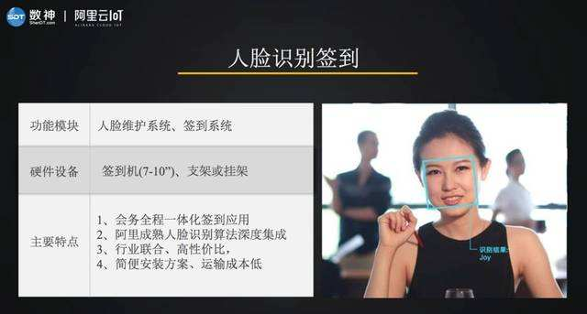
class sign in

Slide 46
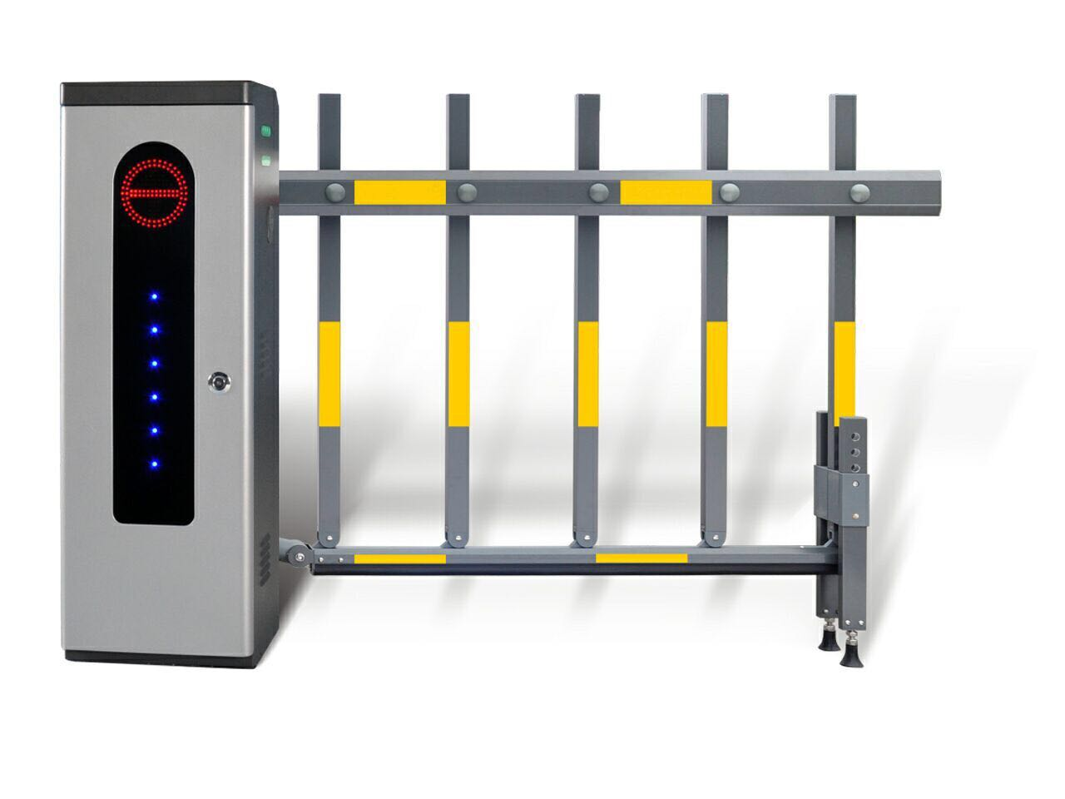
Vehicle license plate detection
recognize the license plate (parking lot, school,..)

Slide 47
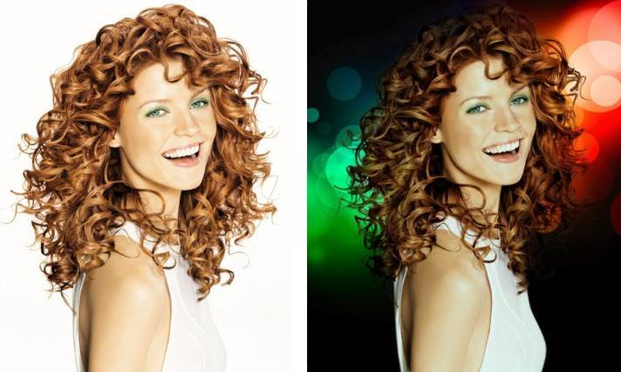
background remove

Slide 48
thank you

