Slide 1
Image basic operations
9.8

Slide 2
Today's contents
Opencv
-opencv installation
-opencv basic operations
Image operations
  -get pixels, property, ROI
  -channel split/combine
  -image fill,adding,mixing...

Slide 3
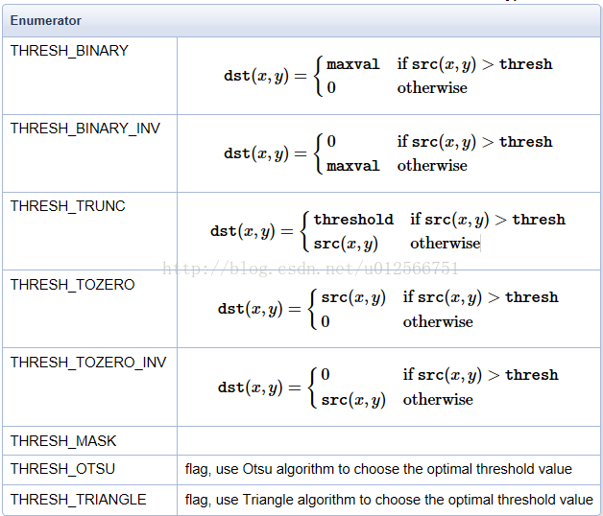
threshold function

Slide 4
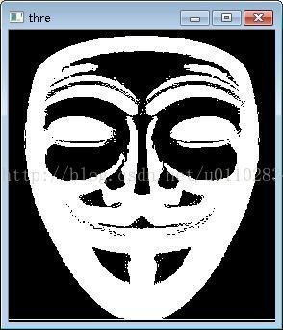
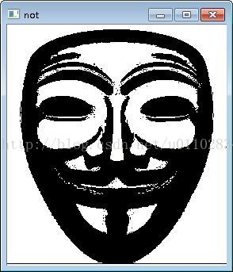
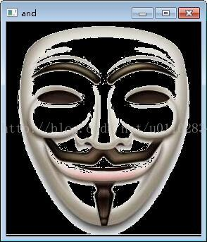

parameter:mask
cvtColor(faceMaskSmall, grayMaskSmall,CV_BGR2GRAY)
threshold(grayMaskSmall, grayMaskSmallThresh, 230, 255, CV_THRESH_BINARY_INV);
bitwise_not(grayMaskSmallThresh, grayMaskSmallThreshInv);
bitwise_and(faceMaskSmall, faceMaskSmall, maskedFace, grayMaskSmallThresh);
bitwise_and(frameROI, frameROI, maskedFrame, grayMaskSmallThreshInv)

