Slide 1
Deep learning for image processing
2020.12

Slide 2
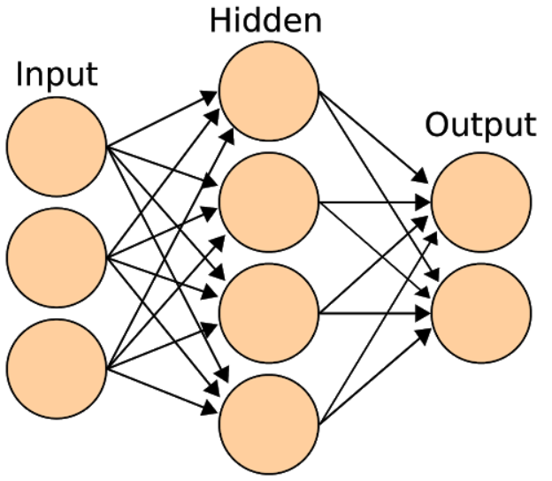
What is deep learning (DP)
Deep learning, an advanced artificial intelligence technique, has become increasingly popular in the past few years, thanks to abundant data and increased computing power.

Slide 3
Deep Learning vs. Machine Learning
Deep learning, a subset of machine learning, utilizes a hierarchical level of artificial neural networks to carry out the process of machine learning.
AI
ML
DL

Slide 4
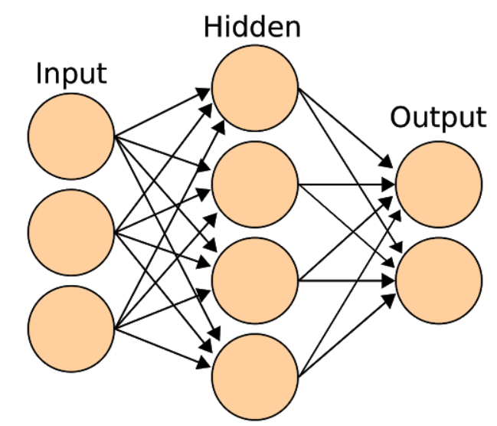
Deep Learning and Neural Networks
Deep-learning algorithms solve the same problem using deep neural networks, a type of software architecture inspired by the human brain.
Neural networks are layers upon layers of variables that adjust themselves to the properties of the data they're trained on and become capable of doing tasks such as classifying images and converting speech to text.

Slide 5
What Is Deep Learning Used For?
Computer vision
Voice and speech recognition
Natural language processing (NLP) and generation (NLG)
....
Bioinformatics

Slide 6
Deep learning framework
pytorch
tensorflow
caffe
mxnet
...

Slide 7
How to deep learning
Install pytorch

Slide 8
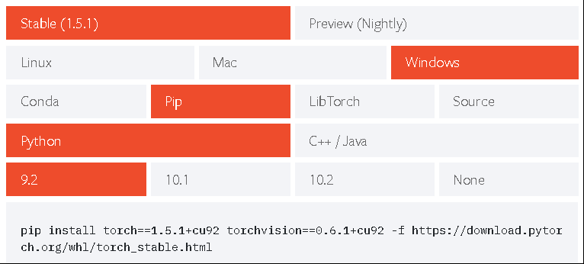
pytorch
pytorch installation from https://pytorch.org/get-started/locally/

Slide 9
Basic operations of pytorch
scalar
tensor
variable
slice
operations

Slide 10
gradient upated with pytorch
data ready
forward pass
compute the loss
backward to compute the gradient
upadte weights

Slide 11
Training procedure for a neural network
Define the neural network that has some learnable parameters (or weights) supervise learning
Iterate over a dataset of inputs
Process input through the network
Compute the loss (how far is the output from being correct)
Propagate gradients back into the network’s parameters
Update the weights of the network, typically using a simple update rule: weight = weight - learning_rate * gradient

Slide 12
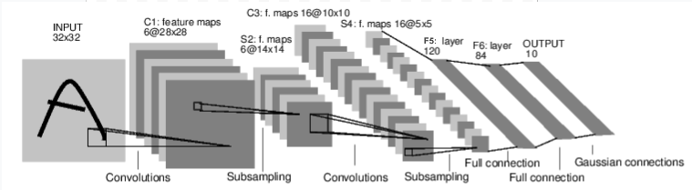
CNN on the digit image
AlexNet

Slide 13
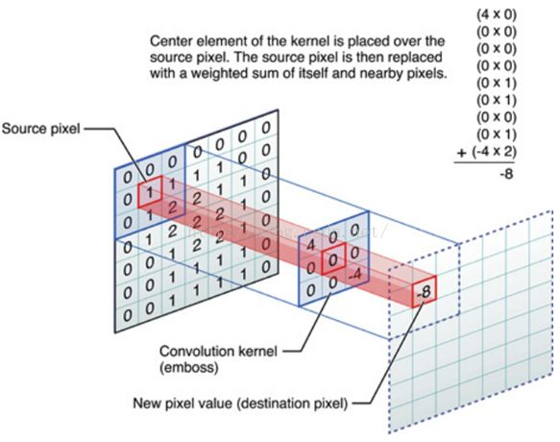
convolution

Slide 14
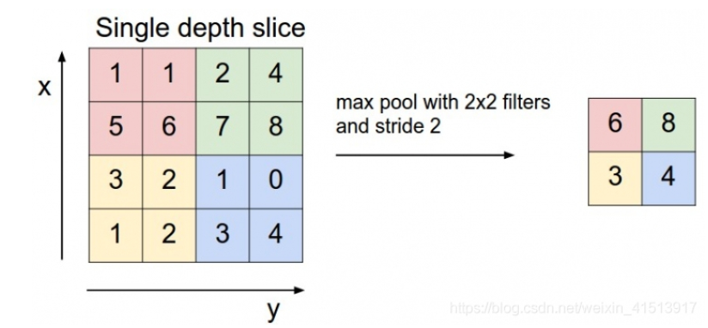
maxpooling

Slide 15
relu

Slide 16
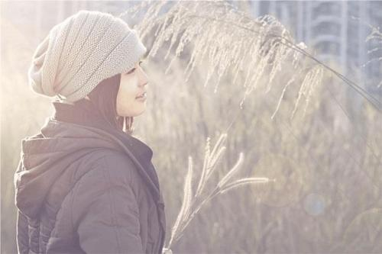
Last assignment
Read one color image with an object in the center, such as people, dog, etc.
Processing the image as follows:
resize the image into 480*360, and smoothing the image on spatal domain
do a horizontal mirror to the image
show the Spectrum of the rotated image, and try to keep the details on the temporal domain
change the original image into gray image
show the histogram of the gray image
show the edges using one method
binarize the gray image with adaptive threshold
remove the blobs whose area is smaller than 40 pixels
do segmentation on this image using watershed
segment the object with graph cut

Slide 17
Requirements
The code is recommened with jupyter, and you should write suitable comments for the codes.
You can do it on the next class or finish it in your spare time.
You must finish it before Dec. 29, and pass it to me by wechat or upload it to my email: 275268490@qq.com

Slide 18
Thank you

