Slide 1
Color spce and edge detection
2020.10

Slide 2
Contents
Color space
Edge detection

Slide 3
Color space
There are many color spaces in image processing, such RGB, HSV, Lab, YUV...

Slide 4
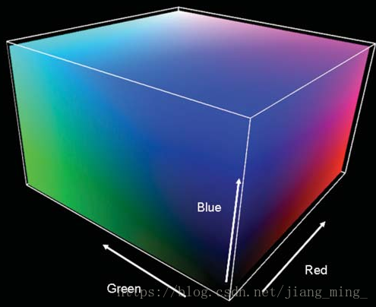
RGB color space
Original point corresponding to the black, the diagonal stands for the gray.
The brightness of each color is represented by 0-255,
the whole color is 256^3

Slide 5
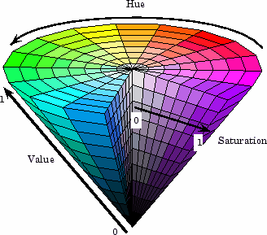
HSV color space
Hue (H), Saturation (S), Value (V)
Hue represents the wavelength of light reflected from the object (color of name).
Saturation is the depth of the color, such as dark red, light red.
Value is the brightness of the color.

Slide 6
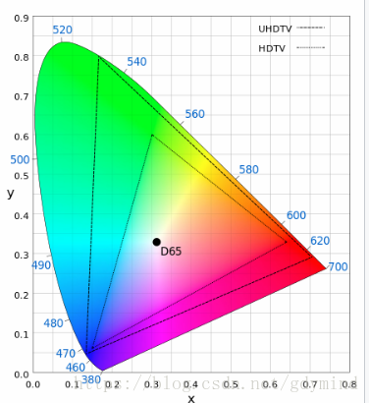
CIELab color space
L is lightness, A represents the components from green to red. B represents the components from blue to yellow.
Lab is device-independent, and more in line with human visual perception

Slide 7
Changing Color-space
There are more than 274color-space conversion methods available in OpenCV.
flag = [i for i in dir(cv2) if i.startswith('COLOR_')]
print(flag)
print(len(flag))

Slide 8
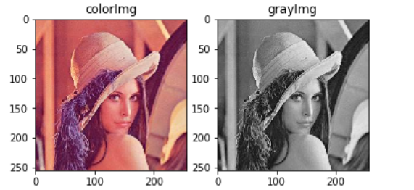
RGB->Gray
img = cv2.cvtColor(im, cv2.COLOR_RGB2GRAY)

Slide 9
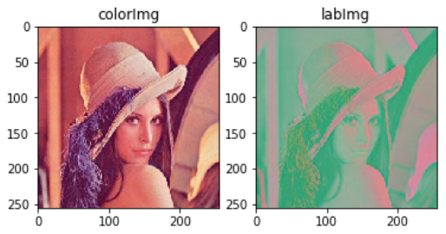
RGB->LAB
img = cv2.cvtColor(im, cv2.COLOR_RGB2LAB)

Slide 10
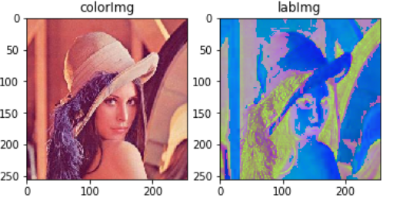
RGB->HSV
img = cv2.cvtColor(im, cv2.COLOR_RGB2HSV)

Slide 11
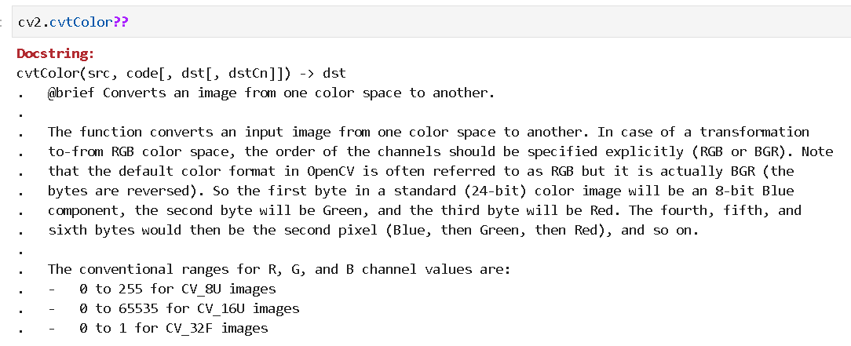
color space conversion function

Slide 12
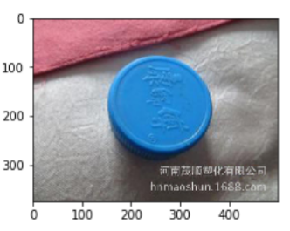
how to extract the blue bottle cab
from the image?

Slide 13
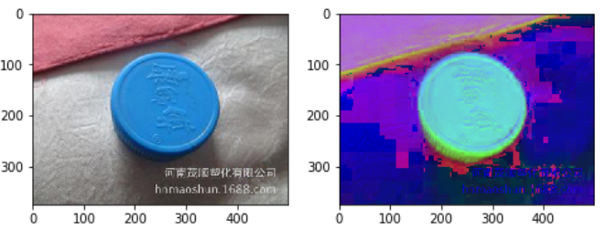
Demo in HSV space
In HSV, it is more easier to represent a color than in BGR color-space.

Slide 14
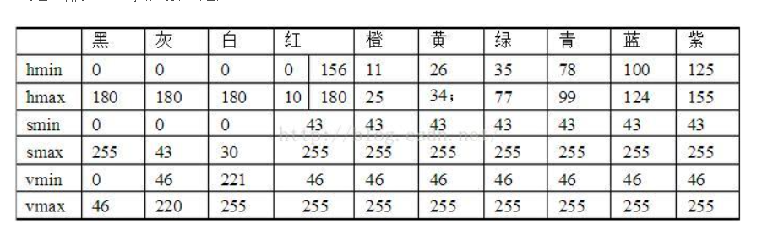
Exercies
lower_blue = np.array([100, 43, 46])
upper_blue = np.array([124, 255, 255])
Find the bottle cap in the image
blue

Slide 15
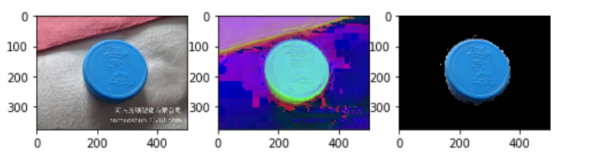

Slide 16
Edge detection
edge filters:
gradient, sobel filter, laplacian
canny edge detection

Slide 17
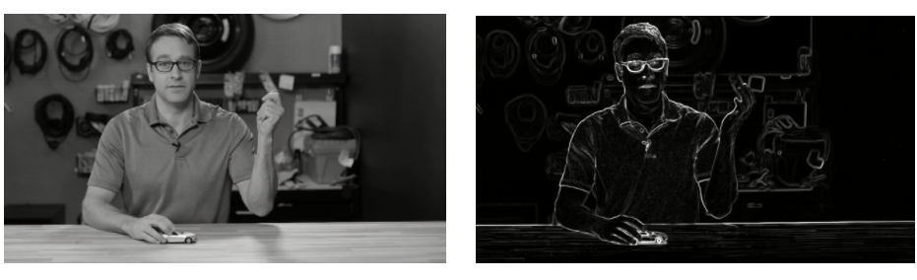
Canny edge detection
Step1: Noise Reduction
Step2: Finding Intensity Gradient of the Image
Step3: Non-maximum Suppression
Step4: Hysteresis Thresholding

Slide 18
step1-Noise Reduction
Remove the noise in the image with a 5x5 Gaussian filter.

Slide 19
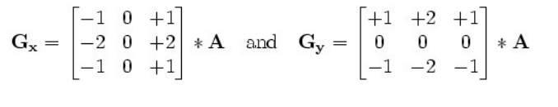
step2-Finding Intensity Gradient of the Image
Using sobel kernel for gradient

Slide 20
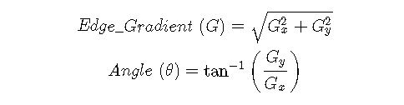
Find edge gradient and direction for each pixel,
is rounded to one of four angles representing
vertical, horizontal and two diagonal directions.

Slide 21
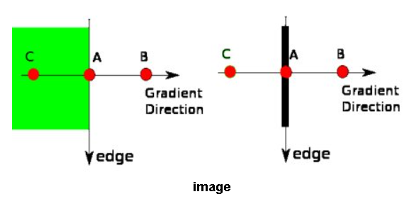
step3-Non-maximum Suppression
Pixel is checked if it is a local maximum in its neighborhood in the direction of gradient
Point A is on the edge, Point B and C are in gradient directions. So point A is checked with point B and C to see if it forms a local maximum.

Slide 22
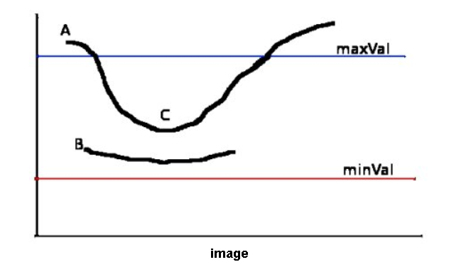
step4-Hysteresis Thresholding
sure-edge
Any edges with intensity gradient more than maxVal are sure to be edges and those below minVal are sure to be non-edges.
If the edges are connected to "sure-edge" pixels, they are considered to be part of edges
This stage also removes small pixels noises on the assumption that edges are long lines.

Slide 23
Canny edge detection in opencv
cv2.Canny(im, threshold1, threshold2[, edges[, L2gradient]]) -> edges

Slide 24
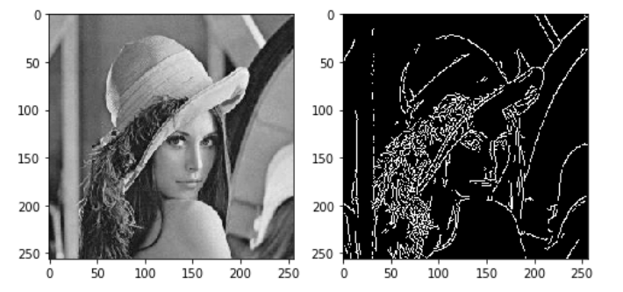
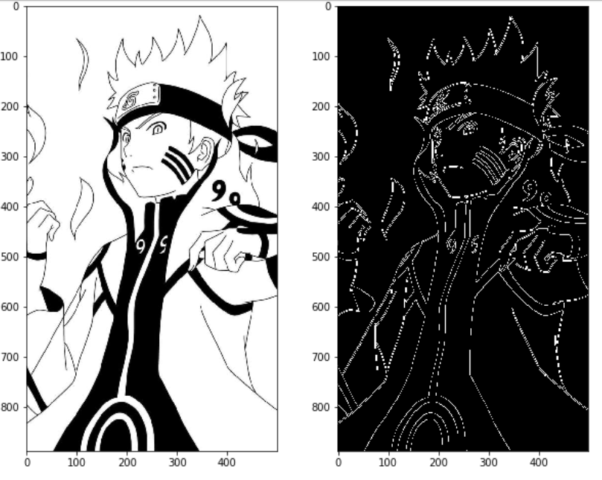
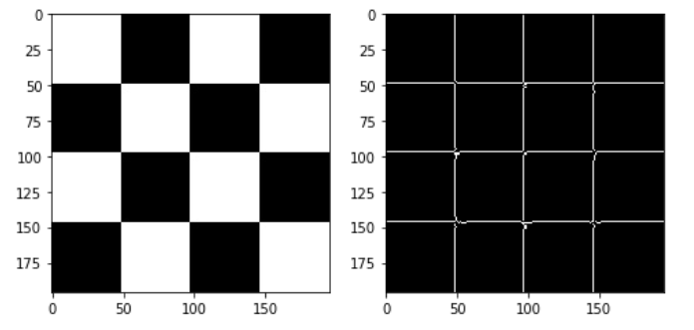

Slide 25
exercises
color space conversion to different color space
find the edge using canny detector
find the blue region in color space

Slide 26
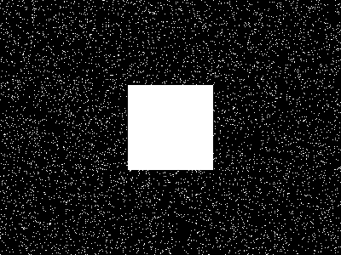
Homework1
There is one noise image (down load from my github)
1. Try to remove the noise of the image
2. Find the edge of the object
3. finish the work and commit it to me

Slide 27
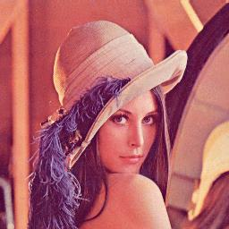
Homework2
find the edge using at least 3 methods

Slide 28
Requirements
finishing the homework using jupyter file(.ipynb)
please upload the homework to my wechat or my email 275268490@qq.com

