Slide 1
Image filtering with kernels
2020.9.29

Slide 2
Two domains of image processing
Spatial domain (image kernel)
Transform domain

Slide 3
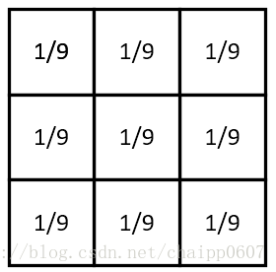
Kernel defination
An image kernel is a small matrix used to apply effects like the ones you might find in Photoshop, such as blurring, sharpening, outlining or embossing.

Slide 4
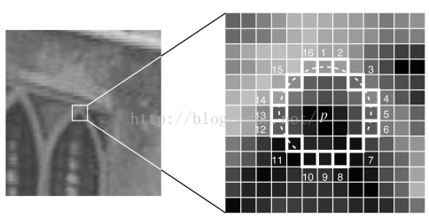
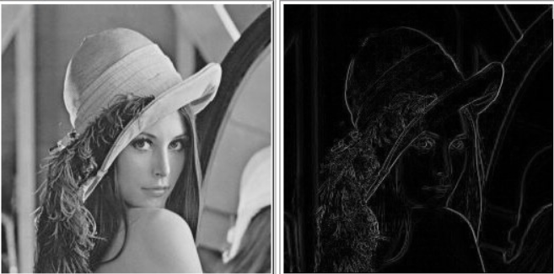
They're also used in machine learning for 'feature extraction', a technique for determining the most important portions of an image.

Slide 5
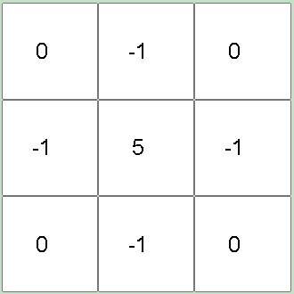
How to work
For each 3x3 block of pixels in the image, we multiply each pixel by the corresponding entry of the kernel and then take the sum. That sum becomes a new pixel in the image on the output image.

Slide 6
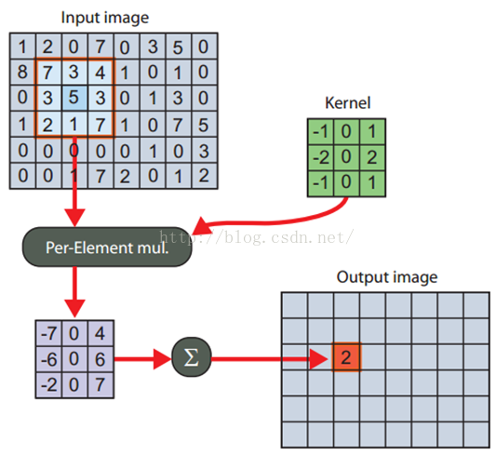
How to work
The position of the
kernel operation
result in the output
image is usually
the same
as the one in the
original image.

Slide 7
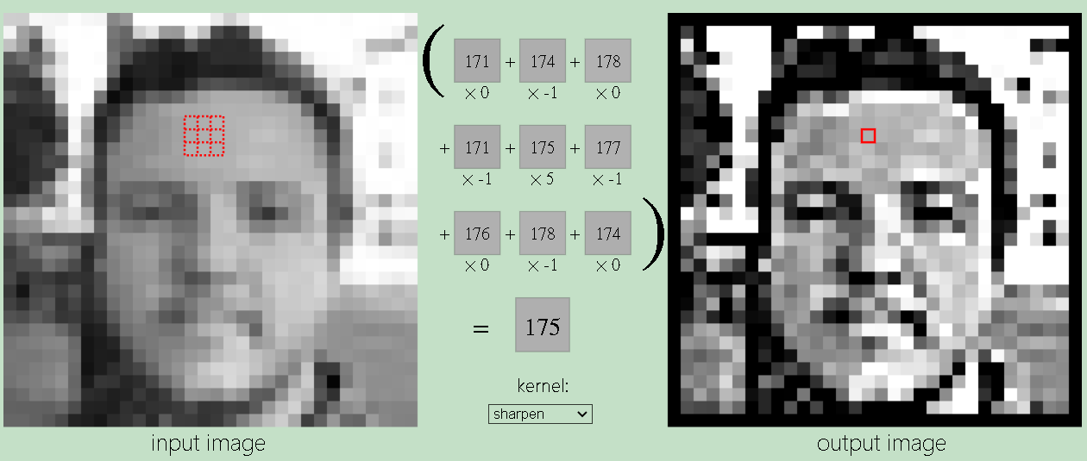
How to work

Slide 8
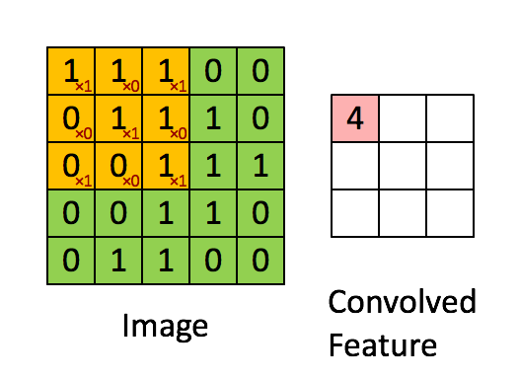
kernel operations
1 | 0 | 1
0 | 1 | 0
1 | 0 | 1

Slide 9
For more detials, please refer to https://setosa.io/ev/image-kernels/

Slide 10
Some common kernels
smooth kernels(gaussian, mean )
edge kernels (gradient, sobel, laplacian)
sharpen kernel
emboss kernel

Slide 11
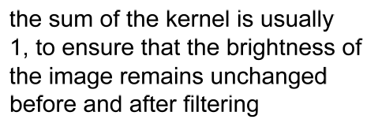
Mean filtering

Slide 12
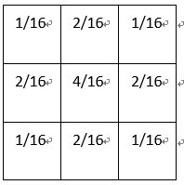
Guassian kernel
The weight in the center is larger
than the surrounding.

Slide 13
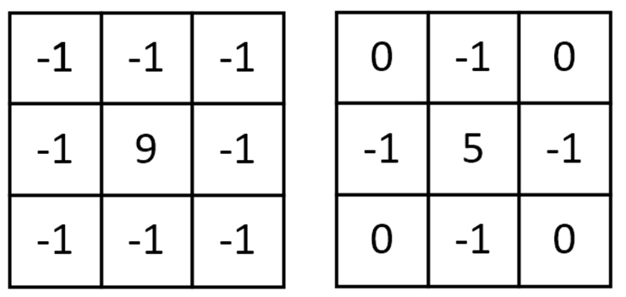
Sharpen kernel
eight directions
forth directions
The value in the center
is more larger than
surrouding pixels, enhance
the contrast

Slide 14
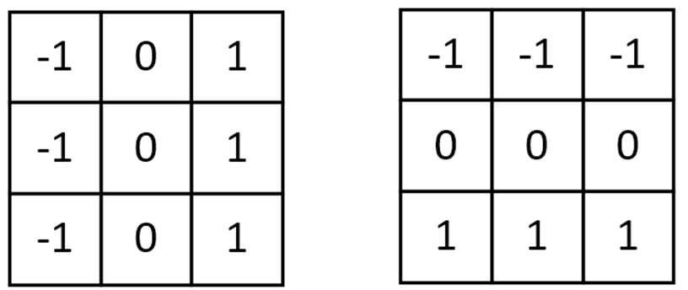
Gradient kernel
vertical gradient
horizontal gradient
Horizontal gradient and vertical gradient

Slide 15
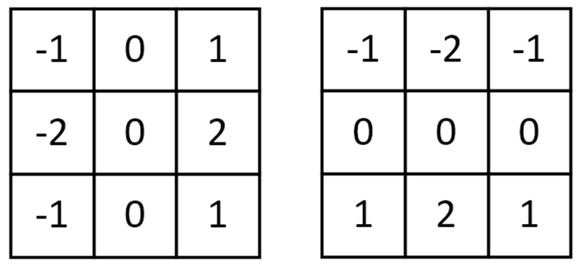
Sobel kernel
vertical
Horizontal
Similar with gradient kernel, but focus on the adjacent pixels

Slide 16

Laplacian
A another sharpening method, can also be used for edge detection, and has no limitation to horizontal and vertical directions.

Slide 17
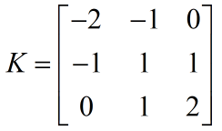
Emboss kernel
There are postive and negative
values in the kernel, the values
mainly on the line from left-top
to right-bottom.

Slide 18
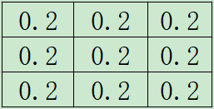
Exercise 1
1.Define one kernel using numpy, such as mean kernel.
2.Fill the image boundary with suitable pixels.
3.Define a function for filtering.
4.Do the image filtering with the defined funciton of the mean kernel.
5.Show the results.
6.Change the kernel values and make the sum of elements larger than 1, then do the convolution, what is the result different from the last one.

Slide 19
Exercise 2
Convolution using opencv
1.Define one kernel using numpy, such as sobel kernel.
2.Convolution with funciton (cv2.filter2D)
3.Show the results.

Slide 20
Exercise 3
Comparison with different kernels: Gradient and sobel kernels
1.Define two different kernels:Gradient and sobel kernels;
2.Convolution with filter2D function;
3.Show the different of the results.

Slide 21
Conclusion
Image kernel is one small matrix, which can be used for blurring, sharpening, outlining or embossing.
The effection can be obtained by sliding the kernel one by one on the input image.
cv2.filter2D() can used for image filtering.

