Slide 1
Graph cut for image segmentation
2020.11

Slide 2
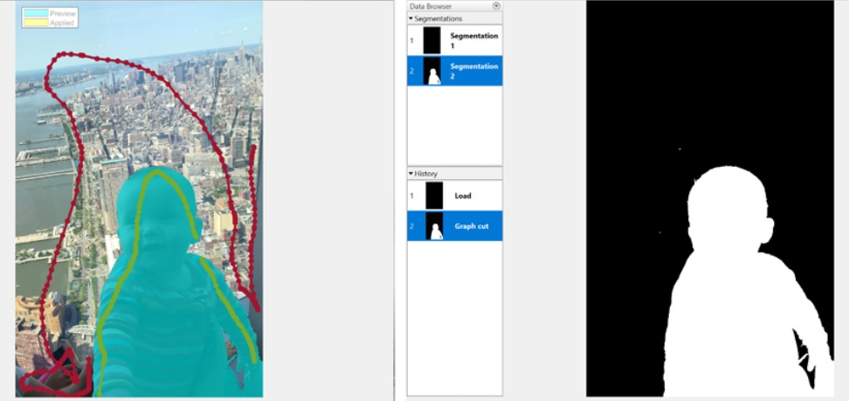
What is graph cut algorithm
Graph cut is a semiautomatic segmentation technique that you can use to segment an image into foreground and background elements.

Slide 3
Characteristics of graph cut
interactive segmentation: user labels some pixels
binary label: foreground vs. background
algorigthm settings: hard constraints+smoothness constraints
segment using min-cut/max flow

Slide 4
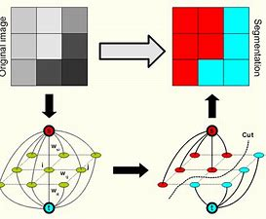
How to work?
The Graph Cut technique applies graph theory to image processing to achieve fast segmentation. The technique creates a graph of the image where each pixel is a node connected by weighted edges.

Slide 5
Steps of graph cut
1. create the graph for the image
2. do the segmentation using min/max flow algorithm

Slide 6
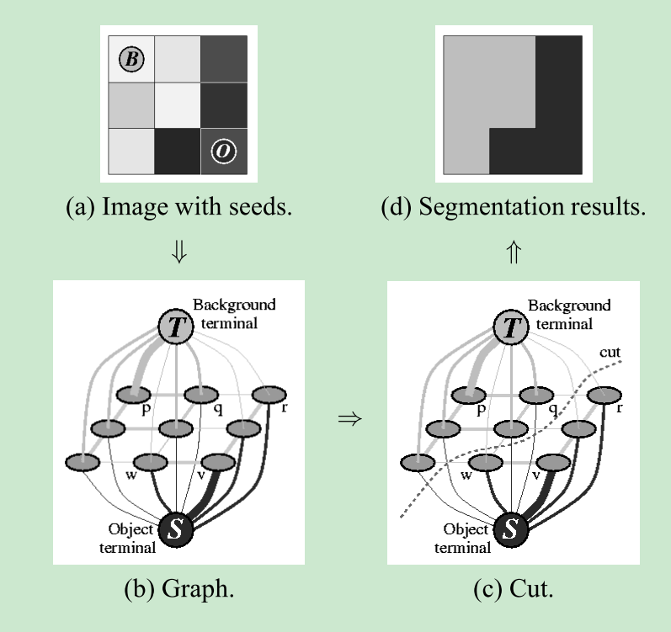
Toy demo

Slide 7
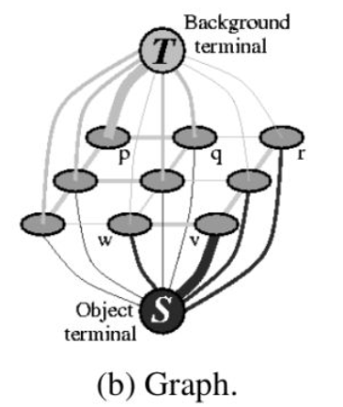
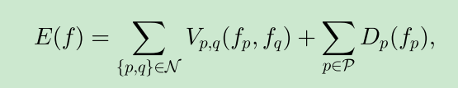
Create the segmented graph

Slide 8
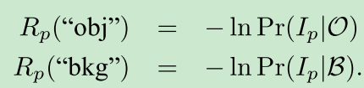

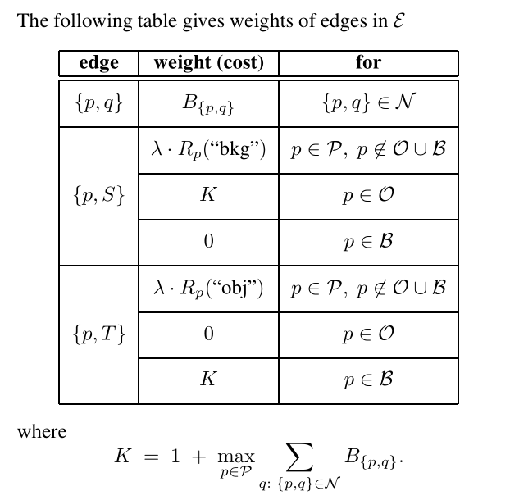
How to set the weight
Yuri Boykov, Marie-Pierre Jolly. Interactive Graph Cuts for Optimal Boundary & Region Segmentation of Objects in N-D Images

Slide 9
nodes: image pixels+S+T
edges: unary terms + pairwise terms
N consists of adjacent pixels,
Dp measures how well label fp fits pixel p given the
observed data.

Slide 10
Min-cut/max-flow algorithm
This theorem states that the maximum flow through any network from a given source to a given sink is exactly the sum of the edge weights that, if removed, would totally disconnect the source from the sink.

Slide 11
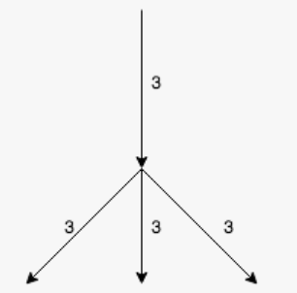
Intutive of max-flow
S
It is a network with four edges. The source is on top of the network, and the sink is below the network. Each edge has a maximum flow (or weight) of 3. How much flow can pass through this network at any given time?
sink

Slide 12
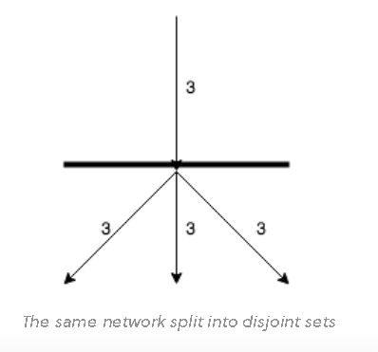
The bottom three edges can pass 9 among the three of them, true. However, the limiting factor here is the top edge, which can only pass 3 at a time. The minimum cut will be the limiting factor.

Slide 13
References
Boykov, Y., Veksler, O., & Zabih, R. (2001). Fast approximate energy minimization via graph cuts. IEEE Transactions on Pattern Analysis and Machine Intelligence, 23(11), 1222–1239.
Boykov, Y. Y. (2001). Interactive Graph Cuts for Optimal Boundary & Region Segmentation of Objects in N-D Image. July, 105–112.
Vladimir Kolmogorov, Ramin Zabih: What Energy Functions Can Be Minimized via Graph Cuts? IEEE Trans. Pattern Anal. Mach. Intell. 26(2): 147-159 (2004)

Slide 14
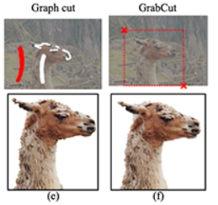
Grabcut
grabcut need to be provided a
rectangle of the object, it is a
improvement for the graph cut

Slide 15
Grabcut steps:
Step #1: Estimating the color distribution of the foreground and background via a Gaussian Mixture Model (GMM)
Step #2: Constructing a Markov random field over the pixels labels (i.e., foreground vs. background)
Step #3: Applying a graph cut optimization to arrive at the final segmentation

Slide 16
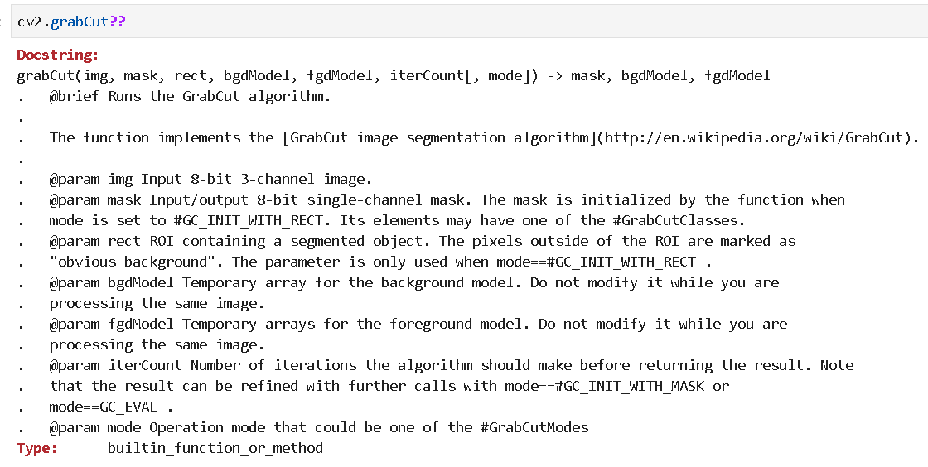
Graph cut and grabcut in opencv

Slide 17
Exercise
Grapbcut with rectangle
graph cut with mask

