Slide 1
Normalized cut for image segmentation
2020.11

Slide 2
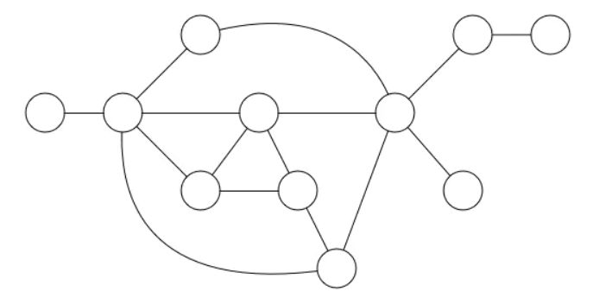
What is graph
A graph has nodes and edges
G = (V, E)，V is the vertex, and E is edge

Slide 3
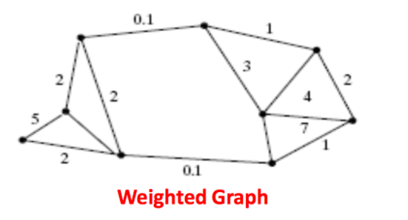
Weighted graph
the edge is defined by weight

Slide 4
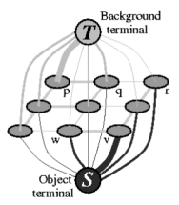
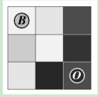
Segmentation with graph

Slide 5


min-cut
A
B
The graph can be partitioned into two
disjoint sets, A, B:
by simply removing edges connecting the two parts.
The degree of dissimilarity between these two pieces can be computed as total weight of the edges that have been removed.

Slide 6
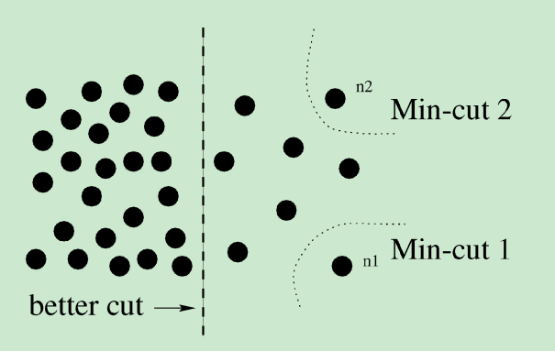
Disadvantage of min-cut
the minimum cut criteria favors cutting small sets of isolated nodes in the graph.

Slide 7
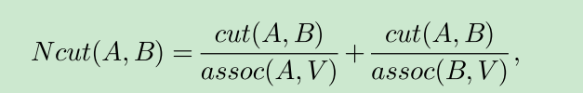
Normalized cut
A and B are the segmentated regions,
cut(A,B) is the weight sumrization of
all the weights from A to B.
assoc(A,V) is the total connection
from nodes in A to all nodes in the graph

Slide 8
Unfortunately, minimizing normalized cut exactly is NP-complete, even for the special case of graphs on grids.
can be computed efficiently by solving a
generalized eigenvalue problem.

Slide 9
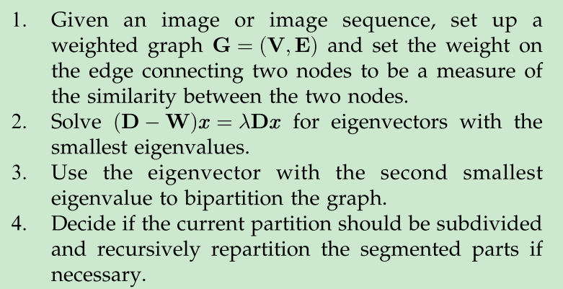
Normalized cut steps

Slide 10
Ncuts in sklearn
skimage.future.graph.cut_normalized(labels, rag, thresh=0.001, num_cuts=10, in_place=True, max_edge=1.0, *, random_state=None)
labels: The array of labels.
rag: The region adjacency graph.
thresh: The threshold. A subgraph won’t be further subdivided if the value of the N-cut exceeds thresh.
num_cuts: The number or N-cuts to perform before determining the optimal one.
max_edge: The maximum possible value of an edge in the RAG. This corresponds to an edge between identical regions. This is used to put self edges in the RAG.

Slide 11
Steps of graph cut
1. create the graph for the image
2. do the segmentation using min/max flow algorithm

Slide 12
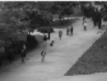
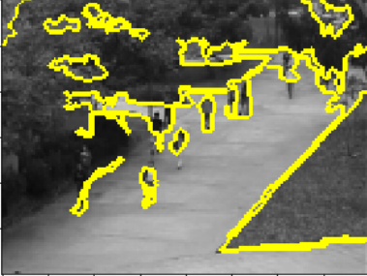
Superpixels

Slide 13
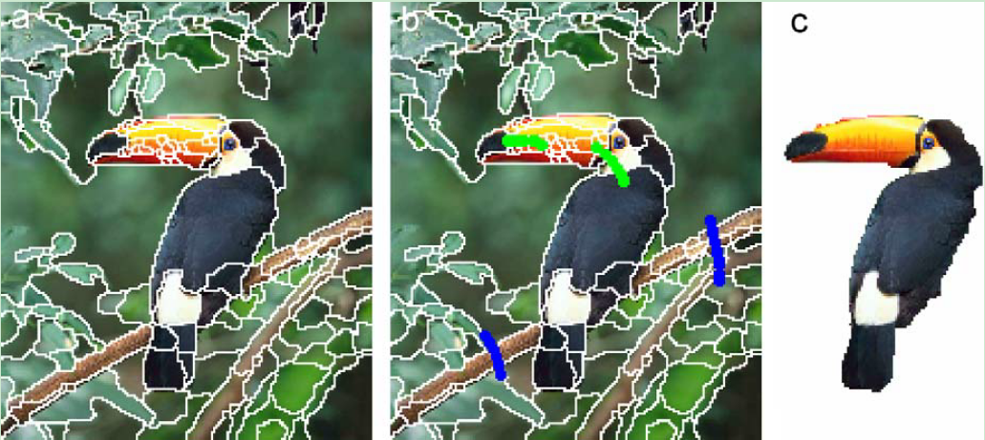
Segmentation with superpixels

Slide 14
Why superpixels
speed
the color in the same region is similar
the superpixel is comactness
the contour is good

Slide 15

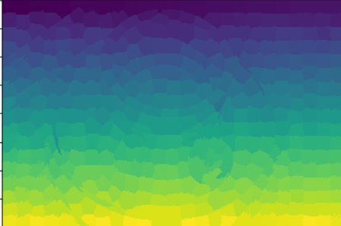

Ncuts with sueprpixels

Slide 16
Exercise
Segmentation with N-cut based on superpixels

