Slide 1
Image geometric transformation
2020.10

Slide 2
Contents
Translation transformation
Mirror transformation
Rotation transformation
Scaling transformation
Shear transformation
Affine transformation
Perspective transformation

Slide 3
Contents
Translation transformation
Mirror transformation
Translation transformation
Rotation transformation
Scaling transformation
Shear transformation
Affine transformation
Perspective transformation

Slide 4

Basic knowledge for pixels
One point (x0,y0) is changed to (x1,y1) by image transformation can be defined as:
(X1，y1)
(X0，y0)

Slide 5


Translation transformation
One image is an 2D matrix, each pixel has one position, and the image can be considered as the combination of pixels.
(△x, △y)

Slide 6
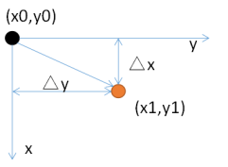

Translation transformation
Translation is the shifting of object's location.
x1 = x0 + △x, y1 = y0 + △y
Mathematical formula
Matrix form
Translation transformation matrix

Slide 7
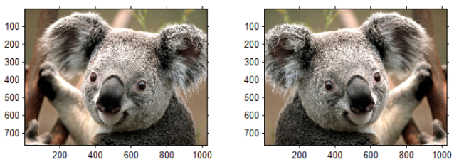
Mirror transformation
Mirror transformation can be divided into horizontal mirror and vertical mirror
Original image
horizontal mirror

Slide 8
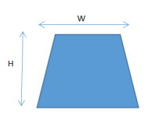
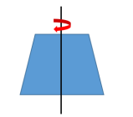
Horizontal mirror
Take the vertical central axis of image as the center, divide the image into two parts, left and right, for symmetrical transformation.

Slide 9

(x0,y0) →(x0,W-y0)
x1 = x0, y1 = W-y0
Horizontal mirror transformation matrix

Slide 10
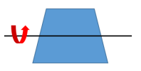
Vertical mirror
Taking the image horizontal central axis as the center, the image is divided into upper and lower parts for symmetrical transformation.
Rotate 180 degrees around the central axis

Slide 11

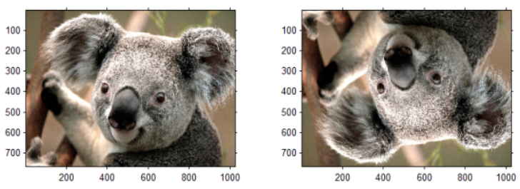
(x0,y0) →(H-x0,W-y0)
x1 = H - x0, y1 = y0 ;
Vertical mirror transformation matrix

Slide 12

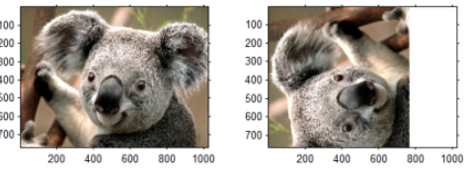
Transpose transformation
Swap x and y

Slide 13


Rotation transformation
The center is usually defined as the image center
The pixel in the original image (x0,y0) clockwise rotation to obtain (x1,y1):

Slide 14
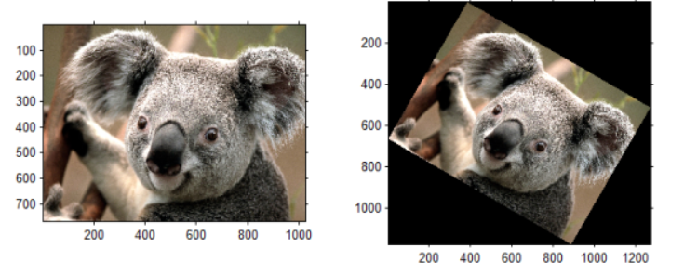
The size of the image in the rotation is usually changed.

Slide 15



Image scaling
Scaling is just resizing of the image

Slide 16

$\left[\begin{matrix}x_{1} \\ y_{1} \\ 1\end{matrix}\right]=\left[\begin{matrix}Sx & 0 & 0 \\ 0 & Sy & 0 \\ 0 & 0 & 1\end{matrix}\right]\left[\begin{matrix}x_{0} \\ y_{0} \\ 1\end{matrix}\right]$
scaling factor

Slide 17
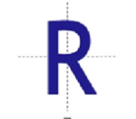

Shear transformation

Slide 18
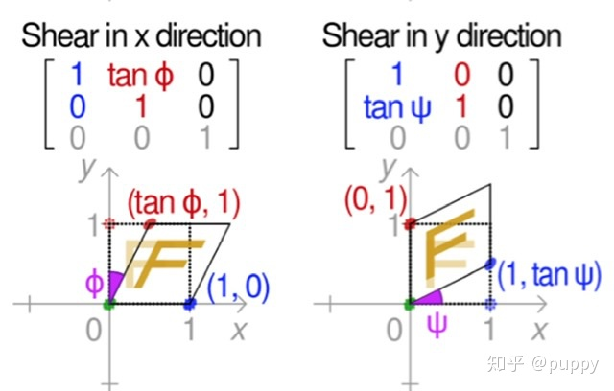

$\left[\begin{matrix}x_{1} \\ y_{1} \\ 1\end{matrix}\right] =\left[\begin{matrix}1 & h_{x} & 0 \\ h_{y} & 1 & 0 \\ 0 & 0 & 1\end{matrix}\right]\left[\begin{matrix}x_{0} \\ y_{0} \\ 1\end{matrix}\right]$
Can be divided into x-direction and y-direction.

Slide 19
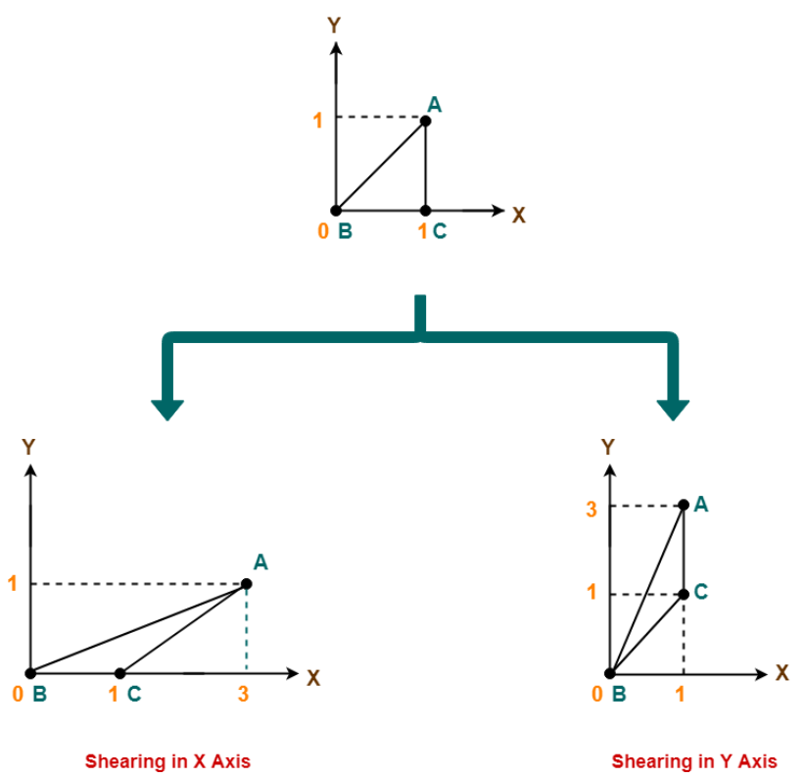
Old corner coordinates of the triangle = A (1, 1), B(0, 0), C(1, 0)
Shearing parameter towards X direction (Shx) = 2
Shearing parameter towards Y direction (Shy) = 2

Slide 20
Affine Transformation
In affine transformation, all parallel lines in the original image will still be parallel in the output image.
Affine transformation = linear transformation + translation
Before transformation | After transformation
Line | Line
Curve | Curve
parallel lines | parallel lines

Slide 21
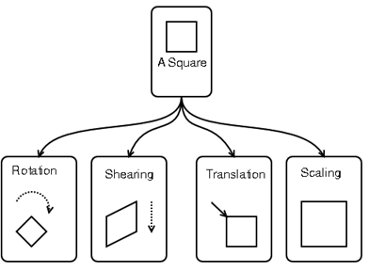
Affine transformation can be considered as combination of rotation, shearing, translation, scaling.

Slide 22
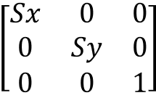
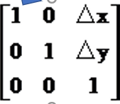
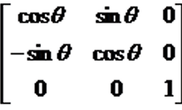
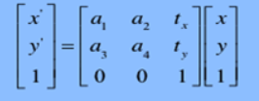
Rotation+scaling
translation

Slide 23
Exercises
Geometric transformation
0 import cv2, matplotlib, numpy
1. read one image (cv2.imread())
2. do translation, scaling, rotate, mirror, shear, and affine transform to this image.
3. show the transformed results.

