Slide 1

Automate API testing

Slide 2
Agenda
Motivation / Existing toolsets
Compare with Postman/Insomnia/etc
Ply flows walk through guide
Side-by-side
Results autogen
Placeholders: values, references, regex
GraphQL
Import from postman
Requests/Cases
CI/CD
Innovations and direction

Slide 3
 | Ply | Postman | Insomnia | REST-Assured | SOAtest | ReadyAPI
Graphical Flows | ✓ | ✗ | ✗ | ✗ | ✗ | ✗
Side-by-Side Results | ✓ | ✗ | ✗ | ✗ | ✗ | ✗
Codeless Testing | ✓ | ✗ | ✗ | ✗ | ✗ | ✗
Auto-Generate Results | ✓ | ✗ | ✗ | ✗ | ✗ | ✗
GraphQL Support | ✓ | ✓ | ✓ | ✗ | ✗ | ✓
Dynamic Input Values | ✓ | ✓ | ✓ | ✓ | ✓ | ✓
Previous Response Refs | ✓ | ✓ | ✓ | ✓ | ✓ | ✓
Regular Expressions | ✓ | ✓ | ✓ | ✓ | ✓ | ✓
Open Source | ✓ | ✗ | ✓ | ✓ | ✗ | ✗
VS Code Extension | ✓ | ✗ | ✗ | ✗ | ✗ | ✗
CI/CD Embeddable | ✓ | ✓ | ✗ | ✓ | ✓ | ✓

Slide 4
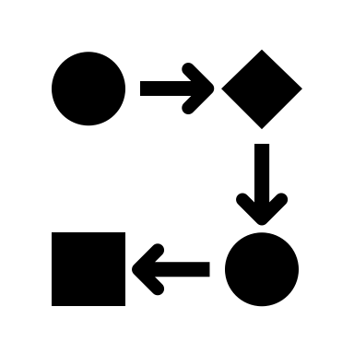



Create API Flow
1
Graphical editor
Orchestrate APIs
Generate expected file & parameterize
2
Auto generate result file
Use regex
Reference previous results in a downstream step
Run
3
Single API
Multiple APIs
Compare Results
4
Graphical side by side diff editor
Integrate with CI/CD
5
Execute test cases during build

Slide 5
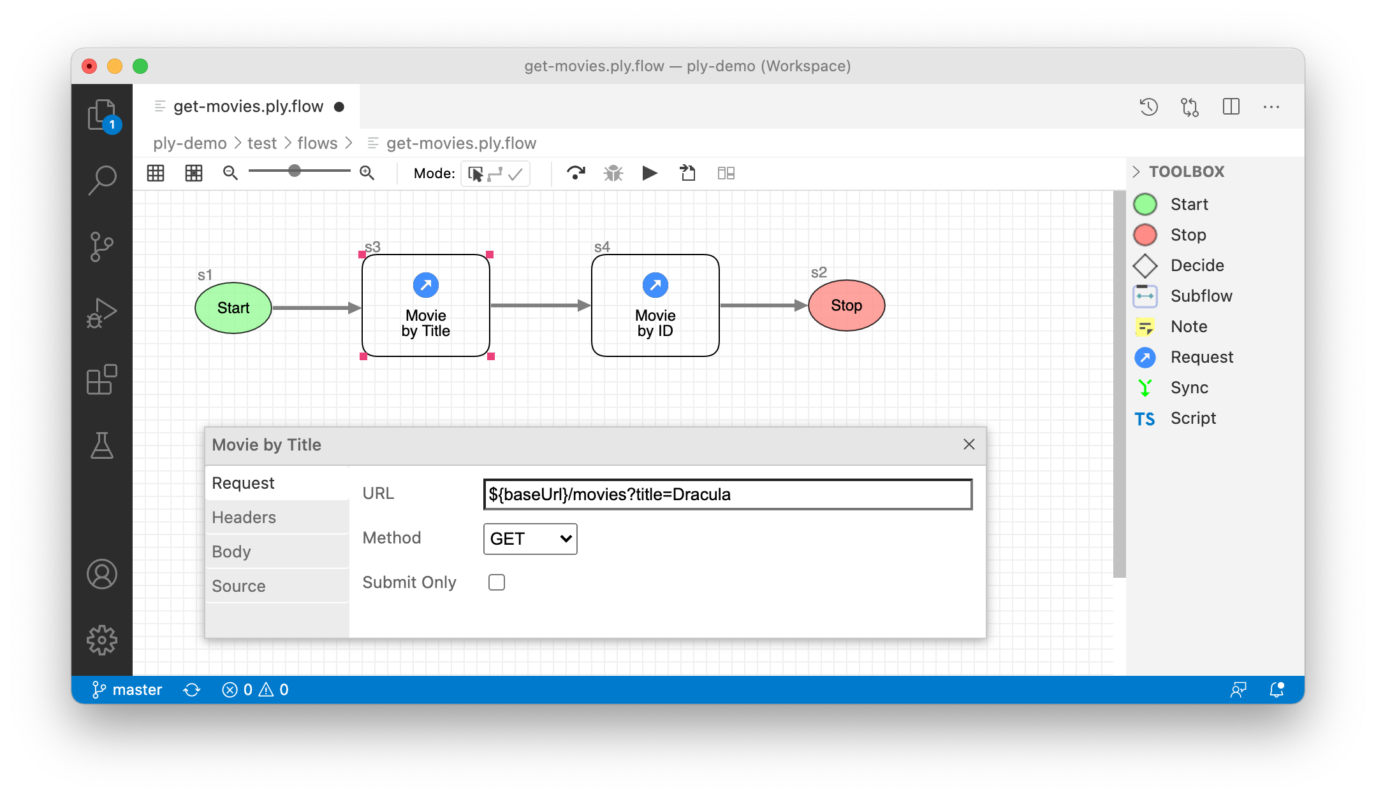
Create API Flow

Slide 6
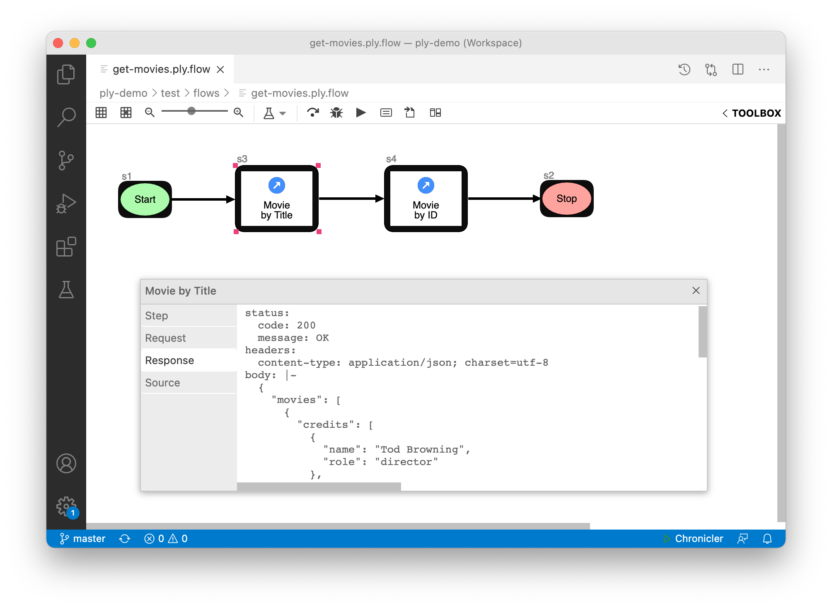
Run

Slide 7
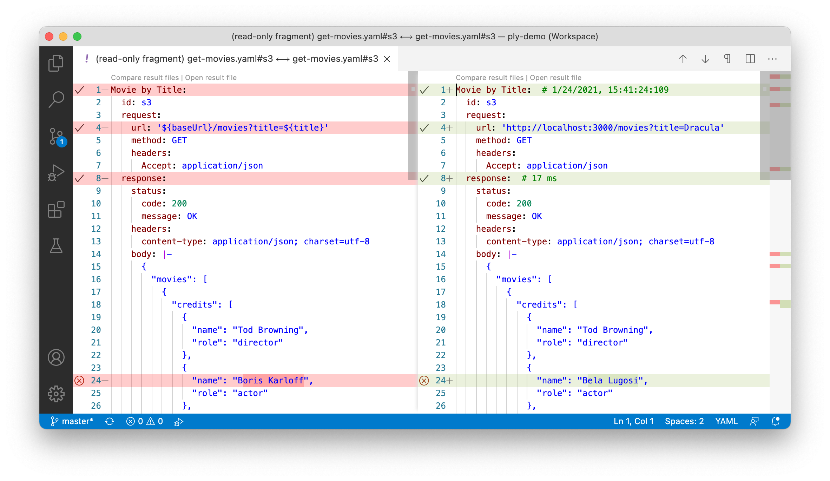
Compare Results

