Slide 1

Institute of Computing Technology Chinese Academy of Sciences
一种面向KMC并行模拟的层次化通信优化策略
吴保东 李士刚 张云泉

Slide 2
01
KMC并行通信问题
CONTENTS
02
层次化通信优化策略
目录
03
实验对比分析
04
总结和展望

Slide 3
1
KMC并行通信问题

Slide 4
01
KMC并行通信问题
KMC并行算法模拟的通信过程
区域分解
对进程做二维或三维划分
对进程内部二次分割为4个或8个sector
近邻粒子数据交换
粒子与邻居粒子在同一进程，直接获取邻居粒子的相关信息
对粒子与邻居粒子非同一进程，进行点到点通信操作实现数据交换

Slide 5
01
KMC并行通信问题
性能瓶颈
32节点(640核)上获得20倍性能提升，并行效率62.5%
通信时间所占百分比从20核的9%增大到640核32%
MPIP工具分析发现点到点通信时间是影响总通信时间的主要因素
通信消息较长，使用点到点通信会引起通信拥塞和进程负载不均衡

Slide 6
2
层次化通信优化策略

Slide 7
02
层次化通信优化策略
算法框架
01
通信合并优化算法
02
进程拓扑优化算法
03
共享内存优化算法
04
邻居集合通信算法
Notes:
Fig.1 shows 8 processes which are mapped into a 3d coordinate, and each process is responsible for the simulation of a sub-domain. In order to avoid data collisions that may occur in parallel simulation, the sub-domain owned by each process is further divided into sectors. When the sites owned by one process need the data of their neighbor sites which are not in the same process, the process will exchange data with neighbor processes.

Slide 8
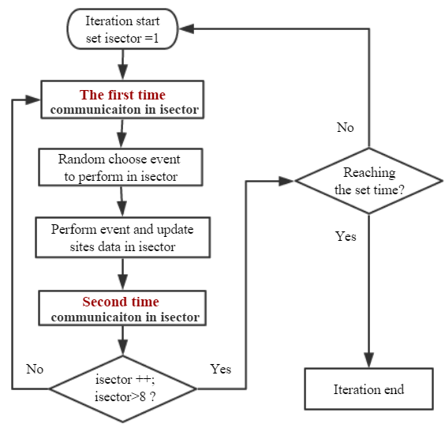
02
层次化通信优化策略
通信合并算法
KMC并行通信是迭代过程
一次迭代中，各sector需要进行两次数据通信
合并两个sector的前后通信消息
通信合并时出现三种情况
面相邻sector情况
边相邻sector情况
角相邻sector情况
Notes:
Fig.1 shows 8 processes which are mapped into a 3d coordinate, and each process is responsible for the simulation of a sub-domain. In order to avoid data collisions that may occur in parallel simulation, the sub-domain owned by each process is further divided into sectors. When the sites owned by one process need the data of their neighbor sites which are not in the same process, the process will exchange data with neighbor processes.

Slide 9
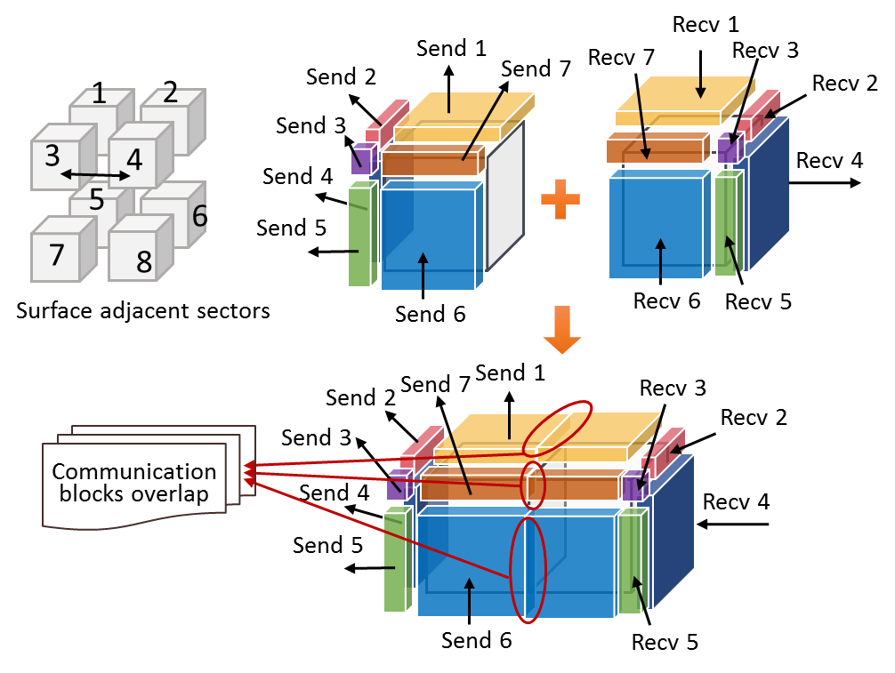
02
层次化通信优化策略
通信合并算法
面相邻sector情况
进行通信块合并的两个sector面相邻
中间出现三个数据块合并冲突
解决冲突：
单独对冲突块进行通信操作
每个sector平均通信次数对比
合并前：14次(2*7次)
合并后：13次(7+2*3次)
Notes:
Fig.1 shows 8 processes which are mapped into a 3d coordinate, and each process is responsible for the simulation of a sub-domain. In order to avoid data collisions that may occur in parallel simulation, the sub-domain owned by each process is further divided into sectors. When the sites owned by one process need the data of their neighbor sites which are not in the same process, the process will exchange data with neighbor processes.

Slide 10
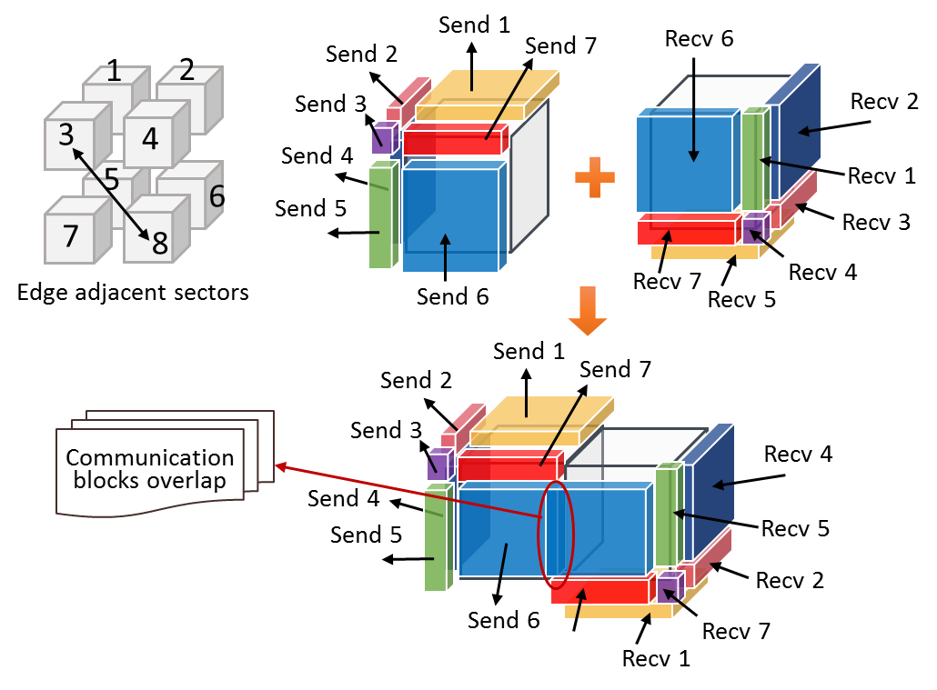
02
层次化通信优化策略
通信合并算法
边相邻sector情况
进行通信块合并的两个sector边相邻
中间出现一个数据块合并冲突
解决冲突：
单独对冲突块进行通信操作
每个sector平均通信次数对比
合并前：14次(2*7次)
合并后：9次(7+2*1次)
Notes:
Fig.1 shows 8 processes which are mapped into a 3d coordinate, and each process is responsible for the simulation of a sub-domain. In order to avoid data collisions that may occur in parallel simulation, the sub-domain owned by each process is further divided into sectors. When the sites owned by one process need the data of their neighbor sites which are not in the same process, the process will exchange data with neighbor processes.

Slide 11
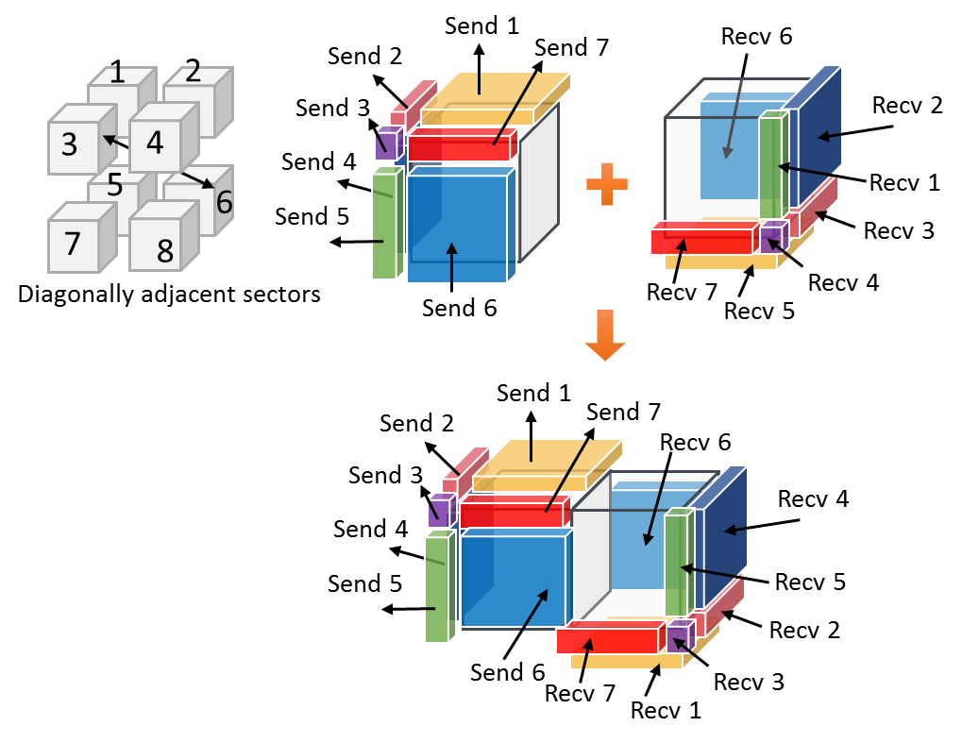
02
层次化通信优化策略
通信合并算法
角相邻sector情况
进行通信块合并的两个sector角相邻
中间没有产生数据块合并冲突
每个sector平均通信次数对比
合并前：14次(2*7次)
合并后：7次(1*7次)
Notes:
Fig.1 shows 8 processes which are mapped into a 3d coordinate, and each process is responsible for the simulation of a sub-domain. In order to avoid data collisions that may occur in parallel simulation, the sub-domain owned by each process is further divided into sectors. When the sites owned by one process need the data of their neighbor sites which are not in the same process, the process will exchange data with neighbor processes.

Slide 12
02
层次化通信优化策略
进程拓扑优化算法
进程拓扑划分特点
三维进程分布尽可能均衡
最大化节点内通信进程数
最小化节点间通信进程数
充分发挥节点内进程通信优势
对节点内的进程进行2次拓扑划分
Notes:
Fig.1 shows 8 processes which are mapped into a 3d coordinate, and each process is responsible for the simulation of a sub-domain. In order to avoid data collisions that may occur in parallel simulation, the sub-domain owned by each process is further divided into sectors. When the sites owned by one process need the data of their neighbor sites which are not in the same process, the process will exchange data with neighbor processes.

Slide 13
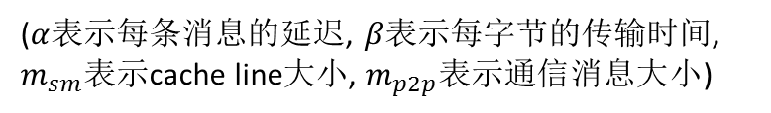


02
层次化通信优化策略
共享内存优化算法
针对节点内进程通信
创建共享内存通信窗口
减少进程间内存拷贝次数
提高通信效率
并行性能对比
$$T_{intrasm}=α_{sm}+β_{sm}∗m_{sm}$$
$$T_{intrap2p}={2∗α}_{p2p}+β_{p2p}∗m_{p2p}$$
($α$表示每条消息的延迟, $β$表示每字节的传输时间, $m_{sm}$表示cache line大小, $m_{p2p}表示通信消息大小$)
Notes:
Fig.1 shows 8 processes which are mapped into a 3d coordinate, and each process is responsible for the simulation of a sub-domain. In order to avoid data collisions that may occur in parallel simulation, the sub-domain owned by each process is further divided into sectors. When the sites owned by one process need the data of their neighbor sites which are not in the same process, the process will exchange data with neighbor processes.

Slide 14
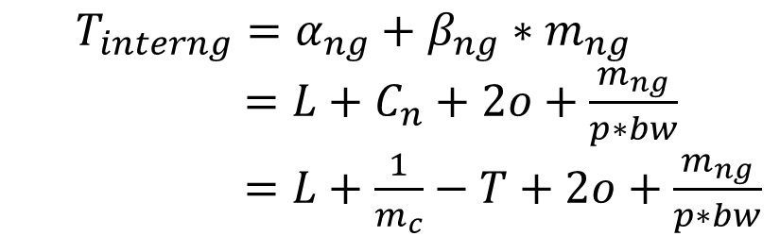
02
层次化通信优化策略
邻居集合通信算法
针对节点间进程通信
优化通信拓扑、大小和缓冲区访问
预定义集合通信缓解网络带宽拥塞
优化通信调度
并行性能对比
$$T_{interng}=α_{ng}+β_{ng}∗m_{ng}$$
$=L+C_{n}+2o+\frac{m_{ng}}{p∗bw}$
$=L+\frac{1}{m_{c}}−T+2o+\frac{m_{ng}}{p∗bw}$
$$T_{interp2p}=L+C_{n}+2o+\frac{m_{ng}}{bw}=L+\frac{1}{m_{c}}−T+2o+\frac{m_{ng}}{bw}$$
Notes:
L is network latency without contention C n is network contention per message message injection rate including contention delay is m c. if the number
of processors is p, and each process contributes its local injection bandwidth bw

Slide 15
3
实验对比分析

Slide 16
03
实验对比分析
实验环境
分别对比SPPARKS原始算法与各优化算法的可扩展性
分别在“元”超级计算机和“天河2号”超算平台上进行优化通信调度
机器名称 | 超级计算机“元”上的计算节点 | 超算中心 “天河2号”上的计算节点
CPU型号 | Intel E5-2680 V2 | Intel E5-4640
CPU核数 | 10（每个CPU核数）*2（CPU数量）=20核 | 12（每个CPU核数）*2（CPU数量）=24核
网络连接方式 | Infiniband | 自主定制的高速互连系统
MPI版本 | mvapich2-2.1
测试用例 | 铒晶格反应扩散模型
并行性能测试 晶格规模 | (200,200,200)
可扩展性测试 晶格规模 | (160,160,160)~(400,400,400)
模拟时间步长 | 100
Notes:
Fig.1 shows 8 processes which are mapped into a 3d coordinate, and each process is responsible for the simulation of a sub-domain. In order to avoid data collisions that may occur in parallel simulation, the sub-domain owned by each process is further divided into sectors. When the sites owned by one process need the data of their neighbor sites which are not in the same process, the process will exchange data with neighbor processes.

Slide 17
03
实验对比分析
强可扩展性
“元”
节点
模拟规模为(200,200,200)
各算法都表现出良好的强可扩展性
相比SPPARKS原始算法
各优化算法性能得到不同程度的提升
在“元”上使用640核时，层次化通信优化策略的通信时间减少了30.7%
在“天河2号”上使用640核时，层次化通信优化策略的通信时间减少了37.5%
天河
二号
Notes:
Fig.1 shows 8 processes which are mapped into a 3d coordinate, and each process is responsible for the simulation of a sub-domain. In order to avoid data collisions that may occur in parallel simulation, the sub-domain owned by each process is further divided into sectors. When the sites owned by one process need the data of their neighbor sites which are not in the same process, the process will exchange data with neighbor processes.

Slide 18
03
实验对比分析
弱可扩展性
模拟规模从(160,160,160)随使用核数同比增长到(400,400,400)
在元节点上，与SPPARKS原始算法相比
各优化算法的通信时间均有所减少
共享内存与邻居集合通信相结合的算法表现最好的弱可扩展性。
Notes:
Fig.1 shows 8 processes which are mapped into a 3d coordinate, and each process is responsible for the simulation of a sub-domain. In order to avoid data collisions that may occur in parallel simulation, the sub-domain owned by each process is further divided into sectors. When the sites owned by one process need the data of their neighbor sites which are not in the same process, the process will exchange data with neighbor processes.

Slide 19
4
总结与展望

Slide 20
04
总结和展望
层次化通信优化策略在KMC并行算法上表现了良好的并行性能和可扩展性
该优化策略适用于基于区域分解的多种并行算法。如MD模拟，stencil计算等
1
总结
与宋梦召基于SPPARKS开发的VKMC空位模拟算法相结合，减少大规模并行中的通信时间
优化空位模拟算法的通信结构，并尝试在天河二号上测试万核规模的并行性能
2
展望
Notes:
Fig.1 shows 8 processes which are mapped into a 3d coordinate, and each process is responsible for the simulation of a sub-domain. In order to avoid data collisions that may occur in parallel simulation, the sub-domain owned by each process is further divided into sectors. When the sites owned by one process need the data of their neighbor sites which are not in the same process, the process will exchange data with neighbor processes.

Slide 21
THANK YOU

