Slide 1
Work report
wangxuan

Slide 2
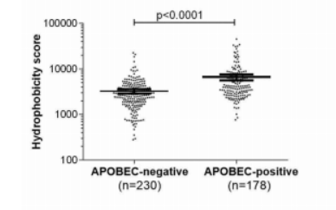
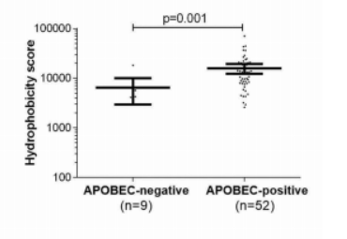
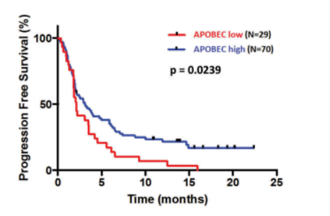
Amélie Boichard, 2019

Slide 3
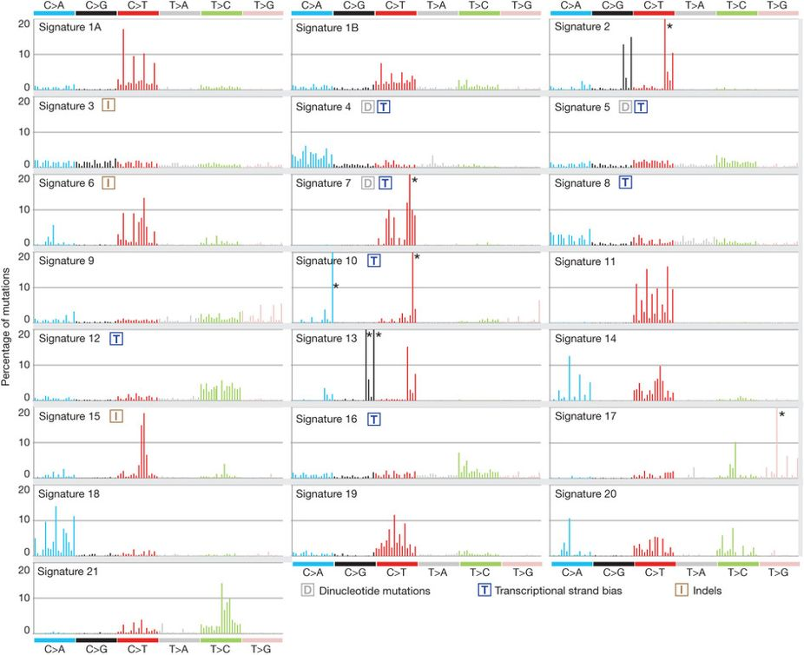

Slide 4
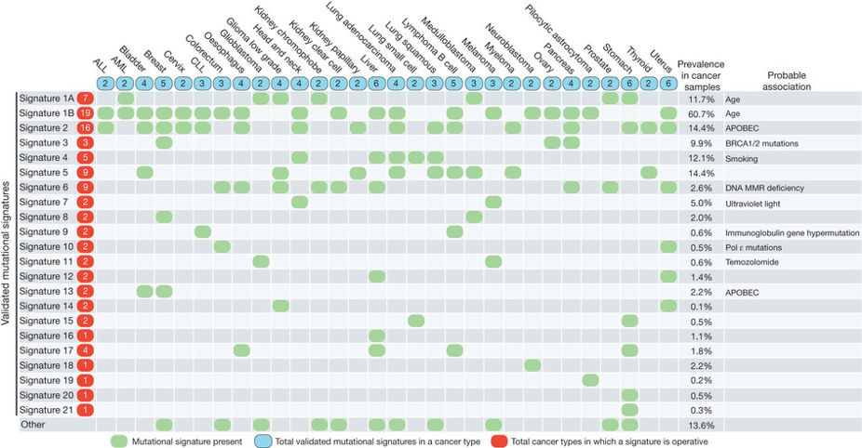
N = 983
Breast cancer from TCGA

Slide 5
samples
mutation calling
APOBEC enrichment
APOBEC enriched samples
扫描所有mutation找到TCW突变

Slide 6
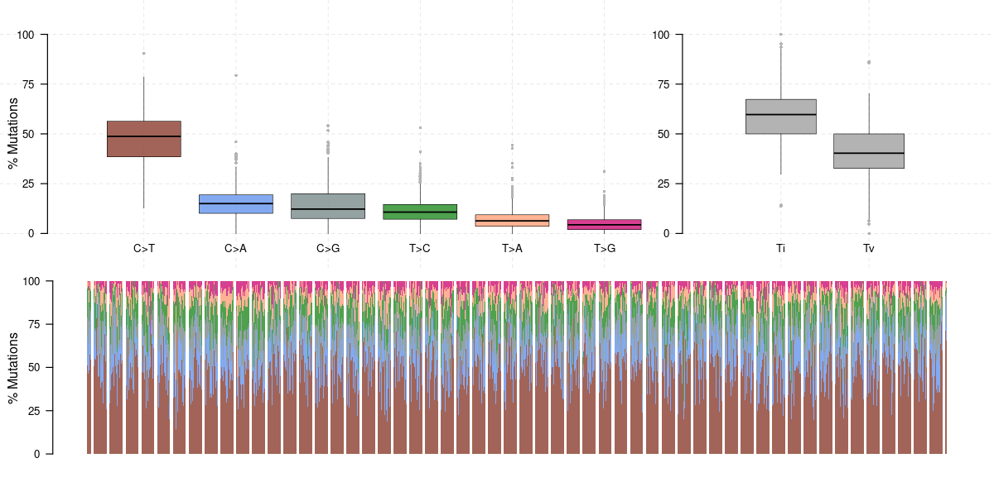

Slide 7

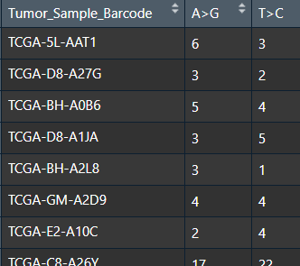
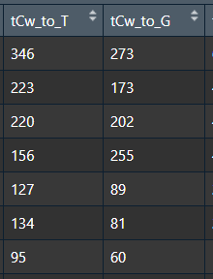
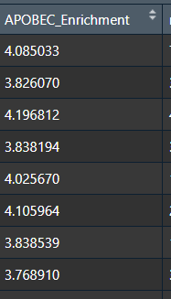
APOBEC enrichment
An APOBEC cytidine deaminase mutagenesis pattern is widespread in human cancers, 2013

Slide 8
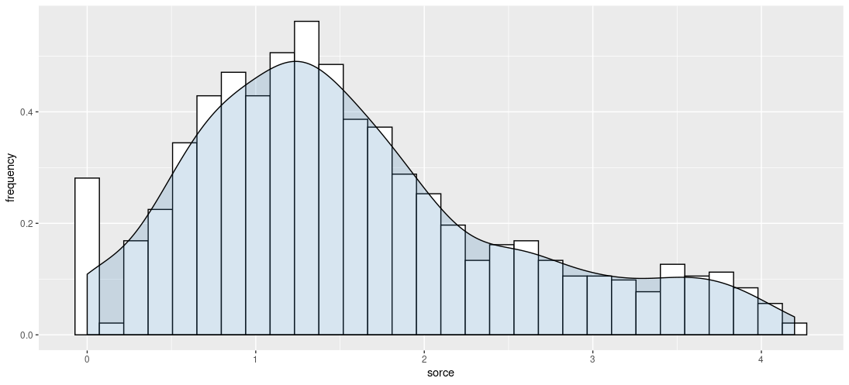

Slide 9
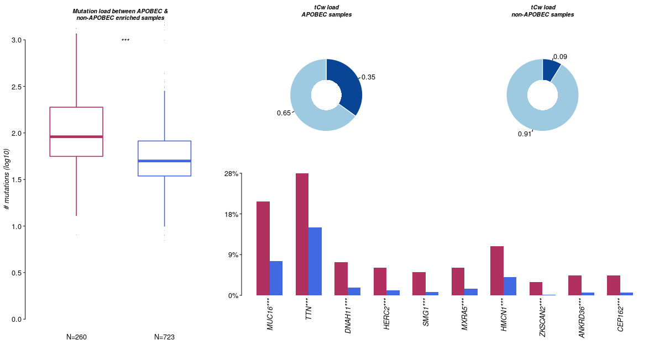

Slide 10
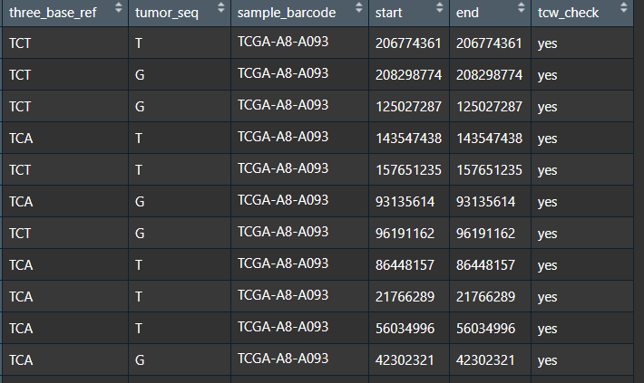
Enrich：260
Nonrich:723
5813 in 260 samples
Mean = 22.3
Find TCW mutation from enrichment group

Slide 11
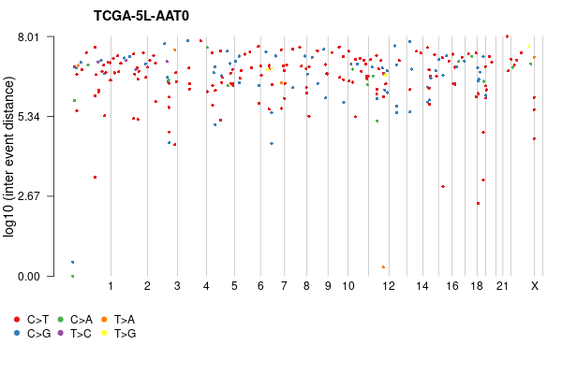
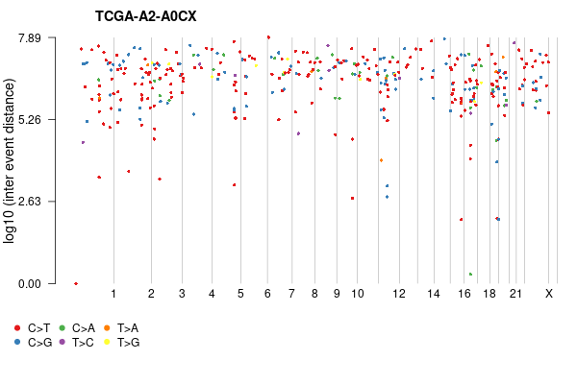

Slide 12
Thanks!

