Slide 1
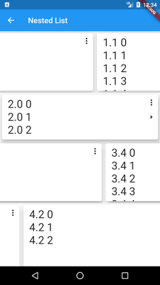

Nested List
Nested horizontal list with dynamic content in vertical list items

Slide 2
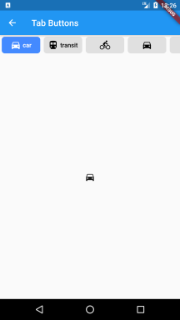
Tab Buttons
Tab bar where each tab indicator is a toggle button

Slide 3
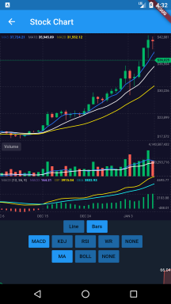
Stock Chart
Stock candlestick or line chart with technical indicators support

Slide 4
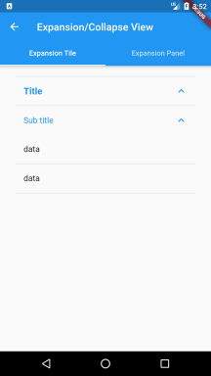
Expansion/Collapse
Expansion/Collapse view using Flutter built-in widgets

Slide 5
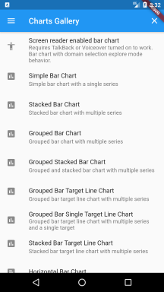
Charts Gallery
Show case the data visualization capability of the charts_flutter package

Slide 6
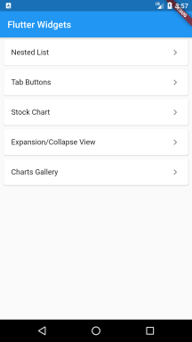
Flutter Widget Explorer
Learn, test and demo flutter widgets in one application

Slide 7
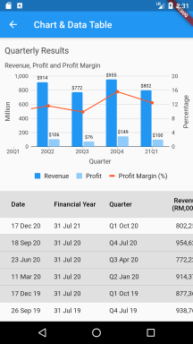
Chart & Data Table
Real world quarterly result data in combo chart and tabular format

Slide 8
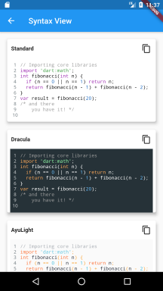
Syntax View
View code, copy and paste

Slide 9
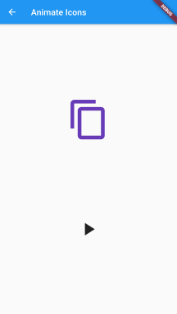
Animate Icons
Animate any two icons

Slide 10
Syntax View
View code, copy and paste

