Slide 1
fb.formbuilder
fb.fbWidget
fb.fbPlainText
fb.fbSingleLineText
fb.fbNumber
fb.fb ...

Slide 2
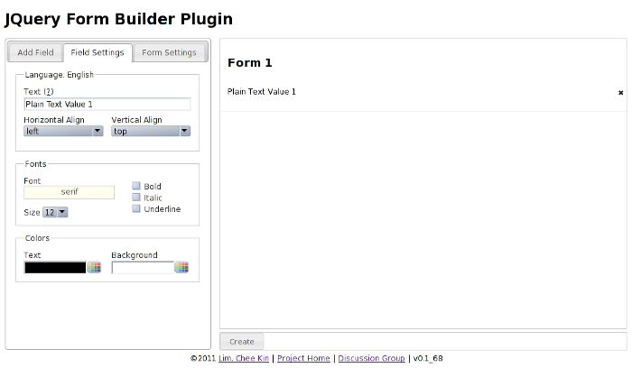
_getFieldSettings
LanguageSection
_getWidget
_getFieldSettings
GeneralSection

Slide 3
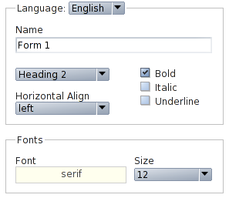
_oneColumn
_oneColumn
_twoRowsOneRow
_twoColumns

