Slide 1
GRADUATE CERTIFICATE IN PATTERN RECOGNITION SYSTEMS
Multimodal Product Matching
for Cross-Merchant Comparison
Proposal Presentation
Lim Choon Rong
Group 43
Notes:
Good evening prof and fellow students
I’m Choon Rong from Group 43.
My project is about Multimodal Product Matching for Cross-Merchant Comparison.
The core problem is identifying when different online listings actually represent the same underlying product.
I approach this as a pattern-recognition problem using both product titles and images.
I'll be sharing about the objective, scope, dataset, and approach

Slide 2
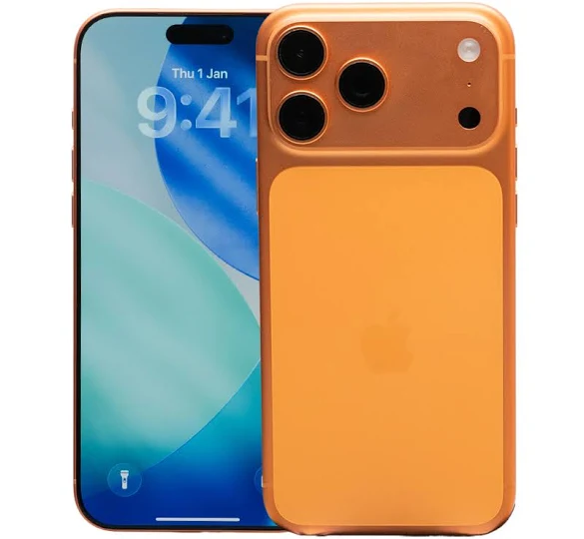
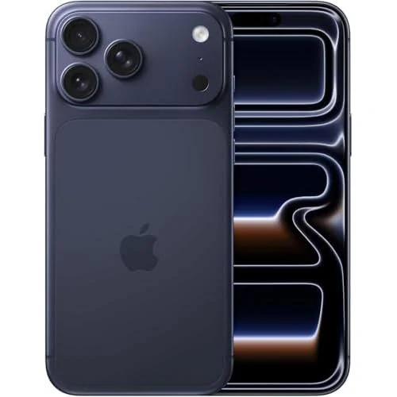
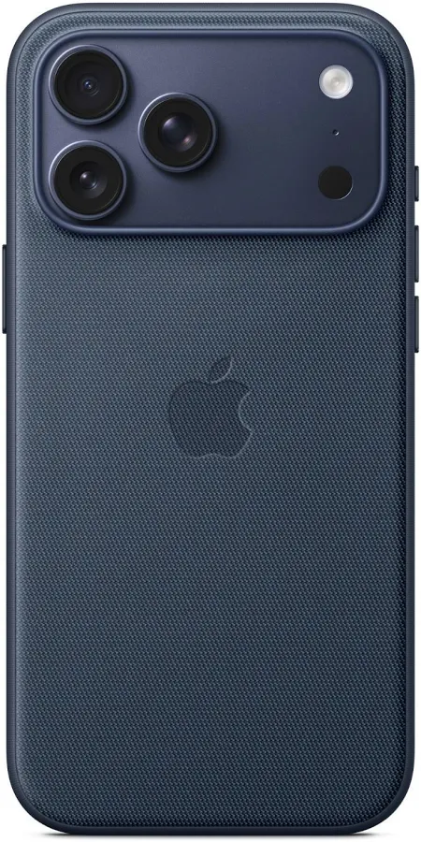
What is Product Matching?
Same product, different listing — across sellers and marketplaces
1
Fragmented listings
2
Poor price comparison
"iPhone 17 Pro Max 256GB - New"
"Apple iPhone17ProMax Model 256G Ori"
"Apple iPhone 17 Pro Max TechWoven Case with MagSafe"
3
Manual matching doesn't scale
Three listings. Two product.
Pattern-recognition task: determine whether two noisy multimodal observations correspond to the same underlying product identity.
Notes:
What is Product Matching?
The same physical product can appear online differently
Sellers use different titles, abbreviations, photographs and descriptions, so exact matching is difficult.
In this example, the first two listings describe the same iPhone, while the third is actually an accessory.
Even though the color is different but it is the same product, and when the image is different it is different product
So the task is: given two noisy multimodal observations, determine whether they represent the same product identity.

Slide 3
Project Goal & Objectives
Combine text and image information to try and improve product matching
compared with simpler, unimodal approaches
1
Build a working, end-to-end product matching prototype
2
Compare classical, text, image and multimodal approaches on equal footing
3
Quantify the contribution of every optimisation with Precision, Recall and F1
4
Demonstrate results interactively against held-out ground truth
5
Apply model on live web results
Notes:
My goal will be to combine text and image information to improve product matching
These are the objectives
Build working prototype
Compare the individual approaches and the multimodal approaches
Quantify using Precision, Recall and F1
Demonstrate and test the results with the ground truth
I’ll apply the trained models to live listings.

Slide 4
The Dataset
Kaggle Shopee Product Matching
~34,250
11,014
2
labelled listings
ground-truth
label groups
modalities per listing
(title + image)
Each listing provides:
Product title (free text)
Product image (JPEG)
label_group (train only)
Notes:
Slide 5 — The Dataset
My primary dataset is the Shopee Product Matching dataset from Kaggle.
It contains roughly 34,250 labelled listings belonging to around 11,014 product groups.
Each listing contains two important modalities: a seller-written title and product image.
It also contains label_group, which helps us identifies product does it represent.

Slide 5
Dataset: Shopee Product Matching
Labels make the matching problem objectively measurable.
Each listing contains
Held-out evaluation
Product title
Query listing
↓
Retrieve predicted matches
↓
Compare each result with label_group
↓
Aggregate metrics across queries
Product image
label_group
label_group = product identity ground truth
Notes:
Slide 6 — Dataset and Ground Truth
Using the label_group, which represents the ground-truth product identity.
Importantly, I separate training, validation and test data
During evaluation, I take a held-out listing that is not seen during training ask the model to retrieve likely matches.
I compare the retrieved products against the query's actual label_group.
Then we aggregate them to obtain the metrics of the model

Slide 6
Proposed system architecture
Text
encoder
Text
embedding
Shopee
listing
Candidate
retrieval
Fusion +
threshold
Match
Image
encoder
Image
embedding
Sentence Transformers • image encoder • FAISS / nearest-neighbour retrieval • weighted fusion
6
Notes:
Slide 9 — Proposed System Architecture
This is the system architecture
A listing title goes through the text encoder, while its image goes through the image encoder.
Both produce embeddings that represent the listing in their respective feature spaces.
Nearest-neighbour retrieval is then used to identify plausible candidate matches.
The text and image similarity scores are fused, and we will determine using a threshold whether it is a match

Slide 7
PLAN
Project Plan
Now
Next
Then
Final
Baseline + evaluation
Deep text + vision
Multimodal
Runnable MVP
TF-IDF Baseline
Embedding
Dataset matcher + live POC
Notes:
Slide 11 — Project Plan
So the project plan will be
To establish a baseline using TF-IDF
Then by adding text embeddings and Image embeddings to compare the results
Once the model is validated, we can use it in the demo.

Slide 8
Technology Stack
Kept simple and appropriate for an academic prototype
1
2
3
4
Modeling
Classical ML & Data
Retrieval
Demo
• PyTorch
• scikit-learn
• FAISS (nearest-neighbour search)
• Streamlit (demo + experiment UI)
• Hugging Face / Sentence-Transformers
• Pandas / NumPy
Notes:
Slide 10 — Technology Stack
This is the tech stack I will be using
PyTorch and Hugging Face for the embeddings
Pandas and NumPy for handling the dataset processing.
(Skip?) Retrieval we will use FAISS
Stremlit for the demo

Slide 9
MODULE FIT
Deliverable alignment
Module requirements
1 Supervised learning
2 ML / Deep Learning
3 Hybrid / Ensemble
Shopee label_group provides ground truth. Positive/negative product relationships support training and objective evaluation.
TF-IDF baseline, transformer text embeddings, CNN/CLIP visual representations and metric learning.
Fuse independent text and visual similarity scores and test whether fusion improves performance.
Notes:
About the module requirements
We have to fulfil 3 out of 4
Supervised learning is applied by using Shopee's label_group to provide ground-truth and train the model.
For ML and deep learning, we use CNN to do visual representations
Hybrid approach is applied by combining independent text and image similarity scores.

Slide 10
Evaluation
For every query
Precision
Of predicted matches, how many are correct?
TP / (TP + FP)
1. Retrieve Top-K candidates
2. Apply match threshold
Recall
Of all true matches, how many did we find?
TP / (TP + FN)
3. Check label_group
4. Count TP / FP / FN
F1
Balanced summary of precision and recall
2PR / (P + R)
Repeat across the held-out set
Notes:
Slide 12 — Evaluation
In the held out set we will
Retrieve top K candidates
Apply threshold
And check against label group
Then count the True Positive and false Positive
Precision measures how many predicted matches are actually correct.
Recall measures how many of the true matching listings the system successfully retrieves

Slide 11
MODEL
What does the model actually learn?
Text encoder
Image encoder
Fusion
Title → embedding
Image → embedding
Merge using voting
Rank candidates and apply a validation-selected threshold.
Same label_group → embeddings/scores should be close
Different label_group → should be separated
Because the model learns similarity rather than a fixed product class, an unseen product can still be encoded and compared with new candidate listings.
Notes:
Slide 7 — What Does the Model Learn?
Because the model is not training to predict one of the 11,000 Shopee label_group IDs.
Instead, the text encoder converts a title into an embedding, while the image encoder produces a visual embedding.
Similar products should have embeddings or similarity scores that are close, while different products should be separated.
I can then combine text and image similarities using voting
This architecture also means an unseen product can technically be encoded and compared without having an existing class ID in the training dataset.

Slide 12
GENERALISATION
What happens with a completely unseen product?
Example: a future iPhone absent from the Shopee training set.
1 No class lookup
2 New candidates
3 Similarity inference
Notes:
Slide 8 — Generalisation to Unseen Products
In the case of an unseen product as I mentioned
For example, a future iPhone model
The system doesn't search for its training label_group; it simply encodes the new query and candidate listings.
It then performs similarity inference between the query and those newly retrieved candidates.
So no class lookup for new candidates

Slide 13
SYSTEM
Demo
A Dataset Matcher — evaluated core
B Visual Shopping Assistant — product POC
Input: held-out Shopee listing
• choose TF-IDF / text / image / multimodal
• retrieve candidates
• show similarity scores
• reveal true/false/missed matches using label_group
• display per-query precision / recall / F1
Input: screenshot or product image + optional text hint
• external service retrieves shopping candidates
• trained matcher re-ranks / filters candidates
• show likely exact-product listings by merchant
• compare available offer prices
Purpose: demonstrate real-world consumer applicability.
Notes:
Slide 13 — Runnable System
In my demo we will show two features
The Dataset Matcher which validates the model with the dataset
We can inspect the values
And we have a visual Shopping Assistant, where a consumer uploads a screenshot or product image.
Then the model will be used to match related products

Slide 14
CONSUMER APPLICATION
Application
1
2
3
4
Upload
Retrieve
Match
Compare
Screenshot / product image
Optional text hint
External visual / shopping search
returns candidate listings
Text + image encoders
multimodal similarity
Filter likely exact matches
show merchant + price
Among predicted exact-product matches return the cheapest available offer.
Notes:
Slide 14 — Consumer Application
In the demo we will apply the model using our POC application
A user might be browsing social media and upload a screenshot of a product
We retrieves a set of potential listings from the web.
The model then uses the title and image information to re-rank or filter those candidates.
We can then return the cheapest offering.

