Slide 1
Lecture 8 Micromouse PCB design guide

Slide 2
Components Placement

Slide 3
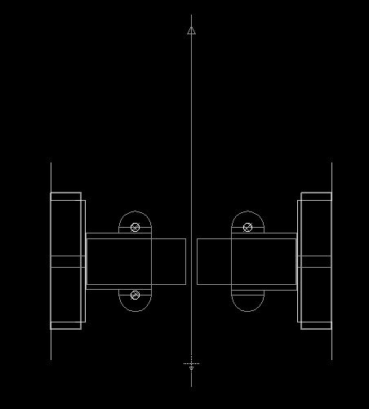
Place library for encoder/motor to (0,0) to make it symmetrical from left and right
Draw a middle reference line

Slide 4
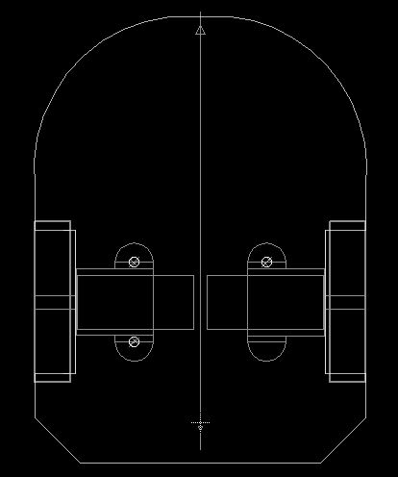
Use dimension layer to draw the outline of the mouse, make sure the length is not exceed 100mm to save cost

Slide 5
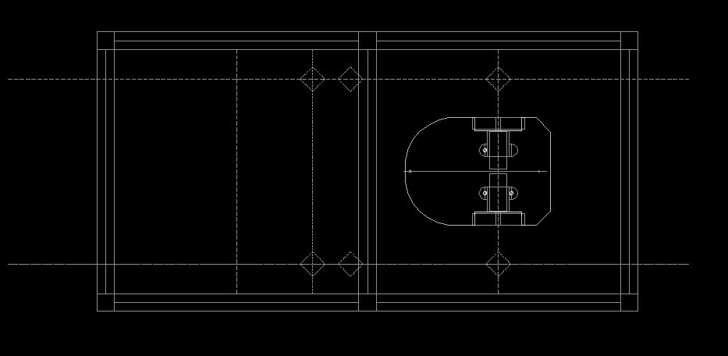
Draw the guide line for the wall and posts in order to determine the sensor point angles later

Slide 6
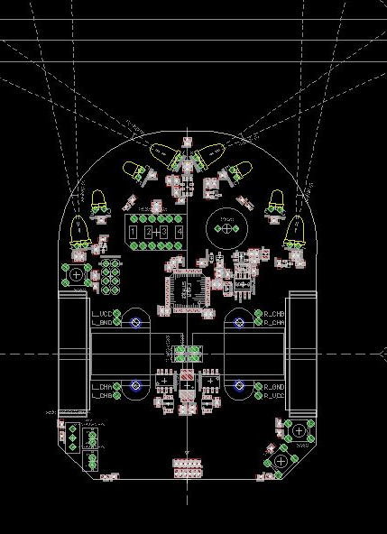
Place the components at proper position
Place sensors at proper position, make sure they point to proper location
Make sure the components won’t be blocked by motor mount/encoder

Slide 7
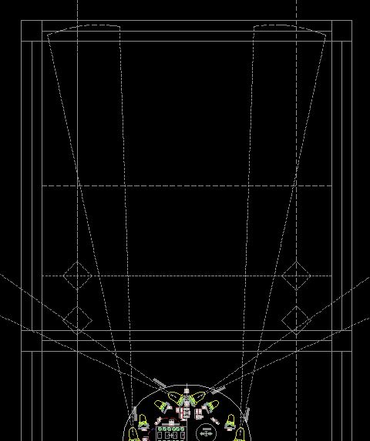
Where should sensors point to?
Side sensors point to somewhere a little to the front of the post, when the mouse is at the center of the cell
Front sensors point outwards about 5-10 degrees, make so it won’t point to the side of the wall when at 1.5 cells away

Slide 8
PCB drawing

Slide 9
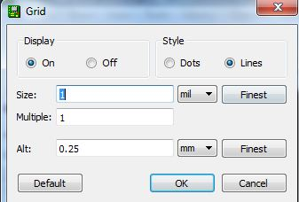
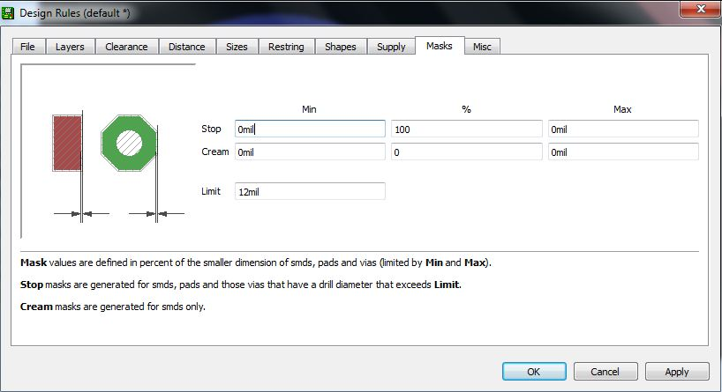
Settings
No mask for via>12 mills
Make 1 mill grid when drawing and parts placing

Slide 10
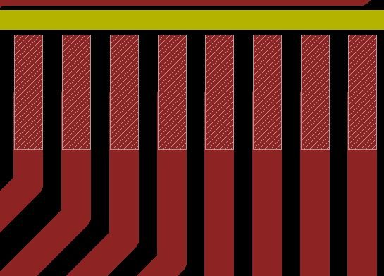
Traces
MCU pins from LQFP package are 10-12 mill wide.
Try maximum tracer width for power/analog signal related trace
Thinner traces are OK for digital signal

Slide 11
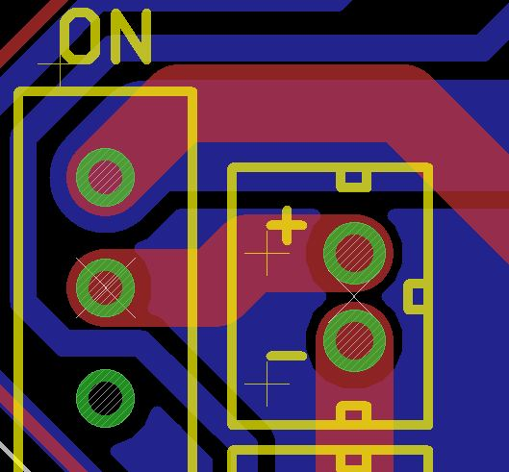
Trace thickness
Wider trace for high power intensive parts, ex. Vbat Power trace
Thinner for signal traces
Polygon may needed to give more area for power trace for thermo performance

Slide 12


Trace style
Shorter the possible
Less turn possible
45 degree turns
good
bad

Slide 13
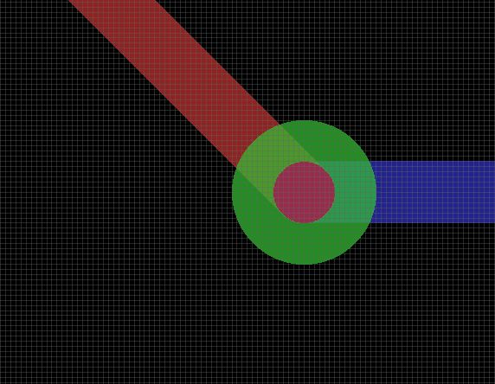
Small via
12 mill via minimum
Good for signal trace
Better be masked

Slide 14

Large Via
Larger via for power/thermo intensive trace/pad/polygon
Should not be masked
Drill shouldn’t bee too big

Slide 15
Polygon
First to the First: Don’t make a single GND polygon for the entire PCB!!!!!
Why? Because it will transfer heat to temperature sensitive components easily from some heat intensive parts
You should place polygon selectively, only on those parts generate a lot of heat(5V LDO, motor driver) or the parts are sensitive with heat(MCU, analog device)

Slide 16
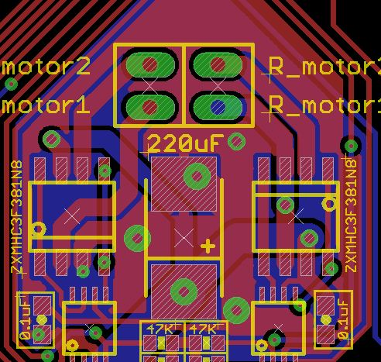
Sample 1
Motor driver, GND polygon, on both sides

Slide 17
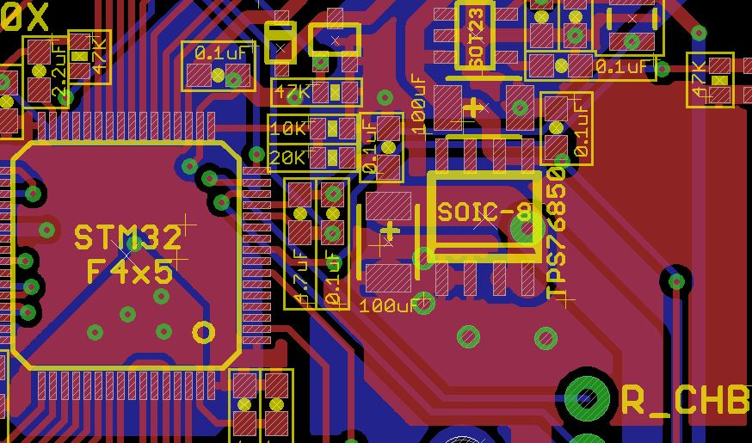
Sample 2
Not make the polygon connected between 5V and MCU since MCU is temperature sensitive

Slide 18
Distincted Ground
MGND
DGND
AGND
Don’t mix them before they reach the negative terminal of battery
AGND is temperature sensitive, make the trace avoid the hot area if possible

Slide 19
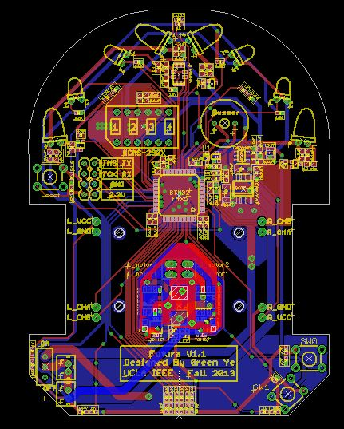
MGND

Slide 20
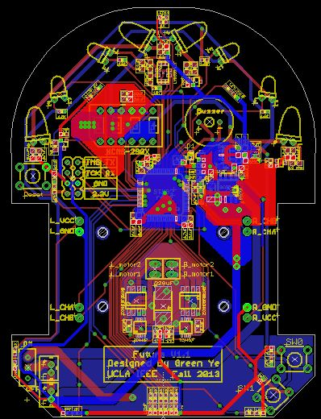
DGND

Slide 21
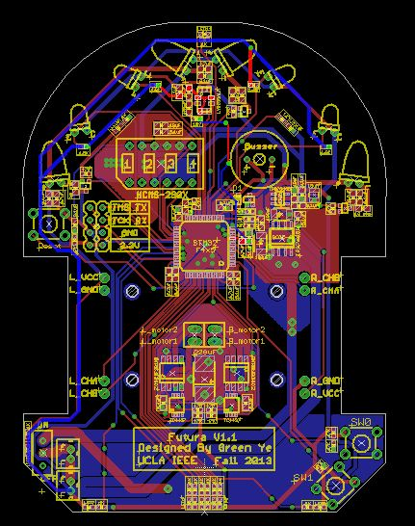
AGND

Slide 22
Questions?

