Slide 1

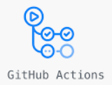







trigger
Build succeed?
No
check-in
Yes
restore
trigger
Start
Database instance
Database schema
create
DNS

