Slide 1
1. Training/validatioin split
2. Spatial patterns - CRF
3. Occlusion – BCNet
4. Largely unbalanced

Slide 2



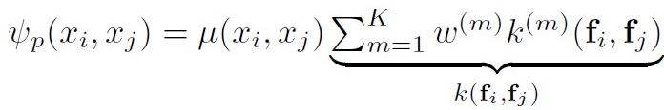
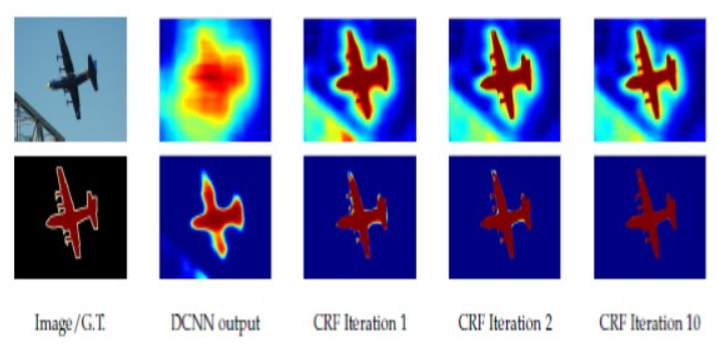
(Fully connected) CRF: convolutional random field
Brief idea:
Output => postprocessing(refinement) => evaluation
Minimize the Gibbs Energy <=> maximize a posterior:
Unary energy and pairwise energy:
Unary energy: output of each pixel independent from the outputs of other pixels
Pairwise energy: kernel functions consider the color vectors and positions of two pixels
Might need several iterations
Take the spatial pattern into consideration

Slide 3
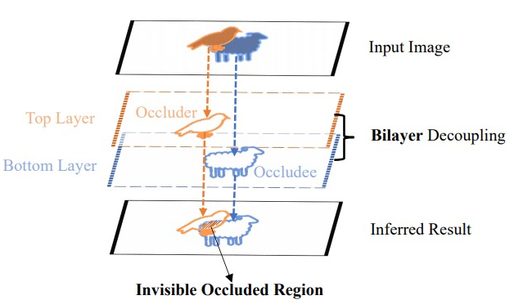
BCNet (Bilayer Convolutional Network) – 2021 CVPR
Consider the occlusion
Region of interest (RoI)
Contract the occluder first, and then contract the occludee
lkeab/BCNet: Deep Occlusion-Aware Instance Segmentation with Overlapping BiLayers [CVPR 2021] (github.com) – built on detectron2

