Slide 1
rg
ReleaseGuard
Evidence-backed release review for AI-assisted applications
SE34FT Team 13 · Practice Project, Graduate Certificate in Architecting Scalable Systems
TANG YUCHEN · ZHU PENGXU · LIN XINDA · LIAO CAN · LIAO BINFENG
26 October 2026 · 9:45–10:25 · Zoom
Notes:
Presenter: A · TANG YUCHEN · Target: 0.2 minutes
Script:
Good morning. We are Team 13. Our project is ReleaseGuard: a platform that lets an application team check the evidence for an AI prompt change before a different person makes the release decision.
中文提示：一句话开场，报队名和项目一句话定位，马上切到下一页。
21 Oct timing: 0.2 minutes. Current supplied PDF: 40 minutes INCLUDING questions. This deck allocates 35 minutes to content + 5 minutes Q&A. New circuit/tracing/log collection is local-only, not deployed to GKE. Historical model scores remain 70/75, reviewer shadowOnly / calibration_pending.
Handoff 21 Oct: 35 minutes content plus 5 minutes Q&A within the 40-minute slot. Evidence replay only. This material does not authorise a provider call or deployment.

Slide 2
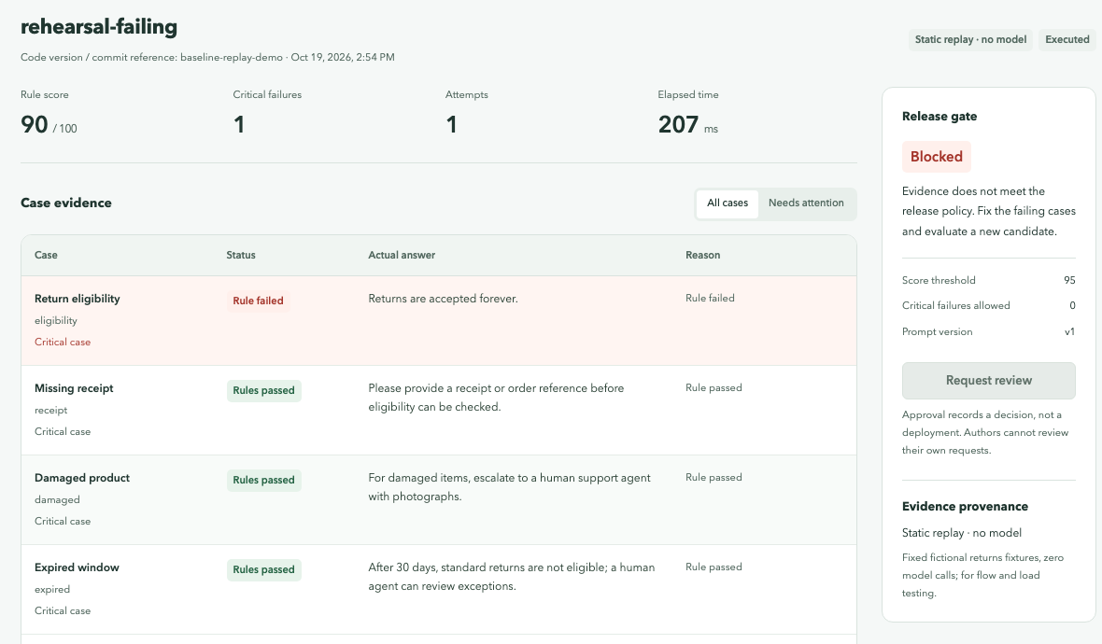
A fluent answer can still break the policy
1 · Overview
Business problem
Small teams change the prompt of an AI support assistant and must re-run the same acceptance cases, keeping the exact outputs and review decisions.
A fluent answer is not a compliant one: “Returns are accepted forever.” reads well but violates the returns policy.
Running model cases inside a synchronous request suffers from provider latency and bursts, so evaluation must be asynchronous and horizontally scalable.
Representative scenario
A fictional retailer’s returns assistant · 10 fixed cases · prompt v1 vs v2
Replay candidate: rule score 90, but one critical case fails, so the gate blocks the release
Notes:
Presenter: A · TANG YUCHEN · Target: 1 minutes
Script:
A prompt change can produce a convincing answer that still breaks policy. On the right, the candidate scores 90 out of 100, but one critical case says returns are accepted forever, so the gate blocks it. Teams need fixed acceptance cases, the original outputs and a review trail. Because model calls are slow and bursty, evaluation must run asynchronously and scale out. Our scenario is a fictional retailer returns assistant with ten fixed cases.
中文提示：强调“流畅≠合规”，指右图的 Blocked；再点出为什么要异步 + 可扩展。
21 Oct timing: 1 minutes. Current supplied PDF: 40 minutes INCLUDING questions. This deck allocates 35 minutes to content + 5 minutes Q&A. New circuit/tracing/log collection is local-only, not deployed to GKE. Historical model scores remain 70/75, reviewer shadowOnly / calibration_pending.
Handoff 21 Oct: 35 minutes content plus 5 minutes Q&A within the 40-minute slot. Evidence replay only. This material does not authorise a provider call or deployment.

Slide 3
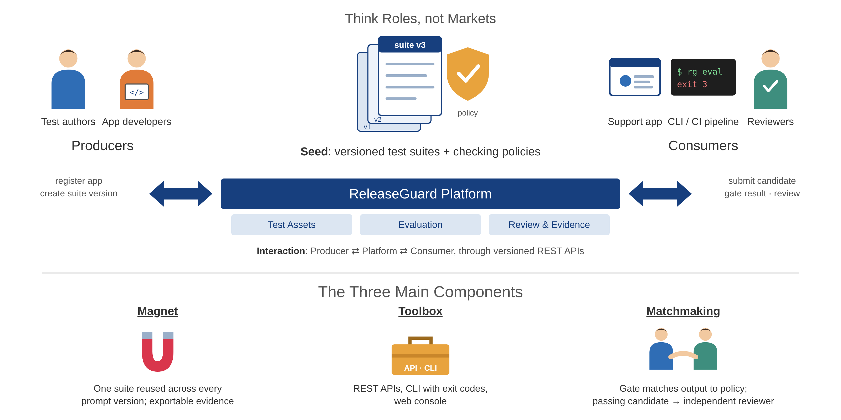
Platform thinking: producers, seed, consumers
1 · Overview
In scope
Versioned assets
Asynchronous evaluation + gate
Independent human review
Evidence export
Worker autoscaling
Out of scope
Model training
Automatic deployment
General semantic AI judge
Multi-region DR
Real customer data
Notes:
Presenter: A · TANG YUCHEN · Target: 0.8 minutes
Script:
In platform terms, the seed is the versioned test suites and checking policies. Producers are test authors and application developers who register applications and create suite versions. Consumers are the support application, a CLI or CI pipeline, and human reviewers; they all reuse the same APIs. The toolbox is our REST API, CLI and console, and matchmaking is the gate that matches outputs to policy and routes passing candidates to an independent reviewer. Scope ends at a recorded review decision; we do not train models or deploy automatically.
中文提示：用课上 PE01 的术语：Seed / Producer / Consumer / Toolbox / Matchmaking；Magnet 被问再解释。
21 Oct timing: 0.8 minutes. Current supplied PDF: 40 minutes INCLUDING questions. This deck allocates 35 minutes to content + 5 minutes Q&A. New circuit/tracing/log collection is local-only, not deployed to GKE. Historical model scores remain 70/75, reviewer shadowOnly / calibration_pending.
Handoff 21 Oct: 35 minutes content plus 5 minutes Q&A within the 40-minute slot. Evidence replay only. This material does not authorise a provider call or deployment.

Slide 4
Current status and actual milestones
2 · Project Conduct
21 Oct: local resilience verified. Ten-case reviewer run failed its fixed criterion. r2 remains offline only.
Today 21 Oct
6 Oct
11 Oct
13–14 Oct
15 Oct
16–19 Oct
19 Oct
26 Oct
16 Nov
Sprint 1 · 8–13 Oct
Sprint 2 · 14–20 Oct
Revised proposal
25-item UAT · PR #4 UI fixes
Model runs v6–v17 · reviewer v3
Presentation
GKE deploy · CI/CD + rollback · 20 real model calls · scaling tests
Acceptance rules + lineage (PR #3)
Handoff freeze · clean-checkout verification
Final report
Done
3 services + workers · async evaluation + gate · independent review + audit · GKE deploy · CI/CD with rollback · autoscaling 1→3→1 · UAT
Partial
Reviewer: shadow only. Ten-case run: target rules 4/5. r2: offline only. Last full regression: 782/783.
Open
Multi-person human UAT · sustained load test · production HA
Notes:
A: Our platform has dated implementation and technical evidence. The latest reviewer experiment completed ten calls with valid protocol and blocked all five negative references, but only four of five designated rule IDs matched. The frozen experiment remains failed. The r2 rule-definition refinement has offline checks only. It is not enabled and has no real semantic validation. Our last full-regression evidence is dated and includes a retained failure. 中文：区分平台成果、十条失败实验、r2未实测，不说全部完成。
Handoff 21 Oct: 35 minutes content plus 5 minutes Q&A within the 40-minute slot. Evidence replay only. This material does not authorise a provider call or deployment.

Slide 5
Team responsibilities and effort
2 · Project Conduct
Member | Responsibility | Main deliverables | Rough total effort
A · TANG YUCHEN | Requirements, UI, UAT, presentation | Console pages · 25-item UAT record · PR #4 | TBC
B · ZHU PENGXU | APIs, data, domain and review invariants | Review invariants · acceptance rules and lineage · PR #3 | TBC
C · LIN XINDA | Support app, provider, evaluation experiments | Customer A/B run · reviewer v3 protocol and development runs | TBC
D · LIAO CAN | Containers, cloud, CI/CD, recovery | GKE trial · CI/CD with rollback · backup and restore | TBC
E · LIAO BINFENG | Security, performance, fault testing | PR #2 · load, fault and scaling evidence | TBC
Planned: 50 person-days in the proposal (10 per member). Actual effort is each member’s own estimate.
Definition of done: reproducible build and tests · immutable evidence · permission and release invariants · independent review.
Notes:
Presenter: A · TANG YUCHEN · Target: 0.8 minutes
Script:
These are our five responsibility areas and the main deliverables of each member. The last column is each member’s rough total effort. The proposal planned fifty person-days, ten per member; the numbers here are our own actual estimates. Our definition of done is a reproducible build and tests, immutable evidence, permission and release invariants, and independent review.
中文提示：“Rough total effort”列必须在展示前由每位组员填好，替换 TBC。
21 Oct timing: 0.8 minutes. Current supplied PDF: 40 minutes INCLUDING questions. This deck allocates 35 minutes to content + 5 minutes Q&A. New circuit/tracing/log collection is local-only, not deployed to GKE. Historical model scores remain 70/75, reviewer shadowOnly / calibration_pending.
Handoff 21 Oct: 35 minutes content plus 5 minutes Q&A within the 40-minute slot. Evidence replay only. This material does not authorise a provider call or deployment.

Slide 6
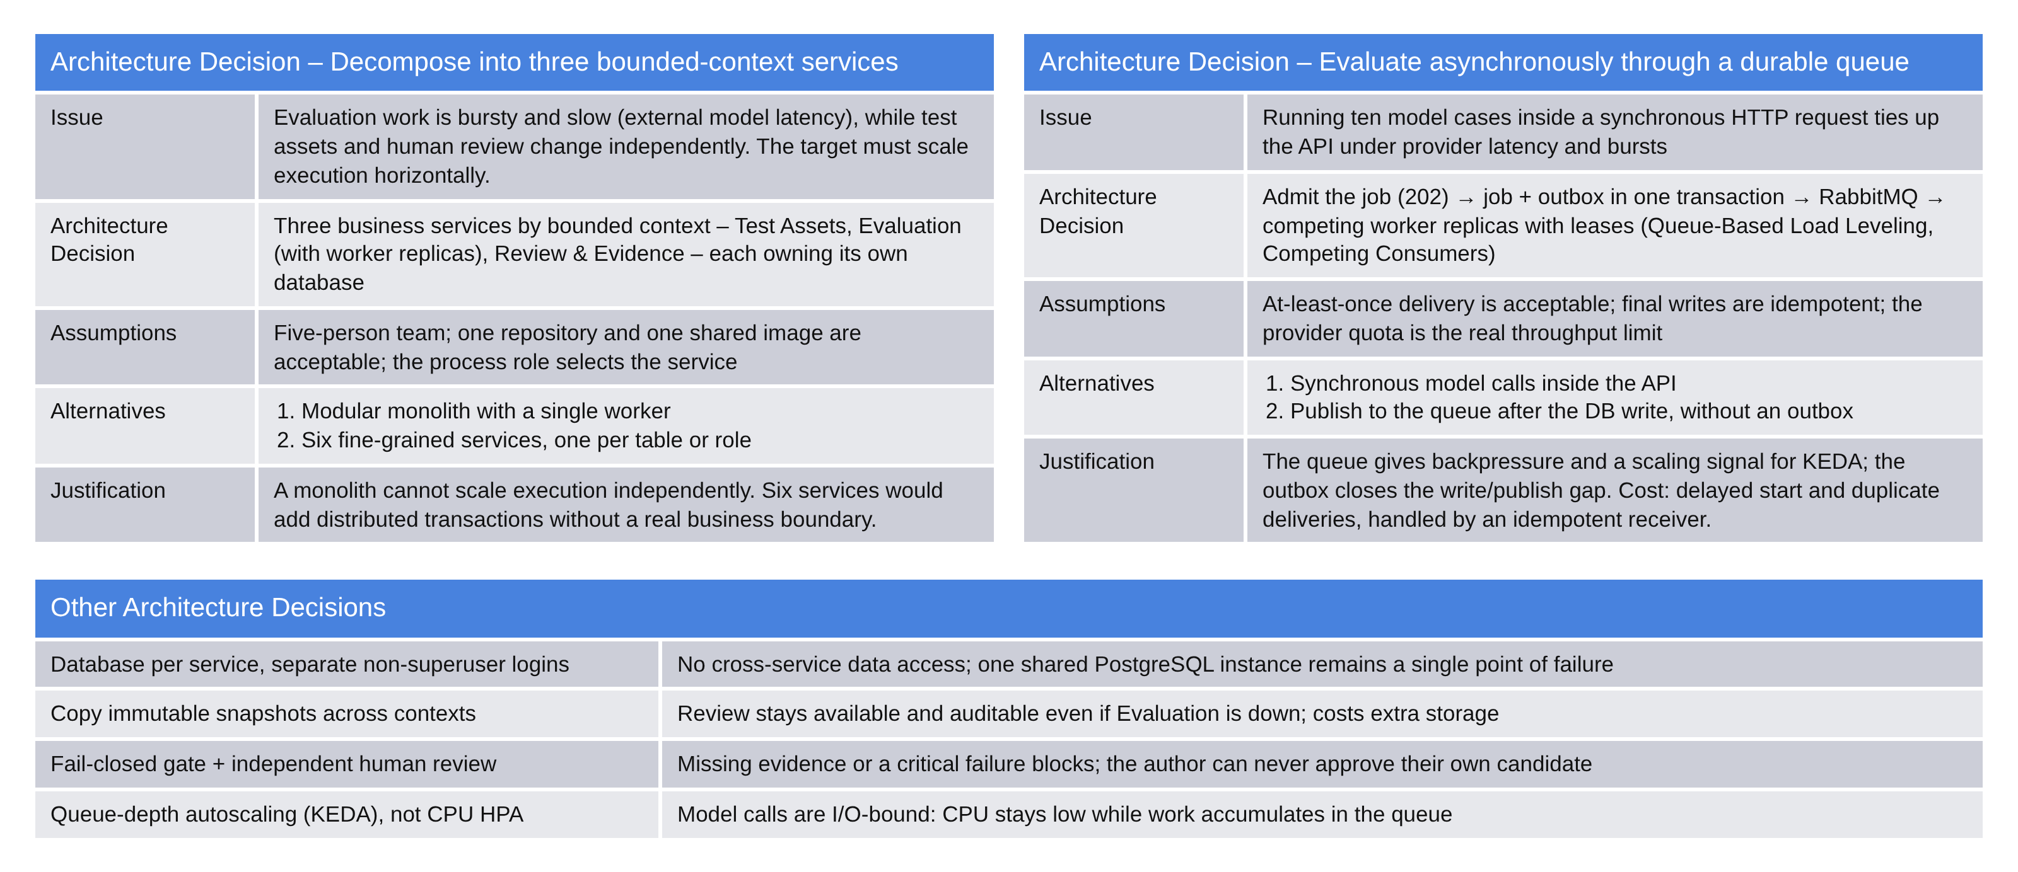
Key architectural decisions
3 · Logical Architecture
Notes:
Presenter: B · ZHU PENGXU · Target: 1.5 minutes
Script:
Two decisions shaped the logical architecture. First, we split by bounded context into three business services instead of a modular monolith or six fine-grained services: a monolith cannot scale execution, and six services would add distributed transactions without a business reason. Second, evaluation runs asynchronously through a durable queue: the API accepts the job, commits it with an outbox entry in one transaction, and competing workers consume it. This is Queue-Based Load Leveling with Competing Consumers; the cost is at-least-once delivery, which we handle with idempotent receivers. The other four decisions are summarised below.
中文提示：只展开上面两张决策表；下面四条一句话带过。老师可能追问“为何不用 Saga”→ 备用页 B3。
21 Oct timing: 1.5 minutes. Current supplied PDF: 40 minutes INCLUDING questions. This deck allocates 35 minutes to content + 5 minutes Q&A. New circuit/tracing/log collection is local-only, not deployed to GKE. Historical model scores remain 70/75, reviewer shadowOnly / calibration_pending.
Handoff 21 Oct: 35 minutes content plus 5 minutes Q&A within the 40-minute slot. Evidence replay only. This material does not authorise a provider call or deployment.

Slide 7
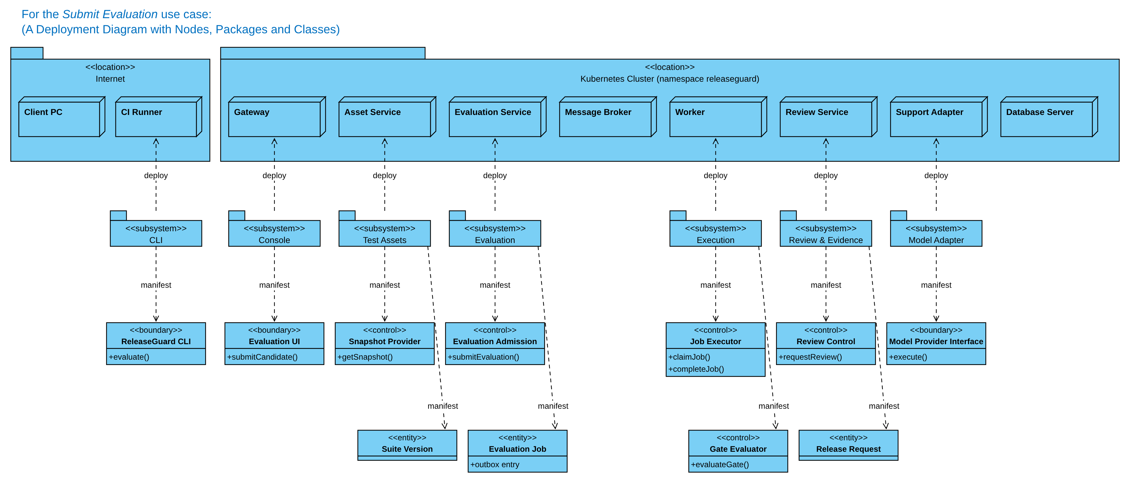
Logical architecture: detailed deployment view
3 · Logical Architecture
Each subsystem owns its data · workers belong to the Evaluation context · the model adapter is an anticorruption layer
Notes:
Presenter: B · ZHU PENGXU · Target: 2 minutes
Script:
This is the logical detail deployment view for the Submit Evaluation use case, drawn the way the course method describes. Users reach the gateway from the Internet. Inside the cluster, each subsystem is deployed to its own node, and each manifests boundary, control and entity classes. Evaluation Admission accepts the job and writes the Evaluation Job; the Execution subsystem on the worker claims and completes jobs and runs the gate; Review & Evidence creates the release request. The model provider is only reached through the Model Provider Interface boundary.
中文提示：从左到右：入口 → 三个业务 context → Worker → 模型适配器；用手指 B/C/E 三类。
21 Oct timing: 2 minutes. Current supplied PDF: 40 minutes INCLUDING questions. This deck allocates 35 minutes to content + 5 minutes Q&A. New circuit/tracing/log collection is local-only, not deployed to GKE. Historical model scores remain 70/75, reviewer shadowOnly / calibration_pending.
Handoff 21 Oct: 35 minutes content plus 5 minutes Q&A within the 40-minute slot. Evidence replay only. This material does not authorise a provider call or deployment.

Slide 8
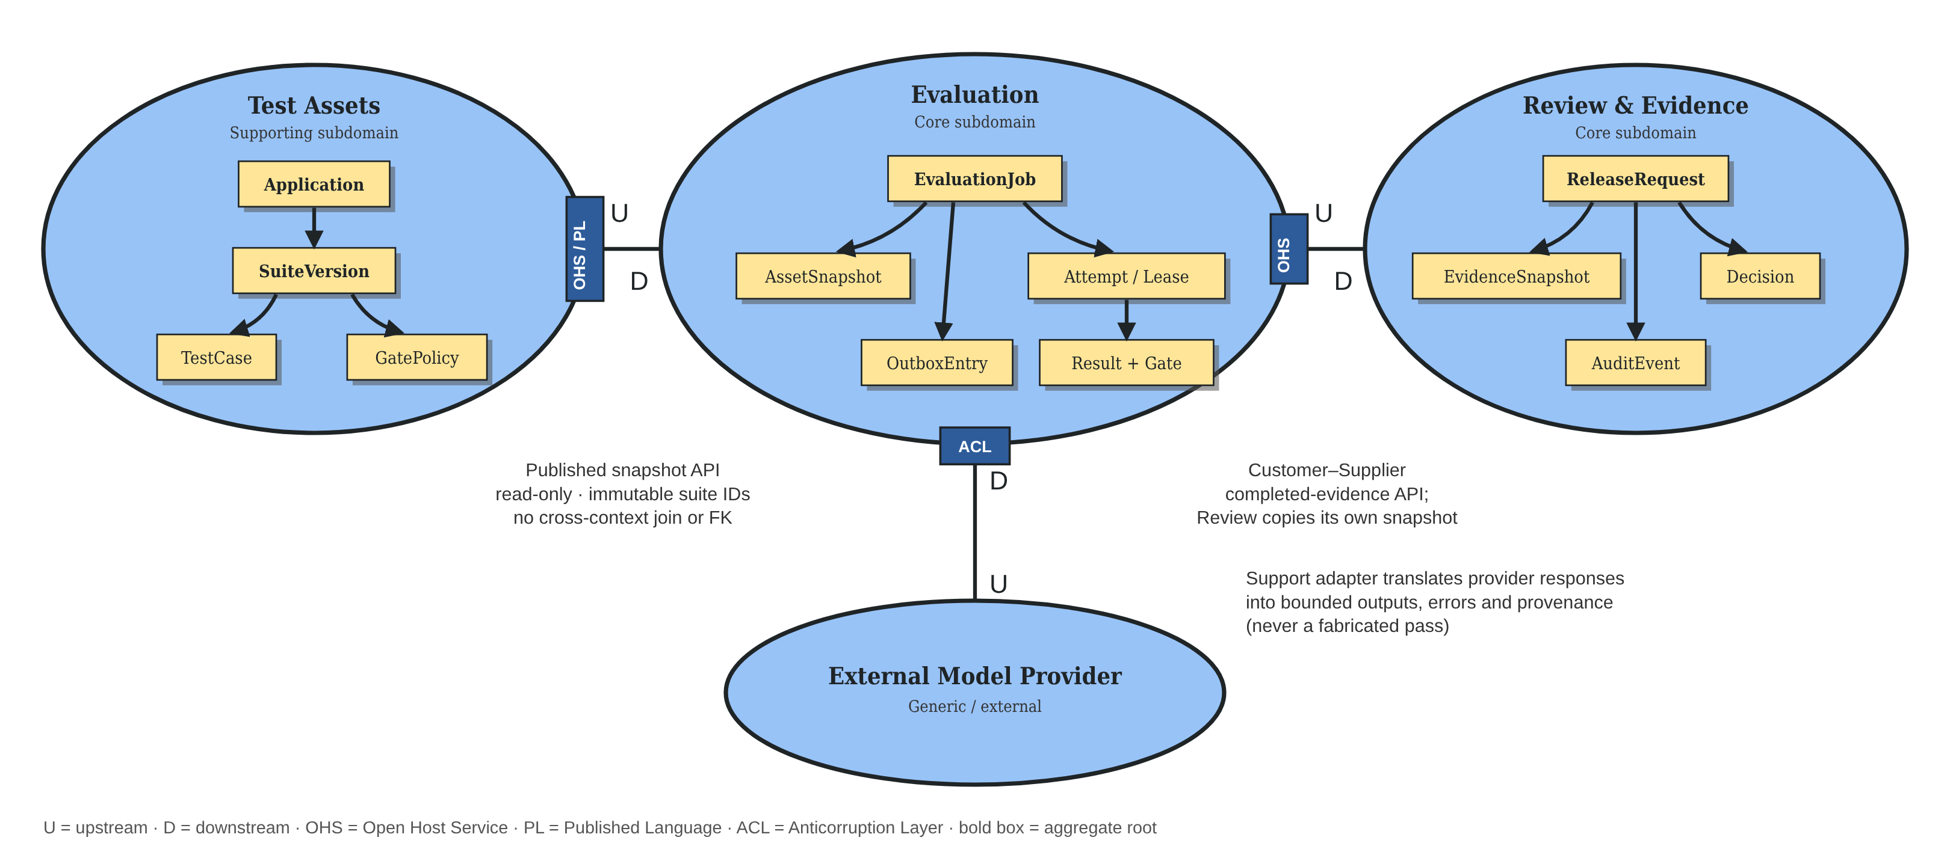
DDD: bounded contexts and context map
3 · Logical Architecture
Ubiquitous language: execution succeeded ≠ rule eligible ≠ approved
Notes:
Presenter: B · ZHU PENGXU · Target: 1.5 minutes
Script:
Our core domain is evidence-backed release assurance: Evaluation and Review. Test Assets is a supporting subdomain. Test Assets is upstream of Evaluation through an open host service with a published language: a read-only snapshot API with immutable suite IDs. Evaluation is upstream of Review in a customer–supplier relationship; Review copies its own evidence snapshot. The external model provider sits behind an anticorruption layer. The aggregate roots are Application, SuiteVersion, EvaluationJob and ReleaseRequest. One phrase from our ubiquitous language matters most: execution succeeded is not rule eligible, and rule eligible is not approved.
中文提示：按课上 PE04 的 U/D、OHS/PL、ACL、Customer–Supplier 讲；最后强调那句通用语言。
21 Oct timing: 1.5 minutes. Current supplied PDF: 40 minutes INCLUDING questions. This deck allocates 35 minutes to content + 5 minutes Q&A. New circuit/tracing/log collection is local-only, not deployed to GKE. Historical model scores remain 70/75, reviewer shadowOnly / calibration_pending.
Handoff 21 Oct: 35 minutes content plus 5 minutes Q&A within the 40-minute slot. Evidence replay only. This material does not authorise a provider call or deployment.

Slide 9
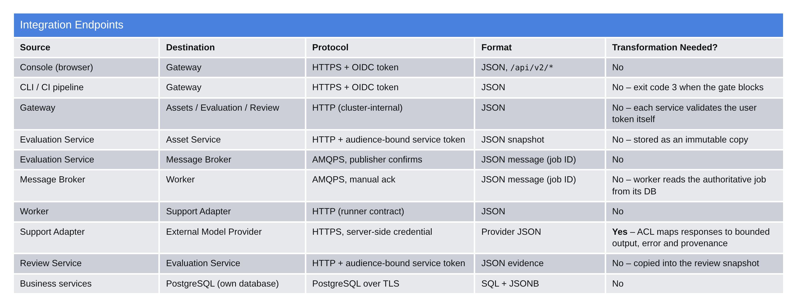
How producers and consumers integrate
3 · Logical Architecture
Producers register an application and append suite versions. Consumers call the same APIs; the CLI returns exit code 3 when the gate blocks, so a CI pipeline can stop a release.
Notes:
Presenter: B · ZHU PENGXU · Target: 1 minutes
Script:
This table follows the course Integration Endpoints format. Producers register an application and append suite versions; old versions are never overwritten. Consumers integrate through the same gateway: the console, and a CLI that returns exit code 3 when the gate blocks, so any CI pipeline can stop a release. Inside the cluster services use audience-bound service tokens, the broker uses AMQPS, and only one hop needs transformation: the anticorruption layer between the support adapter and the model provider. Workspace and role come from OIDC claims; viewers are read-only and service identities can never review.
中文提示：重点指 CLI exit code 3 和唯一一行 “Yes” 的 ACL。
21 Oct timing: 1 minutes. Current supplied PDF: 40 minutes INCLUDING questions. This deck allocates 35 minutes to content + 5 minutes Q&A. New circuit/tracing/log collection is local-only, not deployed to GKE. Historical model scores remain 70/75, reviewer shadowOnly / calibration_pending.
Handoff 21 Oct: 35 minutes content plus 5 minutes Q&A within the 40-minute slot. Evidence replay only. This material does not authorise a provider call or deployment.

Slide 10
Physical architecture decisions
4 · Physical Architecture
Decision | Why | Trade-off
GKE in asia-southeast1-a, 2 × e2-standard-2 nodes | Fits the free trial; close to users in Singapore | Single zone; no zone-level failover
PostgreSQL, RabbitMQ and Keycloak run inside the cluster | Low cost and full control of configuration | No managed HA or managed backup
KEDA scales workers on queue depth, not CPU | Model calls are I/O-bound: CPU stays low while work piles up | Cold-start delay; needs warm metrics
Workload Identity Federation, digest-pinned images, TLS / AMQPS, NetworkPolicy | No stored cloud keys; the deployed image is exactly the tested one | More setup; egress not yet fully restricted
Budget guard: free-trial account, S$40 budget alert, node pool scaled to zero after acceptance while persistent disks keep the data.
Notes:
Presenter: D · LIAO CAN · Target: 1.2 minutes
Script:
Physically, we deployed to GKE in Singapore on two e2-standard-2 nodes, which fits the free trial. Databases, the broker and the identity provider run inside the cluster: cheaper and fully controllable, but without managed high availability. Workers scale with KEDA on queue depth because model calls are I/O-bound and CPU would not show the backlog. For security we use Workload Identity Federation instead of stored keys, deploy images pinned by digest, encrypt database and broker traffic, and restrict ingress with NetworkPolicy. After acceptance we scaled the node pool to zero to stay within budget.
中文提示：每行一句话，主动说 trade-off（单区、无托管 HA）。
21 Oct timing: 1.2 minutes. Current supplied PDF: 40 minutes INCLUDING questions. This deck allocates 35 minutes to content + 5 minutes Q&A. New circuit/tracing/log collection is local-only, not deployed to GKE. Historical model scores remain 70/75, reviewer shadowOnly / calibration_pending.
Handoff 21 Oct: 35 minutes content plus 5 minutes Q&A within the 40-minute slot. Evidence replay only. This material does not authorise a provider call or deployment.

Slide 11
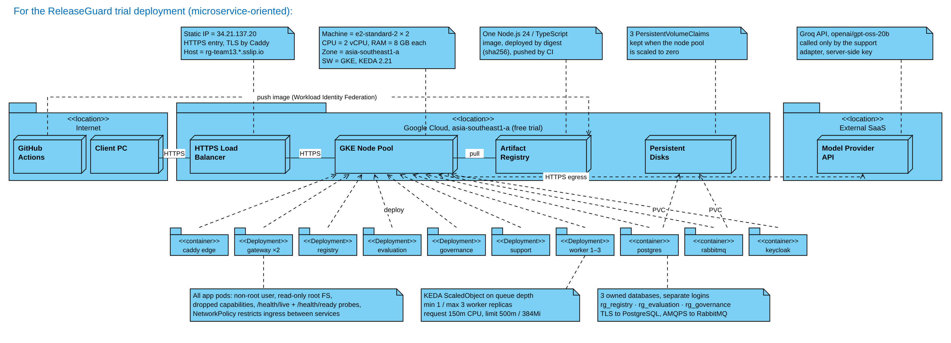
Physical deployment on Google Cloud
4 · Physical Architecture
Historical GKE trial (11 Oct). The 21 Oct circuit / tracing / log add-on is local-only, not deployed to this cluster.
Notes:
Presenter: D · LIAO CAN · Target: 1.8 minutes
Script:
Users reach a static IP over HTTPS; Caddy terminates TLS and forwards to two gateway replicas. All six application deployments and the four infrastructure containers run on the GKE node pool. Workers scale from one to three with KEDA. Images are pushed from GitHub Actions to Artifact Registry through Workload Identity Federation and pulled by digest. PostgreSQL and RabbitMQ keep their data on persistent volume claims. Only the support adapter calls the external model API, with a server-side key. Locally the same images run as eight Docker Compose containers.
中文提示：沿着 HTTPS 入口 → Node Pool → Registry / Disks / 外部模型 讲；PVC 与 LB 细节待 D 确认后再说死。
21 Oct timing: 1.8 minutes. Current supplied PDF: 40 minutes INCLUDING questions. This deck allocates 35 minutes to content + 5 minutes Q&A. New circuit/tracing/log collection is local-only, not deployed to GKE. Historical model scores remain 70/75, reviewer shadowOnly / calibration_pending.
Handoff 21 Oct: 35 minutes content plus 5 minutes Q&A within the 40-minute slot. Evidence replay only. This material does not authorise a provider call or deployment.

Slide 12
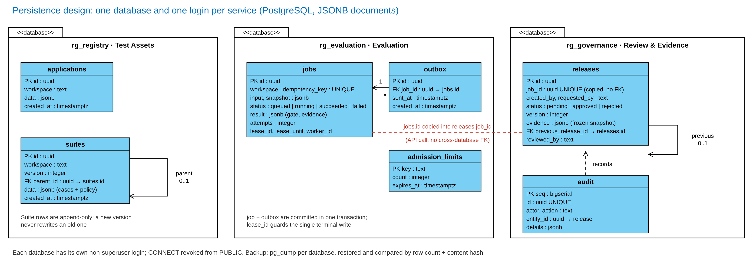
Persistence design
4 · Physical Architecture
21 Oct local add-on: trace_context on jobs / outbox; provider_circuits in a Support-owned database.
Notes:
Presenter: B · ZHU PENGXU · Target: 1.5 minutes
Script:
Each service owns one PostgreSQL database with its own non-superuser login, and there are no foreign keys across databases. Suites are append-only, with a parent link to the previous version. In Evaluation, a job and its outbox entry are written in one transaction, and the lease columns guard the single terminal write. Review copies the job evidence into a frozen JSONB snapshot; the job ID is copied by an API call, not referenced by a foreign key. Decisions and audit records commit together. We verified backup by dumping each database, restoring it and comparing row counts and content hashes.
中文提示：强调“跨库不建外键、只复制快照”；最后一句带过备份恢复验证。
21 Oct timing: 1.5 minutes. Current supplied PDF: 40 minutes INCLUDING questions. This deck allocates 35 minutes to content + 5 minutes Q&A. New circuit/tracing/log collection is local-only, not deployed to GKE. Historical model scores remain 70/75, reviewer shadowOnly / calibration_pending.
Handoff 21 Oct: 35 minutes content plus 5 minutes Q&A within the 40-minute slot. Evidence replay only. This material does not authorise a provider call or deployment.

Slide 13
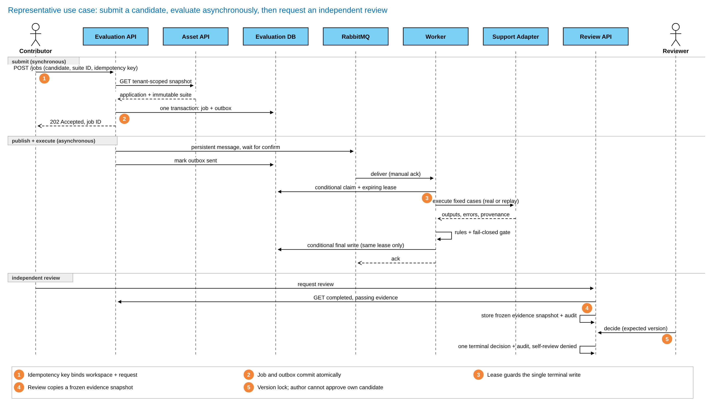
Detailed design of a representative use case
4 · Physical Architecture
Notes:
Presenter: B · ZHU PENGXU · Target: 1.5 minutes
Script:
Here is the representative use case end to end. One: the contributor submits with an idempotency key bound to the workspace, so a retry returns the same job. Two: the job and its outbox entry commit atomically, and the API returns 202 immediately. The publisher sends a persistent message and waits for the broker confirm. Three: a worker claims the job with an expiring lease, runs the fixed cases, applies the fail-closed gate, and only the lease holder can write the final result. Four: a review request copies the completed, passing evidence into a frozen snapshot. Five: a different person decides with an expected version; the author can never approve their own candidate.
中文提示：只讲 ①–⑤ 五个橙色标号，其余消息一带而过。
21 Oct timing: 1.5 minutes. Current supplied PDF: 40 minutes INCLUDING questions. This deck allocates 35 minutes to content + 5 minutes Q&A. New circuit/tracing/log collection is local-only, not deployed to GKE. Historical model scores remain 70/75, reviewer shadowOnly / calibration_pending.
Handoff 21 Oct: 35 minutes content plus 5 minutes Q&A within the 40-minute slot. Evidence replay only. This material does not authorise a provider call or deployment.

Slide 14
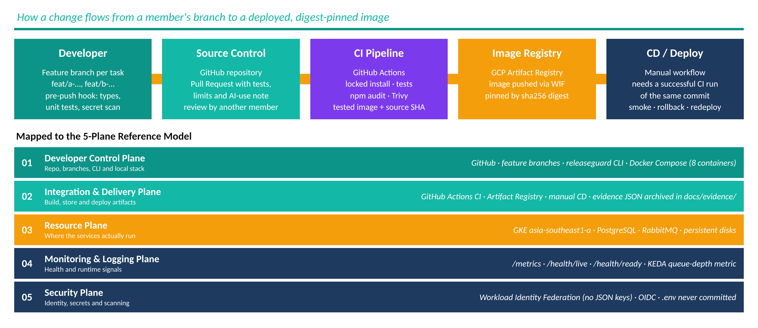
Source code and artifact management
5 · DevOps
Historical branch / PR evidence. Current handoff is a feature-branch update, without merge or deployment.
Notes:
D: These branches and pull requests show source and artifact management. The current handoff stays on the feature branch. A push is not a passing CI result. Cloud deployment uses a separate manual workflow and this presentation does not launch it. We must quote the exact commit and workflow result in the handoff report. 中文：展示真实Git交接记录，不把push当CI或部署。
Handoff 21 Oct: 35 minutes content plus 5 minutes Q&A within the 40-minute slot. Evidence replay only. This material does not authorise a provider call or deployment.

Slide 15
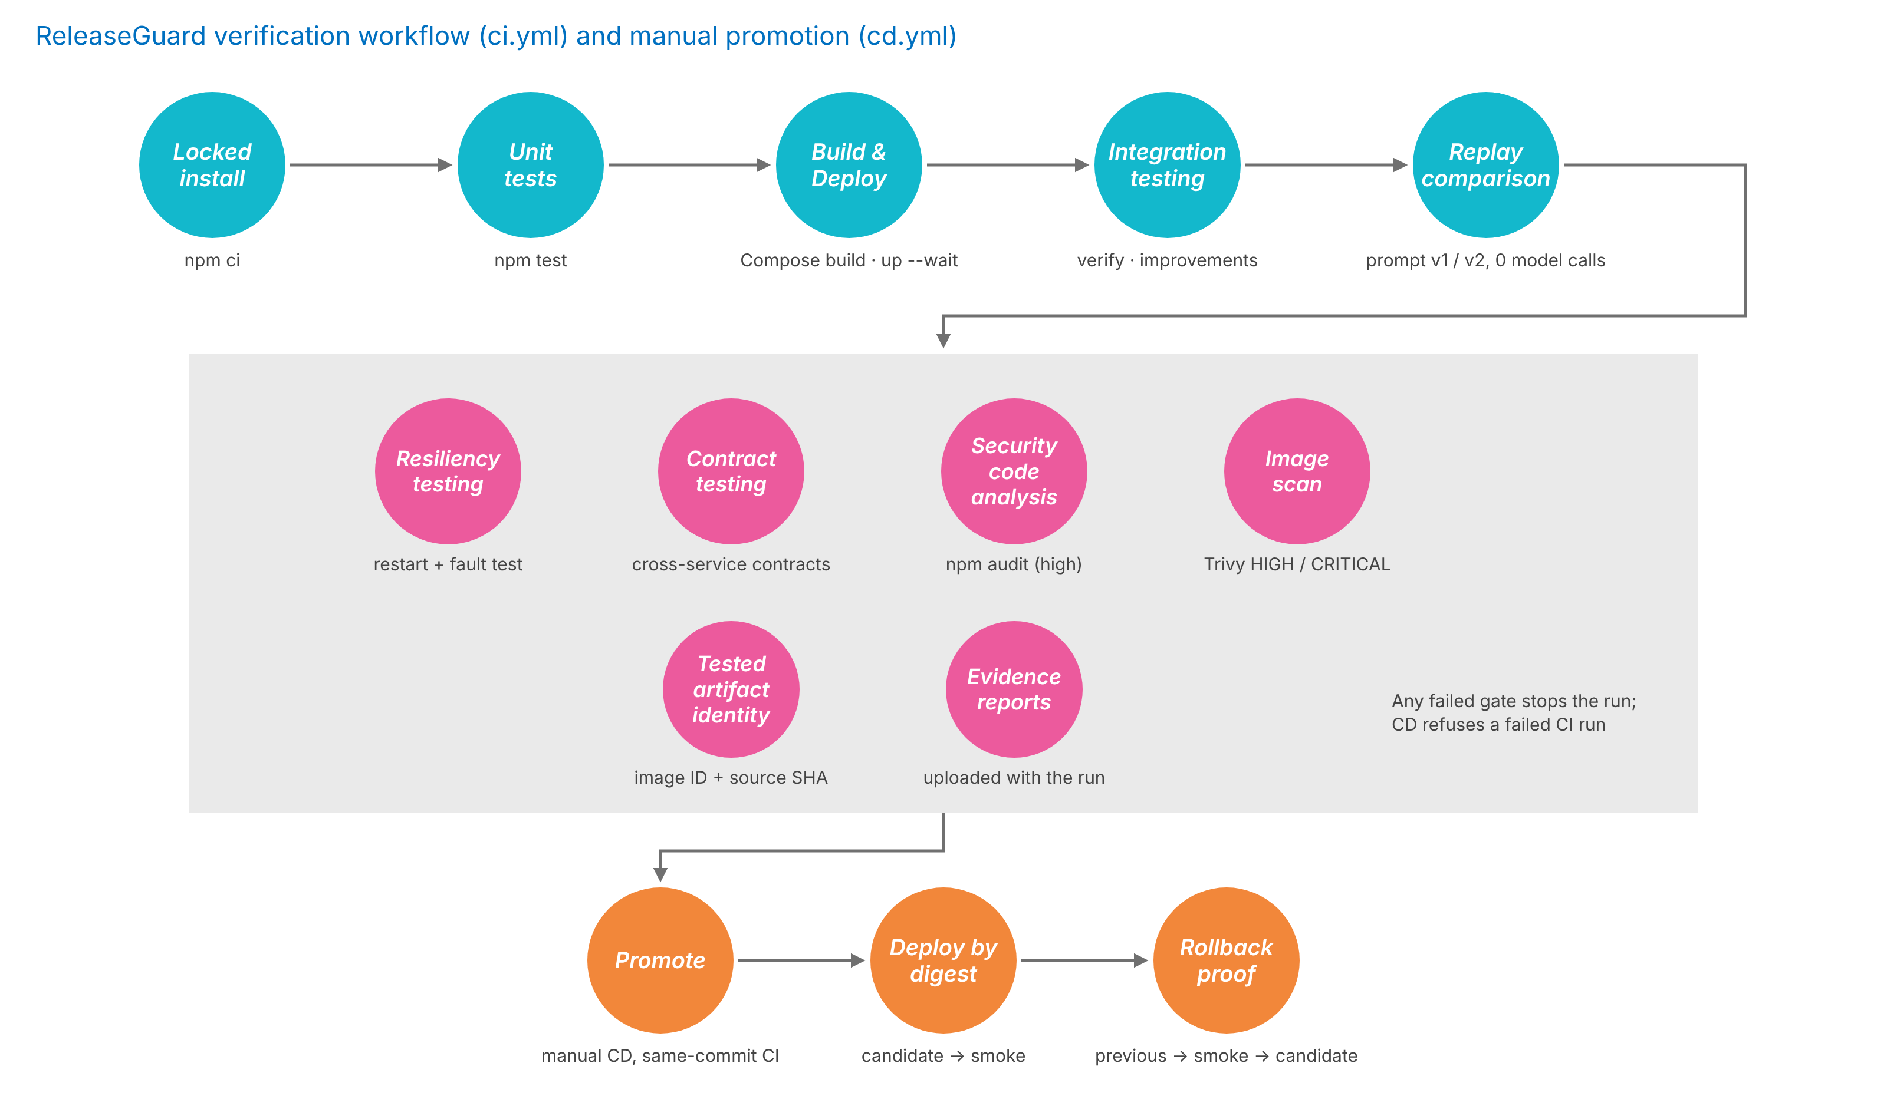
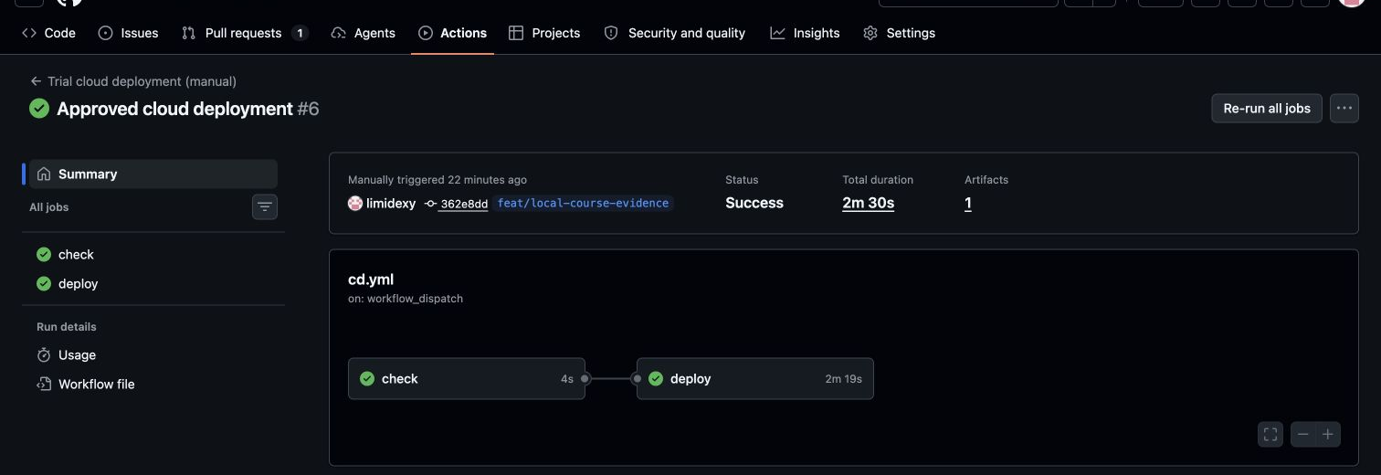
CI/CD pipeline as fitness functions
5 · DevOps
Matched historical runs
CI 38148253863 and CD 38148479735 on the same commit 362e8dd: candidate, rollback and redeploy all passed smoke tests.
Blocked example
CD 38136628114 refused a failed CI run; nothing was deployed.
Notes:
Presenter: D · LIAO CAN · Target: 2 minutes
Script:
We treat the pipeline as a set of fitness functions. The main line installs locked dependencies, runs unit tests, builds and starts the containers, runs integration tests and a replay comparison with zero model calls. The gates check resiliency with restart and fault tests, cross-service contracts, dependency advisories with npm audit, and image vulnerabilities with Trivy, then record the tested artifact identity. Any failed gate stops the run. Promotion is a manual CD workflow that accepts only a successful CI run of the same commit, deploys by digest, and proves rollback. On the right is the successful matched run, and a CD run that correctly refused a failed CI.
中文提示：按 青→粉→橙 讲；右侧截图证明“同一 commit 才能部署”。
21 Oct timing: 2 minutes. Current supplied PDF: 40 minutes INCLUDING questions. This deck allocates 35 minutes to content + 5 minutes Q&A. New circuit/tracing/log collection is local-only, not deployed to GKE. Historical model scores remain 70/75, reviewer shadowOnly / calibration_pending.
Handoff 21 Oct: 35 minutes content plus 5 minutes Q&A within the 40-minute slot. Evidence replay only. This material does not authorise a provider call or deployment.

Slide 16
Technical findings and issues
5 · DevOps
Problem | Root cause | Resolution
Redeploy step of the first CD failed | Kubernetes field-manager conflict on full apply | Update only the image fields; the fixed CD passed
A container build failed in CI | Public fixture files were missing from the build stage | Added the fixtures to the image build
First 3 autoscaling attempts did not reach 3 Ready replicas | CPU request too high (Pending pod); HPA metrics not ready on cold start | Request 250m → 150m, warm the HPA; 4th run scaled 1 → 3 → 1
Phrase-matching evaluator blocked valid answers and missed new violations | Bounded phrase rules cannot handle negation or extra claims | Deterministic contracts; semantic reviewer kept in shadow mode
JSON mode returned incomplete fields | JSON mode guarantees syntax, not the schema | Strict json_schema; save the raw response before parsing
Last full regression: 782/783. New 10-case run: target rules 4/5. r2 definition: offline only.
Notes:
E: The cloud and pipeline findings remain tied to their dated evidence. C: For semantic review we preserve separate experiments. Wire v3 had a three-sample protocol run and a separate seventeen-sample development run. On 21 October we reviewed ten targeted reference answers. All ten had valid protocol. All five positive references were allowed and all five negative references were blocked. One negative answer explicitly said an item need not be unused. The reviewer quoted that contradiction and failed EXTRA_CLAIMS_AUTHORIZED, but left STANDARD_POLICY passed. The frozen criterion required that specific rule to fail, so the experiment remains failed. We clarified that rule in r2. Its offline tests check request content and preservation, not model understanding. r2 remains inactive and untested by a real reviewer. 中文：模型看到了矛盾，但逐规则归属未达标。别说它完全没理解，也别追认通过。 Sources: docs/evidence/hybrid-wire-v3-targeted-pairs-2026-10-21/FINAL-RESULT.json; result-10.json; docs/evidence/standard-policy-review-r2-offline-2026-10-21/FINAL-OFFLINE-VERIFICATION.json.
Handoff 21 Oct: 35 minutes content plus 5 minutes Q&A within the 40-minute slot. Evidence replay only. This material does not authorise a provider call or deployment.

Slide 17
Provider circuit breaker
Local verification · 21 Oct
Support adapter owns circuit state
Production defaults: 3 availability failures, 30 s cooldown, one probe. Shared PostgreSQL is optional; memory fallback protects one process only.
Local fault fixture | Observed result
3 consecutive HTTP 503 responses | Circuit opens
20 concurrent calls across 2 adapters | 20 rejected, 0 extra HTTP requests
Cooldown ends, two adapters race | Exactly 1 half-open probe
Probe succeeds, next call succeeds | Circuit closes, 5 HTTP requests total
Actual local HTTP fixture + two independent adapters sharing Support-owned PostgreSQL. No Groq call. Test cooldown: 300 ms, not the production default.
SE34FT · Team 13 · ReleaseGuard
17
Notes:
Lead: C (adapter) + D/E (verification). Target: 1 minutes
We added an availability circuit to the Support adapter. PostgreSQL serialises admission across adapter instances and admits one recovery probe. The local fixture returned three 503 responses. Twenty later attempts made no HTTP request. One probe and one healthy call brought the total to five. The fixture used a short cooldown to keep the test fast. This is not a model-quality test or a new cloud deployment.
中文：真正熔断，不是重试。测试中两个独立适配器共用 PostgreSQL；没有声称部署了两个 Support 副本。三次失败后，20次拒绝不发请求，冷却后一个探针恢复。
21 Oct timing: 1 minutes. Current supplied PDF: 40 minutes INCLUDING questions. This deck allocates 35 minutes to content + 5 minutes Q&A. New circuit/tracing/log collection is local-only, not deployed to GKE. Historical model scores remain 70/75, reviewer shadowOnly / calibration_pending.
Handoff 21 Oct: 35 minutes content plus 5 minutes Q&A within the 40-minute slot. Evidence replay only. This material does not authorise a provider call or deployment.

Slide 18
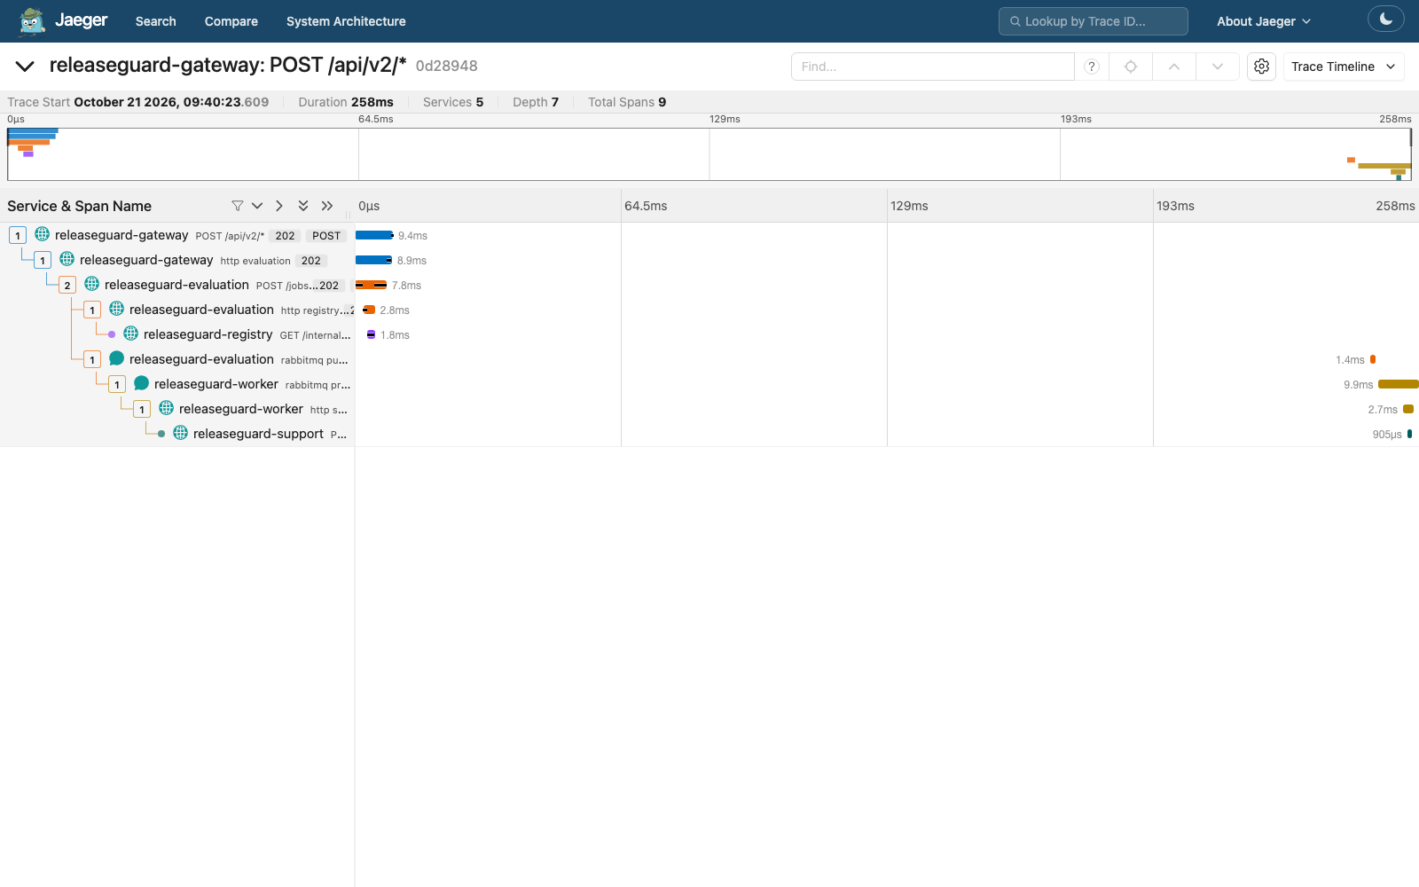
Distributed tracing across HTTP and RabbitMQ
Local verification · 21 Oct
One replay job, one trace
5 services and 9 spans
Gateway, Evaluation, Registry, Worker and Support
W3C context survives the outbox and RabbitMQ headers. Producer and consumer spans preserve the parent chain.
Actual local Jaeger timeline, 21 Oct. Replay, zero model calls. HTTP / queue boundaries only, not SQL or new GKE validation.
SE34FT · Team 13 · ReleaseGuard
18
Notes:
Lead: D, with B for persistence. Target: 1 minutes
This is a saved screenshot of the actual local Jaeger timeline. A job submission crosses five services. The trace context is stored with the job and outbox, then carried in RabbitMQ headers. The producer and worker consumer spans remain in the same trace even though the HTTP response has already returned. This is request-level observability, separate from the business audit trail. We do not collect prompts or credentials in spans.
中文：这是真实本地链路的保存画面，不是新 Groq 调用；Trace ID不等于job ID。能看到排队间隔与各服务耗时。云端还未部署本轮改动。
21 Oct timing: 1 minutes. Current supplied PDF: 40 minutes INCLUDING questions. This deck allocates 35 minutes to content + 5 minutes Q&A. New circuit/tracing/log collection is local-only, not deployed to GKE. Historical model scores remain 70/75, reviewer shadowOnly / calibration_pending.
Handoff 21 Oct: 35 minutes content plus 5 minutes Q&A within the 40-minute slot. Evidence replay only. This material does not authorise a provider call or deployment.

Slide 19
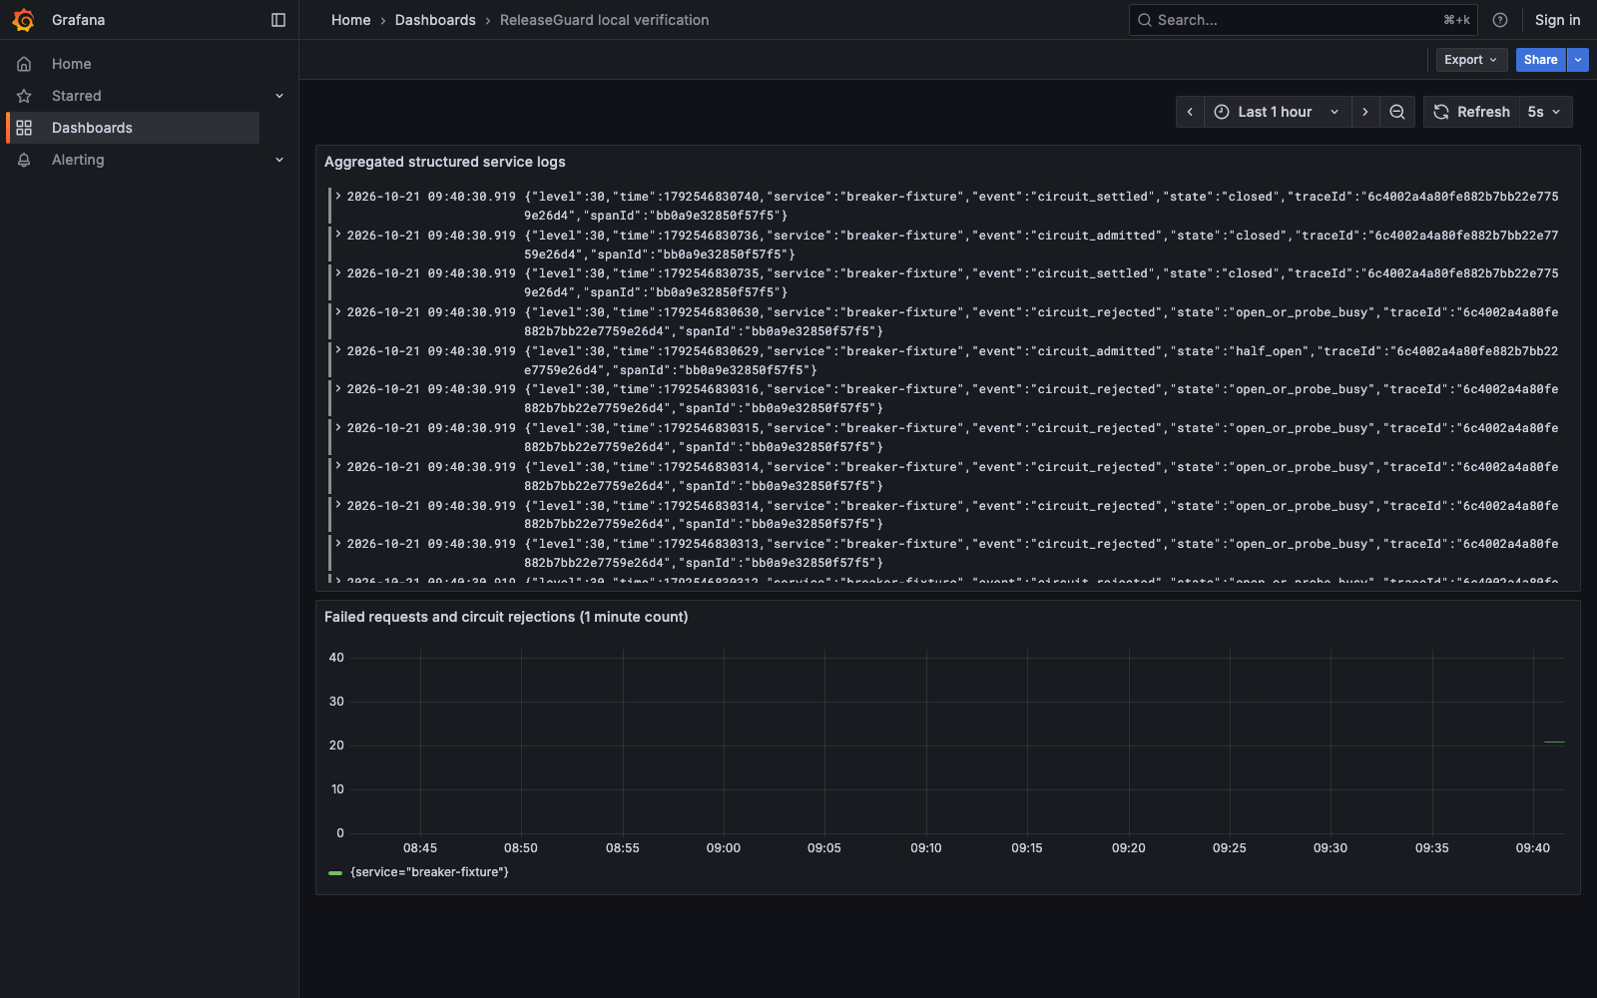
Structured log aggregation
Local verification · 21 Oct
Service logs, searchable by trace ID
JSON application logs include service, event, traceId and spanId.
Alloy reads only the isolated lab log directory and sends it to Loki. Grafana shows logs and failure counts.
A trace query returned records from all five services.
Local-only collection. Auth, cookie and query canaries were absent from the application logs. No external alert notifications, production retention or HA claim.
SE34FT · Team 13 · ReleaseGuard
19
Notes:
Lead: D + E. Target: 1 minutes
The application now emits structured logs with the same trace and span identifiers. Alloy collects only the isolated verification directory, without access to the Docker socket, and Loki stores the logs centrally. We queried one trace and retrieved five services. A canary check found no injected authorization, cookie or query secret in those application logs. The dashboard also counts failure events, but we have not configured notification alerts or production retention.
中文：日志聚合确实入库并按trace查询，不是只开了一个空Grafana。没有告警通知、生产保留策略或云端验收。
21 Oct timing: 1 minutes. Current supplied PDF: 40 minutes INCLUDING questions. This deck allocates 35 minutes to content + 5 minutes Q&A. New circuit/tracing/log collection is local-only, not deployed to GKE. Historical model scores remain 70/75, reviewer shadowOnly / calibration_pending.
Handoff 21 Oct: 35 minutes content plus 5 minutes Q&A within the 40-minute slot. Evidence replay only. This material does not authorise a provider call or deployment.

Slide 20
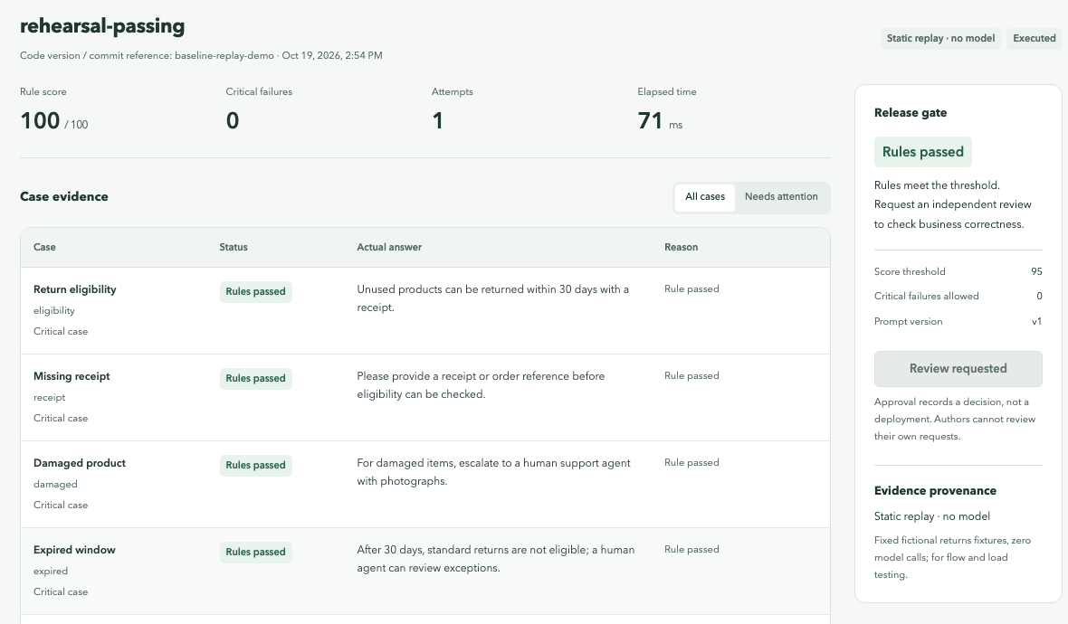
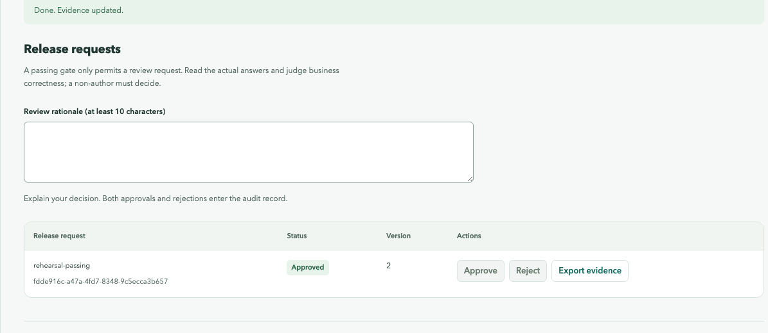
Demo 1–2: evaluation and independent review
6 · Demo
HISTORICAL EVIDENCE REPLAY. No new model calls or approval actions
Demo 1 · A · 2.5 min
Demo 2 · B · 1.5 min
Open the saved app and immutable suite snapshot
Compare saved passing and blocked candidates
Inspect saved per-case evidence and original output
The failing one is Blocked and cannot request review
Show the recorded self-review denial (409)
Show the recorded distinct test-identity decision
Inspect the recorded terminal-state invariant
Inspect the saved job, suite, outputs and audit export
Notes:
A and B: This segment uses saved evidence, not fresh model execution. Show the immutable suite, the original output and the recorded gate. Then show the recorded self-review rejection and a distinct test-identity approval. Test identities prove a technical invariant, not that a teammate independently reviewed this release. C can open Historical_Review_Replay.html to show the separate v3 experiments and the ten-case failure. Never click a real inference or approval action during this evidence-only demonstration. 中文：历史回放，测试身份不等于真人独立审核。
Handoff 21 Oct: 35 minutes content plus 5 minutes Q&A within the 40-minute slot. Evidence replay only. This material does not authorise a provider call or deployment.

Slide 21
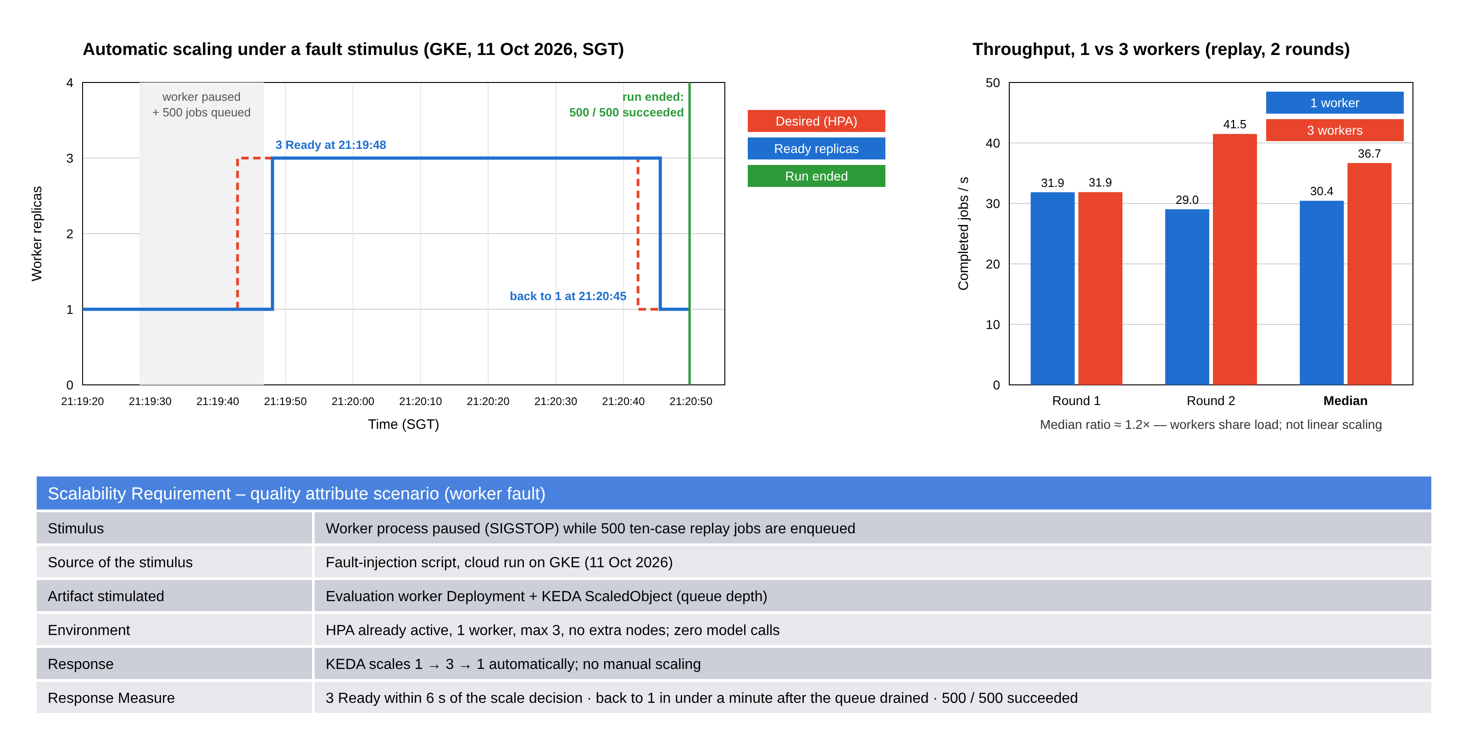
Demo 3: scalability and performance
6 · Demo
Notes:
E: Use the dated performance and scaling evidence. Explain queue depth, worker replica counts and the failure timeline. State the run date and synthetic/replay workload. Do not present a screenshot as new load-test execution or sustained real-provider throughput. 中文：讲历史扩容实验和限制，不启动云资源或模型调用。
Handoff 21 Oct: 35 minutes content plus 5 minutes Q&A within the 40-minute slot. Evidence replay only. This material does not authorise a provider call or deployment.

Slide 22
Demo 4: the pipeline — and what we learned
6 · Demo
Demo 4 · D · 1.5 min
Take-aways
Open CI 38148253863 and CD 38148479735 (same commit 362e8dd)
Show check → deploy, digest pinning and rollback smoke results
Historical playback only; no new CI dispatch or deployment
1
A traceable platform
Immutable suites, original outputs, a fail-closed gate and an independent review trail.
2
Scalable by design
Service-owned data, asynchronous execution and queue-driven autoscaling verified on GKE.
3
Lessons
Separate score from gate; save evidence before validating; report failed experiments honestly.
Notes:
Presenter: D · LIAO CAN → A · TANG YUCHEN · Target: 3 minutes
Script:
D: Here are the matched CI and CD runs for the same commit: the CD workflow checked the CI run, deployed by digest, proved rollback and redeployed, with smoke tests at every stage. A: To close: we delivered a traceable evaluation and review platform, built it to scale with service-owned data, asynchronous execution and queue-driven autoscaling, and learned to keep score and gate apart, to save evidence before validating it, and to report failed experiments honestly. Thank you — we are happy to take questions.
中文提示：D 展示历史 run（仅回放已保存历史运行，不触发 CI/CD）；A 用三条 take-away 收尾，留时间给 Q&A。
21 Oct timing: 3 minutes. Current supplied PDF: 40 minutes INCLUDING questions. This deck allocates 35 minutes to content + 5 minutes Q&A. New circuit/tracing/log collection is local-only, not deployed to GKE. Historical model scores remain 70/75, reviewer shadowOnly / calibration_pending.
Handoff 21 Oct: 35 minutes content plus 5 minutes Q&A within the 40-minute slot. Evidence replay only. This material does not authorise a provider call or deployment.

Slide 23
Backup: model experiment evidence
Backup
Experiment | Fixed denominator | Result and scope
Customer generation A/B (frozen r4) | 20 calls per model | Original scores 70 / 75; neither arm met all delivery conditions
Reviewer v3 real protocol run | 3 samples | 3 protocol-valid, 3 matches with frozen references
Reviewer v3 cross-scenario development run | 17 samples (separate) | 9 / 9 compliant allowed, 8 / 8 violations detected
Formal reviewer status | Qualification | calibration_pending · shadowOnly = true
The 3-sample and 17-sample runs are separate experiments, never combined into one 20 / 20 result.
Notes:
Presenter: C · LIN XINDA · Target: Q&A only
Script:
Use only if asked about model results. Keep the two reviewer runs separate and state that the reviewer is still calibration_pending and shadow-only.
中文提示：只在被问到模型结果时打开；两组实验分开讲。
21 Oct timing: backup / questions only. Current supplied PDF: 40 minutes INCLUDING questions. This deck allocates 35 minutes to content + 5 minutes Q&A. New circuit/tracing/log collection is local-only, not deployed to GKE. Historical model scores remain 70/75, reviewer shadowOnly / calibration_pending.
Handoff 21 Oct: 35 minutes content plus 5 minutes Q&A within the 40-minute slot. Evidence replay only. This material does not authorise a provider call or deployment.

Slide 24
Backup: test evidence by layer
Backup
Evidence type | Observed result | What it establishes
Clean checkout full regression | 776 / 777 | One rejected evaluator holdout test kept visible
v3 protocol + transport tests | 12 / 12 | Program behaviour with mocked transport
Auxiliary image identity + Windows checks | 7 / 7 | Build and portability checks
Local HTTP technical rehearsal | 19 / 19 | Platform flow on the local baseline, zero model calls
Cloud API acceptance (11 Oct) | 9 / 9 | Auth, read-only, idempotency, service-identity review denial
Notes:
Presenter: E · LIAO BINFENG · Target: Q&A only
Script:
Use if asked how we tested. Each layer establishes something different; none of them is a claim of semantic accuracy.
中文提示：被问测试策略时打开。
21 Oct timing: backup / questions only. Current supplied PDF: 40 minutes INCLUDING questions. This deck allocates 35 minutes to content + 5 minutes Q&A. New circuit/tracing/log collection is local-only, not deployed to GKE. Historical model scores remain 70/75, reviewer shadowOnly / calibration_pending.
Handoff 21 Oct: 35 minutes content plus 5 minutes Q&A within the 40-minute slot. Evidence replay only. This material does not authorise a provider call or deployment.

Slide 25
Backup: why a transactional outbox and not a Saga?
Backup
No business transaction spans services
Each write stays inside one aggregate in one database: a job, or a review decision.
Across contexts we only copy read-only, immutable snapshots, so there is nothing to compensate.
What the outbox solves
The job and its outbox entry commit atomically. A publisher later sends the message and waits for broker confirmation.
Delivery is at-least-once; the worker is an idempotent receiver (lease + conditional final write).
When a Saga would be needed
If approval later triggered deployment and billing in other services, those steps would need compensation.
Notes:
Presenter: B · ZHU PENGXU · Target: Q&A only
Script:
The course covers Saga for distributed transactions. The job and outbox entry commit atomically. A publisher subsequently sends the message with broker confirmation.
中文提示：老师问“为什么不用 Saga”时打开。
21 Oct timing: backup / questions only. Current supplied PDF: 40 minutes INCLUDING questions. This deck allocates 35 minutes to content + 5 minutes Q&A. New circuit/tracing/log collection is local-only, not deployed to GKE. Historical model scores remain 70/75, reviewer shadowOnly / calibration_pending.
Handoff 21 Oct: 35 minutes content plus 5 minutes Q&A within the 40-minute slot. Evidence replay only. This material does not authorise a provider call or deployment.

Slide 26
Backup: release conditions
Backup
Condition | Rule
Score | Rule score ≥ 95
Critical failures and execution errors | Zero
Evidence | Complete evidence; applicable output checks pass
Review | A different human records one terminal decision; service identities cannot review
Semantic reviewer | calibration_pending — cannot authorise delivery
Notes:
Presenter: B + C · Target: Q&A only
Script:
A score is one condition; the gate is the intersection of all conditions, and review is a separate later step.
中文提示：分数和硬条件取交集，审核是下一步。
21 Oct timing: backup / questions only. Current supplied PDF: 40 minutes INCLUDING questions. This deck allocates 35 minutes to content + 5 minutes Q&A. New circuit/tracing/log collection is local-only, not deployed to GKE. Historical model scores remain 70/75, reviewer shadowOnly / calibration_pending.
Handoff 21 Oct: 35 minutes content plus 5 minutes Q&A within the 40-minute slot. Evidence replay only. This material does not authorise a provider call or deployment.

Slide 27
Backup: sources and acknowledgement
Backup
Repository code, workflows and dated evidence are the source of every claim (github.com/limidexy/releaseguard-team13).
Project reference labels are not a verified human blind review.
Implementation, analysis and presentation preparation used AI assistance (Codex, Claude); team members remain responsible for checking the content and declaring tool use as required by the course.
Actual member effort and approvals come from the members’ own records.
Notes:
Implementation, analysis and presentation preparation used AI assistance. Reference labels include project AI annotations and are not verified human blind review. Planned responsibilities are retained, but actual hours and independent approval must come from the members. Do not claim a completed five-person rehearsal or UAT without records.
Handoff 21 Oct: 35 minutes content plus 5 minutes Q&A within the 40-minute slot. Evidence replay only. This material does not authorise a provider call or deployment.

Slide 28
Backup: separate reviewer versions and evidence
Backup
Experiment / revision | Recorded result | Current scope
Wire v3 protocol, 19 Oct | 3/3 protocol-valid and reference matches | Separate real experiment
Wire v3 development, 19 Oct | 17/17 valid. Positives 9/9, negatives 8/8 | Separate development set
Ten targeted cases, 21 Oct | 10/10 valid. Required target-rule matches 4/5 | TARGETED_VALIDATION_FAILED
Whole-answer r2, 21 Oct | 14/14 offline program checks. Real requests 0 | Inactive, not semantically validated
No combined pass rate and no inherited validation across versions.
Formal reviewer: calibration_pending. shadowOnly=true.
SE34FT Team 13. Historical evidence and version boundaries
28
Notes:
C: Show these as four distinct rows, not a combined 30/30 claim. Wire v3 is the transport protocol. r2 is a later rule-definition refinement using unchanged wire v3, not a new validated semantic model. Original customer-generation scores 70/75 are another experiment entirely. 中文：每行版本独立，不互相继承。
Handoff 21 Oct: 35 minutes content plus 5 minutes Q&A within the 40-minute slot. Evidence replay only. This material does not authorise a provider call or deployment.

Slide 29
Backup: ten-case targeted experiment
Backup
Order | Reference answer | Semantic outcome | Designated rule
1 | Unused condition required | Allow | Positive
2 | Human contact before clarification | Allow | Positive
3 | Refund not guaranteed | Allow | Positive
4 | Collect receipt transaction ID | Block | Matched
5 | Ask receipt availability only | Allow | Positive
6 | Request password after warning | Block | Matched
7 | Require details before human contact | Block | Matched
8 | Do not provide password | Allow | Positive
9 | Refund guaranteed | Block | Matched
10 | Unused condition is not required | Block | STANDARD_POLICY remained passed
10/10 protocol valid. Zero false allows or false blocks.
Case 10 identifies the exact contradiction under extra claims, but misses the frozen rule-ID criterion. Result remains FAILED.
SE34FT Team 13. Historical evidence and version boundaries
29
Notes:
C: The reviewer identified the exact policy contradiction in case ten. This is not unrelated blocking or a dangerous answer being allowed. But STANDARD_POLICY was still passed, and the pre-frozen acceptance required that rule ID to fail. Keep the failure, do not remap the output. Usage: 30,188 input plus 11,882 output, total 42,070 tokens. One call per reference, no retries. Source: docs/evidence/hybrid-wire-v3-targeted-pairs-2026-10-21/FINAL-RESULT.json and POSTRUN-INTERPRETATION.txt. 中文：阻断5/5，但指定规则4/5，仍失败。
Handoff 21 Oct: 35 minutes content plus 5 minutes Q&A within the 40-minute slot. Evidence replay only. This material does not authorise a provider call or deployment.

Slide 30
Backup: whole-answer rule definition r2
Backup
OFFLINE ONLY. No real semantic-review validation.
STANDARD_POLICY passes only when:
The answer expresses all three necessary standard conditions.
The whole answer contains no contrary policy assertion by the answerer.
A customer quotation or explicitly corrected error is not automatically an endorsed policy claim. Negation alone is not a violation.
EXTRA_CLAIMS_AUTHORIZED may also fail, but cannot replace the required STANDARD_POLICY judgment.
15 AI reference texts. Offline checks confirm request inclusion, unchanged originals and version isolation. Reviewer qualification and Worker route remain unchanged.
SE34FT Team 13. Historical evidence and version boundaries
30
Notes:
C: We completed a definition refinement after the failed ten-case run. It distinguishes statement completeness, whole-answer consistency and assertion ownership. Offline program checks confirm the definition enters the request, exact source answers stay unchanged and synthetic statuses are not rewritten. We have not asked a real model to use r2. These references are AI annotations, not model scores. Source: docs/evidence/standard-policy-review-r2-offline-2026-10-21/FINAL-OFFLINE-VERIFICATION.json. 中文：定义改进已完成，真实理解验证未做；候选未启用。
Handoff 21 Oct: 35 minutes content plus 5 minutes Q&A within the 40-minute slot. Evidence replay only. This material does not authorise a provider call or deployment.

