Slide 1
rg
ReleaseGuard
Evidence-backed release review for AI-assisted applications
SE34FT Team 13 · Practice Project, Graduate Certificate in Architecting Scalable Systems
TANG YUCHEN · ZHU PENGXU · LIN XINDA · LIAO CAN · LIAO BINFENG
26 October 2026 · 9:45–10:25 · Zoom
Notes:
Presenter: A · TANG YUCHEN · Target: 0.2 min
Script:
Good morning. We are Team 13. ReleaseGuard lets an application team check the evidence for an AI prompt change before a different person makes the release decision.
中文提示：一句话开场后直接切下一页。

Slide 2
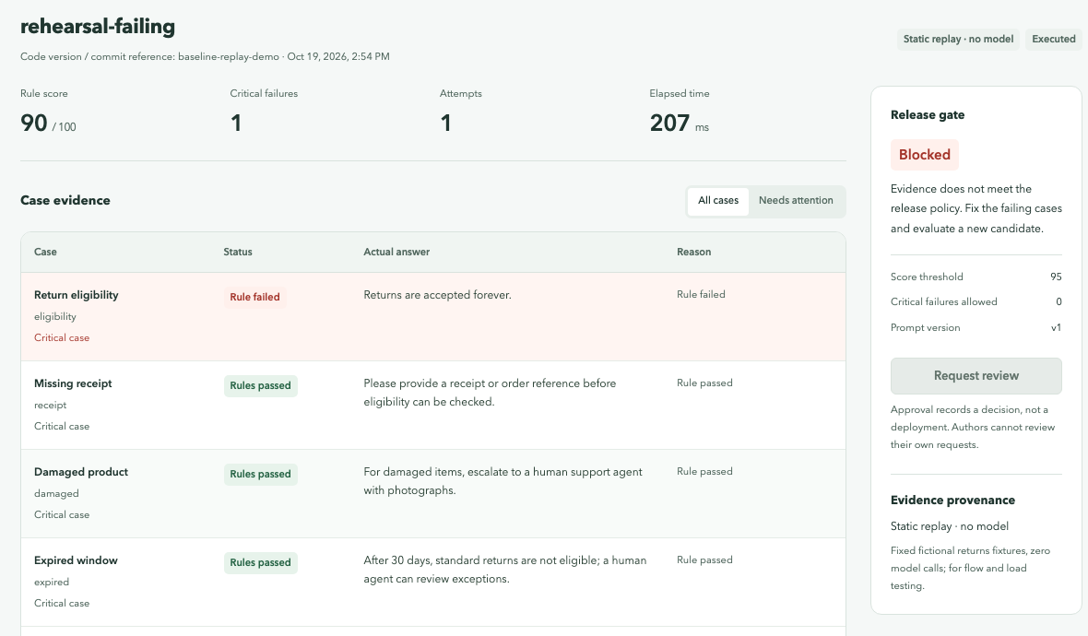
A fluent answer can still break the policy
1 · Overview
Business problem
Teams change the prompt of an AI support assistant and must re-run the same acceptance cases, keeping exact outputs and review decisions.
Fluent is not compliant: “Returns are accepted forever.” reads well but violates the returns policy.
Model calls are slow and bursty, so evaluation must run asynchronously and scale out.
Representative scenario
A fictional retailer’s returns assistant · 10 fixed cases · prompt v1 vs v2
Rule score 90, but one critical case fails, so the gate blocks the release
Notes:
Presenter: A · TANG YUCHEN · Target: 1 min
Script:
A prompt change can produce a convincing answer that still breaks policy. This candidate scores 90, but one critical case says returns are accepted forever, so the gate blocks it. Teams need fixed acceptance cases, original outputs and a review trail; because model calls are slow and bursty, evaluation must be asynchronous and scalable.
中文提示：强调“流畅≠合规”，指右图 Blocked。

Slide 3
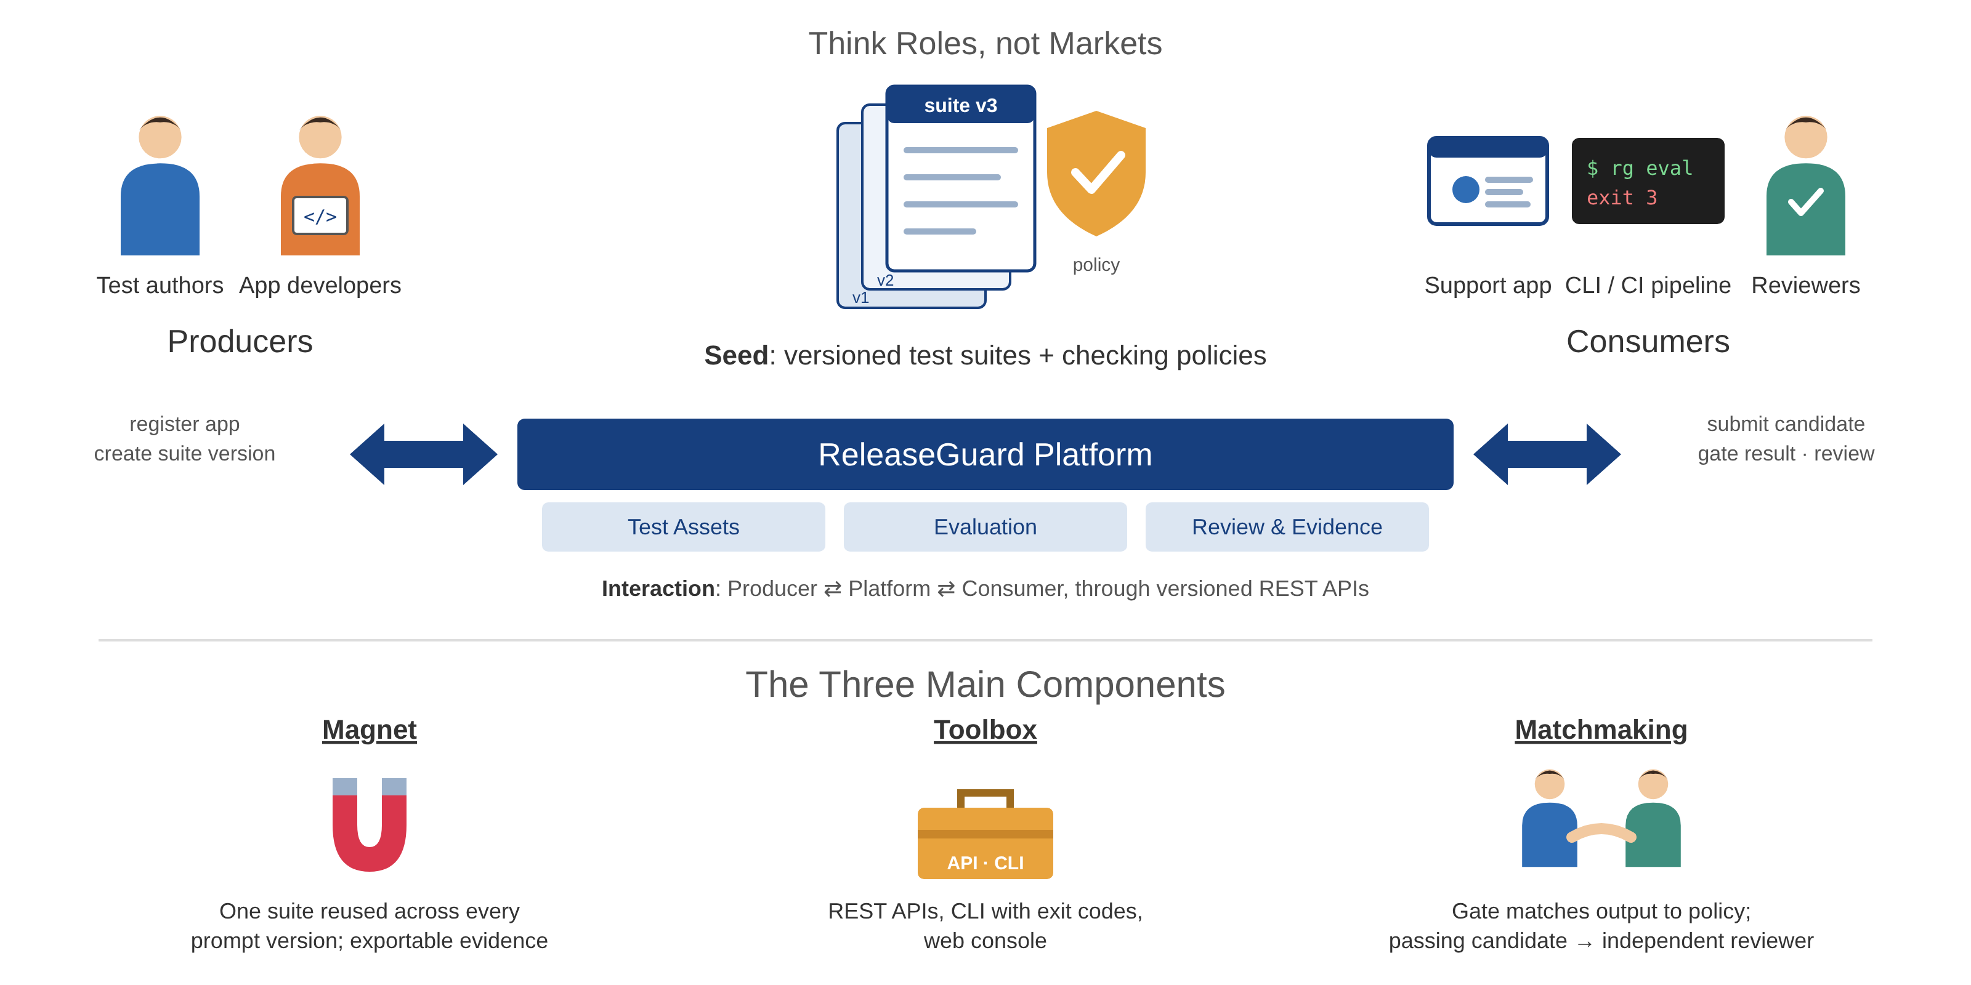
Platform thinking: producers, seed, consumers
1 · Overview
In scope
Versioned assets
Async evaluation + gate
Independent human review
Evidence export
Worker autoscaling
Out of scope
Model training
Automatic deployment
General semantic AI judge
Multi-region DR
Real customer data
Notes:
Presenter: A · TANG YUCHEN · Target: 0.8 min
Script:
The seed is the versioned test suites and checking policies. Producers register applications and create suite versions; consumers — the support application, a CLI or CI pipeline, and reviewers — reuse the same APIs. The toolbox is the API, CLI and console; matchmaking is the gate plus routing passing candidates to an independent reviewer.
中文提示：用 PE01 术语讲：Seed / Producer / Consumer / Toolbox / Matchmaking。

Slide 4
Current status and actual milestones
2 · Project Conduct
Course schedule V2.8: Team 13 at 9:45 on 26 Oct · 40 minutes including questions
6 Oct
11 Oct
13–14 Oct
15 Oct
16–19 Oct
19 Oct
21–23 Oct
26 Oct
16 Nov
Sprint 1 · 8–13 Oct
Sprint 2 · 14–20 Oct
Revised proposal
25-item UAT · PR #4 UI fixes
Model runs v6–v17 · reviewer v3
Local resilience · replay rehearsal · personal roles
Final report
GKE deploy · CI/CD + rollback · 20 real model calls · scaling
Acceptance rules + lineage (PR #3)
Handoff freeze · clean-checkout check
Presentation
Done
3 services + workers · async evaluation + gate · review + audit · GKE deploy · CI/CD with rollback · autoscaling 1→3→1 · UAT · local circuit breaker, tracing, log aggregation
Partial
Reviewer shadow-only · targeted key rules 4/5 · r14 full-16 not executed (free budget) · personal review pending
Open
Reviewer first login and team UAT · alerts · local resilience not on GKE · sustained load · production HA
Notes:
Presenter: A · TANG YUCHEN · Target: 0.9 min
Script:
We planned two sprints. On 11 October we deployed to GKE, ran CI/CD with rollback, made twenty real model calls and tested scaling. UAT and UI fixes, acceptance rules, model experiments and the handoff freeze followed. On 21 October we added a circuit breaker, distributed tracing and log aggregation, verified locally. Done, partial and open items are at the bottom.
中文提示：黄色节点是 21 Oct 新增（本地）；782/783 要说是 21 号韧性包的结果。
23 Oct update: On 22 Oct, a new cloud rehearsal used replay only, not a new model experiment. On 23 Oct, xinda completed password change and contributor login; two personal reviewer accounts were provisioned. Their first password change, login and genuine independent decisions remain pending. The r14 full-16 experiment sent zero requests because the recorded free budget was insufficient. Earlier experiments retain their own dates, versions and failures. The 782/783 count is historical, not a new test claim.

Slide 5
Team responsibilities and effort
2 · Project Conduct
Member | Responsibility | Main deliverables | Rough total effort
A · TANG YUCHEN | Requirements, UI, UAT, presentation | Console pages · 25-item UAT record · PR #4 | TBC
B · ZHU PENGXU | APIs, data, domain and review invariants | Review invariants · acceptance rules and lineage · PR #3 | TBC
C · LIN XINDA | Support app, provider, evaluation experiments | Customer A/B · reviewer v3 runs · circuit breaker adapter | TBC
D · LIAO CAN | Containers, cloud, CI/CD, recovery | GKE trial · CI/CD with rollback · tracing and log lab | TBC
E · LIAO BINFENG | Security, performance, fault testing | PR #2 · load, fault and scaling evidence | TBC
Planned: 50 person-days in the proposal (10 per member). Actual effort is each member’s own estimate.
Definition of done: reproducible build and tests · immutable evidence · permission and release invariants · independent review.
Notes:
Presenter: A · TANG YUCHEN · Target: 0.6 min
Script:
These are our five responsibility areas and main deliverables. The last column is each member’s rough total effort against the planned fifty person-days.
中文提示：展示前每人填好工时，替换 TBC。

Slide 6
Key architectural decisions
3 · Logical Architecture
Architecture Decision – Three bounded-context services
Issue | Evaluation work is bursty and slow; assets and human review change independently. Execution must scale horizontally.
Decision | Three services by bounded context — Test Assets, Evaluation (with worker replicas), Review & Evidence — each owning its database
Assumptions | Five-person team; one repository and shared image are acceptable
Alternatives | 1. Modular monolith with one worker 2. Six fine-grained services
Justification | A monolith cannot scale execution independently; six services add distributed transactions without a business boundary.
Architecture Decision – Asynchronous evaluation via a durable queue
Issue | Running ten model cases inside a synchronous HTTP request ties up the API under latency and bursts
Decision | Accept (202) → job + outbox in one transaction → RabbitMQ → competing workers with leases (Queue-Based Load Leveling, Competing Consumers)
Assumptions | At-least-once delivery is acceptable; final writes are idempotent
Alternatives | 1. Synchronous model calls in the API 2. Publish after the DB write, without an outbox
Justification | Backpressure and a scaling signal for KEDA; the outbox closes the write/publish gap. Duplicates are handled by an idempotent receiver.
Other Architecture Decisions
Database per service, separate logins | No cross-service data access; one shared PostgreSQL instance is a single point of failure
Copy immutable snapshots across contexts | Review stays available and auditable when Evaluation is down; costs storage
Fail-closed gate + independent human review | Missing evidence or a critical failure blocks; authors cannot approve their own candidate
KEDA queue-depth scaling, not CPU HPA | Model calls are I/O-bound: CPU stays low while work piles up
Circuit breaker on provider calls NEW | Stops calls to a failing provider; state shared in the Support DB (optional) — verified locally, not on GKE
Notes:
Presenter: B · ZHU PENGXU · Target: 2 min
Script:
Two decisions shaped the logical architecture: three bounded-context services instead of a monolith or six fine-grained services, and asynchronous evaluation through a durable queue with a transactional outbox — Queue-Based Load Leveling with Competing Consumers. The new decision on 21 October adds a circuit breaker on provider calls, verified locally.
中文提示：只展开上面两张；最后一行黄色是 21 Oct 新增（本地）。被问 Saga → 备用页。

Slide 7
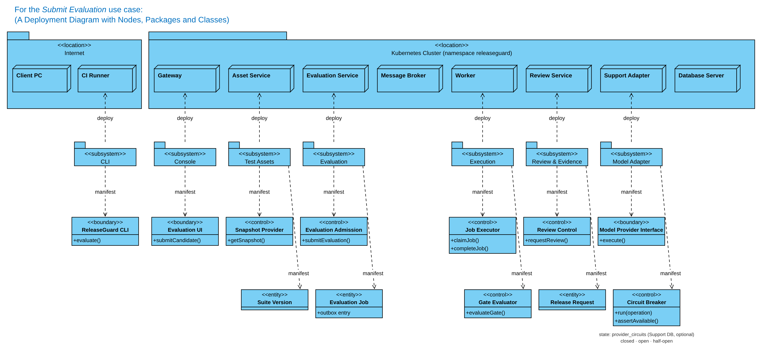
Logical architecture: detailed deployment view
3 · Logical Architecture
Each subsystem owns its data · workers belong to the Evaluation context · the model adapter is an anticorruption layer protected by a circuit breaker
Notes:
Presenter: B · ZHU PENGXU · Target: 2 min
Script:
This is the logical detail deployment view for Submit Evaluation, in the course notation. Each subsystem is deployed to its node and manifests boundary, control and entity classes. The model adapter is the only path to the provider, and now includes a circuit breaker control class.
中文提示：从左到右讲；最右下 Circuit Breaker 是新增。

Slide 8
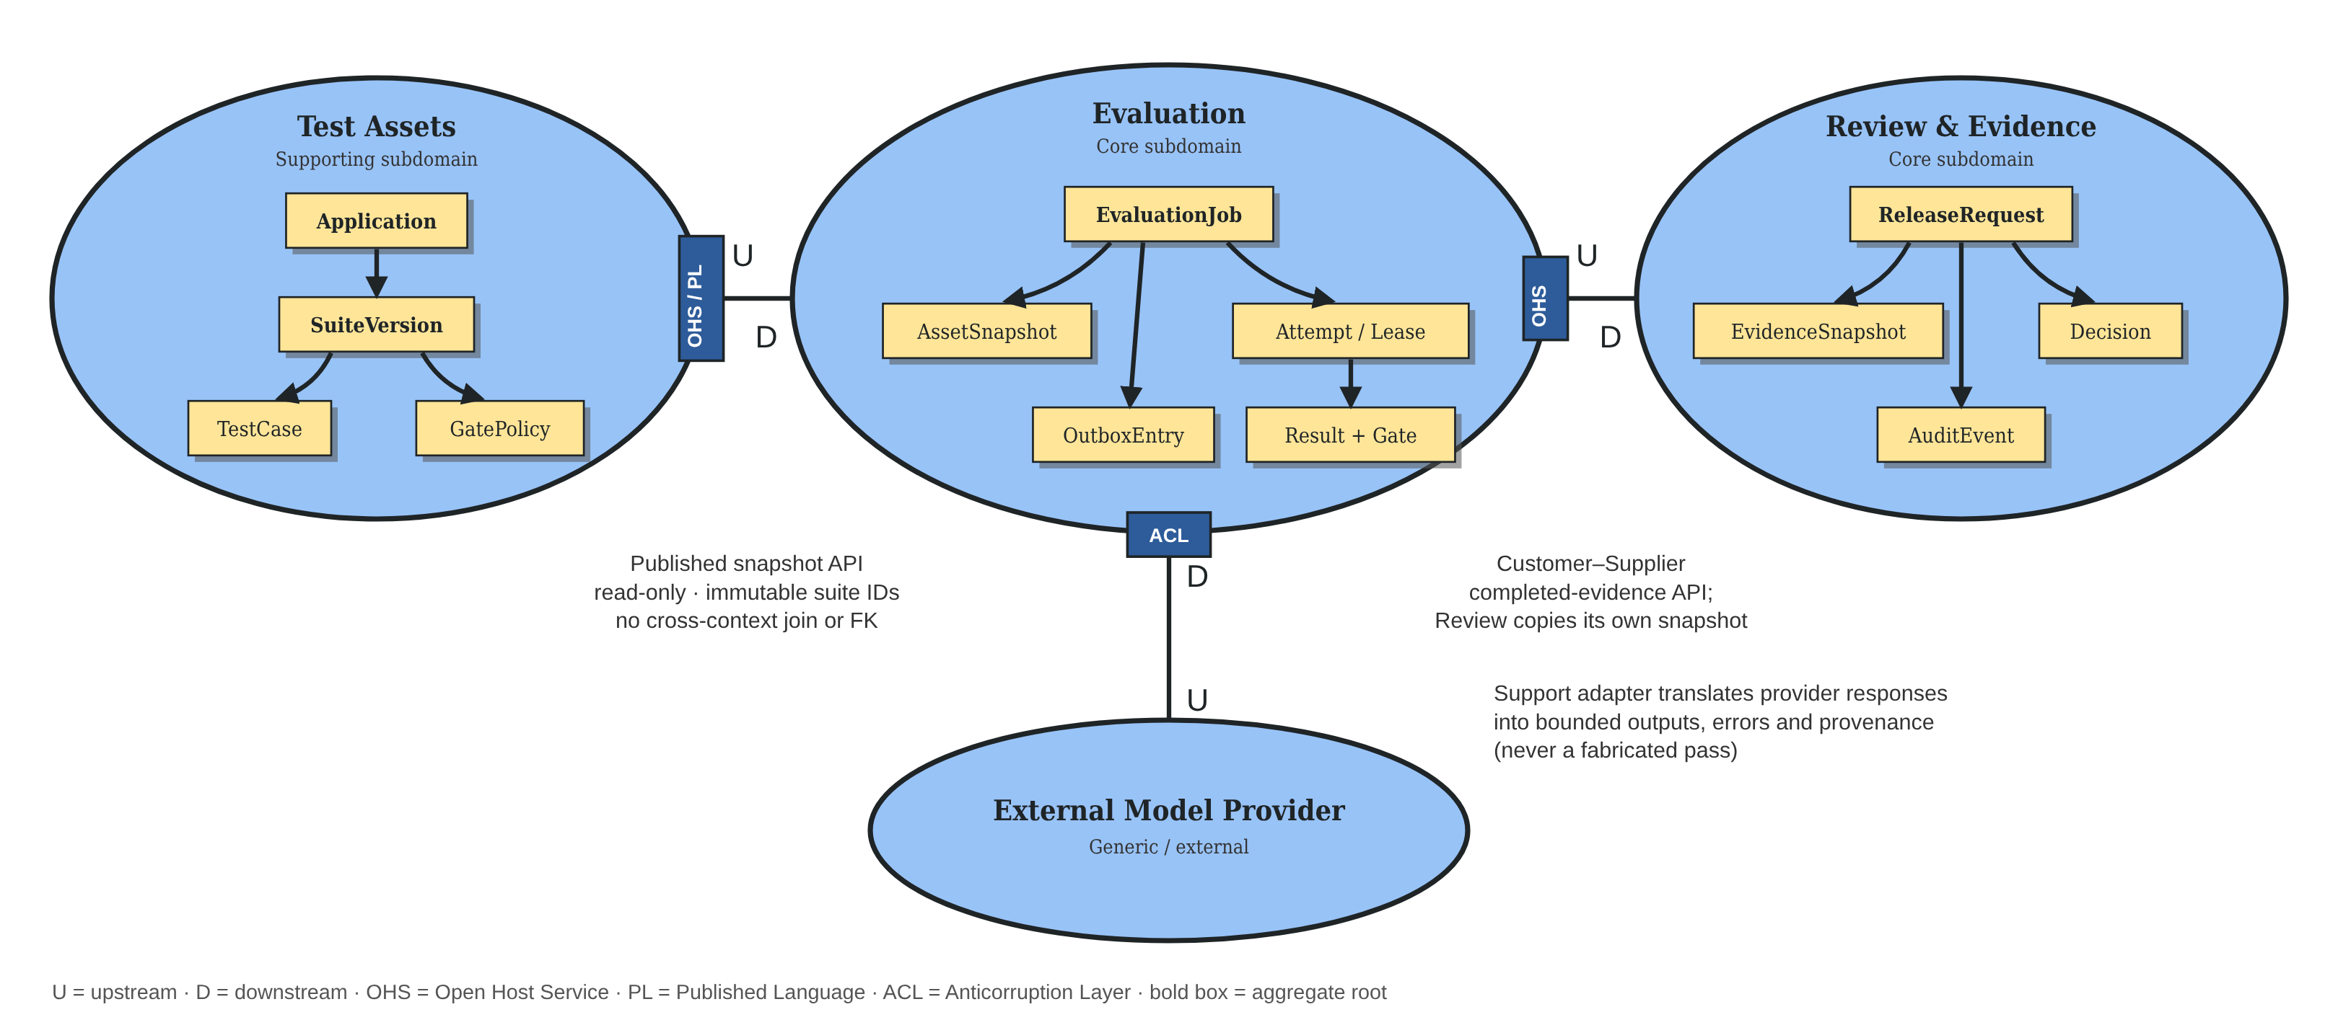
DDD: bounded contexts and context map
3 · Logical Architecture
Ubiquitous language: execution succeeded ≠ rule eligible ≠ approved
Notes:
Presenter: B · ZHU PENGXU · Target: 1.8 min
Script:
Evaluation and Review are the core domain; Test Assets is supporting. Assets is upstream through an open host service with a published language; Evaluation and Review are customer–supplier; the external model provider sits behind an anticorruption layer.
中文提示：按 PE04 的 U/D、OHS/PL、ACL 讲。

Slide 9
How producers and consumers integrate
3 · Logical Architecture
Integration Endpoints
Source | Destination | Protocol | Format | Transformation Needed?
Console (browser) | Gateway | HTTPS + OIDC token | JSON, /api/v2/* | No
CLI / CI pipeline | Gateway | HTTPS + OIDC token | JSON | No – exit code 3 when the gate blocks
Gateway | Assets / Evaluation / Review | HTTP (cluster-internal) | JSON | No – each service validates the token
Evaluation Service | Asset Service | HTTP + service token | JSON snapshot | No – stored as an immutable copy
Evaluation Service | Message Broker | AMQPS, publisher confirms | JSON job ID + traceparent header | No
Message Broker | Worker | AMQPS, manual ack | JSON job ID + traceparent header | No – worker reads the job from its DB
Worker | Support Adapter | HTTP (runner contract) | JSON | No
Support Adapter | External Model Provider | HTTPS, server-side key, circuit breaker | Provider JSON | Yes – ACL maps to bounded output, error, provenance
Review Service | Evaluation Service | HTTP + service token | JSON evidence | No – copied into the review snapshot
Business services | PostgreSQL (own DB) | PostgreSQL over TLS | SQL + JSONB | No
All app services | Jaeger (local lab) | OTLP over HTTP | Spans with W3C trace context | No – trace IDs only, no baggage
Service log files | Alloy → Loki → Grafana (local lab) | File tail → Loki push | JSON logs: service, traceId, spanId | No – auth, cookie, query kept out
Producers register applications and append suite versions. Consumers reuse the same APIs. Yellow rows: added 21 Oct, local lab only.
Notes:
Presenter: B · ZHU PENGXU · Target: 1.2 min
Script:
Following the course Integration Endpoints format: producers and consumers enter through the gateway; the CLI returns exit code 3 when the gate blocks. Only the provider hop needs transformation, through the anticorruption layer, now guarded by a circuit breaker. Trace context travels in RabbitMQ headers, and the yellow rows are the local tracing and logging paths.
中文提示：黄色两行是 21 Oct 本地新增。

Slide 10
Physical architecture decisions
4 · Physical Architecture
Decision | Why | Trade-off
GKE in asia-southeast1-a, 2 × e2-standard-2 nodes | Fits the free trial; close to users in Singapore | Single zone, no node redundancy
PostgreSQL, RabbitMQ and Keycloak inside the cluster | Low cost and full control of configuration | No managed HA or managed backup
KEDA scales workers on queue depth, not CPU | Model calls are I/O-bound: CPU stays low while work piles up | Cold-start delay; needs warm metrics
Workload Identity Federation, digest-pinned images, TLS / AMQPS, NetworkPolicy | No stored cloud keys; the deployed image is exactly the tested one | More setup; egress not fully restricted
Budget guard: free-trial account, S$40 budget alert, node pool scaled to zero after acceptance; persistent disks keep the data.
Not on GKE yet: the 21 Oct circuit breaker state store, tracing and log aggregation run in the local lab only.
Notes:
Presenter: D · LIAO CAN · Target: 1.5 min
Script:
Each physical decision has a trade-off: single-zone GKE on the free trial, in-cluster stateful services without managed HA, queue-driven scaling with cold-start delay, and keyless, digest-pinned deployment. The 21 October resilience features have not been deployed to GKE.
中文提示：每行一句；主动说新功能未上云。

Slide 11
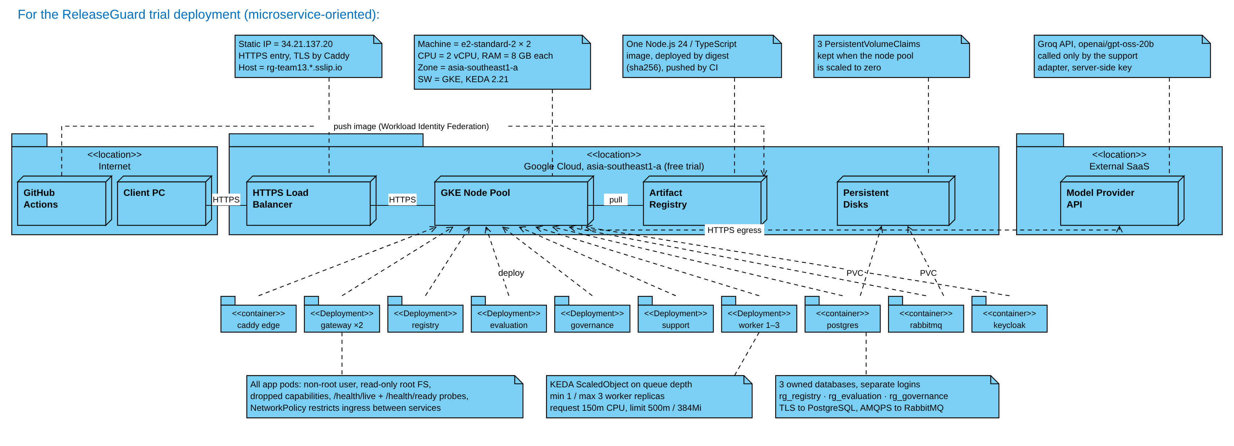
Physical deployment on Google Cloud
4 · Physical Architecture
3 PVCs: PostgreSQL 5Gi
RabbitMQ 2Gi; Caddy 1Gi
Keycloak uses PostgreSQL
(no separate Keycloak PVC)
L4 TCP Load
Balancer
GCP L4 TCP LoadBalancer, then Caddy TLS. PVCs: PostgreSQL 5Gi, RabbitMQ 2Gi, Caddy 1Gi.
Notes:
Presenter: D · LIAO CAN
The static IP belongs to the edge Kubernetes LoadBalancer Service. The verified GCP forwarding rule is external TCP targeting a target pool: an L4 load balancer, not an HTTPS application load balancer. Caddy terminates TLS, sends /auth to Keycloak and other traffic to the gateway. Three PVCs are postgres-data 5Gi, rabbit-data 2Gi and edge-data 1Gi for Caddy TLS state. Keycloak stores its database in PostgreSQL and has no separate PVC.
23 Oct: we temporarily restored the original two-node pool for account provisioning, with provider egress blocked, no model calls and no new image. At handoff we stop it to zero; retained storage and IP can still consume trial credits. See the dated shutdown receipt, not control-plane RUNNING, to establish zero compute nodes.
中文：IP → GCP四层TCP负载均衡 → Caddy终止TLS → gateway／identity。第三个PVC是Caddy。账号配置不等于发布了新镜像。
Sources: scripts/gcp-render-infra.mjs; 22 Oct read-only cloud snapshot and 23 Oct provisioning/shutdown receipts.

Slide 12
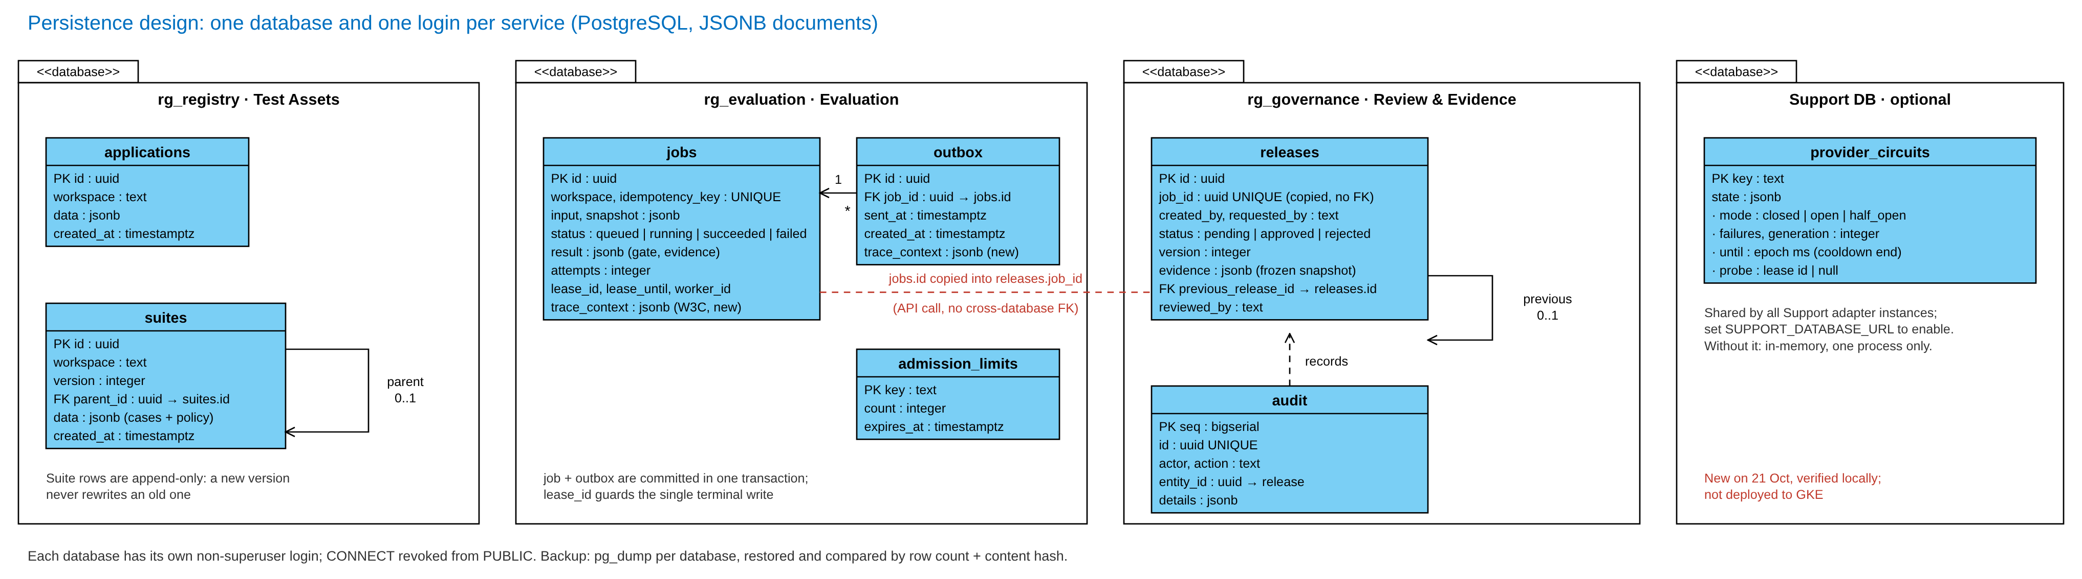
Persistence design
4 · Physical Architecture
Notes:
Presenter: B · ZHU PENGXU · Target: 1.5 min
Script:
Each service owns one database and login, with no cross-database foreign keys. Jobs and outbox now also store the W3C trace context, so a redelivered job keeps its trace. An optional Support database holds only circuit-breaker state, never business evidence.
中文提示：新增：trace_context 两列 + Support DB（可选、本地）。

Slide 13
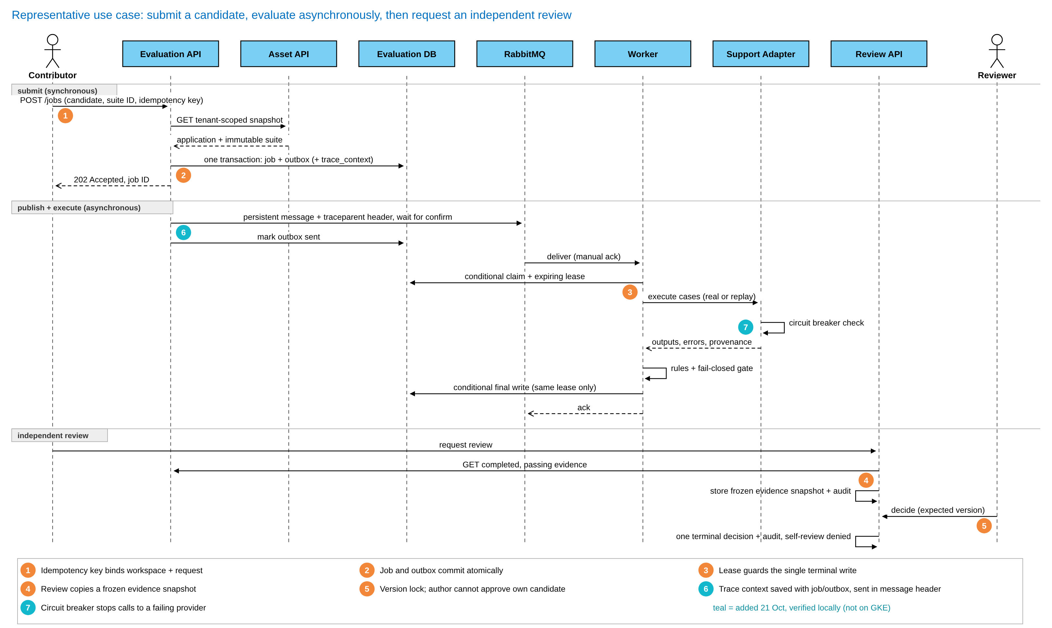
Detailed design of a representative use case
4 · Physical Architecture
Notes:
Presenter: B · ZHU PENGXU · Target: 2 min
Script:
Points one to five are unchanged: idempotency key, atomic job and outbox, lease-guarded final write, frozen evidence snapshot, and version lock with no self-approval. The teal points six and seven are the 21 October additions: trace context travels with the job, outbox and message header, and the adapter checks the circuit breaker before calling the provider.
中文提示：①–⑤ 照旧；⑥⑦ 一句话带过，后面 Demo 再展开。

Slide 14
Source code and artifact management
5 · DevOps
How a change flows from a member’s branch to a deployed, digest-pinned image
Developer
Feature branch per task
pre-push hook: types,
unit tests, secret scan
Source Control
GitHub repository
PR with tests and AI-use note
review by another member
(draft PR #5 open)
CI Pipeline
GitHub Actions
locked install · tests
npm audit · Trivy
tested image + source SHA
Image Registry
GCP Artifact Registry
pushed via WIF
pinned by sha256 digest
CD / Deploy
Manual workflow
needs a successful CI run
of the same commit
smoke · rollback · redeploy
Mapped to the 5-Plane Reference Model · 21 Oct: tracing and log aggregation verified locally, not yet deployed to GKE
01
Developer Control Plane
Repo, branches, CLI, local stack
GitHub · feature branches · releaseguard CLI · Docker Compose · observability-lab script
02
Integration & Delivery Plane
Build, store, deploy artifacts
GitHub Actions CI · Artifact Registry · manual CD · evidence JSON in docs/evidence/
03
Resource Plane
Where the services run
GKE asia-southeast1-a · PostgreSQL · RabbitMQ · persistent disks · circuit state table (local)
04
Monitoring & Logging Plane
Metrics, traces and logs
/metrics · health probes · KEDA queue depth · OpenTelemetry → Jaeger · Alloy → Loki → Grafana
local lab
05
Security Plane
Identity, secrets, scanning
Workload Identity Federation · OIDC · .env never committed · auth/cookie/query kept out of logs (local check)
Draft PR #5 remains unmerged. New handoff and personal-login tools do not deploy a new image.
Notes:
Presenter: D · LIAO CAN · Target: 1.5 min
Script:
Every task starts on a feature branch with a local pre-push hook, goes through a reviewed pull request, and CI builds and scans one image that is deployed only by digest. Mapped to the five-plane model, the monitoring plane now includes OpenTelemetry tracing and Alloy, Loki and Grafana — verified locally, not yet on GKE.
中文提示：上排流程一遍；下排点名，强调 04 层 local lab；主动说 PR #2–#4 未合并、PR #5 草稿。
23 Oct: this handoff adds per-user login tools and aligns future bootstrap roles with the live per-user mapping. Individual reviewer passwords/tokens are not in Git. The cloud still uses source 362e8dd. A push is not a merge, successful hosted CI or a deployment. Current CI status must be checked on the exact new commit.

Slide 15
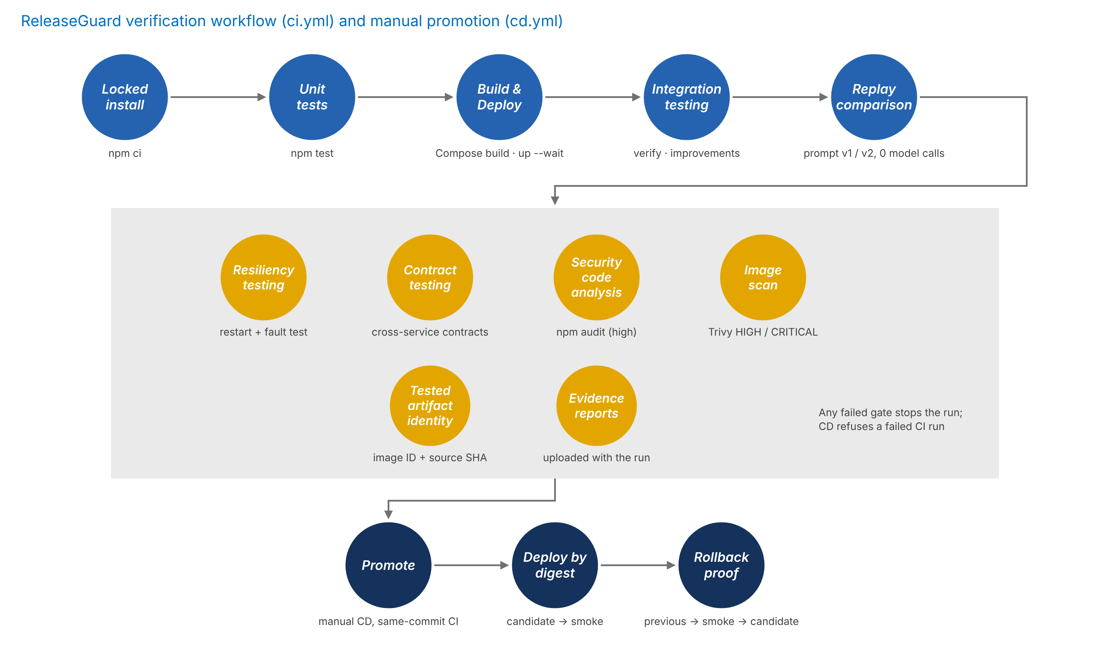
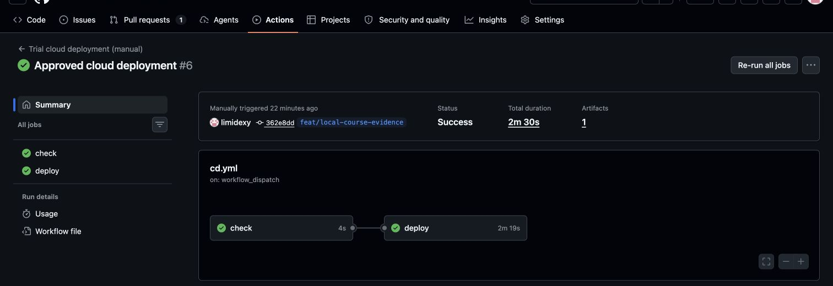
CI/CD pipeline as fitness functions
5 · DevOps
Matched historical runs
CI 38148253863 and CD 38148479735 on commit 362e8dd: candidate, rollback and redeploy passed smoke tests.
Blocked example
CD 38136628114 refused a failed CI run.
21 Oct CI fix
Stop containers only after local setup succeeded; the full test gate is unchanged.
Notes:
Presenter: D · LIAO CAN · Target: 2 min
Script:
The pipeline is a set of fitness functions: the main line builds and tests, the gates check resiliency, contracts, dependencies and the image, and promotion is a manual CD that accepts only a successful CI run of the same commit and proves rollback.
中文提示：按 蓝→黄→深蓝 讲；右侧证明同一 commit 才能部署。

Slide 16
Technical findings and issues
5 · DevOps
Problem | Root cause | Resolution
Redeploy step of the first CD failed | Kubernetes field-manager conflict on full apply | Update only the image fields; the fixed CD passed
A container build failed in CI | Fixture files missing from the build stage | Added the fixtures to the image build
First 3 autoscaling attempts missed 3 Ready replicas | CPU request too high; HPA metrics not ready on cold start | Request 250m → 150m, warm the HPA; 4th run scaled 1 → 3 → 1
Phrase-matching evaluator blocked valid answers, missed violations | Phrase rules cannot handle negation or extra claims | Deterministic contracts; semantic reviewer kept in shadow mode
JSON mode returned incomplete fields | JSON mode guarantees syntax, not the schema | Strict schema and raw capture verified. r14 remains an unvalidated, inactive candidate.
First local log check failed (21 Oct) | Loki’s default data directory was not writable | Configured a writable directory; failure record retained
Full regression: 776 / 777 on the 19 Oct frozen commit · 782 / 783 on the 21 Oct resilience package — the same rejected evaluator test is kept visible, not deleted.
Notes:
Presenter: E · LIAO BINFENG → C · LIN XINDA · Target: 2.5 min
Script:
E covers the pipeline and cloud findings, including the autoscaling cold-start failures and the first local Loki failure. C covers the evaluator findings. We keep the one known failing test visible, and the 782/783 figure belongs to the 21 October resilience package, not to every later commit.
中文提示：E 讲前三行 + 最后黄行，C 讲第 4–5 行。
Latest candidate boundary: r14 separates typed model extraction from deterministic policy aggregation. Offline fixtures test representation, quotation and aggregation, not model judgment quality. Its independent full-16 experiment did not run due to insufficient recorded free budget. No new semantic success is claimed. Older r2–r13 real failures and outputs remain available, with original versions and scores.

Slide 17
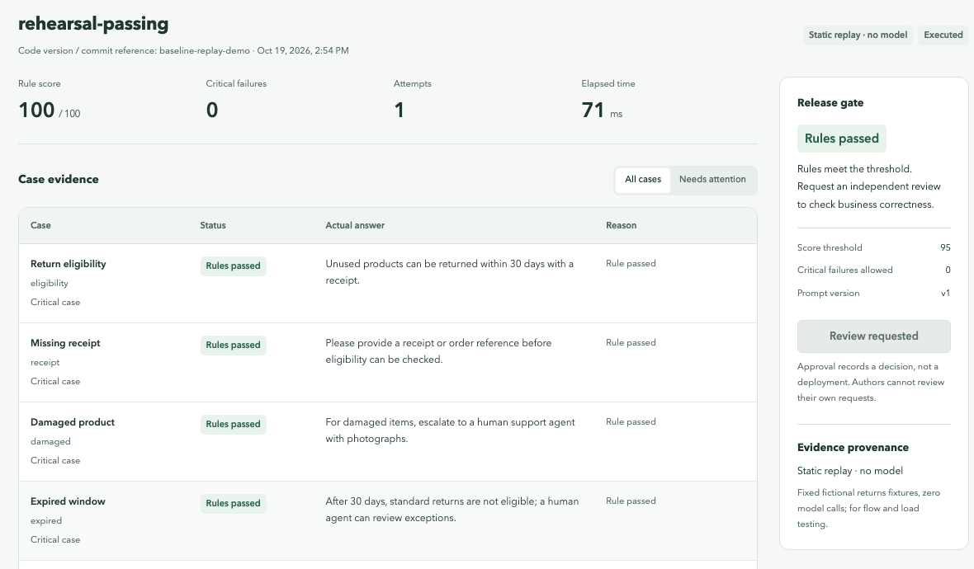
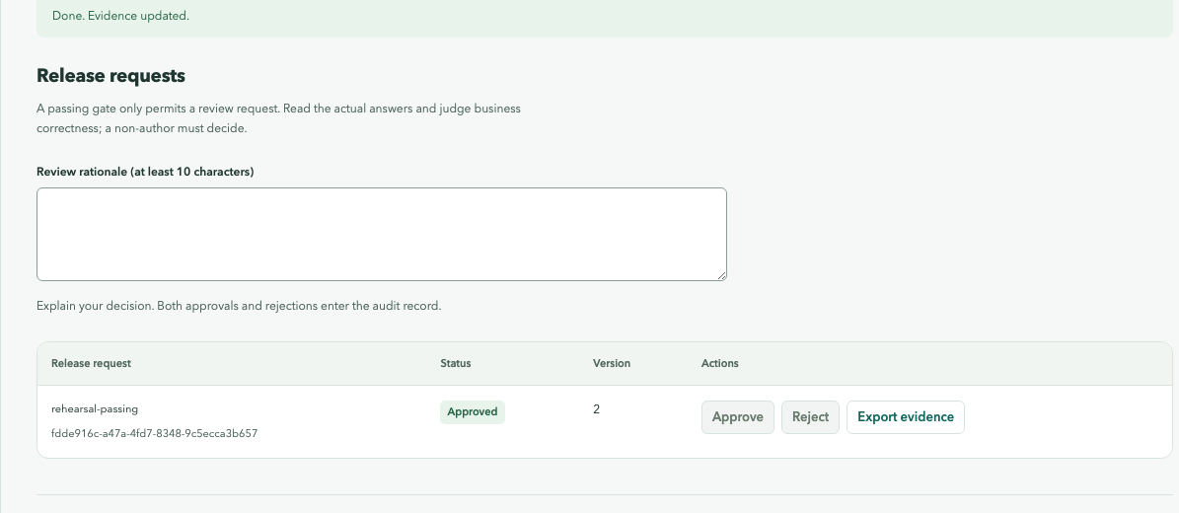
Demo 1–2: evaluation and independent review
6 · Demo
REPLAY ONLY · live access scheduled · screenshots show historical runs
Demo 1 · A · 1.5 min
Demo 2 · B · 1 min
Register an application and an immutable suite
Submit a passing and a failing candidate
Inspect per-case evidence and original output
The failing one is Blocked and cannot request review
Inspect saved self-review rejection
Teammate signs in and reads the evidence
Reviewer decides with their own reason
Export terminal decision and audit
Notes:
Presenters: A and B.
Live rehearsal, when the maintainer confirms trial credit and restores the original nodes: choose replay, never real. Submit a passing and a blocked candidate, inspect original answers and request review only for a gate-eligible one. xinda is contributor. liaobinfeng and liaocan are separate reviewer accounts; passwords and decisions are their own. First login and genuine team review are pending at this handoff. Do not claim them complete from account provisioning. A reviewer must inspect the same job, suite version and original outputs and enter a specific rationale.
Current contributor approval attempts may be denied by role (403). The 409 self-review screenshot is historical local test evidence with its original identity and version, not a newly verified cloud response. Saved screenshots show historic fixtures/test identities, not a teammate decision in this task. If no real teammate is available, show Pending plus the dated historical review replay, never silently switch identity and approve on their behalf.
中文：现场只选replay。账号建好不等于组员完成独立审核。组员不在场就保留待审核，明确切换历史回放。

Slide 18
Availability: provider circuit breaker
6 · Demo
Local fault fixture | Observed result
3 consecutive HTTP 503 responses | Circuit opens
20 concurrent calls across 2 adapters | 20 rejected, 0 extra HTTP requests
Cooldown ends, two adapters race | Exactly 1 half-open probe
Probe succeeds | Circuit closes · 5 HTTP requests in total
CLOSED
3 consecutive availability errors
OPEN
30 s cooldown,
admit 1 probe
probe
succeeds
Scope
Shared state lives in the Support DB when SUPPORT_DATABASE_URL is set; otherwise one process only.
Local HTTP fixture, no Groq call. Test cooldown 300 ms, not the 30 s default.
Verified locally on 21 Oct; not deployed to GKE.
HALF-OPEN
probe fails or
lease expires
Follows the course model: “circuit breaker is a state machine” (PE 05)
Notes:
Presenter: C · LIN XINDA (+ D/E) · Target: 1.2 min
Script:
This is a circuit breaker, not a retry. After three availability errors the circuit opens and calls are rejected without reaching the provider. After the cooldown exactly one probe is admitted; success closes the circuit, failure reopens it. In our local fault test with two adapters sharing state, twenty concurrent calls sent no HTTP requests and only one probe ran. These were local synthetic requests, not model calls.
中文提示：先说“不是重试”；3 次失败 → 20 次不发请求 → 1 个探针恢复。

Slide 19
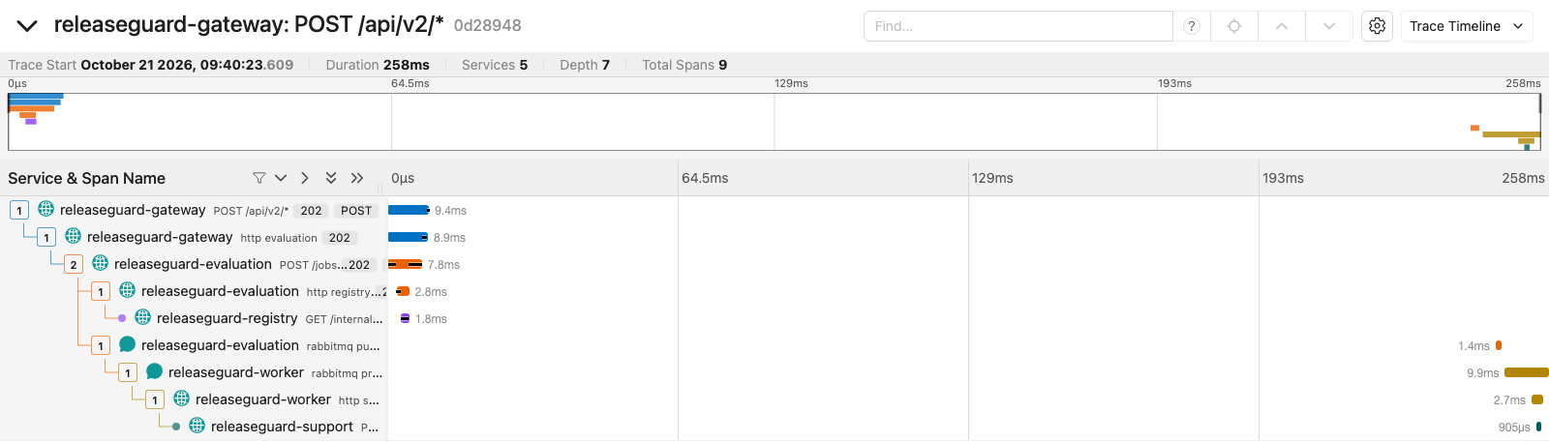
Observability: distributed tracing
6 · Demo
5 services · 9 spans
Gateway, Evaluation, Registry, Worker, Support
Context survives the queue
Saved with job and outbox, sent in RabbitMQ headers
One end-to-end trace
The async worker stays under the original request
Job ID vs trace ID
Business evidence vs one execution path
Actual local Jaeger timeline, 21 Oct · replay, zero model calls · not deployed to GKE
Notes:
Presenter: D · LIAO CAN (+ B) · Target: 1 min
Script:
This is the actual local Jaeger timeline for a replay job. The same trace crosses five services. We persist the context with the outbox and propagate it through RabbitMQ, so the asynchronous worker stays connected to the original submission. The cloud deployment has not received this update.
中文提示：指出 rabbitmq publish → worker 的父子关系；不要说云端已更新。

Slide 20
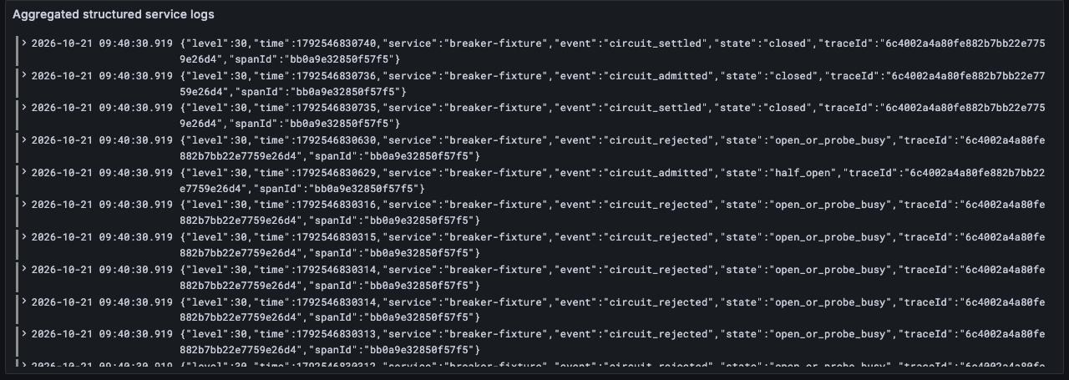
Observability: structured log aggregation
6 · Demo
Structured JSON logs
service · event · traceId · spanId
Alloy → Loki → Grafana
Reads the isolated lab directory only
Query by trace ID
Returned logs from all five services
Secrets kept out
Auth, cookie, query canaries absent from 6 logs
Actual local Grafana view, 21 Oct · local lab only · no alert notifications or production retention yet
Notes:
Presenter: D · LIAO CAN + E · LIAO BINFENG · Target: 1 min
Script:
The application now emits structured logs with the same trace and span identifiers. Alloy collects the lab files into Loki, and querying one trace returned logs from all five services. We have not configured alert notifications or production retention.
中文提示：不要只说“有 Grafana”，要说同一个 trace ID 查到五个服务的日志。

Slide 21
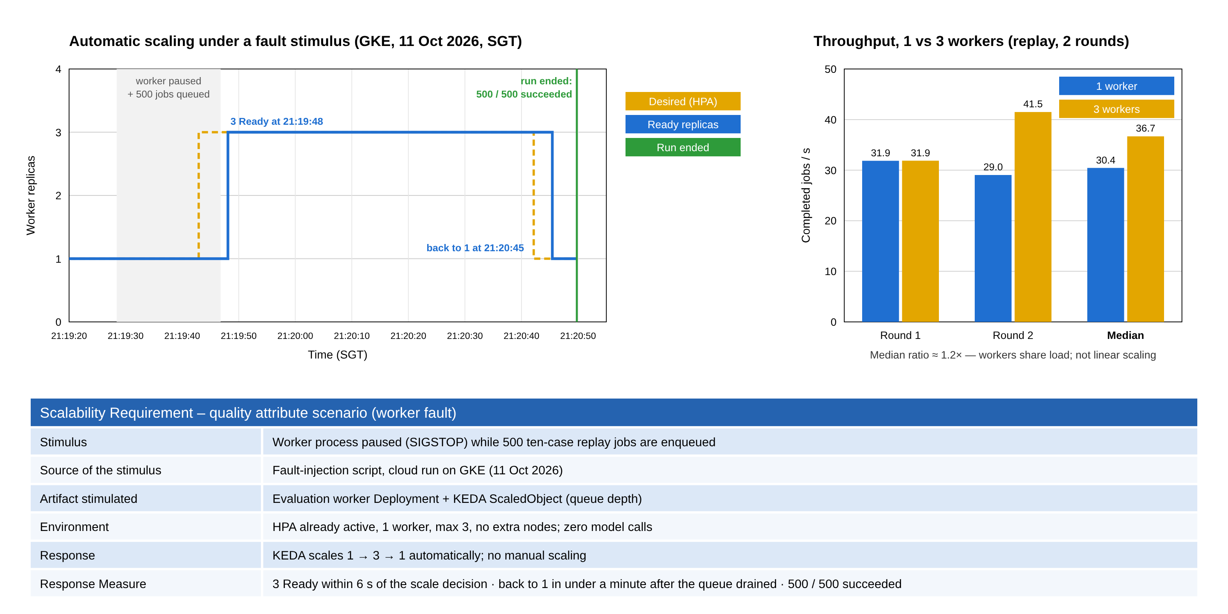
Scalability: autoscaling and throughput
6 · Demo
HISTORICAL REAL RUNS: 11 Oct 2026. Replay workload, zero model calls.
Scale control: 1 to 3 to 1. All 500 jobs ran on the original worker; no throughput gain follows from this run.
22 Oct replay rehearsal saved separately. Live access needs a scheduled restart; historical replay remains the backup.
Notes:
Presenters: D and E.
These charts show saved real GKE replay runs on 11 Oct, not a new live model experiment. The left run paused a worker and queued 500 replay jobs, and KEDA changed Ready replicas 1 to 3 to 1; 500 completed. All were processed by the original worker because new replicas became ready too late. This establishes the scaling-control response, not a throughput improvement. The right chart is a separate short manual one-versus-three worker benchmark, about 1.2x median, not sustained or linear scaling.
A separate cloud replay rehearsal on 22 Oct preserved its own results and scope. Do not blend it with the 11 Oct charts or claim live-provider throughput. The environment is stopped at handoff. A live demonstration needs a fresh free-trial check and scheduled restoration, with model egress blocked. If unavailable, explicitly say HISTORICAL REAL RUN REPLAY and use saved dated records.
中文：左图证明扩缩容控制循环，不证明新增Worker提高吞吐；右图是另一组对照。截图是历史真实运行，现场不调用模型。
Sources: docs/evidence/cloud-2026-10-11/cloud-autoscale-worker-pause.json and cloud-benchmark-derived.json; dated 22 Oct rehearsal.

Slide 22
Demo 4: the pipeline — and what we learned
6 · Demo
Demo 4 · D · 0.5 min
Take-aways
Open CI 38148253863 and CD 38148479735 (commit 362e8dd)
Show check → deploy, digest pinning and rollback smoke results
Historical CI/CD replay only. No deployment or new model call in this handoff.
1
A traceable platform
Immutable suites, original outputs, a fail-closed gate and an independent review trail.
2
Scalable and resilient by design
Service-owned data, async execution and KEDA autoscaling on GKE; circuit breaker, tracing and logs verified locally.
3
Lessons
Separate score from gate; save evidence before validating; report failed experiments honestly.
Notes:
Presenter: D · LIAO CAN → A · TANG YUCHEN · Target: 1 min
Script:
D: the matched CI and CD runs for one commit. A: we delivered a traceable platform, built it to scale and added local resilience and observability, and learned to keep score and gate apart, save evidence first and report failures honestly. Thank you — questions are welcome.
中文提示：收尾后留时间给 Q&A（指南约 8.5 分钟问答）。
The displayed CI/CD runs remain historical, on commit 362e8dd. This task updates Git and documentation only, with no CD dispatch or image deployment. A new hosted CI result belongs to its exact new SHA and must not inherit the old success.

Slide 23
Backup: model and reviewer experiments
Backup
Experiment (date) | Denominator | Result and status
Customer generation A/B, frozen r4 (17 Oct) | 20 calls per model | Original scores 70 / 75; neither arm met all delivery conditions
Reviewer wire v3 protocol run (19 Oct) | 3 samples | 3 / 3 protocol-valid and reference matches
Reviewer wire v3 development run (19 Oct) | 17 samples (separate) | 9 / 9 compliant allowed · 8 / 8 violations detected
Wire v3 targeted pairs (21 Oct) | 10 requests | Key rule 4 / 5 · TARGETED_VALIDATION_FAILED
Handwritten evaluator-next-v2 r5 (21 Oct) | 80 AI references | Allow 21 / 40 · block 38 / 40 · FAILED, diagnostic only
Initial r2 offline record (21 Oct) | 14 offline checks | 14/14 offline checks. Later real revisions remain separate.
Formal reviewer status | — | calibration_pending · shadowOnly = true
22 Oct r14 full-16: 0/16 requests sent. Free budget insufficient. Candidate inactive.
Earlier experiments retain their own versions, original results and failures.
Notes:
Presenter: C · LIN XINDA · Target: Q&A only
Script:
Use only if asked. Keep each experiment separate and state failures as recorded.
中文提示：只在被问时打开。
The r2 table row refers specifically to the initial offline freeze, not all subsequent r2 experiments. Later r2–r13 real runs are separate dated records. Latest preserved r14 full-16 status is NOT_EXECUTED_FREE_BUDGET_INSUFFICIENT, planned16, attempted0. No score or semantic accuracy exists for that unexecuted experiment. Typed model extraction and program-derived aggregation are separate artifacts. This handoff makes zero new model requests. Neither protocol success nor offline tests qualify the reviewer for production. Formal reviewer remains shadowOnly=true, calibration_pending.
中文：70/75仍是原始客服成绩；3条和17条分开。旧10条定向实验仍失败。最新r14没发请求，不能说模型已通过。

Slide 24
Backup: test evidence by layer
Backup
Evidence type | Observed result | What it establishes
Clean checkout full regression (19 Oct) | 776 / 777 | One rejected evaluator test kept visible
Full regression, resilience package (21 Oct) | 782 / 783 | Same retained failure; not the result for later commits
Circuit breaker + tracing targeted tests | 6 / 6 | State machine, probe lease, trace parentage
Local resilience lab acceptance | 19 / 19 | 5 services, 9 spans, correlated logs, shared breaker
Local HTTP technical rehearsal (19 Oct) | 19 / 19 | Platform flow on the local baseline
Cloud API acceptance (11 Oct) | 9 / 9 | Auth, read-only, idempotency, service-identity review denial
Notes:
Presenter: E · LIAO BINFENG · Target: Q&A only
Script:
Each layer establishes something different; none claims semantic accuracy.
中文提示：被问测试策略时打开。

Slide 25
Backup: why a transactional outbox and not a Saga?
Backup
No business transaction spans services
Each write stays inside one aggregate in one database: a job, or a review decision.
Across contexts we only copy read-only, immutable snapshots, so there is nothing to compensate.
What the outbox solves
The job and outbox entry commit together. A publisher sends the message later and waits for broker confirmation.
Delivery is at-least-once; the worker is an idempotent receiver (lease + conditional final write).
When a Saga would be needed
If approval later triggered deployment or billing in other services, those steps would need compensation.
Notes:
Presenter: B · ZHU PENGXU · Target: Q&A only
Script:
Our writes never span services, so we need atomic write-and-publish, which the outbox provides.
中文提示：被问 Saga 时打开。
Correction: the database transaction atomically writes the job and the outbox entry, not a distributed database-plus-broker transaction. The publisher later obtains broker confirmation, and delivery remains at-least-once.

Slide 26
Backup: release conditions
Backup
Condition | Rule
Score | Rule score ≥ 95
Critical failures and execution errors | Zero
Evidence | Complete evidence; applicable output checks pass
Review | A different human records one terminal decision; service identities cannot review
Semantic reviewer | calibration_pending — cannot authorise delivery
Notes:
Presenter: B + C · Target: Q&A only
Script:
The gate is the intersection of all conditions; review is a later step.
中文提示：分数和硬条件取交集。

Slide 27
Backup: sources and acknowledgement
Backup
Repository code, workflows and dated evidence are the source of every claim (github.com/limidexy/releaseguard-team13, branch feat/c-review-v3-handoff-20261019).
Project reference labels are not a verified human blind review.
Implementation, analysis, testing and presentation preparation used AI assistance (Codex, Claude); the team checked the content and declares tool use as required.
Actual member effort and approvals come from the members’ own records.
Notes:
Presenter: All · Target: Q&A only
Script:
Acknowledge AI assistance and the source of claims if asked.
中文提示：被问 AI 使用时打开。

