Slide 1

LIMINAL SPACE × EVERMEMOS
Shruti Rajagopal
Shayaun Nejad
MEMORY GENESIS GRAND FINALE

Slide 2
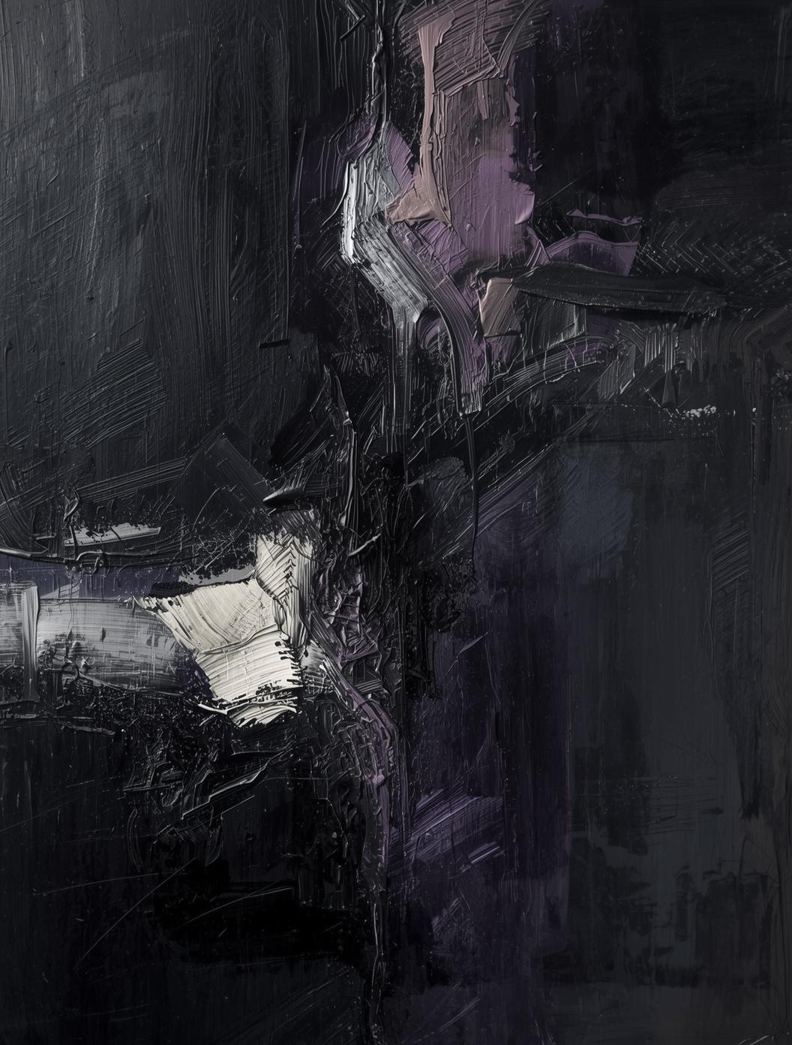
The Gap
Every app that touches inner life has the same problem: amnesia.
You reflect. You check in. Next session — gone. Apps that add memory show you summaries. Charts. Reports. That's passive. We built a system that holds claims about who you've been — specific enough to argue with.

Slide 3

MEMORY ENABLES STANDING
Not a dashboard. Not a chatbot. Not a mirror. An interlocutor.
A system without memory can observe you. A system with memory can argue with you — because it was there, it remembers what you said, and it holds the record you've been unconsciously editing. The closest analogue: a sparring partner who has been watching your footage for months and knows your patterns better than you do.

Slide 4
"When I'm changing and can't tell if it's growth or collapse, I want something that holds a claim about who I've been — so I can argue with it and find out who I actually am."
THE JOB TO BE DONE

Slide 5
DAY 1
Day 1 vs Day 90 — from recording to confrontation
Recorded.
DAY 90
Seven factors. A score. The system doesn't know you yet. Without memory, this is all you get — a number. A system that's honest about its ignorance is more credible when it later claims to see a pattern.
"You've been avoiding connection for nine days. Last time, you told yourself it was fine. It wasn't."
That's not a summary. That's a position — specific enough to argue with. She pushes back. That correction is the highest-signal data in the entire system.

Slide 6
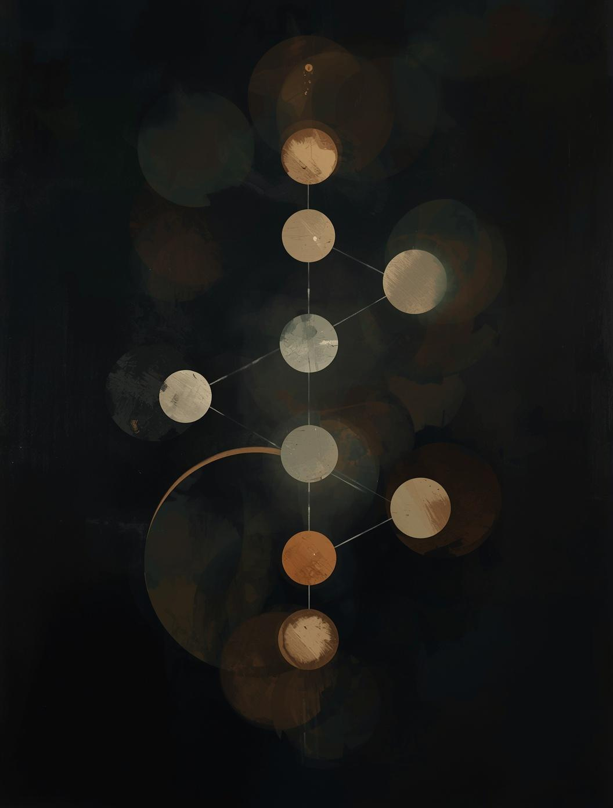
Archetypes with standing
The Warrior and the Sage don't give generic wisdom. They have receipts.
The Warrior: "You told me I was too aggressive. Then you spent three weeks stuck. I'm going to say it again: stop waiting for permission." That's a callback to January — specific, grounded, impossible to dismiss.
The Sage: "You've consulted me four times when clarity was above 80. Every time, you already knew the answer. What do you actually come to me for?" Memory gave it the standing to ask the real question.
The Sovereign: "The Warrior and the Sage have been arguing for weeks. I'm what happens when you stop choosing between them." A new presence — earned, not given.

Slide 7

The Disputable Account
Not a story to read — an account to argue with.
Arc Memory reconstructs three months of inner life. Each section is independently disputable. She marks January wrong: "It wasn't avoidance. I genuinely didn't see the connection gap. That's different." That correction reshapes the next reconstruction. The system learns — not from the data, but from the argument about what the data means.

Slide 8
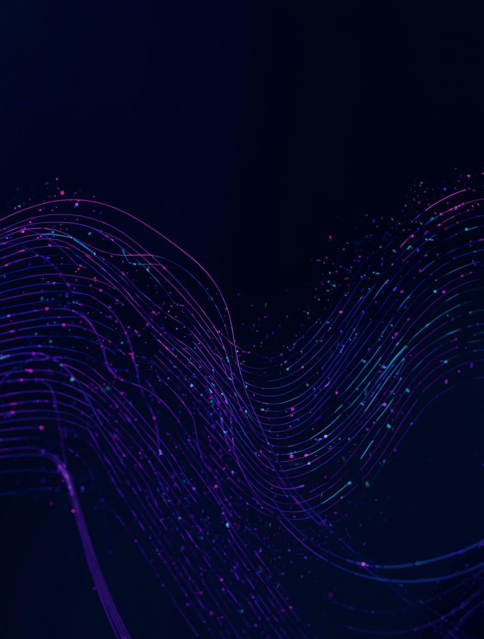
Channels and Handlers
16th handler on a 15-handler EventBus. Fire-and-forget. Zero latency impact.
66 source files. 125 database migrations. 6 API routes. A production app — not a prototype. Three data channels flow into EverMemOS: coherence checks, council deliberations, threshold moments. Episodic trace → semantic consolidation → reconstructive recollection. The central calibration problem: when to confront and when to shut up. A system that confronts too often is annoying. A system that never confronts is a dashboard.

Slide 9
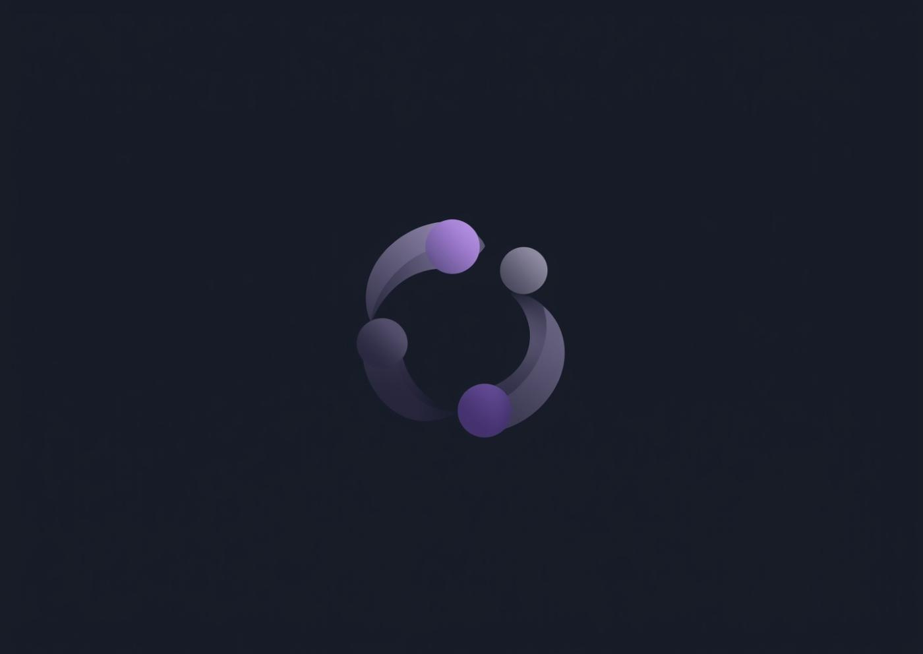
THE CORRECTION LOOP
IS THE PRODUCT
Every disagreement is data. Every argument is self-knowledge.

Slide 10
Memory for who you're becoming.
Built with EverMemOS. Deployed at theliminalspace.io

