Slide 1
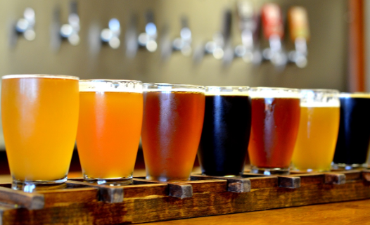
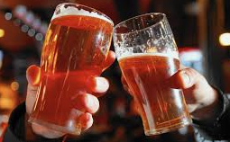
Craft Beer market analysis
Team Members:
Limin Zheng
Linda Eliasen
Video: https://www.youtube.com/watch?v=a-df27UrlJ0

Slide 2
Datasets Available
Craft Beers
Name: Name of the beer.
Beer_ID: Unique identifier of the beer.
ABV: Alcohol by volume of the beer.
IBU: International Bitterness Units of the beer.
Brewery_ID: Brewery id associated with the beer.
Style: Style of the beer.
Ounces: Ounces of beer.
Breweries
Brew_ID: Unique identifier of the brewery.
Name: Name of the brewery.
City: City where the brewery is located.
State: U.S. State where the brewery is located.

Slide 3
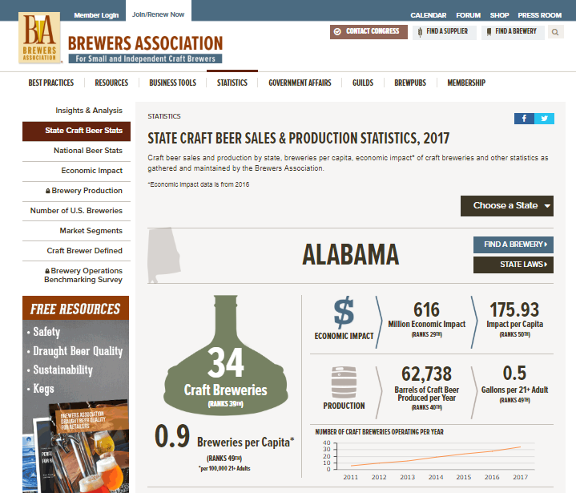
Datasets Available
Economic Stats
State: U.S. State where the brewery is located.
Breweries Per Capita: Craft breweries per 100,000 people aged 21 years and older
Economic Impact Mil: Economic Impact ( million dollar)
Economic Impact Rank: Revenue per year rank
Barrels Per Year
Gallons Per Adult: Consumption per person per year
https://www.brewersassociation.org/statistics/national-beer-sales-production-data/

Slide 4
Data Analysis
Breweries in each state
Economic Impact Mil: Revenue income ( million dollar)
Breweries Per Capita: Craft breweries per 100,000 people aged 21 years and older
Gallons Per Adult: Consumption per person per year
ABV: Alcohol by volume of the beer.
IBU: International Bitterness Units of the beer.
Style: Style of the beer.

Slide 5
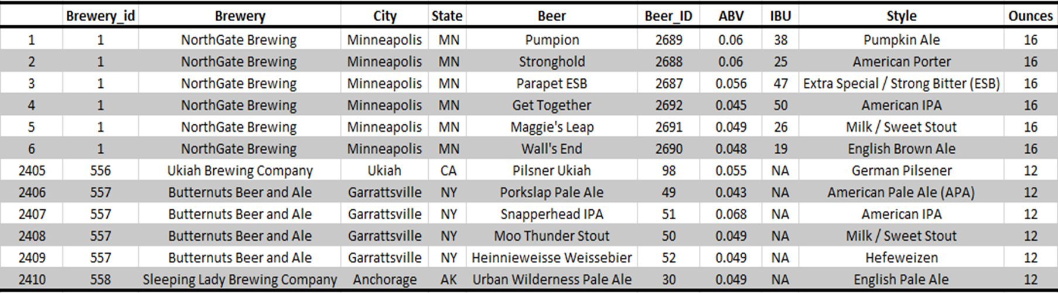
Showcase of Datasets
Beer and Breweries dataset
Missing data

Slide 6
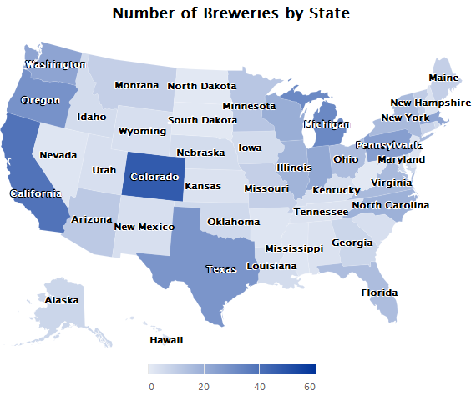
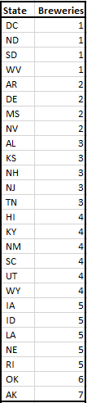
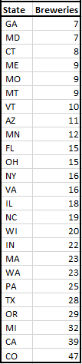
Number of Breweries by State

Slide 7
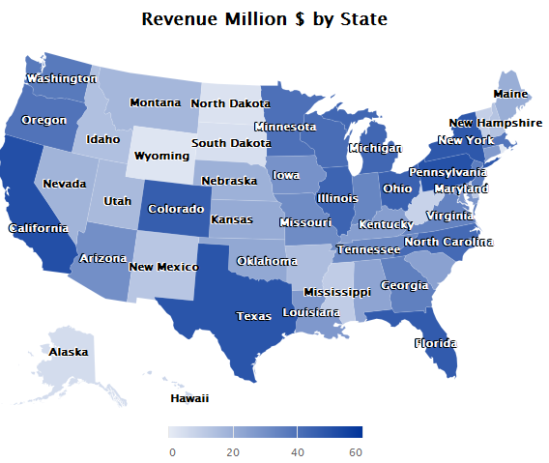
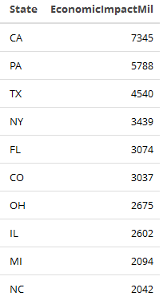
Revenue in Million $ by State

Slide 9
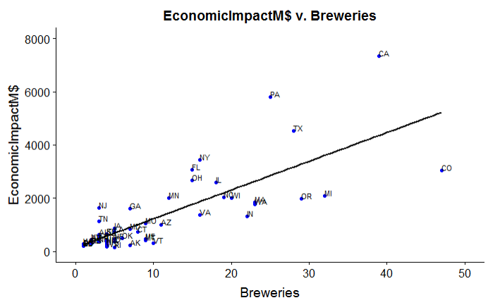
Relationship between EconomicImpactM$ and Breweries in Each State
Cor: 0.779
p-value = 1.607e-10

Slide 10
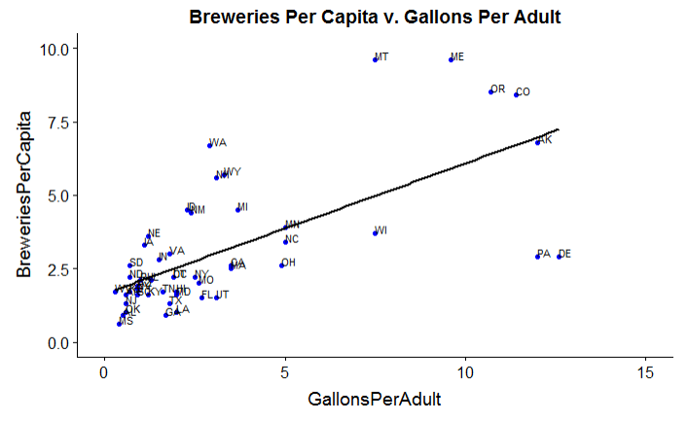
Relationship between Breweries Per Capita (100,000 adult 21+) and Gallons Per Adult in Each State
Cor 0.750
p-value = 2.416e-10

Slide 12
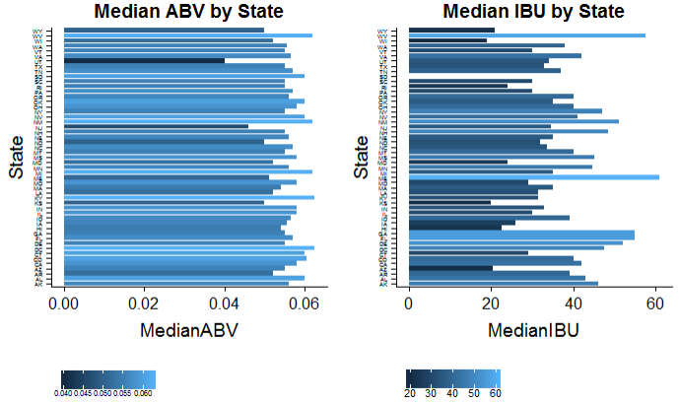
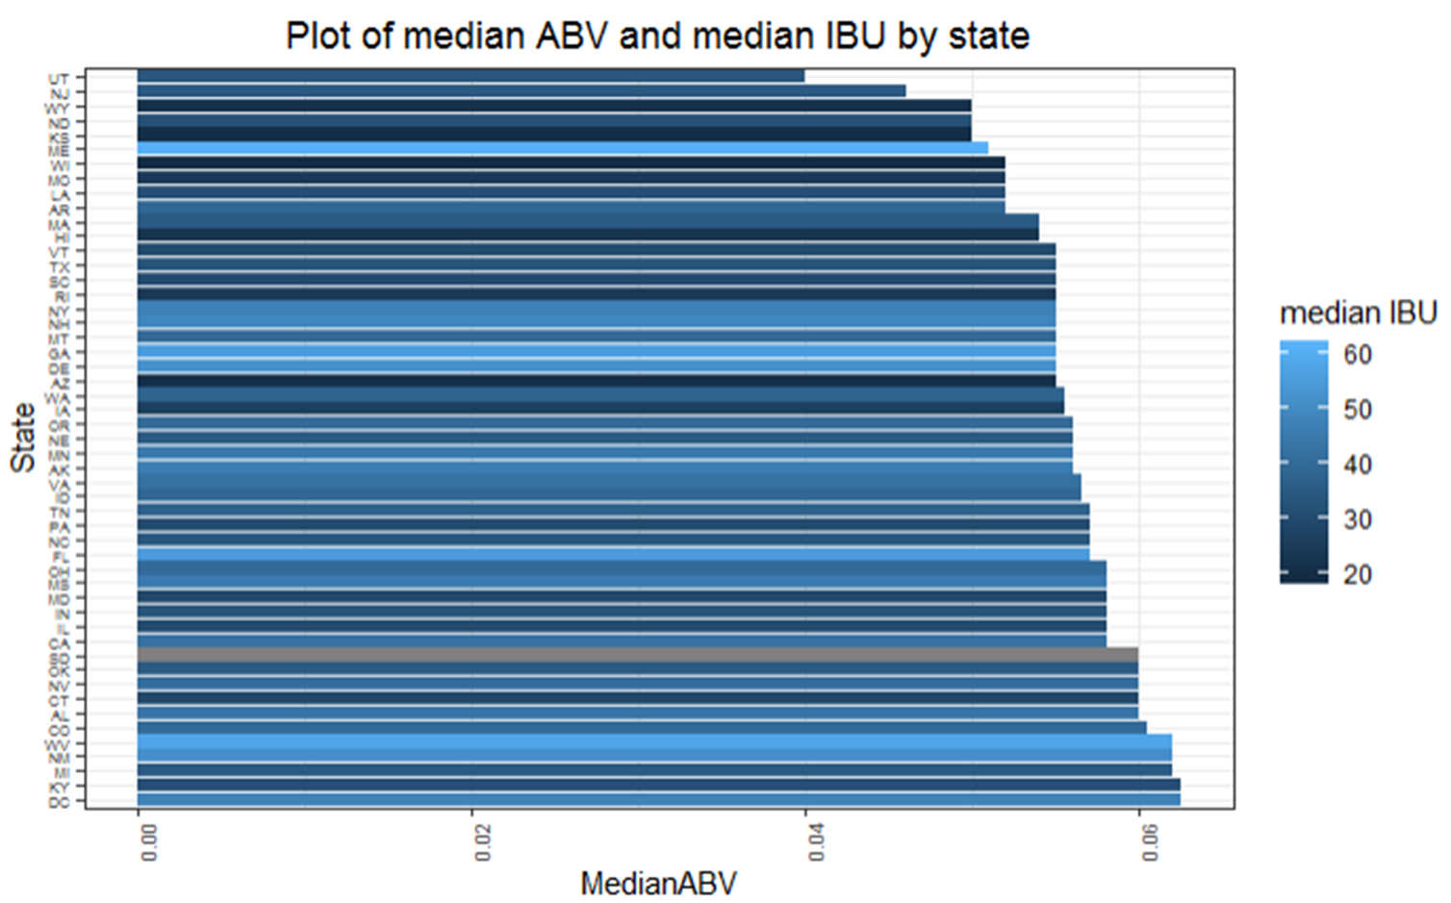
Median ABV and Median IBU by State

Slide 13
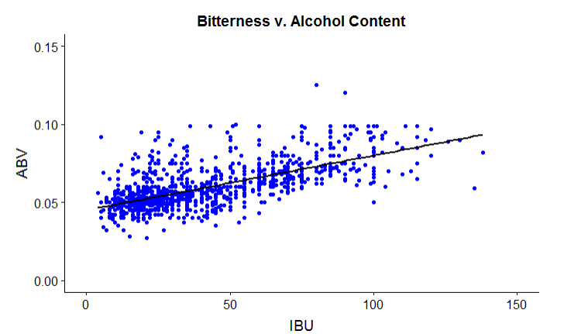


Relationship between ABV and IBU
Summary of stats for ABV
CO
OR
Summary of stats for IBU
Cor: 0.671
p-value < 2.2e-16

Slide 14
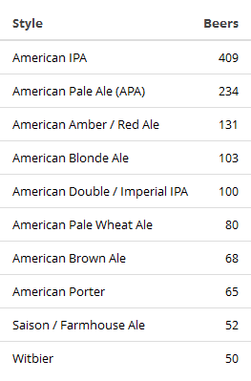
Top 10 Craft Beer Styles

Slide 15
Conclusions and Suggestions
Positive correlation between economic impact million $ and breweries in each state.
Positive correlation between breweries per capita (100,000 adult 21+) and Gallons Per Adult in each state
Positive correlation between ABV and IBU.
American IPA is the most popular beer style
More analysis on specific state, like PA.
More analysis between styles of beers and economic impact

Slide 16
Thank you

Slide 17
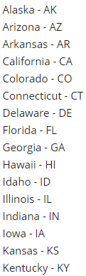
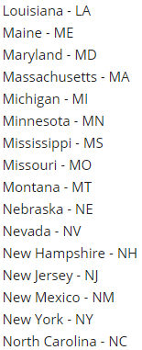
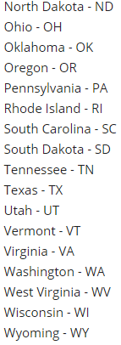
Appendix

Slide 18
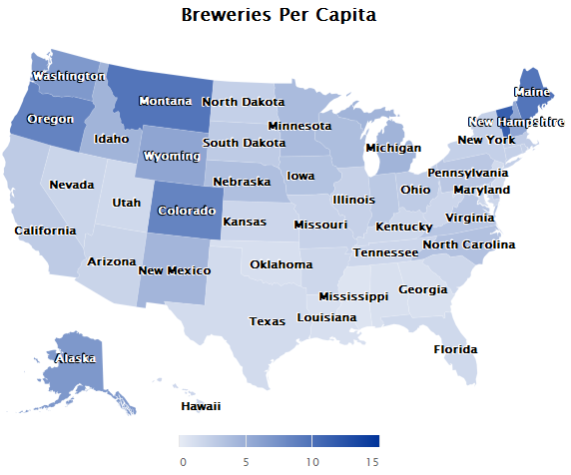
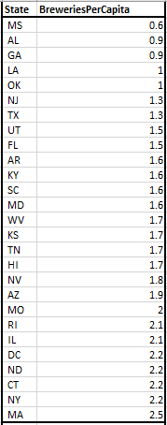
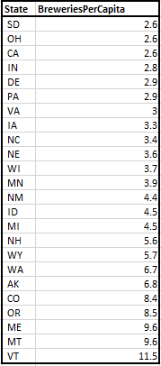
Number of Breweries Per Capita by State (100,000 adult 21+)

Slide 19
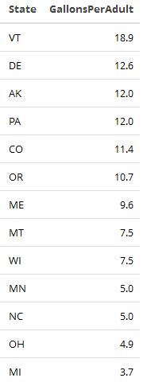
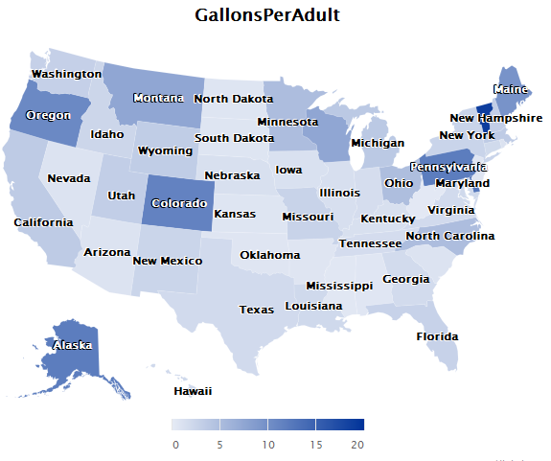
Gallons Per Adult by State

Slide 21
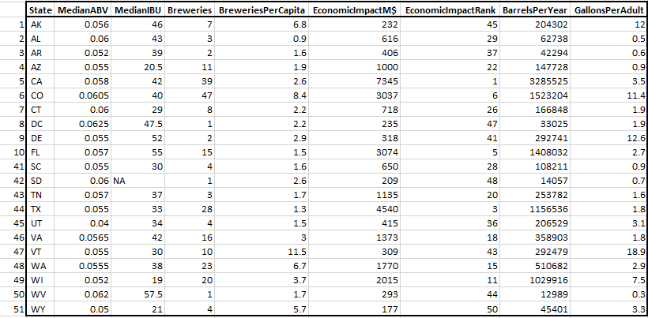
Showcase of Datasets
Breweries by state, Median ABV/IBU and economic impact

