Slide 1
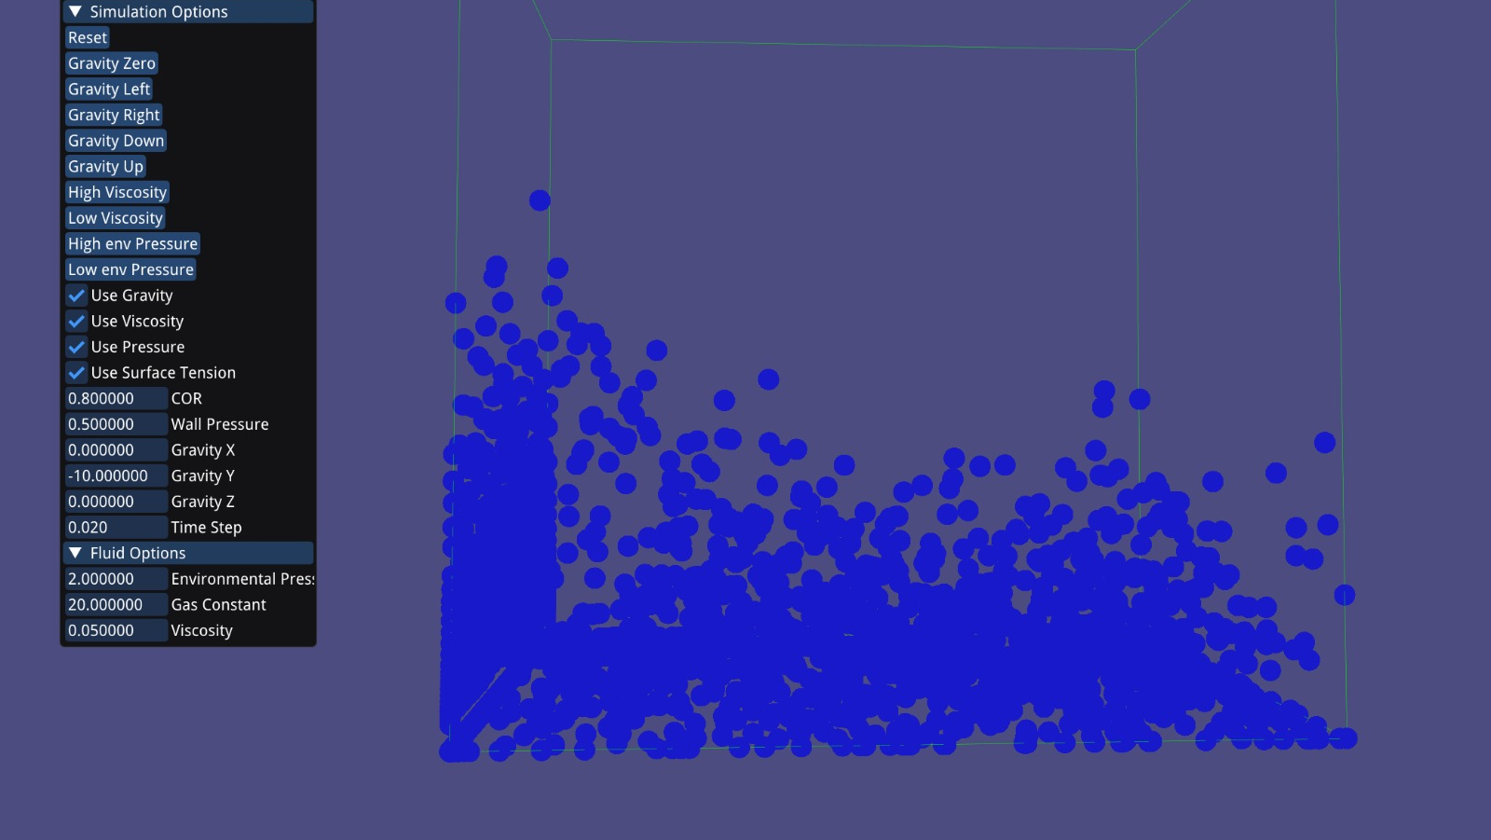
Fluid Simulation
Floris Schild & Thijs Voncken

Slide 2
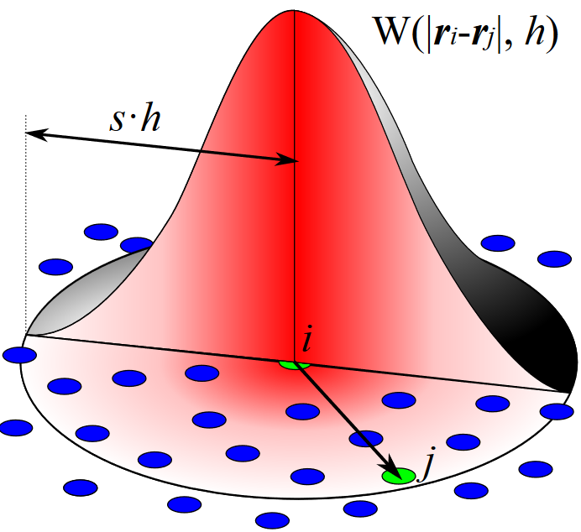
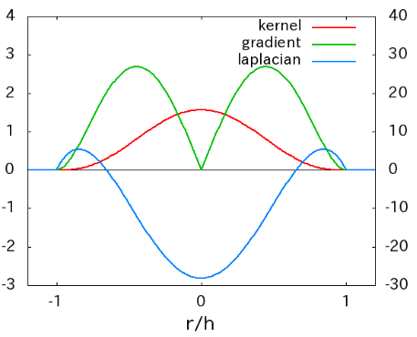
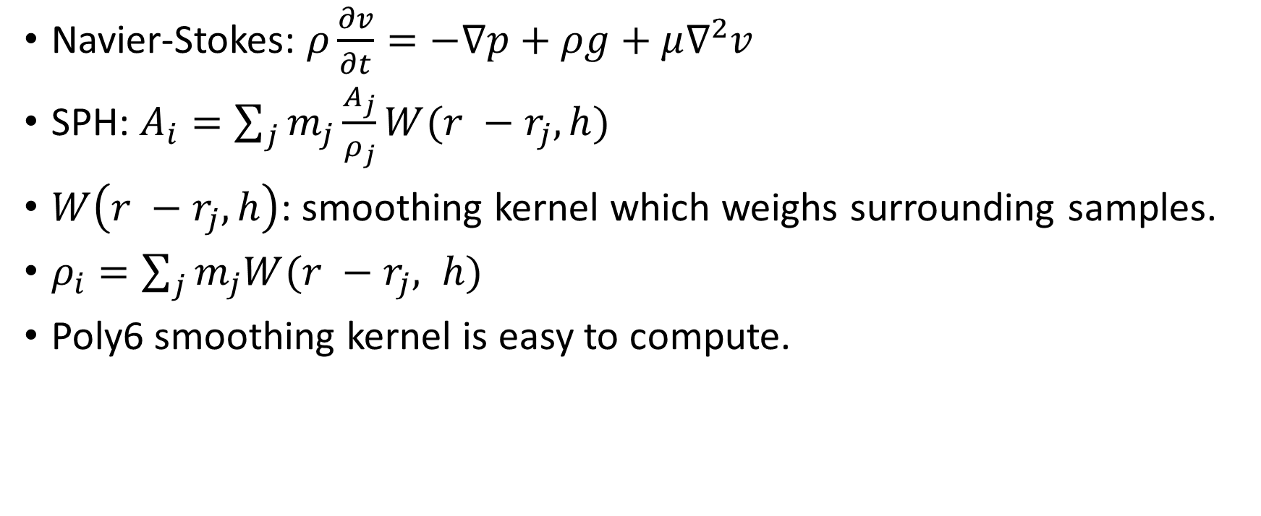
Particle based simulation using SPH
Navier-Stokes: $ρ\frac{∂v}{∂t}=−∇p+ρg+μ∇^{2}v$
SPH: $A_{i}=\sum_{j}{m_{j}\frac{A_{j}}{ρ_{j}}W(r −r_{j}, h)}$
$W\left(r −r_{j}, h\right)$: smoothing kernel which weighs surrounding samples.
$ρ_{i}=\sum_{j}{m_{j}W(r −r_{j}, h)}$
Poly6 smoothing kernel is easy to compute.

Slide 3
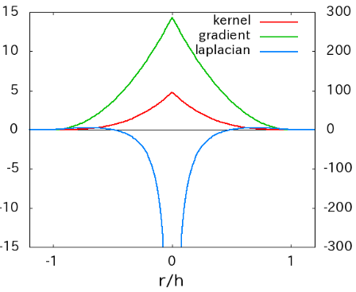

Pressure Forces
$f_{i}^{pressure}=−\sum_{j}{m_{j}\frac{p_{i} + p_{j}}{2ρ_{j}}}∇W\left(r −r_{j}, h\right)$
$p_{i}=k(ρ_{i}−ρ_{0})$
Poly6 leads to particle clustering, Spiky kernel solves this.

Slide 4
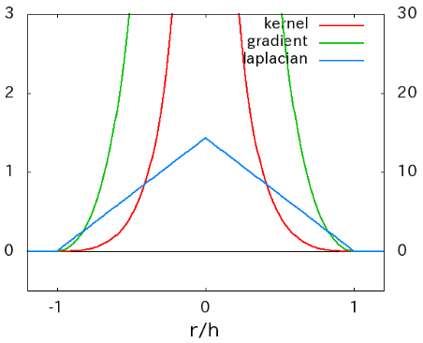

Viscosity
$f_{i}^{viscosity}=μ\sum_{j}{m_{j}\frac{v_{j}−v_{i}}{ρ_{j}}∇^{2}W(r −r_{j},h)}$
Different smoothing kernel because of artefacts when closing in.

Slide 5
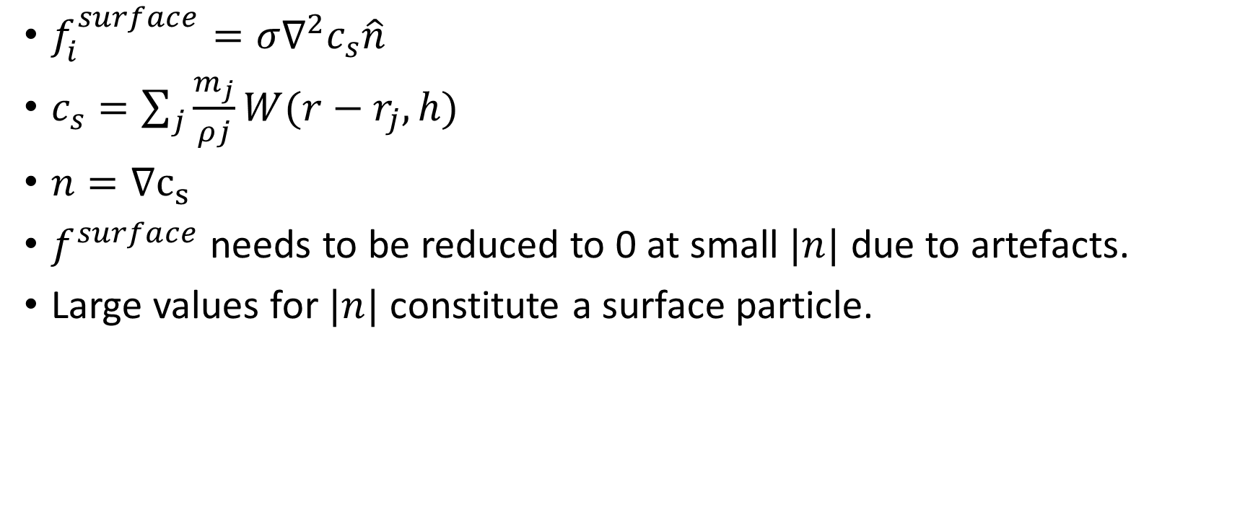
Surface tension
$f_{i}^{surface}=σ∇^{2}c_{s}\hat{n}$
$c_{s}=\sum_{j}{\frac{m_{j}}{ρj}W(r−r_{j}, h)}$
$n=∇c_{s}$
$f^{surface}$ needs to be reduced to 0 at small $|n|$ due to artefacts.
Large values for $|n|$ constitute a surface particle.

Slide 6
Wall Sticking
Particles stick to walls and edges of the space.
Incomplete sampling around edges of fluid.
Naïve solution: walls exert a pressure force on the fluid as well.

Slide 7
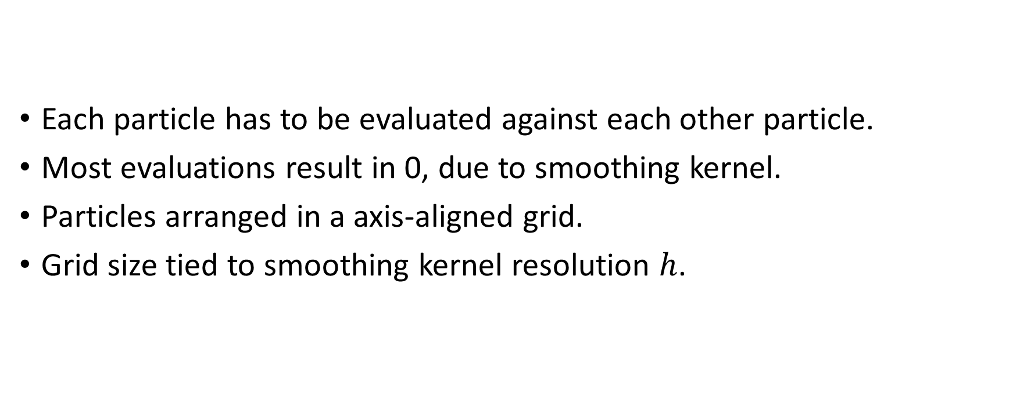
Performance
Each particle has to be evaluated against each other particle.
Most evaluations result in 0, due to smoothing kernel.
Particles arranged in a axis-aligned grid.
Grid size tied to smoothing kernel resolution $h$.

Slide 8
DEMO
Notes:
Default
High Viscosity
Zero Gravity
High Pressure

Slide 9
Questions?

