Slide 1
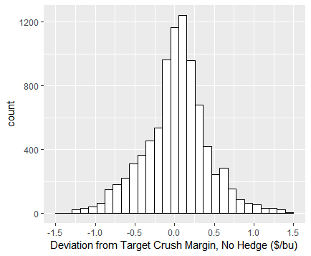
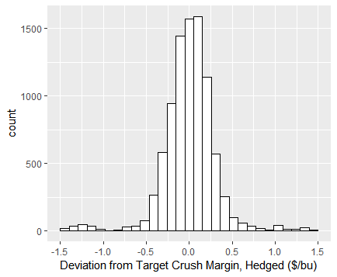
Comparing profits: long spot vs hedged

Slide 2
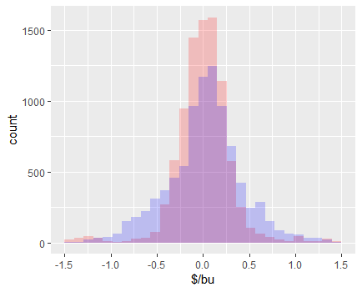
In this graph, I put the two histograms together.
Blue = profits, no hedge
Red = profits, hedged
Purple = overlap
Observations
Thinning left tail on the red histogram (hedged). You can still see some red bars though, meaning the hedge does not completely eliminate risk.
Higher counts in the -0.5 to 0.5 region, hence we see the red bars showing above the purple.

