Slide 1
PG DIPLOMA · ADVANCED COMMUNICATION WITH QUANTUM & AI
Why More Antennas
= Fewer Errors
Error Probability Analysis for MIMO — an intuition-first session
90 minutes
6 numericals
5 quizzes
3 design problems
1

Slide 2
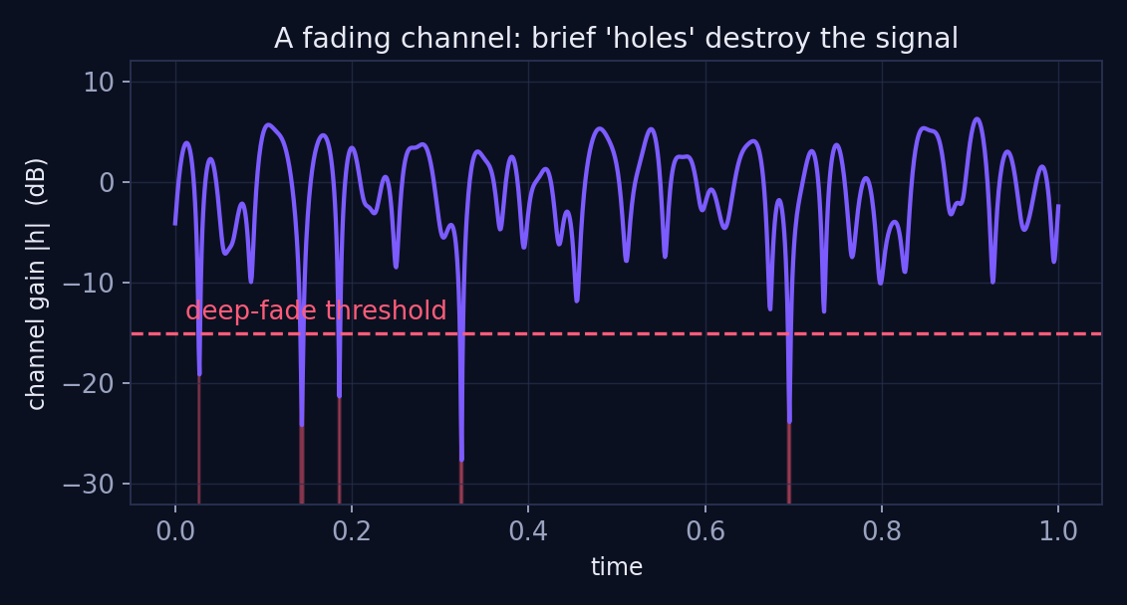
THE HOOK
Your call drops in the lift. Why?
› Signal bounces off walls, floors, people — copies collide.
› Sometimes copies cancel almost perfectly: a DEEP FADE.
› For a few milliseconds the channel gain ≈ 0 — no power survives.
› Errors don't happen 'a little, all the time'. They happen in bursts, inside fades.
Today's single big question
Red zones = deep fades. Tiny fraction of time, almost all of the errors.
How exactly does BER fall when we add antennas?
2

Slide 3
FOUNDATIONS
BER: Just Count the Errors
Definition (no calculus required)
100 / 10,000
BER = erroneous bits ÷ total bits
A probability between 0 and 1. Lower = better link.
bits in error / bits sent — from the classic example
Targets you'll meet in practice
BER = 0.01
› Voice call: BER ≈ 10⁻³ is tolerable
› Data / video: 10⁻⁶ or better
› 5G URLLC (factory robots): 10⁻⁹ reliability targets
one bit in every hundred is wrong — unusable for data
3

Slide 4
NUMERICAL 1
Two Links, One Verdict
Problem
Link P sends 2,000,000 bits and logs 400 errors. Link Q sends 50,000 bits and logs 25 errors. Which link is better, and by how much?
Link P
Link Q
BER = 400 / 2,000,000 = 2 × 10⁻⁴
BER = 25 / 50,000 = 5 × 10⁻⁴
Verdict: Link P is 2.5× better. Raw error counts mislead — always normalise to a rate.
4

Slide 5
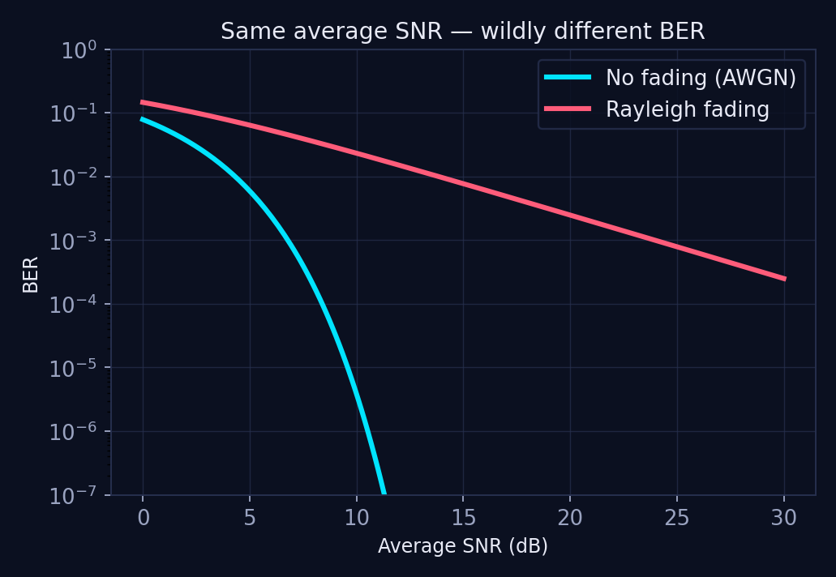
FOUNDATIONS
Same Average SNR, Wildly Different BER
› Cable / AWGN: BER plunges like a cliff — a few extra dB buys orders of magnitude.
› Fading: BER drifts down lazily — 10 dB more buys only ~10× improvement.
› At BER 10⁻⁵, fading costs you tens of dB versus AWGN.
› Reason: averages hide the disasters. Performance is dictated by the worst moments.
5

Slide 6
THE ONE INSIGHT
BER ≈ Probability of a Deep Fade
When |h| is healthy, errors are vanishingly rare. When |h| ≈ 0, you lose almost everything.
So: BER ∝ P( deep fade )
Why this reframing is powerful
The umbrella picture
› Forget integrating Q-functions — think about avoiding holes.
› Cutting fade probability cuts BER, almost one-for-one.
› Diversity = carrying spare channels so one hole can't sink you.
One umbrella with one hole over your head: you get wet whenever the hole lines up.
Carry four independent umbrellas: you only get wet if all four holes line up at once — far rarer.
6

Slide 7
CHECKPOINT QUIZ
Quiz 1 — Your Turn
Q1. A link sends 5 × 10⁶ bits with 50 errors. BER = ?
(a) 10⁻⁴ (b) 10⁻⁵ (c) 10⁻⁶ (d) 5 × 10⁻⁵
Q2. Fading channels have poor BER mainly because…
(a) noise is stronger (b) bandwidth is smaller (c) deep fades occasionally kill the signal (d) receivers are cheaper
Q3. A 'deep fade' means…
(a) high noise burst (b) |h| collapses toward 0 (c) transmitter shuts off (d) interference from 5G
Answers on the next slide — commit before you flip!
7

Slide 8
ANSWERS
Quiz 1 — Answers
A1. (b) 10⁻⁵
50 / 5,000,000 = 1 in 100,000. Always reduce to a clean power of ten when you can.
A2. (c) deep fades
The noise floor is the same as a cable — it's the channel gain collapsing that destroys SNR.
A3. (b) |h| collapses toward 0
Multipath copies cancel; received SNR drops by 20–30 dB for milliseconds.
8

Slide 9
TWO KNOBS
One Formula to Read Every BER Curve
At high SNR: Pₑ ≈ Gc / SNRᵈ
This is the only formula you must internalise today. Everything else is interpretation.
Gc — coding gain
d — diversity order
› Horizontal SHIFT of the curve
› Better constellations, better codes
› Same steepness — you arrive earlier
› SLOPE of the curve on log-log axes
› Number of independent fading paths
› Changes the exponent — the game-changer
9

Slide 10
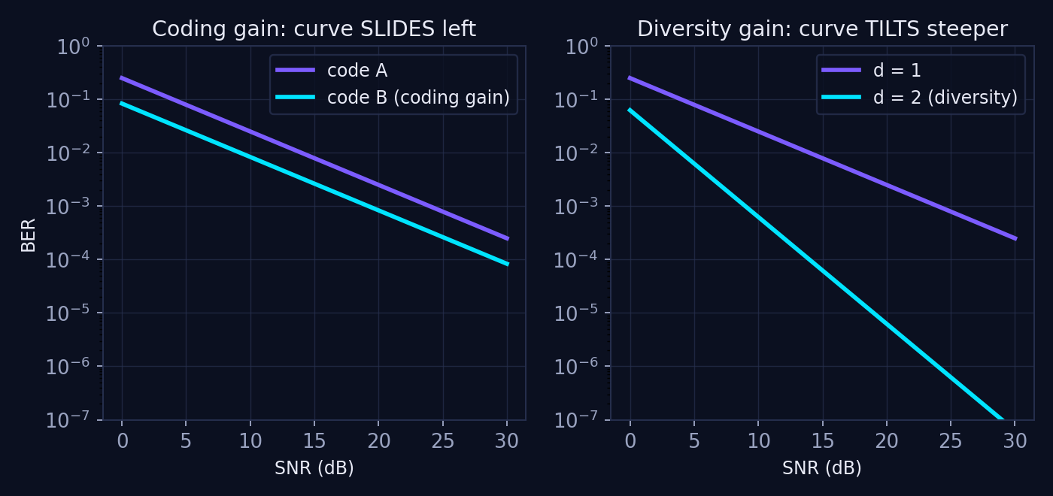
TWO KNOBS
Shift vs Slope — See It
Left: same slope, curve B simply needs fewer dB. Right: same start, but d = 2 pulls away faster with every dB.
10

Slide 11
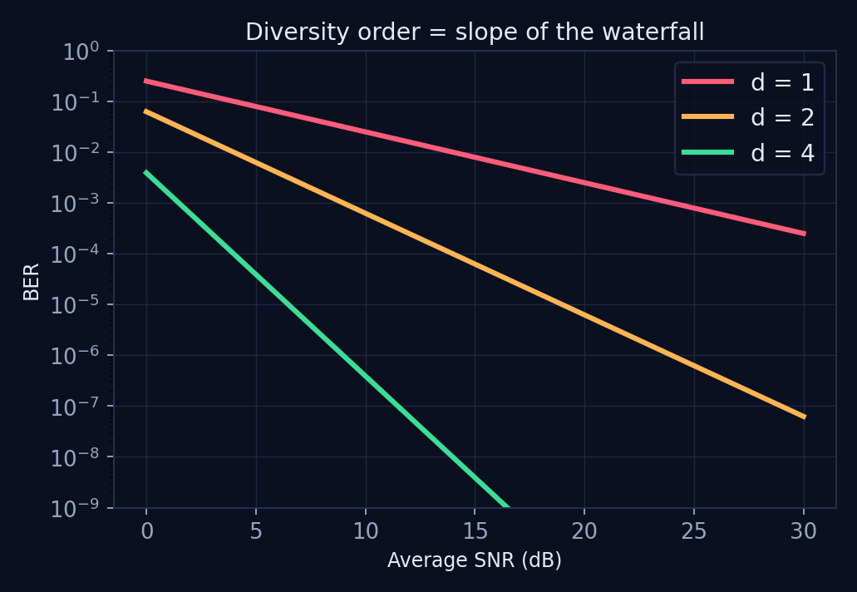
TWO KNOBS
Diversity Order = Slope of the Waterfall
› d = 1: each 10 dB buys one decade of BER.
› d = 2: each 10 dB buys two decades.
› d = 4: each 10 dB buys four decades — the curve falls off a cliff.
› Rule of thumb: slope (decades per 10 dB) = diversity order.
11

Slide 12
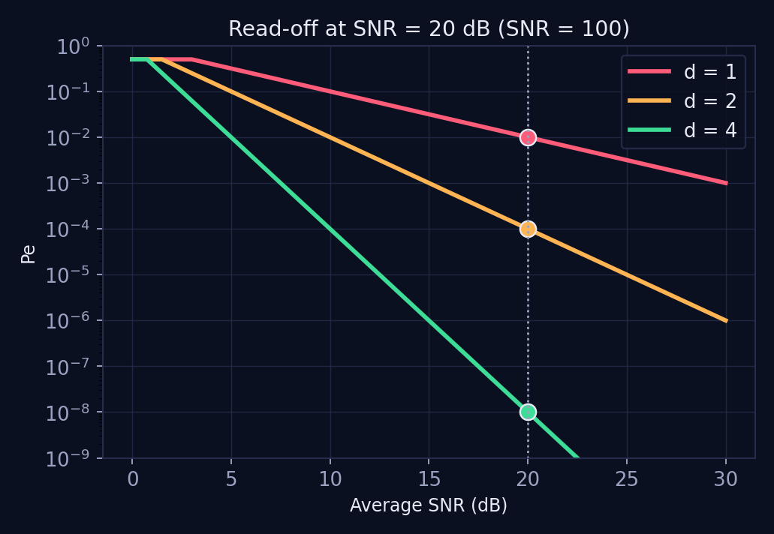
NUMERICAL 2
The Power of the Exponent
Problem
Take Pₑ ≈ SNR⁻ᵈ at SNR = 20 dB (i.e. SNR = 100). Compare d = 1, 2, 4.
10⁻²
10⁻⁴
10⁻⁸
d = 1 — one error per hundred bits
d = 2 — 100× fewer errors
d = 4 — a million times fewer than d = 2... at the SAME transmit power
Free reliability: no extra watts, no extra spectrum — just antennas.
12

Slide 13
INTERVIEW CLASSIC
Which Matters More: Gc or d?
Answer: diversity order, every time. Coding gain adds a constant; diversity changes the exponent.
Analogy: salary vs interest rate
How to answer in a viva
A bonus (coding gain) is nice once.
A higher compounding rate (diversity) wins inevitably as SNR grows.
At high SNR, any d = 2 scheme beats any d = 1 scheme — no matter the coding gain.
› Name the formula Pₑ ≈ Gc / SNRᵈ
› Say: Gc shifts, d tilts
› Add: asymptotically, slope dominates shift
13

Slide 14
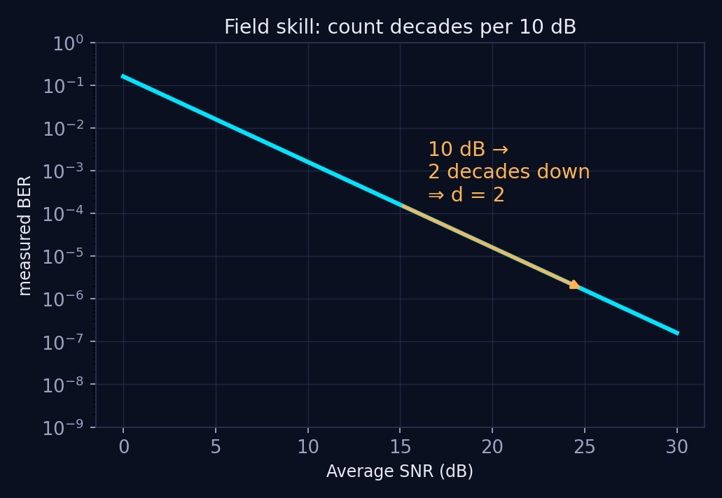
FIELD SKILL
Read d Straight Off a Measured Plot
› Pick two SNR points 10 dB apart on the straight part of the curve.
› Count how many decades the BER drops.
› That count IS the diversity order.
› Here: 10 dB → 100× lower BER → d = 2. The lab will ask you to do this on simulated Alamouti curves.
14

Slide 15
CHECKPOINT QUIZ
Quiz 2 — Your Turn
Q1. Curves A and B are parallel, B sits 10 dB to the left. B has…
(a) higher diversity (b) higher coding gain (c) more antennas (d) lower noise figure
Q2. Curve C drops 2 decades per 10 dB. Its diversity order is…
(a) 1 (b) 2 (c) 4 (d) cannot tell
Q3. True or false: enough coding gain can beat a higher diversity order at any SNR.
(a) True (b) False
Answers on the next slide — commit before you flip!
15

Slide 16
ANSWERS
Quiz 2 — Answers
A1. (b) higher coding gain
Parallel curves = same slope = same d. A pure shift is Gc.
A2. (b) 2
Decades per 10 dB = d. Two decades → d = 2.
A3. (b) False
Eventually SNRᵈ dominates any constant. The steeper curve always crosses below.
16

Slide 17
THE LADDER · RUNG 1
SISO: One Path, One Chance
System: y = h·s + n
The umbrella picture
› One transmitter, one receiver, ONE fading coefficient h
› Receiver picks the symbol closest to y (ML detection)
› Entire link rides on a single random number
Result
Diversity order d = 1
One decade of BER per 10 dB — the lazy red curve from earlier.
One umbrella, one hole. When rain finds the hole — a deep fade — you're soaked. No backup.
17

Slide 18
THE LADDER · RUNG 1
Why a Single Fade Kills You
› 99% of the time, the SISO link is fine.
› The remaining 1% contributes nearly 100% of the errors.
› Raising transmit power barely helps — fades are 20–30 dB deep.
› The fix isn't shouting louder. It's having somewhere else to stand.
18

Slide 19
THE LADDER · RUNG 2
SIMO: Multiple Ears Listening
Maximum Ratio Combining (MRC)
One mouth, many ears
› Nr receive antennas → Nr independent copies of the same symbol
› MRC = weighted vote: trust the strong copies more, whisper-weight the faded ones
› Combined SNR = SUM of branch SNRs — fades on one branch are papered over by the others
› Link dies only if ALL branches fade together
RX1
TX
RX2
RX3
Three independent paths — three chances to dodge a fade.
19

Slide 20
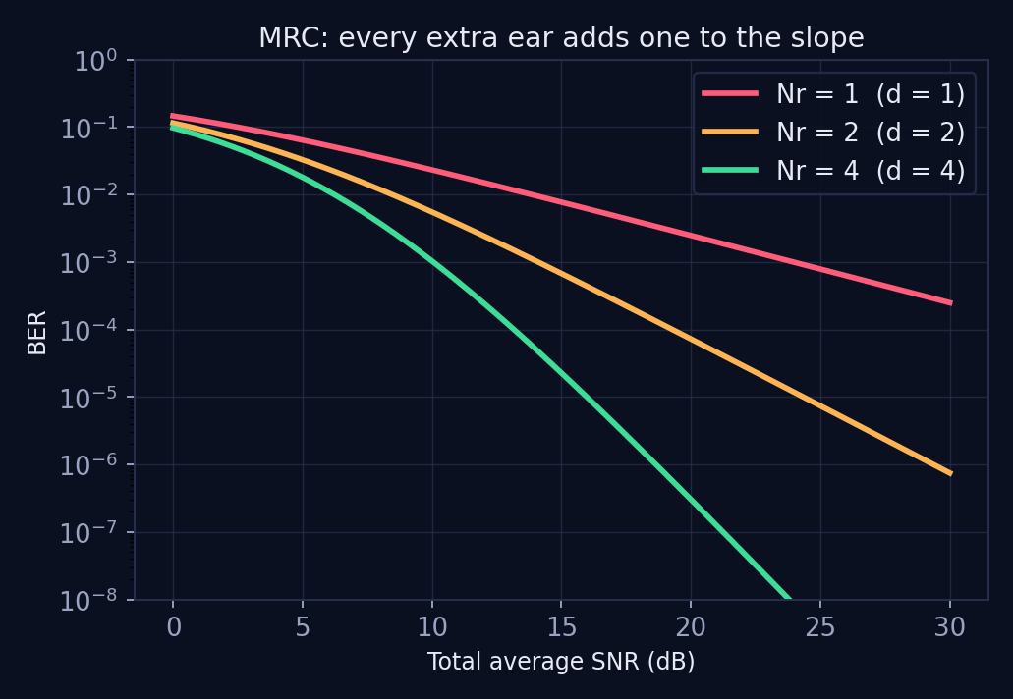
THE LADDER · RUNG 2
Key Result: d = Nr
d = Nr
every extra receive antenna adds one full unit of slope
› 2 antennas → d = 2 → two decades per 10 dB
› 4 antennas → d = 4 → cliff-edge BER
› Intuition: all Nr branches must fade simultaneously — probability multiplies.
20

Slide 21
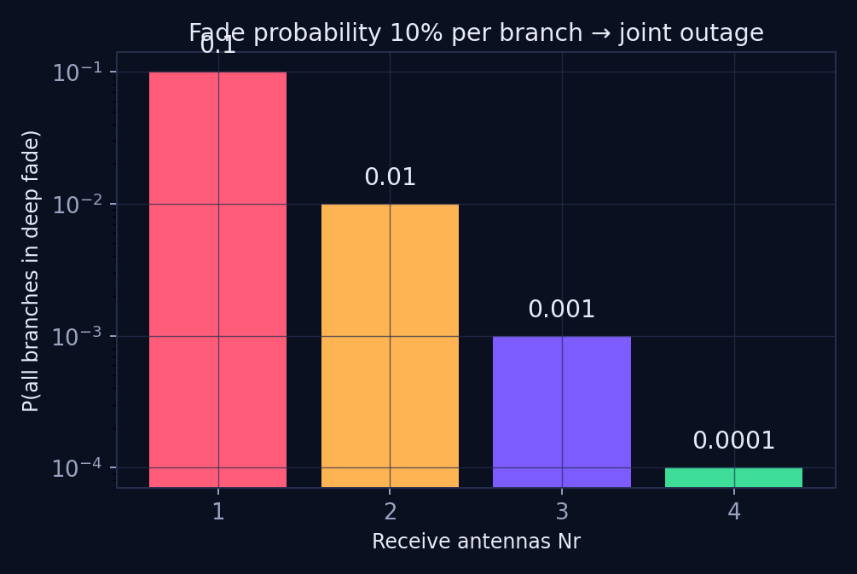
NUMERICAL 3
Joint Outage with Independent Branches
Problem
Each branch independently sits in a deep fade 10% of the time. Find P(link outage) for Nr = 1, 2, 4 with MRC.
Solution
Outage needs ALL branches faded:
Nr = 1: 0.1 → 10%
Nr = 2: 0.1² = 0.01 → 1%
Nr = 4: 0.1⁴ = 0.0001 → 0.01%
Probabilities multiply — that's diversity in one line.
21

Slide 22
THE LADDER · RUNG 3
MISO: Multiple Mouths Speaking
Nt transmit antennas, 1 receive
Many mouths, one ear
› Same idea, mirrored: send the symbol over Nt independent paths
› If TX knows the channel → MRT (beam the energy where it survives)
› If TX is blind → STBC (Alamouti): clever symbol arrangement extracts diversity anyway
› Result: d = Nt
TX1
TX2
RX
TX3
This is your phone's downlink: the tower carries the antennas.
22

Slide 23
COMPARE
SIMO vs MISO: Same Order, Different Engineering
SIMO (1 × Nr)
MISO (Nt × 1)
Diversity order
d = Nr
d = Nt
Where the antennas live
Receiver
Transmitter
Channel knowledge needed
No (MRC works blind at TX)
MRT: yes · STBC: no
Power per path
Full power received Nr ways
Total power SPLIT across Nt
Typical deployment
Uplink (tower listens)
Downlink (tower speaks)
23

Slide 24
5G REALITY CHECK
Why Base Stations Carry the Antennas
› Your phone: 2–4 antennas max — battery, space, cost.
› A 5G gNB panel: 64+ elements, massive MIMO.
› Uplink = SIMO-like: tower's many ears rescue your phone's weak voice.
› Downlink = MISO/MIMO: tower's many mouths beam and protect.
› Diversity is bought once at the tower and shared by thousands of users.
A 64-element gNB panel
Each dot = an antenna element. Diversity AND beamforming.
24

Slide 25
NUMERICAL 4
Design for BER ≤ 10⁻⁵ at 12 dB
Problem
A sensor link has only 12 dB of SNR budget. Using Pₑ ≈ SNR⁻ᵈ as a quick model, how many independent branches d do we need for BER ≤ 10⁻⁵?
Solution sketch
Design takeaway
12 dB → SNR ≈ 16 (10^1.2)
d = 1: 16⁻¹ ≈ 6 × 10⁻² ✗
d = 2: 16⁻² ≈ 4 × 10⁻³ ✗
d = 3: 16⁻³ ≈ 2.4 × 10⁻⁴ ✗ (close)
d = 4: 16⁻⁴ ≈ 1.5 × 10⁻⁵ ≈ target → pick d = 4, e.g. 2×2 MIMO
When the power budget is locked, diversity order is the only dial left.
A 2×2 link (d = 4) meets a target that no amount of realistic coding gain could rescue at d = 1.
25

Slide 26
CHECKPOINT QUIZ
Quiz 3 — Your Turn
Q1. Match: 1×4 MRC receiver. Diversity order = ?
(a) 1 (b) 2 (c) 4 (d) 8
Q2. A 3×1 MISO with Alamouti-style STBC (no CSI at TX) achieves…
(a) d = 0, STBC needs CSI (b) d = 3 (c) d = 1 (d) d depends on the receiver count only
Q3. Trap: MISO with NO channel knowledge and NO space-time code, same symbol on all antennas, gives…
(a) full d = Nt (b) beams may cancel — no guaranteed diversity (c) d = Nt² (d) lower noise
Answers on the next slide — commit before you flip!
26

Slide 27
ANSWERS
Quiz 3 — Answers
A1. (c) 4
SIMO with MRC: d = Nr = 4. Count the independent ears.
A2. (b) d = 3
That's the magic of STBC: full transmit diversity without the transmitter knowing h.
A3. (b) no guaranteed diversity
Identical signals can add destructively — naive repetition across space is NOT diversity. Structure (STBC) is required.
27

Slide 28
CHECKPOINT
The Antenna Ladder So Far
MIMO
Nt × Nr
MISO
d = ?
Nt × 1
SIMO
d = Nt
1 × Nr
SISO
d = Nr
1 × 1
d = 1
Next: the top rung. Spoiler — it's not d = Nt + Nr…
28

Slide 29
MIMO · NEW LANGUAGE
From Symbols to Matrices
› With Nt antennas and T time slots, one 'codeword' is an Nt × T MATRIX X.
› Rows = antennas, columns = time slots.
› The constellation is now a set of matrices — a matrix constellation.
› Alamouti: 2 antennas × 2 slots carrying 2 symbols and their conjugate twists.
Alamouti codeword X (2 × 2)
slot 1
slot 2
ant 1
s₁
−s₂*
ant 2
s₂
s₁*
Each codeword pair stays maximally 'far apart' no matter how the channel rotates it — that's the property we'll now quantify.
29

Slide 30
PEP
Total BER Is Hard — Compare Two at a Time
Pairwise Error Probability
The tournament analogy
› PEP = P(X → X̂): sent X, decoder picked X̂
› Exact BER over all codewords: intractable
› PEP of one pair: tractable
› Union bound: total error ≤ sum of pairwise errors
› Worst pair dominates at high SNR — find it, fix it
Judging a whole league at once is hopeless.
Instead, run head-to-head matches: how often does codeword X̂ 'beat' the true X at the decoder?
The championship is decided by the closest matchup — the most confusable pair of codewords sets your error floor.
30

Slide 31
PEP
Only the DIFFERENCE Matters
Define ΔX = X − X̂ — PEP depends only on ΔX and the channel, never on X alone.
Why this simplifies everything
Everyday analogy
› Don't study codewords — study their gaps
› Good code design = keep every ΔX 'big' in every direction
› Shifting the whole constellation changes nothing
You confuse twins because their DIFFERENCE is small — not because of what either looks like alone.
Codewords are twins; ΔX measures how identical they are.
31

Slide 32
PEP
Eigenvalues: 'Far Apart' From Every Direction
Product distance
Volume picture
› Form ΔXᴴΔX — eigenvalues λ₁, λ₂, …
› Each λᵢ = separation of the pair along one spatial direction
› PEP ∝ 1 / ∏λᵢ — the PRODUCT distance
› One tiny λ ruins the whole product — like one flat tyre
healthy: both λ large → big volume → robust
squashed: one λ ≈ 0 → flat → confusable
The decoder confuses codewords along the squashed direction.
32

Slide 33
CONCEPT
Observability: Different In → Different Out
Two pillars
Lock and key
› DIVERSITY: many independent looks at the same data → reliability
› OBSERVABILITY: distinct codewords must stay distinct at the receiver
› If two inputs can produce the same output, no SNR can save you
› Mapping must be one-to-one through every channel realisation
key A → lock A ✓
key B → lock B ✓
key A & B → SAME lock ✗
A code that 'loses' a direction has duplicate keys.
33

Slide 34
THE HEART OF STBC
The Rank Criterion
Full diversity ⇔ rank(ΔX) = Nt for EVERY codeword pair
Every difference matrix must be full rank — no squashed directions, ever.
Reading it
The equivalence chain
› Full rank → all Nt antennas contribute independent protection
› Rank-deficient pair → some antennas wasted for that pair
Observable ⇔ Full Rank ⇔ Full Diversity
Three views of one property.
34

Slide 35
CASE STUDY
Why Alamouti Always Wins
Check one concrete pair (BPSK)
Consequence
X for (s₁,s₂)=(+1,+1), X̂ for (+1,−1):
ΔX = X − X̂ = [ 0 2 ; 2 0 ]
det(ΔX) = 0·0 − 2·2 = −4 ≠ 0
→ rank 2 = Nt. Full rank. ✓
Alamouti's structure guarantees det(ΔX) ≠ 0 for ALL pairs — orthogonality at work.
With 1 receive antenna:
d = 2 — full transmit diversity, no CSI at TX, simple linear decoding.
d = 2·Nr
Alamouti scales with every receive antenna you add
35

Slide 36
NUMERICAL 5
Rank → Diversity, By Hand
Problem
For a 2-antenna code, two pairs produce these difference matrices. Predict the diversity each pair supports (Nr = 2).
ΔX₁ = [ 2 0 ; 0 2 ]
ΔX₂ = [ 2 2 ; 1 1 ]
det = 4 ≠ 0 → rank r = 2
d = r·Nr = 2 × 2 = 4
Full diversity pair — protected in every direction.
det = 2·1 − 2·1 = 0 → rank r = 1
d = r·Nr = 1 × 2 = 2
Rows are parallel: one spatial direction is invisible. This pair sets the code's error floor.
36

Slide 37
CHECKPOINT QUIZ
Quiz 4 — Your Turn
Q1. A 2-antenna code has one pair with rank(ΔX) = 1, all others rank 2. The CODE's diversity is…
(a) 2 (best pair) (b) 1 (worst pair) × Nr (c) average of pairs (d) undefined
Q2. rank(ΔX) for ΔX = [3 6; 1 2] is…
(a) 0 (b) 1 (c) 2 (d) 3
Q3. Full diversity for an Nt-antenna code requires…
(a) one pair full rank (b) most pairs full rank (c) EVERY pair full rank (d) full-rank channel H
Answers on the next slide — commit before you flip!
37

Slide 38
ANSWERS
Quiz 4 — Answers
A1. (b) worst pair rules
The weakest matchup dominates the union bound — diversity is a worst-case guarantee.
A2. (b) 1
Second row = first row ÷ 3: rows are dependent, det = 0.
A3. (c) every pair
One bad pair caps the slope of the entire BER curve. Code design = policing all pairs.
38

Slide 39
THE GRAND RESULT
The Diversity Multiplication Law
d = r · Nr and d_max = Nt · Nr
r = rank of the worst-case ΔX. When r = Nt, antennas MULTIPLY — they don't add.
2 × 2 → 4
4 × 4 → 16
8 × 4 → 32
not 2 + 2
sixteen independent escape routes
massive-MIMO territory
39

Slide 40
NUMERICAL 6
Massive-MIMO Panel, Dropped Rank
Problem
A 4×4 link uses a code with full-rank ΔX. (a) Max diversity? (b) A cheaper code has one pair with rank 2 — new diversity? (c) BER impact at 20 dB, Pₑ ≈ SNR⁻ᵈ.
Solution
Engineering read
(a) d = Nt·Nr = 4 × 4 = 16
(b) d = r·Nr = 2 × 4 = 8
(c) at SNR = 100:
10⁻³² vs 10⁻¹⁶ — sixteen orders of magnitude surrendered to save code complexity
In practice both are 'error-free' — which is exactly why real systems trade some diversity for RATE (spatial multiplexing).
The theorem tells you how much reliability headroom you're spending. That trade is the diversity–multiplexing story of the next session.
40

Slide 41
DESIGN PROBLEM 1 · 5G
Urban Small Cell: 2×2 or 4×2?
Brief
A smart-city small cell must deliver BER ≤ 10⁻⁶ to meters at the cell edge, where SNR ≈ 15 dB. Option A: 2×2 (cheap). Option B: 4×2 (adds 2 RF chains, +40% cost). Use Pₑ ≈ SNR⁻ᵈ with full-rank STBC. Which option, and what would change your answer?
Worksheet — fill before flipping
› Step 1: convert 15 dB → linear SNR
› Step 2: diversity of each option (assume full rank)
› Step 3: estimate Pₑ for each; compare to 10⁻⁶
› Step 4: decide — and name one non-BER factor that could flip the call
41

Slide 42
DESIGN PROBLEM 1
Model Solution
Numbers
Decision discussion
15 dB → SNR ≈ 31.6
Option A (2×2): d = 4
Pₑ ≈ 31.6⁻⁴ ≈ 10⁻⁶ → marginal, zero headroom
Option B (4×2): d = 8
Pₑ ≈ 31.6⁻⁸ ≈ 10⁻¹² → six orders of safety margin
› Pick B for URLLC-grade meters: the model ignores interference, mobility, estimation error — A's zero margin evaporates in the field.
› Pick A if meters retransmit freely (ARQ buys effective diversity in time).
› Flip factors: shadowing depth, correlated antennas (rank drop!), power budget.
42

Slide 43
DESIGN PROBLEM 2 · BEYOND 5G
Does a RIS Buy Slope or Shift?
Brief
A Reconfigurable Intelligent Surface (RIS) — a wall of passive reflecting elements — is added to assist a 1×1 link in a dense urban canyon. Argue: does the RIS primarily provide coding gain (shift) or diversity gain (slope)? Connect to today's framework.
Case for SHIFT (coding gain)
Case for SLOPE (diversity)
› RIS focuses reflected energy → higher average SNR
› If the RIS path fades together with the surroundings, the slope stays d = 1
› Many elements → many quasi-independent reflected paths
› If element channels fade independently and the RIS adapts, deep fades become jointly rare → effective d > 1
43

Slide 44
DESIGN PROBLEM 2
Model Answer & Discussion
Verdict
Both — and that's the point. A static, well-phased RIS mainly buys coding gain (large SNR shift, slope unchanged). A channel-aware RIS over independently fading elements also hardens the channel — the deep-fade probability collapses, which behaves like added diversity. Published analyses show effective diversity growing with the number of RIS elements under independent fading.
Why this question matters for 6G
› It tests whether you can map ANY new hardware onto the shift-vs-slope axis — the framework outlives the technology.
› Exam strategy: always ask 'does it raise average SNR, or does it make deep fades rarer?'
44

Slide 45
DESIGN PROBLEM 3 · 6G TEASER
Cell-Free MIMO: Antennas Down the Street
Group activity (10 min)
6G cell-free MIMO scatters single-antenna access points along a street, all jointly serving you. Eight APs cooperate. Discuss in pairs: what diversity order can a user expect, what could silently reduce it, and how is this better than 8 antennas on one tower?
Steer the discussion toward…
› Ideal: 8 independently-fading links → d up to 8 (× user antennas)
› Silent killers: correlated shadowing, fronthaul failures, APs behind the same truck — independence is the currency of diversity
› vs one tower: geographic spread defeats LARGE-scale fades (blockage), not just small-scale ones — macro-diversity
45

Slide 46
HANDS-ON
MATLAB Lab Preview
Lab 1
Lab 2
BPSK over AWGN vs Rayleigh — reproduce today's first chart
1×Nr MRC — verify slope = Nr by counting decades
Lab 3
Lab 4
Alamouti 2×1 and 2×2 — confirm d = 2 and d = 4
Rank experiment — break a code on purpose, watch the slope collapse
Deliverable: one figure per lab + the diversity order you measured from each slope.
46

Slide 47
LAB 1 · CODE
BPSK: AWGN vs Rayleigh
MATLAB
Python (NumPy)
N=1e6; SNR=0:2:30;
b=randi([0 1],1,N); s=2*b-1;
for k=1:numel(SNR)
g=10^(SNR(k)/10); sg=sqrt(1/(2*g));
% AWGN
bA(k)=mean(((s+sg*randn(1,N))>0)~=b);
% Rayleigh, coherent detection
h=sqrt(.5)*(randn(1,N)+1j*randn(1,N));
y=h.*s+sg*(randn(1,N)+1j*randn(1,N));
bR(k)=mean((real(conj(h).*y)>0)~=b);
end
semilogy(SNR,bA,SNR,bR); grid on
xlabel('SNR (dB)'); ylabel('BER');
legend('AWGN','Rayleigh');
import numpy as np
import matplotlib.pyplot as plt
N=10**6; SNR=np.arange(0,31,2)
b=np.random.randint(0,2,N); s=2*b-1
bA,bR=[],[]
for sdB in SNR:
g=10**(sdB/10); sg=np.sqrt(1/(2*g))
bA.append(np.mean(((s+sg*np.random.randn(N))>0)!=b))
h=np.sqrt(.5)*(np.random.randn(N)+1j*np.random.randn(N))
y=h*s+sg*(np.random.randn(N)+1j*np.random.randn(N))
bR.append(np.mean((np.real(np.conj(h)*y)>0)!=b))
plt.semilogy(SNR,bA,label='AWGN')
plt.semilogy(SNR,bR,label='Rayleigh')
plt.xlabel('SNR (dB)'); plt.ylabel('BER')
plt.grid(); plt.legend(); plt.show()
47

Slide 48
LAB 2 · CODE
MRC 1×Nr — Slope = Nr
MATLAB
Python (NumPy)
N=2e5; SNR=0:2:24;
b=randi([0 1],1,N); s=2*b-1;
hold on
for L=[1 2 4]
for k=1:numel(SNR)
g=10^(SNR(k)/10)/L; % split SNR budget
h=sqrt(.5)*(randn(L,N)+1j*randn(L,N));
n=sqrt(1/(2*g))*(randn(L,N)+1j*randn(L,N));
y=h.*s+n;
z=real(sum(conj(h).*y,1)); % MRC combine
ber(k)=mean((z>0)~=b);
end
semilogy(SNR,ber)
end
set(gca,'YScale','log'); grid on
legend('Nr=1','Nr=2','Nr=4');
% slope check: decades per 10 dB = Nr
import numpy as np, matplotlib.pyplot as plt
N=2*10**5; SNR=np.arange(0,25,2)
b=np.random.randint(0,2,N); s=2*b-1
for L in [1,2,4]:
ber=[]
for sdB in SNR:
g=10**(sdB/10)/L # split SNR budget
h=np.sqrt(.5)*(np.random.randn(L,N)
+1j*np.random.randn(L,N))
n=np.sqrt(1/(2*g))*(np.random.randn(L,N)
+1j*np.random.randn(L,N))
y=h*s+n
z=np.real(np.sum(np.conj(h)*y,0)) # MRC
ber.append(np.mean((z>0)!=b))
plt.semilogy(SNR,ber,label=f'Nr={L}')
plt.grid(); plt.legend(); plt.show()
# slope check: decades per 10 dB = Nr
48

Slide 49
LAB 3 · CODE
Alamouti 2×1 — d = 2 Without CSI
MATLAB
Python (NumPy)
N=2e5; SNR=0:2:24;
nz=@(r) sqrt(.5)*(randn(r,N)+1j*randn(r,N));
for k=1:numel(SNR)
g=10^(SNR(k)/10); sg=sqrt(1/g); % Es/2 per ant
b=randi([0 1],2,N); s=2*b-1;
h=nz(2);
y1=(h(1,:).*s(1,:)+h(2,:).*s(2,:))/sqrt(2) ...
+ sg*nz(1);
y2=(-h(1,:).*s(2,:)+h(2,:).*s(1,:))/sqrt(2) ...
+ sg*nz(1); % real s: s*=s
z1=conj(h(1,:)).*y1+h(2,:).*conj(y2);
z2=conj(h(2,:)).*y1-h(1,:).*conj(y2);
ber(k)=mean(([real(z1);real(z2)]>0)~=b,'all');
end
semilogy(SNR,ber); grid on % expect d = 2
import numpy as np, matplotlib.pyplot as plt
N=2*10**5; SNR=np.arange(0,25,2); ber=[]
nz=lambda r:np.sqrt(.5)*(np.random.randn(r,N)
+1j*np.random.randn(r,N))
for sdB in SNR:
g=10**(sdB/10); sg=np.sqrt(1/g)
b=np.random.randint(0,2,(2,N)); s=2*b-1
h=nz(2)
y1=(h[0]*s[0]+h[1]*s[1])/np.sqrt(2)+sg*nz(1)[0]
y2=(-h[0]*s[1]+h[1]*s[0])/np.sqrt(2)+sg*nz(1)[0]
z1=np.conj(h[0])*y1+h[1]*np.conj(y2)
z2=np.conj(h[1])*y1-h[0]*np.conj(y2)
dec=np.vstack([np.real(z1),np.real(z2)])>0
ber.append(np.mean(dec!=b))
plt.semilogy(SNR,ber); plt.grid()
plt.show() # expect d = 2
49

Slide 50
LAB 4 · CODE
Rank Experiment — Watch the Slope Collapse
MATLAB
Python (NumPy)
% Break diversity on purpose:
% send the SAME symbol from both antennas
% (every dX is rank 1) vs Alamouti (rank 2)
N=2e5; SNR=0:2:24;
b=randi([0 1],1,N); s=2*b-1;
for k=1:numel(SNR)
g=10^(SNR(k)/10); sg=sqrt(1/(2*g));
h=sqrt(.5)*(randn(2,N)+1j*randn(2,N));
heq=(h(1,:)+h(2,:))/sqrt(2); % naive sum
y=heq.*s+sg*(randn(1,N)+1j*randn(1,N));
berN(k)=mean((real(conj(heq).*y)>0)~=b);
end
semilogy(SNR,berN); hold on; grid on
% overlay Alamouti BER from Lab 3:
% naive stays at slope 1 - heq is STILL Rayleigh
# Break diversity on purpose:
# same symbol on both antennas -> rank-1 dX
import numpy as np, matplotlib.pyplot as plt
N=2*10**5; SNR=np.arange(0,25,2); berN=[]
b=np.random.randint(0,2,N); s=2*b-1
for sdB in SNR:
g=10**(sdB/10); sg=np.sqrt(1/(2*g))
h=np.sqrt(.5)*(np.random.randn(2,N)
+1j*np.random.randn(2,N))
heq=(h[0]+h[1])/np.sqrt(2) # naive sum
y=heq*s+sg*(np.random.randn(N)
+1j*np.random.randn(N))
berN.append(np.mean(
(np.real(np.conj(heq)*y)>0)!=b))
plt.semilogy(SNR,berN); plt.grid(); plt.show()
# overlay Alamouti: naive stays at slope 1,
# because heq is STILL Rayleigh distributed
50

Slide 51
THE WHOLE STORY
One Chain to Remember
BER
Deep fades
PEP
rank(ΔX)
d = r·Nr
errors happen in bursts
the bursts ARE the fades
judge codewords pairwise
worst pair's rank r
slope of your BER curve
d_max = Nt × Nr — the diversity theorem of MIMO
47

Slide 52
EXIT QUIZ
Five Rapid Questions — Answers Live
1. BER of 30 errors in 3×10⁶ bits?
10⁻⁵
2. Curve drops 3 decades per 10 dB → d?
d = 3
3. 1×4 MRC diversity order?
4
4. rank(ΔX) = 1 in a 2×2 system, Nr = 3 → d?
3
5. Max diversity of 4×2 MIMO?
8
Next session: the diversity–multiplexing trade-off — spending slope to buy speed.
48

