Slide 1

PG DIPLOMA · MODULE 6
Maximal Ratio Transmission
Steering signals smartly across antennas
Fading & diversity → MRC → MRT → MIMO eigen-beamforming → 5G/6G, AI & quantum
90-minute live session
Intuition first · worked examples · live code · quizzes

Slide 2

SECTION 1 OF 6
The Problem
Why fading hurts — and the one idea that fixes it: diversity
Maximal Ratio Transmission · Adv. Communication with Quantum & AI
2

Slide 3

LET'S START HERE
Why doesn't your call drop on a moving train?
At 120 km/h your signal arrives as dozens of delayed echoes that constantly add up and cancel out.
The trick
Sometimes the copies cancel and the signal collapses — a deep fade. So why doesn't the call drop every few seconds?
The receiver never relies on a single path. It listens through several antennas / paths and combines them so good copies rescue the bad ones.
That idea — diversity — and how the transmitter can help, is today's story.
Maximal Ratio Transmission · Adv. Communication with Quantum & AI
Maximal Ratio Transmission · Adv. Communication with Quantum & AI
3

Slide 4



SESSION AT A GLANCE
Where we're going — and what you'll take away
1
2–4
5
6
The problem
Build MRT
Make it real
The frontier
Fading & diversity
MRC → MRT → MIMO eigen-BF
Design, 5G, live code
Massive MIMO, AI, quantum
By the end you'll be able to:
Explain diversity, MRC and MRT in plain language
Read a BER curve — and say what its slope and shift mean
Connect MRT to 5G/6G beamforming, AI-native radios and quantum optimization
Maximal Ratio Transmission · Adv. Communication with Quantum & AI
Maximal Ratio Transmission · Adv. Communication with Quantum & AI
4

Slide 5

THE PROBLEM
Fading: when many echoes meet
Multipath. One signal reaches you as many delayed copies — direct, reflected, scattered.
reflected / scattered echoes
Adding up. They arrive with different phases. In phase → reinforce; out of phase → cancel (a deep fade).
direct path (LOS)
Move a few centimetres and the pattern changes completely — that flicker is small-scale fading.
Many copies → constructive & destructive addition
Maximal Ratio Transmission · Adv. Communication with Quantum & AI
Maximal Ratio Transmission · Adv. Communication with Quantum & AI
5

Slide 6
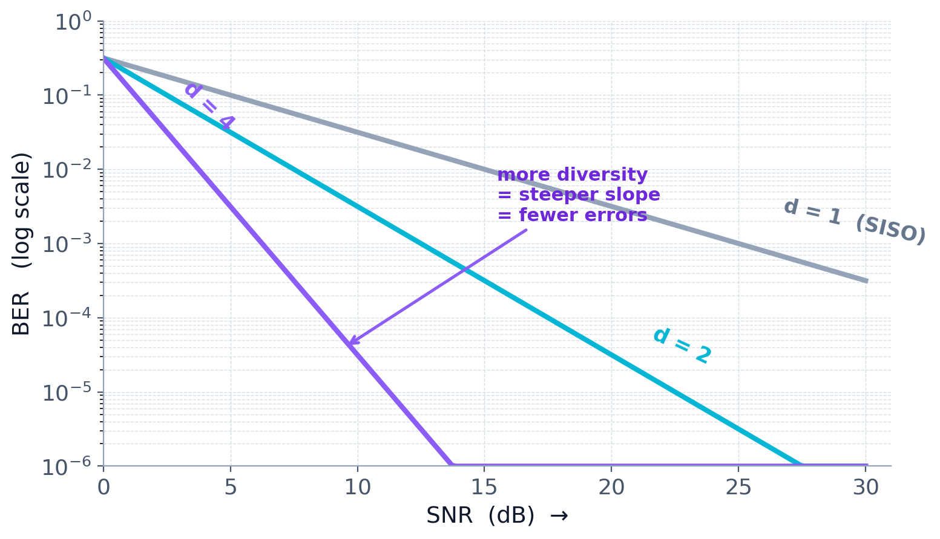
THE PROBLEM
Why fading hurts — and the slope that matters
Deep fades cause bursts of bit errors. How well a scheme fights them is captured by one number — the slope of its BER curve.
The headline number: diversity order
Plot BER vs SNR on a log scale and each scheme is a straight line. Its slope is the diversity order d.
No diversity (d = 1): BER ∝ 1/SNR.
Diversity d: BER ∝ 1/SNRᵈ — far steeper.
To cut errors 10×: SISO needs +10 dB of power; with d = 4, only +2.5 dB.
Goal: steeper slope (diversity) + shift the curve left (array gain).
Maximal Ratio Transmission · Adv. Communication with Quantum & AI
Maximal Ratio Transmission · Adv. Communication with Quantum & AI
6

Slide 7


THE BIG IDEA
Diversity: don't bet on one path
If one copy is in a deep fade, the chance that several independent copies are all faded at once is tiny. Combine them and you almost always have a good one.
Space
Time
Frequency
Multiple antennas, spaced apart
Re-send / code across time
Spread across sub-carriers
Today's focus is space diversity — many antennas. The driving question: once we have several copies, how should we combine them?
Maximal Ratio Transmission · Adv. Communication with Quantum & AI
Maximal Ratio Transmission · Adv. Communication with Quantum & AI
7

Slide 8
QUIZ 1 · DIVERSITY
ANSWER HIDDEN · VOTE FIRST
20s
Why does using several independent signal copies help against fading?
It makes each copy stronger
A
It's unlikely that all copies are in a deep fade at the same time
B
It removes noise completely
C
It increases the transmit bandwidth
D
Vote now — the answer is on the next slide.
Maximal Ratio Transmission · Adv. Communication with Quantum & AI
8

Slide 9

QUIZ 1 · DIVERSITY · ANSWER
ANSWER
Why does using several independent signal copies help against fading?
A
It makes each copy stronger
B
It's unlikely that all copies are in a deep fade at the same time
C
It removes noise completely
D
It increases the transmit bandwidth
Answer: B — Independent copies fade independently, so the chance they all collapse together is small — that's diversity.
Follow-up: Which kind of diversity (space / time / frequency) are we using when we add antennas?
Maximal Ratio Transmission · Adv. Communication with Quantum & AI
9

Slide 10

SECTION 2 OF 6
Receive Combining
MRC: merge the copies you already have, the best possible way
Maximal Ratio Transmission · Adv. Communication with Quantum & AI
9

Slide 11

BUILDING MRT
The antenna ladder: SISO → SIMO → MISO → MIMO
SISO
SIMO
Single Tx, single Rx — the baseline, no diversity.
One Tx, many Rx — diversity at the receiver.
MISO
MIMO
Many Tx, one Rx — diversity made at the transmitter.
Many Tx and Rx — the richest case, home of MRT.
Tx (towers) on the left, Rx (dishes) on the right. More links = more independent copies to exploit.
Maximal Ratio Transmission · Adv. Communication with Quantum & AI
Maximal Ratio Transmission · Adv. Communication with Quantum & AI
10

Slide 12

BUILDING MRT
At the receiver: several copies, one decision
With N_r receive antennas you hold several noisy copies of the same symbol. Merge them into one number to decide what was sent.
The combiner
y₁ = h₁·x + n₁
y₂ = h₂·x + n₂
combine
decision
Each hᵢ is the channel on that antenna — some strong, some weak. The combiner decides how much to trust each copy.
one clean number → 0 or 1
Maximal Ratio Transmission · Adv. Communication with Quantum & AI
Maximal Ratio Transmission · Adv. Communication with Quantum & AI
11

Slide 13


BUILDING MRT
Three ways to combine the copies
Selection
Equal-gain
Maximal-ratio
Pick the strongest copy; ignore the rest.
Add all copies with equal weight.
Weight each copy by its channel quality, then add.
Simple, but throws away information.
Better, but treats weak copies like strong ones.
Optimal — the best possible SNR. This is MRC.
Same hardware, three policies. Maximal-ratio combining wins — and it points us to MRT.
Maximal Ratio Transmission · Adv. Communication with Quantum & AI
Maximal Ratio Transmission · Adv. Communication with Quantum & AI
12

Slide 14
BUILDING MRT · EXAMPLE
Selection vs equal-gain: a worked example
Setup: two received copies, equal noise per branch. |h₁| = 1.0, |h₂| = 0.8 (phases differ). Branch SNR ∝ |h|² → branches worth 1.00 and 0.64.
Selection (SC)
Equal-gain (EGC)
KEEP THE STRONGEST BRANCH
CO-PHASE, THEN ADD
Use the branch with the largest |h|; drop the rest.
Rotate each copy to zero phase, add with equal weight.
z = y₁ (|h₁| > |h₂|)
z = exp(-jφ₁)·y₁ + exp(-jφ₂)·y₂
SNR ∝ max|hᵢ|² = 1.00
SNR ∝ (|h₁|+|h₂|)²/N = 1.62
branch 2's energy is thrown away.
uses both branches; N = 2, all weights = 1.
Combined SNR for this setup
SC
1.00
EGC ≈ MRC — within 0.05 dB here. Selection is ~2 dB worse because it discards branch 2.
EGC
1.62
MRC
1.64
Maximal Ratio Transmission · Adv. Communication with Quantum & AI
11a

Slide 15
BUILDING MRT
MRC in one sentence: weight by the conjugate channel
Maximal-ratio combining forms its decision variable by multiplying each received copy by the conjugate of its channel, then summing:
Each copy scaled by hᵢ*
h1
counts more
z = hᴴ y = Σᵢ hᵢ* · yᵢ
h2
counts less
h3
counts more
Strong, clean copies (large |hᵢ|) count more; weak ones count less — and the phase is corrected so copies add, never cancel. Nothing is thrown away.
h4
counts less
Result: the maximum possible SNR — provably the best linear combiner.
Maximal Ratio Transmission · Adv. Communication with Quantum & AI
Maximal Ratio Transmission · Adv. Communication with Quantum & AI
13

Slide 16
SECTION 3 OF 6
Transmit Beamforming
MRT: the mirror of MRC — pre-weight the antennas using CSIT
Maximal Ratio Transmission · Adv. Communication with Quantum & AI
16

Slide 17

BUILDING MRT
Now flip it: help from the transmitter
MRC lives at the receiver. If diversity is at the transmitter (many Tx, one Rx), the receiver can't combine copies it never separately sees.
Two ways to learn the channel
Feedback (FDD):
the receiver measures the channel and reports it back. Costs uplink bandwidth.
So the transmitter must pre-shape what it sends — and for that it must know the channel in advance.
Reciprocity (TDD):
up- and downlink share a frequency, so the channel measured one way is reused the other.
CSIT — Channel State Information at the Transmitter
The transmitter learns the channel (via feedback or reciprocity) so it can steer energy intelligently.
Maximal Ratio Transmission · Adv. Communication with Quantum & AI
Maximal Ratio Transmission · Adv. Communication with Quantum & AI
17

Slide 18
BUILDING MRT
MRC ↔ MRT: the same idea, mirrored
Receive diversity and transmit diversity are mirror images. The only real differences are where the combining happens and what must be known.
Receiver diversity — MRC | Transmit diversity — MRT
Receiver has many observations | Transmitter has many antennas
Combines copies AFTER the channel | Pre-combines BEFORE the channel
Needs CSIR (channel known at Rx) | Needs CSIT (channel known at Tx)
Weight each copy by hᵢ* | Pre-weight antenna i by hᵢ* / |h|
Same principle — weight by channel quality so copies add in phase — applied on opposite ends of the link.
Maximal Ratio Transmission · Adv. Communication with Quantum & AI
Maximal Ratio Transmission · Adv. Communication with Quantum & AI
18

Slide 19
BUILDING MRT · TRY IT
Hands-on: does matching really help?
Your turn (60 seconds)
Take a 2-antenna channel h = [0.8, 0.6j] (so |h| = 1).
Compare two transmit weightings and work out the received power |g|² for each:
g = h·w = h₁w₁ + h₂w₂
received power =|g|²
matched: w = h* / |h| = [0.8, -0.6j]
equal-gain: w = [1, 1] / √2
Which delivers more received power — and why?
Maximal Ratio Transmission · Adv. Communication with Quantum & AI
Maximal Ratio Transmission · Adv. Communication with Quantum & AI
14
Notes:
Let learners compute before revealing. This motivates the formal derivation in the appendix.

Slide 20
BUILDING MRT · TRY IT
Hands-on: does matching really help?
Your turn (60 seconds)
Reveal
matched: |g|² = 1.0
Take a 2-antenna channel h = [0.8, 0.6j] (so |h| = 1).
Compare two transmit weightings and work out the received power |g|² for each:
equal-gain: |g|² = 0.5
matched: w = h* / |h| = [0.8, -0.6j]
equal-gain: w = [1, 1] / √2
Matching doubles the received power (+3 dB) — by lining the phases up so the two paths add. And it's provably the most you can get.
Which delivers more received power — and why?
Maximal Ratio Transmission · Adv. Communication with Quantum & AI
Maximal Ratio Transmission · Adv. Communication with Quantum & AI
14
Notes:
Let learners compute before revealing. This motivates the formal derivation in the appendix.

Slide 21
BUILDING MRT
The payoff: SNRs add up
Combine the right way and the signal-to-noise ratios of the branches simply add together.
Combined SNR = SNR₁ + SNR₂ + … + SNR_Nr
More antennas, more SNR
Diversity order = N_r
No extra transmit power
Each branch adds its own SNR — the average link gets stronger (array gain).
With N_r antennas the BER curve gets N_r times steeper. Deep fades become rare.
The gain comes from smart combining, not from shouting louder.
Maximal Ratio Transmission · Adv. Communication with Quantum & AI
Maximal Ratio Transmission · Adv. Communication with Quantum & AI
15

Slide 22
BUILDING MRT
Maximal Ratio Transmission: the transmit-side twin
MRT is MRC done at the transmitter. Knowing the channel, the transmitter pre-weights each antenna so the copies arrive in phase and add up at the receiver.
Receiver MRC
Transmit MRT
Listen harder to the antennas that hear best.
Steer power toward the antennas that reach best.
Same rule, mirror image: weight by channel quality so energy concentrates where it counts. MRT needs CSIT; MRC does not.
Maximal Ratio Transmission · Adv. Communication with Quantum & AI
Maximal Ratio Transmission · Adv. Communication with Quantum & AI
19

Slide 23
BUILDING MRT
When does ideal MRT actually work?
MRT isn't magic. The clean results that follow rest on five assumptions — keep them in view:
Assumption | What it means
Perfect CSI / CSIT | Transmitter knows the channel accurately
Same total transmit power | Gain comes from beamforming, not extra power
Independent fading branches | Antennas / channels are not highly correlated
Coherent receiver | Receiver can track and correct phase
Narrowband / flat fading | A single matrix H represents the link
Break any one of these and real MRT degrades — we'll see exactly how in Section 5.
Maximal Ratio Transmission · Adv. Communication with Quantum & AI
Maximal Ratio Transmission · Adv. Communication with Quantum & AI
20

Slide 24

BUILDING MRT
Choosing the weights: just match the channel
The beamformer w and combiner v always follow one rule — conjugate the phase, weight by strength, normalize:
Scheme | Channel | Optimal weight — how it's chosen | Best SNR
MRC · receive (1 Tx · Nr Rx) | h (Nr×1) | combiner output z = Σ hᵢ* · yᵢ | Σ |hᵢ|²
MRT · transmit (Nt Tx · 1 Rx) | h (Nt×1) | beamformer w = h* / |h| | Σ |hᵢ|²
MIMO · eigen-BF (Nt Tx · Nr Rx) | H (Nr×Nt) | w = v₁ (dominant right singular vector) v = u₁ (dominant left singular vector) | λ_max(HᴴH)
Bottom line: with ideal CSI and beamforming, the diversity order can reach (up to) Nt × Nr. The full proof is in the appendix.
h* = conjugate (flips phase) · |h| = channel length · v₁, u₁ = dominant singular vectors of H
Maximal Ratio Transmission · Adv. Communication with Quantum & AI
Maximal Ratio Transmission · Adv. Communication with Quantum & AI
21

Slide 25
SECTION 4 OF 6
MIMO Eigen-Beamforming
Send along the channel's strongest mode — the dominant singular vector
Maximal Ratio Transmission · Adv. Communication with Quantum & AI
22

Slide 26
MIMO EIGEN-BF
The derivation in three layers
What's happening
y = H w s + e
1
received signal = channel × beamformed symbol + noise
What we want
maximize SNR(w, v)
2
the beam direction that maximizes the received SNR
The answer (via SVD)
ρ·σ₁² = ρ·λ_max(HᴴH)
3
H = U Σ Vᴴ → w = v₁, v = u₁, SNRₘₐₓ = ρ · σ₁²
Maximal Ratio Transmission · Adv. Communication with Quantum & AI
Maximal Ratio Transmission · Adv. Communication with Quantum & AI
23

Slide 27
Model, combining and the SNR
Send symbol s along beamformer w (||w||² ≤ γ²); receive with column combiner v. Noise e ~ CN(0, σ²I).
y = H w s + e
z = vᴴ y = vᴴH w s + vᴴe
received vector (Nr × 1)
v is an Nr × 1 column vector
Effective channel h = vᴴH. Signal power |hw|²·Es; noise power σ²·vᴴv. Hence:
SNR = |vᴴ H w|² · Es / ( σ² · vᴴv )
Maximal Ratio Transmission · Adv. Communication with Quantum & AI
Maximal Ratio Transmission · Adv. Communication with Quantum & AI
47

Slide 28
Optimal beamformer, then a quotient in v
Fix v and maximize |hw|² over ||w||² ≤ γ². Cauchy–Schwarz gives equality when w aligns with hᴴ:
|h w|² ≤ ||h||²·||w||² ≤ γ²||h||²
w_opt = γ · hᴴ / ||h||
Substitute back and write ρ = γ²Es/σ². Using ||h||² = ||vᴴH||² = vᴴHHᴴv:
SNR = ρ · ( vᴴ H Hᴴ v ) / ( vᴴ v )
a generalized Rayleigh quotient in v — maximized by the dominant eigenvector of H Hᴴ
Maximal Ratio Transmission · Adv. Communication with Quantum & AI
Maximal Ratio Transmission · Adv. Communication with Quantum & AI
48

Slide 29
Eigen-decomposition, maximize, result
Diagonalize H Hᴴ = U Λ Uᴴ (λ₁ ≥ λ₂ ≥ …). The Rayleigh quotient is a weighted average of eigenvalues, so:
( vᴴ H Hᴴ v ) / ( vᴴ v ) ≤ λ_max, attained at v = u₁
Back-substituting (with SVD H = U Σ Vᴴ) gives the clean MRT solution:
w_opt = γ · v₁
v_opt = u₁
SNR = ρ · σ₁²
MISO corollary (Nr = 1): w_opt = γ Hᴴ/||H||, SNR = ρ·||H||² = ρ·Σ|hᵢ|². Also σ₁² = λ_max(HᴴH).
Maximal Ratio Transmission · Adv. Communication with Quantum & AI
Maximal Ratio Transmission · Adv. Communication with Quantum & AI
49

Slide 30
APPENDIX · WORKED EXAMPLE
A 2×2 eigen-beamforming example, end to end
The full SVD H = U Σ Vᴴ. (Real entries keep the arithmetic clean — the method is identical for complex H.)
1 · CHANNEL H
2 · EIGENVALUES OF HᴴH → SINGULAR VALUES
[ 1.0 0.5 ]
[ 0.5 1.0 ]
λ(HᴴH) = 2.25, 0.25 → σ = √λ = 1.5, 0.5
σ₁ = 1.5 (strong mode) σ₂ = 0.5 (weak mode)
3 · SINGULAR VALUE DECOMPOSITION H = U Σ Vᴴ
U — left singular vectors
Σ — singular values
V — right singular vectors
[ 0.71 0.71 ]
[ 0.71 -0.71 ]
[ 1.5 0 ]
[ 0 0.5 ]
[ 0.71 0.71 ]
[ 0.71 -0.71 ]
u₁ = first column
σ₁ on top → use it
v₁ = first column
4 · Solution: w = γ·v₁ = γ[0.71, 0.71] , v = u₁ = [0.71, 0.71] , SNR = ρ·σ₁² = 2.25 ρ = λ_max(HᴴH)·ρ.
H is symmetric here, so U = V. Putting all power into the strong mode beats the weak one (σ₂² = 0.25) by 9× ≈ 9.5 dB. Diversity order = nt × nr = 4.
Maximal Ratio Transmission · Adv. Communication with Quantum & AI
49a

Slide 31
MIMO EIGEN-BF
Eigen-beamforming, by analogy
A MIMO channel has several hidden “lanes” (modes). Eigen-beamforming pours all the energy into the single strongest lane.
Channel modes (eigenvalues)
Put all the power here →
mode 1 (λ_max)
Like pushing a swing at its natural rhythm — match the channel's strongest mode and the response is huge for the same effort.
mode 2
mode 3
Strongest mode ↔ λ_max(HᴴH). That one number sets the best SNR you can reach.
Send everything along mode 1; ignore the weak lanes. That is MRT for MIMO.
Maximal Ratio Transmission · Adv. Communication with Quantum & AI
Maximal Ratio Transmission · Adv. Communication with Quantum & AI
24

Slide 32
QUIZ 2 · MRC VS MRT
ANSWER HIDDEN · VOTE FIRST
20s
Which statement is true about MRT (Maximal Ratio Transmission)?
It works without any channel knowledge at the transmitter
A
It needs CSIT, and weights transmit antennas by channel quality
B
It only reduces noise, never improves diversity
C
It always needs more transmit power than SISO
D
Vote now — the answer is on the next slide.
Maximal Ratio Transmission · Adv. Communication with Quantum & AI
25

Slide 33
QUIZ 2 · MRC VS MRT · ANSWER
ANSWER
Which statement is true about MRT (Maximal Ratio Transmission)?
A
It works without any channel knowledge at the transmitter
B
It needs CSIT, and weights transmit antennas by channel quality
C
It only reduces noise, never improves diversity
D
It always needs more transmit power than SISO
Answer: B — MRT is the transmit-side twin of MRC: it needs CSIT and pre-weights antennas (w = h*/|h|) so copies add in phase — no extra power.
Follow-up: What breaks if the transmitter does NOT know the channel? (This is exactly why CSIT matters.)
Maximal Ratio Transmission · Adv. Communication with Quantum & AI
26

Slide 34

SECTION 5 OF 6
Design & Practice
Put numbers on it: a 2×2 link, the BER curve, 5G, and live code
Maximal Ratio Transmission · Adv. Communication with Quantum & AI
26

Slide 35
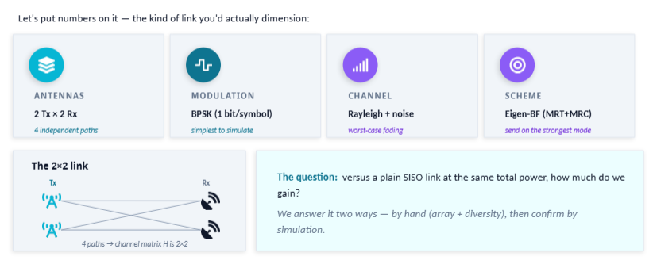
MAKE IT REAL
A concrete design: a 2×2 link
Let's put numbers on it — the kind of link you'd actually dimension:
ANTENNAS
MODULATION
CHANNEL
SCHEME
2 Tx × 2 Rx
BPSK (1 bit/symbol)
Rayleigh fading + noise
Eigen-BF (MRT+MRC)
The question: versus a plain SISO link at the same total power, how much do we gain? We'll answer by hand, then by simulation.
Maximal Ratio Transmission · Adv. Communication with Quantum & AI
Maximal Ratio Transmission · Adv. Communication with Quantum & AI
27

Slide 36
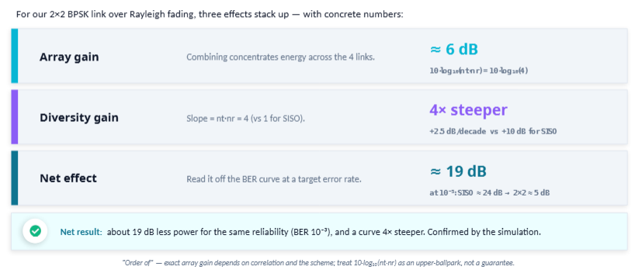
MAKE IT REAL
Worked example: where the gain comes from
Array gain
Combining concentrates energy across the links.
order of 10·log₁₀(nt·nr) dB → a few dB for 2×2
Diversity gain
Curve slope steepens from 1 toward nt·nr = 4.
at BER 10⁻³, tens of dB vs SISO
Net effect
Same power, dramatically fewer errors.
reach a target BER at far lower SNR
“Order of” — exact array gain depends on correlation and the scheme; treat 10·log₁₀(nt·nr) as an upper-ballpark, not a guarantee.
Maximal Ratio Transmission · Adv. Communication with Quantum & AI
Maximal Ratio Transmission · Adv. Communication with Quantum & AI
28

Slide 37

MAKE IT REAL
How to read a BER curve
Bit Error Rate vs SNR is the universal scorecard. Two features tell you almost everything:
The slope
The shift
How steep the line falls.
How far left the line sits.
= diversity order. Steeper means fades vanish faster as SNR grows.
= array / coding gain. Further left means the same reliability at lower power.
Lower-and-to-the-left is the goal. Next we generate exactly this plot from a few lines of Python.
Maximal Ratio Transmission · Adv. Communication with Quantum & AI
Maximal Ratio Transmission · Adv. Communication with Quantum & AI
29

Slide 38

MAKE IT REAL · 5G
Why 5G can't live without beamforming
5G uses millimetre-wave bands for huge bandwidth — but those waves lose energy fast and are easily blocked.
From one antenna to an array
SISO: energy sprayed everywhere
The fix is MRT scaled up: pack dozens of tiny antennas into an array and steer a tight beam at the user, concentrating energy where it's needed.
Array: a tight steered beam
Beamforming turns path loss from a dealbreaker into a manageable cost — it's what makes mmWave 5G viable.
same power, far more reach
Maximal Ratio Transmission · Adv. Communication with Quantum & AI
Maximal Ratio Transmission · Adv. Communication with Quantum & AI
30

Slide 39
MAKE IT REAL · 5G
How 5G actually picks the beam
In real 5G NR, MRT-style precoding appears in two flavours — the same CSIT trade-off as before:
Codebook-based
Reciprocity-based
FDD / mmWave
TDD / massive MIMO
Pick the best beam from a fixed menu (a codebook).
Receiver reports the best index + quality.
Low feedback, coarse — robust & standardized.
Estimate the channel from uplink pilots; reuse downlink.
Compute a tailored precoder — close to ideal MRT.
Sharper beams, but needs calibration & reciprocity.
Maximal Ratio Transmission · Adv. Communication with Quantum & AI
Maximal Ratio Transmission · Adv. Communication with Quantum & AI
31

Slide 40
MAKE IT REAL · REALITY CHECK
When ideal MRT becomes difficult
Each assumption from Section 3, broken in practice — this is exactly what motivates AI-native beamforming:
Practical issue | Effect on MRT
Feedback delay | Beam points to an old channel
CSI quantization | Beam is only approximately matched
Mobility | Channel changes faster than it can be tracked
Antenna correlation | Effective diversity order drops
Multi-user interference | Helping one user can hurt another
Hardware calibration error | TDD reciprocity becomes imperfect
The harder real life gets, the more appealing it is to learn the beam from data → Section 6.
Maximal Ratio Transmission · Adv. Communication with Quantum & AI
Maximal Ratio Transmission · Adv. Communication with Quantum & AI
32

Slide 41
MAKE IT REAL · LIVE CODE
The simulation, in plain pseudocode
Full Python (numpy/matplotlib) is in the appendix. The logic fits in a few lines:
set seed = 7 # reproducible
N = 300000 bits # per SNR point
for each Eb/N0 in sweep:
bits -> BPSK symbols s (+/-1)
h <- Rayleigh channel cn()
apply one of:
SISO | MRC | MRT | eigen-BF
(same total power in each)
decide bit = ( Re{z} > 0 )
BER = mean( decided != bits )
plot BER vs Eb/N0 (log scale)
The 5 things that make it honest
Fixed random seed
results reproduce exactly
cn() = CN(0,1)
unit-power complex Gaussian
Same total power
fair SISO-vs-MIMO comparison
Matched weights
conjugate channel (h* / SVD)
Decision rule
sign of the real part
Maximal Ratio Transmission · Adv. Communication with Quantum & AI
Maximal Ratio Transmission · Adv. Communication with Quantum & AI
33

Slide 42
CODE
Full Python listing
ber_demo.py
import numpy as np
rng = np.random.default_rng(7) # fixed seed
EbN0_dB = np.arange(0, 31, 2); N = 300_000
def cn(*s): # CN(0,1) channel
return (rng.standard_normal(s) + 1j*rng.standard_normal(s)) / np.sqrt(2)
def ber(scheme):
out = []
for snr in EbN0_dB:
n0 = 1/10**(snr/10)
bits = rng.integers(0, 2, N); s = 2*bits - 1 # BPSK +/-1
if scheme == 'SISO': # 1x1, no diversity
h = cn(N); z = np.conj(h)*(h*s + np.sqrt(n0)*cn(N))
elif scheme == 'MRC': # 1x2 receive diversity
h = cn(2, N); z = np.sum(np.conj(h)*(h*s + np.sqrt(n0)*cn(2, N)), 0)
elif scheme == 'MRT': # 2x1 transmit diversity
g = cn(2, N); w = np.conj(g)/np.linalg.norm(g, 0); he = np.sum(g*w, 0)
z = np.conj(he)*(he*s + np.sqrt(n0)*cn(N))
else: # 2x2 eigen-beamforming
s1 = np.linalg.svd(cn(N, 2, 2), compute_uv=False)[:, 0]
z = np.conj(s1)*(s1*s + np.sqrt(n0)*cn(N))
out.append(np.mean((z.real > 0) != bits)) # decide: Re{z} > 0
return out
Maximal Ratio Transmission · Adv. Communication with Quantum & AI
50

Slide 43
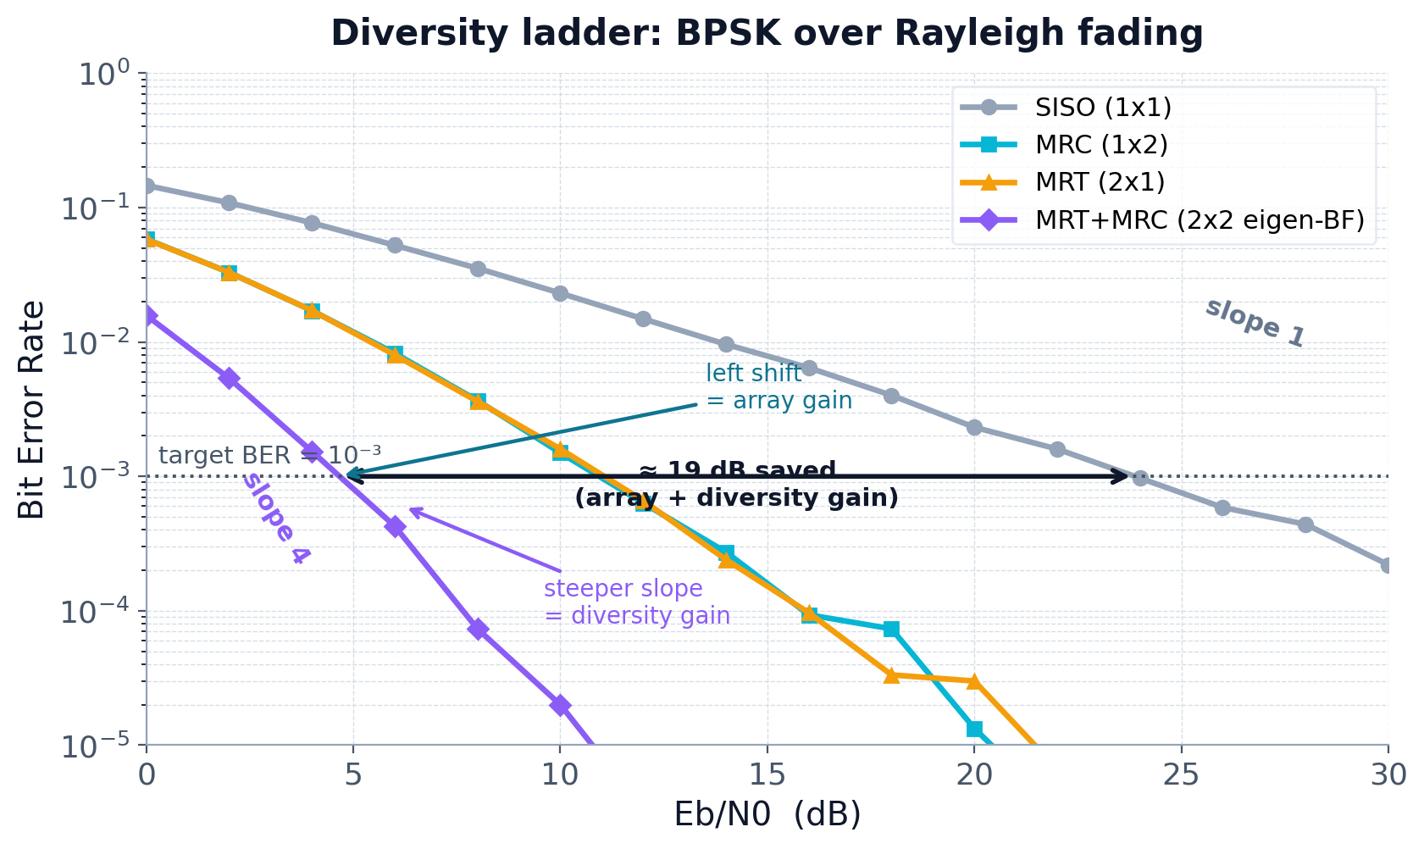
MAKE IT REAL · LIVE CODE
The result: the ladder, annotated
Reading it
SISO — slope 1, no diversity.
MRC (1×2) & MRT (2×1) overlap — same diversity (2). Rx or Tx, the physics is symmetric.
2×2 eigen-BF — slope 4 = nt×nr.
Left shift = array gain; steeper slope = diversity gain. ~19 dB saved at 10⁻³.
Maximal Ratio Transmission · Adv. Communication with Quantum & AI
Maximal Ratio Transmission · Adv. Communication with Quantum & AI
34

Slide 44
QUIZ 3 · READ THE CURVE
ANSWER HIDDEN · VOTE FIRST
20s
Two schemes are parallel on a BER-vs-SNR plot, but one sits to the left. What differs?
Their diversity order
A
Their array/coding gain (same diversity, one needs less SNR)
B
Their modulation type
C
Nothing — parallel curves are identical
D
Vote now — the answer is on the next slide.
Maximal Ratio Transmission · Adv. Communication with Quantum & AI
35

Slide 45
QUIZ 3 · READ THE CURVE · ANSWER
ANSWER
Two schemes are parallel on a BER-vs-SNR plot, but one sits to the left. What differs?
A
Their diversity order
B
Their array/coding gain (same diversity, one needs less SNR)
C
Their modulation type
D
Nothing — parallel curves are identical
Answer: B — Parallel = same slope = same diversity. A left-shift means more array/coding gain: same reliability at lower SNR.
Follow-up: If instead one curve were steeper, which gain would that signal?
Maximal Ratio Transmission · Adv. Communication with Quantum & AI
36

