Slide 1
PROBLEM SESSION · 90 MIN
Ninety minutes, three gears
Part A · Math (35′)
Parts B · C · D (50′)
Ground rules
▸ A1 Alamouti by hand — build, verify, decode, SNR
▸ A2 prove the slope is 2 — convolve, integrate, substitute
▸ A3 ρ(p) drill · A4 QOSTBC: see the break, then pair up
▸ A5 the equal-throughput identity, proved
▸ B1–B3 design (25′) — telemetry, 3 b/s/Hz, mobility
▸ C1–C3 brainstorm (15′) — break it, build it, rotate it
▸ D1–D2 traps (10′) — flaw hunt, predict-then-check
▸ simulation reveals after B1 and D2 — curves close each arc
Warm-up first (5′). Ninety minutes buys depth: estimate before you compute, defend every dB, run the code only AFTER the prediction — and say each assumption out loud before you use it.

Slide 2
WARM-UP · 5 MINUTES
Six answers, sixty seconds each
Q1 · True / False
Q2 · Compute
Q3 · Compute
Alamouti improves the AVERAGE SNR over SISO
ρ(7) = ?
diversity order of 2×2 Alamouti?
Q4 · Yes / No
Q5 · Recall
Q6 · Standards
does an OSTBC need CSIT?
max rate of a square complex design, 4 Tx?
who runs Alamouti across subcarriers?

Slide 3
WARM-UP · ANSWERS
Check yourself
A1 · FALSE
A2 · ρ(7) = 1
A3 · Four
E[γ] = P/σ² either way — diversity shrinks the variance
odd p ⇒ c = d = 0 ⇒ 8·0 + 2⁰
Nₜ × Nᵣ = 2 × 2
A4 · No
A5 · 3/4
A6 · LTE
open loop is the whole point
rate 1 stops at Nₜ = 2 (Alamouti)
SFBC — the two 'slots' are subcarriers

Slide 4
PROBLEM A1 · MATH
Alamouti by hand, start to finish
Scenario: a 2×1 Alamouti downlink: QPSK, Rayleigh fading, total power P, noise σ². Work every stage with real numbers — no simulator allowed.
Given: h₁ = 2 − j , h₂ = 1 + j ; s₁ = (1+j)/√2 , s₂ = (1−j)/√2 ; P/σ² = 10 dB
Tasks
1
Write the 2-slot transmission table and the stacked model r = ℋs + n.
2
Compute ℋᴴℋ and verify it is a scaled identity — what is the scale?
3
Form ŝ = ℋᴴy and show each symbol appears interference-free.
4
Compute the post-combining SNR in dB, and state the diversity order.

Slide 5
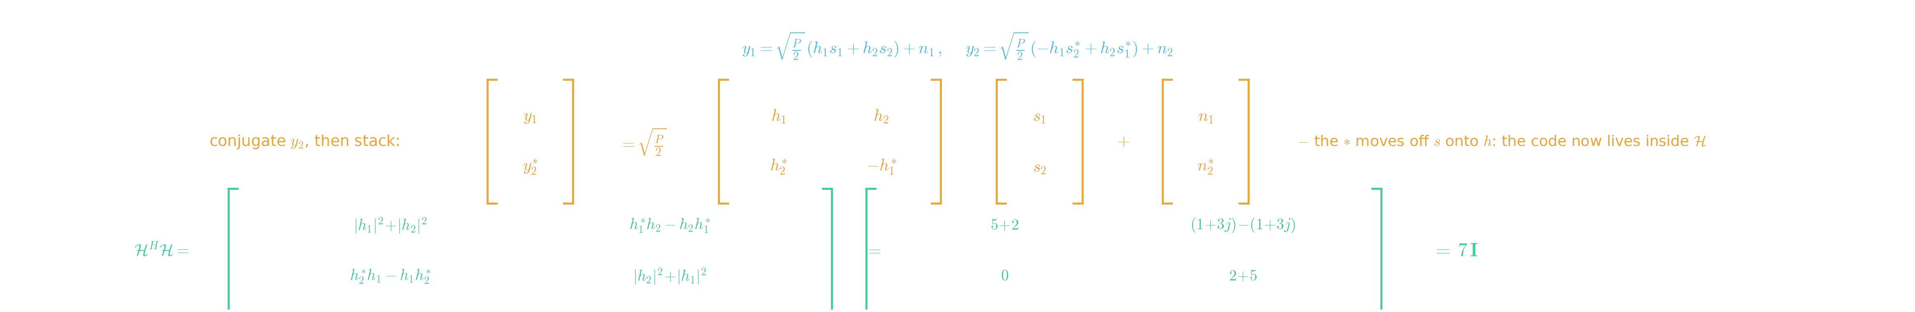
SOLUTION A1 · PART 1
Build the machine, verify the identity
Steps 1–2 — how the code's orthogonality moves into ℋ
▸ Slot 1 sends (s₁, s₂); slot 2 sends (−s₂*, s₁*), each antenna at power P/2 — the receiver hears the two mixtures y₁, y₂ below.
▸ The trick: conjugate y₂ BEFORE stacking. The * jumps off the symbols onto the channels — the code's orthogonal pattern is absorbed into ℋ = [h₁ h₂; h₂* −h₁*].
▸ Multiply with the numbers: |h₁|² = 5, |h₂|² = 2, and h₁*h₂ = (2+j)(1+j) = 1+3j = h₂h₁* — the cross terms cancel identically: ℋᴴℋ = 7I.
Bottom line: orthogonality verified with numbers, not faith: ℋᴴℋ = 7I. The machine is interference-free before any noise enters — whatever the constellation.

Slide 6


SOLUTION A1 · PART 2
Decode and read off the SNR
Steps 3–4 — signal gains 7², noise gains 7: SNR keeps one 7
▸ Decode = apply ℋᴴ. The signal is multiplied by ℋᴴℋ = 7I — each symbol arrives alone with amplitude ×7, hence signal power ×49.
▸ The noise passes through the SAME filter: cov(ñ) = σ²ℋᴴℋ = 7σ²I — noise power grows by 7 only. The ratio keeps exactly one factor of 7.
▸ γ = (P/2σ²)·7 = 3.5·(P/σ²) → 35 → 15.4 dB at the given budget. The 7 = |h₁|²+|h₂|² holds TWO independent fades: diversity 2 (×Nᵣ).
Bottom line: post-combining SNR = (P/2σ²)(|h₁|²+|h₂|²) = 15.4 dB here. Slope-2 protection: an outage now needs |h₁|² AND |h₂|² to fade together.

Slide 7
PROBLEM A2 · MATH
Prove the slope is 2 — no simulator
Scenario: show analytically that Alamouti 2×1 error probability falls as SNR⁻² at high SNR. The plot's slope must come out of an integral, not a simulation.
Given: γ = (P/2σ²)·X, X = |h₁|²+|h₂|², hᵢ ~ i.i.d. 𝒞𝒩(0,1); outage proxy: Pe ≈ P(γ < γ₀)
Tasks
1
What distribution does X follow? Write its pdf and its behaviour near x = 0.
2
Show P(X < x) ≈ x²/2 for small x.
3
Conclude Pe ∝ SNR⁻² — identify the diversity order in the exponent.
4
Generalize: why does an Nₜ-antenna OSTBC give slope Nₜ?

Slide 8
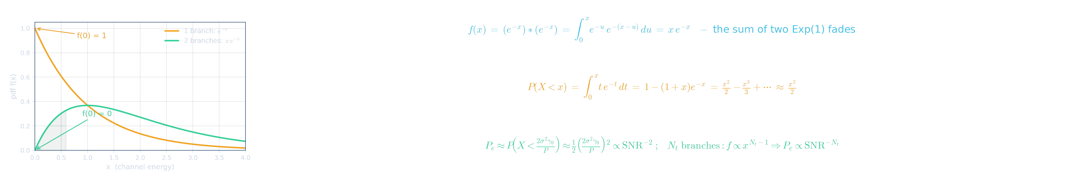
SOLUTION A2
Diversity = how fast fades become rare
The three-line proof — convolve, integrate, substitute
▸ Each |hᵢ|² is Exp(1); the sum's pdf is their convolution (below): f(x) = x·e⁻ˣ, which VANISHES at x = 0 — while one branch keeps f(0) = 1 (see plot).
▸ Integrate: P(X < x) = 1 − (1+x)e⁻ˣ, whose Taylor series STARTS at x²/2 — deep-fade probability is quadratically small, because the pdf gave it nothing at 0.
▸ Substitute the outage threshold X < 2σ²γ₀/P: the x²/2 becomes ∝ SNR⁻². With Nₜ branches f ∝ x^(Nₜ−1) ⇒ Pe ∝ SNR^(−Nₜ): the slope IS the branch count.
Bottom line: diversity order = the power of x at which the fade pdf vanishes at zero = the number of independent |hᵢ|² summands. The sum of squares IS the slope.

Slide 9
PROBLEM A3 · MATH
The ρ(p) drill
Scenario: the Hurwitz–Radon recipe: write p = 2^(4c+d)·(odd) with 0 ≤ d ≤ 3, then ρ(p) = 8c + 2ᵈ. A rate-1 real design with n antennas in p slots exists iff n ≤ ρ(p).
Given: targets: ρ(12), ρ(24), ρ(48), ρ(56); then the minimum p for rate-1 real designs at Nₜ = 5, 6, 7
Tasks
1
Factor each p and read off (c, d).
2
Compute the four ρ values.
3
For Nₜ = 5, 6, 7 find the smallest p with ρ(p) ≥ Nₜ.
4
What do the answers say about the price of odd antenna counts?

Slide 10
SOLUTION A3
ρ only cares about powers of two
Worked answers
▸ 12 = 2²·3 → (c,d) = (0,2) → ρ = 4. 24 = 2³·3 → (0,3) → ρ = 8.
▸ 48 = 2⁴·3 → (1,0) → ρ = 8+1 = 9. 56 = 2³·7 → (0,3) → ρ = 8. The odd factor is thrown away every time.
▸ ρ(5) = ρ(7) = 1 and ρ(6) = 2 — all too small. The first p with ρ(p) ≥ 5, 6, or 7 is p = 8 (ρ(8) = 8): all three land on the SAME block length.
Bottom line: ρ jumps only at powers of two: once you pay 8 slots for the 5th antenna, antennas 6, 7, 8 ride free. Odd p (ρ = 1) is nearly useless — delay comes quantized.

Slide 11
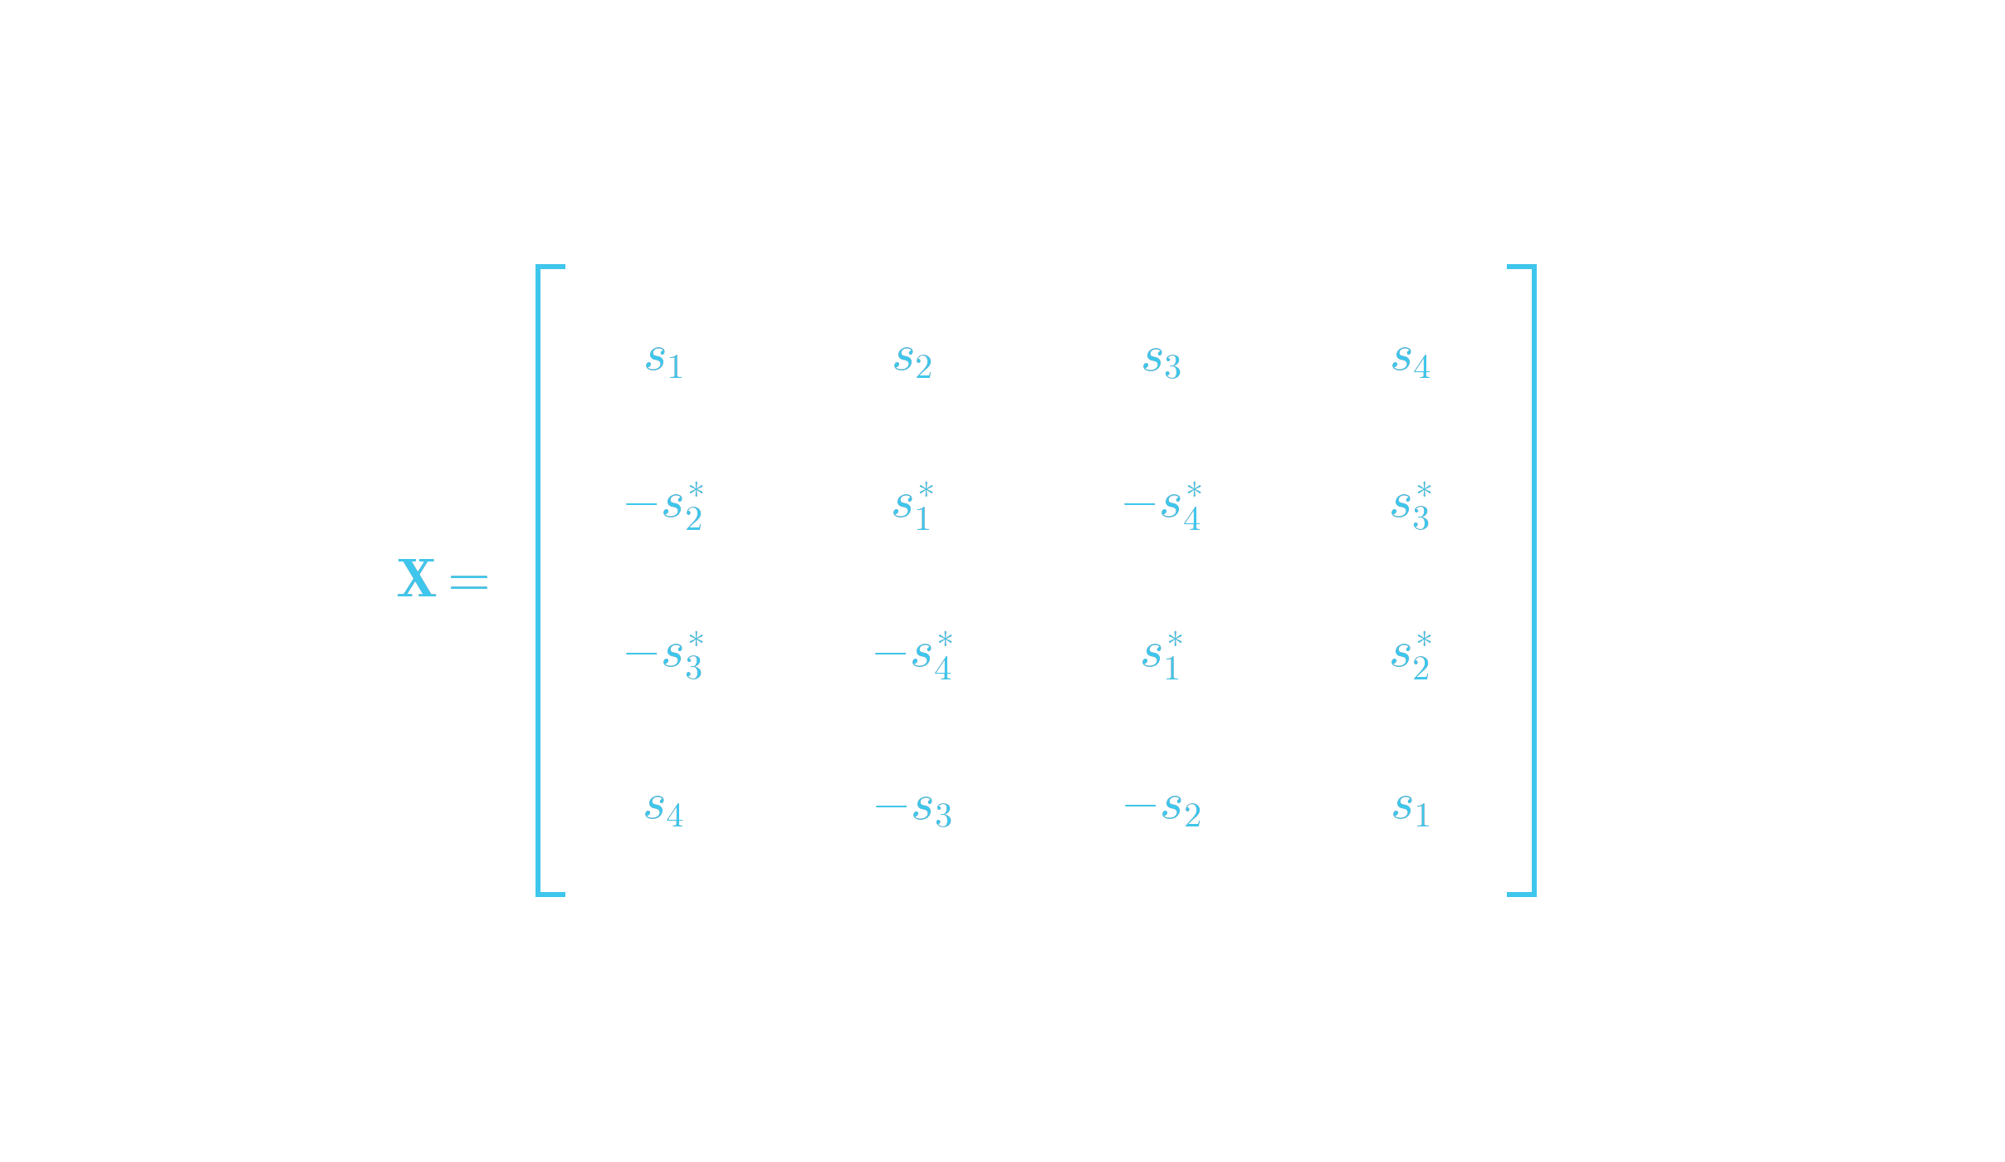

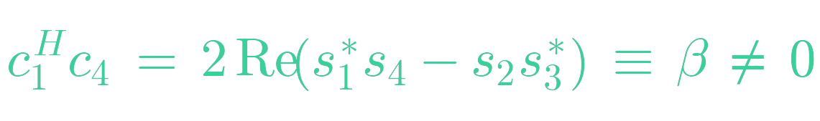
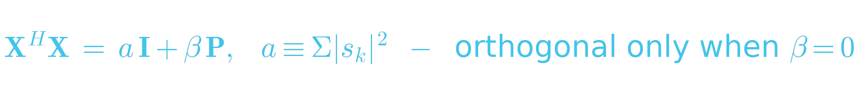
QOSTBC · NON-ORTHOGONALITY
QOSTBC: the code matrix is not orthogonal
The ABBA code matrix: rows = time slots, columns = antennas
Multiply it out: XᴴX
Antenna pairs 1·4 and 2·3 collide
Eight entries cancel exactly as in Alamouti; the (1,4) and (2,3) pairs survive — X is one real number short of orthogonal.
The consequence
β rides into decoding
Almost orthogonal
The collision
Why it's still usable
8 of 12 cross terms vanish — each Alamouti block protects its own pair
streams 1 & 4 and 2 & 3 overlap by β = 2Re(s₁*s₄ − s₂s₃*)
the damage is ONE bounded real number — pairwise ML absorbs it

Slide 12
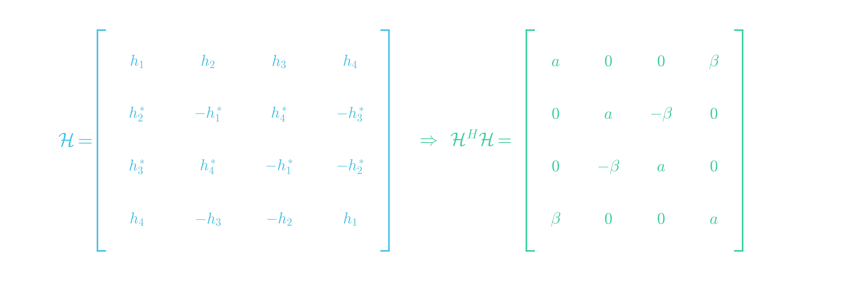
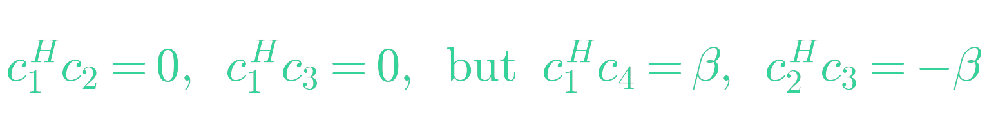
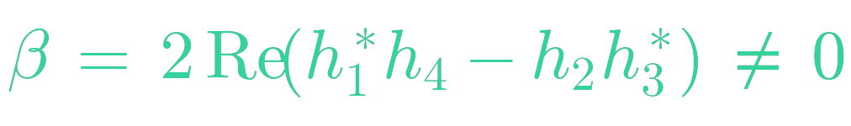
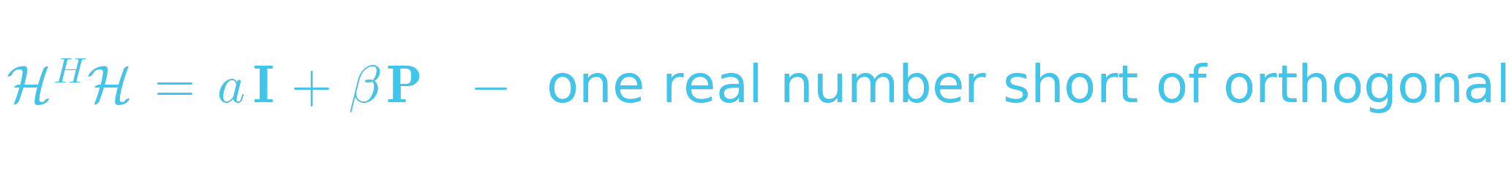
A4 · SEE THE BREAK
QOSTBC: multiply it out
Same recipe as Alamouti: y = ℋs + n, then form ℋᴴℋ
Eight zeros, four β's
Columns 1·2, 1·3, 2·4, 3·4 cancel exactly as in Alamouti — but pairs 1·4 and 2·3 refuse. The product is NOT a scaled identity: QOSTBC lands one real number short of orthogonal.
The one number that survives
In matrix shorthand
P couples (1,4) and (2,3)
Almost
Two couples
One number
8 of 12 cross terms vanish — Alamouti's cancellation nearly survives the 4-Tx stretch
only (s₁,s₄) and (s₂,s₃) talk; every other pair stays silent
all the interference is a single real β — bounded by ‖h‖², often near zero

Slide 13
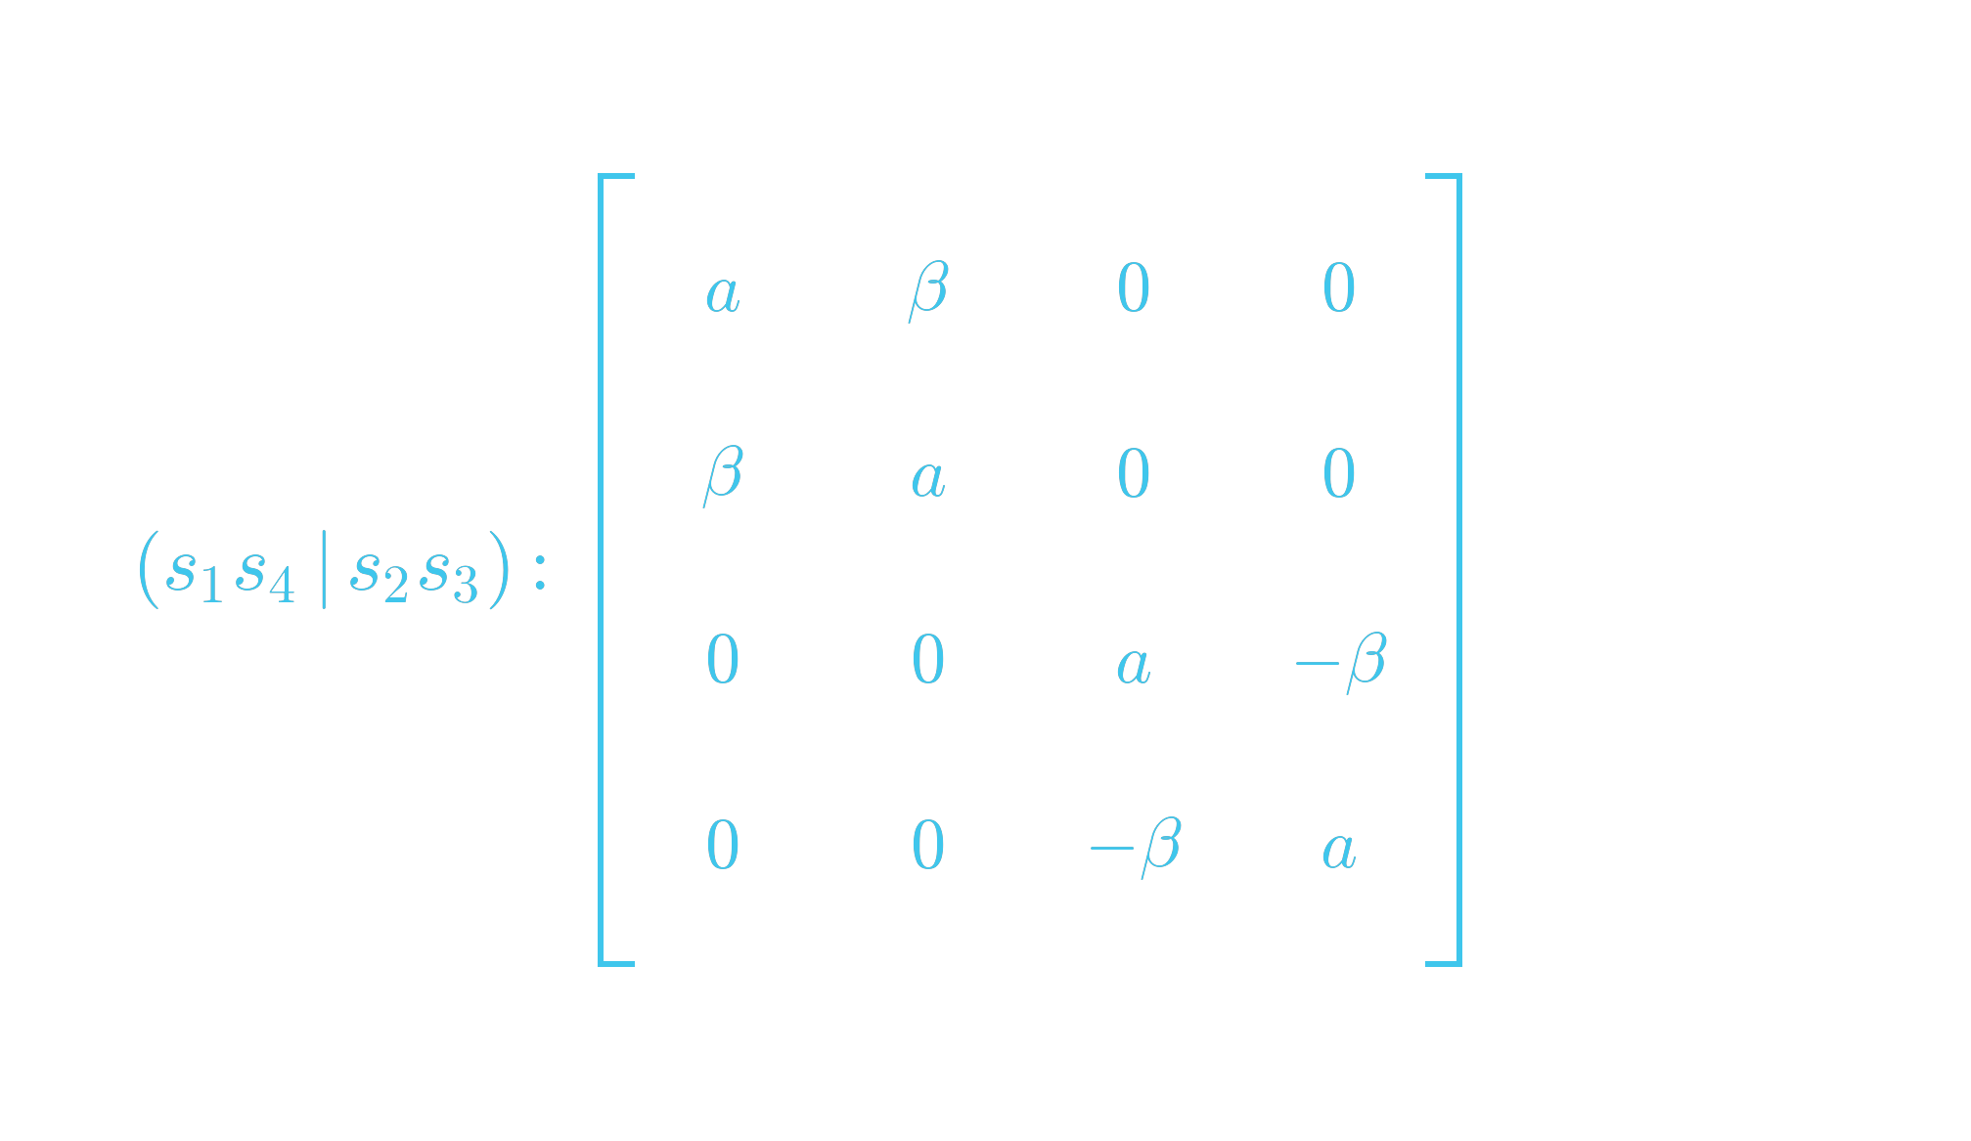

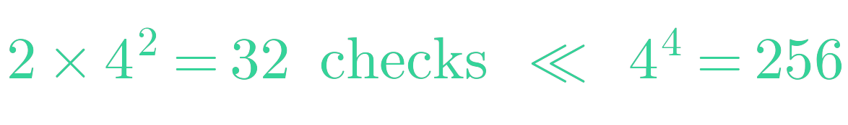
A4 · PAIRWISE DECODING
Divide and conquer the β
Reorder the symbols: (s₁, s₄ | s₂, s₃) — the matrix goes block-diagonal
Each pair is its own tiny channel
The two blocks share no symbols and no noise — solving each 2×2 pair alone IS exact ML. Nothing is approximated: the structure simply splits one big puzzle into two small ones.
The price, counted
The last hole, and the fix
Δ = candidate-pair difference
Cheap
Exact
Rotated
two 16-hypothesis searches per block — 32 checks instead of 4⁴ = 256 joint
block-diagonal means pairwise ML = full ML — zero information thrown away
Δ₄ = −Δ₁ costs a factor (a−β) — π/4 rotation deletes it: slope 4

Slide 14
PROBLEM B1 · DESIGN
Six antennas, BPSK only, rate 1
Scenario: a satellite telemetry modem transmits BPSK only (legacy hardware). The array has 6 elements. The link must run at rate 1 with maximum diversity at BER 10⁻⁴ — and there is no feedback channel.
Given: HR recipe ρ(p) = 8c + 2ᵈ for p = 2^(4c+d)·odd — here ρ(6) = 2, ρ(7) = 1, ρ(8) = 8. Simulated rate-1 ladder @ BER 10⁻⁴ (from the results slide): 2 Tx 19.3 · 3 Tx 15.1 · 4 Tx 13.1 dB
Tasks
1
Why do complex OSTBCs not even enter the shortlist for BPSK?
2
From the HR recipe, find the minimum block length p — then construct the code.
3
State rate, delay, diversity — then write the high-SNR law Pe ≈ K·(snr/Nₜ)^(−Nₜ).
4
Solve it for snr_req[dB] = 10log₁₀Nₜ + 40/Nₜ + c, fit c on the ladder, predict 6 Tx.

Slide 15

SOLUTION B1
An 8×6 code out of the master design
Design walkthrough — an extrapolation you can defend
▸ BPSK is real — real designs give rate 1 at ANY Nₜ; complex machinery buys nothing. ρ(6) = 2 and ρ(7) = 1 fail: the smallest p with ρ(p) ≥ 6 is p = 8.
▸ Construction: take the 8×8 real design and DELETE two columns → an 8×6 code. Rate = 8 symbols / 8 slots = 1; delay 8 slots; diversity 6Nᵣ; power P/6 per antenna.
▸ Extrapolate with a MODEL, not a guess: required SNR = power-split term (10log₁₀Nₜ, grows) + fade-margin term (≈40/Nₜ at BER 10⁻⁴, shrinks) + constant — calibrated and machine-checked below: 6 Tx ≈ 11.5 dB.
Bottom line: 8×6 column-deleted real OSTBC: rate 1, diversity 6, ≈ 11.5 dB at BER 10⁻⁴ (simulated). The delay for antennas 5–8 was paid once, at p = 8 — the 6th antenna itself rode free.

Slide 16
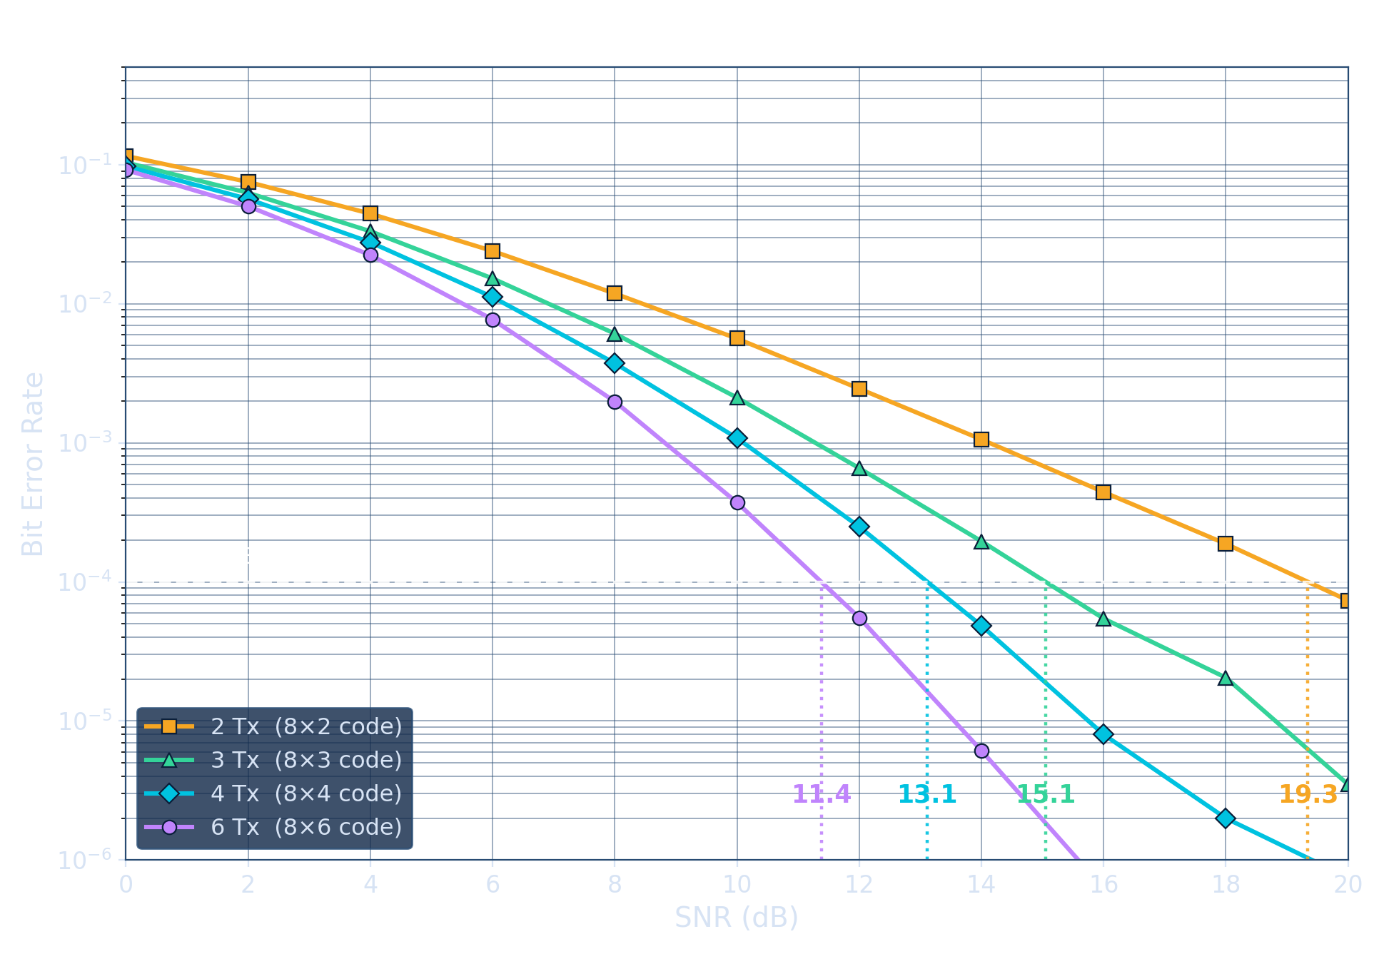
B1 · SIMULATION · RESULTS
Required SNR, read off the plot
Reading the curves
One code, four ladders
the 8×8 master design; Nₜ = 2, 3, 4, 6 by deleting columns
Required SNR @ 10⁻⁴
19.3 → 15.1 → 13.1 → 11.4 dB — where each curve cuts the dashed target
The model's verdict
10log₁₀Nₜ + 40/Nₜ − 3.2 predicts 11.2 dB — measured 11.4: within 0.3 dB
Diminishing returns
gains 4.2, 2.0, then 1.7 dB for TWO antennas — power split catches up
the required SNR is not guessed: it is where the simulated curve crosses the target line — and the two-term model lands within 0.3 dB of it.

Slide 17
B1 · SIMULATION · MATLAB
MATLAB: the rate-1 ladder to 6 Tx
% Rate-1 real OSTBC at ANY Nt <= 8: one master 8x8 design, keep the first Nt columns.
% Design encoded as symbol-index + sign tables (rows = slots, columns = antennas):
IDX = ['01234567';'10325476';'23016745';'32107654';'45670123';'54761032';'67452301';'76543210'] - '0' + 1;
SGN = double(['+-------';'++-+-++-';'+++---++';'+-++-+-+';'+++++---';'+-+-+++-';'+--++-++';'++--++-+'] == '+')*2 - 1;
C = zeros(8,8,8); for t = 1:8, for a = 1:8, C(t,a,IDX(t,a)) = SGN(t,a); end, end
SNRdB = 0:2:20; N = 3e5; Nts = [2 3 4 6]; ber = zeros(4,numel(SNRdB));
Cm = reshape(permute(C,[2 1 3]), 8, 64); % columns index (slot,symbol) pairs
for v = 1:4, Nt = Nts(v);
for k = 1:numel(SNRdB)
snr = 10^(SNRdB(k)/10); amp = sqrt(snr/Nt);
h = zeros(N,8); h(:,1:Nt) = (randn(N,Nt)+1i*randn(N,Nt))/sqrt(2); % column deletion
x = 2*(rand(N,8) > .5) - 1; % 8 BPSK symbols in 8 slots -> rate 1
H = reshape(h*Cm, N, 8, 8); % H(n,t,k): equivalent channel X(e_k)h
Y = amp*squeeze(sum(H .* reshape(x,N,1,8), 3)) + (randn(N,8)+1i*randn(N,8))/sqrt(2);
D = real(squeeze(sum(conj(H) .* reshape(Y,N,8,1), 2))); % Re(H'H)=||h||^2 I
ber(v,k) = mean(mean((D < 0) ~= (x < 0)));
end
end
semilogy(SNRdB, ber, '-s', 'LineWidth', 1.5); hold on; grid on
plot([0 20], [1e-4 1e-4], 'w--'); % the target: read each crossing
xlabel('SNR (dB)'); ylabel('BER');
legend('2 Tx (8x2)','3 Tx (8x3)','4 Tx (8x4)','6 Tx (8x6)');
title('Required SNR @ BER 10^{-4}: 19.3 / 15.1 / 13.1 / \approx11.4 dB');

Slide 18
B1 · SIMULATION · PYTHON
Python: the rate-1 ladder to 6 Tx
import numpy as np, matplotlib.pyplot as plt
# Rate-1 real OSTBC at ANY Nt <= 8: one master 8x8 design, keep the first Nt columns.
# Design encoded as symbol-index + sign tables (rows = slots, columns = antennas):
IDX = ['01234567','10325476','23016745','32107654','45670123','54761032','67452301','76543210']
SGN = ['+-------','++-+-++-','+++---++','+-++-+-+','+++++---','+-+-+++-','+--++-++','++--++-+']
I = np.array([[int(c) for c in r] for r in IDX]); S = np.array([[1 if c=='+' else -1 for c in r] for r in SGN])
C = np.zeros((8,8,8)) # C[t,a,k]: coefficient of x_k at slot t, antenna a
for t in range(8):
for a in range(8): C[t, a, I[t,a]] = S[t,a]
rng = np.random.default_rng(1)
def real_ostbc_ber(snr, N, Nt): # column deletion: antennas Nt+1..8 silent
amp = np.sqrt(snr/Nt); h = np.zeros((N,8), complex)
h[:,:Nt] = (rng.standard_normal((N,Nt)) + 1j*rng.standard_normal((N,Nt)))/np.sqrt(2)
H = np.einsum('tak,na->ntk', C, h) # equivalent channel: column k = X(e_k) h
x = 2.0*(rng.random((N,8)) > .5) - 1 # 8 BPSK symbols in 8 slots -> rate 1
y = amp*np.einsum('ntk,nk->nt', H, x) + (rng.standard_normal((N,8))+1j*rng.standard_normal((N,8)))/np.sqrt(2)
d = np.real(np.einsum('ntk,nt->nk', np.conj(H), y)) # Re(H'H) = ||h||^2 I: symbols decouple
return np.mean((d < 0) != (x < 0))
SNRdB = np.arange(0, 21, 2); N = 300_000
for Nt in (2, 3, 4, 6):
ber = [real_ostbc_ber(10**(db/10), N, Nt) for db in SNRdB]
plt.semilogy(SNRdB, ber, '-s', label=f'{Nt} Tx (8x{Nt} code), rate 1 + BPSK')
plt.axhline(1e-4, ls='--', lw=1) # the target: read each curve's crossing
plt.legend(); plt.grid(True, which='both'); plt.xlabel('SNR (dB)'); plt.ylabel('BER')
plt.title('Required SNR @ BER 1e-4: 19.3 / 15.1 / 13.1 / ~11.4 dB')

Slide 19
PROBLEM B2 · DESIGN
Three roads to 3 b/s/Hz, 4 antennas
Scenario: A 4-Tx open-loop downlink — the product team wants 3 b/s/Hz. Build the candidate table and defend one choice per deployment.
Given: pairs that hit 3 b/s/Hz: H₄ (rate 3/4) + 16-QAM · QOSTBC (rate 1) + 8-PSK · G₄ (rate 1/2) + 64-QAM
Tasks
1
Verify each pair's spectral efficiency.
2
Rank the constellations by d²min at equal average energy.
3
Fold in the code factors: G₄'s ×2 energy, QOSTBC's pairwise decoding + rotation.
4
Choose for (a) a battery IoT node and (b) a base station — justify both.

Slide 20
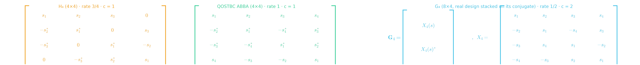
SOLUTION B2
The ranking flips on decoding budget
Candidate table, resolved — and the three codes as deployed
▸ Efficiency: (3/4)·4 = 1·3 = (1/2)·6 = 3 b/s/Hz. d²min ≜ smallest squared distance between constellation points at unit average energy: 8-PSK 4sin²(π/8) = 0.59 > 16-QAM 6/15 = 0.40 > 64-QAM 6/63 = 0.095.
▸ Code energy factor c ≜ the scale in 𝒢ᴴ𝒢 = c·(Σ|sᵢ|²)·I — how much energy the code hands each symbol: H₄, QOSTBC c = 1; G₄ c = 2 (every symbol sent twice, once conjugated). Link figure ∝ c·d²min.
▸ Rank by c·d²min: QOSTBC 0.59 > H₄ 0.40 > G₄ 2×0.095 = 0.19 ⇒ +1.7 dB and −3.2 dB vs H₄. Costs: H₄ symbol-by-symbol; QOSTBC two 64-hypothesis searches + rotation; diversity 4 for all (QOSTBC only if rotated).
Bottom line: (a) IoT node: H₄ + 16-QAM — simplest decoder, small penalty. (b) Base station: rotated QOSTBC + 8-PSK — best link budget; complexity lives where compute is cheap. Same curves, two right answers.

Slide 21
PROBLEM B3 · DESIGN
The feedback that arrives too late
Scenario: a 2-Tx downlink serves a user driving 100 km/h at 2 GHz carrier. The closed-loop path (measure → report → apply) takes 5 ms. MRT promises 3 dB over Alamouti — IF the CSIT is fresh.
Given: f_D = v/λ ; coherence time T_c ≈ 0.423 / f_D (Clarke) ; λ = c/f_c = 15 cm
Tasks
1
Compute the Doppler frequency and the coherence time.
2
Compare T_c to the 5 ms loop — is the CSIT alive on arrival?
3
What actually happens to MRT with stale phases? Worst case?
4
Decide — and find the speed at which you would switch back to MRT.

Slide 22
SOLUTION B3
Open loop wins on wheels
The numbers decide
▸ v = 27.8 m/s, λ = 0.15 m ⇒ f_D ≈ 185 Hz ⇒ T_c ≈ 0.423/185 ≈ 2.3 ms. The 5 ms loop is ≈ 2.2 coherence times: the channel the weights describe is gone before they arrive.
▸ Stale MRT is not 'MRT minus a bit': with drifted phases the two antennas can combine DESTRUCTIVELY — below SISO. The promised +3 dB becomes a coin flip.
▸ Alamouti needs nothing, keeps diversity 2 at rate 1, and never combines destructively. Break-even: loop ≲ T_c/2 ⇒ T_c ≥ 10 ms ⇒ f_D ≤ 42 Hz ⇒ v ≲ 23 km/h.
Bottom line: above ~25 km/h, MRT's 3 dB promise is repaid in stale-phase losses — take Alamouti. This is exactly why every standard ships BOTH modes and switches on mobility.

Slide 23
PROBLEM C1 · BRAINSTORM
Break Alamouti: the channel moves
Scenario: Alamouti's derivation silently assumed h constant across both slots. Let slot 2 see h₁′ = h₁+δ₁, h₂′ = h₂+δ₂. Break the scheme — then invent fixes.
Given: ℋ rows now built from DIFFERENT channels ; δ small but nonzero, growing with Doppler
Tasks
1
Recompute the off-diagonal of ℋᴴℋ — what survives?
2
How does the leakage scale with Doppler and slot duration?
3
Brainstorm at least three distinct fixes.
4
Which fix did LTE adopt — and under what name?

Slide 24
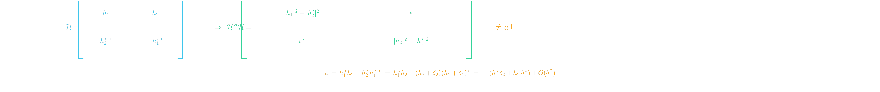
SOLUTION C1
You just re-derived SFBC
Break, then fix — the computation, spelled out
▸ Build ℋ with slot-1 channels h and slot-2 channels h′ (below): the off-diagonal ε ≠ 0 — s₁ leaks into s₂. Leakage ∝ (f_D·T)²: an error FLOOR no SNR can buy off.
▸ Fixes: shorten the block; track and pre-rotate the drift; interleave + code over the residual; or pair across FREQUENCY instead of time — two adjacent subcarriers of one OFDM symbol.
▸ The frequency pairing is exact: two subcarriers of the same symbol are SIMULTANEOUS — the channel cannot move between them, only across them, which coherence bandwidth covers.
Bottom line: LTE chose exactly that: SFBC — Alamouti across subcarriers. Every assumption in a derivation is a future failure mode; attacking 'h constant' re-derives a standard's design decision.

Slide 25
PROBLEM C2 · BRAINSTORM
Build the missing 3×3 — try
Scenario: the catalog jumps from Alamouti (rate 1, 2 Tx) straight to rate-3/4 codes at 3–4 Tx. Spend five honest minutes trying to construct the missing 3×3 rate-1 complex design.
Given: wanted: a 3×3 matrix in s₁, s₂, s₃ and conjugates with 𝒢ᴴ𝒢 = (Σ|sᵢ|²)·I
Tasks
1
Try Alamouti-style extensions — where do cross terms refuse to cancel?
2
Count constraints vs free sign/conjugation choices — why does bookkeeping fail?
3
What CAN you salvage — which rate does your best attempt reach?
4
Name the theorem your failure is a shadow of.

Slide 26
SOLUTION C2
The failure IS the lesson
Post-mortem
▸ Every patchwork leaves one stubborn pair: cancelling (1,2) and (1,3) forces signs that UN-cancel (2,3) — three compatible sign structures don't exist at n = 3.
▸ Salvage: give the symbols a 4th slot — a 4×3 design carrying 3 symbols cancels everything. Rate 3/4: exactly the catalog's G₃/H₃. Your best honest attempt IS the textbook code.
▸ The obstruction is Hurwitz wearing engineering clothes: square rate-1 complex designs exist only at n = 2 (ℂ); the next division algebra is ℍ — real dimension 4, not complex 3.
Bottom line: you cannot value the rate-3/4 codes until you have personally failed to beat them. The wall is algebra, not lack of cleverness — and now the class knows where the wall stands.

Slide 27
PROBLEM D1 · SPOT THE FLAW
A too-good-to-be-true derivation
Scenario: a student writes: 'each Alamouti symbol is transmitted from BOTH antennas across the block, so it collects power P from each — 2P total. With gain ‖h‖² that is 3 dB ABOVE MRC. Alamouti beats closed loop!'
Given: the true ledger: per-antenna power P/2 ; the 2-slot block carries TWO symbols on total power P per slot
Tasks
1
Where exactly does the phantom 2P appear from?
2
Recompute the energy per symbol honestly.
3
State the correct relation to MRC 1×2.
4
Write the one-line conservation law that catches this whole error class.

Slide 28
SOLUTION D1
Audit the energy ledger
The flaw, dissected
▸ The 2P double-counts twice: each of the symbol's two transmissions runs at P/2 (not P), and the block's budget is SHARED by two symbols — not stacked onto one.
▸ Honest ledger: 2 slots × P = 2P total for 2 symbols → energy P per symbol, split P/2 + P/2 across its two appearances. γ = (P/2σ²)‖h‖².
▸ MRC 1×2 collects the same ‖h‖² at FULL power: γ = (P/σ²)‖h‖² — Alamouti sits exactly 3 dB BELOW, not above. No CSIT ⇒ no array gain; that arrow is on the results slide.
Bottom line: conservation law: Σ over slots × antennas of transmitted energy = P × (number of slots), always. Every 'free 3 dB' in MIMO folklore dies against this one line.

Slide 29
PROBLEM D2 · PREDICT, THEN CHECK
Call the gap before the reveal
Scenario: two 4-Tx OSTBCs on QPSK at equal total power: H₄ (rate 3/4, 𝒢ᴴ𝒢 = Σ|sᵢ|² I) and G₄ (rate 1/2, 𝒢ᴴ𝒢 = 2Σ|sᵢ|² I). Predict their curves BEFORE seeing any plot.
Given: post-combining SNR: γ = c · (P/Nₜσ²) · ‖h‖² , c = the code's energy factor
Tasks
1
Same slope or different? Argue from the SNR expression.
2
Predict the horizontal gap between the curves, in dB.
3
Does the gap depend on the target BER?
4
The simulation measured 3.01 dB at BER 10⁻³ — reconcile.

Slide 30
SOLUTION D2
Energy shifts curves; diversity bends them
Prediction vs measurement
▸ Same slope: both codes are orthogonal with full diversity 4 — slope counts the ‖h‖² summands and ignores rate entirely.
▸ c = 1 vs c = 2 makes the two γ distributions identical up to a factor 2 ⇒ the BER curves are pure horizontal translates by 10·log₁₀ 2 = 3.01 dB.
▸ A translate has the same gap at EVERY BER — the curves never converge and never cross. (What the plot hides: G₄ paid half its rate for the shift.)
Bottom line: the simulation returned 3.01 dB — prediction confirmed to the second decimal. Energy factors slide curves sideways; diversity changes their bend. Predict first, simulate to confirm.

Slide 31
D2 · SIMULATION · MATLAB
MATLAB: H₄ vs G₄ — call the gap
% D2: H4 (rate 3/4, c = 1) vs G4 (rate 1/2, c = 2) -- 4 Tx, QPSK, equal total power P.
% Both orthogonal => exact scalar channel gamma = c*(snr/4)*||h||^2, QPSK per-bit Q(sqrt(gamma)).
SNRdB = 0:2:20; N = 5e5; cs = [1 2]; ber = zeros(2,numel(SNRdB));
for v = 1:2, c = cs(v); % c = the code's energy factor
for k = 1:numel(SNRdB)
snr = 10^(SNRdB(k)/10);
g = c*snr/4 * sum(abs((randn(N,4)+1i*randn(N,4))/sqrt(2)).^2, 2);
s = ((2*(rand(N,1)>.5)-1) + 1i*(2*(rand(N,1)>.5)-1))/sqrt(2);
y = sqrt(g).*s + (randn(N,1)+1i*randn(N,1))/sqrt(2);
ber(v,k) = mean([(real(y)<0)~=(real(s)<0); (imag(y)<0)~=(imag(s)<0)]);
end
end
semilogy(SNRdB, ber, '-s', 'LineWidth', 1.5); grid on
xlabel('SNR (dB)'); ylabel('BER');
legend('H_4: rate 3/4, c = 1', 'G_4: rate 1/2, c = 2');
title('A pure translate: 10log_{10}2 = 3.01 dB at every BER');

Slide 32
D2 · SIMULATION · PYTHON
Python: H₄ vs G₄ — call the gap
import numpy as np, matplotlib.pyplot as plt
# D2: H4 (rate 3/4, c = 1) vs G4 (rate 1/2, c = 2) -- 4 Tx, QPSK, equal total power P.
# Both orthogonal => exact scalar channel gamma = c*(snr/4)*||h||^2, QPSK per-bit Pe = Q(sqrt(gamma)).
rng = np.random.default_rng(1)
def ostbc_qpsk_ber(snr, N, c): # c = the code's energy factor
g = c*snr/4*np.sum(np.abs(rng.standard_normal((N,4))+1j*rng.standard_normal((N,4)))**2/2, 1)
s = ((2*(rng.random(N)>.5)-1) + 1j*(2*(rng.random(N)>.5)-1))/np.sqrt(2)
y = np.sqrt(g)*s + (rng.standard_normal(N)+1j*rng.standard_normal(N))/np.sqrt(2)
return np.mean([(y.real<0)!=(s.real<0), (y.imag<0)!=(s.imag<0)])
SNRdB = np.arange(0, 21, 2); N = 500_000
bH = [ostbc_qpsk_ber(10**(d/10), N, 1) for d in SNRdB] # H4: c = 1
bG = [ostbc_qpsk_ber(10**(d/10), N, 2) for d in SNRdB] # G4: c = 2 (+3 dB energy)
plt.semilogy(SNRdB, bH, '-s', label='H4: rate 3/4, c = 1')
plt.semilogy(SNRdB, bG, '-o', label='G4: rate 1/2, c = 2')
plt.grid(True, which='both'); plt.legend(); plt.xlabel('SNR (dB)'); plt.ylabel('BER')
plt.title('A pure translate: 10*log10(2) = 3.01 dB at every BER')

Slide 33
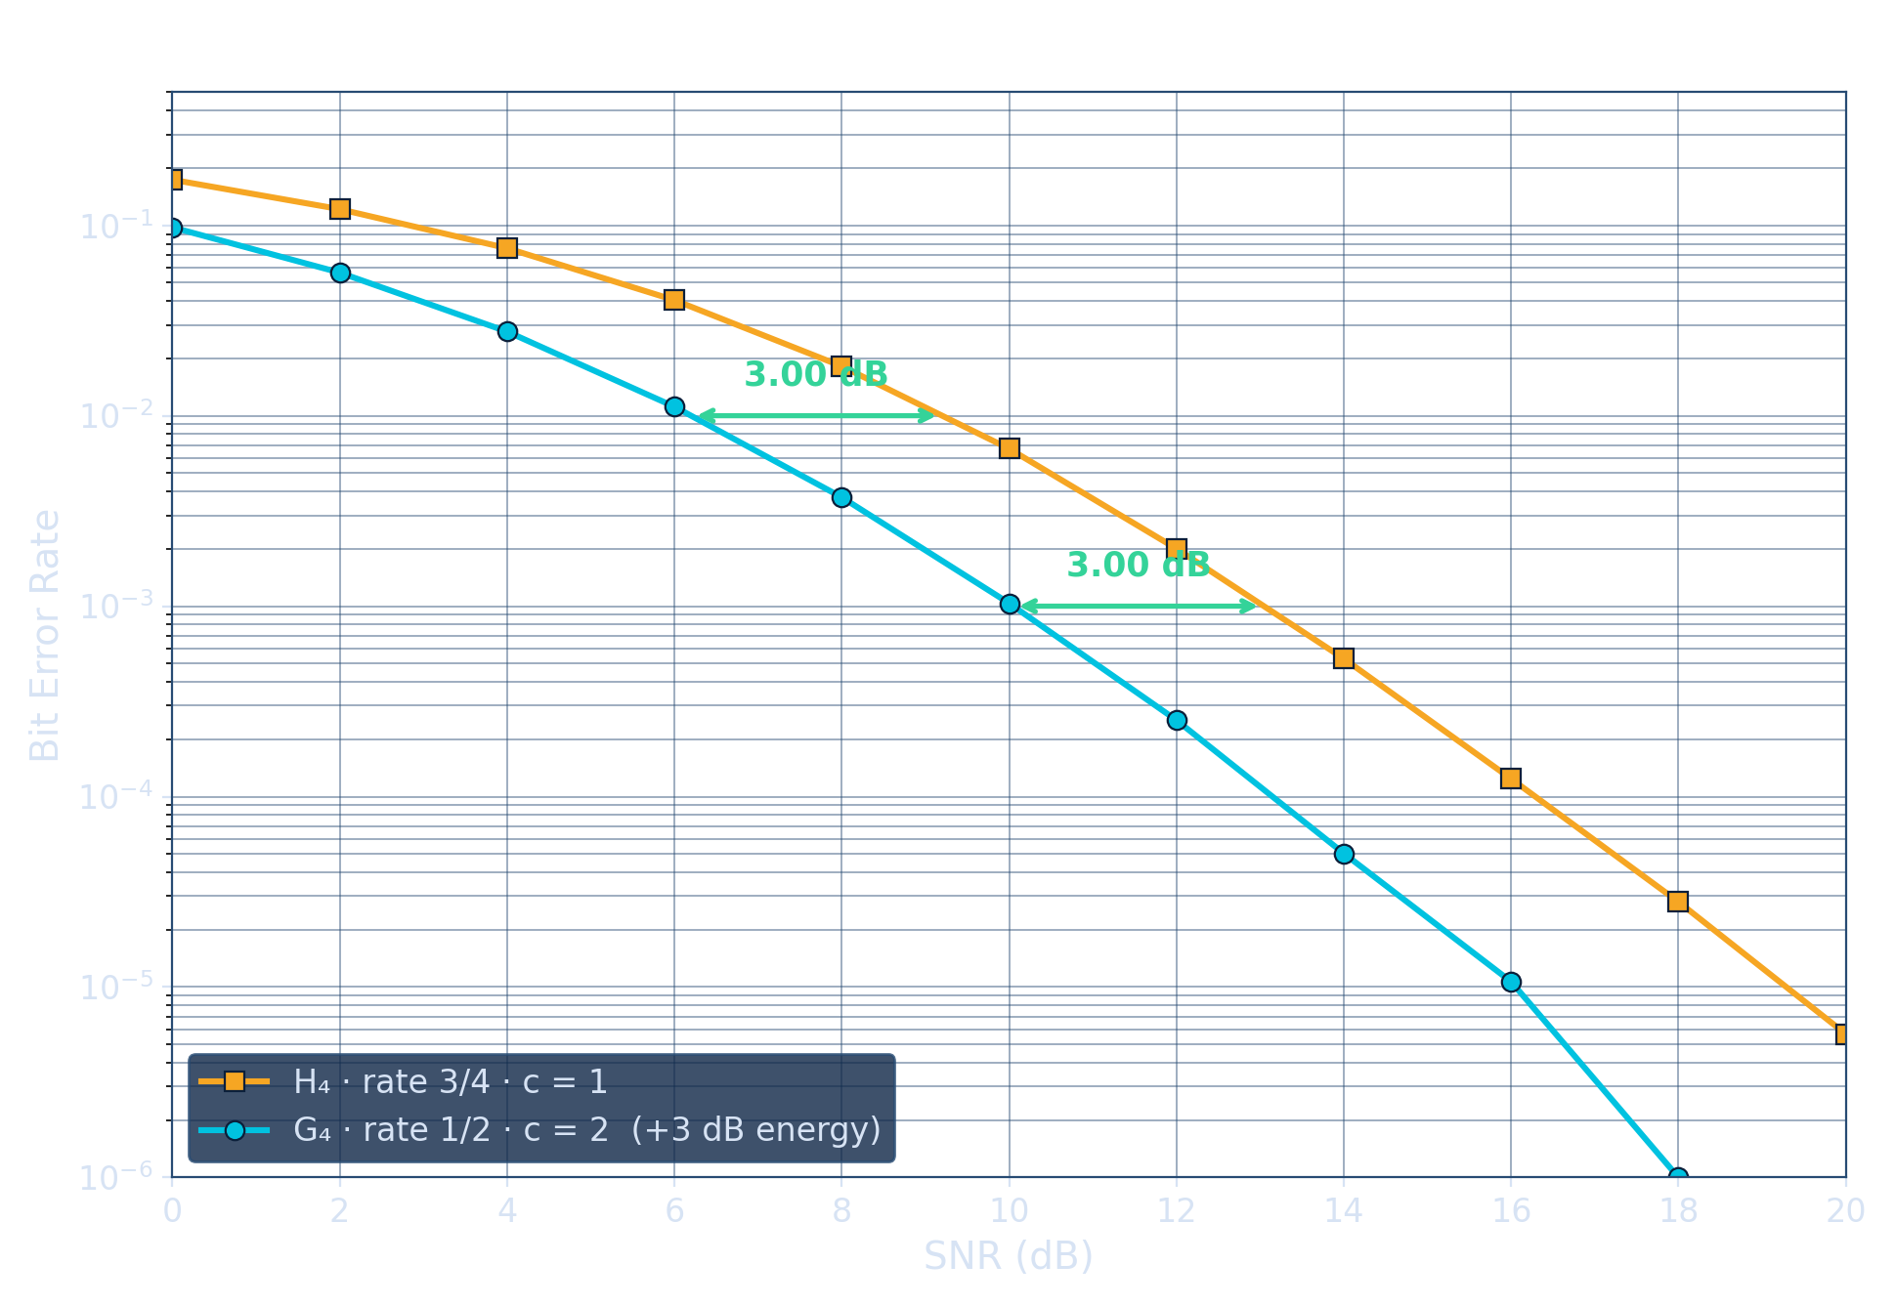
D2 · SIMULATION · RESULTS
The predicted 3.01 dB, measured
Reading the curves
Same slope, everywhere
both orthogonal, diversity 4 — rate never touches the bend
The gap, measured
3.00 / 3.00 / ≈3.1 dB at BER 10⁻², 10⁻³, 10⁻⁴ — a pure translate
Where it comes from
the two γ distributions are identical up to ×2 ⇒ shift = 10log₁₀2 exactly
What the plot hides
G₄ paid HALF its rate: 1.0 vs 1.5 b/s/Hz here — fair fights need equal throughput (B2)
energy factors slide curves sideways by exactly 10log₁₀c; diversity sets the bend. The gap was predictable to the second decimal — simulation as confirmation, not exploration.

