Slide 1
Image Caption Generator with
CNN and LSTM
Submitted By
Md Shamihul Islam Khan
Reg No: 2016331078,
CSE, SUST
Submitted To
Dr. Md Forhad Rabbi
Associate Professor,
CSE, SUST

Slide 2
Image caption generator is a task that involves computer vision and natural language processing concepts to recognize the context of an image and describe them in a natural language like English.
What is Image Caption Generator?

Slide 3
Image Caption Generator Model
1
Convolutional Neural networks (CNN)
2
Long short term memory (LSTM)

Slide 4
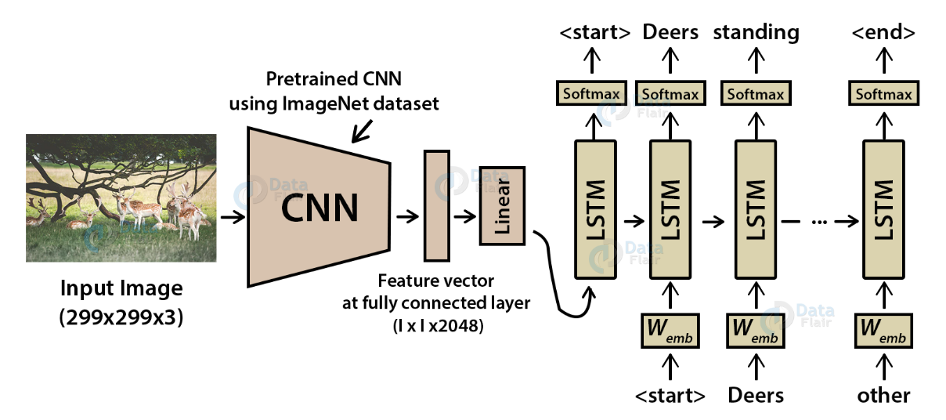
Image Caption Generator Model

Slide 5
Convolutional Neural networks are specialized deep neural networks which can process the data that has input shape like a 2D matrix. Images are easily represented as a 2D matrix and CNN is very useful in working with images.
What is CNN?

Slide 6
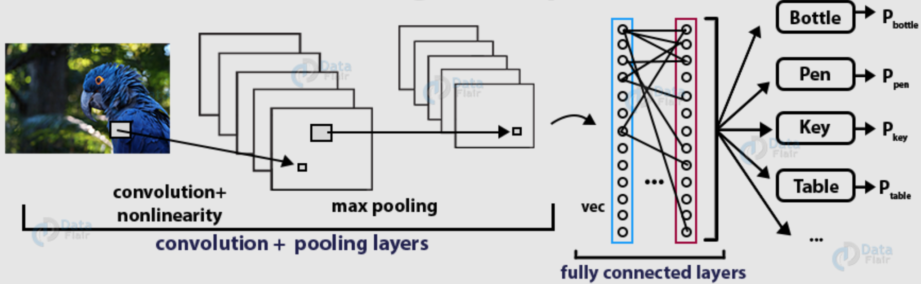
Working On Deep CNN

Slide 7
LSTM stands for Long short term memory, they are a type of RNN, which is well suited for sequence prediction problems. LSTM can carry out relevant information throughout the processing of inputs and with a forget gate, it discards non-relevant information.
What is LSTM?

Slide 8
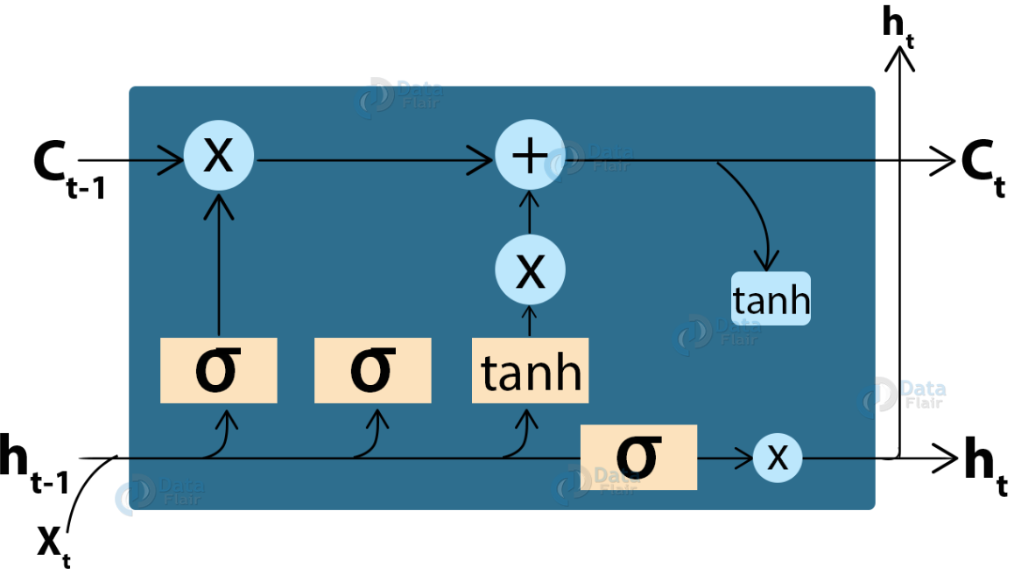
LSTM Cell Structure

Slide 9



Dataset
8000
6000
7577
Total
Train
Vocabulary size

Slide 10
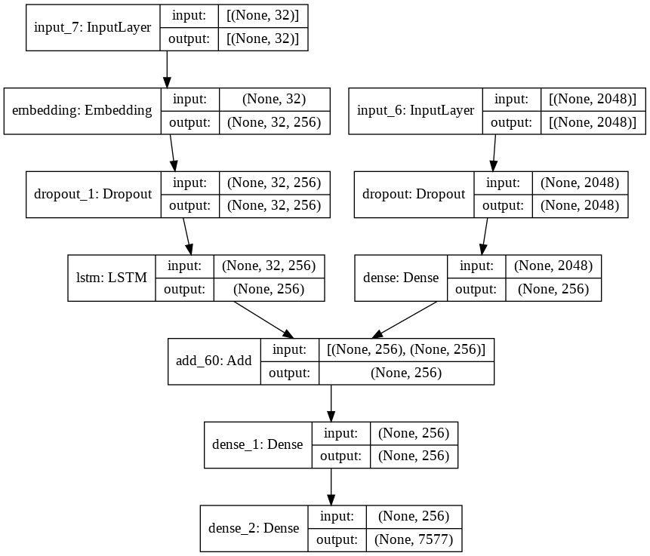
Visual Representation of the Final Model

Slide 11
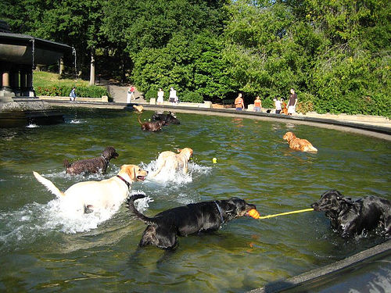
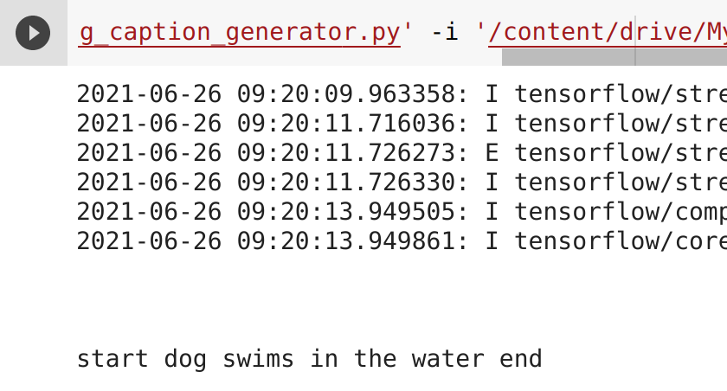
Results

Slide 12


