Slide 1
WELCOME TO OUR PRESENTATION

Slide 2
Name
Tanjil Ahmed Limon
Roll:17CSE005
Israt Jahan Mili
Roll:17CSE025

Slide 3
Content
Definition
Usage
Advantages
Applicability
Participants
Consequences
UML Diagram
Motivating Examples
Collaborates
Implementation
References

Slide 4
Definition
Abstract Factory Pattern is to provide an interface for creating families of related or dependent objects without specifying their concrete classes.

Slide 5
Usage
The factory determines the actual concrete type of object to be created, and it is here that the object is actually created.
When the system needs to be configured with one of a multiple family of objects.

Slide 6
Advantages
Abstract Factory Pattern isolates the client code from concrete (implementation) classes.
It eases the exchanging of object families.
It promotes consistency among objects.

Slide 7
Applicability
a system should be independent of how its products are created, composed, and represented.
a system should be configured with one of multiple families of products.
A family of related product objects is designed to be used together.
you want to provide a class library of products, and you want to reveal just their interfaces, not their implementations.

Slide 8
Participants
Abstract Factory
Concrete Factory
Abstract Product
Concrete Product
Client

Slide 9
Consequences
It isolates concrete classes.
It makes exchanging families product easy
It promotes consistency among products
Supporting new kinds of product is difficult

Slide 10
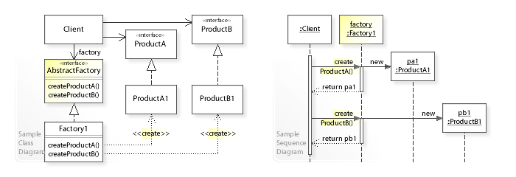
UML Diagram

Slide 11
Motivating examples
Clients call these operations to obtain widget instances, but clients aren't aware of the concrete classes they're using.
Target multiple platform by creating component instances for selected platform
Design neural network layers to contain the technology for their own construction, allowing networks to focus on learning strategies

Slide 12
Collaborates
Normally a single instance of a Concrete Factory class is created at run-time.
This concrete factory creates product objects having a particular implementation.
To create different product objects, clients should use a different concrete factory.
Abstract Factory defers creation of product objects to its concrete factory subclass.

Slide 13
Implementation Of Abstract Factory Design Pattern In Java

Slide 14
References
https://sourcemaking.com/design_patterns/abstract_factory
http://en.wikipedia.org/wiki/Abstract_factory_pattern
https://en.wikipedia.org/wiki/Software_design_pattern
https://www.youtube.com/watch?v=mIq-R6f6m30

