Slide 1
ONLINE MOVIE TICKET BOOKING
Website using ASP.NET with C Sharpe
Sachin Kumar Dubey 14300211038
1
SK Nadim Riaz 14300211044
Suman Bose
14300211052

Slide 2
CONTENTS
❑
Objectives
❑
Tools and Languages Used
❑
System Requirement
❑
Features Available
❑
Future Scope of Improvement
❑
Limitation
❑
Conclusion
2

Slide 3
OBJECTIVE
The primary objective of the design is to deliver the requirement as delivered by the feasibility report. There are some objective that we kept in mind.
❑ Practically : The system is quite stable and can be operated by the people with average intelligence.
❑ Efficiency : We tried to involve accuracy, timeliness and comprehensiveness of the system output.
❑ Cost : It is desirable to aim for the system with a minimum cost subject to the condition that it must satisfy the entire requirement.
3

Slide 4
TOOLS AND LANGUAGES USED
❑
Front End

Visual Studio 13

HTML

CSS

JavaScript

ASP.NET
❑
Back End

MySql Server

Internet Information Service

Structured Query Language
4

Slide 5

SYSTEM REQUIREMENT
The basic system requirements for running this project are listed below
Hardwire Requirement
Software Requirement
▪ Intel Pentium Processor or equivalent.
▪ 572 MB Random Access Memory.
▪ 200 MB of free space on Hard Disk.
▪ Input / Output devices like Display Screen ( 1024 * 786), Mouse, Keyboard.
▪ Microsoft Windows XP or Linux or equivalent OS.
▪ Web browser Internet
Explorer version 10.
5

Slide 6
FEATURES AVAILABLE
○
Customer
❑
Administrator
 Register & Sign up  Login
▪
Login
▪
Add Movie Details
▪
Remove Movie Details
 Explore Movies
 Choose Seat
 Use Cart
 Online Payment

E-Ticket
6

Slide 7
CUSTOMER
7

Slide 8
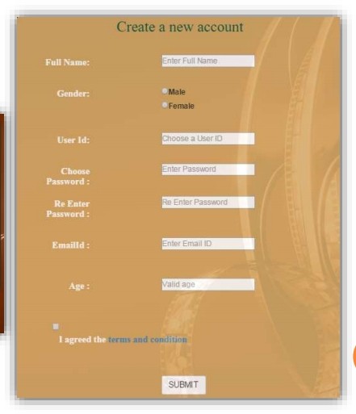
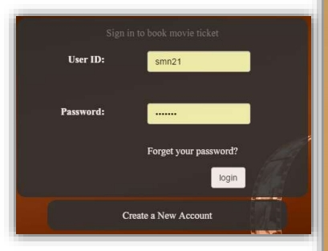
LOGIN AND REGISTRATION
8

Slide 9
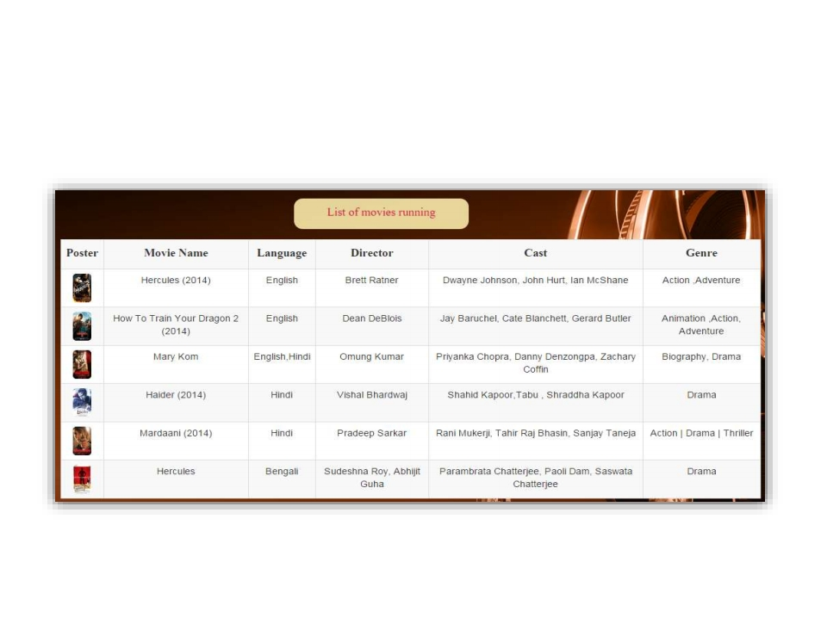
LIST OF MOVIES RUNNING
9

Slide 10
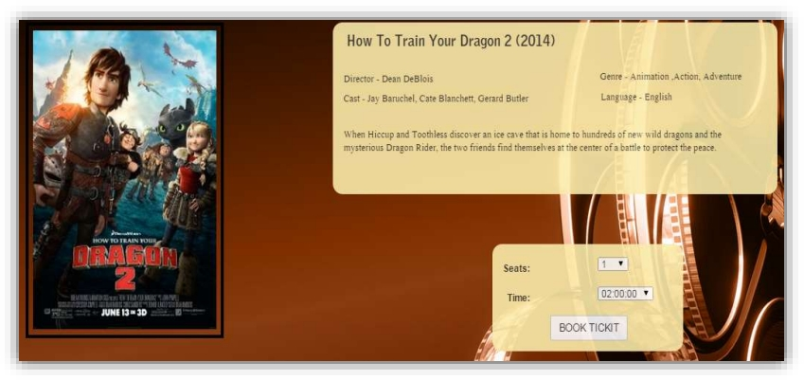
INFORMATION ABOUT MOVIE
10

Slide 11
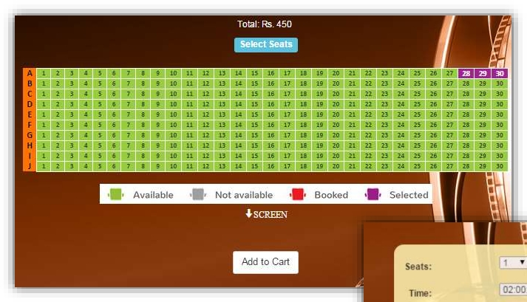
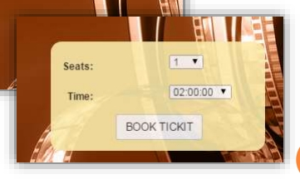
TIMING AND NO. OF SEAT SELECTION
11

Slide 12
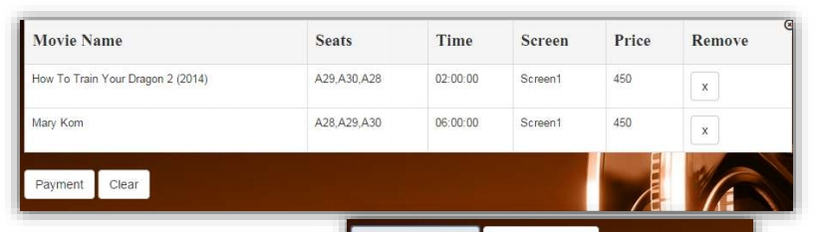
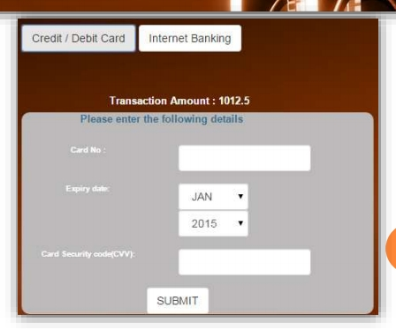
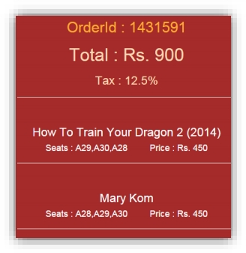
CART AND PAYMENT
12

Slide 13
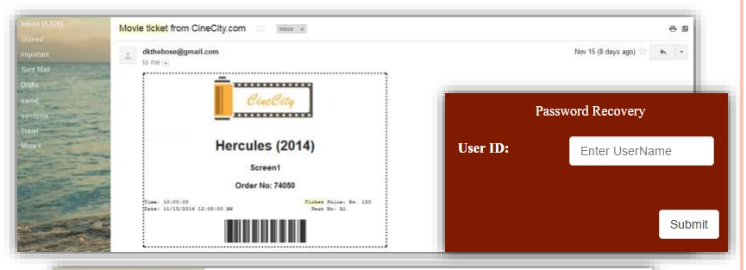
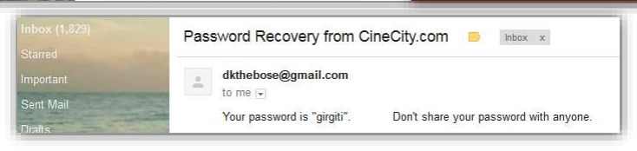
E- TICKET AND PASSWORD RECOVERY
13

Slide 14
ADMINISTRATOR
14

Slide 15
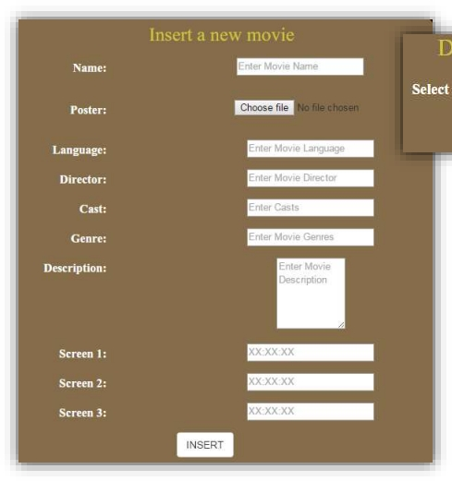
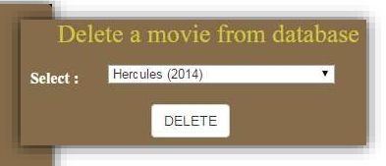
ADD AND DELETE MOVIE
15

Slide 16
FUTURE SCOPE OF IMPROVEMENT
❑
More features can be added like

Allow customers to comment on movies. Provide a list of upcoming movies.


SMS notification after successful seat reservation.
❑ Encrypted Webpage to ensure customer privacy and transaction security.
❑ More user friendly interface also in small screen devices.
16

Slide 17
LIMITATION
○ Not suitable for large organization where number of network is very large.
○
No backup and restore utilities are incorporated.
○
Seat reservation history is not recorded.
○
Admin cannot maintain customer details.
17

Slide 18
CONCLUSION
○ This project has been developed successfully and the performance of the system has been found satisfactory.
○ Use of this interface helps customer in having immediate information about running movies and reserve their seat without wasting their precious time.
○ User friendly Interface also for the admin to add and delete movie information.
18

