Slide 1


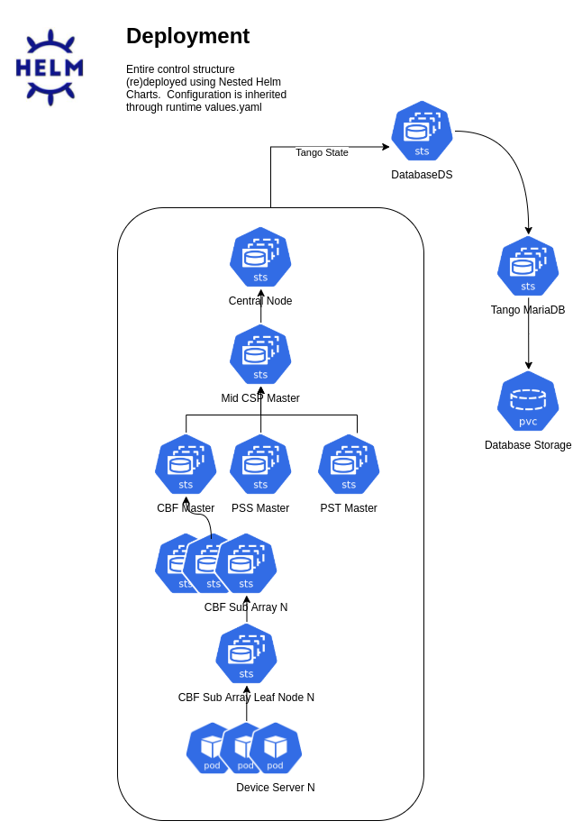
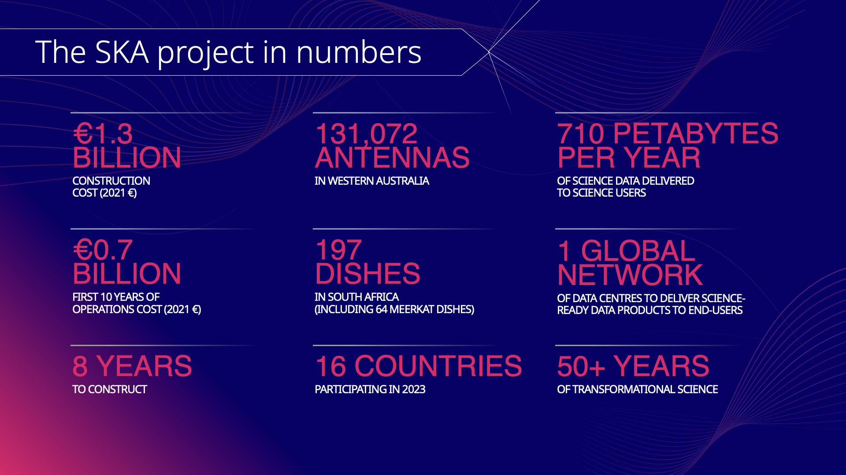
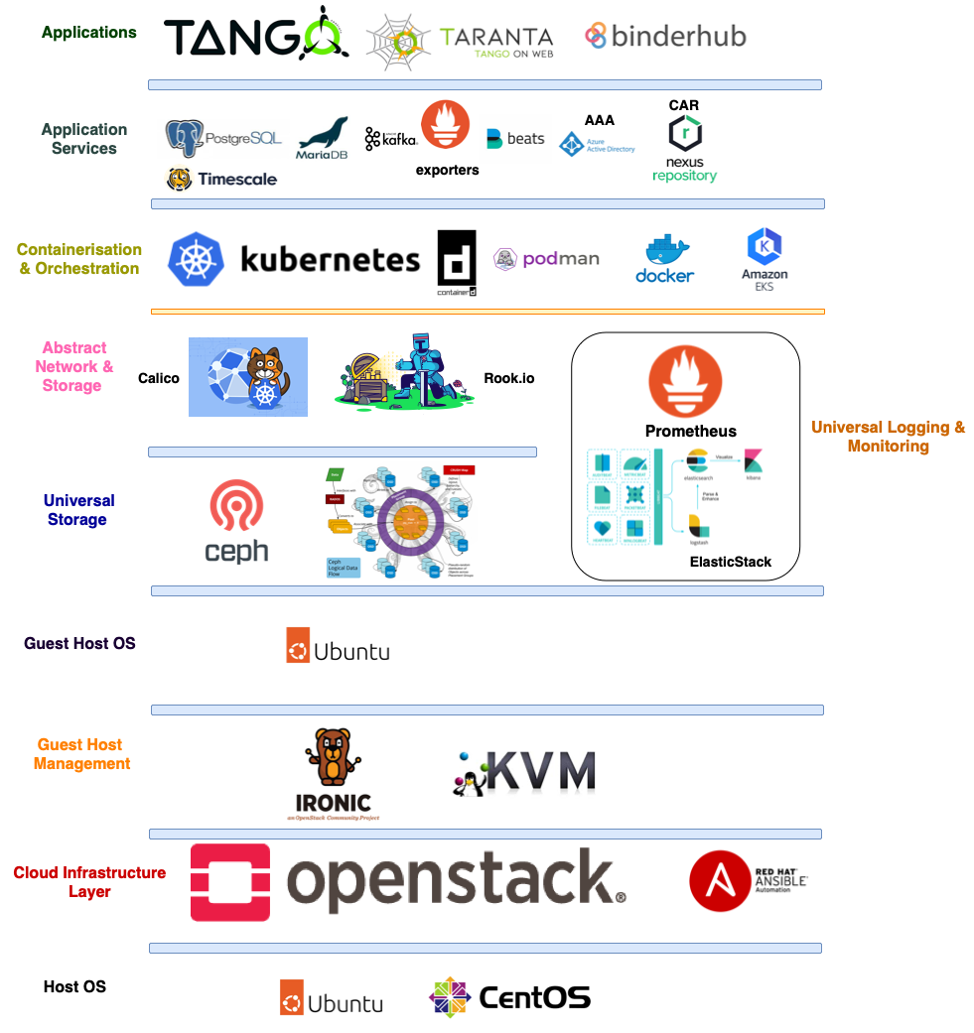
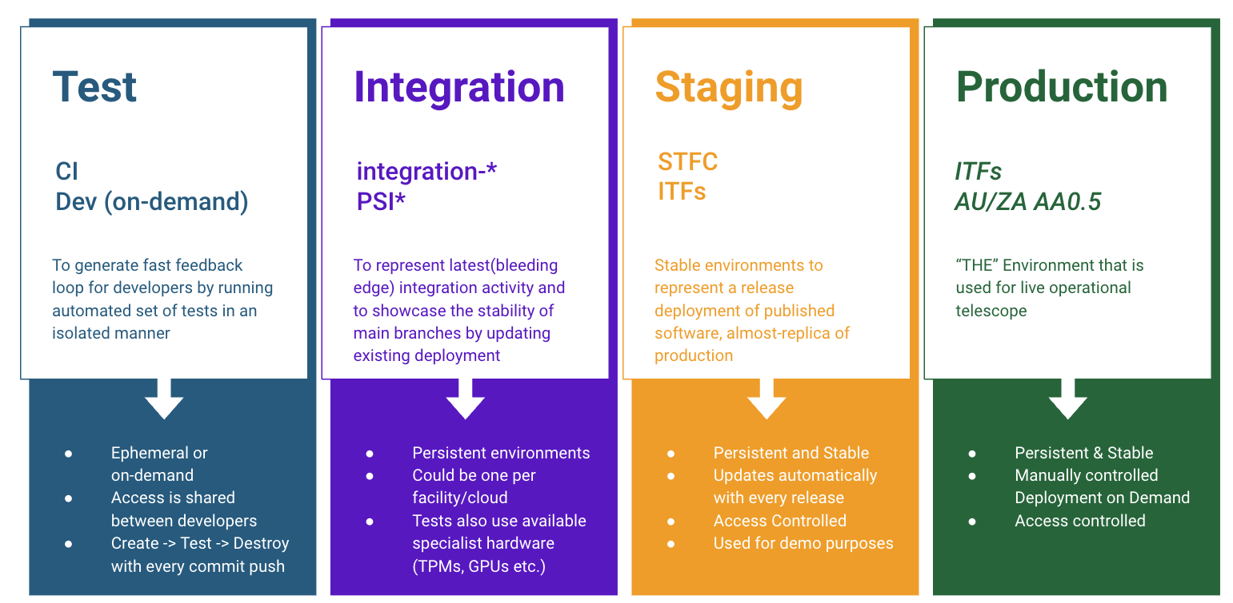
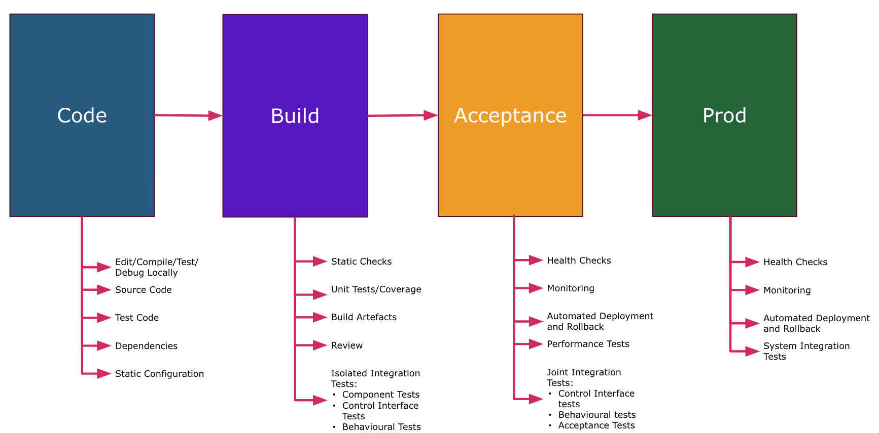

Building a control system with cloud native technologies: Leveraging Kubernetes and Tango-Controls for CI/CD practices in SKA Observatory software Ugur Yilmaz*, Matteo Di Carlo**, Piers Harding* * SKA Observatory
** INAF
2nd LOGO
INTRODUCTION
CLOUD NATIVE
TANGO CONTROLS
“The SKAO’s mission is to build and operate cutting-edge radio telescopes to transform our understanding of the Universe, and deliver benefits to society through global collaboration and innovation.”
Orchestration layer to abstract and schedule the primitives of compute, storage, and network resources.
Abstraction allows us to focus on the API with the platform, largely shielding developers from the hardware complexities.
SKAO JOURNEY INTO CLOUD
Key Objectives for being Cloud Native:
Portability from desktop to production
Insulate hardware from production platform concerns (50 years operational time)
Lower barrier to entry, reduce time-to-share
Timeline
SKAO Platform Layers
Benefits:
Hierarchical Control Structure translates to Kubernetes Resources
Manage Decoupled deployments as individually or nested helm charts
Inject and inherit configuration with runtime
Custom Operator for Operational Lifecycle Management
~2018
First Manual Cluster Setup with 3 control plane + 5 worker nodes
Dec 2019
First MVP Deployed via CD
CONTINUOUS INTEGRATION & DEPLOYMENT
July 2020
Move CI/CD into the cluster from VM/Shell runners
June 2021
Move Logging and Monitoring to Containers
RESULTS & FUTURE
Sept 2021
Centralised Logging and Monitoring (Multi Cluster Integration)
We have
Early Detection of Issues & Fast feedback loop
Clear separation of responsibility and jobs
Visibility & Rollback of each stage when needed
Nov 2021
Automation of SDLC for all projects
We need
Gradual stabilization and compatibility testing
Large Scale Changes
Feb 2022
Automated Environment Provisioning and tear-down
Mar 2023
Move to ClusterAPI (allow multiple cluster creation with ease)
REFERENCES
Oct 2023
Temp Move all CI/CD to AWS and back
Kubernetes, https://kubernetes.io/
Yilmaz, U., Android, M., De Beer, M., 2023. Driving Behavioural Change of Software Developers in a Global Organisation Assisted by a Paranoid Android. https://doi.org/10.18429/JACOW-ICALEPCS2023-MO2BCO01
SKA TANGO Operator, Matteo Di Carlo, 37th Tango Community meeting at SKAO, June 2023
Di Carlo, M., Bartashevich, D., Bartolini, M., Madisa, K., Morgado, J.B., Nunes, D., Venter, A., Williams, S., De Beer, M., 2020. CI-CD Practices with the TANGO-controls Framework in the Context of the Square Kilometre Array (SKA) Telescope Project. Proceedings of the 17th International Conference on Accelerator and Large Experimental Physics Control Systems ICALEPCS2019, USA. https://doi.org/10.18429/JACOW-ICALEPCS2019-MOCPR05
Statistics from last 6 months
24,000+ Pipeline Runs
1000+ vCPU Dynamic Usage
1500+ Deployments

