Slide 1
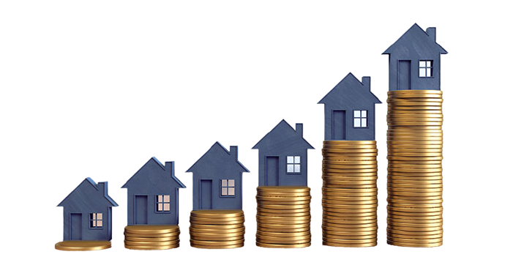
Predicting apartment prices
Limor Biran – 208209676
Almog Anconina - 318376431

Slide 2


Overview
We divided the crawling into 4 different neighborhoods in Ashdod city:
-Rova Bet
-Rova Daled
-Rove Yud-Alef
-Rova Vav
The data were taken from the Gov-Nadlan website.
Each data frame was about 2000 rows.

Slide 3







Research
Data
Acquisition
Data
Cleaning
EDA
Machine
learning
Conclusions

Slide 4


Research questions
Is it possible to predict the rise in apartment prices in given neighborhoods?
Is a particular neighborhood better for investing or living?

Slide 5

Step 1 – Data Acquisition

Slide 6

Crawling
We took the data from Gov-Nadlan website and using Selenium & Beautiful Soup for the crawling.
During the crawl step we encountered two main difficulties:
1. Scroll down the page
2. Get to know the selenium

Slide 7
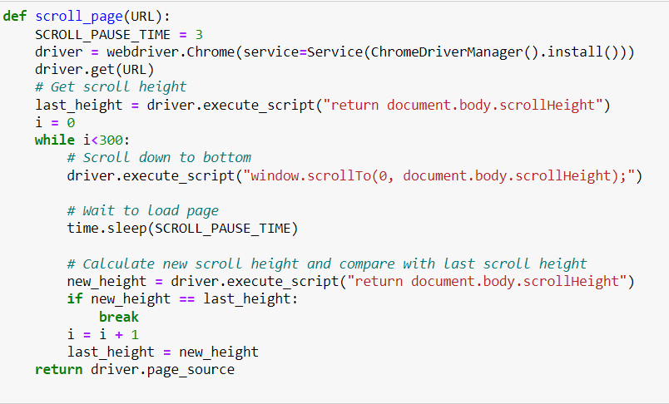

Selenium Library - we used Selenium Library to scroll down the page 300 times or to the end of the page

Slide 8
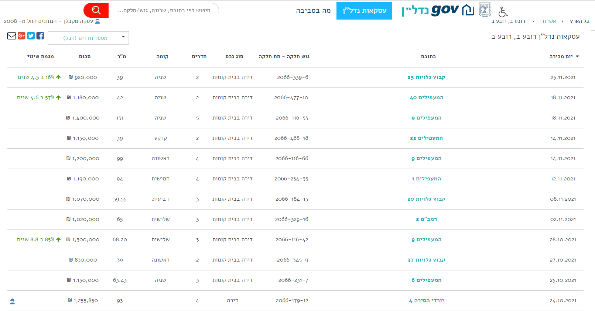

Slide 9

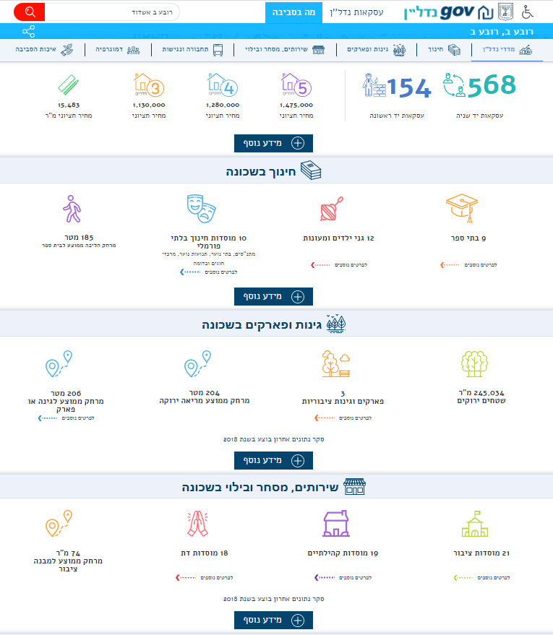
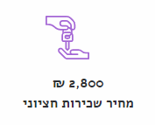

Slide 10
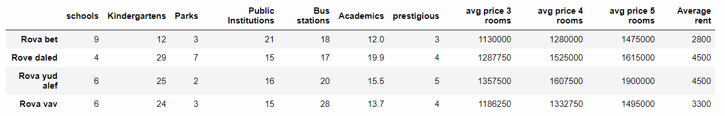
Neighborhood Information Data Frame

Slide 11
Step 2 - Data Cleaning
we analyzed each neighborhood individually
we removed irrelevant columns
we removed rows with outliers and missing values
we changed the values to numeric

Slide 12

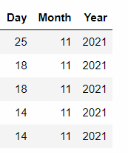
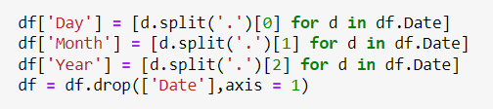

We split the column: Date
into columns: Day, Month, Year
We removed
rows with missing values

Slide 13


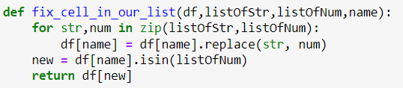
we changed the values to numeric

Slide 14
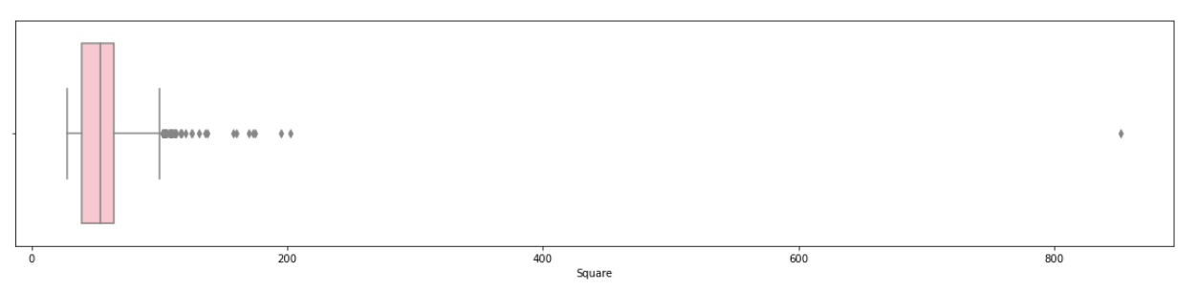
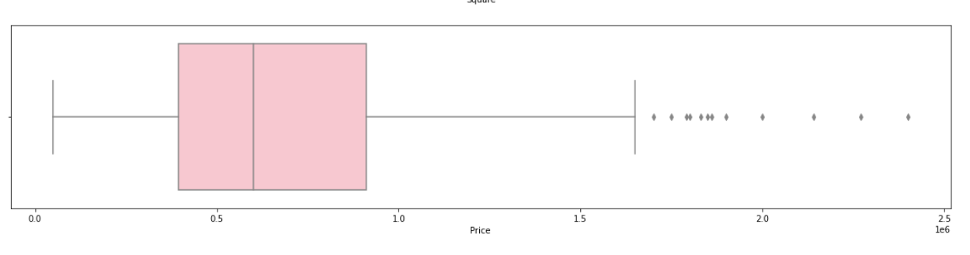
Drop outliers
Rova-Bet:
Square meter
For drop outliers we used IQR.
The pink square is defined by the 25th and 75th percentiles.
And see the median marked within it.
Price

Slide 15
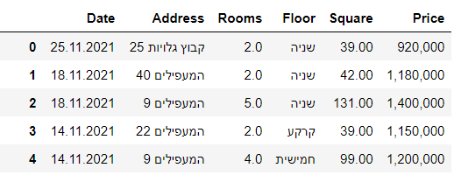
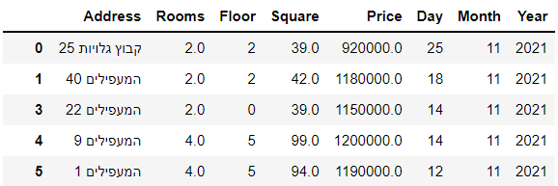
before
after

Slide 16

Step 3 - EDA
In the data analysis phase, we chose visualization that will help a person decide whether in a certain neighborhood it is better to buy an apartment for investment or living.

Slide 17

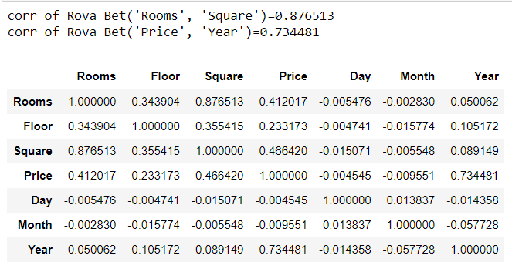
We correlated each neighborhood

Slide 18
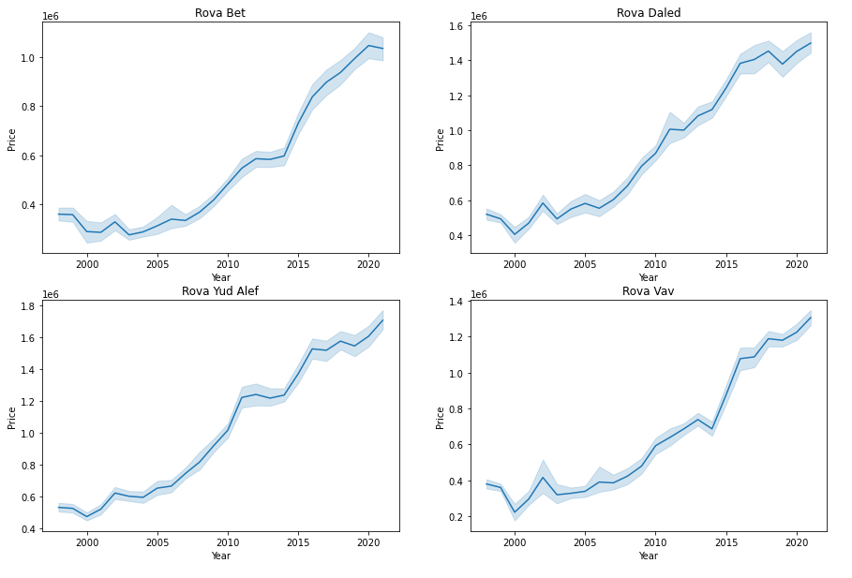
We used linePlot for each neighborhoods, which represents the rise in apartment prices by the year.

Slide 19
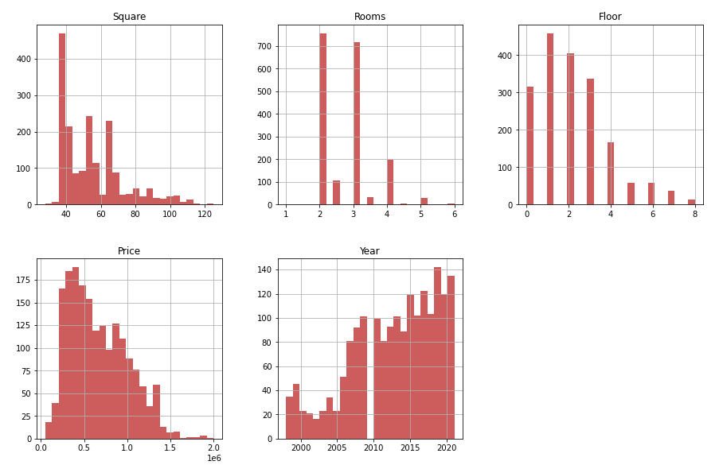
We used a graphical analysis of the dataset columns

Slide 20
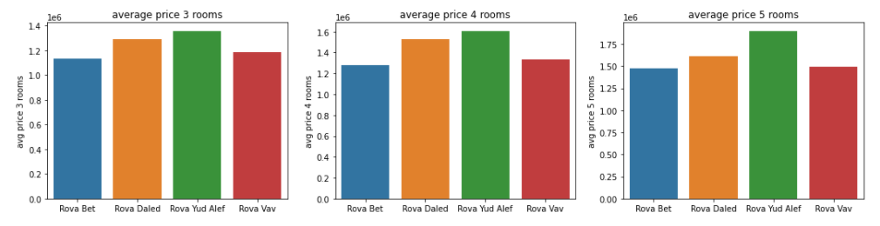
We used BarPlot to present an average price of 3/4/5 room apartments

Slide 21
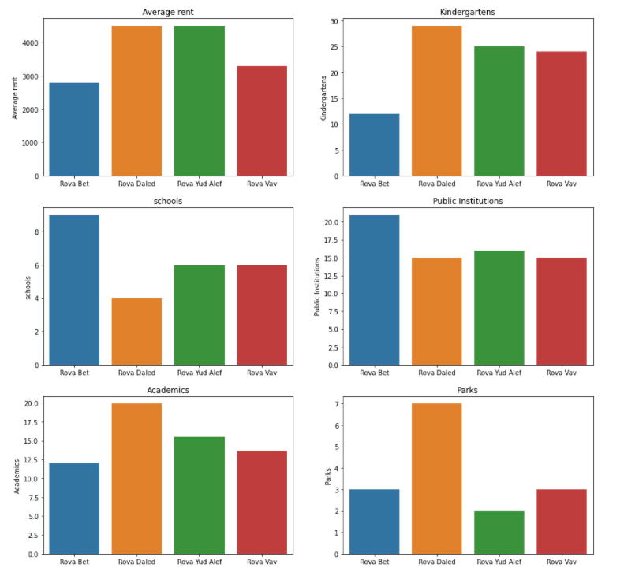
We used BarPlot to rank neighborhoods in a variety of areas

Slide 22

Step 4 - Machine Learning
In the machine learning section, we anticipate the future price of an apartment.
we performed actions to increase the chances of success.

Slide 23
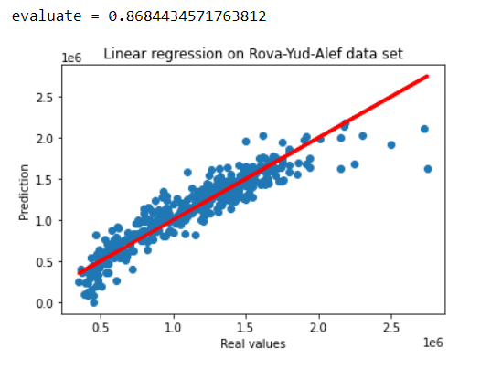
We used Scatter Plot to presents the model forecast against reality

Slide 24
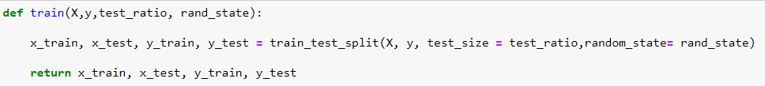
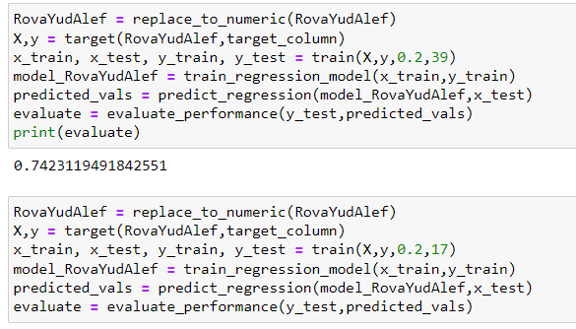

Improving the model

Slide 25

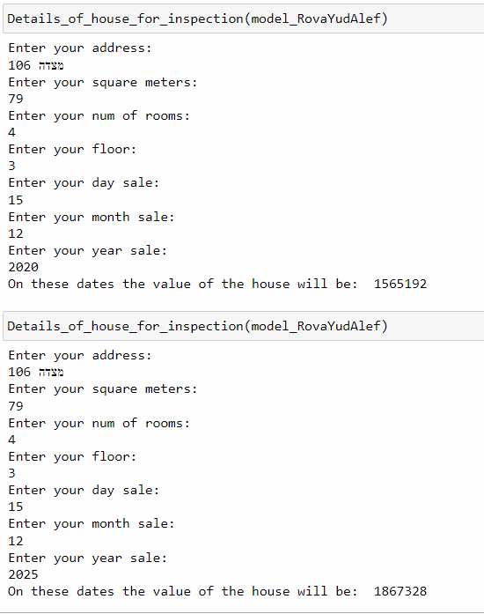
Here we can find out about the price of a particular apartment after X years
And this is a tool that can help decide whether to purchase an apartment for investment

Slide 26

Conclusions

Slide 27

We succeeded to predict whether it would be worth buying an apartment in a neighborhood for investment or living
We succeeded to predict the price of a particular apartment X years later
You can buy apartment in Rova-Yud-Alef in Ashdod at 1,565,192 NIS
After 5 years you can sell this apartment for 1,867,328 NIS
If we add the average rent to 12 months a year 12 * 4,500 we will save another 54,000 NIS
After 5 years the rental profit of the apartment will be 270,000 NIS
We get an expected profit model of: 572,136 NIS

Slide 28


