Slide 1
Yes Bank Campus Datathon
Team Kubernetis : Somil Singhai and Ashutosh sancheti
Bits Pilani, Pilani campus

Slide 2
Data Cleaning Null values estimation(for both current and permanent addresses)
If more than 3 fields in each address types(current and permanent) including the pin code are missing then it is better to drop that address, since there is no way to get its respective latitude and longitude. We understand that it is specifically mentioned not to remove any address field, but there is nothing much that can be with the given data.
Null values in addresses :
Pin code available : Use the google geocode service to get an approximate address.
Pin code unavailable : This data can be shown when making a heat map for the whole country or even the whole state, but isn’t useful when viewing a heatmap for a city.
Null values in city or state:
Address and pin code given : Again, we can get the state and city by using the geocode service.
Only Address given : We can get the city or state, however there can be an error, since two places can have similar addresses.

Slide 3
Null values in pin code:
Address, city available: It is possible to get a good estimate of the pin code using geocoding.
Address not available : Address should be neglected when viewing a heatmap of a particular city.
Remove stop words as front, of, beside, behind, etc. which indicate spatial location, from address field using nltk library.
Some people put address lines into the city entry. An interesting observation from the data regarding the cities column is that if there are some garbage (not really) strings attached to the city entry, then the city name comes at the last. Hence we just extracted the last word from the string. This gave us the city name most of the time.
Although a more sophisticated approach may also be taken by constructing a dictionary with key as the ‘State Name’ and a list containing all the available towns and cities in that particular state. This will speed up the validation process as we won’t have to search through all the available places. Unfortunately due to unavailability of such a list, we were unable to use this approach. We could do this only for India but the database also consists of foreign cities which posed a problem.

Slide 4
Algorithm
Once the Data has been preprocessed, address, city and pin are concatenated to give a search string.
This String is then sent to google maps via geocode API call. A json file is returned with the latitude and longitude for the particular search string. These fields are then extracted and attached to the original dataframe to give a new dataframe containing the Geographical positional attributes.
Once the dataframe is ready, we use mapbox as an layer for base map, and Plotly/deck.gl as an overlay for showing our visualizations.

Slide 5
Sample output for Mumbai we used about 13,000 entries out of 2.5 Lakh entries for making this ‘3D Heatmap’. Mumbai was chosen because of its large amount of data. Higher bars indicate more customers in that area.. This was made using deck.gl and mapbox.

Slide 6
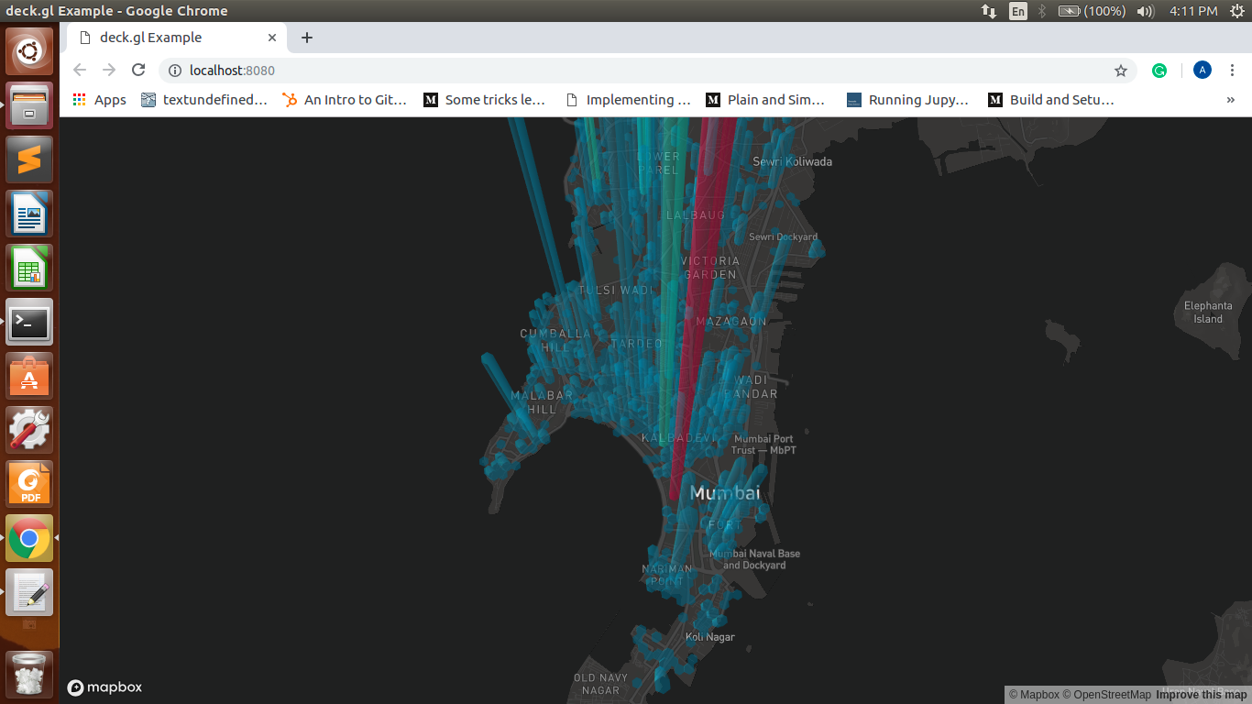
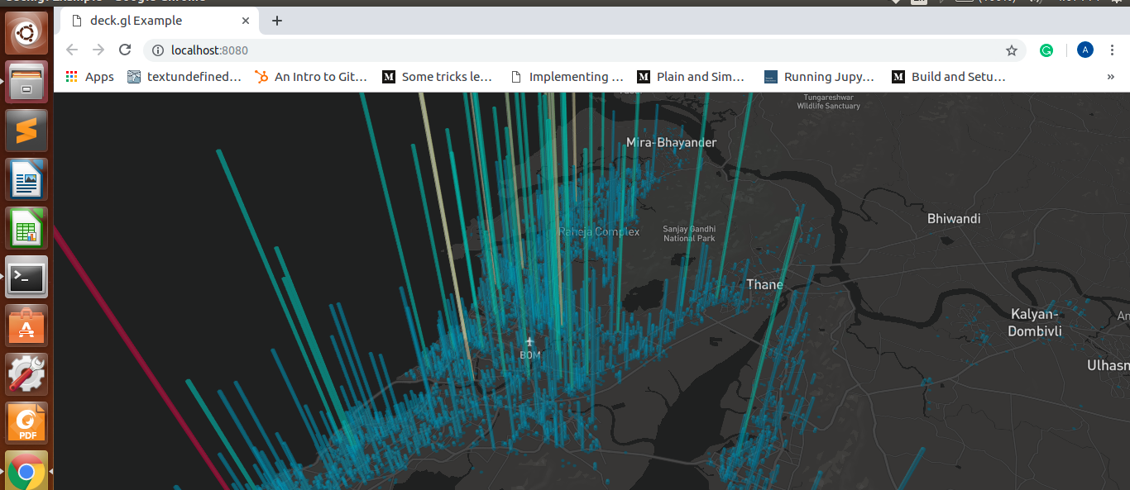
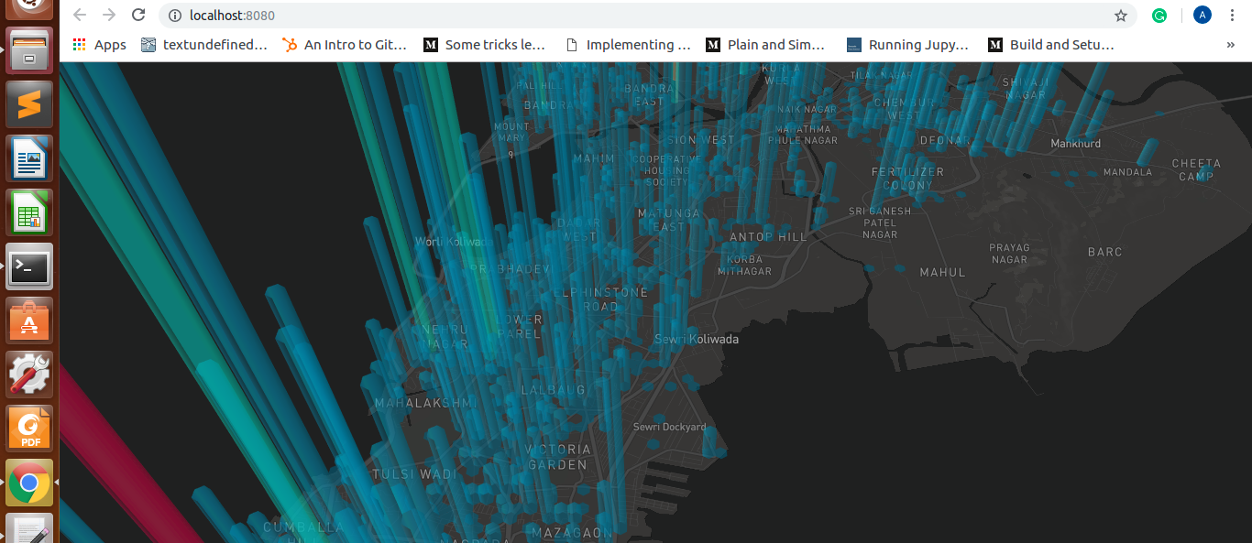
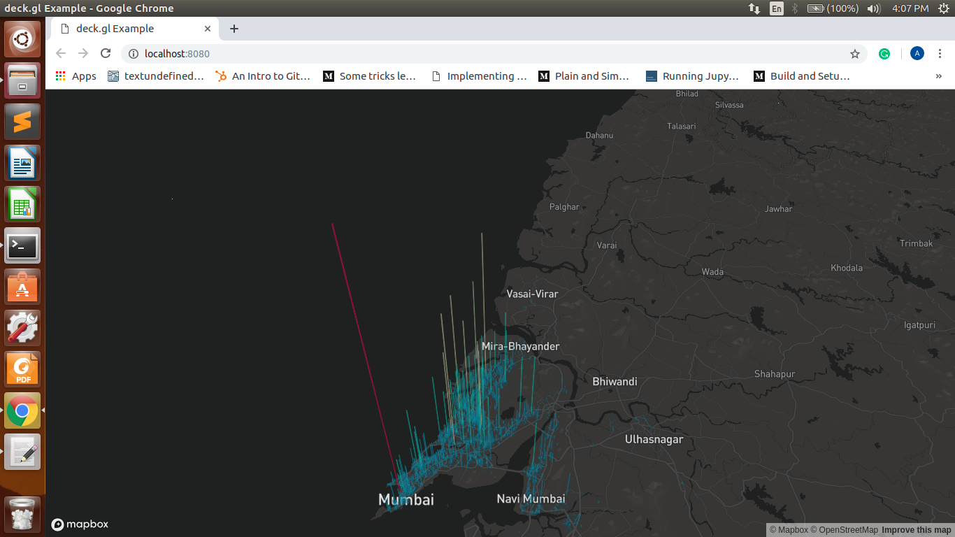

Slide 7
Sample output for Mumbai Scatter Plot for the data This was made using Plotly and mapbox.

Slide 8
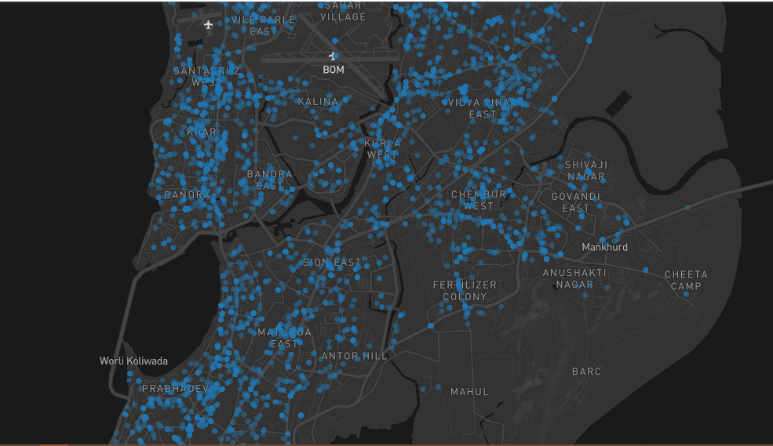
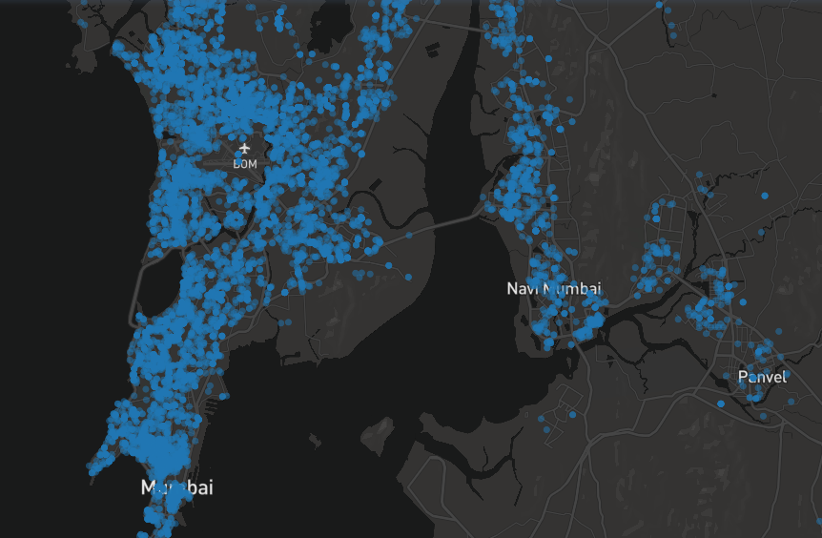
You can check this plot out on : https://plot.ly/~limosin/0/

Slide 9
Future work
Currently we have constructed a dictionary consisting of states, cities and the customers in that city(we store the customer id, as it is unique). So when a user selects the particular city using a drop-down menu approach, it zooms to that city and then shows the relevant 3d heatmap. We still need to work on the GUI for this method.
Need to work on a model which shows relevant correlation between the current address and the permanent address. This can provide us with useful insights which may prove useful in expanding the customer base. Right now they are plotted individually.

