Slide 1
Basolateral amygdala at P10: cell types, P10 vs P21, and candidate cues for Mef2c-cKO ectopic cortical axons
Hansol Lim - BLA 10x scRNA-seq (P10 n=1, P21 n=2), 13,625 cells after QC
Reference: Allen Whole Mouse Brain atlas (Yao et al. 2023), amygdala ROIs CTXsp + sAMY (199k adult cells)
October 2026 - first-pass analysis for discussion

Slide 2
The question and what this data can answer
Collaborator's finding
• Mef2c cKO: L2/3 callosal axons lose contralateral S1/S2 targeting
• Ectopic axons appear around BLA / FoxP2+ ITCs from ~P5, increasing and branching at P8-P10
• Source neurons may not be in SSc - still open
Strategy: amygdala first, then back to cortex
• Which BLA/ITC cell populations exist at P10?
• Which of them express guidance / adhesion cues during P5-P10?
• Which cortical neurons carry the matching axon-side partners?
• Where is Mef2c itself expressed in the amygdala?
Data
• BLA dissections, 10x 3' v3 (Klein lab, processed by T. Straub, mm10-2020-A)
• P10s1: 6,037 cells | P21s1: 2,507 | P21s2: 5,081 (after QC)
• 3,079 cells removed: doublets (two-lineage co-expression) and low-quality clusters, logged per sample
• Labels from marker genes plus correlation mapping to Allen subclasses / supertypes
Caveats
• P10 is ONE animal; P10 vs P21 differences include dissection and batch
• The dissection includes CeA / MeA / BMA neighbours (expected for a BLA punch)
• Allen reference and the cortex panel are ADULT; P10 neurons are immature

Slide 3
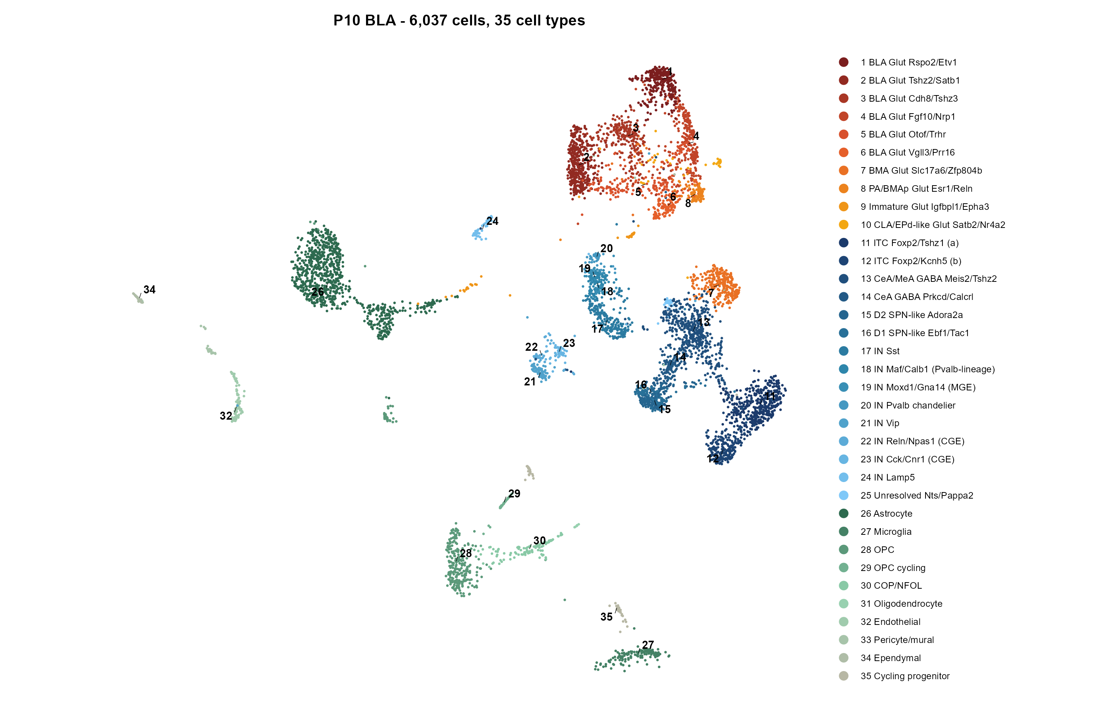
35 cell types in P10 amygdala
BLA glutamatergic (1-10), ITC / CeA / MeA GABA (11-16), interneurons (17-25), glia and vasculature (26-35)

Slide 4
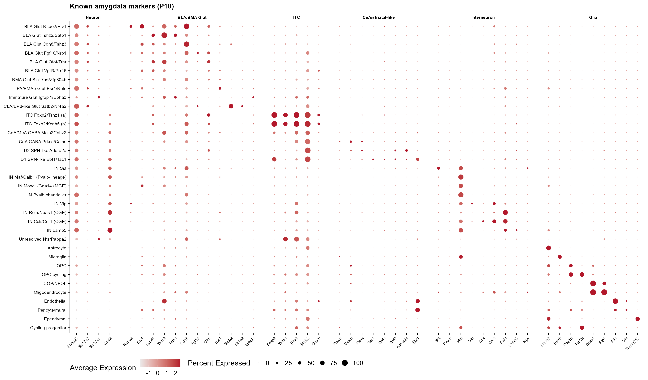
Labels agree with known amygdala markers
Dot size = % cells, colour = scaled mean expression, P10 cells only
Allen mapping (cells agreeing)
• Rspo2/Etv1 BLA Glut -> 014 LA-BLA-BMA-PA Glut (92%)
• ITC (a) / (b) -> 064 STR-PAL Chst9 Gaba (91% / 80%); Foxp2+ Tshz1+ Pbx3+ Meis2+
• D2 SPN-like -> 062 STR D2 Gaba (83%)
• Vip -> 046 Vip Gaba (93%); Pvalb chandelier -> 051 (72%)
• OPC 99%, Microglia 85%, Ependymal 87%
Other immature P10 glut types partly map to adult DG / IMN types; their labels rest on markers (next slide)

Slide 5
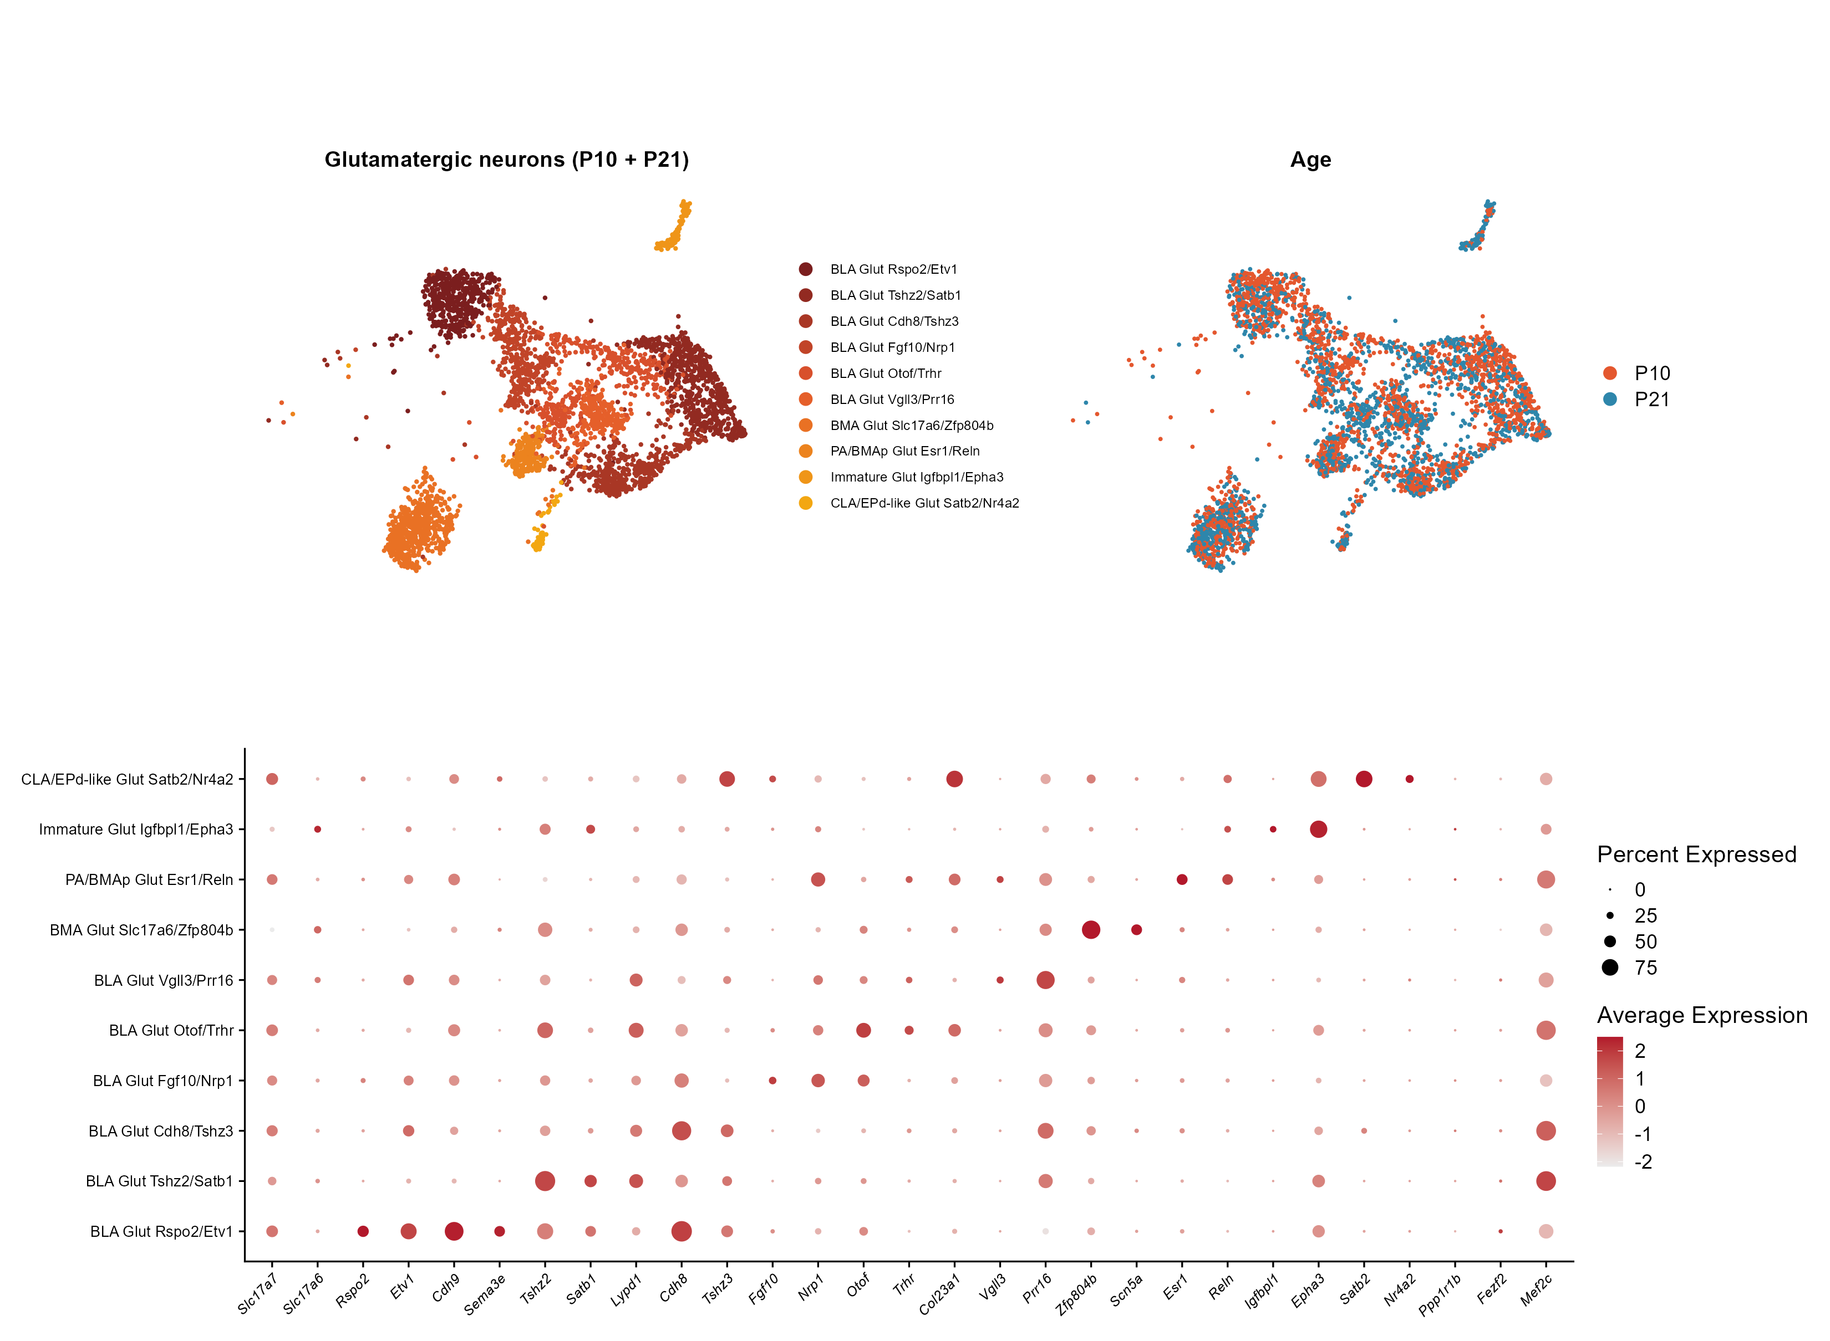
BLA glutamatergic sub-populations
Re-clustered glutamatergic neurons only (P10 + P21, Harmony across samples)
Ten glutamatergic groups
• Rspo2/Etv1: anterior-BLA Rspo2 population (Kim et al. 2016); also Cdh9, Sema3e, C1ql3
• Tshz2/Satb1, Cdh8/Tshz3, Fgf10/Nrp1, Otof/Trhr, Vgll3/Prr16: Rspo2-negative BLA/LA groups
• BMA Slc17a6/Zfp804b and PA/BMAp Esr1/Reln: neighbouring nuclei
• Immature Igfbpl1/Epha3 (Dcx/Sox11+, still present at P21)
• CLA/EPd-like Satb2/Nr4a2
Ppp1r1b (posterior BLA) and Fezf2 are barely detected at P10/P21 in this dissection
All groups are found at both ages

Slide 6
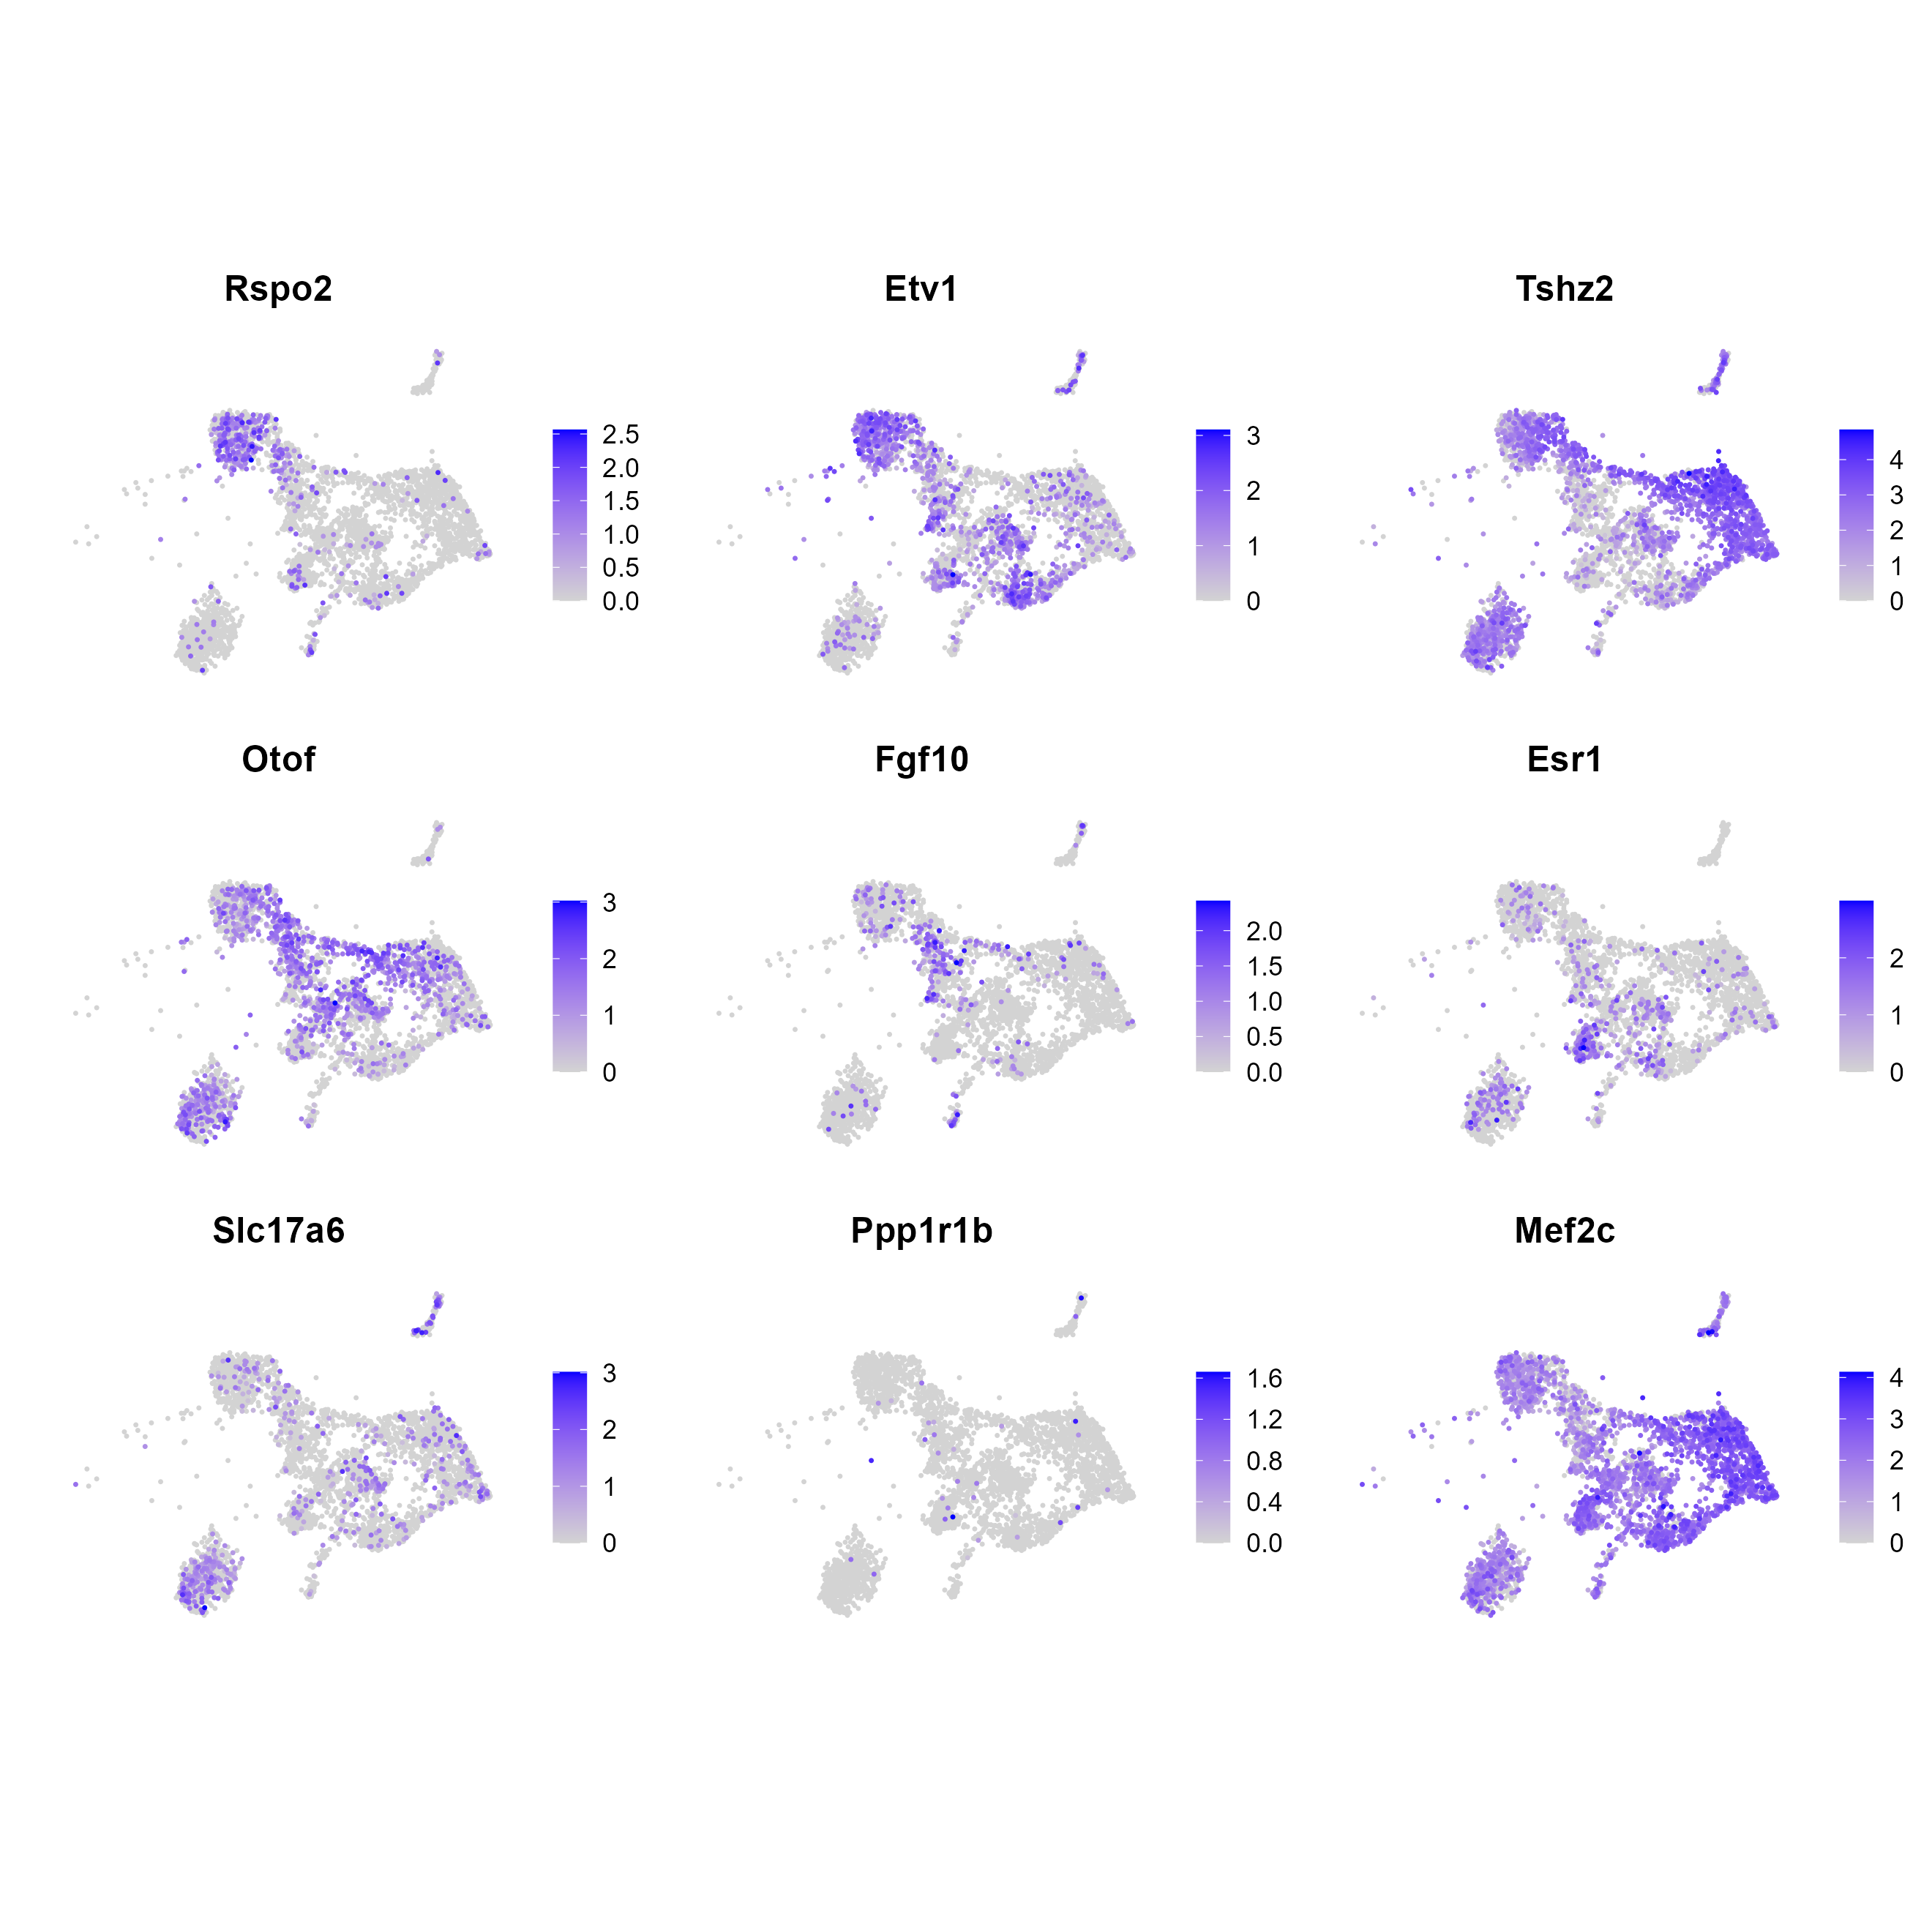
BLA glutamatergic marker genes on the glutamatergic map

Slide 7
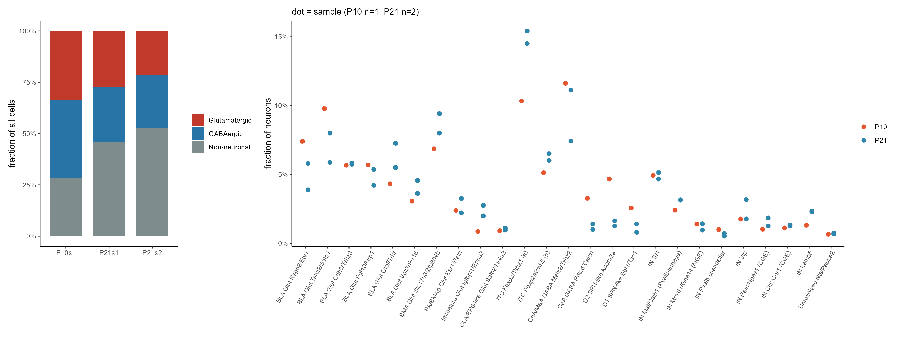
Cell-type composition, P10 vs P21
Dots = individual samples. With one P10 animal, read these as observations, not tests.
• Neuronal share falls from P10 to P21 (more glia are captured as the brain matures)
• CeA / D1 / D2 SPN-like fractions are higher at P10, most likely a wider medial punch; ITC fractions are higher at P21

Slide 8
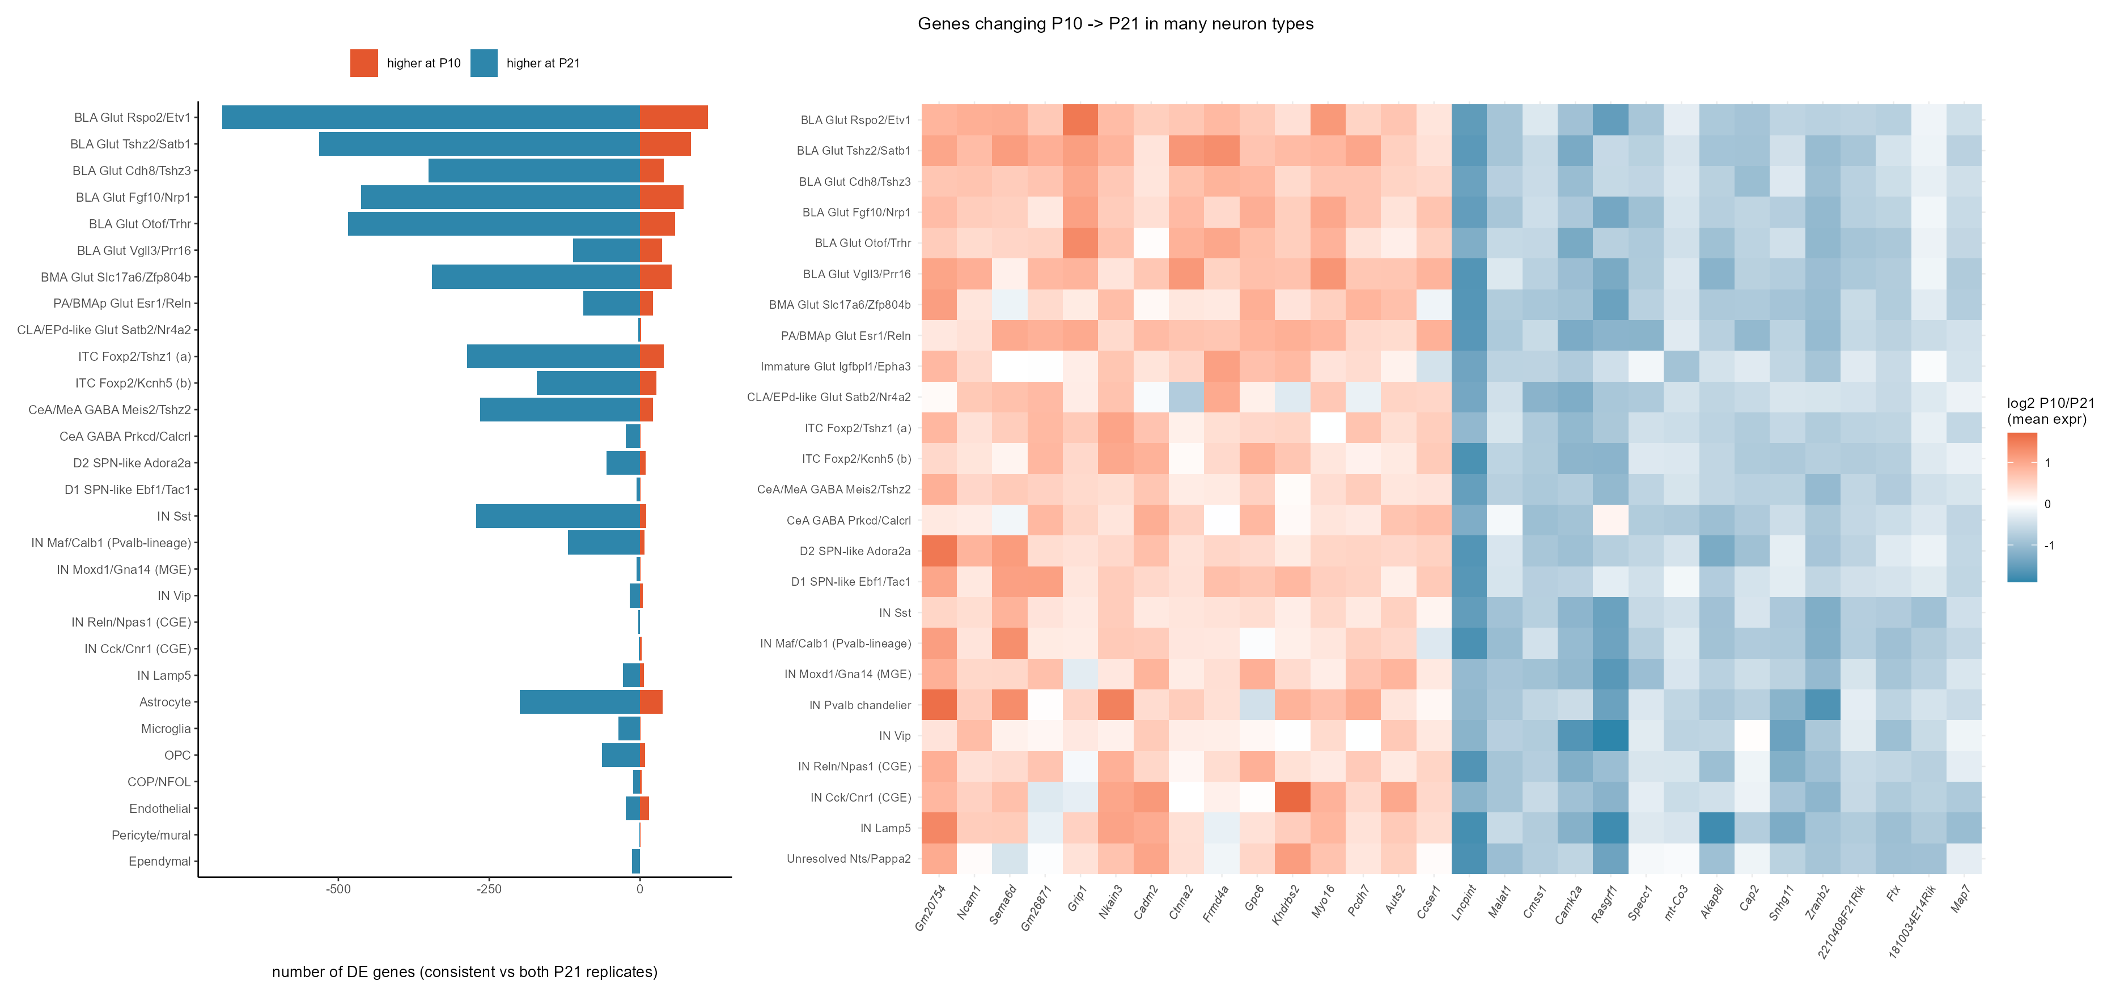
Gene-expression changes P10 -> P21
Wilcoxon per cell type, kept only if the direction holds against BOTH P21 replicates (pseudo-bulk)
Most change is in BLA glutamatergic neurons. Shared P10-high genes include Ncam1, Sema6d, Cadm2, Grip1 and Pcdh7 (adhesion/guidance). P21-high genes include activity/maturation genes (Camk2a, Rasgrf1).

Slide 9
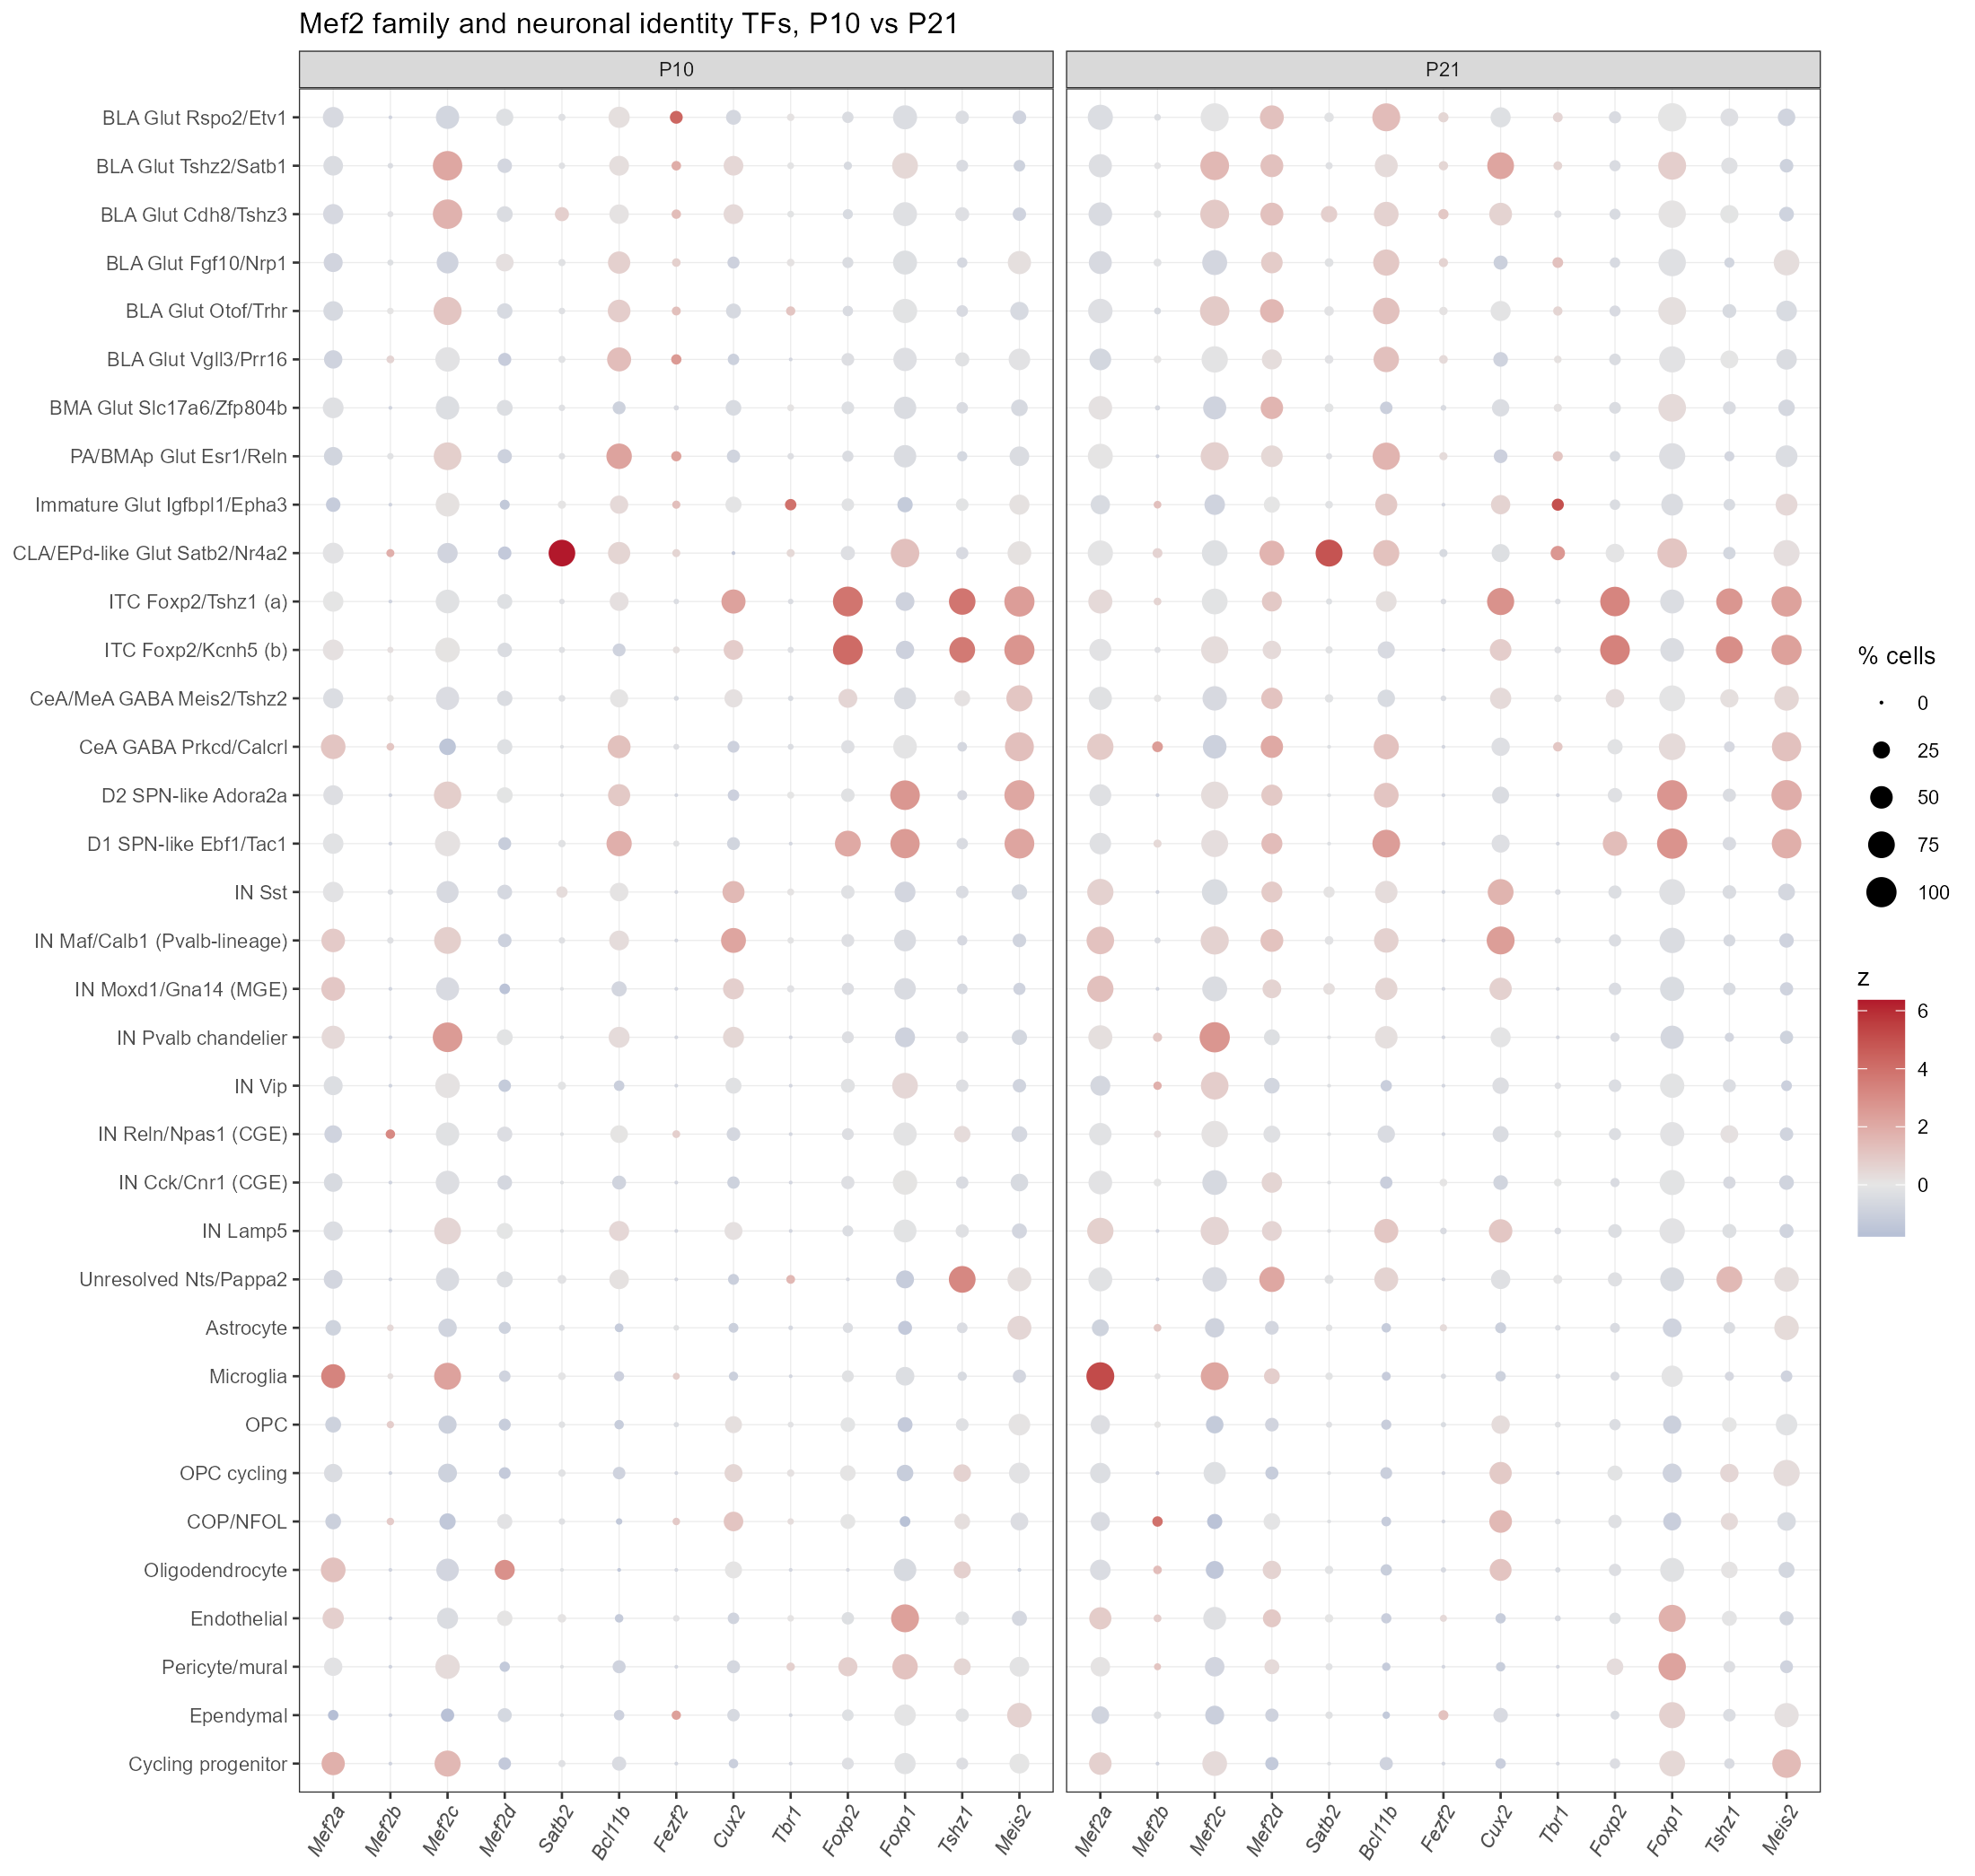
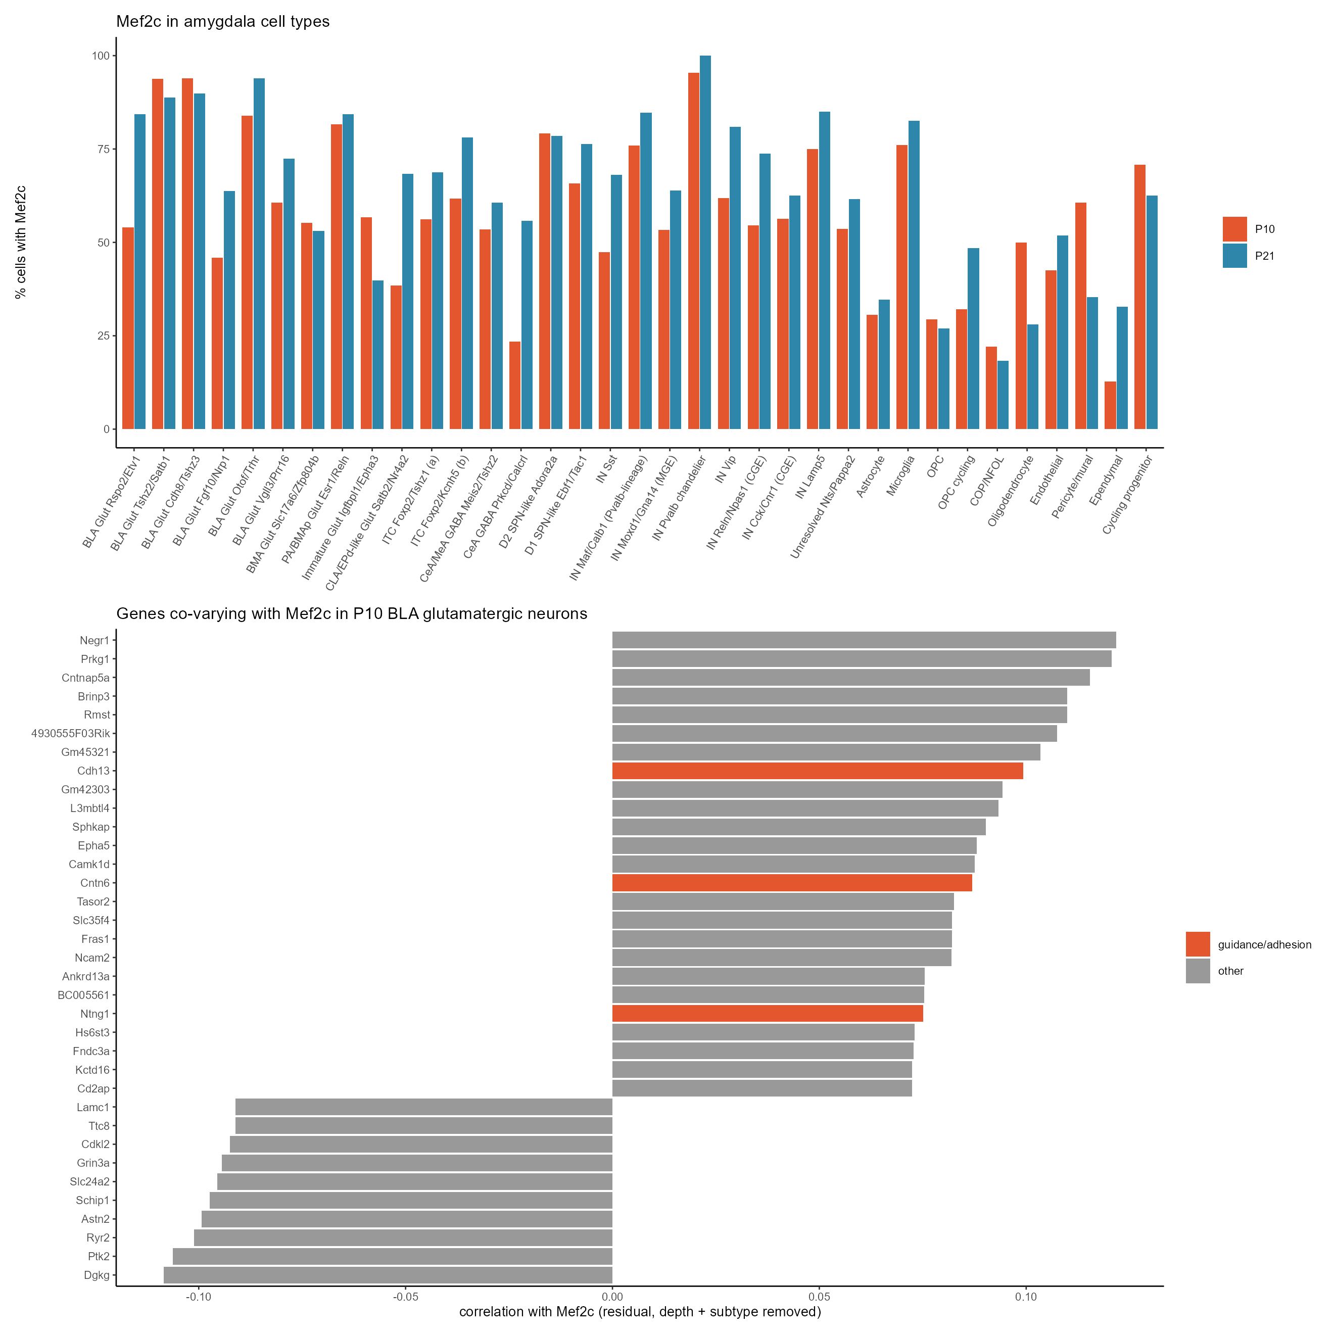
Mef2c in the amygdala
Mef2c is high in most BLA glutamatergic groups, Pvalb chandelier cells and microglia; moderate in ITCs

Slide 10
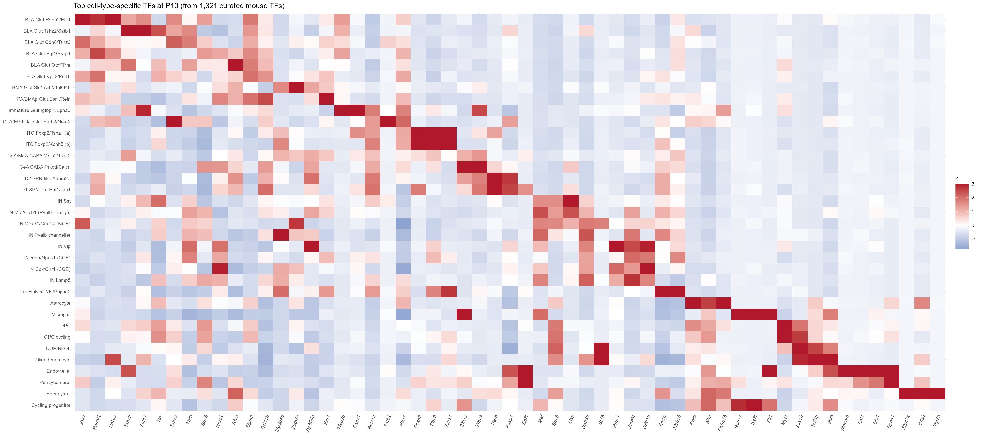
Transcription factors that define each P10 cell type
Top 3 TFs per cell type from 1,321 curated mouse TFs (AnimalTFDB-based list from the GPCR/TF panel project)

Slide 11
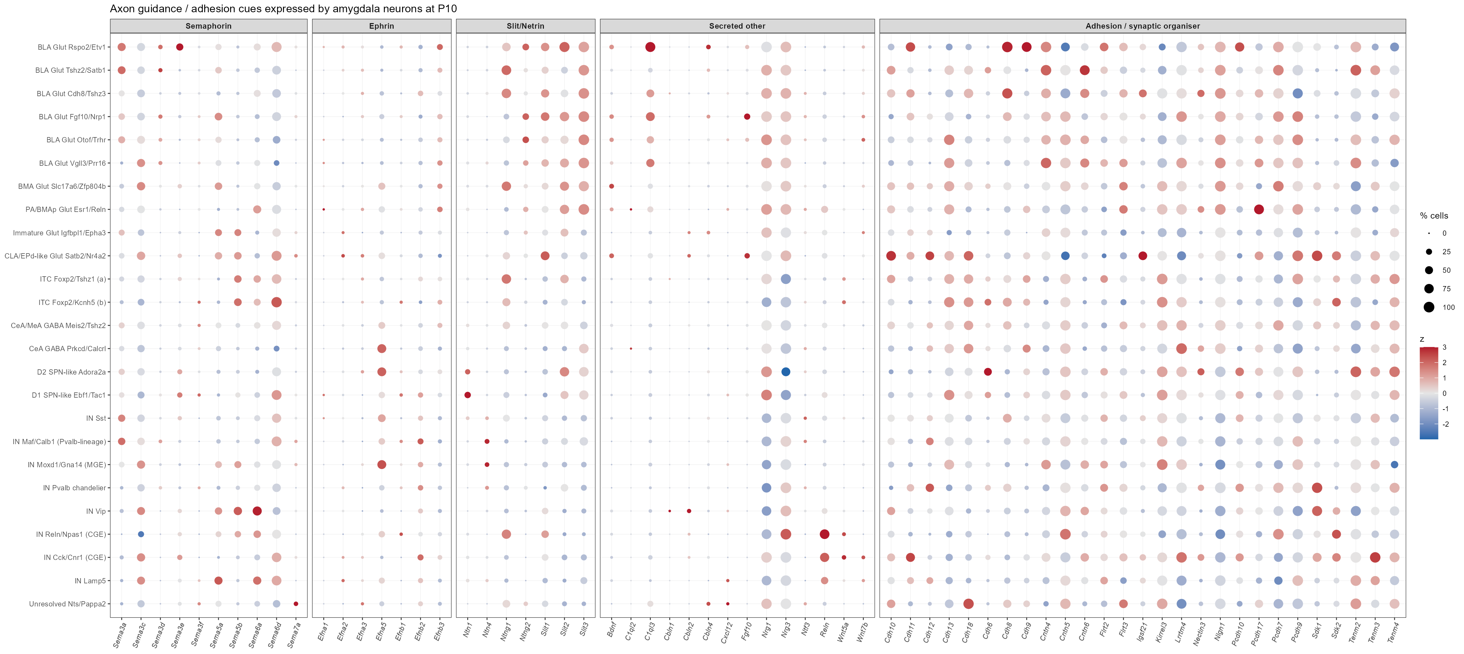
Guidance / adhesion cues expressed by amygdala neurons at P10

Slide 12
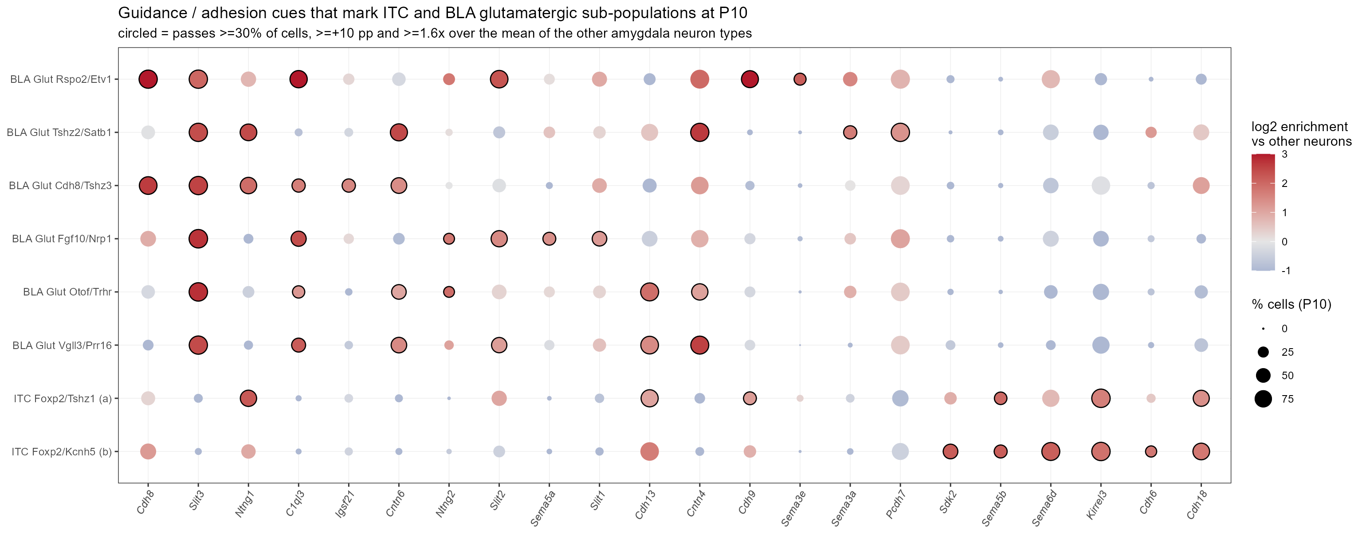
Candidate cues that mark ITC and BLA sub-populations at P10
Circled = >=30% of cells and >=1.6x / +10 pp over the mean of the other amygdala neuron types
• ITC: Kirrel3 (98%), Sdk2, Sema6d, Sema5b, Cdh18, Ntng1 (both ITC groups) - homophilic adhesion and semaphorin cues
• Rspo2/Etv1 BLA: C1ql3 (x10.7), Cdh8, Cdh9, Slit2, Sema3e. Other BLA groups: Cntn4/6, Ntng1/2, Slit3, Cdh13

Slide 13
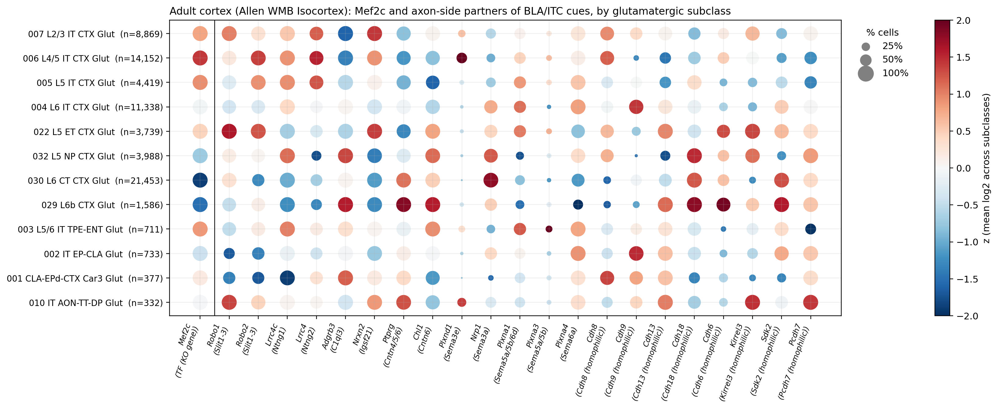
Back to cortex: which cortical neurons carry the matching partners?
Adult Allen Isocortex, all areas pooled - a ranking aid only, not P5-P10 and not area-specific
• Kirrel3 (homophilic, ITC 98%): 90% of L2/3 IT and 99% of L5 ET cells, but only 37-39% of L5/L6 IT
• Plxnd1 (receptor for Sema3e, made by Rspo2 BLA cells) is restricted to L4/5 IT (50%) and L2/3 IT (25%)
• Many partners (Robo1/2, Lrrc4c, Adgrb3, Nrxn2) are near-ubiquitous in adult cortex, so they cannot single out a source population

Slide 14
Why would Mef2c-cKO axons over-innervate BLA? Six testable scenarios
Hypotheses for discussion; slides that follow test scenarios 2 and 3 with this data
Axon / cortex side
• 1 Identity shift: Mef2c loss pushes L2/3-L4 IT neurons toward an amygdala-projecting IT programme (cf. Satb2 KO re-routing callosal axons; Alcamo 2008, Britanova 2008)
• 2 Failed refinement: MEF2 limits excitatory synapse number and drives activity-dependent elimination (Flavell 2006; Pfeiffer 2010; Tsai 2012, via Pcdh10), so transient branches persist and grow from P5
• 3 Receptor switch: Mef2c changes guidance receptors, e.g. Plxnd1 + Nrp1 turns Sema3e from repulsive to attractive (Chauvet 2007)
• 4 Route: axons that fail to enter contralateral S1/S2 run on along the external capsule, which borders LA/BLA
Target side / labelling
• 5 Target change: an Emx1-type Cre also deletes Mef2c in BLA glutamatergic neurons (>90% Mef2c+ in several groups here)
• 6 Compensation: losing the normal target frees axons and trophic competition, so they branch in an open neighbour
Tests that separate them
• Cre line; ipsi vs contra; time course of the route (P1-P5)
• Retrograde CTB from BLA in the cKO -> source area and layer
• Identity markers (Satb2, Cux2, Rorb, Bcl11b, Lmo4) in labelled cKO neurons
• HCR at P5-P10 for the candidate cues (next slides)

Slide 15
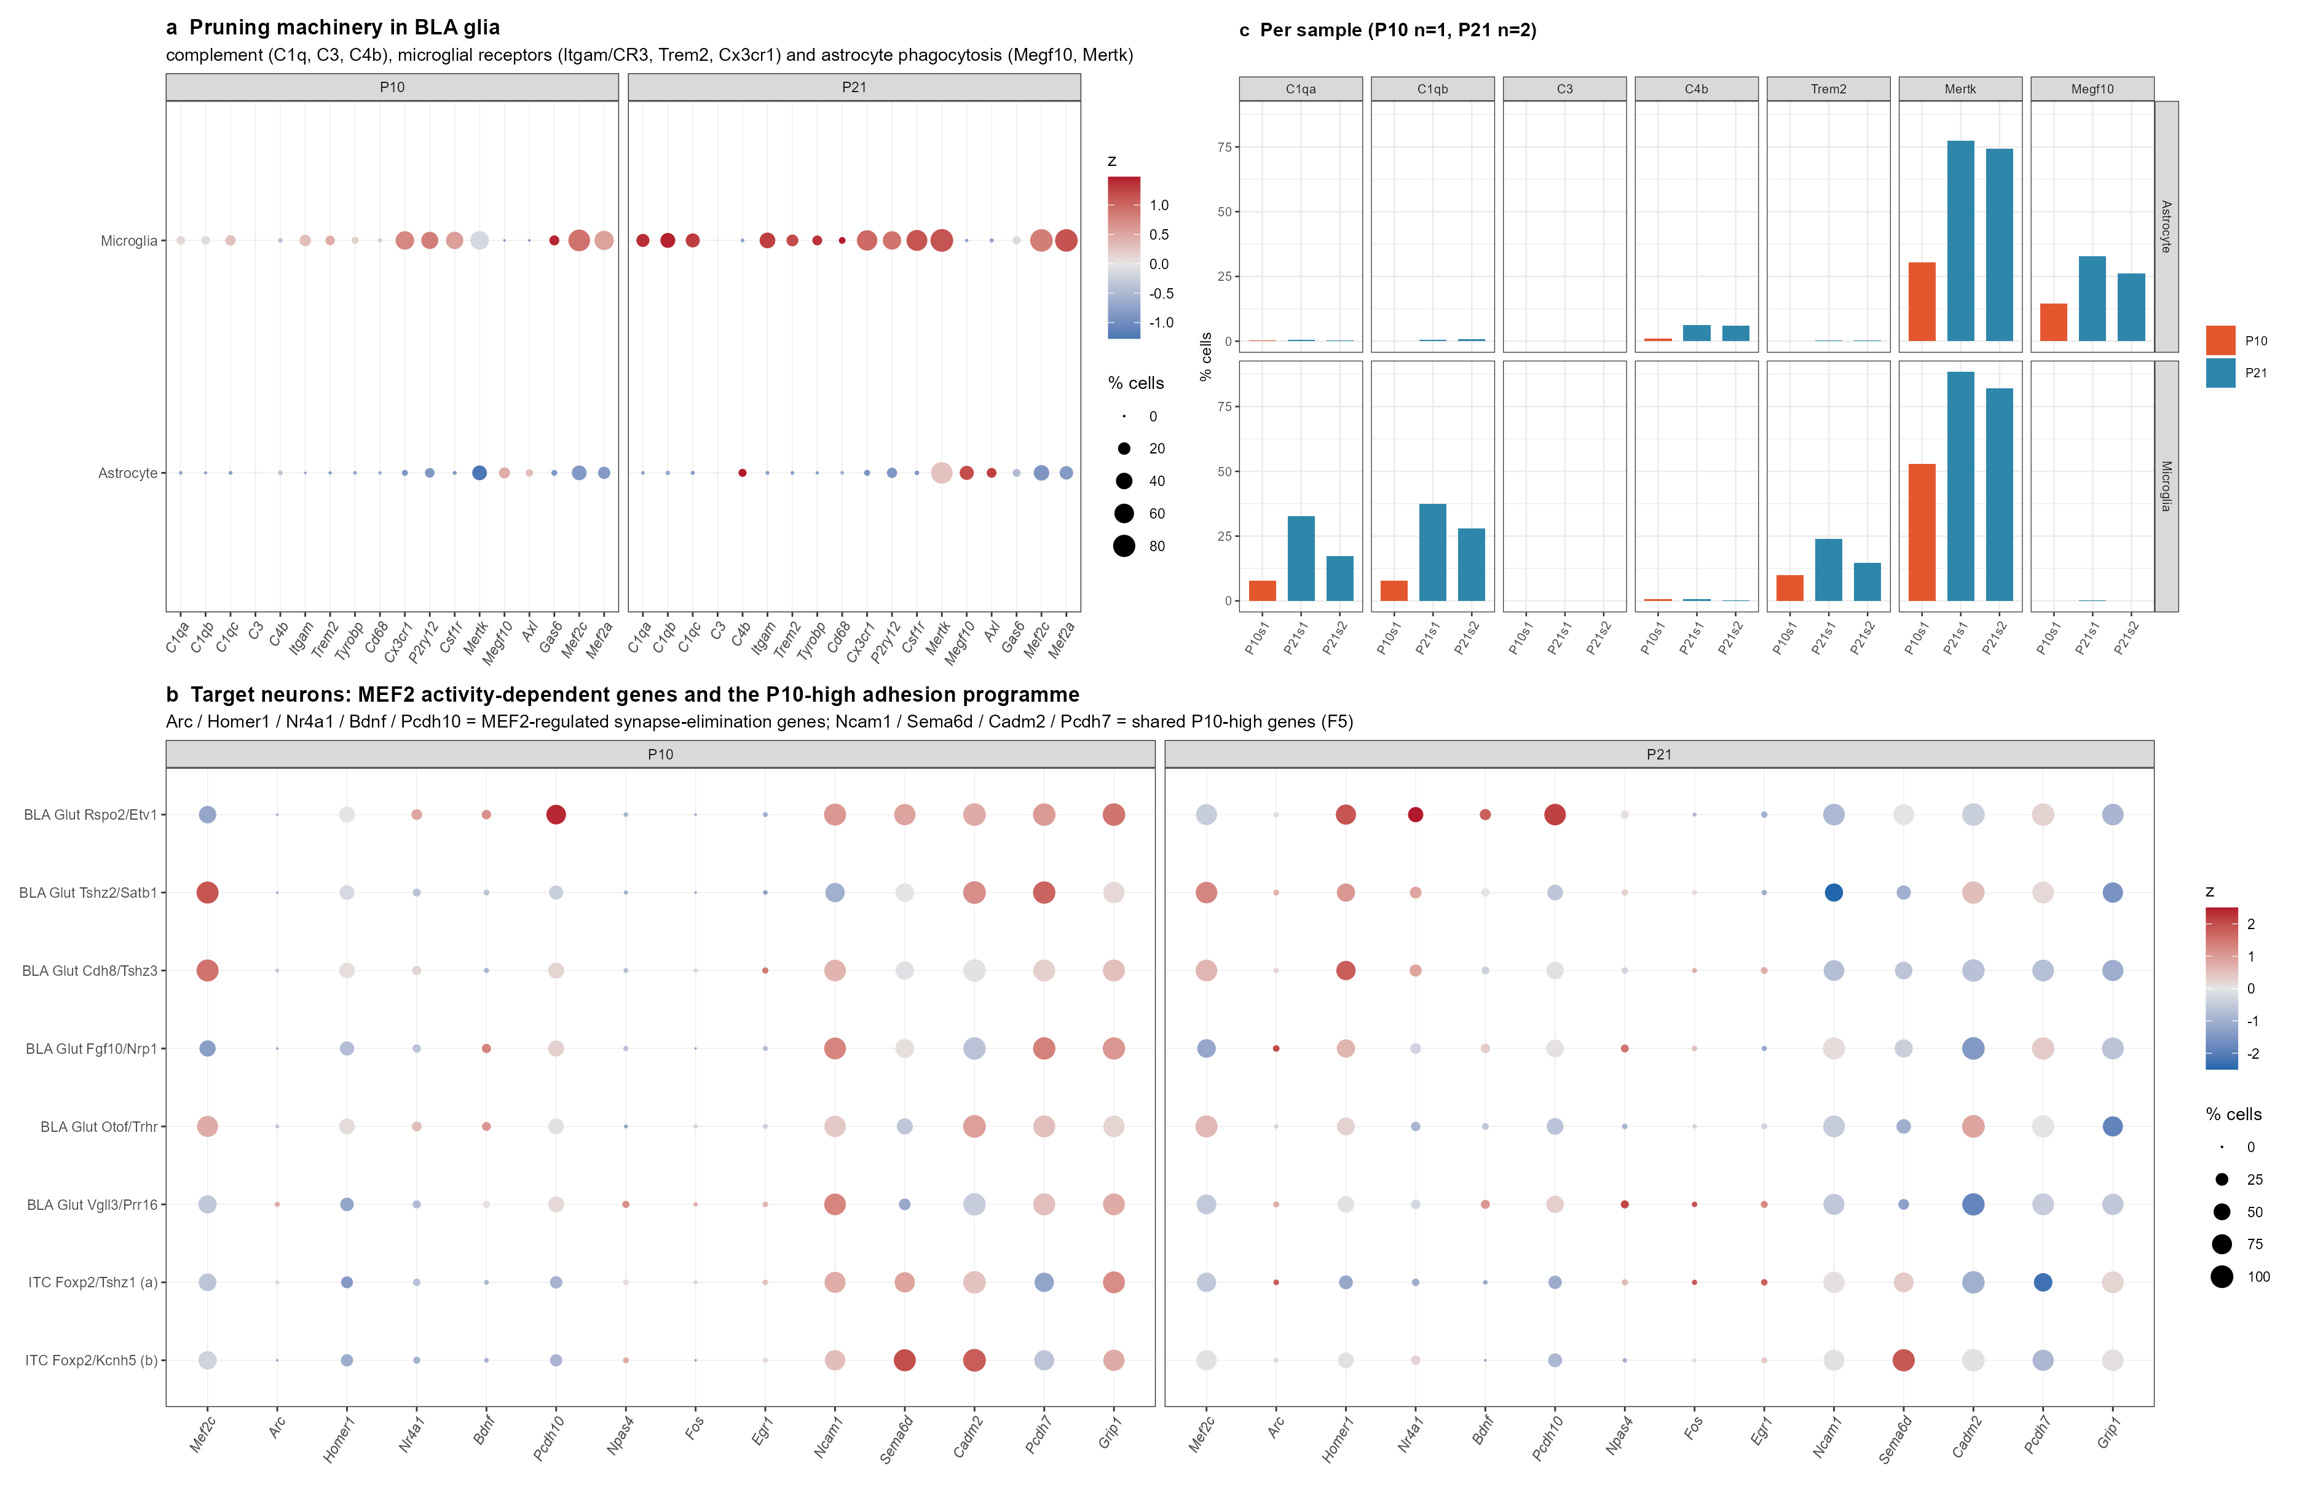
Scenario 2 - BLA at P10 is a pre-pruning, pro-adhesion window
Glial elimination machinery is still low at P10; target neurons express a P10-high adhesion programme
What the data show
• Astrocyte Mertk 30% (P10) vs 75-77% (P21); Megf10 15% vs 26-33%
• Microglial C1qa / C1qb 8% vs 17-37%; Trem2 10% vs 15-24%
• Neurons: Ncam1, Sema6d, Cadm2, Pcdh7 higher at P10; Homer1, Nr4a1 (MEF2 targets) higher at P21 in Rspo2 BLA
Reading
• Ectopic axons arriving at P5-P10 meet a target that is not yet pruning
• If Mef2c-null axons also lack their own MEF2-driven elimination, nothing removes them
Caveat: one P10 animal; glial capture rises with age

Slide 16
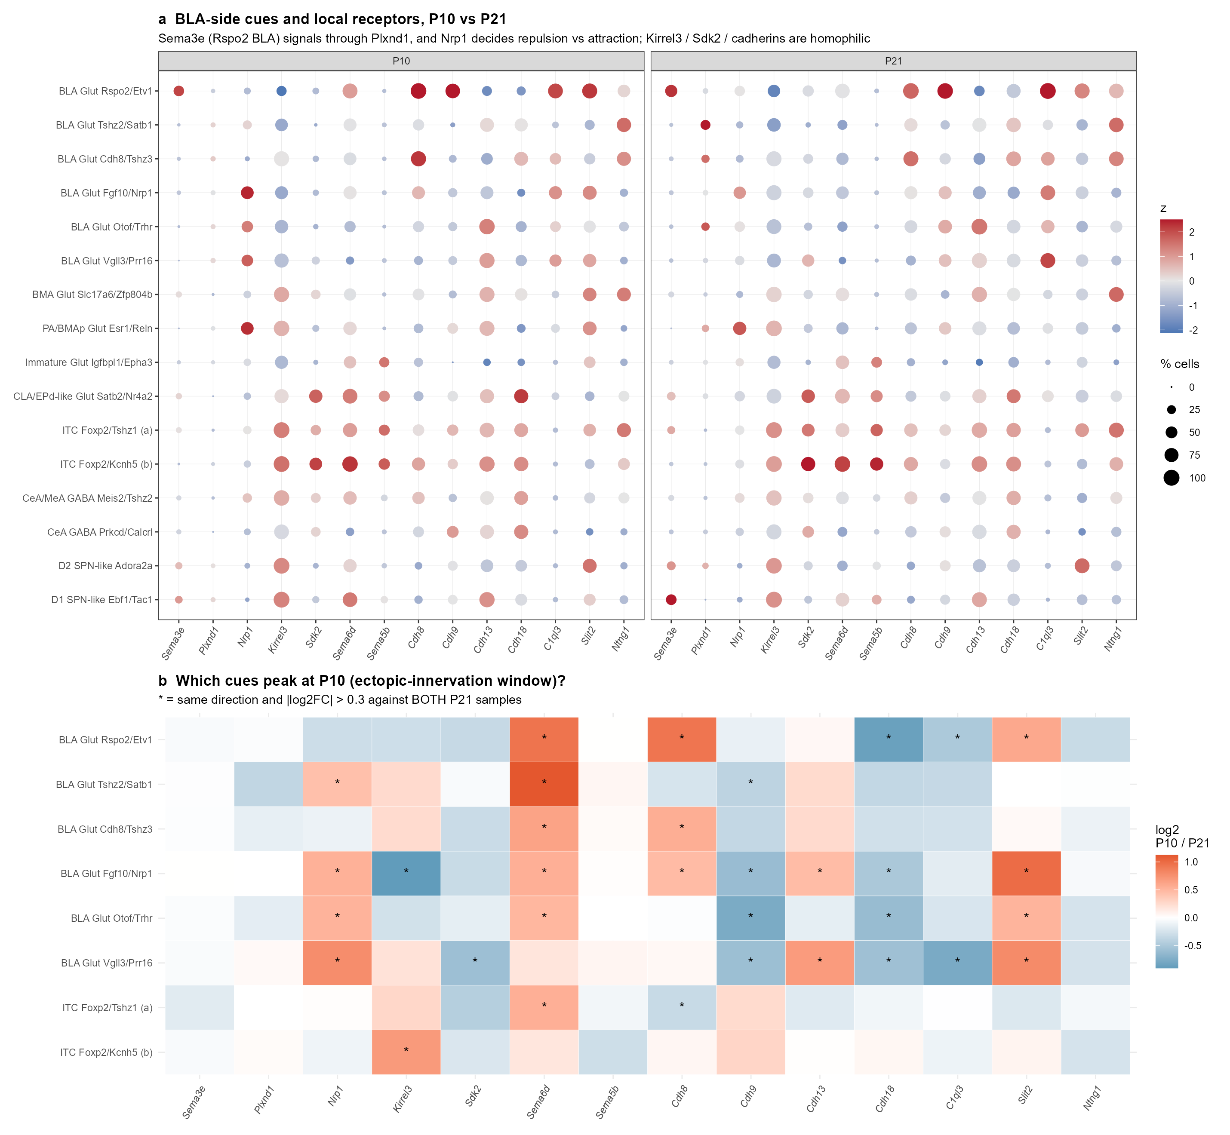
Scenario 3 (BLA side) - which cues peak in the P5-P10 window?
* = same direction against both P21 samples
Higher at P10
• Sema6d: BLA Tshz2/Satb1, Rspo2/Etv1, Cdh8/Tshz3, ITC (a)
• Slit2: Fgf10/Nrp1, Vgll3/Prr16, Rspo2/Etv1
• Nrp1 in several BLA groups; Cdh8 in Rspo2/Etv1
• Kirrel3 in ITC (b) (already 98%)
Higher at P21 (maturing synapses)
• Cdh9, Cdh18, C1ql3, Sdk2
Sema3e is made by Rspo2 BLA at both ages (38% at P10); its receptor Plxnd1 is barely expressed inside the amygdala, so Sema3e acts on incoming axons

Slide 17
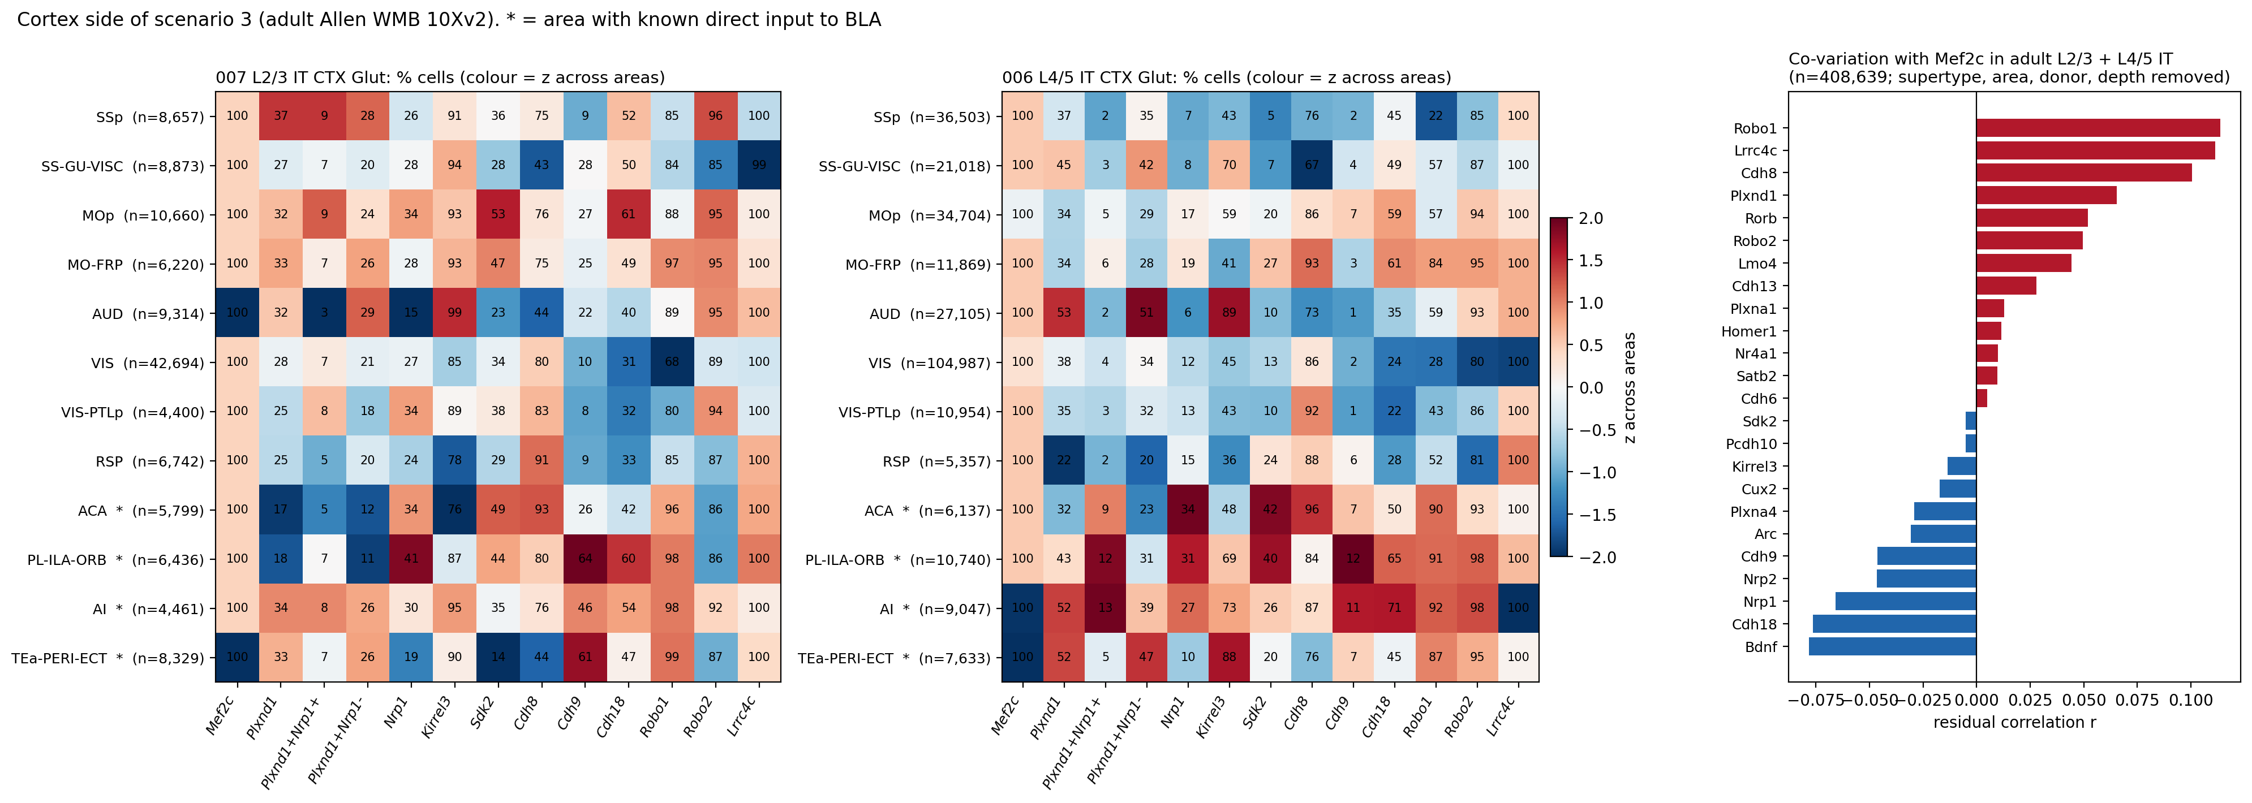
Scenario 3 (cortex side) - partner receptors by cortical area
Adult Allen WMB 10Xv2 (408,639 L2/3 + L4/5 IT cells). Numbers = % cells. * = area with known BLA input
• Cdh9 (homophilic; marks Rspo2 BLA): L2/3 IT 61-64% in TEa-PERI-ECT and PL-ILA-ORB, 46% in AI, but only 9% in SSp
• Sema3e response: SSp L4/5 IT is mostly Plxnd1+ Nrp1- (35%, repulsion-type), with only 1.6% Plxnd1+ Nrp1+ (attraction-type)
• Inside IT neurons Mef2c co-varies weakly and negatively with Nrp1, Cdh9 and Cdh18 (r = -0.05 to -0.08). Hypothesis: Mef2c loss de-represses Nrp1 / Cdh9 in SSp neurons, switching them toward BLA-type partners

Slide 18
Summary and suggested next steps
Cell populations to watch
• ITCs (Foxp2+ Tshz1+ Pbx3+), two groups: the FoxP2 cells next to the ectopic axons
• Rspo2/Etv1 BLA glutamatergic neurons, the most distinct BLA group
• Mef2c-high BLA groups (Tshz2/Satb1, Cdh8/Tshz3, Otof/Trhr): if the Cre also hits BLA neurons (e.g. Emx1 lineage), the target side changes too
Gene candidates
• ITC: Kirrel3, Sdk2, Sema6d, Sema5b, Cdh18, Ntng1
• BLA Rspo2: C1ql3, Cdh8, Cdh9, Sema3e, Slit2
• Cortex (test in cKO SSp L2/3-L4/5 at P5-P10): Nrp1 / Plxnd1 ratio, Cdh9, Kirrel3
Next steps
• Confirm which Cre line drives the cKO: this decides whether BLA neurons also lose Mef2c
• HCR / RNAscope at P5-P10: Foxp2 + Kirrel3 / Sdk2 / Sema6d, and Rspo2 + Sema3e / Cdh9, next to the ectopic axons
• Cortex: check the candidate partners (Kirrel3, Plxnd1, Cdh8/9, Sdk2) in WT vs Mef2c-cKO L2/3 neurons at P5-P10
• Retrograde tracing from BLA in the cKO to find the source area, then profile it
• New P10 replicates (P10_1, P10_2, run P173) are being processed and will make P10 vs P21 testable

