Slide 1
Developmental amygdala scRNA-seq
E18 · P0 · P10 · P21 — an exploratory update for Wei-Ming Kao
What changes when the early libraries are added?
76,446 putative singlets
10 libraries across four stages
25,029 shared genes
Population inventory
P10 transcription factors
Guidance / remodelling candidates
This dataset can generate testable candidates. It cannot explain a MEF2C-KO projection phenotype by itself.
Hansol Lim • Developmental amygdala scRNA-seq • 06 Oct 2026
1
Notes:
Source: input_manifest.csv, sample_qc_summary.csv, doublet_summary.csv. No labelled KO/WT data, animal IDs, or connectivity measurements. All experimental units are libraries, not cells.

Slide 2
What is in the combined dataset?
Seven new libraries + three previous P10/P21 libraries
Library | Stage | Source | Input | QC-pass | Putative singlets
E18_1 | E18 | New | 4,686 | 3,779 | 3,332
E18_2 | E18 | New | 5,026 | 4,018 | 3,604
P0_1 | P0 | New | 21,750 | 7,784 | 6,943
P0_2 | P0 | New | 60,941 | 4,888 | 4,296
P0_3 | P0 | New | 4,872 | 4,604 | 3,960
P10_1 | P10 | New | 40,994 | 33,548 | 31,017
P10_2 | P10 | New | 18,458 | 17,171 | 11,654
P10s1 | P10 | Previous | 7,254 | 6,546 | 5,086
P21s1 | P21 | Previous | 3,141 | 2,824 | 2,287
P21s2 | P21 | Previous | 6,309 | 5,443 | 4,267
Shared-gene analysis avoids treating the 7,256 new-only genes as absent in old samples.
Hansol Lim • Developmental amygdala scRNA-seq • 06 Oct 2026
2
Notes:
Sources: sample_qc_summary.csv, doublet_summary.csv. New samples: E18_1 P188 SI-GA-F3; E18_2 P189 SI-GA-F4; P0_1/P0_2 P165 SI-GA-E6/E9; P0_3 P188 SI-GA-F2; P10_1/P10_2 P173 SI-GA-E10/E11. Original new object 32285 genes x156727 barcodes; counts-only. P56 old samples are excluded. Animal independence and reference build are undocumented.

Slide 3
QC is a major source of uncertainty
Simple QC retention and classifier-labelled doublets — separate measures
P0_2: only 8.0% pass QC. P10_2: 32.1% putative doublets. Old/new mitochondrial capture differs sharply.
Hansol Lim • Developmental amygdala scRNA-seq • 06 Oct 2026
3
Notes:
Source: QC summaries. Main QC >=500 genes, >=1000 UMIs, mito<=20%. scDblFinder per library; dbr=.08,dbr.sd=1. Doublets are putative. P0 low-count barcodes cannot be proven empty droplets from this supplied object alone. https://www.bioconductor.org/packages/release/bioc/vignettes/scDblFinder/inst/doc/scDblFinder.html

Slide 4
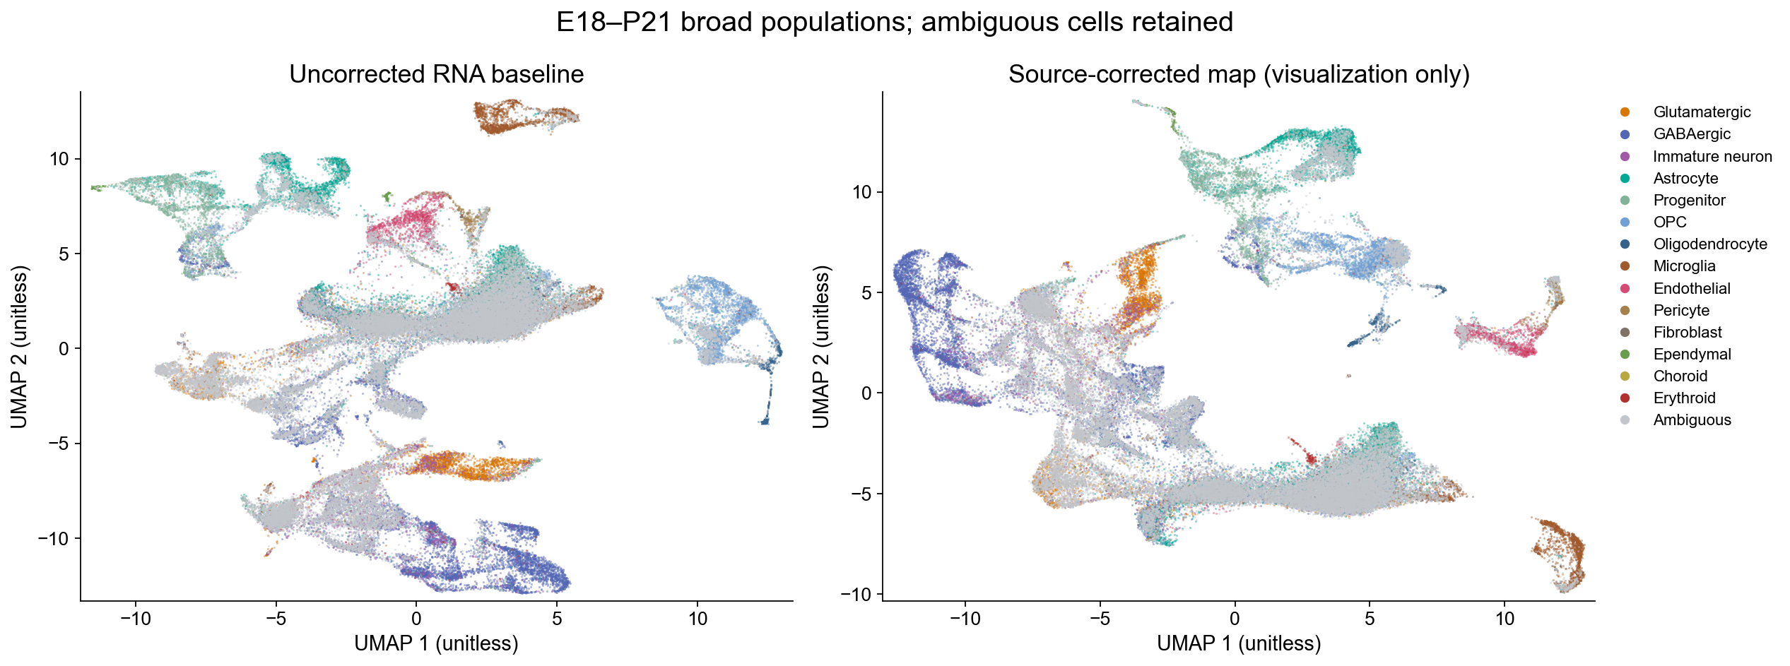
A broad map, not a cell-type verdict
Both uncorrected and source-corrected UMAPs are preserved
Labels use excluded markers and reference checks. Ambiguous cells remain visible; fine developmental identities are provisional.
Hansol Lim • Developmental amygdala scRNA-seq • 06 Oct 2026
4
Notes:
Source: V2_F02 and cell_metadata.csv. Embedding only: shared-gene RNA log normalization, HVG3000 excluding candidates/ribo/mito, PCA30, Harmony source theta1/lambda1, UMAP30/min_dist.3/cosine/seed1062026. Neither map is ground truth. RNA integrity hashes unchanged. Source correction does not fully mix old/new P10.

Slide 5
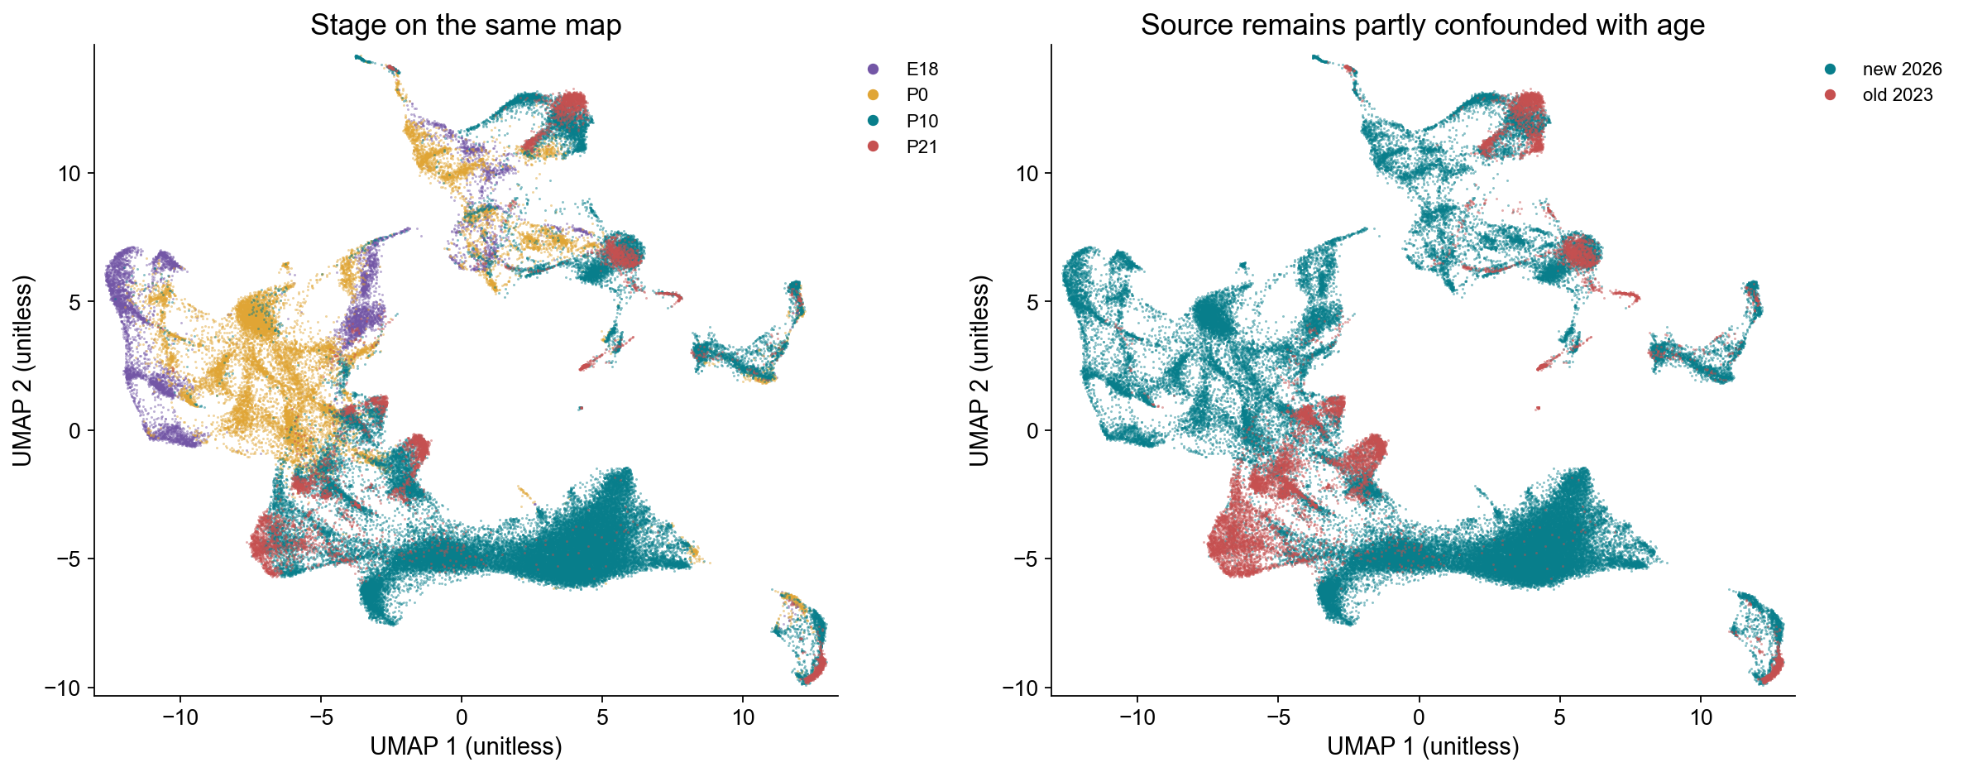
Stage and source are partly confounded
P10 overlaps sources; P21 exists only in the previous source
Harmony is for visualization only. All expression calculations use unchanged, uncorrected RNA counts.
Hansol Lim • Developmental amygdala scRNA-seq • 06 Oct 2026
5
Notes:
Source: V2_F03, embedding_validation.csv. P10 balanced-source neighbor mixing rises but remains far below balanced random mixing. Do not interpret a source-specific island as maturation or a new subtype.

Slide 6
Captured populations differ by library
Fractions of retained barcodes — not proportions in intact tissue
Library capture, depth, ambiguous labels and doublet selection prevent a definitive developmental cell census.
Hansol Lim • Developmental amygdala scRNA-seq • 06 Oct 2026
6
Notes:
Source: population_composition_per_library.csv, primary_singlets. Minor classes grouped only in this chart; full CSV retains all classes. ITC-like and Rspo2-positive subsets are nested and not added to broad denominators. No independent animal n.

Slide 7
Annotation checks expose unresolved cells
The adult-atlas-only baseline did not validate well
Library | Adult atlas / marker | Previous broad split | Ambiguous (QC %)
E18_1 | 6.6% | 75.0% | 2.8%
E18_2 | 3.8% | 74.7% | 2.5%
P0_1 | 10.9% | 67.3% | 55.0%
P0_2 | 15.6% | 72.3% | 44.0%
P0_3 | 22.3% | 84.3% | 11.9%
P10_1 | 25.8% | 59.1% | 45.1%
P10_2 | 25.8% | 60.2% | 39.5%
P10s1 | 35.4% | 94.7% | 67.1%
P21s1 | 58.3% | 97.2% | 30.0%
P21s2 | 56.2% | 95.9% | 40.7%
Broad marker-supported assignments are useful candidates. Novel or low-depth identities require further validation.
Hansol Lim • Developmental amygdala scRNA-seq • 06 Oct 2026
7
Notes:
Source: annotation_validation_per_sample.csv computed before doublet exclusion. Training1457 and heldout1457 reference genes exclude marker/candidate genes. Previous-reference predictions inherit v1 uncertainty. Leave-one-old-library-out label agreement84.6/90.5/90.5% is consistency, not independent truth. Adult reference Yao2023: https://www.nature.com/articles/s41586-023-06812-z

Slide 8
Mef2c expression: library-level evidence
Each dot is one library; old and new P10 are shown separately
Glutamatergic
GABAergic
ITC-like GABA*
*ITC-like identity is provisional and not spatially verified. Similar expression does not imply similar MEF2C function.
Hansol Lim • Developmental amygdala scRNA-seq • 06 Oct 2026
8
Notes:
Source: sample_population_expression.csv.gz, primary singlets, n>=30 per group. CPM uses total shared-gene pseudobulk UMIs. No per-cell p-values or KO inference. MEF2C activity/binding is not measured.

Slide 9
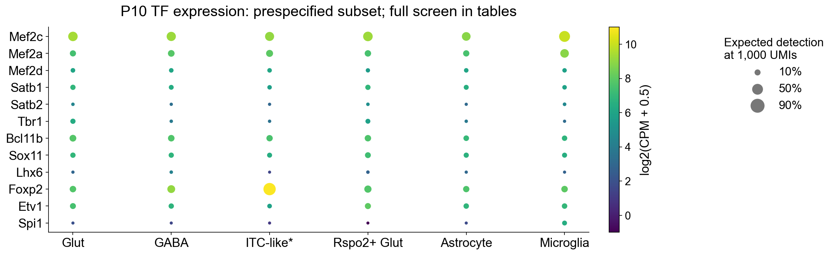
P10 transcription-factor expression
A candidate screen, not TF activity or a causal target ranking
Use cell identity + candidate availability to plan experiments; verify protein, location and genotype-specific regulation.
Hansol Lim • Developmental amygdala scRNA-seq • 06 Oct 2026
9
Notes:
Source: TF_expression_per_library.csv.gz, supplied mouse_TF_list_1321.csv. Figure shows prespecified developmental/lineage TFs. Color is log2(mean library CPM+.5), size is expected detection at1000UMIs. Marker TFs such as Foxp2/Etv1 are annotation anchors.

Slide 10
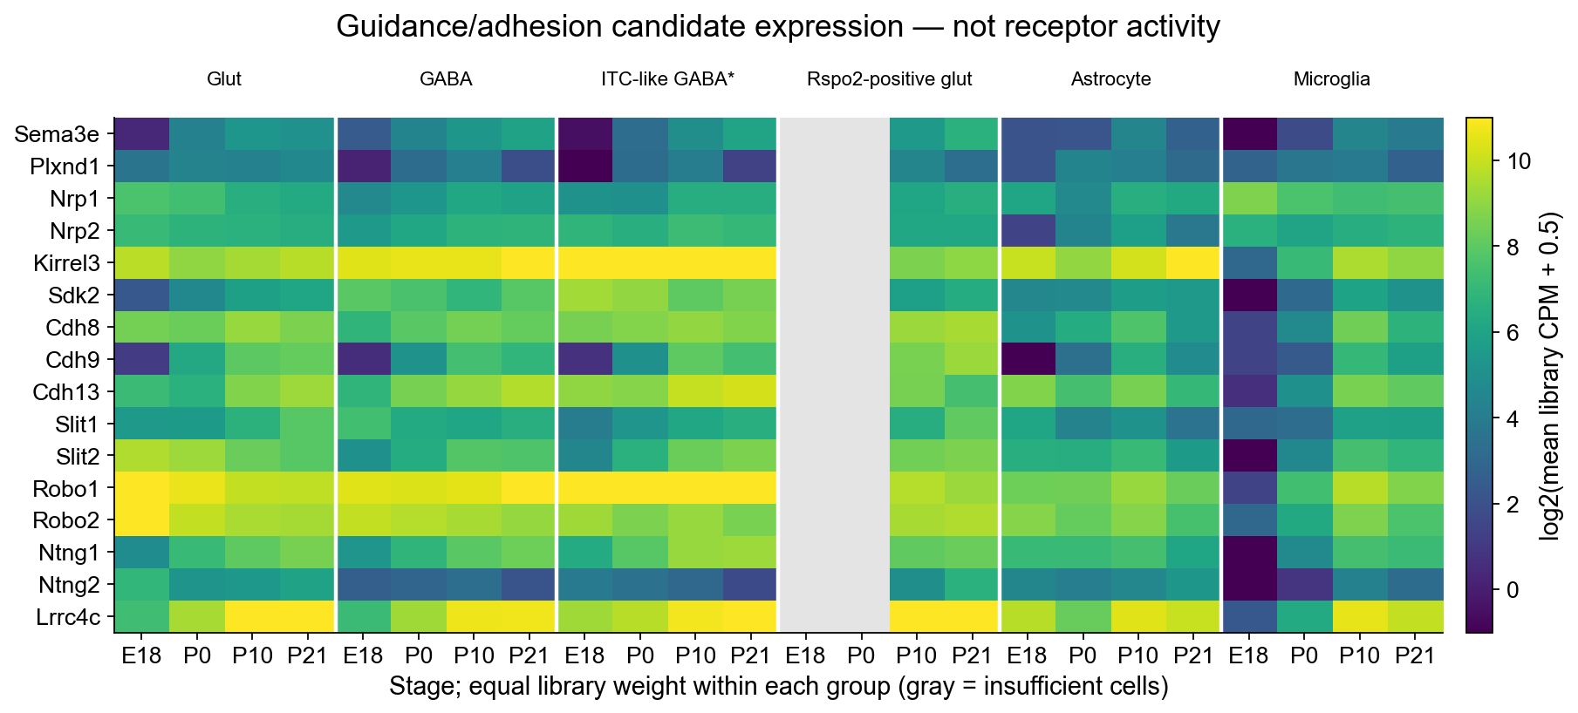
Guidance and adhesion candidates across stages
Sema3e · Plxnd1/Nrp1 · Kirrel3 · cadherins · Slit/Robo
Expression nominates components. Functional cue response and the projecting cortical cell must be tested independently.
Hansol Lim • Developmental amygdala scRNA-seq • 06 Oct 2026
10
Notes:
Source: V2_F06 and candidate_expression_per_library.csv. Equal library weights, groups>=30 cells, common genes only. Rspo2-positive subset selected by Rspo2 detection; ITC-like tentative. Transcript detection is not receptor stoichiometry or attraction/repulsion. Chauvet2007 primary: https://doi.org/10.1016/j.neuron.2007.10.019

Slide 11
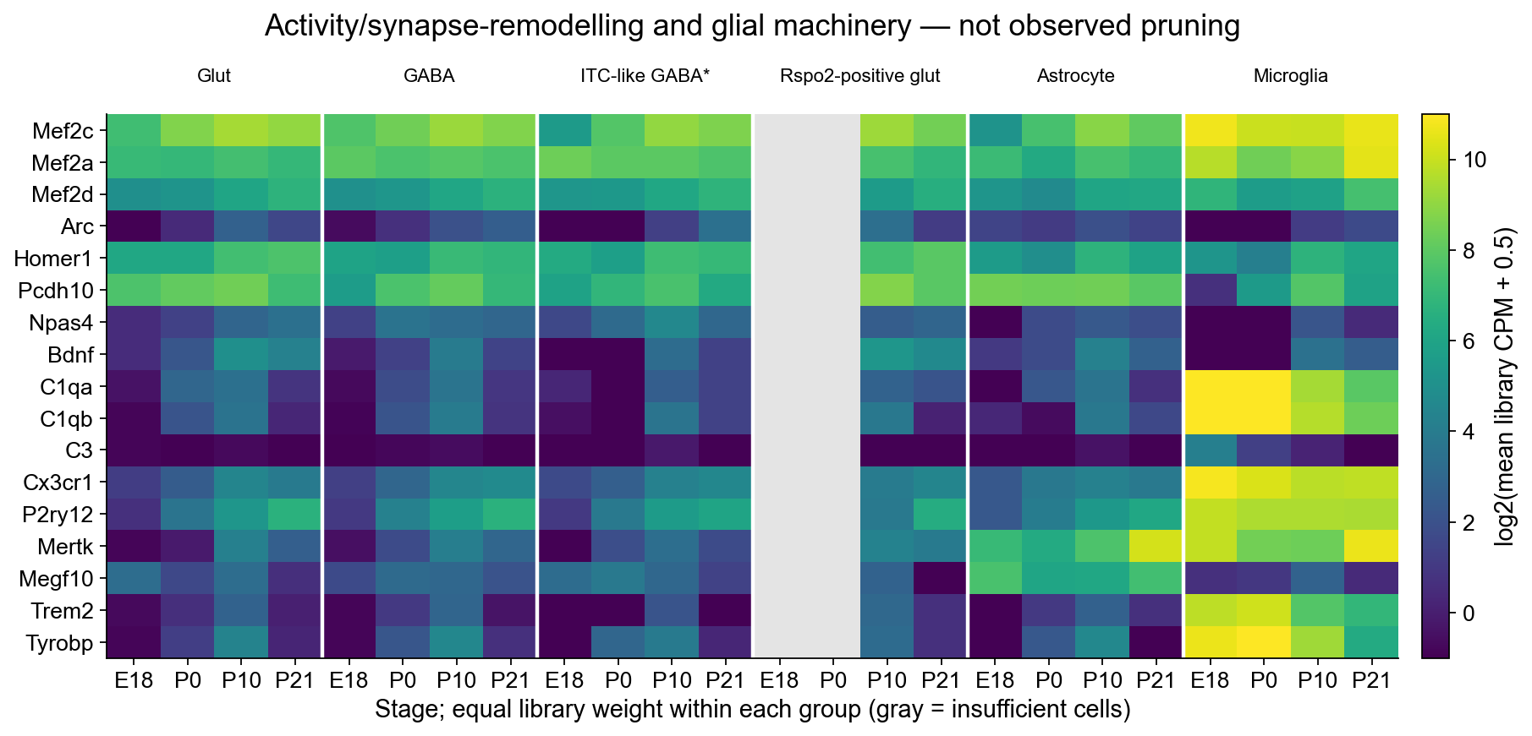
Synapse-remodelling and glial candidates
MEF2-associated activity genes and engulfment/complement machinery
These observations do not distinguish retained axon branches, additional synapses, altered tracer labeling or changed cortical cell identity.
Hansol Lim • Developmental amygdala scRNA-seq • 06 Oct 2026
11
Notes:
Source: V2_F07, raw pseudobulk CPM. C1qa/C1qb/Cx3cr1/P2ry12 are also annotation markers: expression in microglia is not independent cell-type enrichment proof. Flavell2006 activity-dependent MEF2 regulation in hippocampal synapses https://pubmed.ncbi.nlm.nih.gov/16484497/. No axonal pruning measurement here.

Slide 12
Cortical context is external adult reference
The new experiment samples amygdala, not the projecting cortex
Gene | L2/3 IT Detection % | L4/5 IT Detection % | L5 ET Detection %
Kirrel3 | 89.9 | 73.0 | 99.1
Plxnd1 | 24.8 | 50.0 | 7.1
Nrp1 | 45.7 | 34.0 | 75.0
Nrp2 | not available | not available | not available
Sdk2 | 52.1 | 44.6 | 91.0
Robo1 | 98.6 | 91.4 | 99.9
Do not claim Plxnd1 is exclusive to one cortical class, or that Nrp1-negative RNA means a repulsive receptor state.
Hansol Lim • Developmental amygdala scRNA-seq • 06 Oct 2026
12
Notes:
Source: prior results/tables/C01_cortex_glut_receptor_pct_adult_Allen.csv. Adult Allen atlas, not P10 or KO cortex. Detection does not indicate co-localized receptor complexes. Martin2015 Kirrel3 hippocampal targeting https://elifesciences.org/articles/09395.

Slide 13
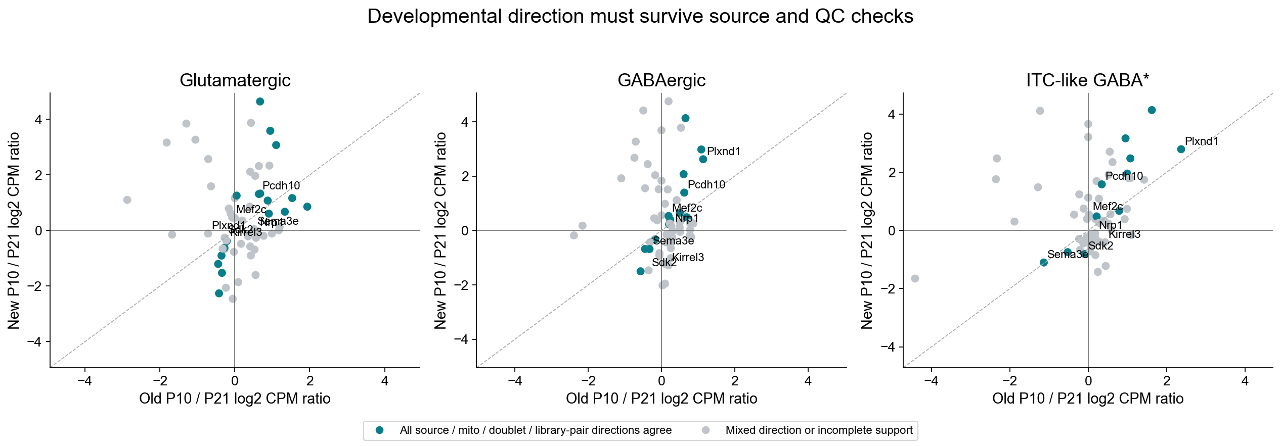
P10–P21 directions must survive source checks
True pseudobulk CPM ratios; mito and putative-doublet sensitivity
A consistent direction is stronger descriptive evidence, but P21-only-old-source confounding and unknown animal n remain.
Hansol Lim • Developmental amygdala scRNA-seq • 06 Oct 2026
13
Notes:
Source: candidate_P10_P21_descriptive_effects.csv and candidate_source_QC_sensitivity.csv. Gray means mixed directions or incomplete support; teal requires agreement across old/new sources,20/15% mito,inclusion/exclusion of putative doublets,and every library pair. No cell-level significance. Prior mean-log differences are not fold changes.

Slide 14
Core hypotheses: consistent and unstable patterns
Prespecified genes shown whether they pass or fail the sensitivity rule
Gene / population | Old P10 / P21 log2 ratio | New P10 / P21 log2 ratio | All direction checks
Mef2c — Glut | -0.07 | 0.46 | Mixed / unstable
Mef2c — GABA | 0.19 | 0.53 | Consistent direction
Pcdh10 — Glut | 0.64 | 1.31 | Consistent direction
Kirrel3 — ITC-like GABA* | 0.43 | -0.41 | Mixed / unstable
Sema3e — Glut | 0.52 | 0.04 | Mixed / unstable
Plxnd1 — ITC-like GABA* | 2.37 | 2.79 | Consistent direction
Nrp1 — Glut | 0.57 | -0.01 | Mixed / unstable
Pcdh10 is direction-consistent. Kirrel3 ITC-like change reverses by source. Neither observation is a KO result.
Hansol Lim • Developmental amygdala scRNA-seq • 06 Oct 2026
14
Notes:
Source: candidate_P10_P21_descriptive_effects.csv and candidate_source_QC_sensitivity.csv. Log2(CPM ratio) P10/P21, separately old/new P10. Consistency means all source/mito/doublet/library-pair directions agree, not significance or causality. All candidates, including failures, remain in CSVs.

Slide 15
Three scenarios remain plausible — not established
More cortical labeling in BLA can have several explanations
Scenario | Candidate components | Decisive independent test
Retained branches / synapses | MEF2 activity pathway, Pcdh10; glial engulfment machinery | Sparse axons at several ages + boutons/synapses, normalized to cortical labeling
Altered cue response / matching | Sema3e–Plxnd1/Nrp1, Kirrel3, cadherins, Slit/Robo | KO/WT projecting cortical neurons; protein/cue-response and rescue tests
Cell identity / labeling difference | Cortical fate, survival, reporter expression or tracer uptake | Count labeled cortical neurons; match layer/type, injection and survival
BLA RNA availability helps choose a test. It cannot decide which scenario caused the projection phenotype.
Hansol Lim • Developmental amygdala scRNA-seq • 06 Oct 2026
15
Notes:
Hypotheses only. MEF2 family regulation is not equivalent to Mef2c-specific cortical axon pruning. Harrington2016 context-dependent cortical outcomes https://pmc.ncbi.nlm.nih.gov/articles/PMC5094851/; Flavell2006 https://pubmed.ncbi.nlm.nih.gov/16484497/; Chauvet2007 doi10.1016/j.neuron.2007.10.019; Martin2015 https://elifesciences.org/articles/09395.

Slide 16
A practical follow-up for the wiring project
Prioritize measurements that distinguish mechanisms
1. Establish the anatomical phenotype
Same-age KO/WT; normalize axon signal to cortical labeling and injection.
Separate axon branches, boutons, synapses and reporter intensity.
2. Identify both sides of the connection
Spatially validate P10 candidate BLA / ITC-like cells; profile or label
the actual cortical projection neurons rather than using adult atlas alone.
3. Test one candidate mechanism with a rescue
Choose guidance/matching versus branch retention only after these checks.
Hansol Lim • Developmental amygdala scRNA-seq • 06 Oct 2026
16
Notes:
Experimental proposals, not observed results. No new perturbation is inferred from these transcriptomes. Biological replicates and confirmed genotype are required. ITC-like / Rspo2-positive hypotheses must be spatially verified.

Slide 17
Reproducible pipeline and data handoff
Original inputs are preserved; all important decisions are documented
Step | What it does | Saved evidence
00 / 01 | Input audit → shared-gene QC → putative doublets | Manifest, QC, barcode check, classifier calls
02 / 03 | Marker/reference checks → two maps | Predictions, ambiguous labels, RNA integrity
04 / 05 | Library pseudobulk → sensitivity → figures | CPM, detection, TF/candidate tables
PowerPoint | Editable charts/tables + scientific plots | Builder, source JSON, rendered/validated deck
Start: read analysis_development_v2/README.md. Load the processed object with readRDS(); use RNA counts for reanalysis.
Hansol Lim • Developmental amygdala scRNA-seq • 06 Oct 2026
17
Notes:
Sources: ANALYSIS_PLAN.md, METHODS.md, README.md, scripts/run_pipeline.R. Package versions in results/validation/. Public/private sharing choice must be respected; large data are release assets only if authorized. Analysis works independently of presentation runtime.

Slide 18
Bottom line for collaboration
A useful developmental resource — with explicit uncertainty
Available now
Not established
Four-stage maps and provisional populations
P10 TF and candidate-gene expression
Per-library P10/P21 source/QC checks
Reproducible R/Python pipeline
MEF2C KO transcriptional changes
Direct MEF2 targets or TF activity
Cortical axon pruning / cue switching
Definitive developmental tissue fractions
The strongest next step is matched KO/WT projection-neuron data plus anatomical validation, not a causal claim from UMAP.
Hansol Lim • Developmental amygdala scRNA-seq • 06 Oct 2026
18
Notes:
This deck reports exploratory analysis, not validated biological causality. Exact sample-level values, failed baselines and sensitivity are supplied. Missing animal metadata/reference/Cell Ranger background prevent definitive inference.

