Slide 1
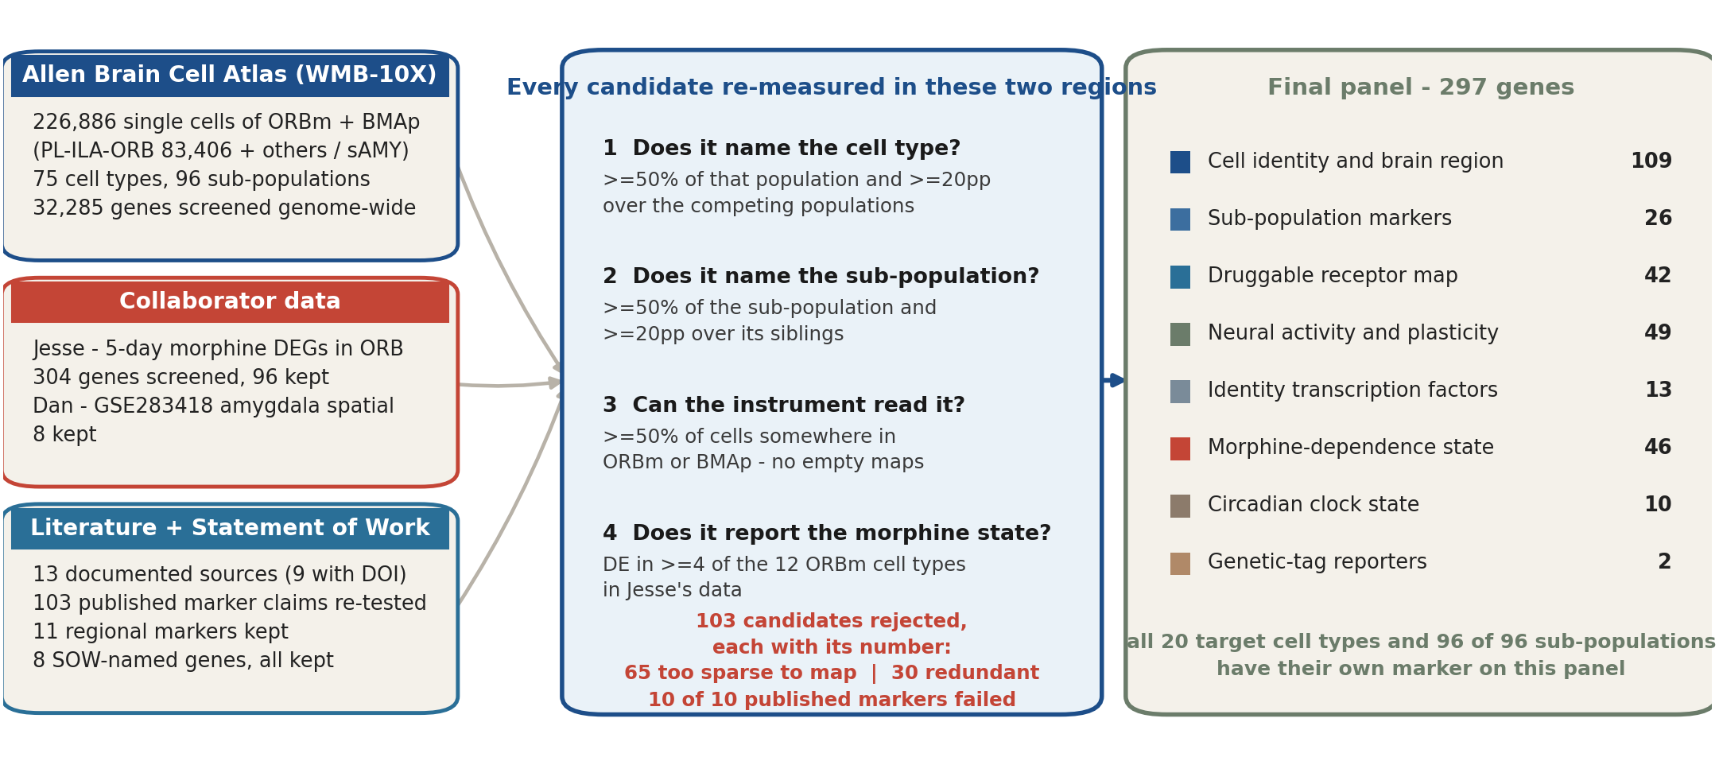
How the 297 genes were selected
The instrument reads a fixed number of genes per section, so every slot has to be earned. Four measured rules decided which genes earned one.
ORBm + BMAp custom Xenium panel | Allen WMB-10X | 1/5

Slide 2
Why a gene is in - and why a similar one is out
Each rule is a measurement with a cutoff. For every rule there is a gene that passed and a comparable gene that did not, so the line is visible rather than asserted.
1
Does it identify the cell type?
2
Does it identify the sub-population?
>=50% of that population, >=20pp over the competing types
>=50% of the sub-population, >=20pp over its siblings
IN Vwc2l 97% of L5 NP cells, +42pp over the next type
IN Hpse 88% of Sst_7 (229 cells) vs 8% in the rest of Sst
OUT Cux1 72% in L2/3 but 94% in an amygdala GABA type
OUT 20 discovery candidates their sub-population already had one
3
Will the instrument actually detect it?
4
Does it report the morphine state?
>=50% of cells somewhere in ORBm or BMAp
DE in >=4 of the 12 ORBm cell types in Jesse's data, and detectable
IN Adrb1 84%, the beta1-adrenergic receptor the SOW names
IN Mbnl2 DE in 4 ORBm types, 99.8% detected
OUT Sstr4 1.4% of cells - the probe returns an empty map
OUT Zbtb40 DE in 6 types but only 29% detected where we image
Two more rules, because this is a standalone panel
5 Minimum non-neuronal set. 28% of the section is glia and vessels, but measured: they are never called neurons even with no glial probe, so only 2 are kept (Aqp4, Siglech).
6 Genes the SOW names stay regardless of level - the SOW asks whether they are expressed, so a low answer is still an answer. All 8 are on the panel.
What did not make it: 103 candidates rejected, each with its measured number
65 detected in under half the cells of any population we image
30 redundant - a gene already on the panel does the same job
10 of 10 published markers failed when re-tested in the Allen cells (Cux1, Scnn1a, Crym, Reln ...)
4 sex-determination genes, excluded on request
ORBm + BMAp custom Xenium panel | Allen WMB-10X | 2/5

Slide 3
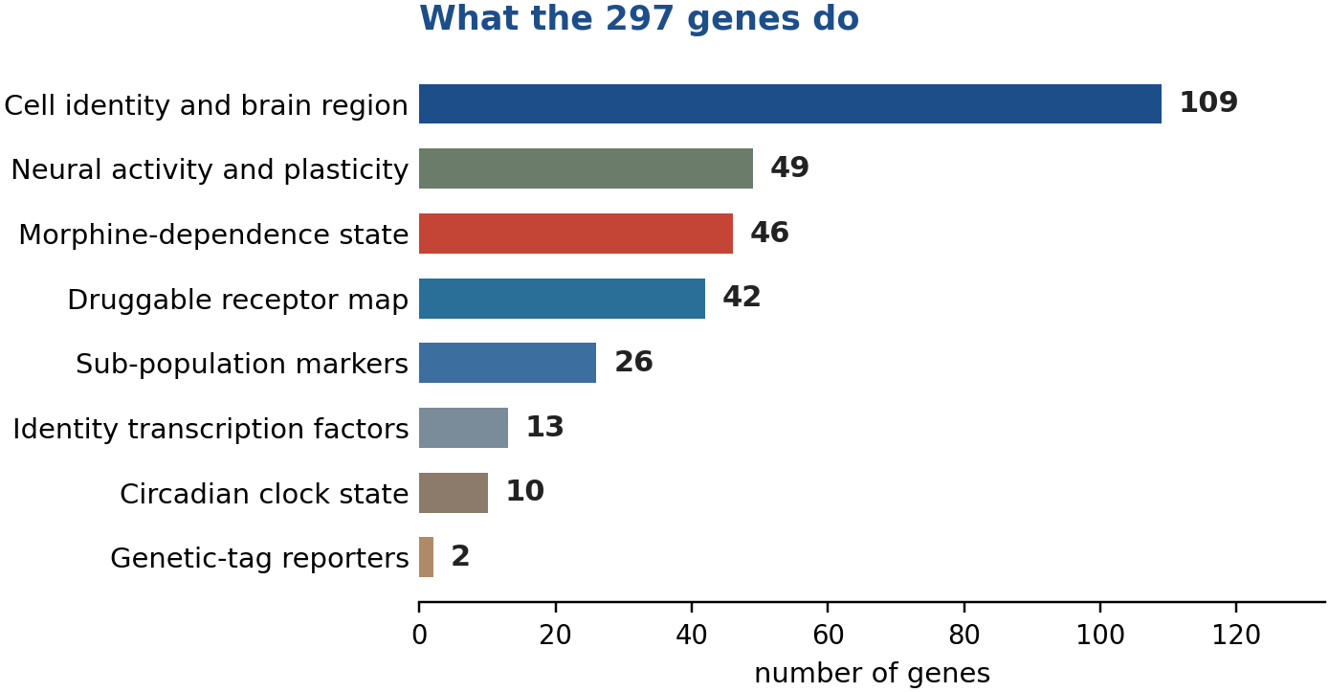
Final panel - 297 genes, one section, two regions
One shared Xenium panel read from the same mouse. All 20 target cell populations have their own marker.
297
20 / 20
96 / 96
12 + 8
genes on the
shared panel
cell populations with
their own marker
sub-populations with
their own marker
populations in
ORBm + BMAp
What each cell will tell us
Identity
Which of the 20 populations it is - cortical layer, interneuron class, or amygdala subtype (109 genes)
Sub-type
Which sub-population inside that type - where a new TRAP+ population would appear (26 genes)
Activity
Whether it was recently active - Fos and Arc, plus the TRAP2 genetic tag (19 IEGs + 2 reporters)
State
Whether it carries the morphine-dependence signature, and its circadian state (46 + 10 genes)
Receptors
Which druggable receptors sit on it - opioid, adrenergic, serotonergic, muscarinic, glutamate (42 genes)
The last two rows are the new capability: within a single cortical cell type, the panel separates cells that carry the dependence signature from those that do not.
ORBm + BMAp custom Xenium panel | Allen WMB-10X | 3/5

Slide 4
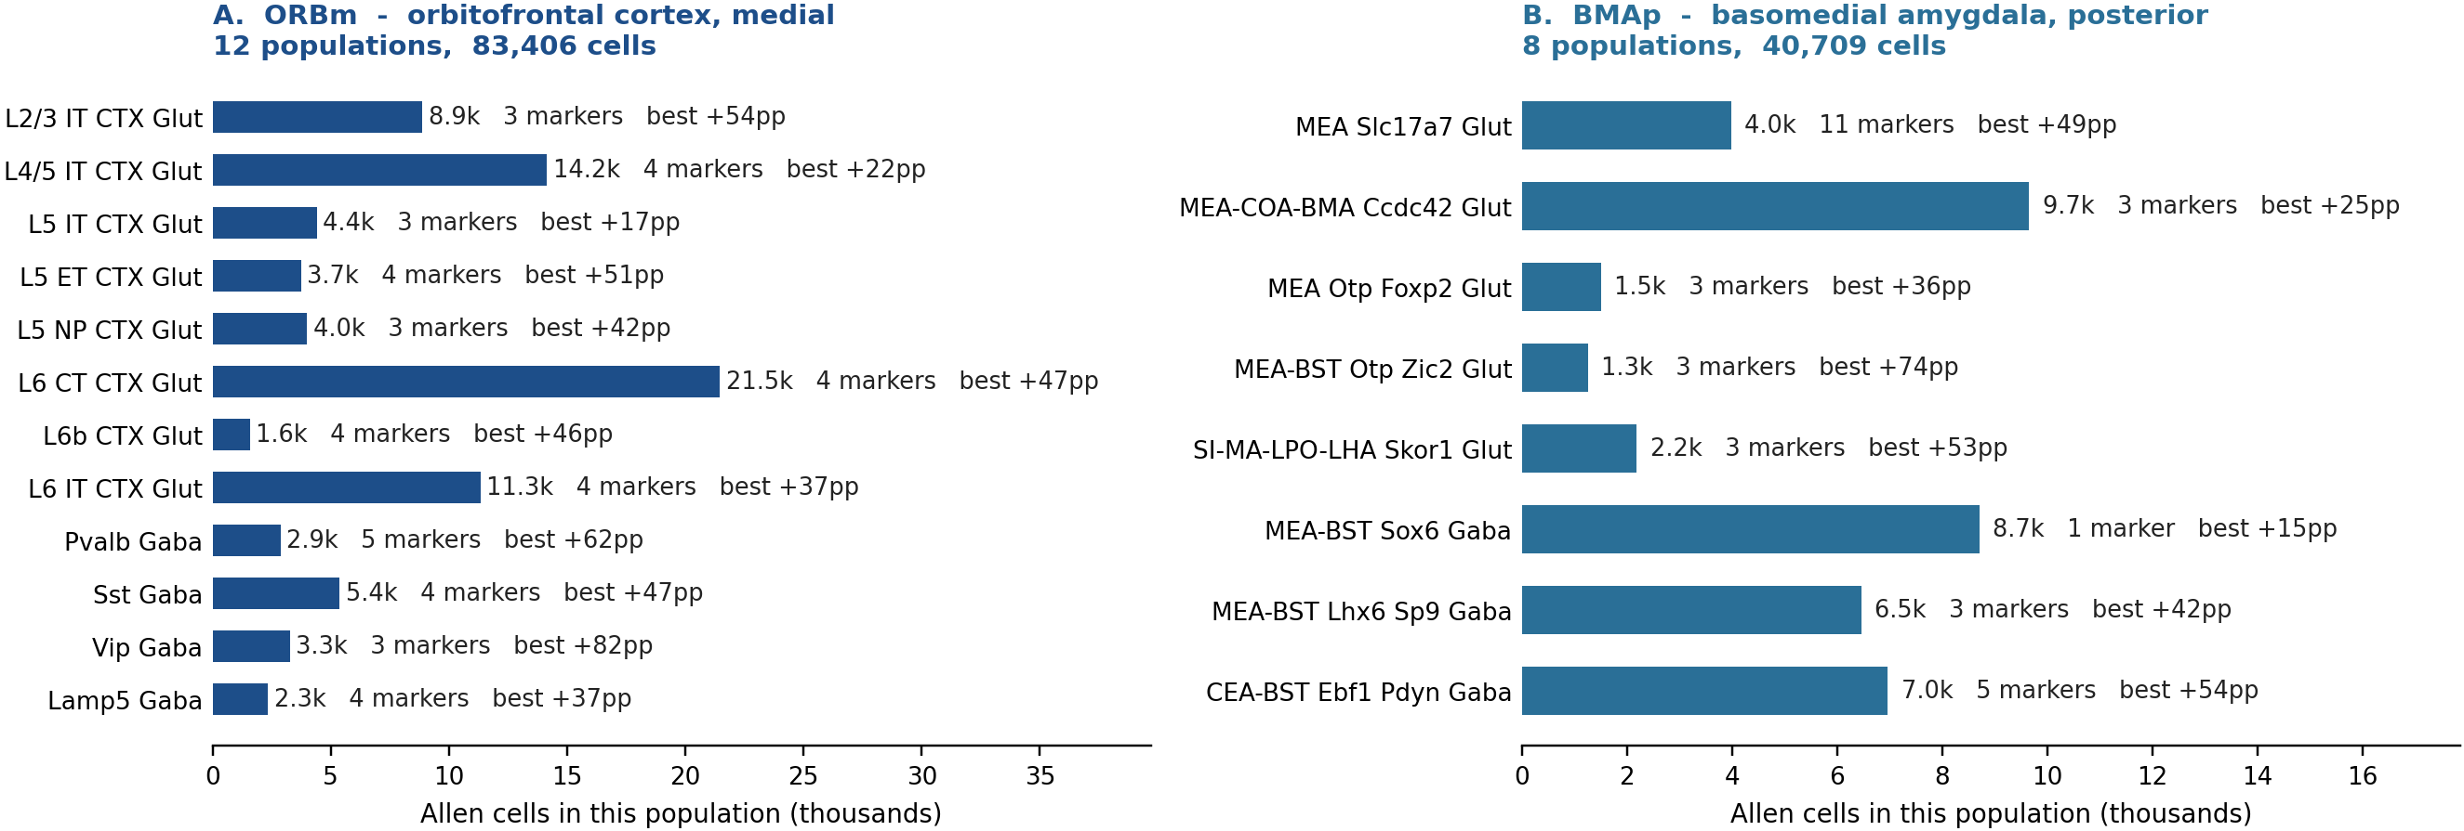
The 20 populations we must tell apart
The target list comes from the Allen Brain Cell Atlas taxonomy: 12 populations in orbitofrontal cortex, 8 in basomedial amygdala.
12
8
124,115
20 / 20
ORBm populations
83,406 Allen cells
BMAp populations
40,709 Allen cells
cells in the 20
target populations
have a dedicated marker
on the final panel
Marker = a panel gene detected in >=50% of that population and >=10pp above every other target population. Two populations sit below a 20pp margin - L5 IT (Adam19, +17pp) and MEA-BST Sox6 (Chn2, +15pp) - and no gene in the 32,285-gene atlas does better for them.
BACKUP · ORBm + BMAp custom Xenium panel | Allen WMB-10X | 4/5

Slide 5
The list rests on a full re-analysis of the reference atlas
No gene was taken on a paper's word. Every candidate was re-scored in the Allen atlas, restricted to these two regions, in the population it is meant to report.
226,886
32,285
602
103
single cells scored across
the two target regions
genes screened genome-wide
for a better marker
candidates measured
cell by cell
candidates rejected,
each with its number
82 / 103
96 / 304
13
64
published marker claims
confirmed in the atlas
Jesse morphine DEGs that
passed detection
documented sources,
9 with a DOI
FDA-approved drugs mapped
to panel receptors (IUPHAR)
What that analysis produced, in order
1. Region-restricted expression matrices
2. Per-population marker ranking
Cells from ORBm and BMAp were pulled out of the whole-brain atlas, so every percentage describes these two regions, not a brain-wide average.
For each of the 20 targets every candidate was ranked by how much of that population expresses it and how far it sits above the next population.
3. Detection and expression-level screen
4. Held-out cell-type calling
65 candidates were dropped for being detected in under half the cells of any population we image - a probe that returns an empty map is money spent twice.
A classifier given only the panel genes labels held-out cells at 93% mean recall across the 20 populations - and the same at simulated Xenium sparsity.
BACKUP · ORBm + BMAp custom Xenium panel | Allen WMB-10X | 5/5

