Slide 1
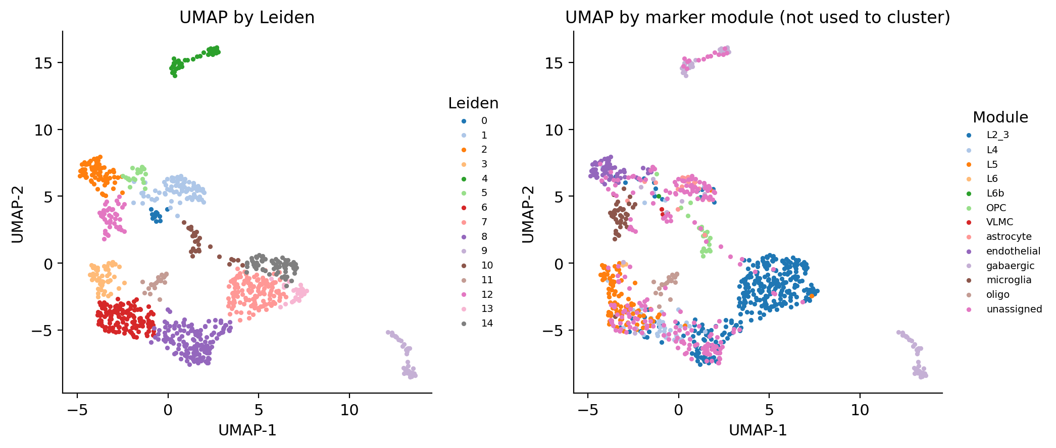
Xenium pipeline: biological questions
ORBm and BMAp pilot validation. Cell identity comes first, followed by reporter and behavior comparisons.
Primary analysis
REAL PILOT: ORBm UMAP
01
Known cell type or reproducible new cluster?
Annotate cells with identity markers while excluding reporter and activity genes from the identity PCA.
02
Which known types contain more tdTom+ cells?
Estimate enrichment per animal before testing whether reporter-positive cells form an unexplained, stable subtype.
03
Which genes differ by reporter status and behavior?
Compare GPCR, TF and plasticity programs within each cell type using animal-level pseudobulk contrasts.
Current pilot: 247 measured genes; tdTomato absent; one animal per anatomy.
The pilot can validate cell identity and detection. It cannot test tdTom specificity or Active versus Passive effects.
Xenium ORBm + BMAp Pipeline results 1/5
Notes:
Sources: outputs/orbm_right/summary.json; outputs/orbm_right/figures/03_umap.png; PRIMARY_AIM_ANALYSIS.md. The displayed UMAP is real pilot data.

Slide 2
Story 1: cell identity in the real pilot
Reference-aware annotation uses identity genes only. Reporter and activity genes do not drive the cell identity PCA.
Allen/reference concordance
Interpretation
NMI 0.738 in ORBm and 0.673 in BMAp. ARI is approximately 0.50 in both regions.
Broad classes are interpretable, but unassigned cells remain 24.6% in ORBm and 25.3% in BMAp.
Xenium ORBm + BMAp Pipeline results 2/5
Notes:
Sources: outputs/orbm_right/summary.json and outputs/bmap_left/summary.json. Composition values are calculated from module_counts divided by n_after_qc. These are real pilot results.

Slide 3
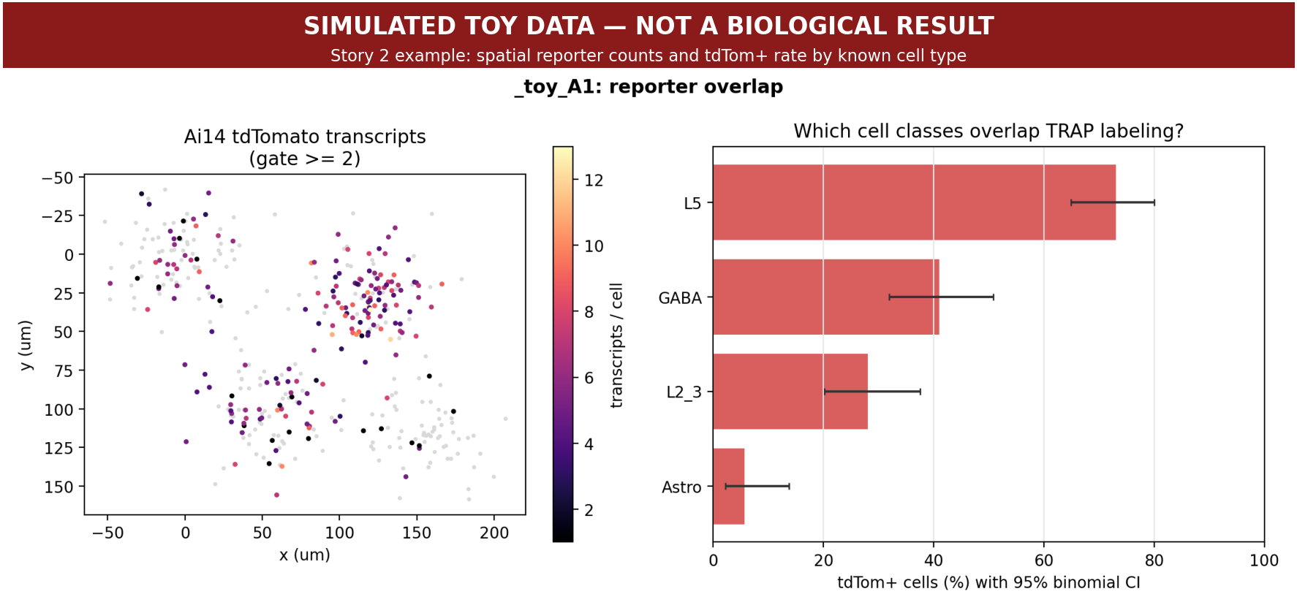
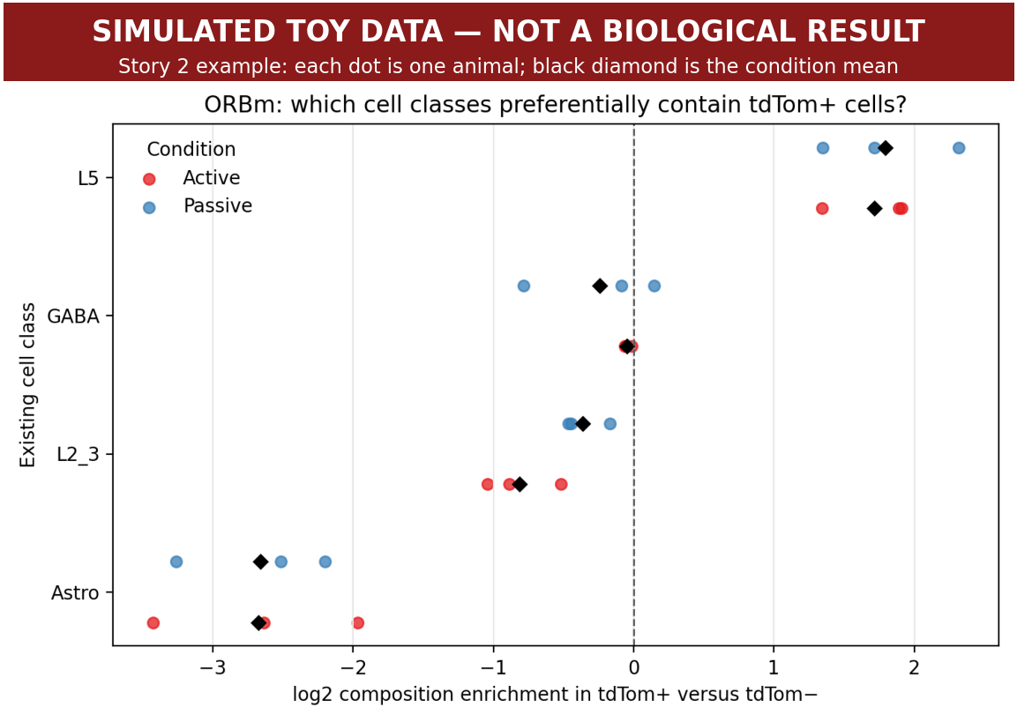
Story 2: tdTom enrichment within existing cell types
Simulated demonstration because tdTomato is absent from the pilot matrix. The real analysis will use the same outputs.
Expected real interpretation
Calibrate the reporter threshold with controls. Estimate enrichment for each animal. Claim a new type only when a stable tdTom-associated cluster remains unexplained by reference subtypes and reproduces across animals.
SIMULATED OUTPUT
Toy data were designed to enrich tdTom+ cells in L5 and GABA classes.
Xenium ORBm + BMAp Pipeline results 3/5
Notes:
Sources: toy_demo_results/story2_toy_reporter_overlap.png and toy_demo_results/story2_toy_celltype_enrichment.png. These are simulated toy data and are not biological results. Real pilot status: outputs/story2_tdtom/SKIPPED.md.

Slide 4
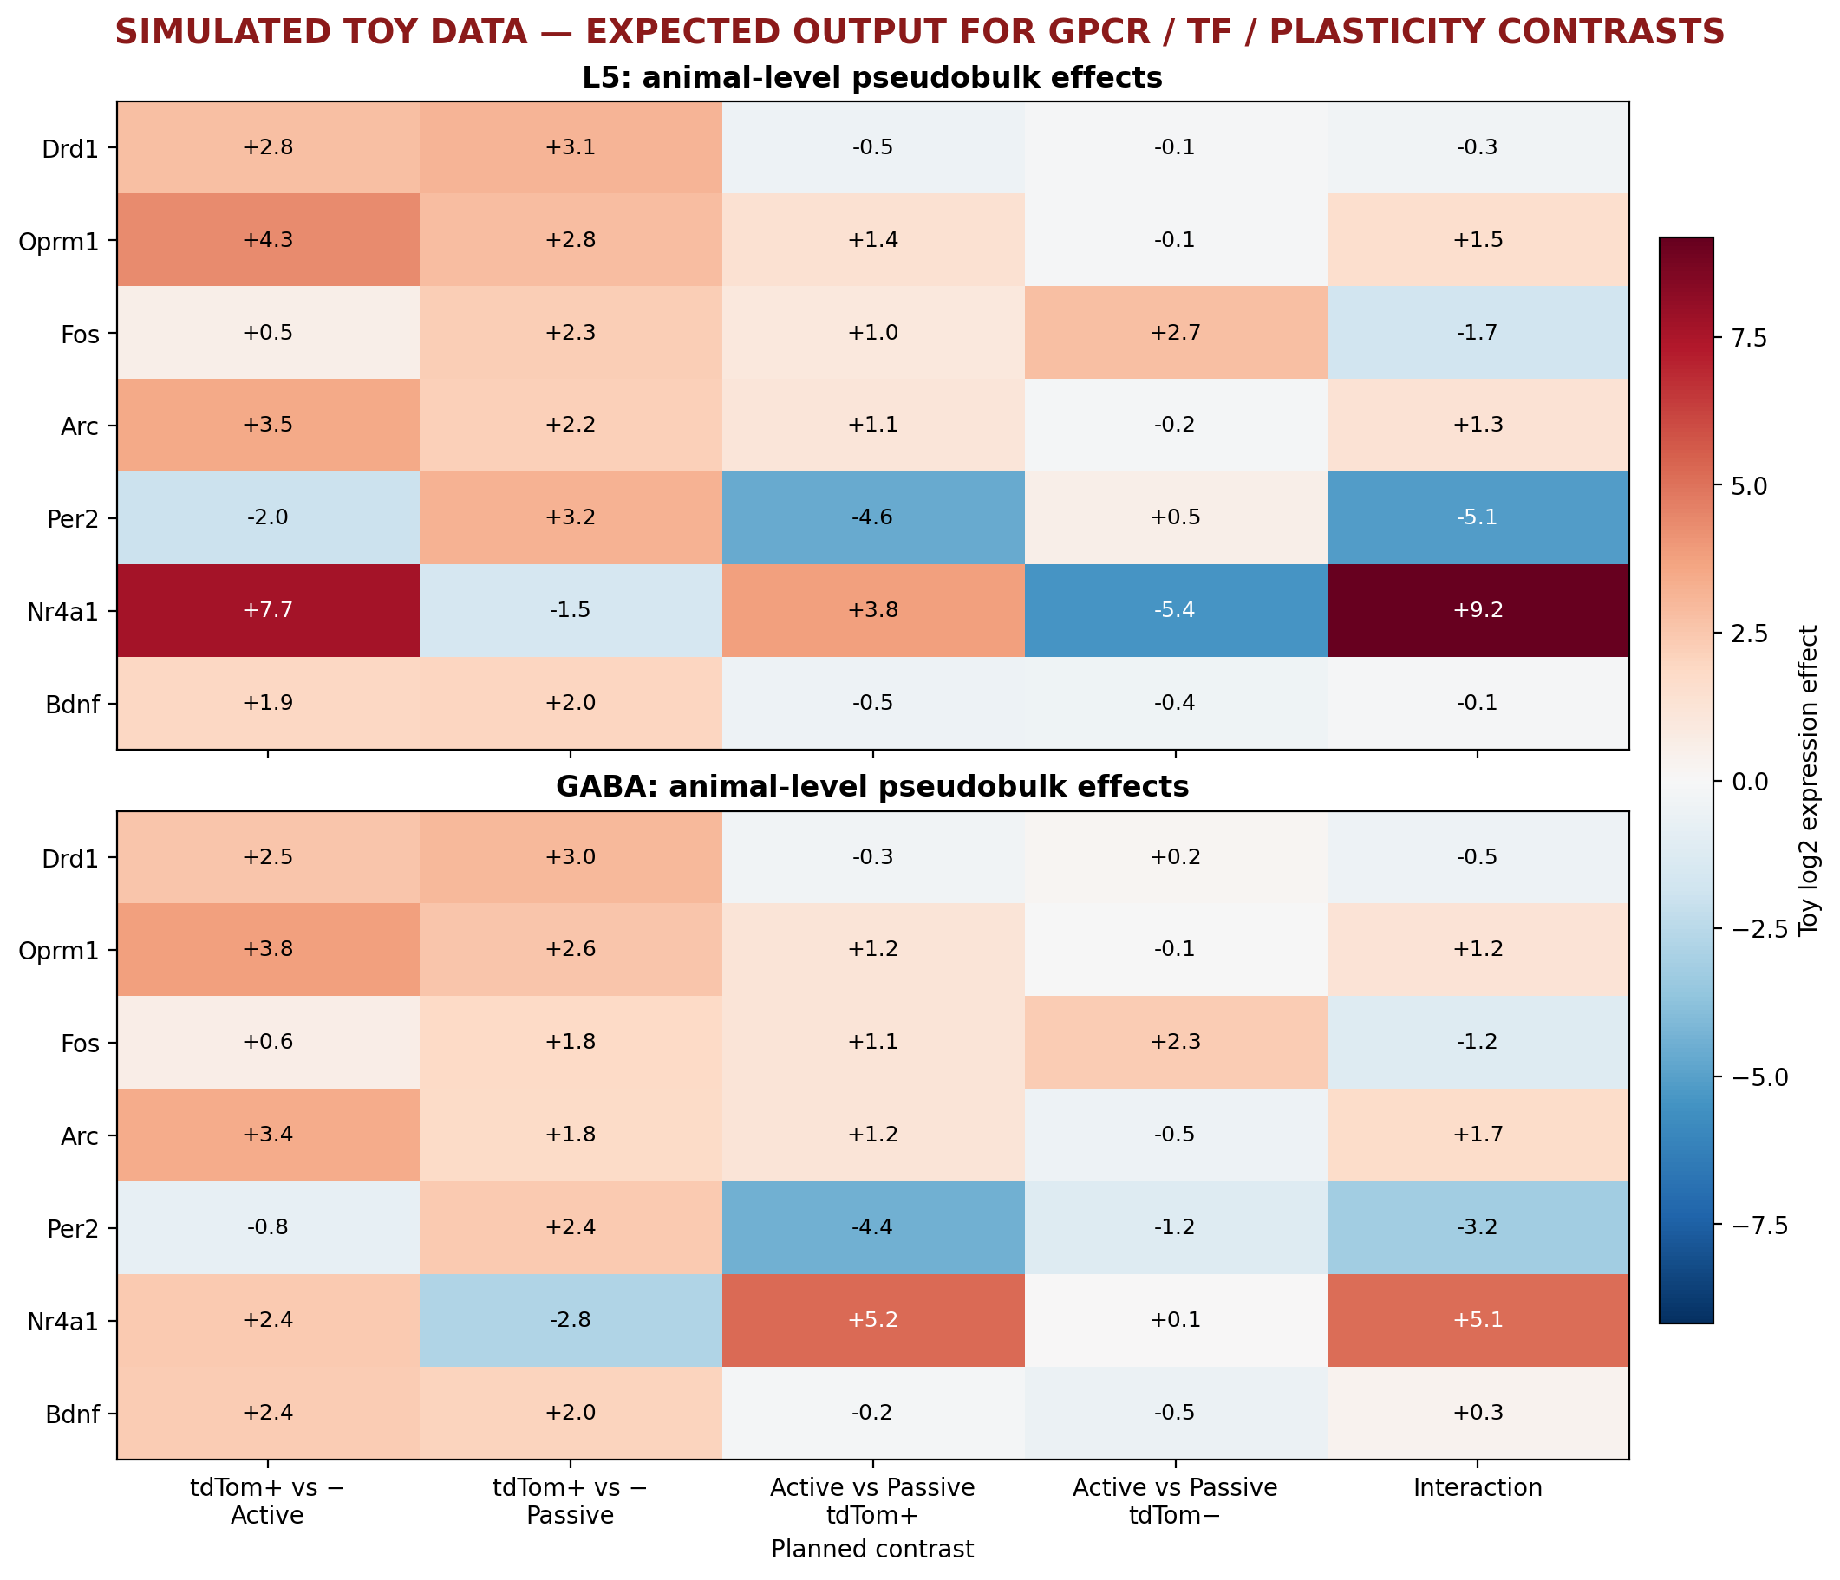
Story 3: reporter and condition effects
Simulated animal-level pseudobulk output. Five planned contrasts separate reporter, condition and interaction effects.
Planned contrasts
01
tdTom+ vs tdTom− within Active
02
tdTom+ vs tdTom− within Passive
03
Active vs Passive within tdTom+
04
Active vs Passive within tdTom−
05
Reporter-by-condition interaction
Animal is the experimental unit
Toy values show effect size only. Real output adds confidence intervals and FDR.
Xenium ORBm + BMAp Pipeline results 4/5
Notes:
Source: toy_demo_results/factorial_toy_gene_effects.png. The figure contains simulated toy data and is not a biological result. Real design requirement is described in outputs/story3_mouse_ab/DESCRIPTIVE_ONLY.md and design_status.json.

Slide 5
Final decision: pipeline ready, inference awaits the full design
The pilot validates cell identity and detectability. It cannot answer the tdTom or Active and Passive questions.
Question | Current pilot | Real-data criterion | Primary output
Cell identity | Runnable | Stable labels across resolution and Allen reference checks | Cell-type map and confidence
tdTom specificity | Blocked: reporter absent | Custom tdTomato probe and calibrated control threshold | Per-animal enrichment with 95% CI
Active vs Passive | Descriptive only | At least 3 independent animals per condition within each anatomy | Pseudobulk effect, CI and FDR
Novel cell type | No conclusion | Reporter-associated cluster persists within known types and reproduces across animals | New type only with stable subtype markers
Current decision: analysis code is ready; biological conclusions remain pending.
Preferred minimum: at least 3 independent animals per condition within each anatomy. Animal is the experimental unit.
Xenium ORBm + BMAp Pipeline results 5/5
Notes:
Sources: PRIMARY_AIM_ANALYSIS.md; PIPELINE_REVIEW.md; outputs/story2_tdtom/SKIPPED.md; outputs/story3_mouse_ab/design_status.json. The minimum of three animals per condition is the pipeline readiness criterion, not a power calculation.

