Slide 1
How the gene panel was selected
Every slot had to be earned against measured data. Four rules decided which genes earned one, and a genome-wide sweep confirmed nothing was missed.
WHERE THE CANDIDATES CAME FROM
FOUR DECISION RULES
WHAT WE ORDER
OUR MARKER SCREEN
Does it identify the cell type?
FINAL PANEL
Allen Brain Cell Atlas, re-scored in these two regions only. Cell-type and subtype markers.
1
299
32,285 screened
179 kept
Is the receptor or factor really expressed here?
GENOME-WIDE GPCR + TF
2
Every curated mouse receptor and transcription factor, scored here to prove the set is complete.
genes on one section
1,747 screened
58 kept
Does it report the morphine-dependent state?
Cell identity, subtype and region
135
JESSE NIEHAUS
3
Morphine-dependence state
46
Morphine-dependence gene expression in orbitofrontal / prefrontal cortex.
Druggable receptor map
44
431 screened
50 kept
Will the instrument actually detect it?
Neuronal plasticity
30
4
Activity and immediate-early
19
BERG & SCHERRER
Published amygdala spatial panel (GSE283418).
Standalone panel - every gene
is a probe we order
98 screened
10 kept
Every rule is a measurement in the Allen Brain Cell Atlas, restricted to these two regions
226,886
79
20
1,747
0.922
cells re-analysed
cell types present
target populations
GPCRs + TFs swept
mean recall, 20 types

Slide 2
Why a gene is in - and why a similar one is out
Each rule is a measurement with a cutoff. For every rule there is a gene that passed and a better-known gene that failed.
1
Does it identify the cell type?
2
Is the receptor really expressed here?
50% of its own population, and a clear margin over the other target types.
50% of cells somewhere in these two regions.
IN Tnnc1 53% of L4/5 IT, +22pp - the best marker for that type anywhere in the transcriptome
IN Chrm1 M1 muscarinic, 98% of cells - previously only M2 was visible
OUT Scnn1a the classic L4 marker, but 1.8% here; it is really an ependymal gene
OUT Adrb2 50.7%, and its peak is in macrophages rather than neurons
3
Does it report the morphine-dependent state?
4
Will the instrument detect it?
Differential expression counted only in our 12 ORBm populations.
Sparse probes give sparse maps. Activity genes are exempt.
IN Per2 changes in 11 of 12 populations - the broadest gene in Jesse's data
IN Cux2 95% of L2/3 IT - the paralog that actually works in this tissue
OUT Hspa5 an ER-stress gene in 71 of 75 cell types; it can only report a global shift
OUT Tcf4 expressed in all 75 cell types, never below 37%; separates nothing

Slide 3
Final panel - 299 genes, one section, two regions
One shared standalone panel read from the same mouse on the same slide, so ORBm and BMAp are compared with no batch difference between them.
299
20 / 20
0.922
12 + 8
genes on the
shared panel
target cell types
identified
mean recall across
those 20 types
populations in
ORBm + BMAp
What the 299 genes do
What each cell will tell us
Cell identity, subtype and region
135
Identity
Morphine-dependence state
46
Which of the 20 populations it is - cortical layer, interneuron class, or amygdala subtype.
Druggable receptor map
44
TRAP label
Neuronal plasticity
30
Whether it was active during the morphine window. tdTomato and iCre read the genetic tag directly.
Activity and immediate-early
19
Activity now
Transcription factors
13
Whether it is active at fixation - Fos, Arc, Npas4 and the wider immediate-early set.
Circadian
10
Molecular state
Genetic-tag reporters
2
Its receptors, transcription factors, plasticity genes and morphine-response genes.
it is the complete list for these two regions
Every mouse GPCR (426) and every mouse transcription factor (1,321) was scored here; none is missing from the 20 atlas target types. A drug-target cross-check added Adora2a. The 247-gene Xenium pilot added Opn3, the only 247-only neuronal GPCR marking the ORBm Leiden 5 L4/5 IT split. The pilot used one cassette/animal, so this fine-subtype evidence remains provisional.

Slide 4
The 20 populations we must tell apart
The target list comes from the Allen Brain Cell Atlas taxonomy: 12 populations in orbitofrontal cortex, 8 in posterior basomedial amygdala.
12
8
125,313
3 - 28
ORBm populations
84,604 Allen cells
BMAp populations
40,709 Allen cells
cells in the 20
target populations
dedicated markers per
type, median 6
A. ORBm - orbitofrontal cortex, medial
B. BMAp - basomedial amygdala, posterior
12 populations, 84,604 cells | bar = cells, label = dedicated markers and recall
8 populations, 40,709 cells | bar = cells, label = dedicated markers and recall
L2/3 IT CTX Glut
8.9k 7 markers r=0.93
MEA Slc17a7 Glut
4.0k 28 markers r=0.99
L4/5 IT CTX Glut
14.2k 4 markers r=0.88
MEA-COA-BMA Ccdc42 Glut
9.7k 5 markers r=0.94
L5 IT CTX Glut
4.4k 6 markers r=0.69
MEA Otp Foxp2 Glut
1.5k 8 markers r=0.99
L5 ET CTX Glut
3.7k 7 markers r=0.96
MEA-BST Otp Zic2 Glut
1.3k 5 markers r=0.93
L5 NP CTX Glut
4.0k 8 markers r=0.99
SI-MA-LPO-LHA Skor1 Glut
2.2k 12 markers r=0.98
L6 CT CTX Glut
21.5k 6 markers r=0.93
MEA-BST Sox6 Gaba
8.7k 3 markers r=0.91
L6b CTX Glut
1.6k 6 markers r=0.93
MEA-BST Lhx6 Sp9 Gaba
6.5k 4 markers r=0.93
L6 IT CTX Glut
11.3k 6 markers r=0.71
CEA-BST Ebf1 Pdyn Gaba
7.0k 9 markers r=0.95
Pvalb Gaba
2.9k 6 markers r=0.96
Sst Gaba
5.6k 5 markers r=0.94
Vip Gaba
3.7k 6 markers r=0.95
Lamp5 Gaba
2.9k 6 markers r=0.96

Slide 5
The list rests on a full re-analysis of the reference atlas
No gene was taken on a paper's word. Every candidate was re-scored in the Allen atlas, restricted to these two regions.
226,886
79
32,285
23,305
27,730
single cells scored across
the two target regions
cell types profiled,
not only the 20 targets
genes screened for
cell-type markers
gene x cell-type abundance
and specificity measurements
pairwise tests: can gene X
separate type A from type B?
1,747
426
147
59
13
receptors and factors
swept genome-wide
receptors evaluated one by
one, 153 expressed here
dedicated marker-to-type
assignments, 3 to 28 each
FDA-approved drugs mapped
to panel receptors (IUPHAR)
documented sources,
9 of them with a DOI
What that analysis produced, in order
1.
Region-restricted expression matrices
2.
Per-population marker ranking
ORBm and BMAp cells were pulled out of the whole-brain atlas, so every abundance and specificity number describes these two regions, not a brain-wide average.
For each of the 20 targets, every candidate was ranked by how much of that population expresses it and how tightly it is restricted to it.
3.
Separability, tested two independent ways
4.
Receptor sweep and drug-target layer
All 94 same-region pairs of target types are separable - every pair has a panel gene differing by 20 points or more. And on held-out cells a classifier using only these genes recovers all 20 types, mean recall 0.922.
All 426 mouse GPCRs and 1,321 transcription factors were screened against the 20 atlas target types. A drug-target cross-check added Adora2a. Pilot data added Opn3 for the ORBm Leiden 5 L4/5 IT split; replication across animals is pending.

Slide 6
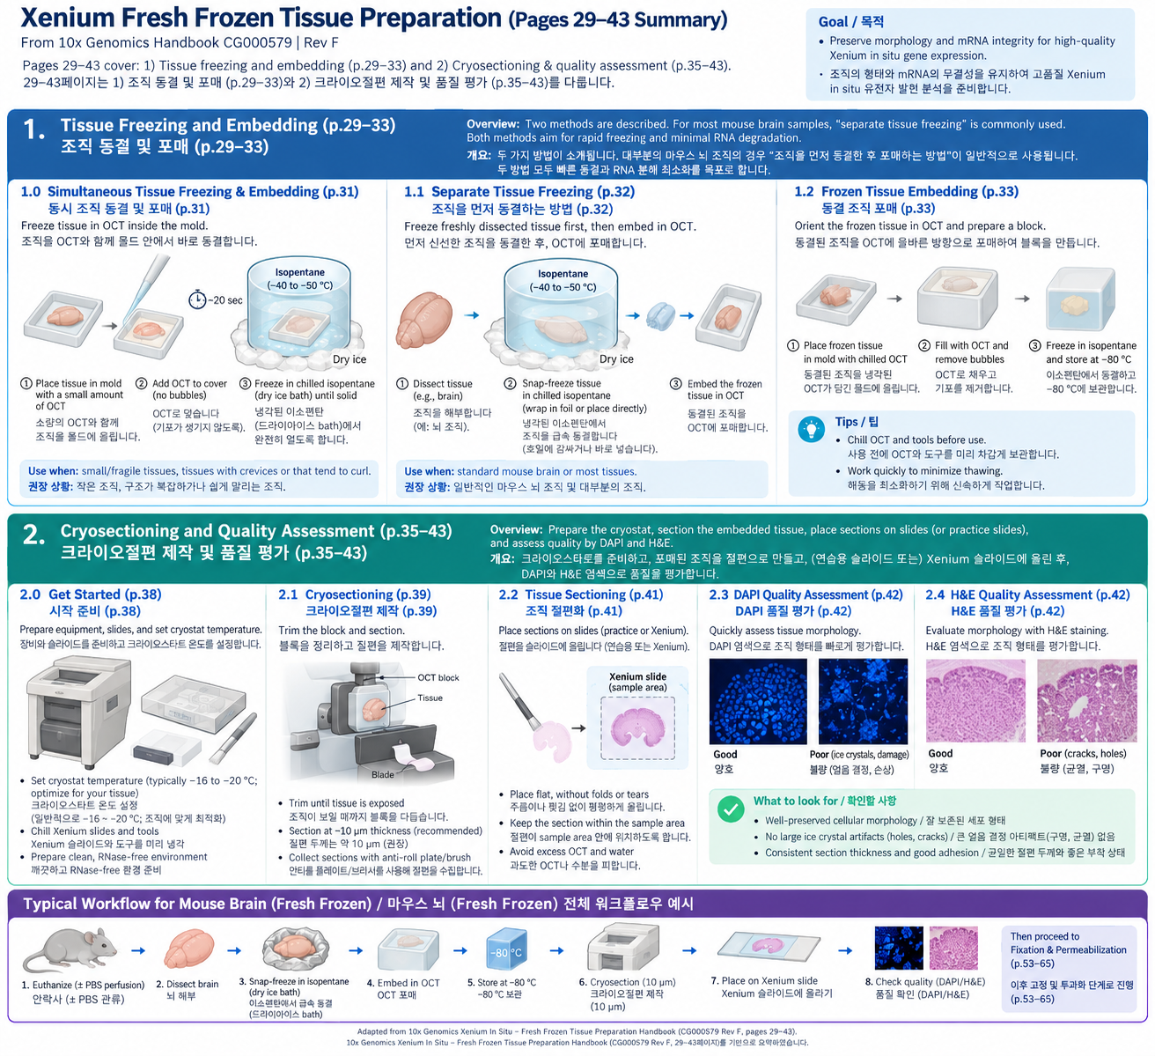
Xenium protocol for TRAP
Fresh Frozen

Slide 7
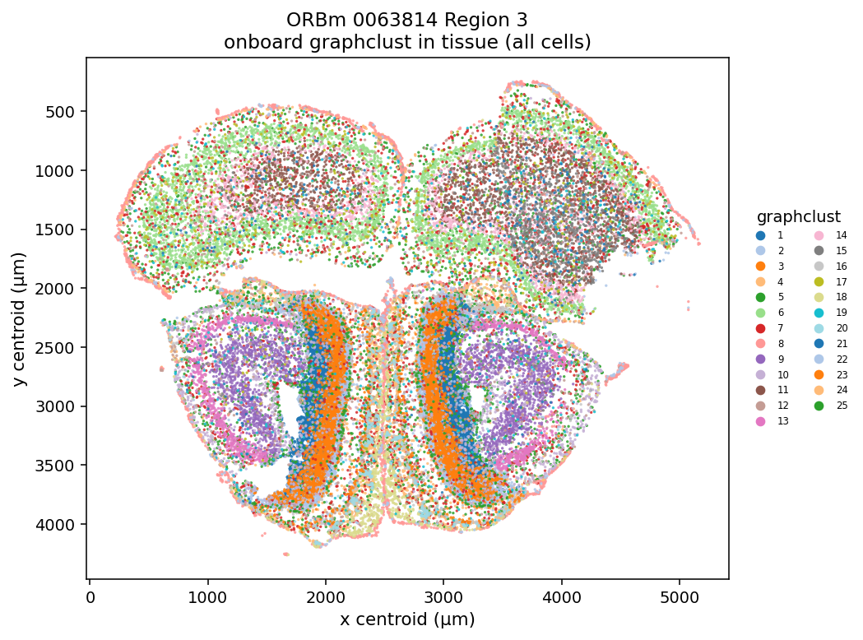
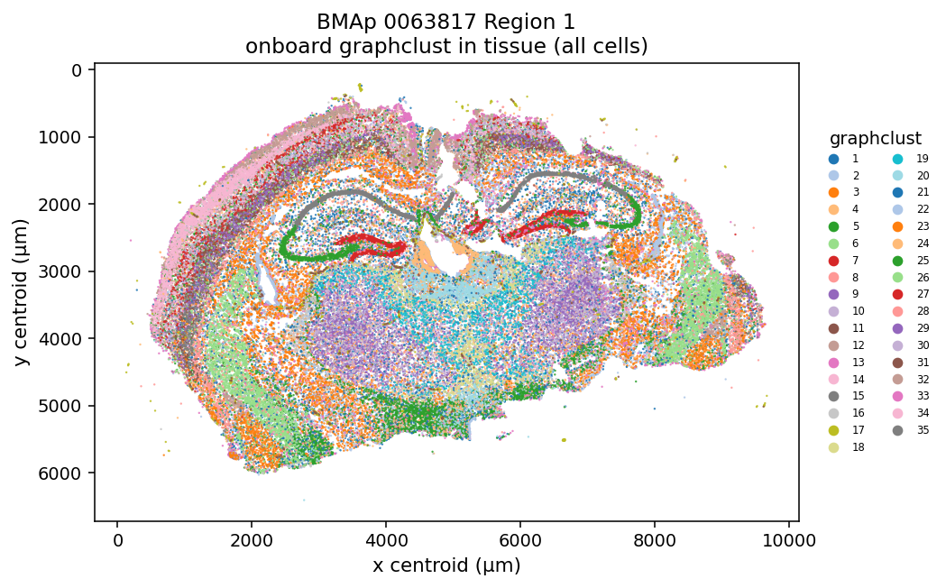
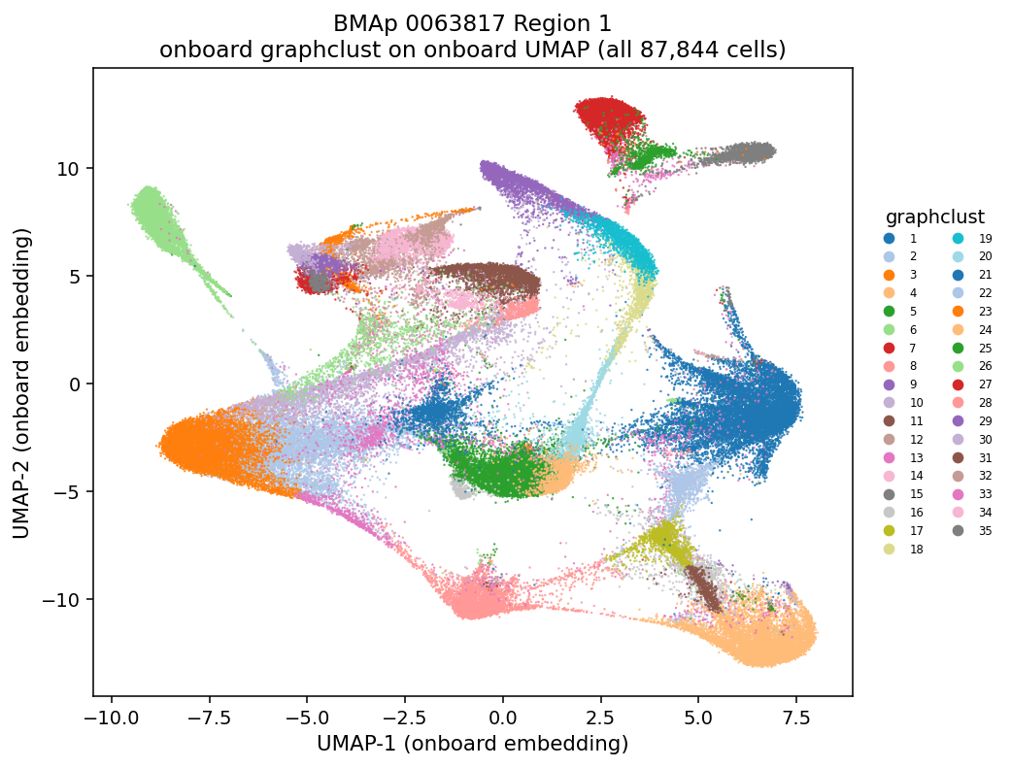
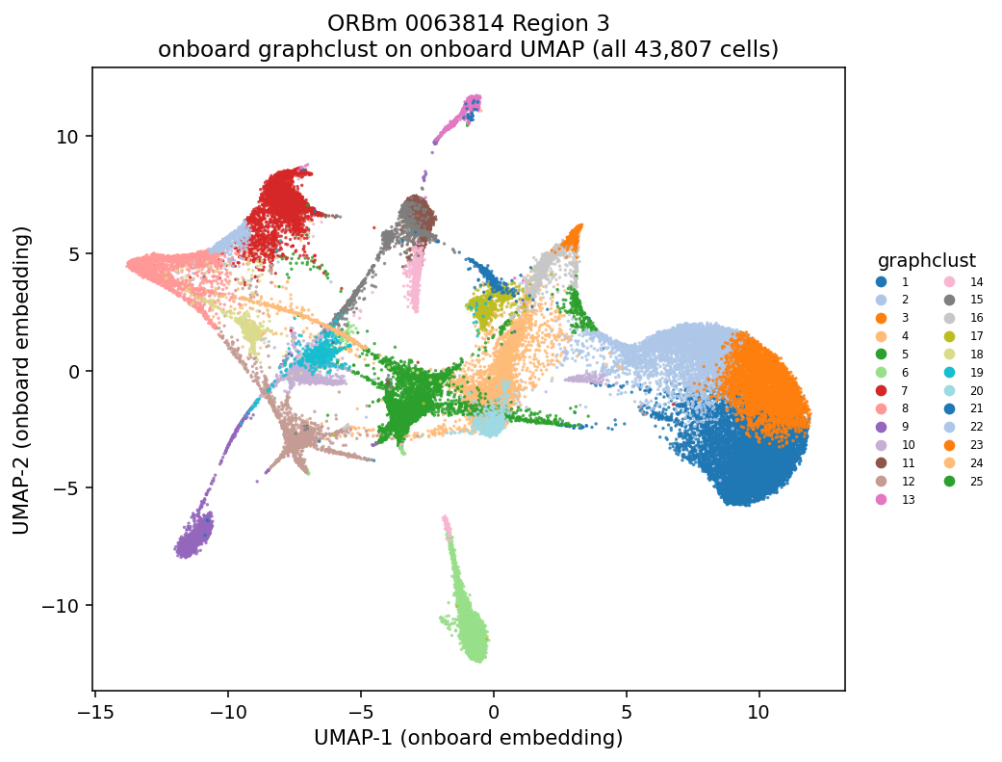
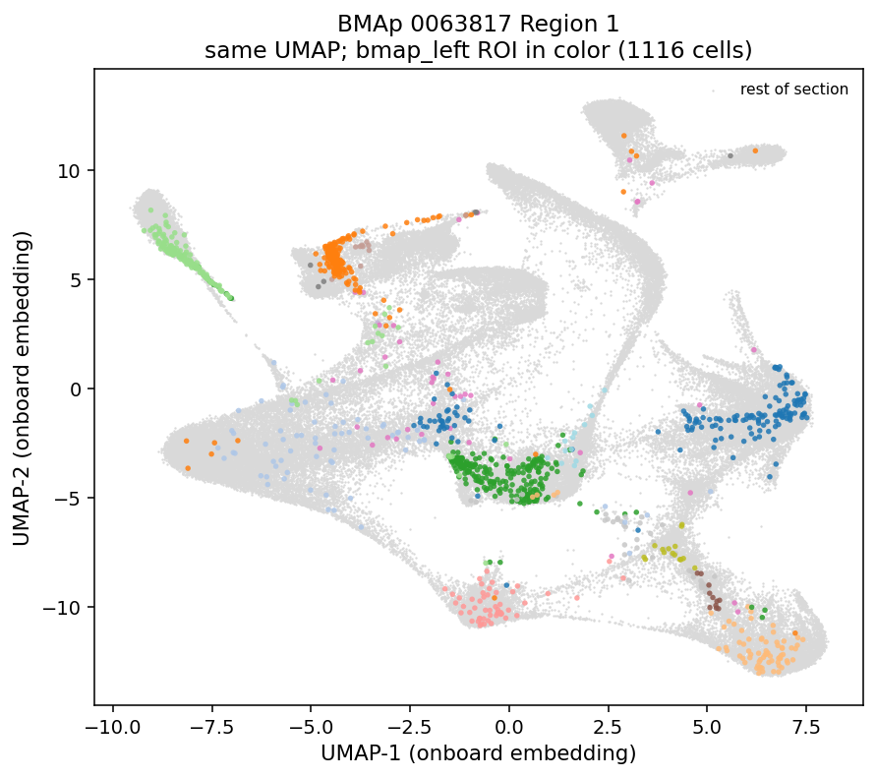
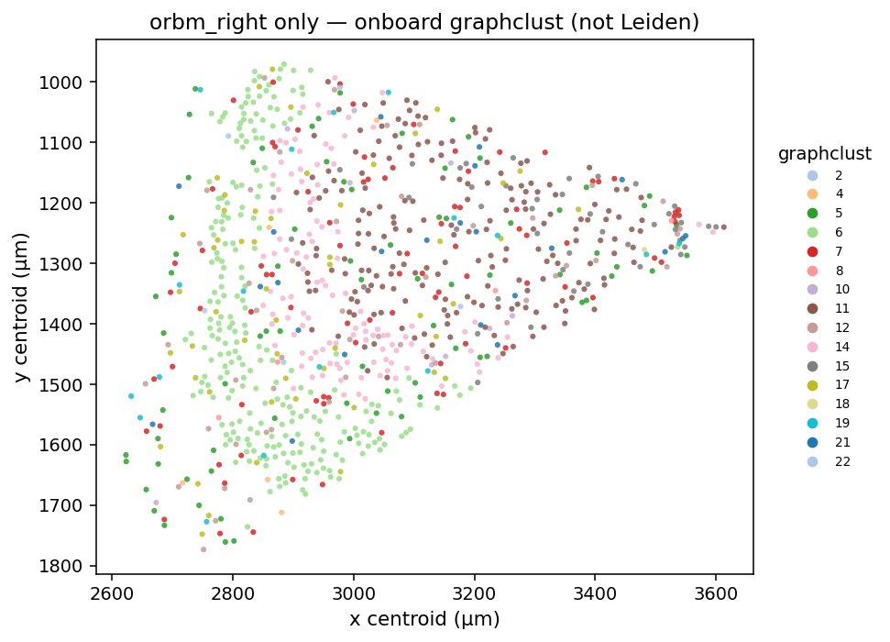
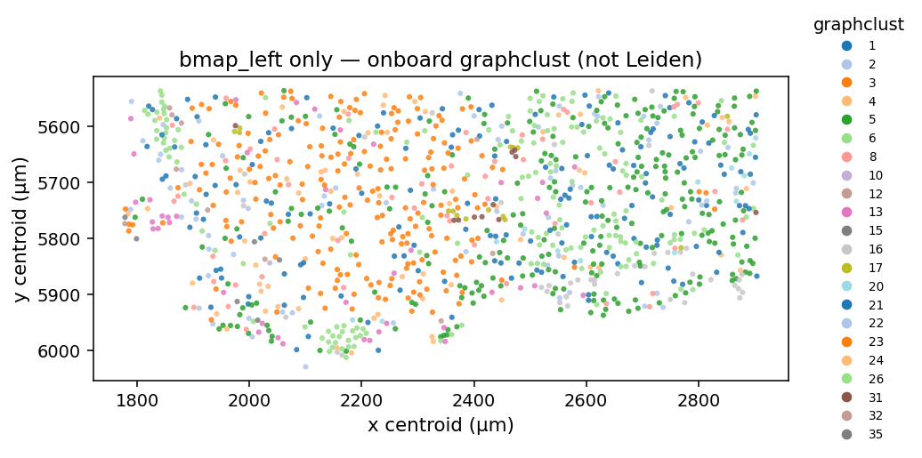
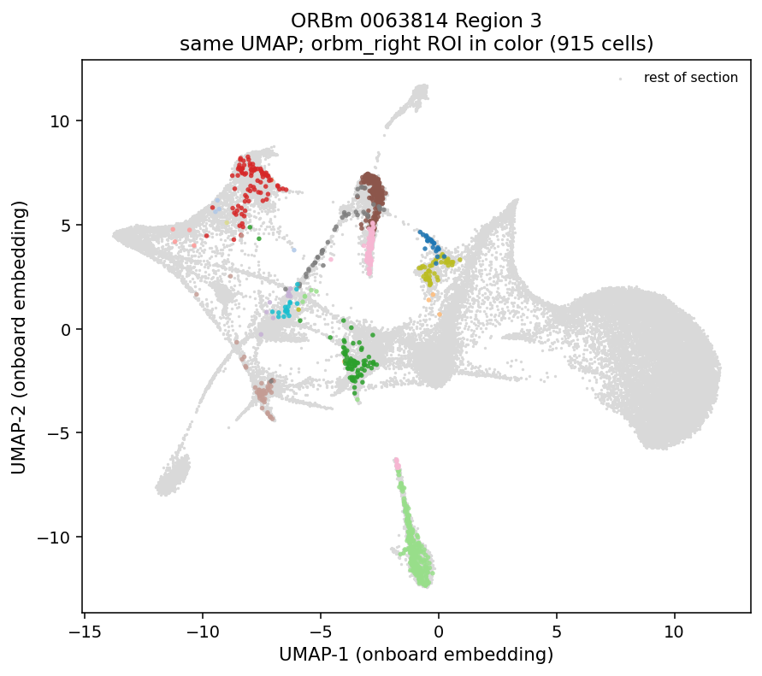
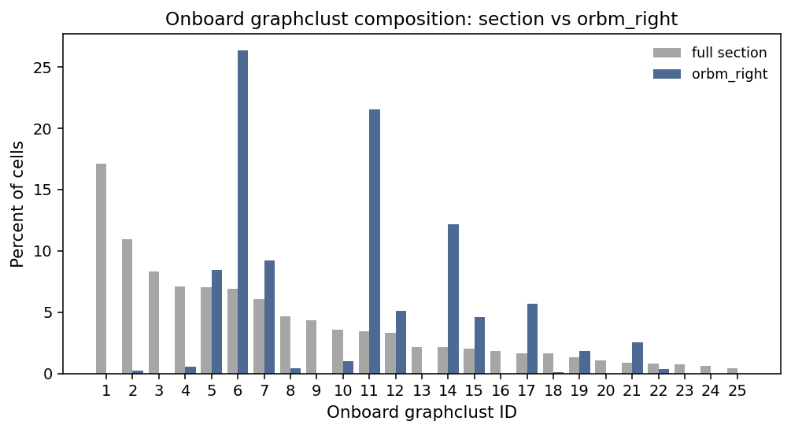
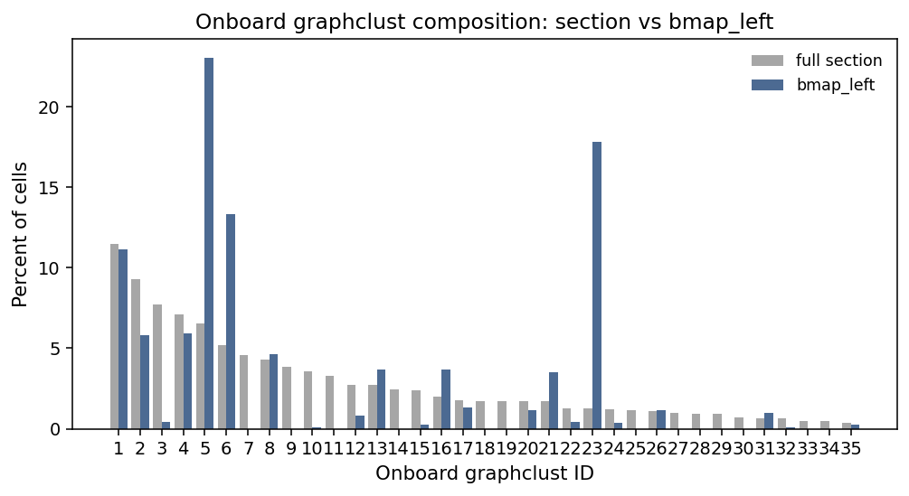
Pilot Xenium data

Slide 8
Panel update
Opn3 added as an ORBm Leiden 5 L4/5 IT fine-subtype marker and GPCR.
Final standalone panel: 299 genes. The 247-gene pilot measured Opn3 in 93.0% (119/128) of Leiden 5 neurons versus 31.1% (164/528) of other ORBm neurons. Biological replication across animals remains pending.

