Slide 1
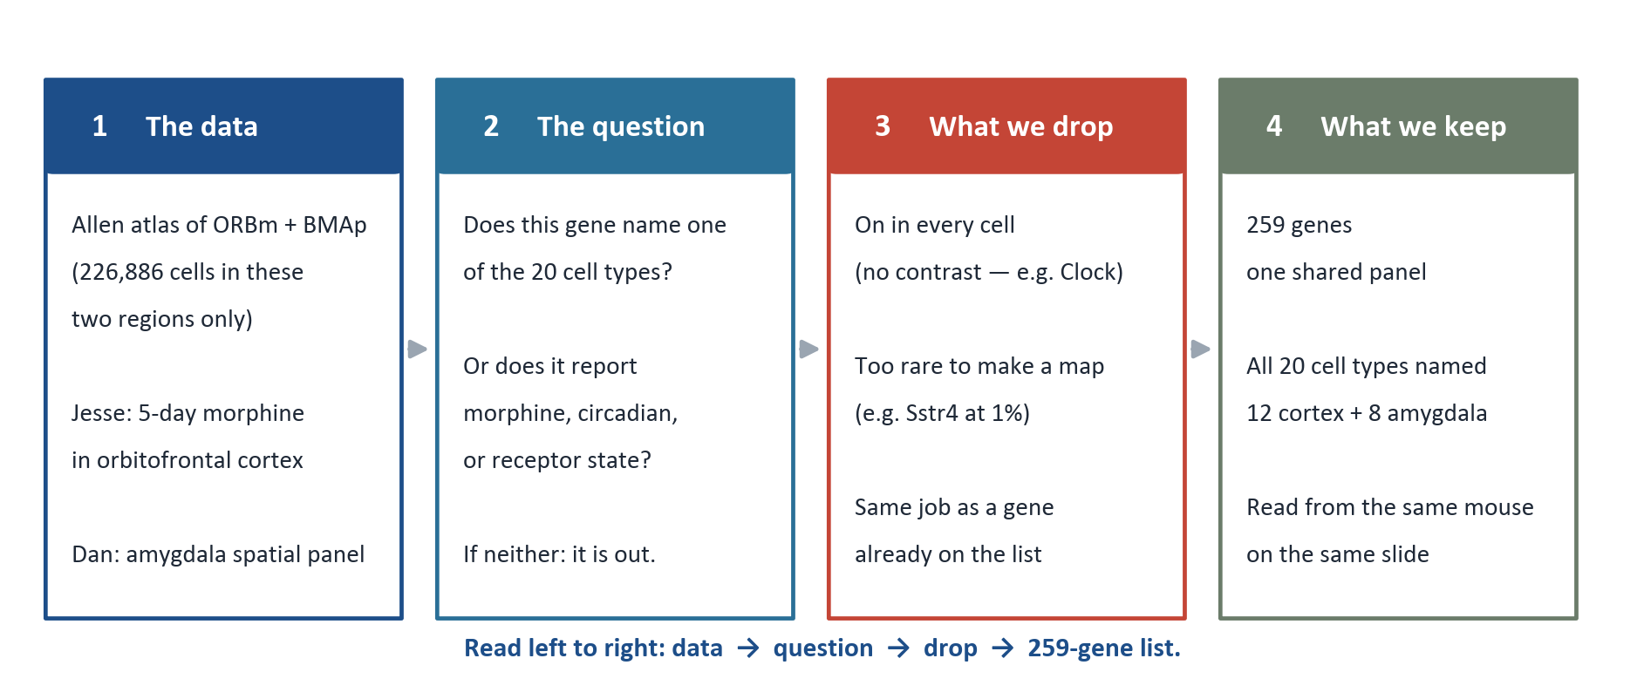
How the gene panel was selected
Xenium reads a fixed gene list. We kept a gene only if it names one of the 20 cell types, or reports morphine, circadian, or receptor state.
ORBm + BMAp custom Xenium panel | Allen WMB-10X | 1/5

Slide 2
Why a gene is in - and why a similar one is out
Each rule is a measurement with a cutoff. For every rule there is a gene that passed and a comparable gene that did not, so the line is visible rather than asserted.
1
Does it identify one of the 20 cell types?
2
Does it split a type into a sub-type?
Must be high in that type and low in the other 19, or in its closest neighbour.
Rare overall is fine if one sub-population is high and its siblings are not.
IN Prox1 +50pp for 073 Sox6 GABA vs 074 Lhx6 Sp9 GABA
IN St18 8.8% overall, 95% of one 194-cell sub-type (+66pp)
OUT Sstr4 1.4% of cells - an empty map, cannot call any type
OUT Gpr63 2.7% of cells and 1.5pp gap - rare and uninformative
3
Does it report morphine or circadian state?
4
Will the instrument actually detect it?
Jesse's 5-day morphine DEGs in ORBm. Circadian genes are from that list.
State genes must be present in enough cells to read a level.
IN Per2 up in 13 of Jesse's ORBm clusters; circadian + morphine
IN Grm8 99% of cells; also +31pp at a sub-population
OUT Clock 97% of every type, 8pp gap - no contrast, Npas2 does this job
OUT Mas1 most ORB-enriched receptor in the donor list, but 45% of cells
The basic requirement this forces
ORBm = 12 Allen cell types. BMAp = 8. That is 20, and a panel that cannot call all 20 is not finished.
073 Sox6 GABA has no second gene unique versus all 19 others. It is still called: Prox1 / Sox6 / Lhx6 / Sp9 / Chn2 / Dlx1. Held-out recall 0.98.
Circadian genes are circadian genes, from Jesse's ORBm morphine data.
On the panel: Per1, Per2, Cry2, Arntl, Npas2, Nr1d1, Nr1d2, Rora, Bhlhe40, Bhlhe41, Hlf, Nfil3, Id2, Ep300, Ppargc1a. Clock itself is out (no contrast).
ORBm + BMAp custom Xenium panel | Allen WMB-10X | 2/5

Slide 3
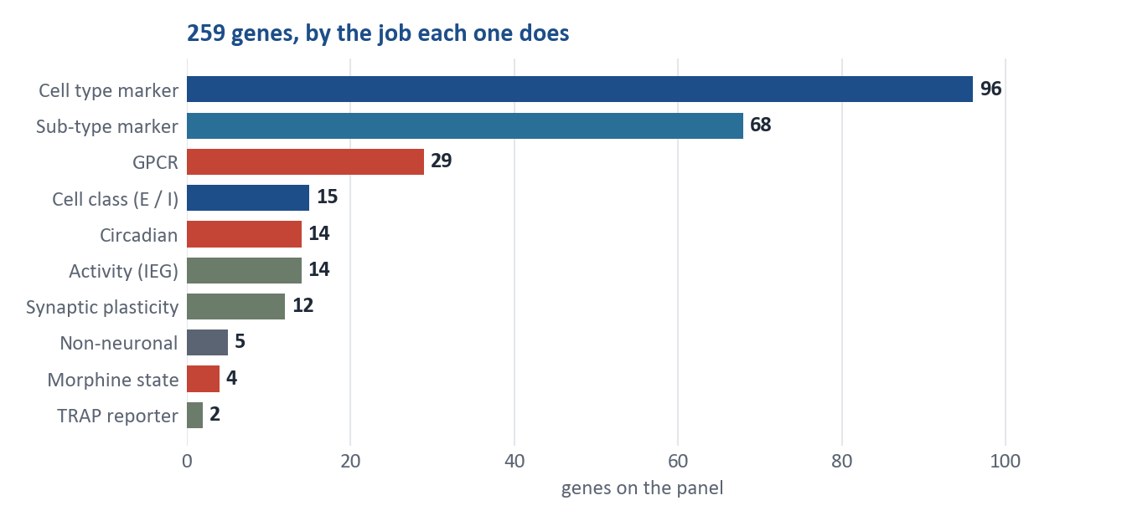
Final panel - 259 genes, one section, two regions
One shared Xenium panel read from the same mouse. All 20 target cell populations remain separable.
259
20 / 20
86 / 86
12 + 8
genes on the
shared panel
cell populations
still separable
sub-populations
resolved
populations in
ORBm + BMAp
What each cell will tell us
Identity
Which of the 20 populations it is - cortical layer, interneuron class, or amygdala subtype
Activity
Whether it was recently active - Fos and Arc, plus the TRAP2 genetic tag
Circadian / morphine
Jesse ORBm state: Per2, Per1, Nr1d1 and the circadian gene set
Receptors
Which GPCRs sit on it - opioid, monoamine, muscarinic, peptide
The last row is the new capability: inside one of the 20 types, separate cells that were TRAP-active during morphine seeking from those that were not, and ask which receptors differ.
ORBm + BMAp custom Xenium panel | Allen WMB-10X | 3/5

Slide 4
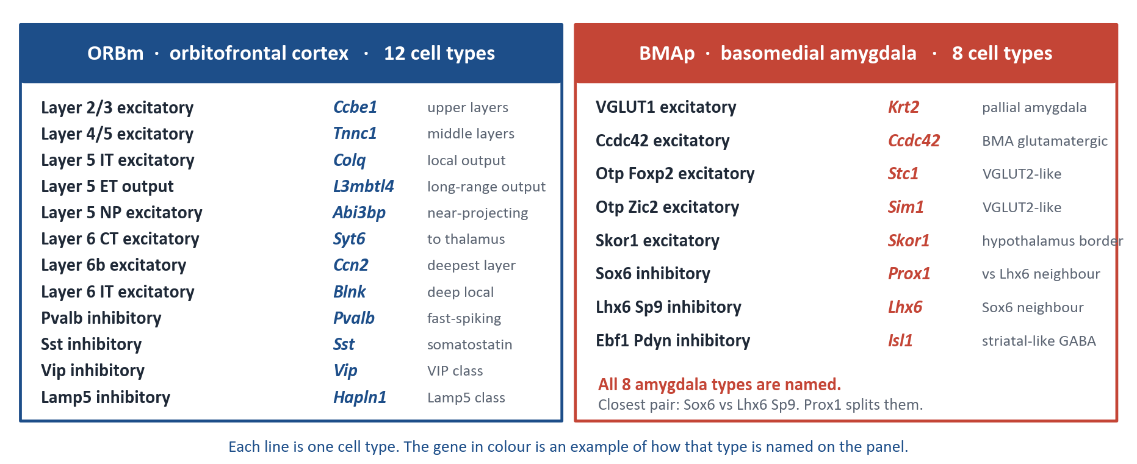
The 20 cell types we have to tell apart
12 in orbitofrontal cortex (ORBm), 8 in basomedial amygdala (BMAp). Every line is one type. The coloured gene is how that type is named.
ORBm + BMAp custom Xenium panel | Allen WMB-10X | 4/5

Slide 5
The list rests on a full re-analysis of the reference atlas
No gene was taken on a paper's word. Every candidate was re-scored in Allen WMB-10X, restricted to these two regions.
226,886
32,245
20 / 20
0.948
single cells scored in
the two target regions
genes re-scored,
not a shortlist
cell types called,
the basic requirement
held-out accuracy
across the 20 types
13
280
86 / 86
14
documented sources,
9 with a DOI
GPCRs swept,
35 kept
sub-populations
resolved
circadian genes,
from Jesse, not a name
What that analysis produced, in order
1. Restrict to the 20 types
12 ORBm + 8 BMAp. Nothing is scored as a whole-brain average.
2. Per-type marker ranking
Unique versus the other 19, and versus the closest neighbour.
3. Circadian + morphine from Jesse
Clock genes that are DE in PL-ILA-ORB after 5-day morphine, plus the
PER:CRY and ROR/REV-ERB limbs those DEGs need to be readable.
4. Receptor layer
35 GPCRs, each with where it sits among the 20 and whether a drug exists.
5. Drop what cannot be seen
Empty maps (Sstr4 1%) and no-contrast genes (Clock, Syt1).
6. Held-out check on the 20 types
0.948 balanced accuracy. 073 Sox6 GABA recall 0.98. L5 IT and L6b
grade into their neighbour - that is cortex, not a missing marker.
ORBm + BMAp custom Xenium panel | Allen WMB-10X | 5/5

