Slide 1
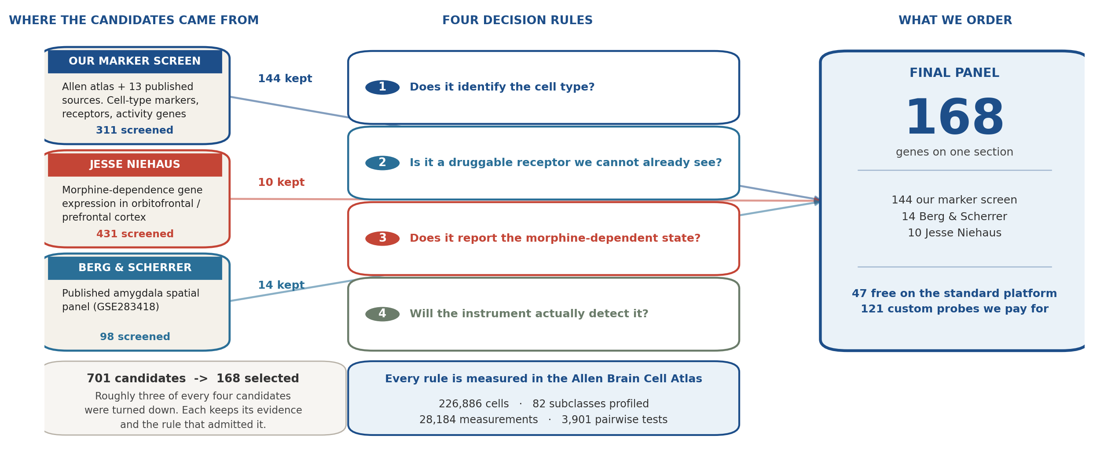
How the gene panel was selected
The instrument reads a fixed number of genes per tissue section, so every slot has to be earned. Four rules decided which genes earned one.
ORBm + BMAp custom Xenium panel | Allen WMB-10X | 1/5

Slide 2
Why a gene is in - and why a similar one is out
Each rule is a measurement with a cutoff. For every rule there is a gene that passed and a comparable gene that did not, so the line is visible rather than asserted.
1
Does it identify the cell type?
2
Is it a druggable receptor we cannot already see?
Specificity against genes the panel already carries. Must beat them (ratio > 1).
Regional enrichment, plus whether that receptor family is already covered.
IN Col23a1 3.7x more specific - no equal marker existed for that amygdala population
IN Chrm1 M1 receptor, enriched in 8 populations - we could only see M2 before
OUT Sfrp1 0.9x - a gene already on the panel does the job better
OUT Glipr1 its population already carries Penk (2.3x) and Lamb3 (1.5x)
3
Does it report the morphine-dependent state?
4
Will the instrument actually detect it?
Differential expression counted only in our 12 ORBm populations, not the donor's whole dataset.
Fraction of cells expressing it in the atlas. Sparse probes give sparse, unusable maps.
IN Per2 changes in 11 of 12 populations - the broadest gene in Jesse's dataset
IN Grm8 99% of cells, above 50% in 8 of the 12 populations
OUT Nr4a3 strong at 8 clusters, but only 5 of ours; the rest we do not image
OUT Mas1 most enriched receptor of all, but only 45% of cells and absent from GABA
The constraint that forces all of this
The standard 10x Mouse Brain panel gives ~248 genes free. The custom add-on is capped near 100.
So 168 genes on one section means 47 taken free and 121 paid for - and roughly three of every four candidates we screened were turned down.
The four rules are independent, and that is deliberate.
A receptor earns a slot by showing where a drug target sits, whether or not morphine changes it. So one panel serves the pharmacology aim and the addiction aim at the same time, instead of forcing a choice between them.
ORBm + BMAp custom Xenium panel | Allen WMB-10X | 2/5

Slide 3
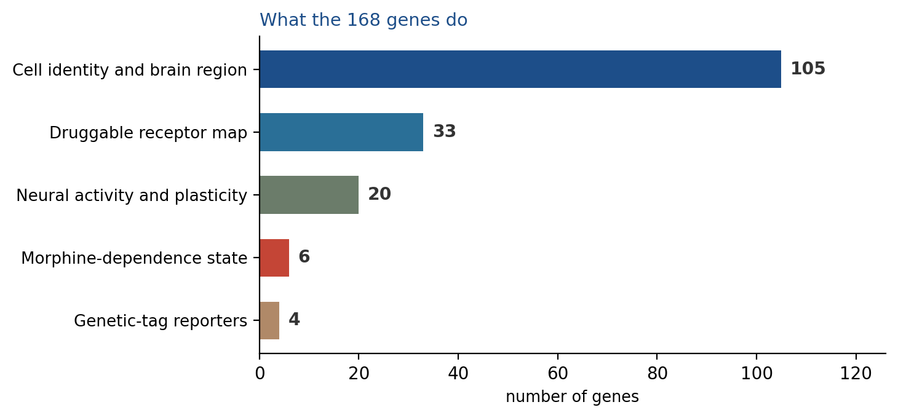
Final panel - 168 genes, one section, two regions
One shared Xenium panel read from the same mouse. All 20 target cell populations remain separable.
168
20 / 20
47
12 + 8
genes on the
shared panel
cell populations
still separable
already free on the
10x base panel
populations in
ORBm + BMAp
What each cell will tell us
Identity
Which of the 20 populations it is - cortical layer, interneuron class, or amygdala subtype
Activity
Whether it was recently active - Fos and Arc, plus the TRAP2 genetic tag
State
Whether it carries the morphine-dependence signature - Per2, Pcsk1, Per1, Camk2g
Receptors
Which druggable receptors sit on it - opioid, muscarinic, glutamate, relaxin
The last row is the new capability: within a single cortical cell type, it separates cells that carry the dependence signature from those that do not.
ORBm + BMAp custom Xenium panel | Allen WMB-10X | 3/5

Slide 4
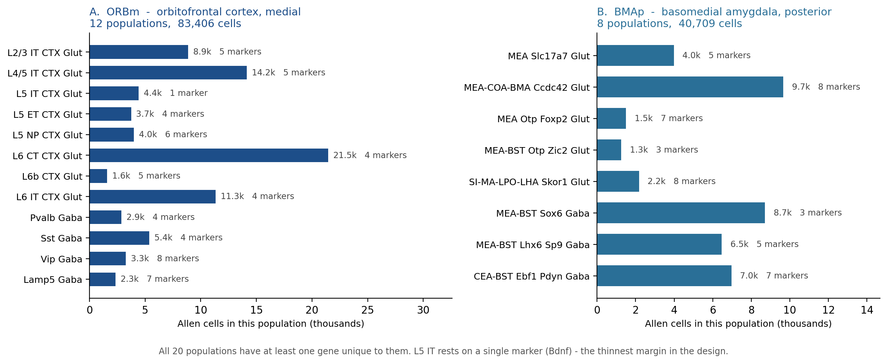
The 20 populations we must tell apart
The target list comes from the Allen Brain Cell Atlas taxonomy: 12 populations in orbitofrontal cortex, 8 in basomedial amygdala.
12
8
124,115
20 / 20
ORBm populations
83,406 Allen cells
BMAp populations
40,709 Allen cells
cells in the 20
target populations
have a dedicated marker
on the final panel
BACKUP · ORBm + BMAp custom Xenium panel | Allen WMB-10X | 4/5

Slide 5
The list rests on a full re-analysis of the reference atlas
No gene was taken on a paper's word. Every candidate was re-scored in the Allen atlas, restricted to these two regions, against the genes the panel already carried.
226,886
82
28,184
3,901
single cells scored across
the two target regions
cell subclasses profiled,
not only the 20 targets
gene x subclass abundance
and specificity measurements
pairwise tests: can gene X
separate type A from type B?
13
127
39
64
documented sources,
9 with a DOI
region-enriched receptors
evaluated one by one
receptors tiered specific,
intermediate or universal
FDA-approved drugs mapped
to panel receptors (IUPHAR)
What that analysis produced, in order
1. Region-restricted expression matrices
Cells from ORBm and BMAp were pulled out of the whole-brain atlas, so every abundance and
specificity number describes these two regions, not a brain-wide average.
2. Per-population marker ranking
For each of the 20 targets, every candidate was ranked by how much of that population
expresses it and how tightly it is restricted to it.
3. Pairwise separability testing
3,901 tests confirmed that neighbouring populations - L5 IT vs L5 ET, MEA vs BMA -
remain distinguishable using only the genes actually on the panel.
4. Receptor and drug-target layer
Receptors were tiered by specificity and cross-referenced to the IUPHAR pharmacology
database, so the map covers targets that drugs already exist for.
BACKUP · ORBm + BMAp custom Xenium panel | Allen WMB-10X | 5/5

