Slide 1
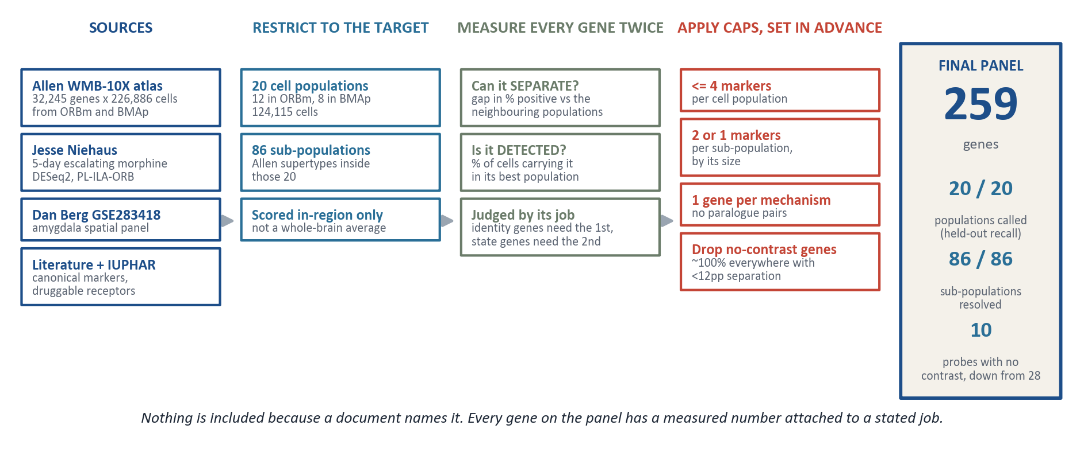
How the gene panel was selected
Xenium reads a fixed set of genes per section, so every slot has to be earned. Four public and internal sources went in; four measured rules decided what came out.
ORBm + BMAp custom Xenium panel | Allen WMB-10X | 1/5

Slide 2
Why a gene is in - and a similar one is out
Every rule is a measurement with a cutoff. For each one there is a gene that passed and a comparable gene that did not, so the line is visible rather than asserted.
1
Does it identify the cell population?
2
Does it split a population into sub-types?
Gap in percent of cells positive, against the 19 neighbouring populations.
A gene can be rare overall and still decisive inside one sub-population.
IN Ccbe1 74% of L2/3 cells, +54pp over any other population
IN St18 only 8.8% of cells, but 95% of one 194-cell sub-type (+66pp)
OUT Sstr4 1.4% of cells and no separation anywhere - an empty map
OUT Gpr63 2.7% of cells, 1.5pp gap - rare and uninformative
3
Will the instrument actually detect it?
4
Is a gene already on the panel doing this job?
State genes report a level, so they must be present in enough cells to read.
Redundant paralogues cost optical capacity and return no extra information.
IN Grm8 99% of cells, and +31pp at a sub-population as a bonus
IN Gria1 the AMPA subunit that traffics in opioid plasticity
OUT Mas1 most ORB-enriched receptor in the donor data, but 45% of cells
OUT Syt1 100% of cells in all 20 populations, 0.0pp gap - no contrast
The two exceptions, both deliberate
Immediate-early genes are exempt from rule 3. The reference atlas is resting tissue, so a low resting number is the expected result, not a defect - induction is what the experiment measures.
Npas4 sits at 34% of cells in the atlas and stays on the panel for exactly that reason.
Glia get 5 probes, not more, and that number was tested rather than assumed. 28% of the section is non-neuronal, but a held-out test on 188,849 cells put neuron-vs-glia accuracy at 0.9998 both with and without glial probes: a glial cell is already negative for the 40 pan-neuronal genes on the panel. The 5 probes are there to NAME each population, one each, not to find them.
Two probes were kept knowingly below the detection bar on request: Htr1a at 28% of cells and Nfil3 at 20%.
ORBm + BMAp custom Xenium panel | Allen WMB-10X | 2/5

Slide 3
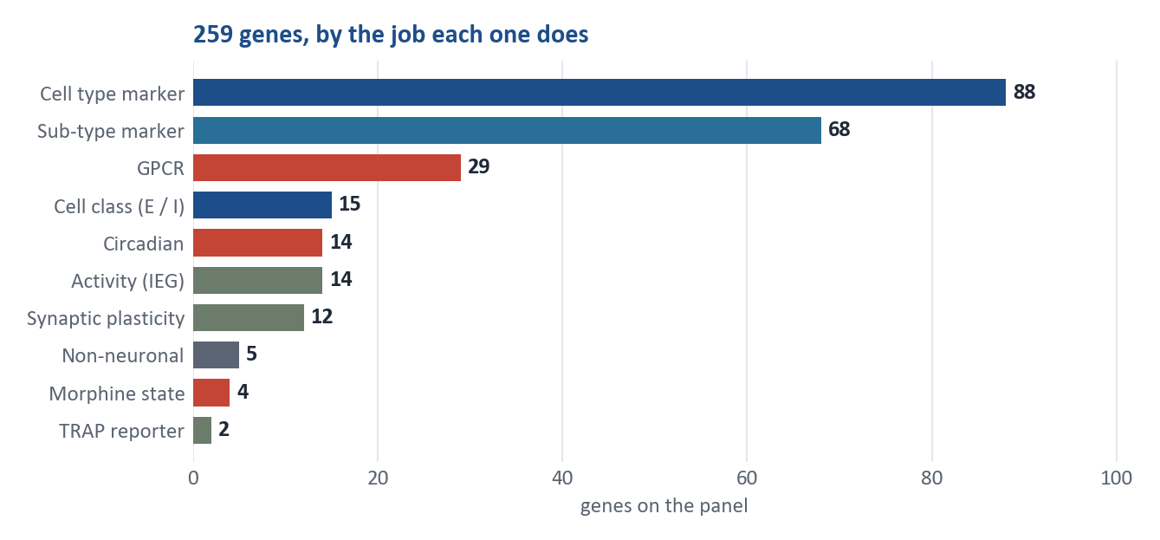
Final panel - 259 genes, one section, two regions
One shared panel, read from the same mouse. Each cell returns four layers of information at once.
259
0.948
86 / 86
12 + 8
genes on the
shared panel
balanced accuracy calling
the 20 populations
sub-populations
resolved
populations in
ORBm + BMAp
What each cell will tell us
Identity
Which of the 20 populations it is, and which sub-type inside it - cortical layer, interneuron class, amygdala subtype
Activity
Whether it was active during the POST window - the TRAP2 tdTomato tag, plus Fos, Arc and 12 more IEGs
State
Whether it carries the morphine-dependence signature - Per2, Per1, Nr1d1 and the rest of the clock module
Receptors
Which druggable receptors sit on it - opioid, monoamine, muscarinic, metabotropic, peptide
The capability this buys: inside one cortical cell type, separate the cells that were active during morphine seeking from those that were not - then ask which receptors differ.
ORBm + BMAp custom Xenium panel | Allen WMB-10X | 3/5

Slide 4
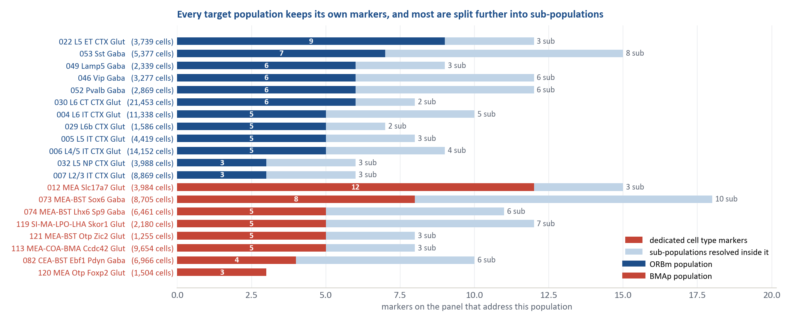
The populations the panel has to tell apart
Targets come from the Allen Brain Cell Atlas taxonomy: 12 populations in orbitofrontal cortex, 8 in basomedial amygdala, and the sub-types inside each.
Marker counts are a proxy, so the panel was tested directly: a classifier using only these genes, on 125,313 held-out cells over 3 seeds, reaches 0.948 balanced accuracy across the 20 populations, 18 of them above 0.90 recall.
073 MEA-BST Sox6 Gaba, the one population with a single marker, scores 0.982 - the count was misleading. The two that fall short, 005 L5 IT and 029 L6b, are graded into their neighbours: tripling the gene set moves them by 0.01-0.02, so this is cortical biology rather than a missing probe.
ORBm + BMAp custom Xenium panel | Allen WMB-10X | 4/5

Slide 5
What was removed, and what the evidence rests on
The panel got smaller on purpose. A 318-gene draft was cut to 259 without losing a single cell population or sub-population.
32,245
226,886
113
13
genes re-scored,
not a shortlist
ORBm and BMAp cells
in the reference atlas
genes cut from the draft,
each with a written reason
documented sources,
9 with a DOI
What came off the 318-gene draft
What the numbers are measured on
85
another marker already covered that population or sub-type
Allen WMB-10X
single-cell expression for ORBm and BMAp only, so every number describes these two regions
25
no contrast: ~100% of cells in all 20 populations, under 12pp of separation
Jesse Niehaus
5-day escalating-morphine DESeq2 in PL-ILA-ORB - source of the circadian module and the state genes
3
too rarely detected to produce a usable map
Berg GSE283418
amygdala spatial panel, used to check the BMAp markers
Why the result should be trusted
The caps were written down before the panel was assembled, so the size is a consequence of the rules rather than a target that was aimed at.
Every gene carries its measured detection and separation numbers in the delivered workbook, and every removal carries a one-line reason.
The draft and the final panel were scored with identical code, so the comparison is like for like: 318 genes to 259, with sub-population coverage going from 73 to 74 of 86 rather than down.
Remaining limitation: detection is measured on dissociated single-cell data, which predicts relative detectability, not Xenium's absolute sensitivity.
ORBm + BMAp custom Xenium panel | Allen WMB-10X | 5/5

