Slide 1
How the gene panel was chosen
One shared Xenium panel for two regions of the same mouse: orbitofrontal cortex (ORBm) and basomedial amygdala (BMAp).
Format · standalone custom Xenium panel · no 100-gene add-on cap · every gene is a designed probe
A gene still has to earn its place: detectable in these two regions, and informative for cell type, activity, state, or receptor map.
1
Map the cell types
2
Score in a brain atlas
3
Build the core
4
Add Jesse + Dan
20 populations we must tell apart
226,886 cells, two regions
Markers + activity + receptors
Same tests, not whole tables
12 in ORBm + 8 in BMAp
Allen Brain Cell Atlas taxonomy
Allen WMB-10X
Is the gene abundant?
Is it specific to one type?
Cell-type separators
IEGs and TRAP tags
Druggable GPCRs
All 20 types separable
Morphine-state genes
Amygdala spatial genes
Final panel: 245 genes
A gene is not added because it appeared in a paper or a DEG table. It is added if the atlas says it is detectable here, and it answers a question the rest of the panel cannot. We do not cut to a 100-gene vendor cap.
ORBm + BMAp custom Xenium panel | Allen WMB-10X | 1/3

Slide 2
Collaborator lists were filtered — not copied in
Two external datasets were tested against the same rule: will the probe be visible, and does it add information we do not already have?
Jesse · morphine transcriptomics in ORB / prefrontal cortex
Dan · amygdala spatial panel (GSE283418)
304 unique DEGs
→ 71 kept
98 spatial genes
→ 26 extras
Rule Keep if it changes in at least 4 of our 12 ORBm cell types, or is an ORB-enriched receptor. Not a 100-slot cut.
Rule Keep if it is informative in Allen BMAp. 52 of 98 were already in the core, so they are not counted twice.
KEPT
54 morphine-state genes (Per2, Pcsk1, Per1, Camk2g, …)
17 ORB-enriched receptors (Chrm1, Grm8, Gpr26, Rxfp1, …)
Includes genes DE in both glutamatergic and GABA types
KEPT AS EXTRAS
14 stronger BMAp genes + 12 additional amygdala genes
Includes Sfrp1, Glipr1, Vdr once slots are not scarce
No existing gene was removed or re-ranked
NOT COPIED IN · 233 genes
DE in fewer than 4 of our 12 ORBm cell types
Most remaining transcription factors
A panel is not a transcriptome.
NOT COPIED IN · remainder
Not scored in Allen BMAp, or below a low-information cutoff
Genes that only mark distant nuclei
Do not copy the whole 98-gene spatial list.
ORBm + BMAp custom Xenium panel | Allen WMB-10X | 2/3

Slide 3
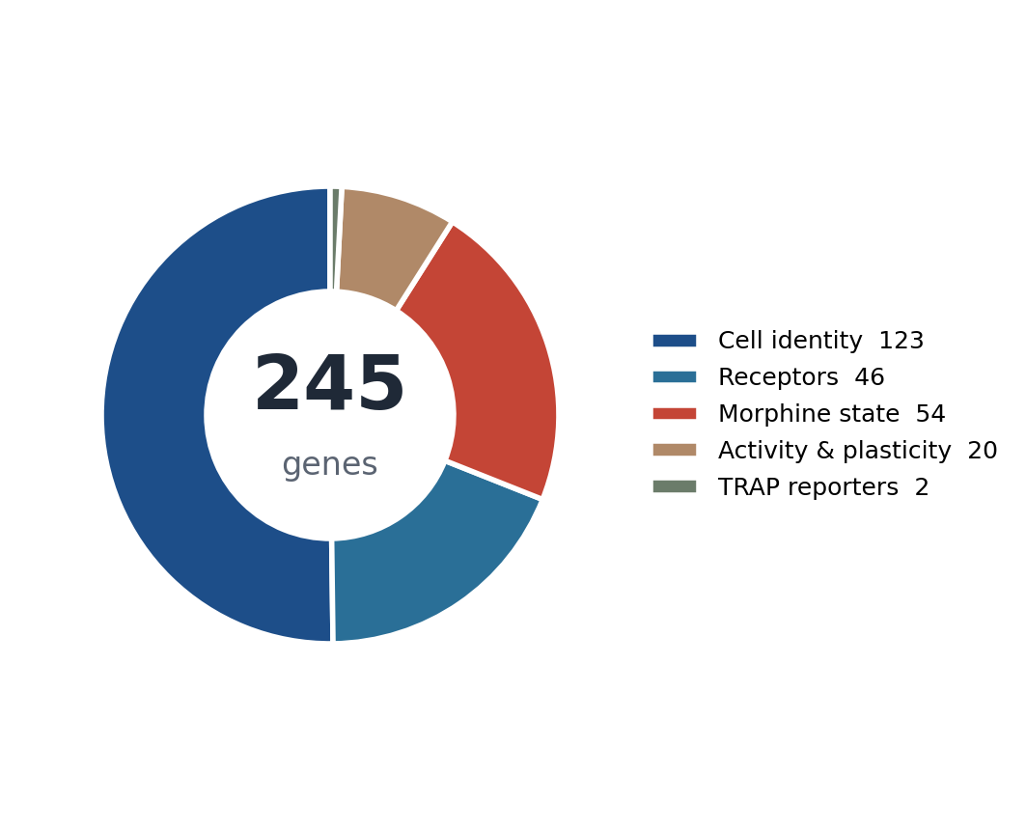
Final panel · 245 genes, one slide, two regions
Standalone custom Xenium panel for ORBm and BMAp. Jesse and Dan genes included. All 20 cell types remain separable.
245
20 / 20
no cap
2
genes on the
shared panel
cell types still
separable
standalone custom
all 245 are probes
regions read from
the same mouse
What each cell can tell us
Identity
Which of the 20 types it is (layer, interneuron class, amygdala subtype)
Activity
Whether it was recently active (Fos / Arc / TRAP2 reporter)
State
Morphine-dependence signature (Per2, Pcsk1, Per1, Camk2g)
Receptors
Druggable GPCRs on that type (opioids, muscarinic, mGlu, Rxfp1)
ORBm + BMAp custom Xenium panel | Allen WMB-10X | 3/3

