Slide 1
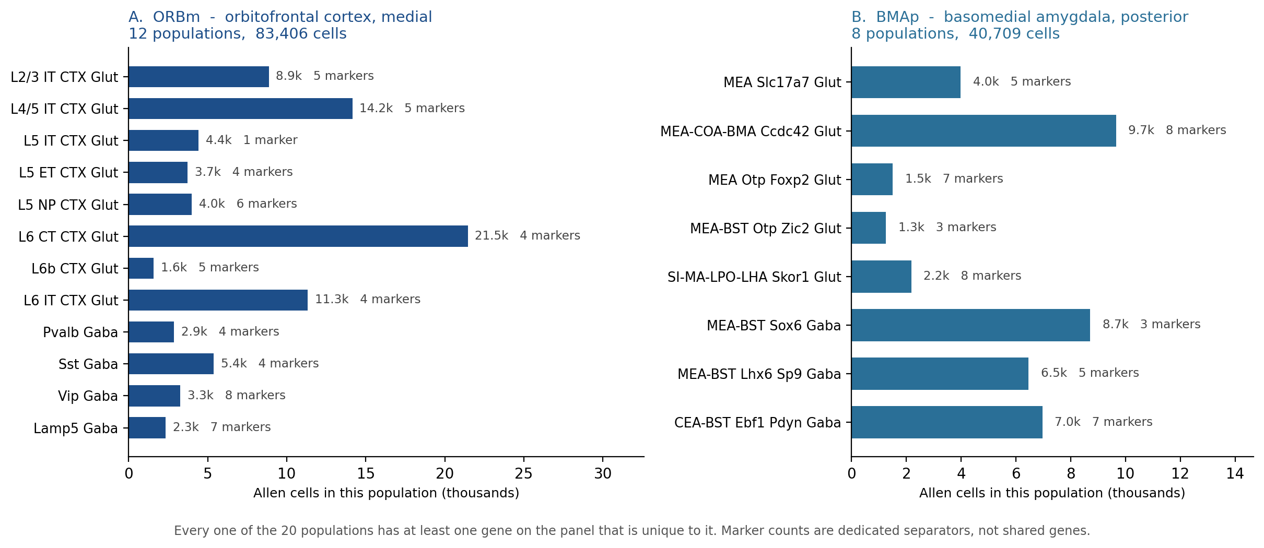
The 20 populations we must tell apart
The panel is designed around a fixed target list: 12 cell populations in orbitofrontal cortex and 8 in basomedial amygdala, taken from the Allen Brain Cell Atlas taxonomy.
12
8
124,115
20 / 20
ORBm populations
(cortical layers + interneurons)
BMAp populations
(glutamatergic + GABAergic)
Allen cells in the
20 target populations
have a dedicated marker
on the final panel
ORBm + BMAp custom Xenium panel | Allen WMB-10X | 1/5

Slide 2
The list rests on a full re-analysis of the reference atlas
No gene was taken on a paper's word. Every candidate was re-scored in the Allen atlas, in these two regions, against the genes the panel already carried.
226,886
82
28,184
3,901
single cells scored across
the two target regions
cell subclasses profiled,
not only the 20 targets
gene x subclass abundance
and specificity measurements
pairwise tests: can gene X
separate type A from type B?
13
127
39
64
documented sources,
9 with a DOI
region-enriched GPCRs
evaluated one by one
receptors tiered as specific,
intermediate or universal
FDA-approved drugs mapped
to panel receptors (IUPHAR)
What that analysis produced, in order
1. Region-restricted expression matrices
Cells from ORBm and BMAp were pulled out of the whole-brain atlas, so every abundance and
specificity number describes these two regions - not a brain-wide average.
2. Per-population marker ranking
For each of the 20 targets we ranked every candidate by how much of that population expresses
it and how strongly it is restricted to it.
3. Pairwise separability testing
3,901 tests confirmed that neighbouring populations - L5 IT vs L5 ET, MEA vs BMA - can still be
told apart with the genes actually on the panel.
4. Receptor and drug-target layer
Receptors were tiered by specificity and cross-referenced to the IUPHAR pharmacology database,
so the map is of targets that drugs exist for.
ORBm + BMAp custom Xenium panel | Allen WMB-10X | 2/5

Slide 3
Why a gene is in - and why a similar one is out
Four rules, each a measurement with a cutoff. For every rule there is a gene that passed and a comparable gene that did not, so the line is visible rather than asserted.
1
Does it identify the cell type?
2
Is it a druggable receptor we cannot already see?
Specificity against genes the panel already has. Cutoff: must beat them (ratio > 1).
Regional enrichment, plus whether that receptor family is already covered.
IN Col23a1 3.7x more specific - the panel had no equal marker for that BMA population
IN Chrm1 M1 receptor, enriched in 8 populations - we could only see M2 before
OUT Sfrp1 0.9x - a gene already on the panel does the same job better
OUT Glipr1 its population already has Penk (2.3x) and Lamb3 (1.5x) on the panel
3
Does it report the morphine-dependent state?
4
Will the instrument actually detect it?
Differential expression counted only in our 12 ORBm populations, not the donor's whole dataset.
Fraction of cells expressing it in the atlas. Sparse probes give sparse, unusable maps.
IN Per2 changes in 11 of 12 populations - the broadest gene in the entire dataset
IN Grm8 99% of cells, above 50% in 8 of 12 populations
OUT Nr4a3 looked strong at 8 clusters, but only 5 of ours; the rest were regions we do not image
OUT Mas1 the single most enriched receptor, but only 45% of cells and absent from GABA
The rules are independent, and that is deliberate. A receptor earns a slot by showing where a drug target sits, whether or not morphine changes it - so one panel serves the pharmacology aim and the addiction aim at the same time.
The hard constraint that forces all of this
The 10x Mouse Brain panel gives ~248 genes free; the custom add-on is capped near 100. So 168 genes on one section means 47 taken free and 121 paid for. A gene that merely appeared in a paper, or in a differential-expression table, does not qualify - roughly three of every four candidates we screened were turned down.
ORBm + BMAp custom Xenium panel | Allen WMB-10X | 3/5

Slide 4
Collaborator lists were filtered, not copied in
Two external datasets arrived as gene tables. Both were put through the same four rules as everything else.
Morphine transcriptomics in orbitofrontal / prefrontal cortex
Amygdala spatial panel (GSE283418, published)
304 unique DEGs -> 10 kept
98 spatial genes -> 14 kept
Rule applied: will Xenium see it in our 12 ORBm populations, and does it change in enough of them? Relative enrichment is not abundance.
Rule applied: does it mark BMAp more specifically than a gene the panel already carries? 52 of the 98 were already covered.
KEPT
KEPT
Clock and peptide program Per2 Pcsk1 Per1 Camk2g
High-abundance receptors Chrm1 Grm8 Gpr26 Rxfp1
Free on the 10x base panel Bhlhe40 Sema3e Rxfp1
14 genes that add BMAp information
Appended on top of the curated core
No existing gene was removed or re-ranked
DROPPED
DROPPED
294 genes dropped
Sparse receptors - Mas1 at 45% of cells and near-absent in GABA
Most transcription factors, and the long tail of the DEG table
A 100-slot panel is not a transcriptome.
Remainder dropped
Below the specificity cutoff - Sfrp1, Glipr1, Vdr all under 1.0
Several peak in neighbouring nuclei, not BMAp itself
Do not spend a slot on a weaker third marker.
ORBm + BMAp custom Xenium panel | Allen WMB-10X | 4/5

Slide 5
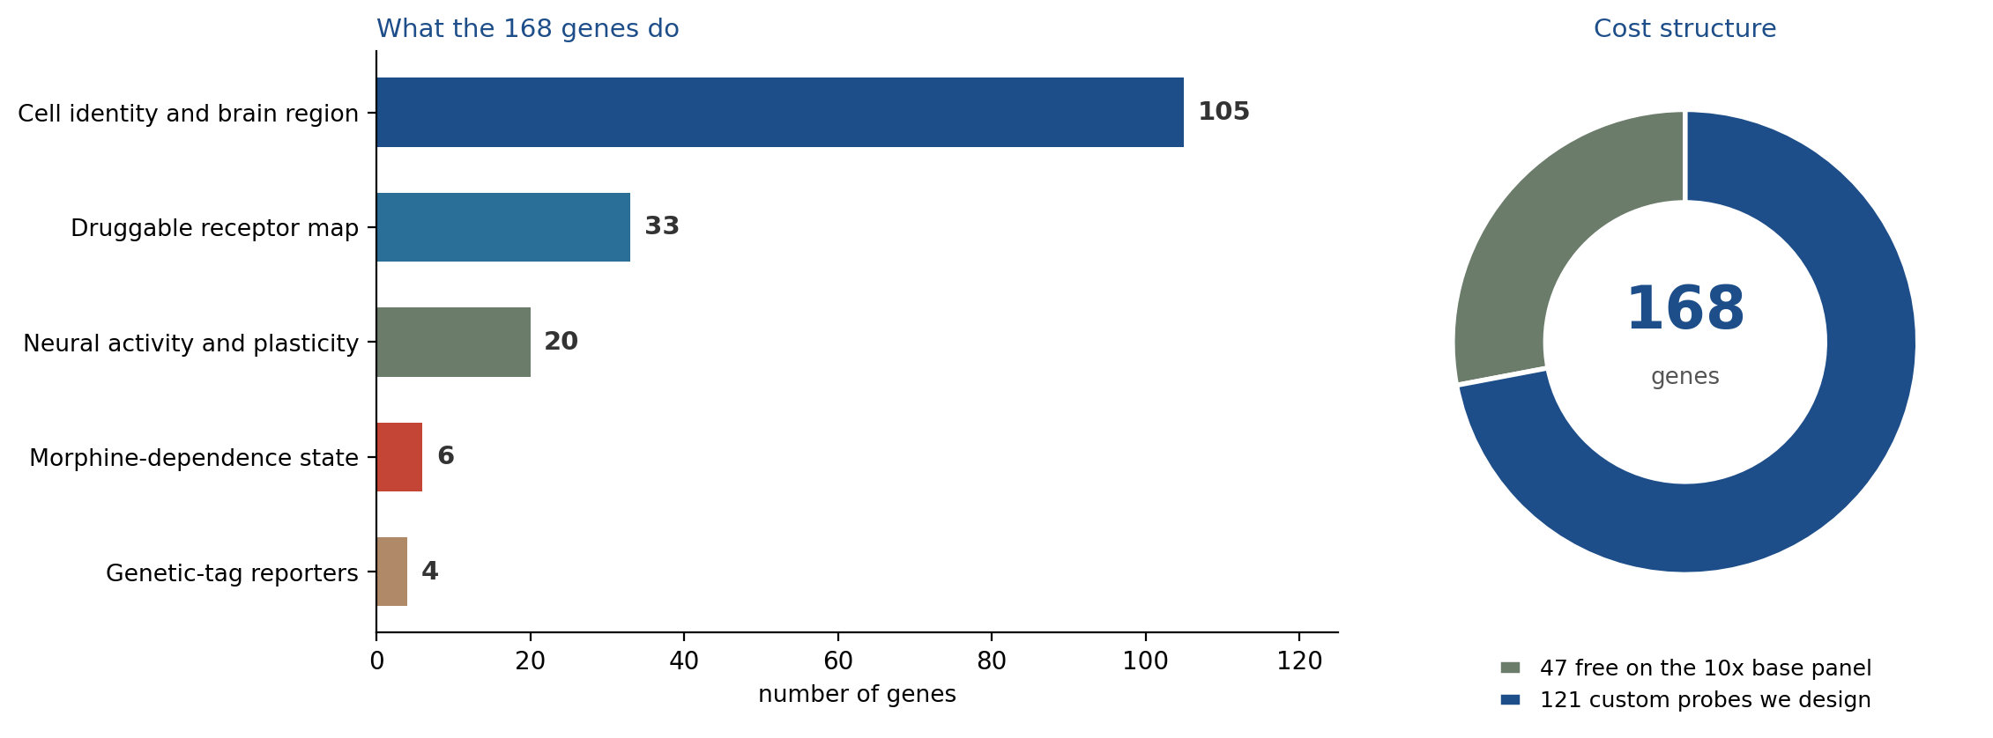
Final panel - 168 genes, one section, two regions
One shared Xenium panel read from the same mouse. All 20 target populations remain separable.
168
20 / 20
47
2
genes on the
shared panel
cell populations
still separable
already free on the
10x base panel
regions read from
the same mouse
What each cell can tell us
Identity
Which of the 20 populations it is - layer, interneuron class, amygdala subtype
Activity
Whether it was recently active - Fos / Arc plus the TRAP2 reporter
State
Morphine-dependence signature - Per2, Pcsk1, Per1, Camk2g
Receptors
Druggable GPCRs present on that cell - opioid, muscarinic, mGlu, relaxin
ORBm + BMAp custom Xenium panel | Allen WMB-10X | 5/5

