Slide 1
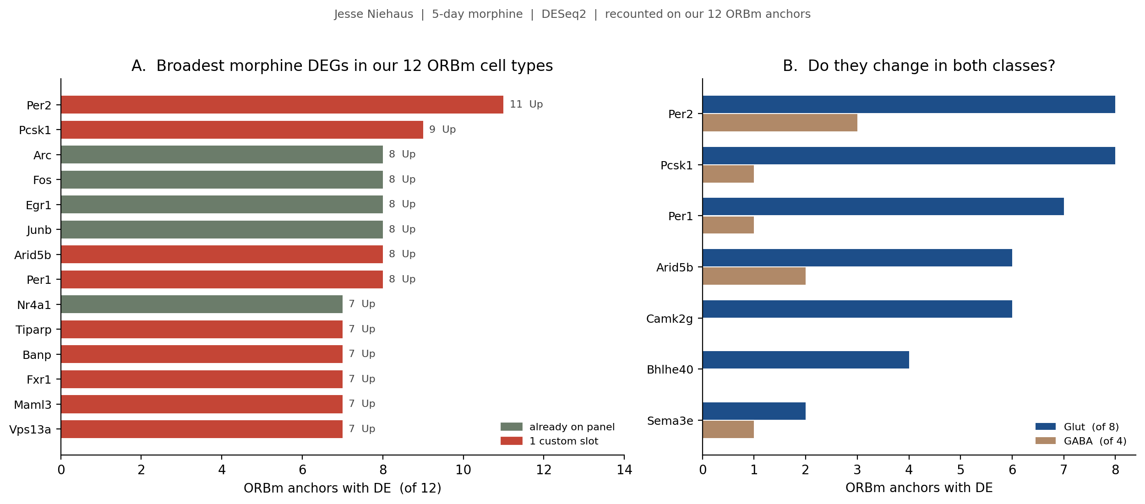
Jesse | how the morphine DEGs look
Recounted on the 12 ORBm cell types we image, not Jesse's raw PL-ILA-ORB cluster count. Lamp5 has no DEG, so 11/12 is the ceiling.
Per2 (11/12) and Pcsk1 (9/12) are the broadest genes in the whole dataset and were both missing. Fos / Arc / Egr1 / Junb start at 8/12 — the activity core is already on the 144.
ADD from this figure: Per2, Pcsk1, Per1, Camk2g + Bhlhe40, Sema3e (free on base). Do not add the other ~263 custom Jesse DEGs — 304 unique genes is a transcriptome, not a 100-slot panel. Arid5b (8/12) is a chromatin TF and was left out.
ORBm + BMAp Xenium | Jesse Niehaus + Daniel Berg / Scherrer + Allen WMB-10X | 1/4

Slide 2
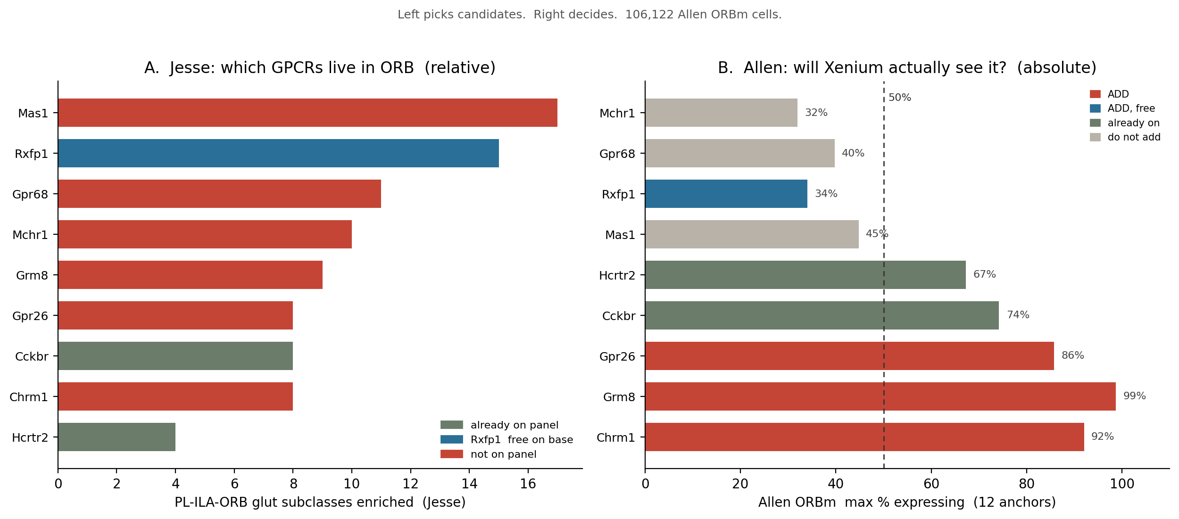
Jesse | how the ORB GPCRs look — relative vs absolute
Left ranks by enrichment. Right is the buy list: ADD red / teal, skip grey. Gpr26 is included (86%).
ADD: Chrm1 (92%) Grm8 (99%) Gpr26 (86%) Rxfp1 (free, 34%). Already on: Cckbr (74%) Hcrtr2 (67%).
DO NOT ADD: Mas1 (Jesse #1, but 45% and ~1% in GABA) Gpr68 (40%) Mchr1 (32%, only 2 anchors ≥20%). Enrichment is not abundance — those three fail the 50% line.
ORBm + BMAp Xenium | Jesse Niehaus + Daniel Berg / Scherrer + Allen WMB-10X | 2/4

Slide 3
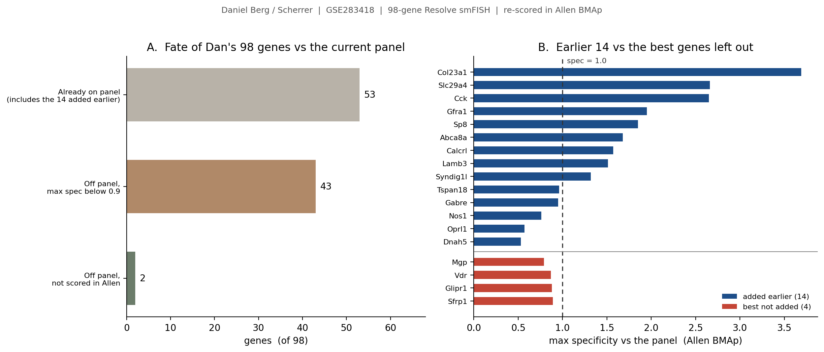
Dan | how the 98-gene spatial panel looks
GSE283418 Resolve smFISH. 52/98 already on the 158-gene sheet. Rule: add only if max_spec > 1.0 (beats a gene we already carry).
DO NOT ADD Sfrp1 / Glipr1 / Vdr. All three fail spec > 1.0. Sfrp1 (21%) peaks in 119 SI–LHA, not BMAp. Vdr (11%) peaks in 082 CEA–BST. Glipr1 (22%) is true 113 Ccdc42, but Penk (2.31) and Lamb3 (1.51) already cover it.
Caveat: Nos1 / Oprl1 / Dnah5 on the sheet sit below those leftovers on spec. That is a reason to drop them later if we hit the 100-slot cap — not a reason to stack three more weak probes.
ORBm + BMAp Xenium | Jesse Niehaus + Daniel Berg / Scherrer + Allen WMB-10X | 3/4

Slide 4
Final decision | genes added to the panel
These 10 genes are now on SHARED_PANEL_ORDER (168 genes). Skip Mas1 / Gpr68 / Mchr1, Dan leftovers Sfrp1 / Glipr1 / Vdr, and the rest of Jesse's 304 DEGs.
Decision | Genes | Why (from the figures) | Slots
Already on sheet | Dan 14 + Fos Arc Egr1 Cckbr Hcrtr2 | Cell-type 144 and Dan extras stay. No further Dan gene this round. | done
ADDED (Jesse state) | Per2 Pcsk1 Per1 Camk2g Bhlhe40 Sema3e | Slide 1: broadest missing morphine DEGs (11 / 9 / 8 / 6 of 12). Bhlhe40 and Sema3e are free on base. | 4 + 2 free
ADDED (Jesse GPCR) | Chrm1 Grm8 Gpr26 Rxfp1 | Slide 2: ORB GPCRs Allen actually sees (92% / 99% / 86% / free 34%). Chrm2 and Grm5 are already on. | 3 + 1 free
On SHARED_PANEL_ORDER | 168 genes = 144 + Dan 14 + Jesse 10 | 47 free on the Xenium base panel + 121 custom. Original add-on cap is 100 — confirm extras with 10x. | 7 new custom
Do not add | Mas1 Gpr68 Mchr1 Sfrp1 Glipr1 Vdr Arid5b Gadd45a rest of Jesse | Low Allen % / wrong nucleus or spec < 1.0 / TF / 263 other custom DEGs. Not a transcriptome panel. | —
On the order sheet: Per2 Pcsk1 Per1 Camk2g Bhlhe40 Sema3e + Chrm1 Grm8 Gpr26 Rxfp1
Seven new custom slots on top of Dan 14 → 121 custom if every Dan gene is kept. Cap is 100 — confirm with 10x, or drop CEA-border Dan genes first.
ORBm + BMAp Xenium | Jesse Niehaus + Daniel Berg / Scherrer + Allen WMB-10X | 4/4

