Slide 1
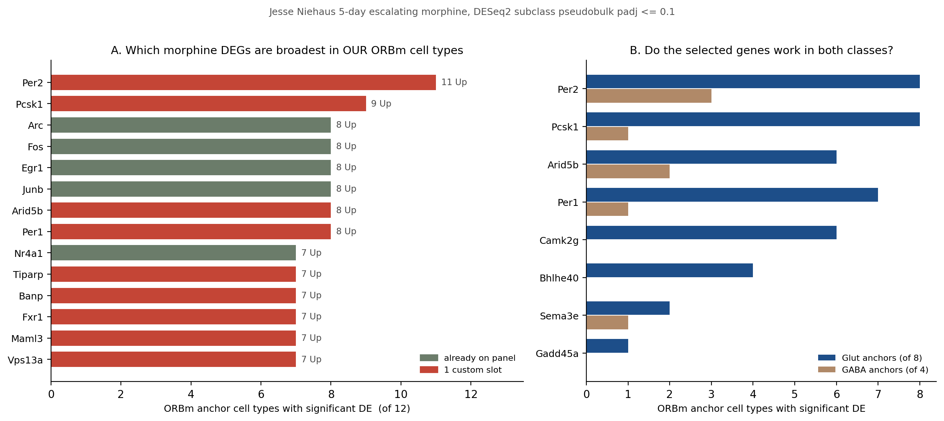
Jesse | which morphine genes are worth a slot
Ranked by how many of the 12 ORBm anchor cell types we image actually show DE, not by Jesse's raw cluster count.
304 unique DEGs across four lists (IEG 77, TF 179, synaptic plasticity 45, GPCR 34) plus 127 ORB-enriched GPCRs. Only 30 of the DEGs are already on our panel.
The two broadest genes in the whole dataset - Per2 (11/12) and Pcsk1 (9/12) - were both missing. Our existing IEGs (Egr1, Arc, Fos, Junb) start at 8/12, so the activity core was fine but the top of the list was not.
Why 11 and not 12: Lamp5 Gaba carries no DEG at all in this dataset, so 11 is the ceiling - Per2 changes in every ORBm cell type where anything changes. Re-counting on our 12 anchors drops Jesse's raw numbers by 0.13 clusters on average; the only gene it demotes out of contention is Nr4a3 (8 raw, 5 here).
ORBm + BMAp Xenium add-on | Jesse Niehaus + Daniel Berg / Scherrer | 1/4

Slide 2
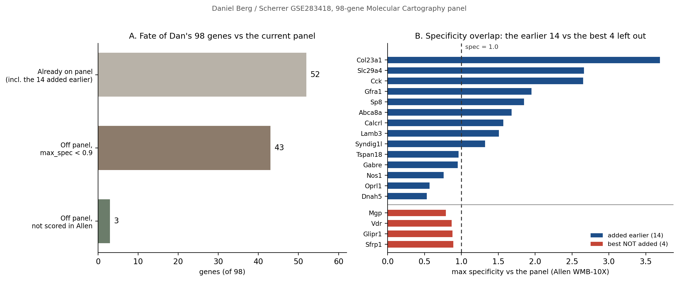
Dan | re-checked, nothing further to add
All 98 genes re-scored against the current 158-gene panel.
52 of 98 are already on the panel. The best of the 46 left off scores max_spec 0.89 - below 1.0, so none of them beats a gene the panel already carries for that anchor.
Honest caveat: the 14 added earlier span max_spec 0.53-3.69, so Nos1 (0.76), Oprl1 (0.57) and Dnah5 (0.53) sit BELOW Sfrp1 (0.89), Glipr1 (0.88) and Vdr (0.87), which were left out. Those three went in on pharmacology, not specificity (Oprl1 = nociceptin receptor, Nos1 = interneuron marker).
Glipr1 (0.88) looked like the one borderline case because it serves anchor 113 MEA-COA-BMA Ccdc42, the true BMAp core. But that anchor already carries Penk (2.31) and Lamb3 (1.51) on the panel, so Glipr1 would be a third, weaker probe for a cell type that is already resolved. Recommendation: add nothing from Dan.
ORBm + BMAp Xenium add-on | Jesse Niehaus + Daniel Berg / Scherrer | 2/4

Slide 3
How the genes were selected
One rule for Jesse, one for Dan, and a slot budget.
Source | Metric | Threshold applied | Result
Jesse (ORBm) | DE breadth across the 12 ORBm anchor cell types | 8+ anchors = core add; free-on-base at any breadth = add (no slot cost) | 5 custom + 4 free
Dan (BMAp) | max specificity vs the panel in Allen WMB-10X (max_spec) | max_spec > 1.0 = beats an existing panel gene. Best remaining is 0.89 | 0 (nothing added)
Panel block | Genes | Slots | Change
Curated core (blocks 1-11) | 144 | 100 custom + 44 free | unchanged
Dan GSE283418 (block 12) | 14 | 14 custom | unchanged
Jesse morphine state (block 13, NEW) | 9 | 5 custom + 4 free | this round
Total | 167 | 119 custom + 48 free | +9 genes / +5 slots
Custom count rises 114 -> 119. The original cap was 100 custom add-on slots, so 119 needs vendor confirmation before ordering - this is the one open item.
These 9 genes report morphine-dependence state, not cell identity, so ANCHOR_COVERAGE is untouched and all 20 cell types remain separable.
ORBm + BMAp Xenium add-on | Jesse Niehaus + Daniel Berg / Scherrer | 3/4

Slide 4
FINAL | 9 genes added to the panel
Appended as block 13_Jesse_morphine_state. No existing gene removed or re-ranked.
Gene | ORBm anchors | Glut / GABA | Direction | Slot cost | Why it earns a place
Per2 | 11 / 12 | 8 / 3 | Up | 1 custom | Top DEG overall. Circadian clock.
Pcsk1 | 9 / 12 | 8 / 1 | Up | 1 custom | Prohormone convertase 1 (proenkephalin / POMC).
Arid5b | 8 / 12 | 6 / 2 | Up | 1 custom | Broad TF; also reaches interneurons.
Per1 | 8 / 12 | 7 / 1 | Up | 1 custom | Second clock gene; confirms Per2.
Camk2g | 6 / 12 | 6 / 0 | Down | 1 custom | Strongest DOWN gene. Direction control.
Bhlhe40 | 4 / 12 | 4 / 0 | Up | free (base) | Metabolic / circadian TF. Free on base.
Sema3e | 3 / 12 | 2 / 1 | Up | free (base) | Free on base; previously missed.
Gadd45a | 1 / 12 | 1 / 0 | Up | free (base) | IEG-adjacent TF. Free on base.
Rxfp1 | 0 / 12 | 0 / 0 | n/a | free (base) | ORB-enriched GPCR (19 subclasses). Circuit marker.
New question the panel can now answer: within one L5 IT cell, is the morphine-dependence signature ON or OFF? Cell typing and TRAP comparison worked before; morphine state did not.
Order sheet: FINAL_Xenium_panel_ORBm_BMAp_MSGS111_v2_167genes.xlsx - formatting, column widths, frozen panes and every existing row are byte-identical to MSGS111; rows were only appended.
Open for decision: (1) approve 119 custom slots - the original cap was 100, so this needs vendor confirmation, (2) keep Camk2g as the DOWN control. Nothing from Dan is proposed.
ORBm + BMAp Xenium add-on | Jesse Niehaus + Daniel Berg / Scherrer | 4/4

