Slide 1
The panel does four jobs - each needs its own metric
An earlier draft judged the GPCR candidates by whether morphine regulates them. That was the wrong test: this is a GPCR panel first.
Job | The right metric | What the panel already has | This round
1. Cell typing | Specificity vs the panel in Allen WMB-10X | 53 separators + backbone | unchanged - all 20 types still separable
2. Activity / TRAP | Established IEG set | Fos, Arc, Egr1, Junb, Npas4 ... | unchanged
3. Druggable GPCR map | ORB enrichment + Allen detectability + receptor-family gap | 29 GPCRs | ADD Chrm1, Grm8 (+ Rxfp1 free)
4. Morphine-dependence state | DE breadth across the 12 ORBm anchors + detectability | nothing - this axis was missing | ADD Per2, Pcsk1, Arid5b, Vps13a, Camk2g (+3 free)
Jobs 3 and 4 are independent. A receptor can earn a slot purely by showing where a druggable target sits, whether or not morphine moves it - Chrm1 is not a morphine DEG and still belongs on the panel.
Equally, a morphine-state gene does not need to be druggable. Judging either by the other's metric is what produced two conflicting drafts.
Xenium ORBm + BMAp add-on | Jesse Niehaus + Daniel Berg / Scherrer | 1/4

Slide 2
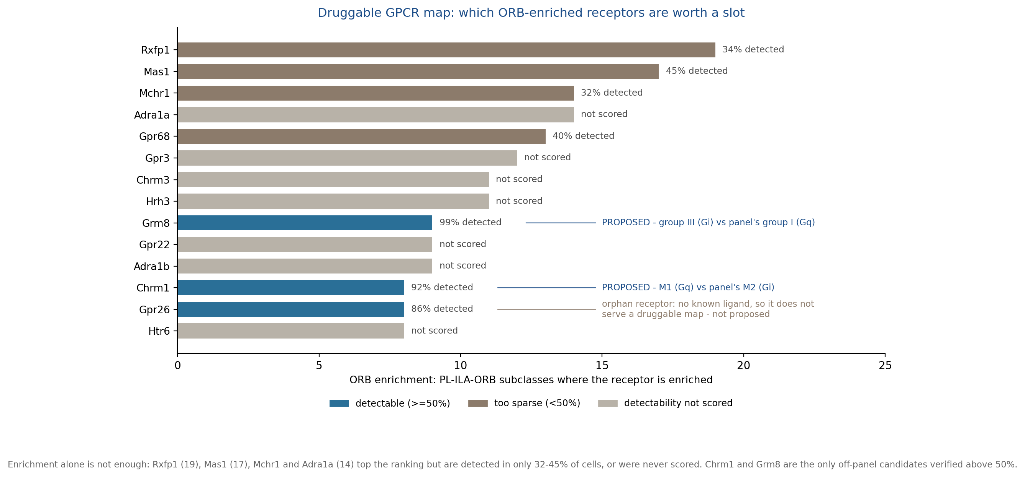
Job 3 | which ORB-enriched GPCRs are worth a slot
Enrichment ranks them; Allen detectability decides which are usable in Xenium; family gaps break the tie.
Chrm1 (M1, Gq) and Grm8 (mGlu8, group III, Gi) are the only off-panel candidates verified above 50% detection - 92% and 99%, in 9 and 8 of the 12 anchors. Both also fill a real family gap: the panel's only muscarinic is Chrm2 (M2, Gi, opposite signalling) and its only mGlus are Grm1/Grm5 (group I, Gq).
Rxfp1 tops the enrichment ranking (19 subclasses) but is detected in only 34% of cells. It is free on the base panel, so it is worth taking anyway - just expect a sparse map. Mas1, Mchr1, Adra1a, Hrh3 and Gpr3 are either too sparse or unscored, so they are not proposed.
Xenium ORBm + BMAp add-on | Jesse Niehaus + Daniel Berg / Scherrer | 2/4

Slide 3
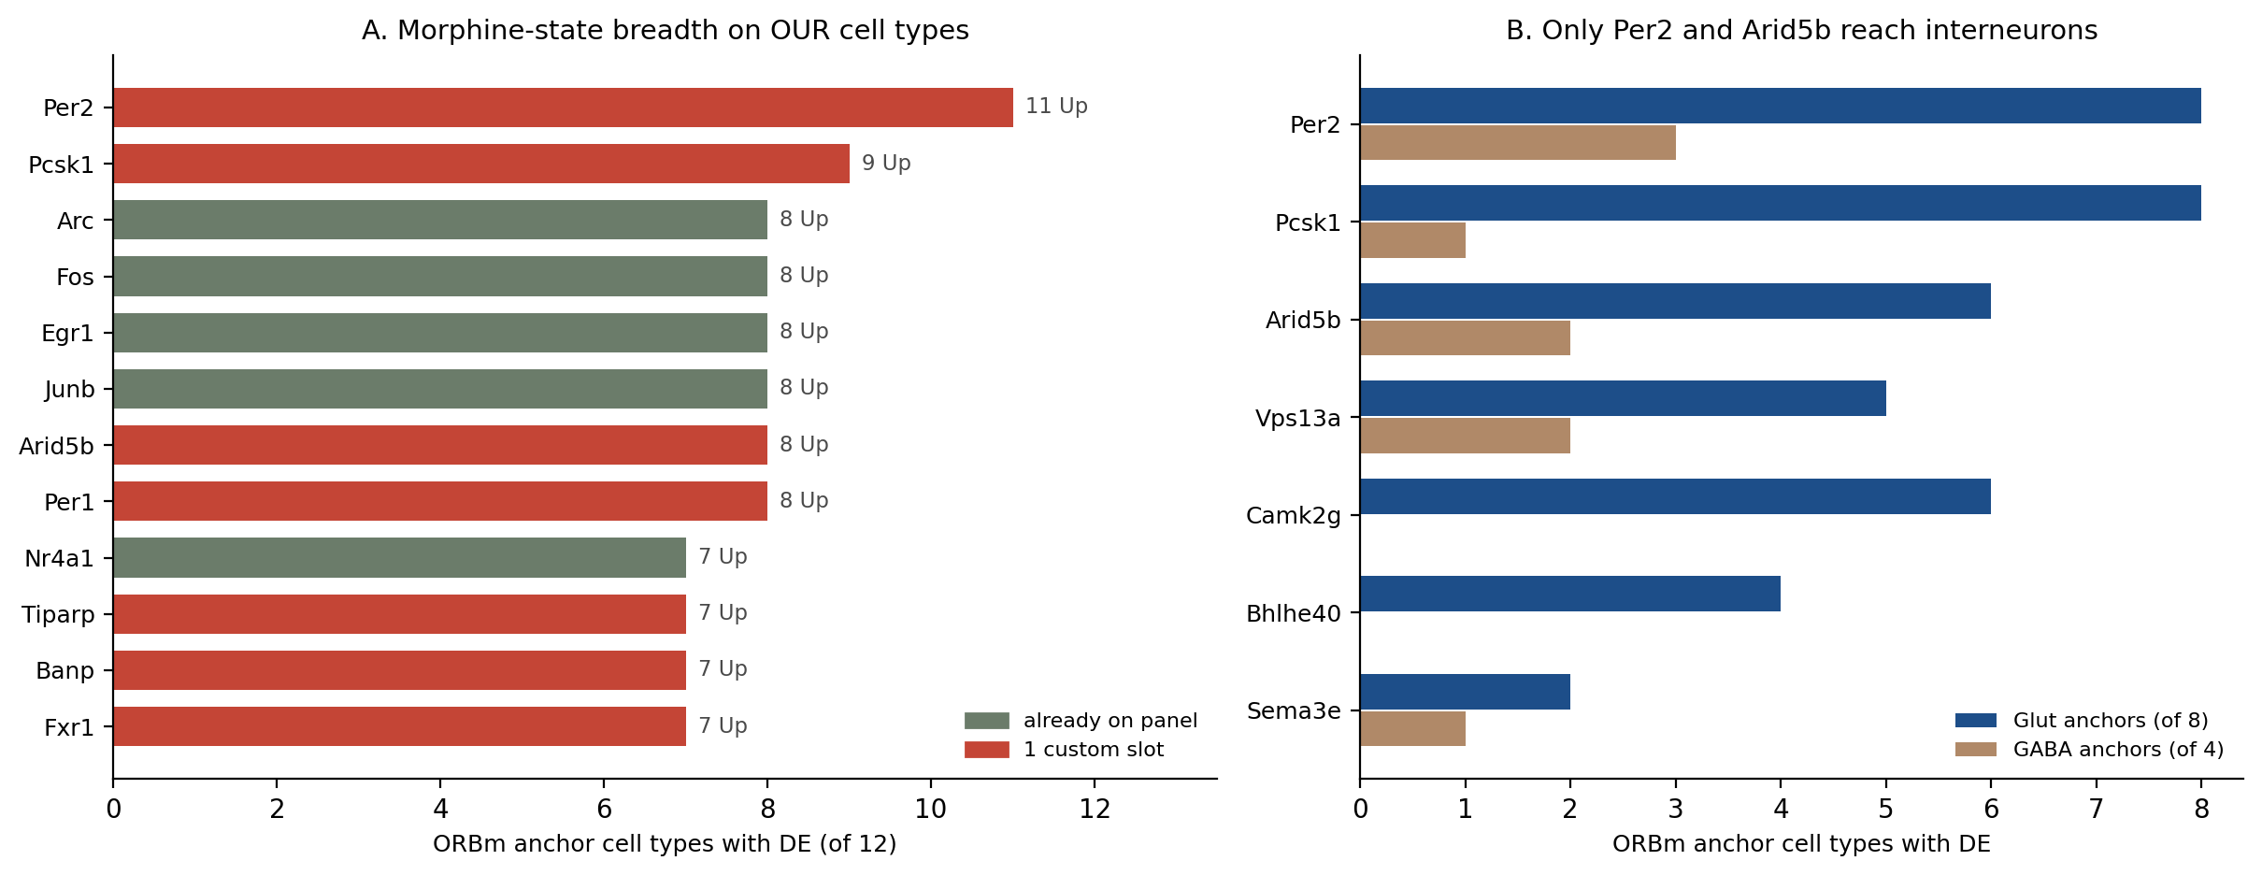
Job 4 | the morphine-state genes
New axis: within one L5 IT cell, is the dependence signature ON or OFF?
Per2 (11/12) and Pcsk1 (9/12) are the two broadest genes in Jesse's whole dataset and both were missing. Lamp5 carries no DEG at all, so 11 is the ceiling - Per2 changes wherever anything changes.
Vps13a (7/12, 95% detection) and Camk2g (6/12 DOWN, 93%) are the strongest on detectability. Camk2g is the only DOWN gene, which shows the change is directional rather than a global lift. Arid5b is kept because it and Per2 are the only broad genes reaching interneurons (panel B) - its own detectability is unscored.
Xenium ORBm + BMAp add-on | Jesse Niehaus + Daniel Berg / Scherrer | 3/4

Slide 4
FINAL | 11 genes added, 7 custom slots
158 -> 169 genes = 48 free on base + 121 custom. Nothing added from Dan.
Gene | Job | Slot | Why
Per2 | morphine state | 1 custom | 11/12 ORBm anchors Up, glut 8 / GABA 3. Broadest gene in Jesse's data.
Pcsk1 | morphine state | 1 custom | 9/12 Up. Proenkephalin / POMC convertase.
Arid5b | morphine state | 1 custom | 8/12 Up, glut 6 / GABA 2. Only broad gene besides Per2 reaching interneurons.
Vps13a | morphine state | 1 custom | 7/12 Up AND 95% Allen detection - best measured on both axes.
Camk2g | morphine state | 1 custom | 6/12 DOWN, 93% detection. Only direction control in the set.
Bhlhe40 | morphine state | free | 4/12 Up. Free on Xenium base.
Sema3e | morphine state | free | 3/12 Up. Free on base.
Gadd45a | morphine state | free | 1/12 Up. Free on base.
Chrm1 | GPCR map | 1 custom | M1 muscarinic (Gq). ORB-enriched in 8 subclasses, 92% detection, 9/12 anchors >50%. Panel has only Chrm2 (M2, Gi) - op
Grm8 | GPCR map | 1 custom | mGlu8, group III (Gi, presynaptic autoreceptor). Enriched in 9 subclasses, 99% detection, 8/12 anchors >50%. Panel has
Rxfp1 | GPCR map | free | Relaxin-family RXFP1. Highest ORB enrichment of all (19 subclasses) but only 34% detection. Free on base, so worth tak
BLOCKING: custom slots go 114 -> 121, against an original vendor cap of 100. This needs confirming before ordering.
If the cap is firm, drop in this order: Arid5b (detectability unscored, Per2 still covers GABA), then Camk2g (loses the direction control), then Grm8 (Chrm1 is the bigger family gap). Alternatively drop the weakest Dan genes - Gabre (spec 0.95, CEA-BST), Tspan18 (0.96, SI/LPO border), Syndig1l (1.32, CEA-BST) serve neighbours, not BMAp core.
Order sheet FINAL_Xenium_panel_ORBm_BMAp_MSGS111_v3_169genes.xlsx keeps MSGS111 formatting, column widths, frozen panes and every existing row byte-identical; rows were only appended.
Xenium ORBm + BMAp add-on | Jesse Niehaus + Daniel Berg / Scherrer | 4/4

