Slide 1
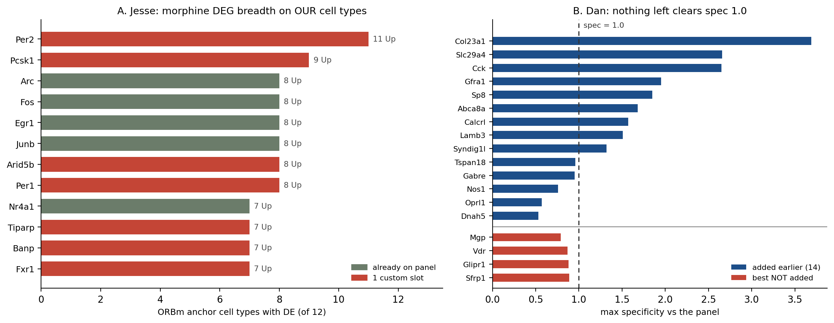
The two datasets, scored against our panel
Left: Jesse's morphine DEGs, counted only in the 12 ORBm cell types we image. Right: Dan's 98 amygdala genes, re-scored in Allen BMAp.
Jesse: 304 unique DEGs; only 30 already on the panel. The two broadest genes in the whole dataset, Per2 (11/12) and Pcsk1 (9/12), were both missing. Our existing IEGs start at 8/12. Lamp5 carries no DEG at all, so 11 is the ceiling.
Dan: 52 of 98 already on the panel. The best of the 46 left off scores max_spec 0.89, below the 1.0 line where a gene starts beating what the panel already carries. Glipr1 (0.88) serves anchor 113, but that anchor already has Penk (2.31) and Lamb3 (1.51). Nothing further to add from Dan.
Xenium ORBm + BMAp add-on | Jesse Niehaus + Daniel Berg / Scherrer | 1/4

Slide 2
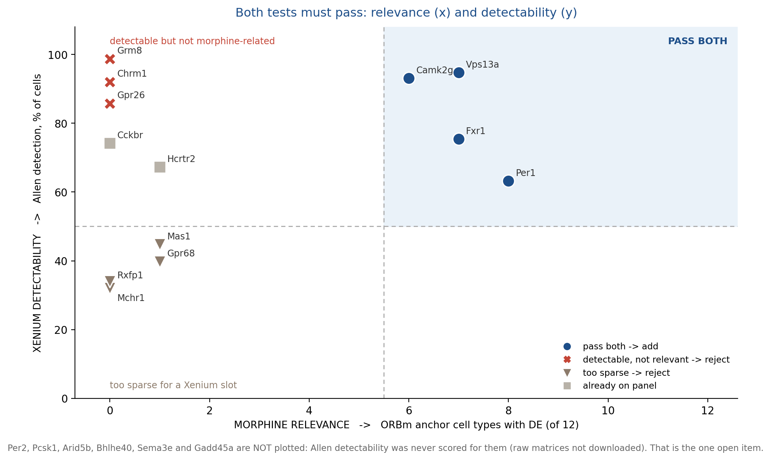
Why two earlier drafts disagreed - and the test that settles it
A gene earns a slot only if it is BOTH morphine-relevant in our cell types AND detectable enough for Xenium.
The earlier draft that proposed Chrm1 and Grm8 was right to introduce a detectability test - every number in it is correct (Chrm1 92%, Grm8 99% vs Mas1 45%, Gpr68 40%, Mchr1 32%). But both fail the other axis: Chrm1 is not a morphine DEG at all, and Grm8 is DE in 0 of our 12 anchors. Detectable everywhere means no contrast to image.
Applying both tests promotes Vps13a (7/12 anchors AND 95% detection) and Camk2g (6/12 DOWN, 93%) over Chrm1 / Grm8.
Xenium ORBm + BMAp add-on | Jesse Niehaus + Daniel Berg / Scherrer | 2/4

Slide 3
FINAL | 9 genes added, 5 custom slots
Appended as block 13_Jesse_morphine_state. No existing gene removed or re-ranked. Nothing added from Dan.
Gene | Slot | Why
Per2 | 1 custom | 11/12 anchors Up, glut 8 / GABA 3. Broadest gene in the dataset.
Pcsk1 | 1 custom | 9/12 Up. Proenkephalin / POMC convertase.
Vps13a | 1 custom | 7/12 Up AND 95% detection - best measured on both axes.
Camk2g | 1 custom | 6/12 DOWN, 93% detection. Only direction control.
Arid5b | 1 custom | 8/12 Up, glut 6 / GABA 2. Only broad gene besides Per2 reaching GABA.
Bhlhe40 | free | 4/12 Up. Free on Xenium base.
Sema3e | free | 3/12 Up. Free on base.
Gadd45a | free | 1/12 Up. Free on base.
Rxfp1 | free | ORB-enriched GPCR (19 subclasses) but 34% detection - weak signal.
Rejected | Reason
Chrm1 | 92% detection but NOT a morphine DEG at all. Detectable everywhere = no contrast.
Grm8 | 99% detection but DE in 0 of our 12 anchors (its DE was in PL/ILA).
Per1 | 8/12 Up, but 63% max / only 4 of 12 anchors above 50%. Redundant with Per2.
Mas1 / Gpr68 / Mchr1 | ORB-enriched but 45 / 40 / 32% detection - too sparse for a slot.
Panel: 158 -> 167 genes = 48 free on base + 119 custom (was 44 + 114).
Xenium ORBm + BMAp add-on | Jesse Niehaus + Daniel Berg / Scherrer | 3/4

Slide 4
What needs a decision
Two open items, one of them blocking.
# | Type | Issue | Option
1 | BLOCKING | Custom slots go 114 -> 119, but the original vendor cap was 100 custom add-ons. Needs confirmation before ordering. | If the cap holds at 100, drop the weakest Dan genes first: Gabre (spec 0.95, CEA-BST), Tspan18 (0.96, SI/LPO border), Syndig1l (1.32, CEA-BST). They serve neighbours, not BMAp core.
2 | Data gap | Allen detectability is unscored for Per2, Pcsk1, Arid5b, Bhlhe40, Sema3e and Gadd45a - the raw Allen matrices were never downloaded. | Per2 and Pcsk1 are the top two morphine genes and worth the risk. If detectability matters more than breadth, Fxr1 (7/12, 75% verified) is the ready substitute for Arid5b.
Everything else is settled and orderable: FINAL_Xenium_panel_ORBm_BMAp_MSGS111_v2_167genes.xlsx keeps MSGS111's formatting, column widths, frozen panes and every existing row byte-identical - rows were only appended.
The 9 genes report morphine-dependence state, not cell identity, so ANCHOR_COVERAGE is unchanged and all 20 cell types remain separable. New question the panel can answer: within one L5 IT cell, is the dependence signature ON or OFF?
Xenium ORBm + BMAp add-on | Jesse Niehaus + Daniel Berg / Scherrer | 4/4

